Slide 1
Advanced Control of Phase Space Presentation of Slow-Extraction Separatrix at ES
M. Fraser, B. Goddard, V.Kain, M. Pari, L. Stoel, F. Velotti

Slide 2
Slow extraction at the CERN SPS
First slow extraction to SPS North Area:1978
  Transfer lines designed for 400 GeV/c
p⁺: 400 GeV/c extraction momentum
Heavy ions: ~ 30 GeV/c to ~ 380 GeV/c proton equivalent
  Very low intensities
SPS parameters 2018 proton operation
Extraction Momentum [GeV/c] | # p⁺ at flattop [ ✕ 10¹³] | Min. repetition period [s] | flattop length [s] | # cycles/day
400 | 3.5 | 14.4 | 4.8 | ~ 4000
max. 4 x 10¹³
min. 1.2 s

Slide 3
Evolution of beam requests over years
Ever increasing interest in NA fixed target physics
Record total intensity extracted to NA in 2018
Courtesy K. Elsner
From 40 years NA physics Celebration

Slide 4
Many new ideas for NA → "Physics Beyond Colliders"
New projects → increase further the number of protons extracted to NA (e.g. with SHiP: 5e+19 p+/year)
…and keep activation constant (level of ~ 1e+19)

Slide 5
Ideas to reduce losses/activation in extraction channel
Various ideas for loss reduction
  New ES materials,…
→ slow extraction with crystal shadowing and octupole phase-space folding; but…
  Limited angular acceptance for crystal shadowing
  Requires constant separatrix/optics for octupole phase-space folding,…
See talks later today

Slide 6
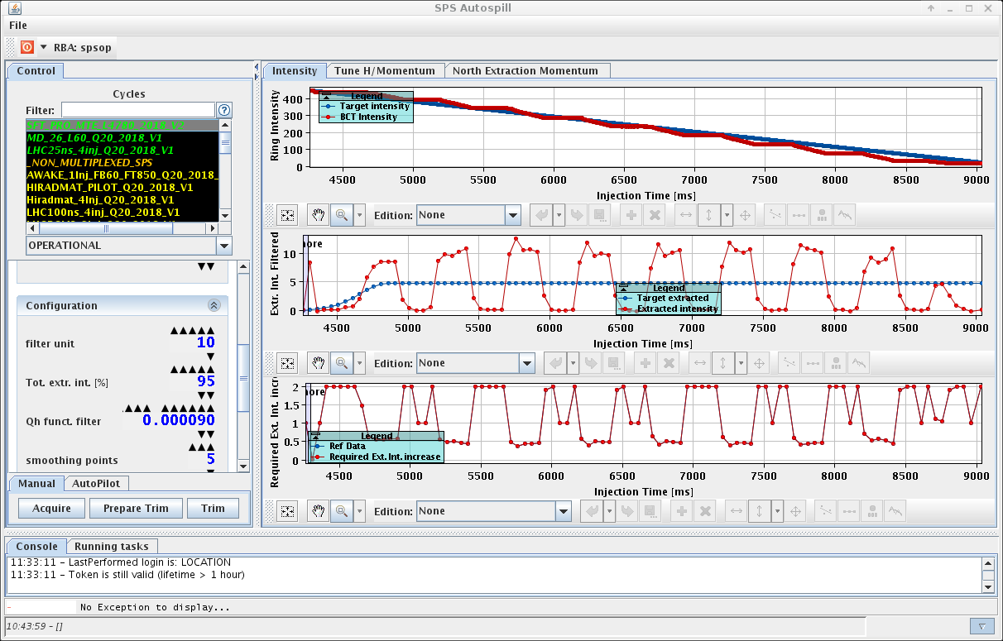
Driving slow extraction at CERN SPS
Third order resonance slow extraction driven by tune sweep
Chromaticity ξ_{x} = -1, increase momentum spread through RF gymnastics to
Hardt-condition not fulfilled at the SPS, but D_{x}, D’_{x} small
Feed-forward correction of Q_{h} function (main quadrupoles) in the SPS to linearize ring intensity decay on the slow extraction flattop
  Correction algorithm built exploiting
No servo-quadrupole feedback system in the SPS since 2015
Autospill control room application

Slide 7
Evolution of separatrix during slow extraction
Tune driven slow extraction → changing machine optics
→ rotating separatrix @ ES
β_{x} @ ES
particles with different momenta arrive on different separatrices
Lowest momenta particles, extracted first.
Extraction momentum is proxy for time on extraction plateau.

Slide 8
Evolution of separatrix during slow extraction
Tune driven slow extraction → changing machine optics
→ rotating separatrix @ ES
β_{x} @ ES
Phase-space distribution of entire spill of extracted beam @ ES.
Lowest momenta particles, extracted first.
Extraction momentum is proxy for time on extraction plateau.

Slide 9
Is it possible to compensate this?
Use dynamic bump? Orthogonal knobs in x and x’ at ES
Beginning of 2018 run: idea of running slow extraction betatron-core-like without beatron core
→ Constant optics slow extraction (COSE)
Test with linear tune sweep, x and x’ sweep.
Feed-down effects on tune to be compensated.
Implementation details were not finalized due to other idea…

Slide 10
COSE Concept
Separatrix change is consequence of moving resonance to select particles to be extracted via their momenta
COSE: keep resonance fixed and scale machine settings according to momentum to be extracted.
  → normalized strengths stay constant; fields change with momentum (or Bρ)
In many ways similar to betatron core
  Difference: momentum of extracted beam not constant
k_{n}: constant

Slide 11
What would we expect from simulation?
Optics is constant; circulating beam is off-momentum; extracted beam on-momentum; tune resonant for on-momentum beam
Simulation of particle distribution at ES
Q_{x} of circulating beam
Correlation between x’ and momentum disappears.
Reduction of angular spread by ~ 20 %.

Slide 12
Expect also loss improvement?
Parametric study of dynamic bump in simulation
Measurements from 2018 indicate ES effective thickness of ~ 500 μm
  → very little loss reduction expected with COSE
  → main purpose reduction of angular spread, fix optics and separatrix
  → important for loss-reduction techniques like crystal shadowing
Loss reduction with reduction of angular spread?
→ Depends on ES effective thickness

Slide 13
Implementation? → SPS settings management
SPS control system based on LHC Software Architecture (LSA)
”Only” work with normalized strengths k_{n} and high level physics parameters
  E.g. physics parameter Q_{h} defined on top of k_{QD} and k_{QF}.
  All functions of time in "cycle"
  The fields/currents functions calculated
    using centrally stored calibration curves
    and Bρ or momentum function
  Bρ or momentum function can also be trimmed
    → re-calculate all fields/currents
One trim of Bρ in the SPS = update several 100s of parameters
D. Jacquet et al., LSA - The High Level Application Soft-
ware of the LHC and its Performance during the first 3 years of Operation, ICALEPS, San Francisco, CA, USA, 6 - 11 Oct 2013, pp.thppc058.

Slide 14
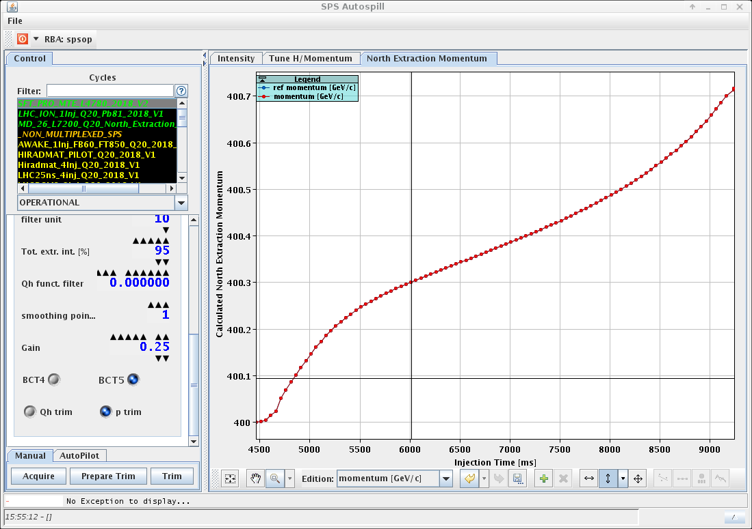
Implementation? → SPS settings management
Already all prepared in Autospill…
SPS works with momentum p instead of Bρ
Application interfaces LSA
New flattop momentum function following momentum distribution for dI/dt_{extr} = const
One open issue: transactional behavior. Will come post-LS2

Slide 15
What does COSE look like?
The slow extraction flattop momentum function follows the momentum distribution
All high level parameters stay constant

Slide 16
Confirm expectations from simulation in measurements?
Reduced angular spread → reduced beam size of total spill in transfer line to NA
  Expect 10 % beam size reduction at locations with SEM grids from 20 % reduction of angular spread
Loss reduction experiment with bent crystals at ES
  Most direct proof of constant separatrix through spill → constant loss reduction
→ Confirmed by measurement
Crystal aligned to shadow ES. Loss reduction as a function of time for 1.2 s flattop.

Slide 17
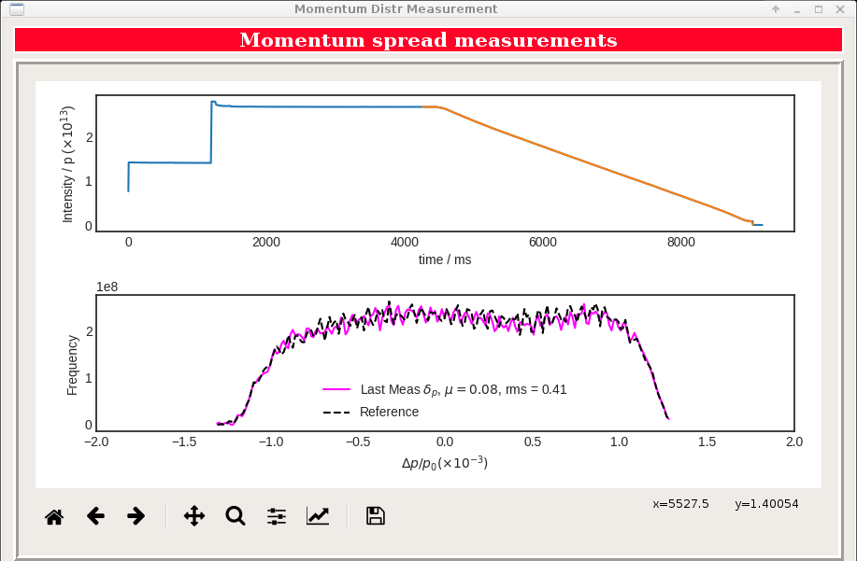
Operation with COSE
COSE tested during machine development in summer 2018
Put in operation on 20th of September, 2018 for the rest of the proton and ion FT run
No degradation of spill ripple or other issues; losses at similar level
Byproducts: how to adjust Brho in transfer line for stable trajectory, automatic "measurement" of momentum distribution

Slide 18
Summary
Continuously growing demand for POT on the SPS North Area targets
Activation needs to remain constant → losses reduction
Loss reduction concepts require constant separatrix, reduced angular spread
Constant optics slow extraction (COSE) removes the rotation of the separatrix over time by driving slow extraction with Bρ at constant magnetic strengths
  Removing the need of dynamic bump
COSE straight forward implementation at the CERN SPS due to
  High level parameter settings management based on LSA
  Previous experience with feed-forward spill control
COSE has become the new standard for driving slow extraction at the SPS

