Slide 1
Using the multipoles and higher order effects in the 3rd integer Slow Extraction
Fermilab, Batavia
July 22, 2019
Vladimir Nagaslaev

Slide 2
Content
Why do we want to avoid the higher orders
Why do we want the higher orders
Some history
How this can be treated
How to introduce the higher multipoles
How to introduce the natural higher orders
Conclusions/Discussions

Slide 3

Why do we want to avoid higher order content?
We know from the textbooks:
Red: Delivery Ring case
Green: Single sextupole
$H=δ⋅J+{\left(2J\right)}^{3/2}⋅G_{3,N}⋅cos⁡(3Φ$)
Can only do the measurement in limited area.
It is desirable to have a good prediction beyond that limited area.
Higher orders are normally considered an unwanted contamination.

Slide 4
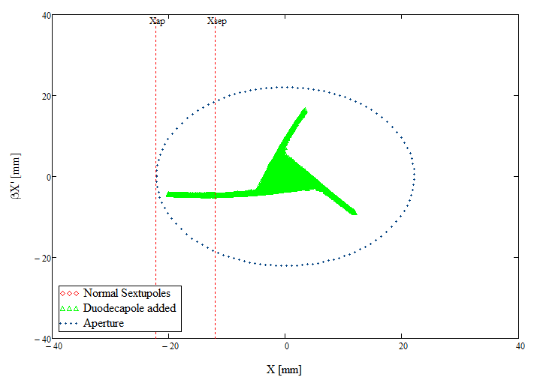
Why do we want to add the higher order content?
The field strength, separatrix, and therefore, the beam losses are constrained by the machine parameters.

Slide 5
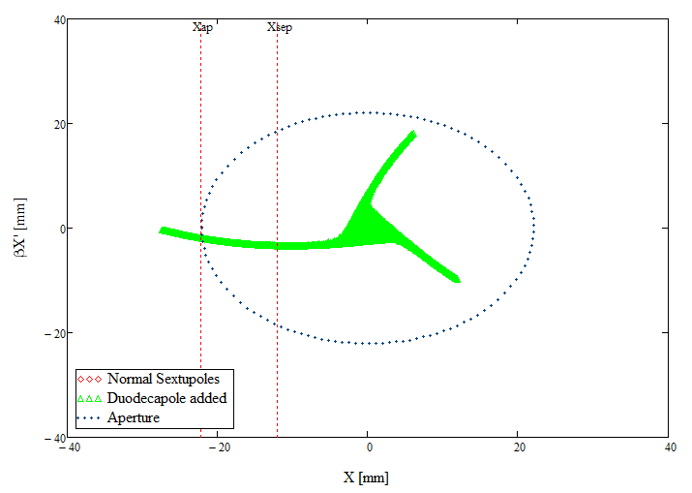
Why do we want to add the higher order content?
What you want to do to improve efficiency…

Slide 6
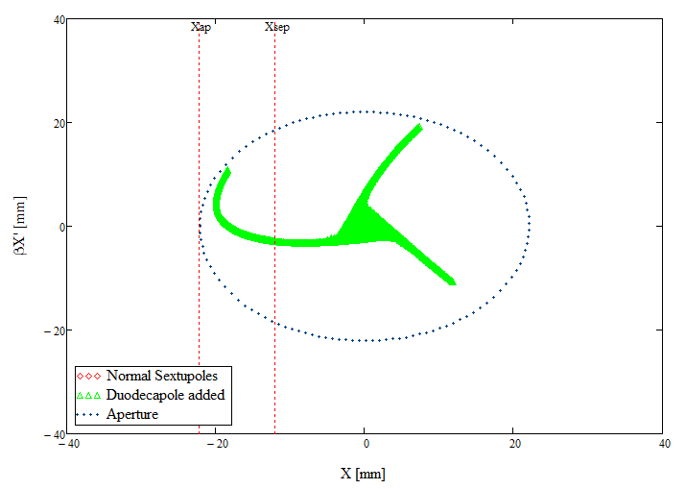
Why do we want to add the higher order content?
And the apply the higher multipole field to fold the separatrix back. Clearly, we win in the effective spiral step size.

Slide 7
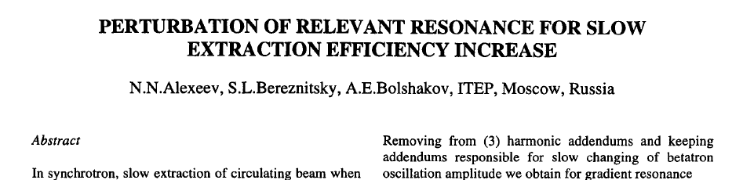
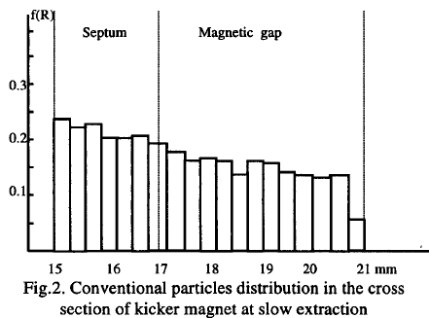
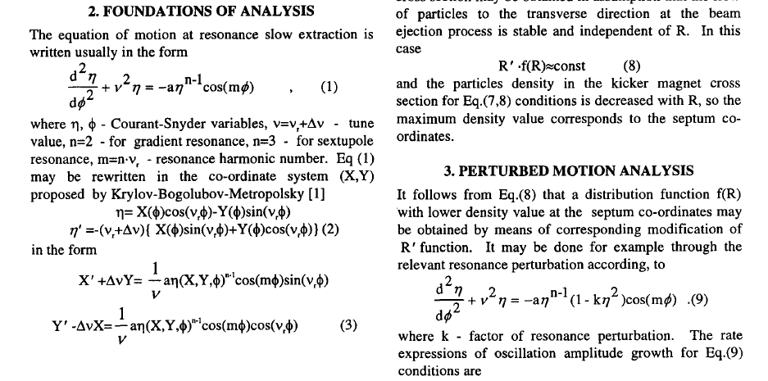
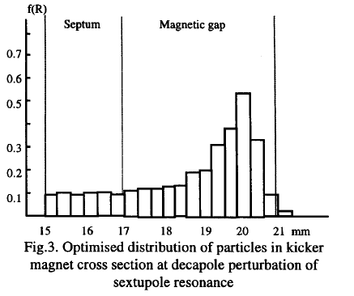
Brief history-I
PAC-97, Vancouver, 1997
Possible beam loss reduction by 50%

Slide 8
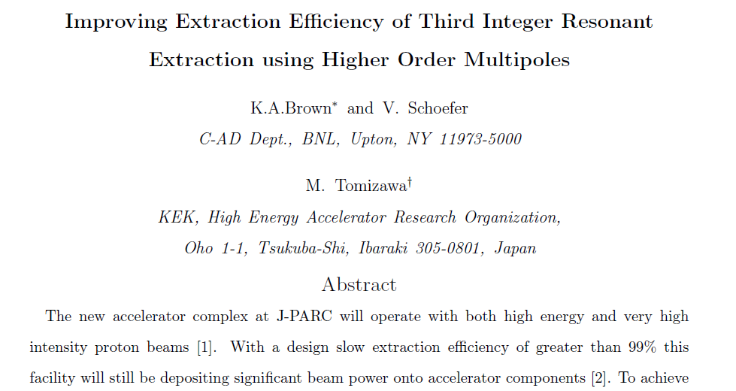
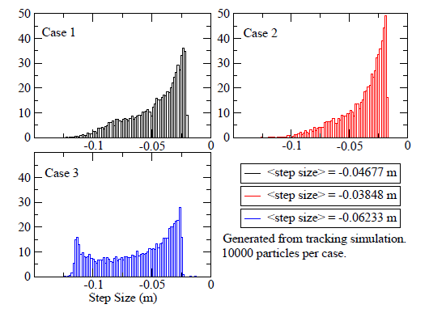
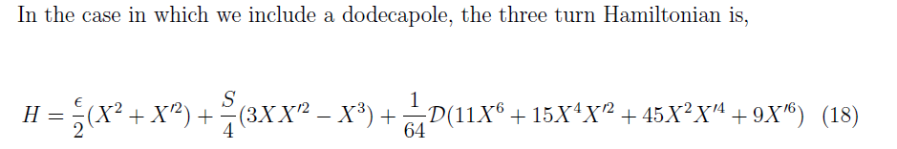

Brief history-II
Submitted in 2008;
Published as a BNL Internal Note in 2017
Possible beam loss reduction by 30%

Slide 9
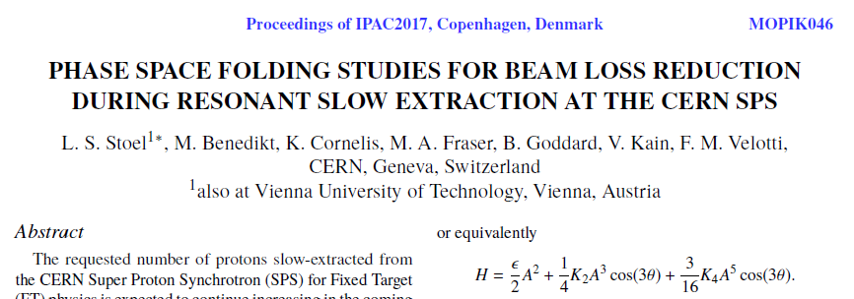
Brief history-III
IPAC-2017,
see also IPAC-2018,
see also IPAC-2019,
See also M.Fraser’s talk here
Possible beam loss reduction by 50%
And we are now entering the new page in this history

Slide 10
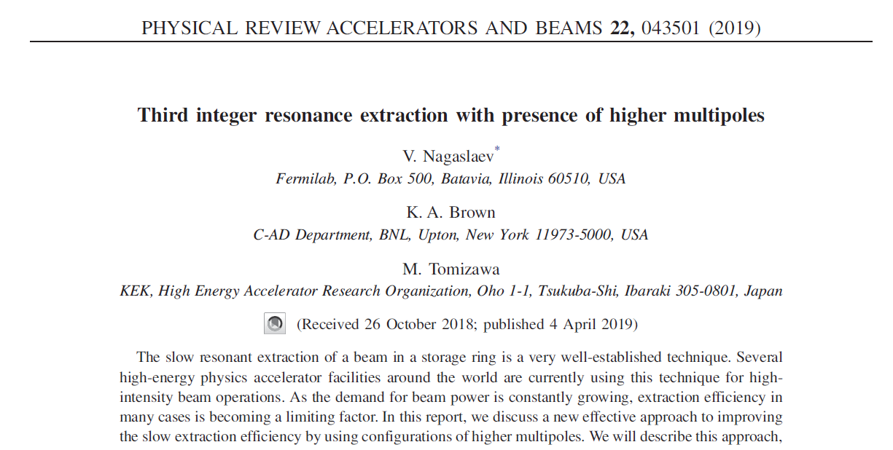
Brief history-IV
Triggered by:
  Workshop #2
  Publication #2
  New simulations
Possible beam loss reduction by 40%
Discussing the practical aspects

Slide 11


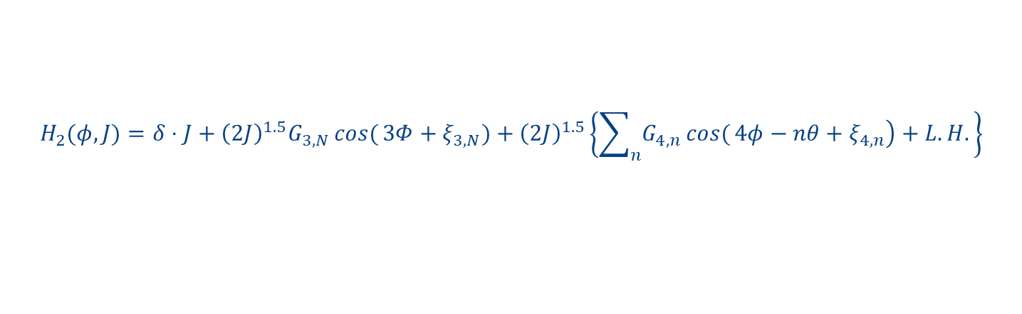
Practical questions
What kind of multipole is needed?
Where this magnet has to be placed?
$$∆H=\frac{S}{6}\left(x^{3}−3xy^{2}\right)+\frac{O}{4}\left(x^{4}−6x^{2}y^{2}+y^{4}\right)$$
Kobayashi form for the case Δφ_{oct}=0
Very difficult to handle for arbitrary Δφ_{oct}
Harmonic form is more transparent:
$$H_{2}(φ,J)=δ⋅J+{\left(2J\right)}^{1.5}G_{3,N}\cos{(}3Φ+ξ_{3,N})+{\left(2J\right)}^{1.5}\left\{\sum_{n}{\left.G_{4,n}\cos{(}4φ−nθ+ξ_{4,n}\right)}+L.H.\right\}$$
But what do you do with infinite summation?

Slide 12

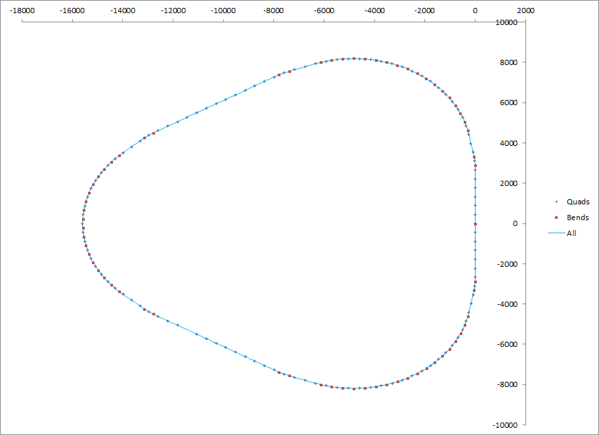
Trying to enter through the back door
Setting up numerical simulations
Very simple tracking, 2D only, thin lens
Using the Delivery ring as the model
Ext. to Mu2e
SS20-30
Inj. from RR
Electro-Static septa
Insert an Octupole at arb. location
Sextupole circuit 60
Sextupole circuit 50
SS10-60
SS40-50

Slide 13
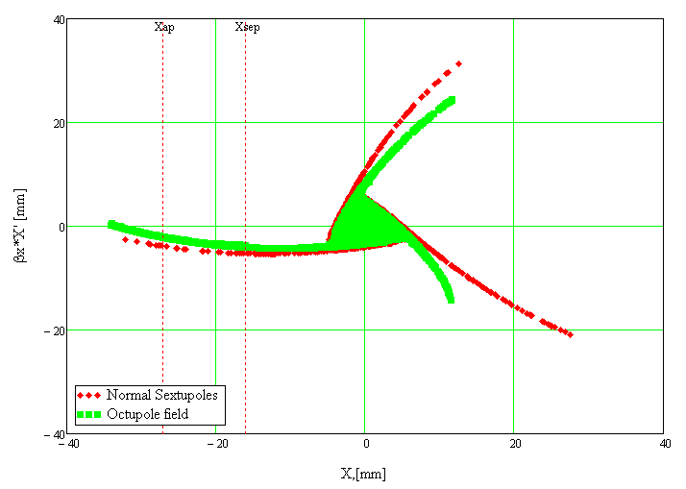
Auxiliary octupole field

Slide 14

Octupole field: changing location

Slide 15
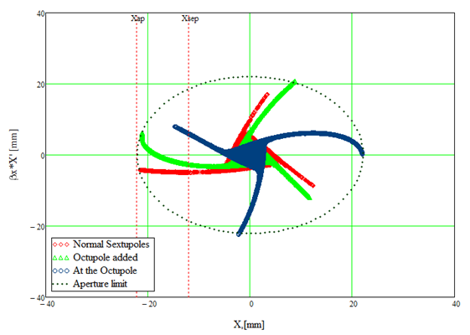
Octupole field: Optimal locations
Optimal Octupole locations:
$$μk=0.10+0.5∗k, k=0,±1,±2…$$
Fine tuning around μ_{k}
Single turn kick mapping
Recipe for the multipole placement:
  Near 180°phase advance
  Tune angle, M and S strengths
  Now can be optimized analytically

Slide 16
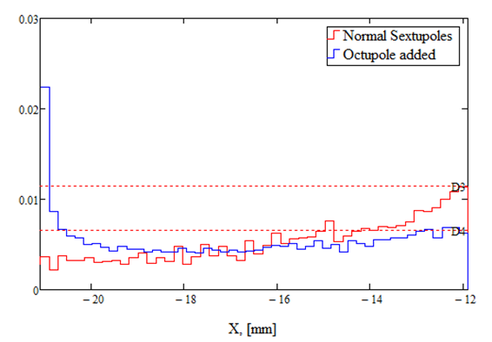
Octupole field: Effect to losses
Extracted beam density
Septum plane
Expect beam loss reduction by 45%

Slide 17
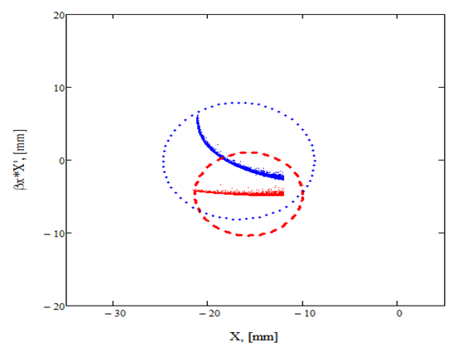
Octupole field: Effect to emittance
100% emittance increase for the extracted beam

Slide 18
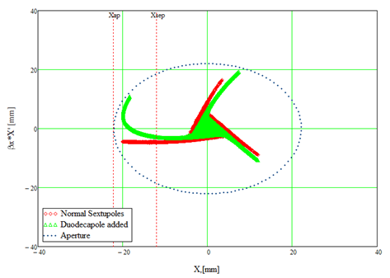
Duo-decapole field
Same recipe should also work for higher multipoles as well.
Duodecapole yields similar performance.
Easier to control the bending.

Slide 19
Exploring Effects of Natural Multipole Terms
Continues discussion from the previous Workshop
Want to understand the underlying dynamics
May change the way sextupole circuits are designed

Slide 20


Higher orders of the Perturbation Theory (PT)
Full Hamiltonian to 2nd order PT:
$$∆H_{2}=\frac{3}{2}{\left(2J\right)}^{2}\frac{G_{3,29}}{δ}\left\{G_{3,29}+\sum_{N}{G_{1,N−29}∙cos}\left[4φ−Nθ+ξ_{3,29}+ξ_{1,N−29}\right]\right\}$$
Only terms containing 1/δ
Detuning – configuration independent
Similar to the Octupole case
Can go to higher orders
G1 is the key function
Higher orders of PT are not small
PT is not valid for large amplitudes
Gives us a hint but doesn’t give a solution
Looking for the back door again
$$H=δ⋅J∙\left\{1+O\left(\left[\frac{J}{J_{∗}}\right]\right)+O\left({\left[\frac{J}{J_{∗}}\right]}^{1.5}\right)+…\right\}$$

Slide 21
Choice of sextupole configurations
Back to simulations
Searching through available sextupole configurations:
  Across sectors
  In sectors: degeneracy
  Keep present locations
  Keep common bus in each circuit
  For each combination adjust circuit strengths
Procedure specific to 60° FODO
1
6
2
5
3
4

Slide 22
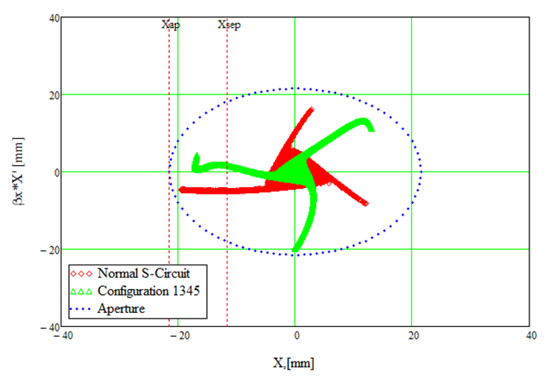
Sextupole configurations
Found interesting configuration 1345
BL reduction 30%
Emittance reduced!
Higher orders?

Slide 23
Benchmarking
6D pyOrbit tracking to benchmark
Limitations and issues
  Momentum spread – angular spread
  Adding 138 chromaticity sextupoles
  Space charge
  Coupling
Same configuration 1345 still gives the best performance

Slide 24
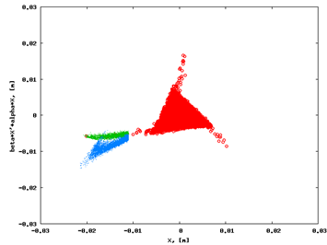
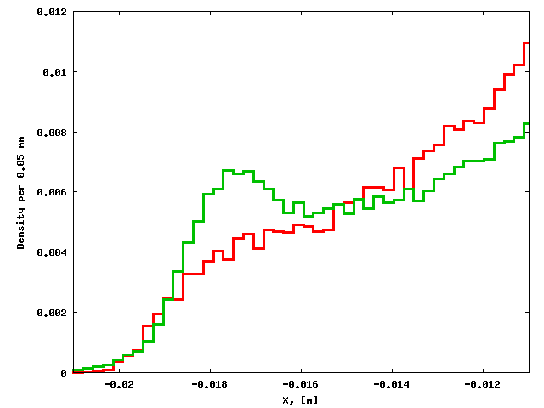
Benchmarking
BL reduction 25%
Emittance increase 27%

Slide 25
Conclusions
We found the rule for the optimal multipole magnet placement to produce the separatrix folding and its interpretation.
We showed that it is also possible to achieve the similar separatrix folding without using higher multipole magnets.
This can be used for a better design of the sextupole circuits.

Slide 26
More remarks for further discussions
Looking for more insight from the theory of nonlinear dynamics
In some case we needed to increase the sextupole strength by a factor of 3 and more – room for this increase has to exist.
Stronger fields may be limited by the coupling issues.
Higher order sextupole effects can be studied experimentally in electron beam machines.

Slide 27
Backup Slides

Slide 28
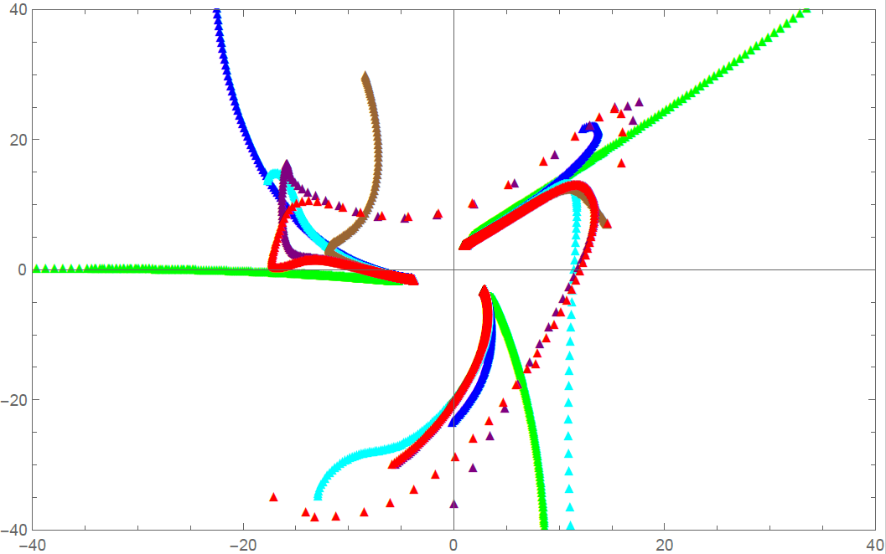
Analytical comparison with high order mapping model

