Slide 1
Spill structure improvements at GSI
(in quad-driven slow extraction with coasting beams)
Rahul Singh, Peter Forck, Stefan Sorge
with enthusiastic support of Andrzej Stafiniak and Horst Welker
July 23rd, 2019
Main source of spill fluctuations : Dipoles, quads or sextupoles?
Effect of extraction and beam settings on spill via transit time spread
Spill structure improvement by modulating tune with specific frequencies and amplitude

Slide 2
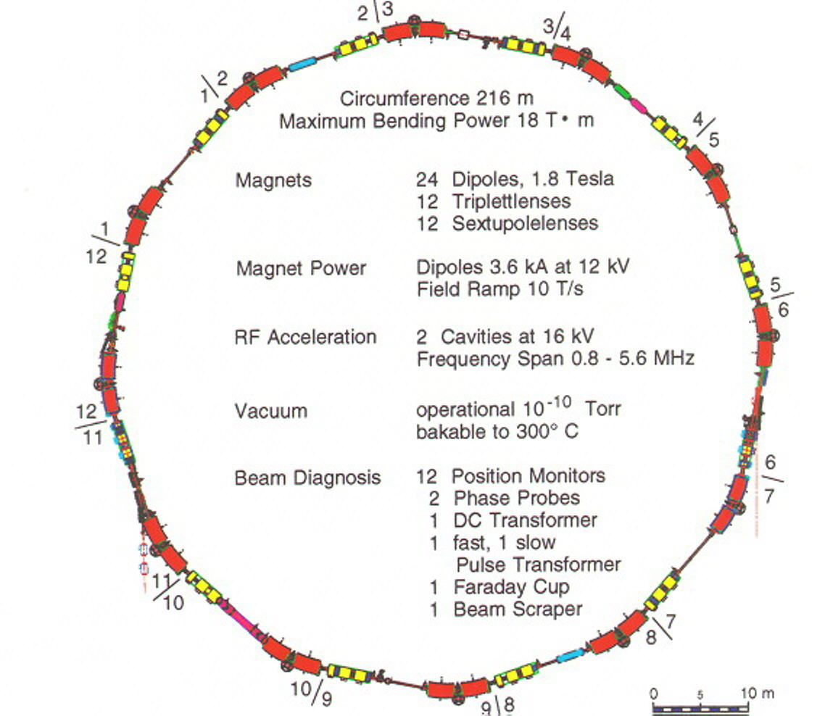
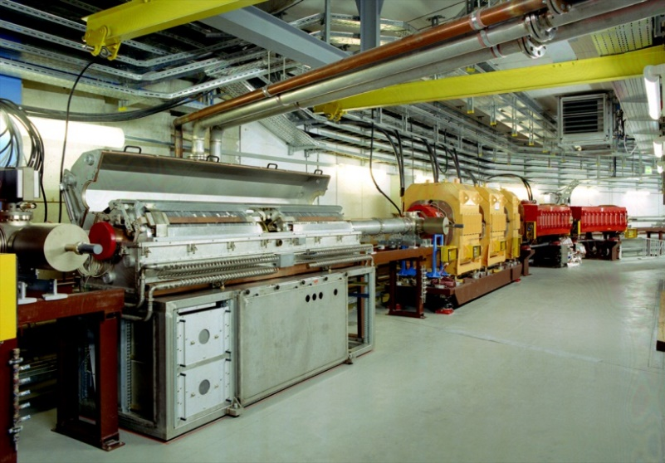
GSI Heavy Ion Synchrotron SIS18 (Bρ=18Tm): Overview
acceleration
acceleration
Important parameters of SIS-18
Ion range (Z) | 1 → 92 (p to U)
Circumference | 216 m
Injection type | Hor. multi-turn
Energy range | 11 MeV/u → 2 GeV/u
Ramp duration | 0.1 → 1.5 s
Acc. RF | 0.8 → 5 MHz
Harmonic | 4
Bunching factor | 0.4 → 0.08
Tune h/v | 4.29 / 3.27
Trans. size σ_{h} / σ_{v} | ≈ 10 / 5 mm at inj.
Circumference | 216 m
Inj. type | Multiturn
Energy range | 11 MeV → 2 GeV
Acc. RF | 0.8 → 5 MHz
Harmonic | 4 (= # bunches)
Bunching factor | 0.4 → 0.08
Ramp duration | 0.06 → 1.5 s
Ion range (Z) | 1 → 92 (p to U)
injec-
tion
SIS18 → booster for SIS-100
Third order resonance → Quad driven and knock-out extraction → coasting and bunched beams
Variety of fixed target experiments with detector times from 100 μs to 10 ns → upto 20s spills
extrac-
tion
extraction
injection
electron cooling

Slide 3
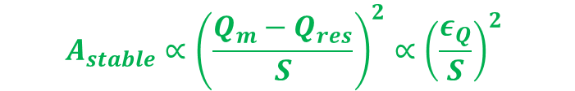




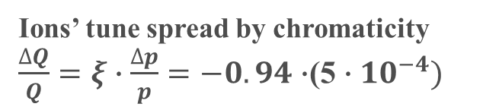
Slow Extraction by Tune Ramp (Quad driven)
Horizontal phase space at electrostatic septum
x’
Quad. tune ramp
$$A_{stable}$$
shrinkage of $A_{stable}$
by tune ramp
Q_{m} (t) → 4 + 1/3
$ε_{Q}(t)$→ 0
Q_{m} < Q_{res}
for low current
ele.-stat. septum
tune $ε_{Q}$
Q_{end}
thickness
Q_{res} = $4.\overline{3}$
0.00
extr.
channel
x
ΔQ_{spill}
Q_{start}
-0.03
0
3
time [s]
$$A_{stable}∝{\left(\frac{Q_{m}−Q_{res}}{S}\right)}^{2}∝{\left(\frac{ε_{Q}}{S}\right)}^{2}$$
transit time T_{transit}
Sextupoles: Create non-linear fields
Sext. strength S: Ion’s amplitude growth per turn ⇔ T_{transit} & x_{step}
last spiral step x_{step}
after 3 turns
Ions’ tune spread by chromaticity $\frac{∆Q}{Q}=ξ∙\frac{∆p}{p}=−0.94$ $∙$(5 $∙{10}^{−4})$
Typical values: S = (0.08±0.04) m⁻²
Abbreviation: S ≡ k ≡ k₂L

Slide 4
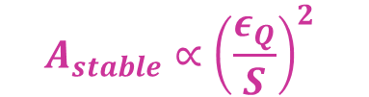
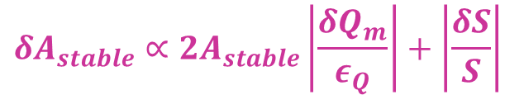

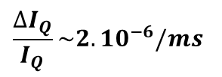
Slow Extraction by Tune Ramp (Quad driven)
Horizontal phase space at electrostatic septum
x’
Quad. tune ramp
$$A_{stable}$$
shrinkage of $A_{stable}$
by tune ramp
Q_{m} (t) → 4 + 1/3
$ε_{Q}(t)$→ 0
Q_{m} < Q_{res}
for low current
ele.-stat. septum
tune $ε_{Q}$
Q_{end}
thickness
Q_{res} = $4.\overline{3}$
0.00
extr.
channel
x
ΔQ_{spill}
Q_{start}
-0.03
0
3
time [s]
unintended stable area variation typically due to quad/sextupole PS ripple
$$\frac{∆\text{Q}\text{m} }{\text{Q}\text{m}}\sim {10}^{−5}/ms$$
transit time T_{transit}
$$\frac{{∆I}_{Q}}{I_{Q}}\sim {2.10}^{−6}/ms$$
last spiral step x_{step}
after 3 turns
Quad
$$A_{stable}∝{\left(\frac{ε_{Q}}{S}\right)}^{2}$$
Sextupole
Ions’ tune spread by chromaticity $\frac{∆Q}{Q}=ξ∙\frac{∆p}{p}=−0.94$ $∙$(5 $∙{10}^{−4})$
$${δA}_{stable}∝{2A}_{stable}\left|\frac{δQ_{m}}{ε_{Q}}\right|+\left|\frac{δS}{S}\right|$$

Slide 5
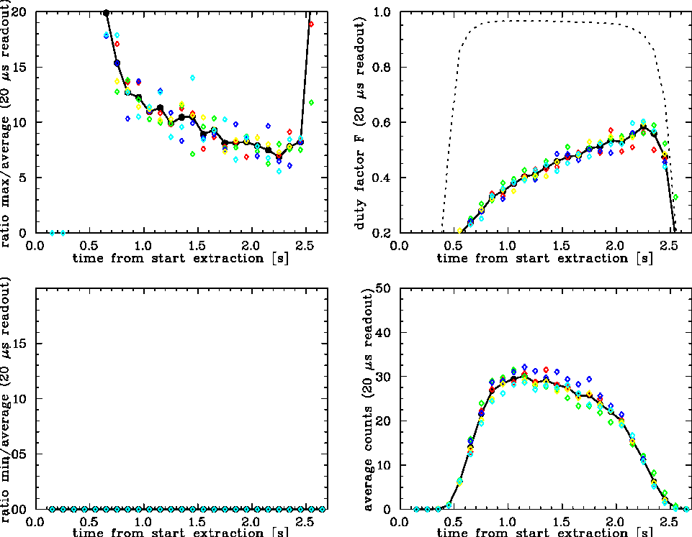
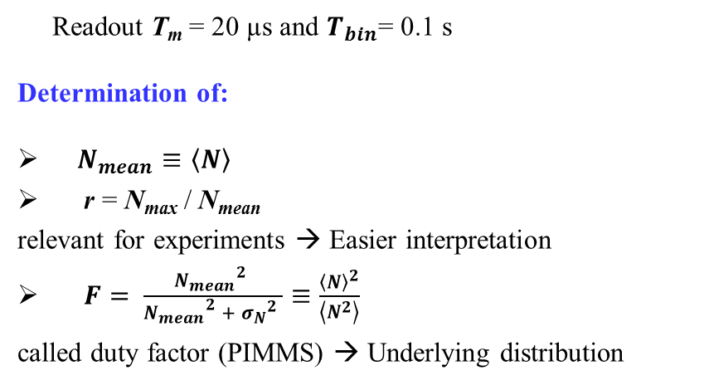
Spill measurement and characterization
Example: C⁶⁺ at 300 MeV/u, recorded spills in consecutive cycles with same parameters
Quad. scan, un-bunched beam
average of 6 spills
color: individual spills
F(t)
Poisson limit
N_{mean}(t)
r(t)=N_{max}(t)/N_{mean}(t)
Readout T_{m} = 20 µs and $T_{bin}$= 0.1 s
Determination of:
$N_{mean}≡\left\langle N\right\rangle$
r = N_{max} / N_{mean}
relevant for experiments → Easier interpretation
$F= \frac{{N_{mean}}_{}^{2}}{{N_{mean}}_{}^{2}+ {σ_{N}}_{}^{2}}≡\frac{{\left\langle N\right\rangle }^{2}}{\left\langle N^{2}\right\rangle }$
called duty factor (PIMMS) → Underlying distribution
Observation for quad. scan:
individual spills have comparable r and F
r and F are not constant
r ≈ 10 and F ≈ 0.5
far away from Poisson limit
Microspill quality: One number per spill?
Source of fluctuations?

Slide 6
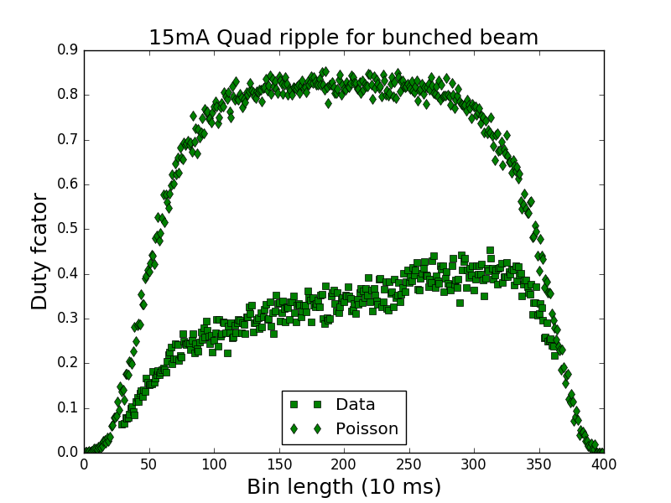
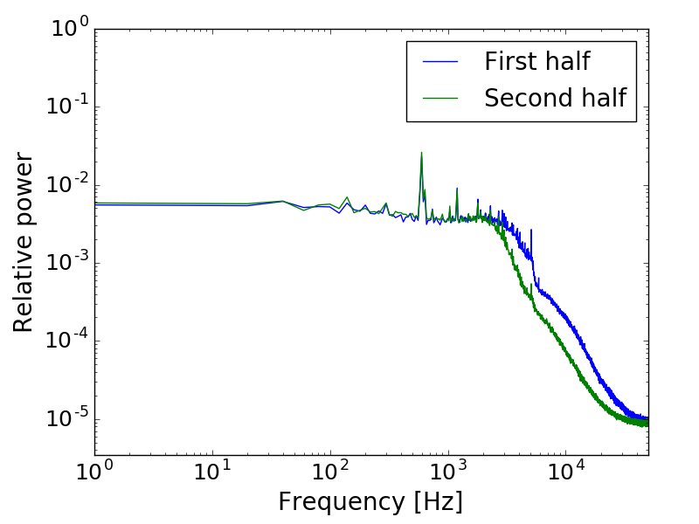

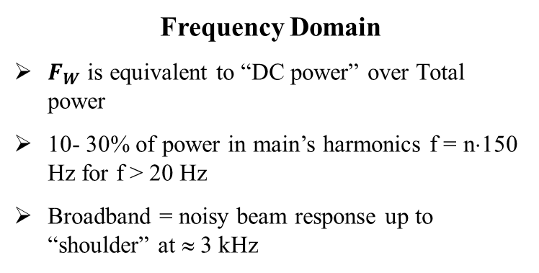




Spill measurement and characterization
Poisson
$${T_{m}=11 μs ,T}_{bin}=10 ms$$
$$F_{W}$$
spill
Time Domain
Duty factor calculated in the chosen interval
as
Poisson duty factor $F_{poisson}=\frac{N_{mean}}{N_{mean}+1}≡\frac{\left\langle N\right\rangle }{\left\langle N\right\rangle +1}$
Evolution of $F$ during the spill is visible, weighted duty factor, $F_{W}= \frac{\sum_{k=1}^{n}{F_{k}}{\left\langle N\right\rangle }_{k}}{\sum_{k=1}^{n}{{\left\langle N\right\rangle }_{k}}}$
Frequency Domain
$F_{W}$ is equivalent to “DC power” over Total power
10- 30% of power in main’s harmonics f = n⋅150 Hz for f > 20 Hz
Broadband = noisy beam response up to “shoulder” at ≈ 3 kHz
$$T_{bin}$$
$$F= \frac{{N_{mean}}_{}^{2}}{{N_{mean}}_{}^{2}+ {σ_{N}}_{}^{2}}≡\frac{{\left\langle N\right\rangle }^{2}}{\left\langle N^{2}\right\rangle }$$

Slide 7
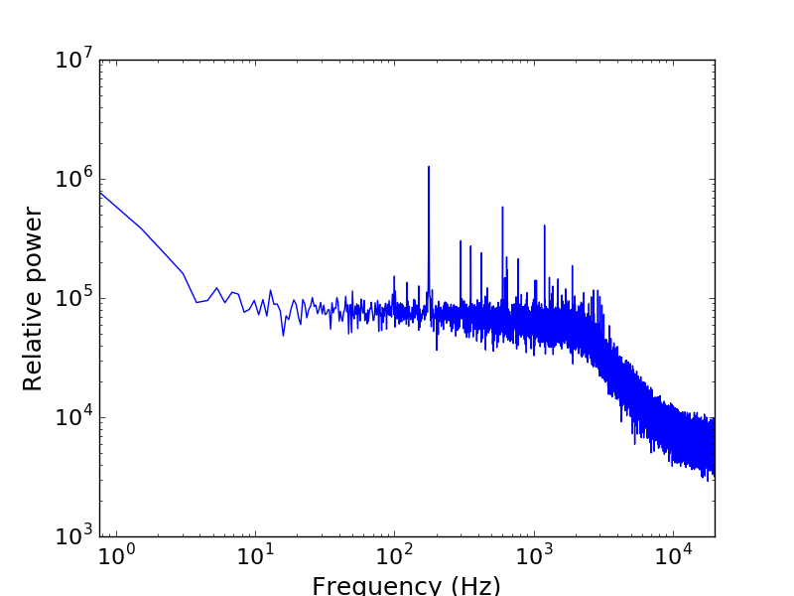
Coupling of external ripples into power supplies
DCCT
PS Control System
Power Supply
Magnet family
Current generator
We introduced ripples at a different frequency (177 Hz), and measured them relative to inherent ripples in the spill spectrum
Gives a clearer interpretation in terms of effect on spill and points out the main sources
Injected ripple
Inherent ripple
DC Power
Shoulder
at ≈ 3kHz
More details
R. Singh et al.,``Slow Extraction Spill Characterization From Micro to Milli-Second Scale", J. Phys.: Conf. Ser.1067 072002 (2018).

Slide 8
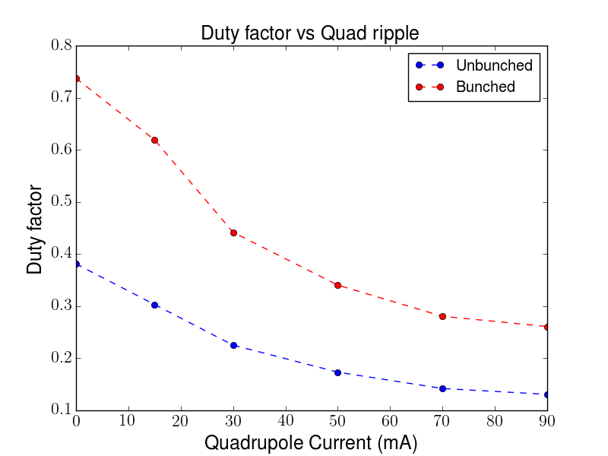
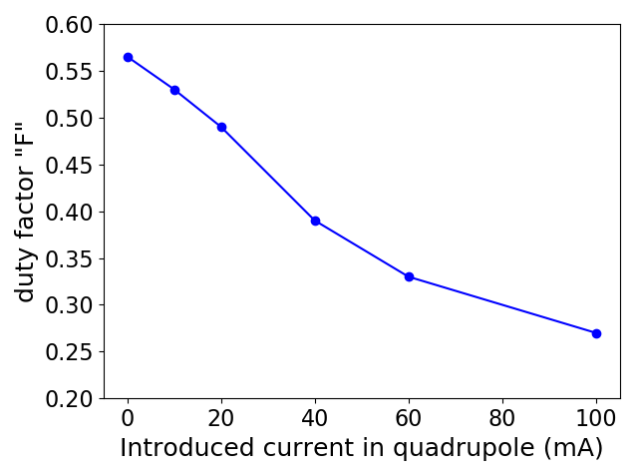
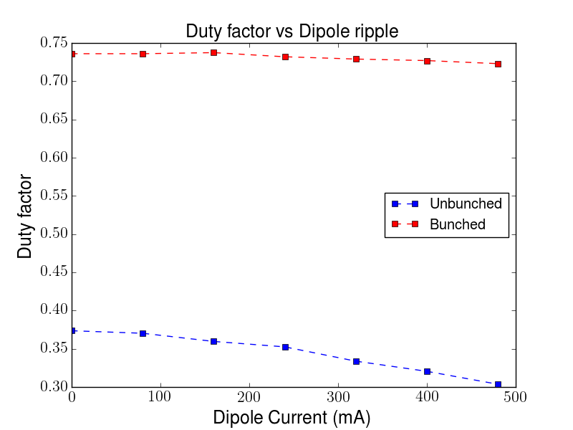
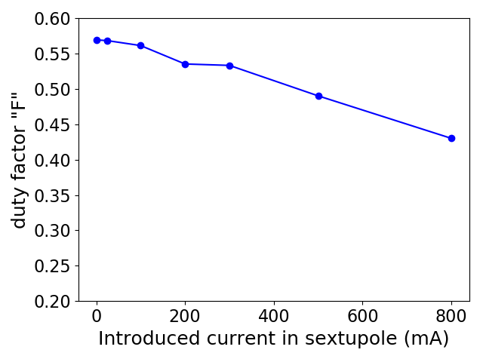
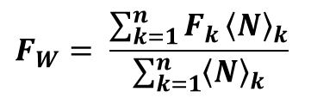


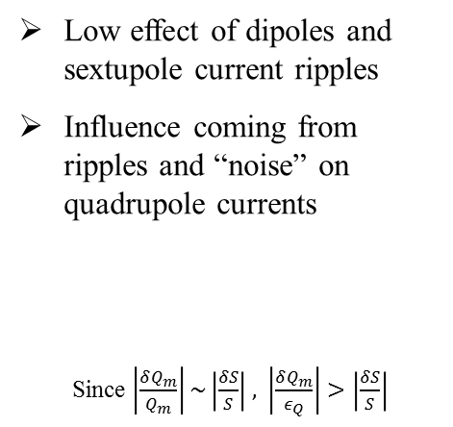



Main source: Dipoles, quads or sextupoles
$$F_{W}= \frac{\sum_{k=1}^{n}{F_{k}}{\left\langle N\right\rangle }_{k}}{\sum_{k=1}^{n}{{\left\langle N\right\rangle }_{k}}}$$
Weighted duty factor
$F_{k} and {\left\langle N\right\rangle }_{k}$ calculated on consecutive 10 ms bins
Low effect of dipoles and sextupole current ripples
Influence coming from ripples and “noise” on quadrupole currents
Since $\left|\frac{δQ_{m}}{Q_{m}}\right|\sim \left|\frac{δS}{S}\right|$, $\left|\frac{δQ_{m}}{ε_{Q}}\right|>\left|\frac{δS}{S}\right|$
Quadrupole
Quadrupole
$$F_{W}$$
$$F_{W}$$
$${δA}_{stable}∝{2A}_{stable}\left|\frac{δQ_{m}}{ε_{Q}}\right|+\left|\frac{δS}{S}\right|$$
Dipole
$$F_{W}$$
$$F_{W}$$
Sextupole
The largest ripples at 600 Hz ~ 10-15 mA broadband noise~ 5-10 mA rms
2016 measurements
2019 measurements

Slide 9
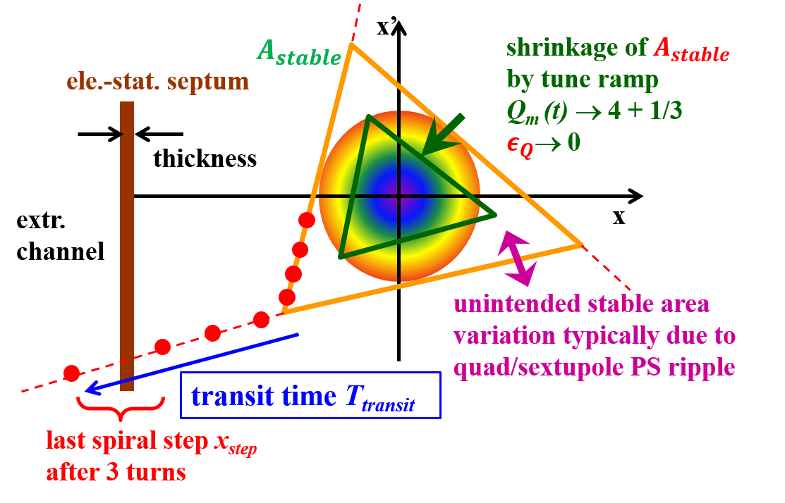




Extraction settings and transit time (Quad driven)
Steinbach diagram
Phase space
∆T_{tr}
Large S
Small S
A
B
Beam
$$ε_{Q}$$
Small $S=$ Small $ε_{Q}$
For smaller sextupole strength: Tune ramp starts close to resonance to obtain the same spill length
Particle unstable at a small amplitude: Transit time increases and spiral step decreases (amplitude dependence due to sextupole fields)
Transit time distribution is broader for small sextupole strengths
$$\overline{T_{tr}}∝\frac{1}{\overline{ε_{Q}}}$$
$${∆T}_{tr}∝\frac{{∆ε}_{Q}}{{\overline{ε_{Q}}}^{2}}$$
More details
L. Badano et al., ``Proton-ion medical machine study (PIMMS) part I'', CERN/PS/ 99-010 (DI), Geneva (1999).
PIMMS Report part 1
S. Sorge et al., ``Measurements and Simulations of the Spill Quality of Slowly Extracted Beams from the SIS-18 Synchrotron", J. Phys.: Conf. Ser. 1067 052003, (2018).
R. Singh et al., ``Smoothing of the slowly extracted coasting beam from a synchrotron", https://arxiv.org/abs/1904.09195 (2019).

Slide 10
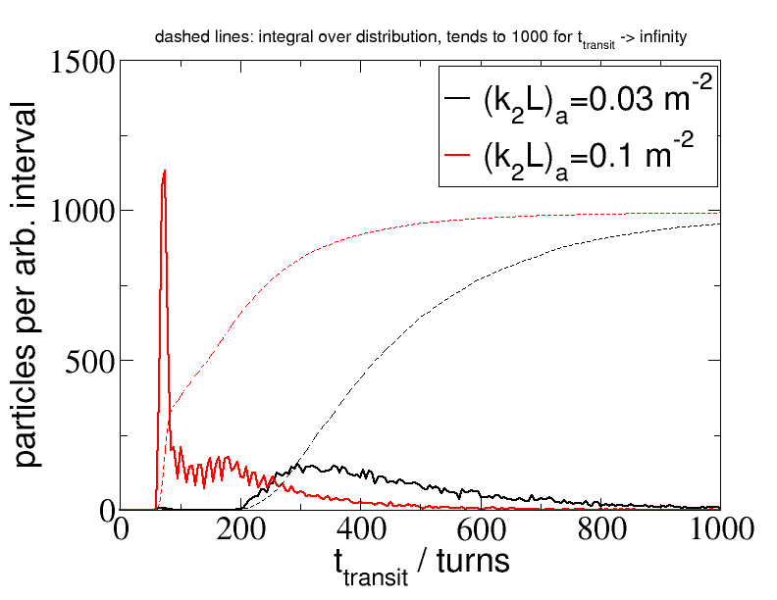
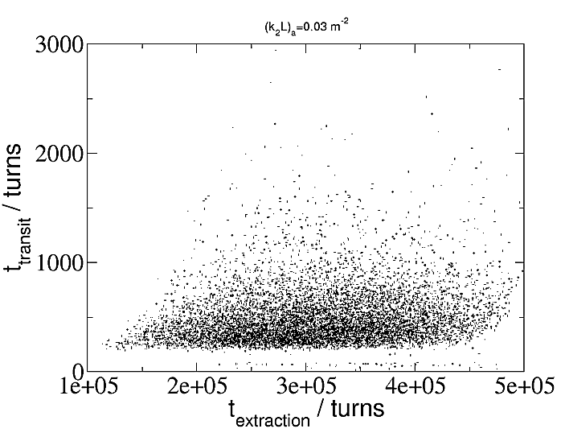
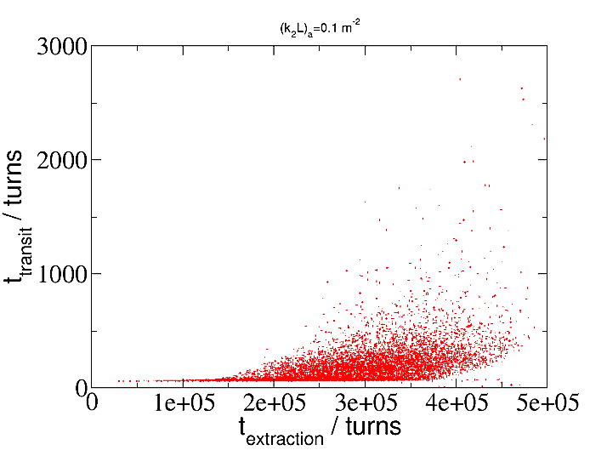
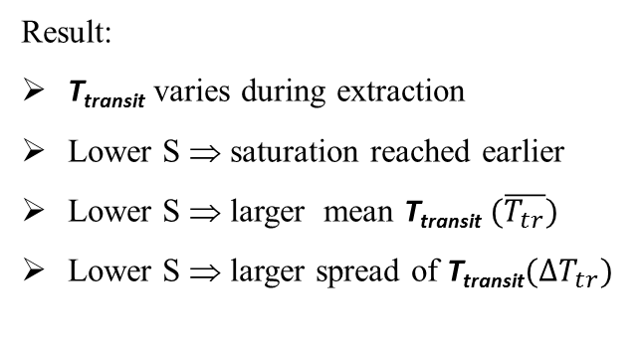
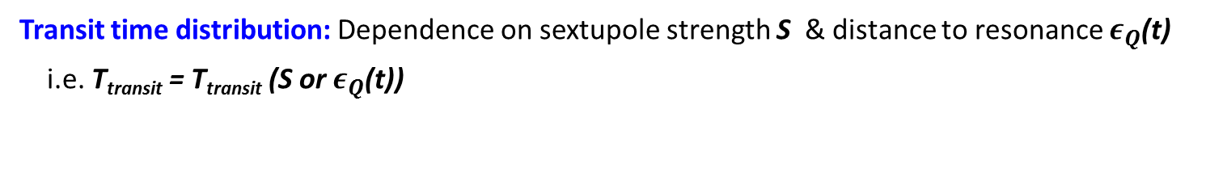


Extraction settings and transit time distribution (Quad driven)
Transit time distribution: Dependence on sextupole strength S & distance to resonance $ε_{Q}$(t)
i.e. T_{transit} = T_{transit} (S or $ε_{Q}$(t))
1 turn ~ 1 μs in SIS-18
Histogram of transit time T_{transit}
Small S
A_{β}
Small S = 0.03 m⁻²
extr.
beam
stable
beam
Large S = 0.1 m⁻²
Δp
Small S = 0.03 m⁻²
δ${ ε}_{Q}$(t)
Large S
A_{β}
extr.
beam
Large S = 0.1 m⁻²
Result:
T_{transit} varies during extraction
Lower S ⇒ saturation reached earlier
Lower S ⇒ larger mean T_{transit} $(\overline{T_{tr}})$
Lower S ⇒ larger spread of T_{transit}$({∆T}_{tr})$
stable
beam
δ${ ε}_{Q}$(t)
Δp

Slide 11



Effect of transit time (Quad driven)
A
Counts
Time
A
$$\overline{T_{tr}}$$
Convolution
B
Transit time spread
∆T_{tr}
Counts
Time
Large S
A_{β}
Only delay!
extr.
beam
B
$$\overline{T_{tr}}$$
stable
beam
Counts
δ${ ε}_{Q}$(t)
Δp

Slide 12

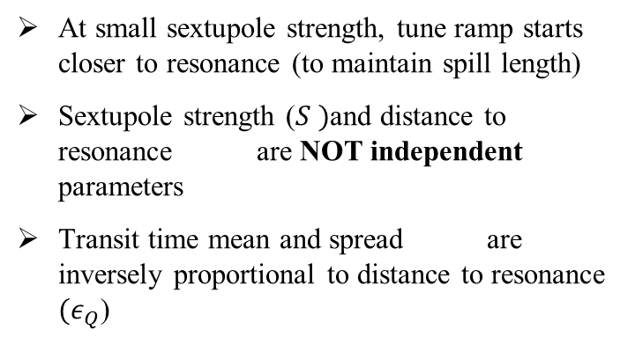

Effect of transit time (Quad driven)
A
Counts
Small S
A_{β}
extr.
beam
Time
$$\overline{T_{tr}}$$
stable
beam
Convolution
∆T_{tr}
Transit time spread
δ${ ε}_{Q}$(t)
Δp
Counts
At small sextupole strength, tune ramp starts closer to resonance (to maintain spill length)
Sextupole strength ($S )$and distance to resonance are NOT independent parameters
Transit time mean and spread are inversely proportional to distance to resonance ${(ε}_{Q}$)
B
$$\overline{T_{tr}}$$
${(ε}_{Q})$
Delay and smoothing!
Counts
∆T_{tr}
Time

Slide 13
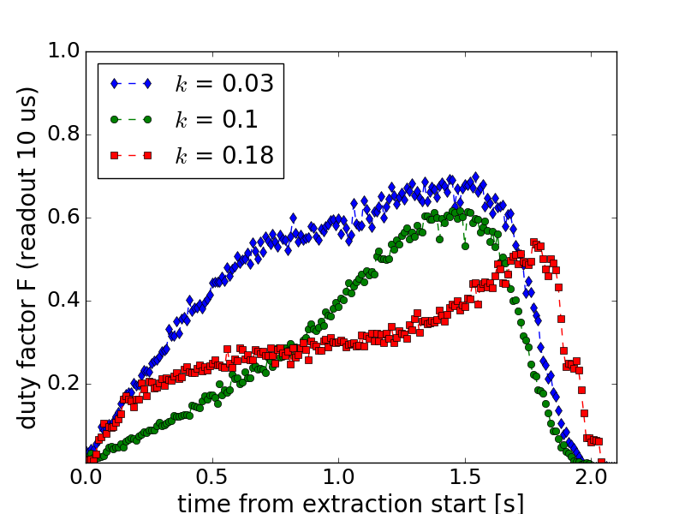
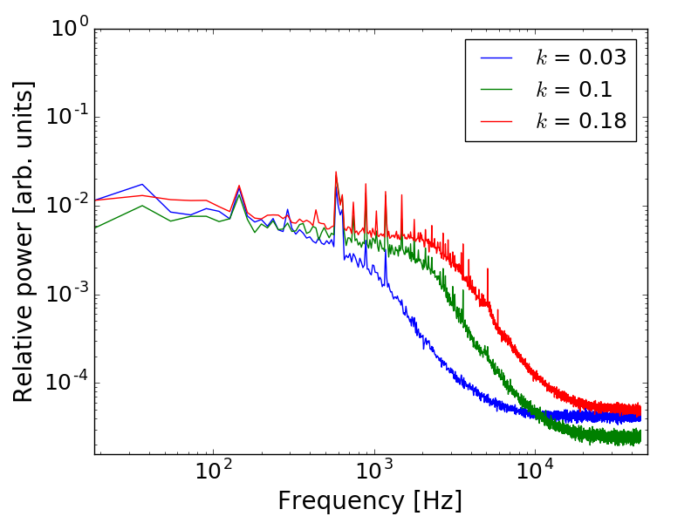
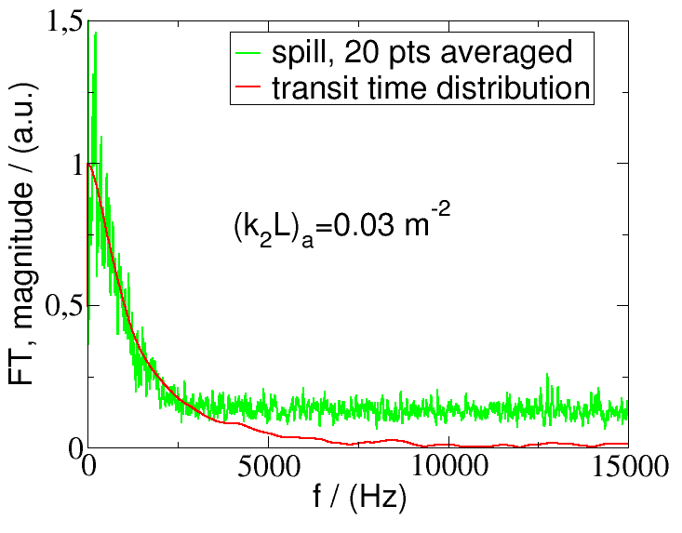
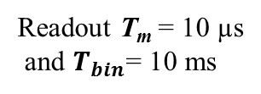
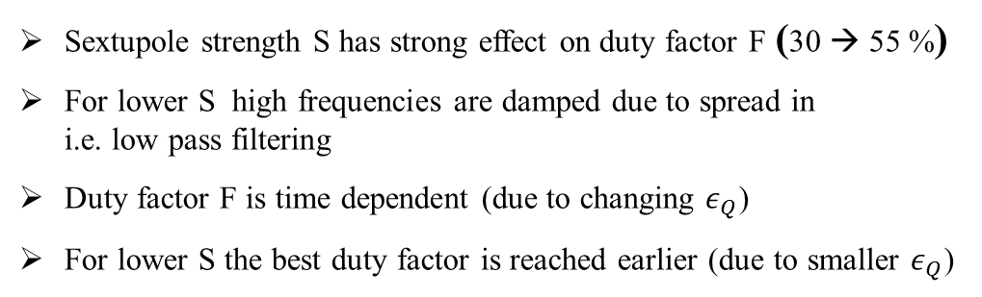


Sextupole Strength Variation: Experiments
Experiment: Ar¹⁸⁺, 300 MeV/u
Experiment: Fourier transformation
S = 0.03 m⁻²
Readout T_{m} = 10 µs
and $T_{bin}$= 10 ms
Bin size = 18 Hz
S = 0.03 m⁻²
S = 0.10 m⁻²
S = 0.10 m⁻²
S = 0.18 m⁻²
S = 0.18 m⁻²
900 Hz
4 kHz
Further lowering sextupole leads to beam losses,
spiral step x_{step} becomes too small
Sextupole strength S has strong effect on duty factor F (30 → 55 %)
For lower S high frequencies are damped due to spread in i.e. low pass filtering
Duty factor F is time dependent (due to changing $ε_{Q}$)
For lower S the best duty factor is reached earlier (due to smaller $ε_{Q}$)
Simulation
$$f_{cut}∝1/{∆T}_{tr}$$
$$f_{cut}=1/{2π∆T}_{tr}$$
13

Slide 14



Minimize transverse beam size at extraction
Case 1
Case 2
Case 3
Large S
Small S
Small S
A_{β}
A_{β}
A_{β}
extr.
beam
extr.
beam
extr.
beam
stable
beam
stable
beam
stable
beam
δ${ ε}_{Q}$(t)
Δp
δ${ ε}_{Q}$(t)
Δp
δ${ ε}_{Q}$(t)
Δp
Experimental results (C⁶⁺, 300 MeV/u)
Reduce the transverse beam size and start further closer to resonance
Multi Turn Injection : Injecting in less turns
→ reduced intensities!
Beam cooling: Cool the beam at injection with electron cooler
→ reduced cumulative events for experiments !
14

Slide 15
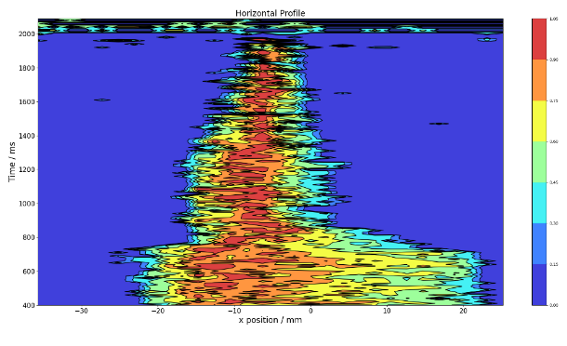
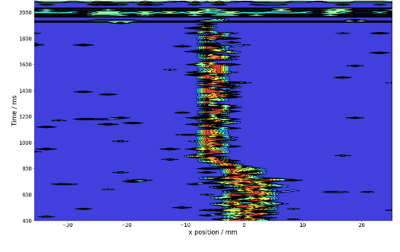
Minimize transverse beam size at extraction
Beam size measurements
Experimental results (C⁶⁺, 300 MeV/u)
200 Hz
4 kHz
10 mm
Case 1: S = 0.06 m⁻², ~10 mm (2σ)
Case 2: S = 0.03 m⁻², ~10 mm (2σ)
Case 3: S = 0.03 m⁻², ~2 mm (2σ)
15

Slide 16
Introduce external tune modulation
Counts
Introduced ripple
A
B
Counts
Modulate tune with a higher frequency 3-5 times the cut-off frequency and amplitude 5-15 times the inherent ripple (1-3% of total tune ramp)
This high frequency separatrix modulation does not allow lower frequency inherent fluctuations to “feed” on particles
Modulation frequency high enough such that it is suppressed by transit time spread → but not too high
Stable Area
Time

Slide 17
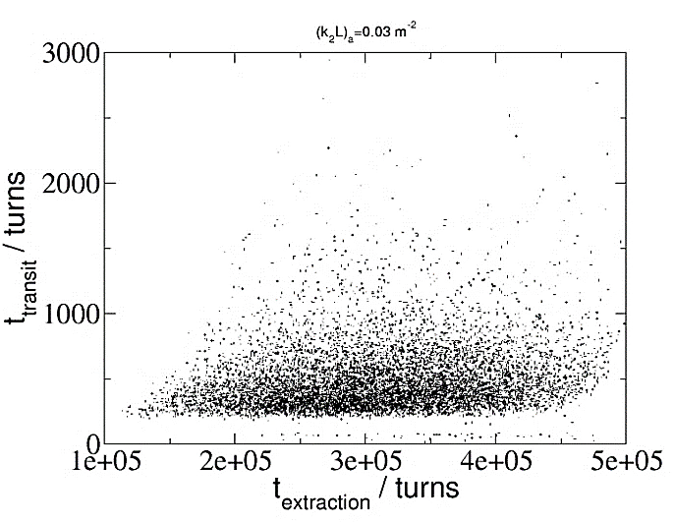




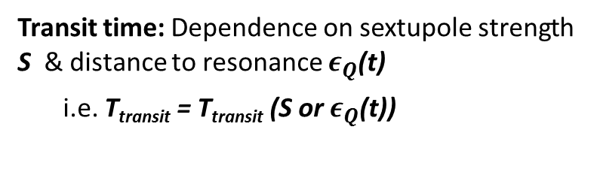
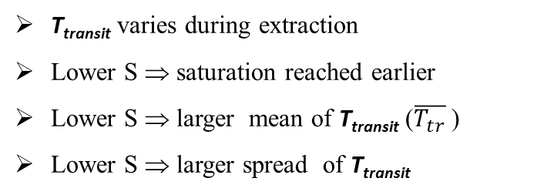

Undertanding the excitation frequency
Small S = 0.03 m⁻²
Histogram of transit time T_{transit}
$$\overline{T_{tr}}$$
$${∆T}_{tr}$$
Large S = 0.1 m⁻²
$$\overline{T_{tr}}$$
$${∆T}_{tr}$$
T_{transit} varies during extraction
Lower S ⇒ saturation reached earlier
Lower S ⇒ larger mean of T_{transit} ($\overline{T_{tr}}$)
Lower S ⇒ larger spread of T_{transit}
Transit time: Dependence on sextupole strength S & distance to resonance $ε_{Q}$(t)
i.e. T_{transit} = T_{transit} (S or $ε_{Q}$(t))
$${(∆T}_{tr})$$

Slide 18
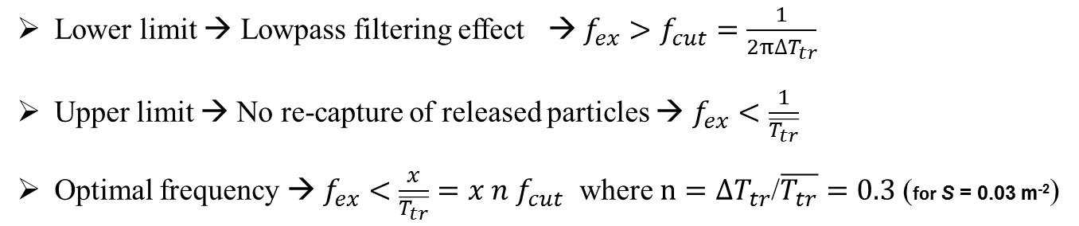


Choice of excitation frequency
Histogram of transit time T_{transit} for S = 0.03 m⁻²
$${f_{cut}<f}_{ex}<{xn f}_{cut}$$
Both $n$ and $f_{cut}$ may evolve during extraction
Lower limit → Lowpass filtering effect → $f_{ex}>f_{cut}=\frac{1}{{2π∆T}_{tr}}$
Upper limit → No re-capture of released particles → $f_{ex}<\frac{1}{\overline{T_{tr}}}$
Optimal frequency → $f_{ex}<\frac{x}{\overline{T_{tr}}}=x {n f}_{cut}$ where $n={∆T}_{tr}$/$\overline{T_{tr}}=0.3$ (for S = 0.03 m⁻²)
Transit time: Dependence on sextupole strength S & distance to resonance $ε_{Q}$(t) i.e. T_{transit} = T_{transit} (S or $ε_{Q}$(t))

Slide 19
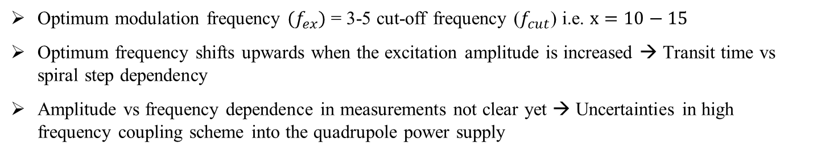
Scaling of modulation frequency with cut-off frequency
S = 0.03 m⁻²
S = 0.06 m⁻²
Measurements
Measurements
Simulations
Simulations
Optimum modulation frequency ${(f}_{ex})$ = 3-5 cut-off frequency ($f_{cut}$) i.e. $x=10−15$
Optimum frequency shifts upwards when the excitation amplitude is increased → Transit time vs spiral step dependency
Amplitude vs frequency dependence in measurements not clear yet → Uncertainties in high frequency coupling scheme into the quadrupole power supply
19

Slide 20
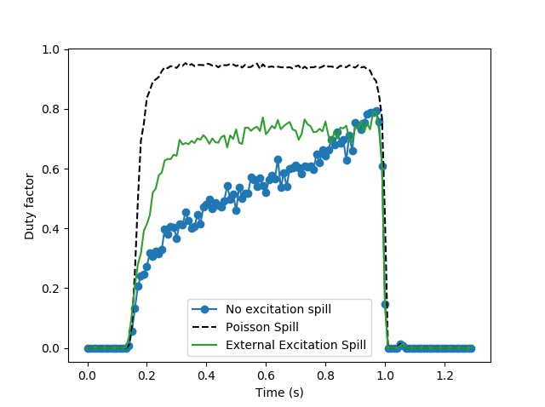
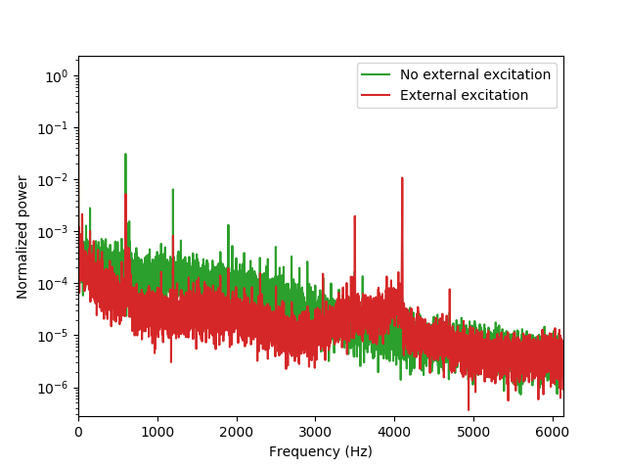
Results of tune modulation for 300 MeV/u C⁶⁺ beam
Introduced modulation
Noise reduction
Be close to resonance: Always use as low sextupole strength and beam size as possible and always start tune ramp close to resonance
Excitation method was not optimized: Since the transit time spread evolves (increases from low to high) based on tune ramp, apply a decreasing frequency sweep correlated to tune ramp
Even when excitation was not triggered, no effects visible on the normal operation
20

Slide 21
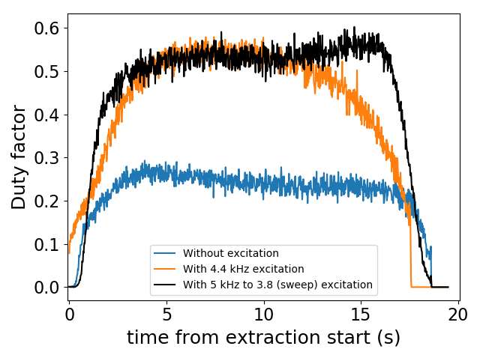
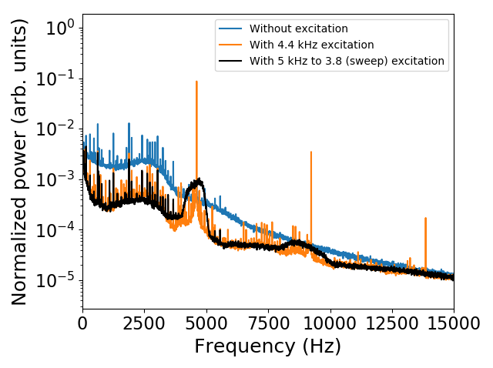
Tune modulation with 1.58 GeV/u Ag⁴⁵⁺ (HADES) beam
Noise reduction
Introduced excitation
Be close to resonance: Always use as low sextupole strength and beam size as possible and always start tune ramp close to resonance → done
The transit time spread evolves (increases from low to high) based on tune ramp, apply a frequency sweep correlated to tune ramp. → Triggered linear sweep applied
Amplitude still not optimized (150 mA applied i.e. 15 times of inherent 600 Hz)
21

Slide 22
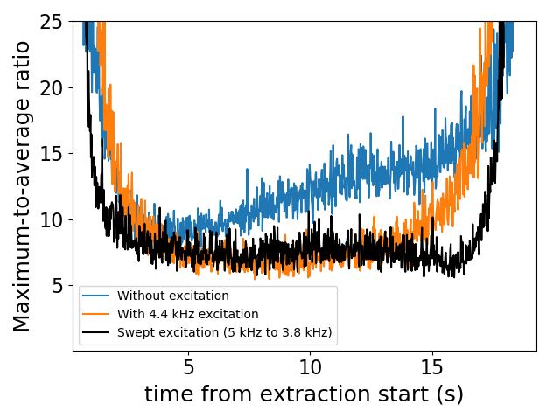
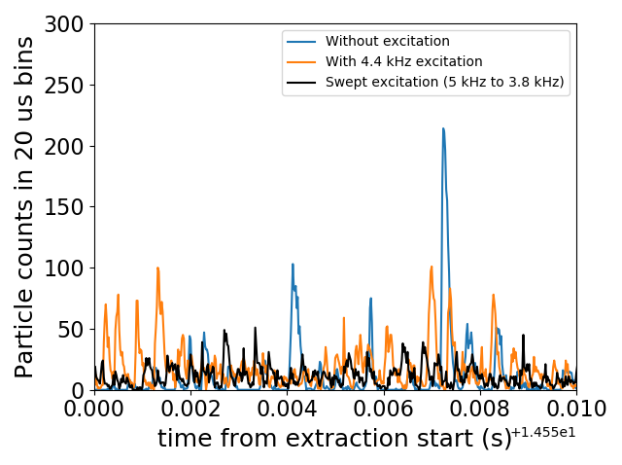
Tune modulation with 1.58 GeV/u Ag⁴⁵⁺ (HADES) beam
20 s spills
Translates directly
into beam-time days!
Buy 2 get 1 free offer !!
22

Slide 23
HADES Collaboration in Slow extraction workshop 2016

Slide 24
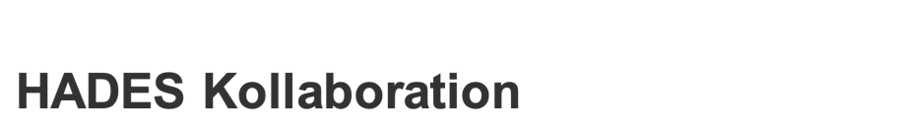
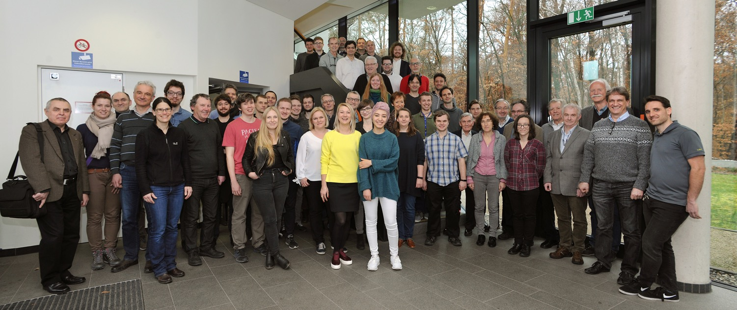



Wir strahlen immer noch!
Wir bedanken uns herzlichst für die perfekte Zusammenarbeit!

Slide 25



Putting into context: Quad-driven vs Knock-out extraction
Quad-driven
Knock-out
A_{β}
A_{β}
extr.
beam
extr.
beam
stable
beam
stable
beam
δ${ ε}_{Q}$(t)
Δp
Transverse Exciter
Δp
Spill Begin
Spill End
Spill Begin
Spill End
Transit time spread increase towards the end of spill is the improvement mechanism
Similar trend for bunched beams
Fast separatrix crossing towards the end of spill is the improvement mechanism
Excitation noise spectrum plays an important role

Slide 26



Conclusion and Outlook
Current fluctuations in Quadrupole power supplies → difficult to improve power supplies further
Disease
Optimization of extraction settings, i.e. $ε_{Q}$, $S$ and beam size for inducing a large transit time spread → provides ``natural“ suppression of fluctuations
Increase Immunity
Tune modulation at 3-5 $f_{cut}$ with of inherent noise → modulation itself suppressed by the transit time spread while reducing low frequency inherent fluctuations
$I_{ex}$= 5-15
Vaccination
Combine with a feedback system on coherent components at 600 Hz and 1200 Hz
Prevention
Cure → Is a feedback system with 3-4 kHz bandwidth possible with delay (transit time)?
Investigations needed for knock-out extraction → no simulations or experiments about the effect of tune modulation
26

Slide 27
Tune modulation with 1.58 GeV/u Ag⁴⁵⁺ (HADES) beam
Buy 4 atleast get 3 !!
27

Slide 28



Coasting vs Bunched beam extraction
Binning with 10 Hz
and 9 spill average
Bunched beam: T_{m} =11 µs, T_{bin} =10 ms
Coasting beam: T_{m} =11 µs, T_{bin} =10 ms
Start
End
Same machine settings

Slide 29









Coasting vs bunched beam for event rates
Important terms: Mean extraction rate $N_{rate}$ ; Max-to-mean ratio $r$ ; Detector time resolution $T_{det}$; Time between bunches $T_{rf}$ ; Bunching factor $B_{f}=I_{av}/I_{pk}$
Tune distribution along the synchrotron
$$(Q)$$
Coasting beam extraction
Bunched beam extraction
$$Q_{res}$$
$$Q_{res}$$
$$Q$$
$$Q$$
s
s+C
s
s+C
Condition for maximum event rate
$N_{rate} r T_{det}$ = 1
Condition for maximum event rate
$N_{rate }r {(T}_{rf}/{ B}_{f})$= 1
Improvement in coasting beam $r$ proportionally increases $N_{rate}$
Bunched beam trades-off $r$ with $B_{f}$ and $T_{rf}$ if $T_{rf}>T_{det}$
If $T_{det}$ >> $T_{rf}$, coasting beam condition applies

Slide 30

Putting into context: Bunched beam extraction
Histogram of arrival time:
‘Bunch’ duration during extraction:
1/2 rf-period
10 s extraction
20 ns
‘Bunch’ width
2σ = 11 ns
1 ns
‘bunch’ width σ [ns]
Results:
‘Bunch’ duration at target in the range of 2σ ≈ 10 ... 30 ns even for energies of some 100 MeV/u
‘Bunch’ duration at target much shorter than bunch length inside SIS18
Reason: Only ions with extreme value of Δp/p are extracted

Slide 31


Putting into context: Knock-out vs Quad-driven extraction
Bunched Quad driven
Bunched knock out
Spill Begin
Spill End
Spill Begin
Spill End
Transit time spread increase towards the end of spill is the improvement mechanism
Fast separatrix crossing towards the end of spill is the improvement mechanism
Excitation noise spectrum plays an important role

