Slide 2
ALTERNATIVE MATERIAL CHOICES TO REDUCE ACTIVATION OF EXTRACTION EQUIPMENT
Bruno Balhan, Daniel Björkman, Jan Borburgh, Francesco Cerutti, Luigi S. Esposito,
Matthew A. Fraser, Brennan Goddard, Linda S. Stoel, Helmut Vincke

Slide 3
Outline
Introduction
Alternative e.s.materials considered using ActiWiz
Fluka simulation results for the SPS s.x. region
Cost benefit analysis
Conclusions

Slide 4
Introduction
Low-Z materials could be selected for the vacuum vessel, or even the anode support.
J-Parc built a Ti vacuum vessel, anode support and endplates to reduce residual radioactivity [1]
LEP used Al vacuum chambers
CERN PS electrostatic septa use Al anode supports

Slide 5
Alternative materials considered
Electrostatic septum tank:
Stainless steel: dimensions as present
Aluminium: 67% thicker material (10 mm tank body, 50 mm covers)
Titanium: 33% thinner material (4 mm tank body, 25 mm covers)
Anode (dimensions identical for all cases):
Stainless steel
Invar
Titanium

Slide 6
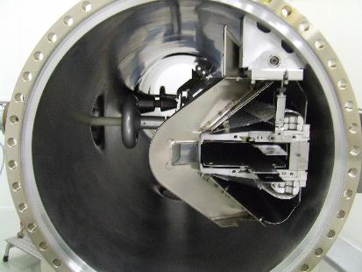
Actual SPS e.s. simplified model
Tank: 3.2m x Ø0.6m tank made of stainless steel 304L, 6 mm thick sheet.
Anode support: 3.1m x 200 x 94 mm C-shaped support made of Invar or stainless steel.
Accessories and supports neglected
for the time being.

Slide 7
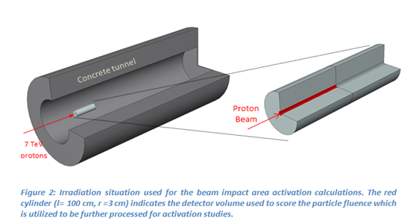
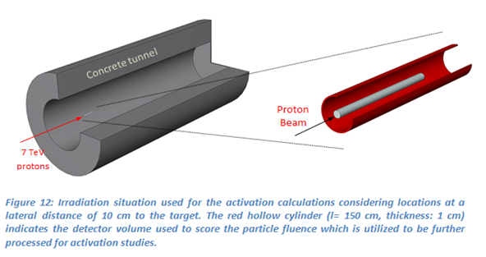
ActiWiz Modelling
 | Tank |  | Anode
 | Weight [kg] | Volume [dm³] | Weight [kg] | Volume [dm³]
Stainless steel | 367 | 47 | 239 | 30
Aluminium | 211 | 78 | n.c. | n.c
Titanium | 146 | 33 | 135 | 30
Invar | n.c. | n.c. | 245 | 30
 | ZS tank
 |  | anode
Case 1: Activation occurring at the beam impact area
Case 2: Activation occurring at 10 cm lateral distance to the target

Slide 8
Activation in operation for various tank/anode material combinations
First estimates obtained using ActiWiz [2].

Slide 9
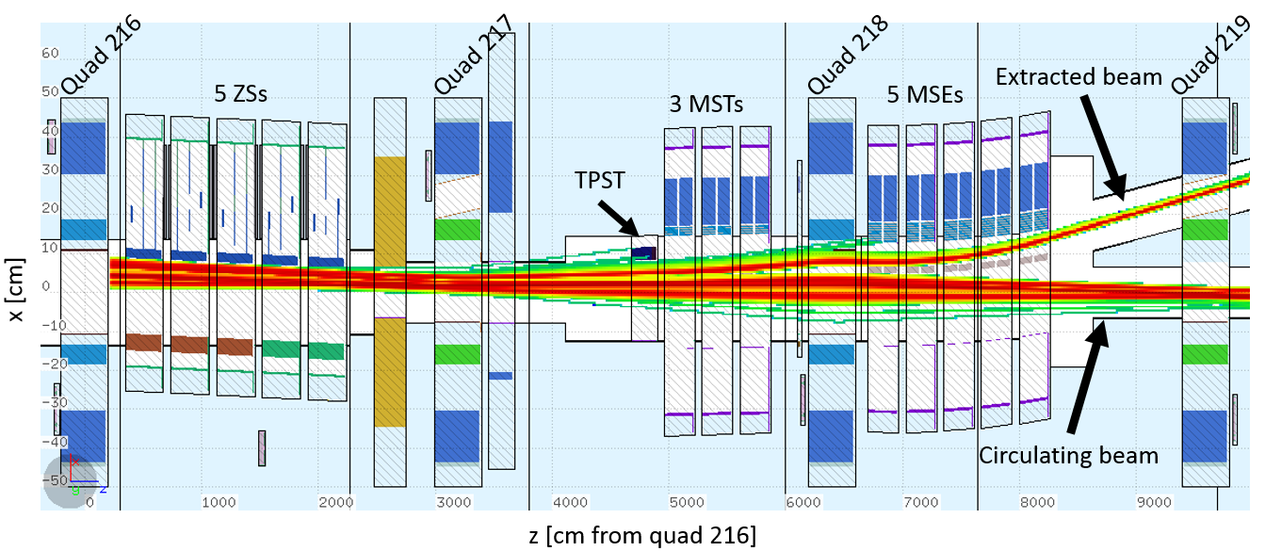
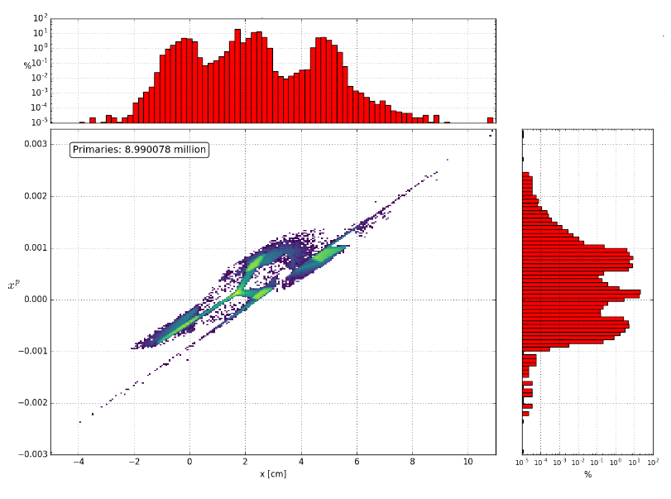
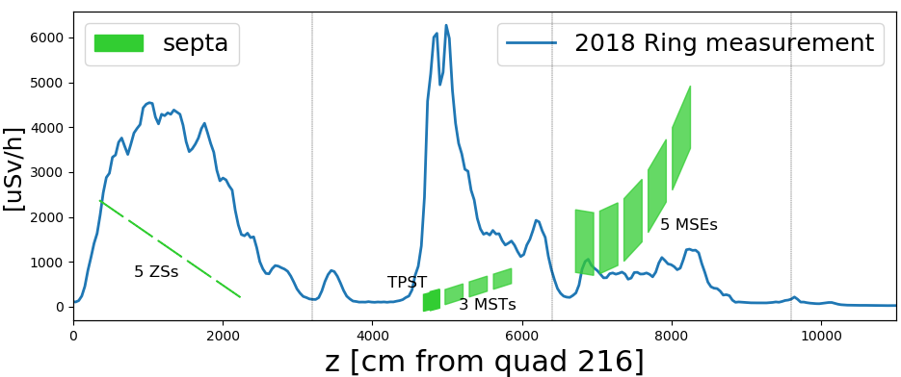
Fluka simulation of the CERN SPS slow extraction channel (LSS2)
LSS2 Fluka model [1,2]
Source representing last four turns of the third-integer resontant slow extraction process
MADX input distribution including contribution from protons scattered off ZS septa [3,4]

Slide 10
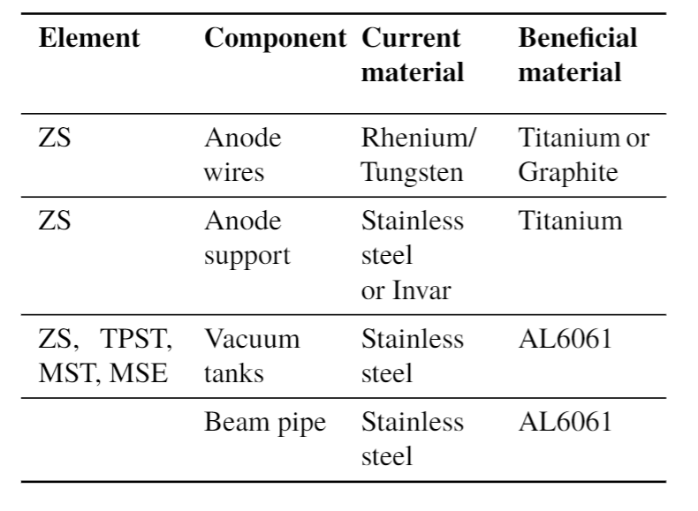
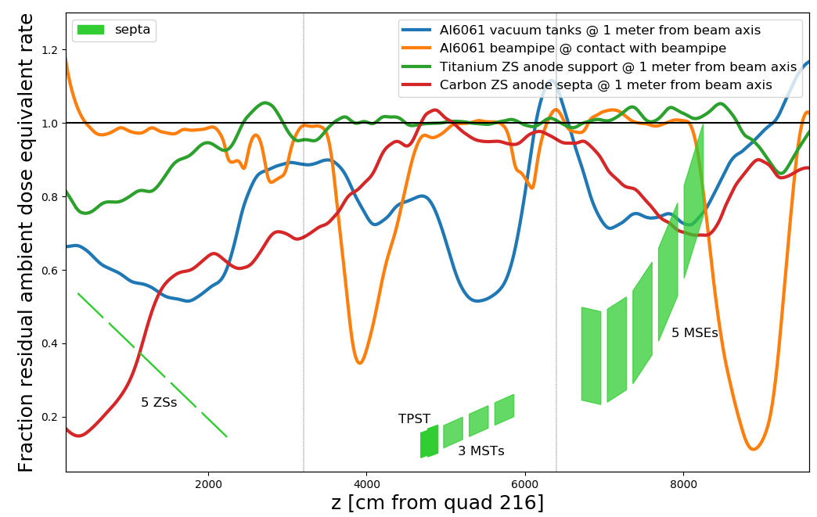
Overview of material exchange
All material exchanges have been found to be radiologically advantageous through both the FLUKA and Actiwiz codes [2-4].
1 week cool down

Slide 11
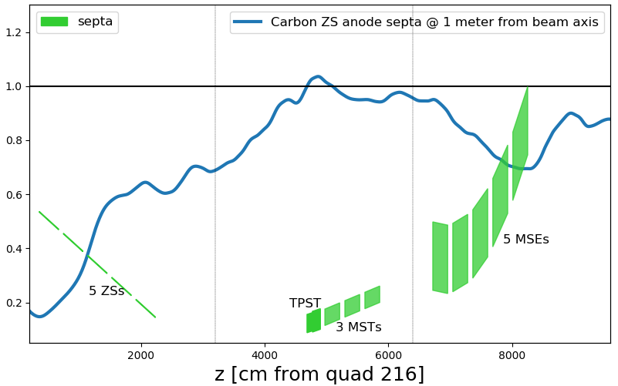
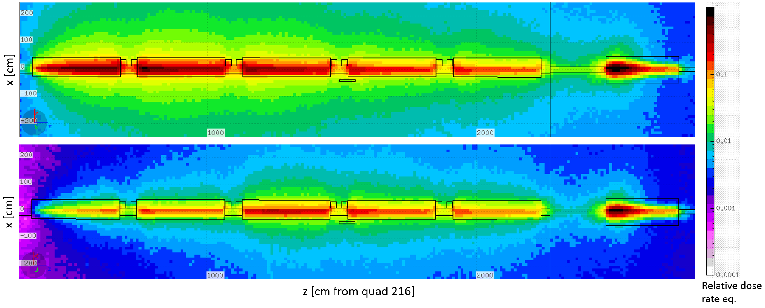
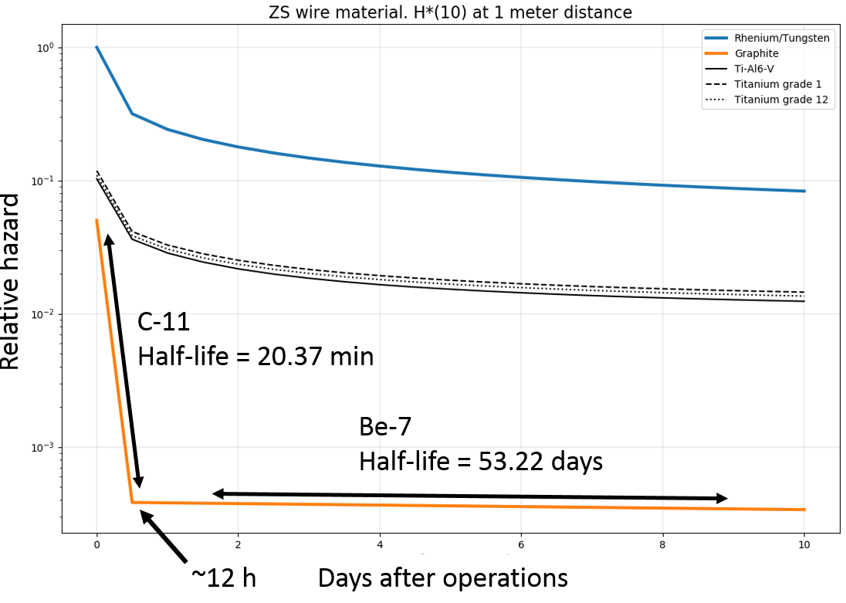
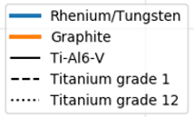
Carbon vs. WRe septum wires
ZS region
Current setup after 30h cooldown
Fraction residual dose rate
Pessimistic*
Carbon nanotube septa after 30h cool down
1 week cool down
FLUKA residual dose rate comparison for the ZS tanks of the current setup (top) to a carbon nanotube (CNT) wires setup (bottom), simulated as graphite, in tanks ZS1 and ZS2.
*Scattered particles off ZS septa same as for the reference case with WRe wires
ZS wire septa radiological contribution at 1 meter distance
CNT wires provoke less secondary particles → Less activation throughout the extraction region
Implementation challenge: CNT wires for ZS have not yet been demonstrated to be compatible with high electric fields
Notes:
reduced probability of hadronic interactions between the beam particles and the nuclei of the lower-Z wire septa

Slide 12
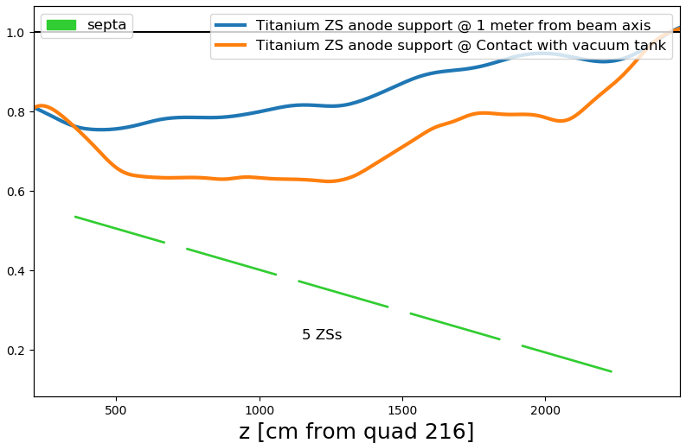
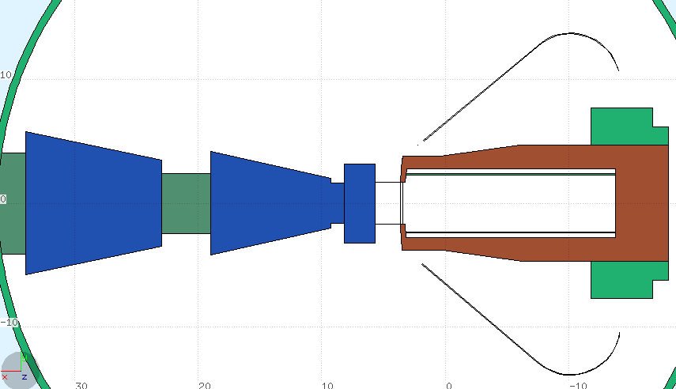
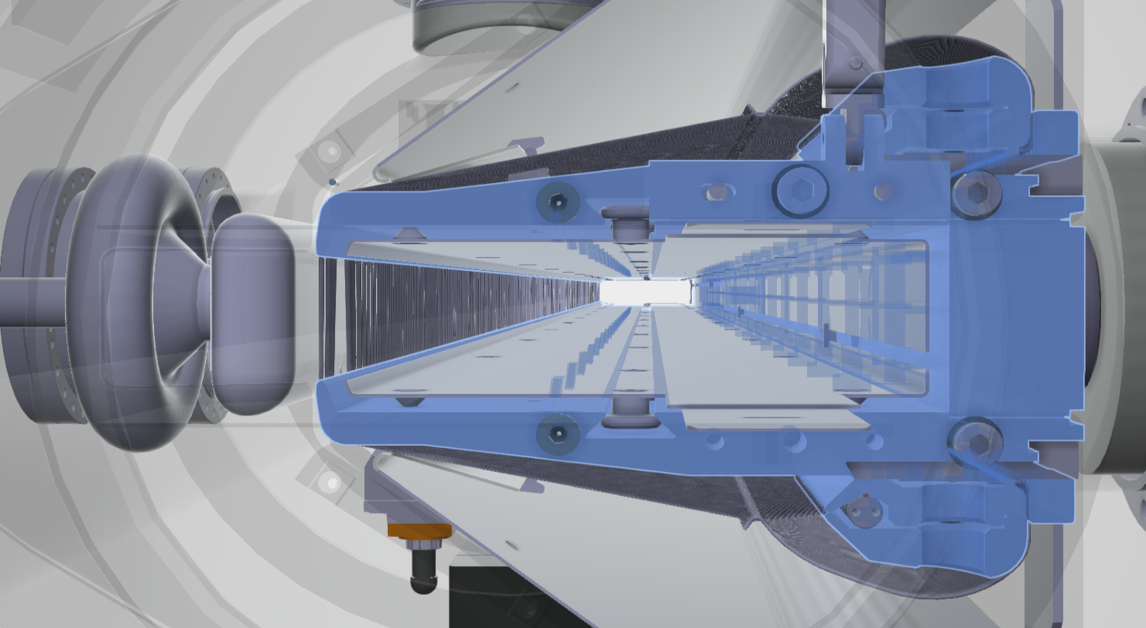
Titanium vs Invar /Stainless steel anode supports
Fraction residual dose rate
Anode support
1 week cool down
Reduced residual radiation hazard in the ZS region
Strongest effect for first 2 tanks
Implementation challenge: will Ti anode support keep wire array straight under operational conditions?

Slide 13
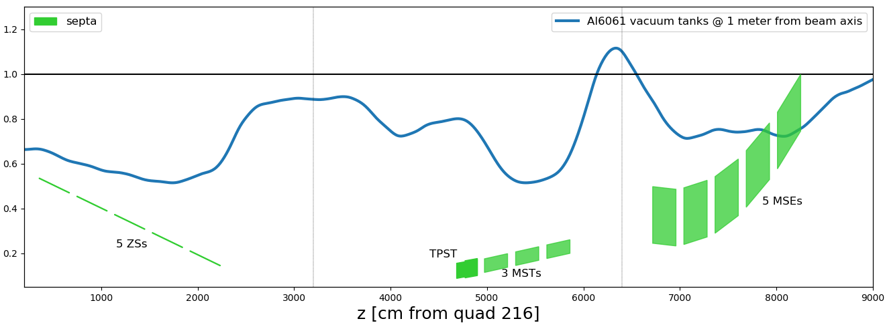
Aluminum vacuum tanks
Reminder:
Tanks exchanged for ZSs, TPST, MSTs and MSEs
Fraction residual dose rate
1 week cool down
Al vacuum tanks can reduce residual dose rate at 1 meter distance by almost half
Al Vacuum tanks directly addresses some of the hottest parts of the extraction beamline
Implementation challenge: development of large Ø590 mm flanges

Slide 14
Aluminum vs stainless beampipes between elements
Most beneficial area
~10 m
~11.3 m
1 week cool down
0.047
Multiple beneficial zones throughout the beamline
Comparatively simple to implement

Slide 15
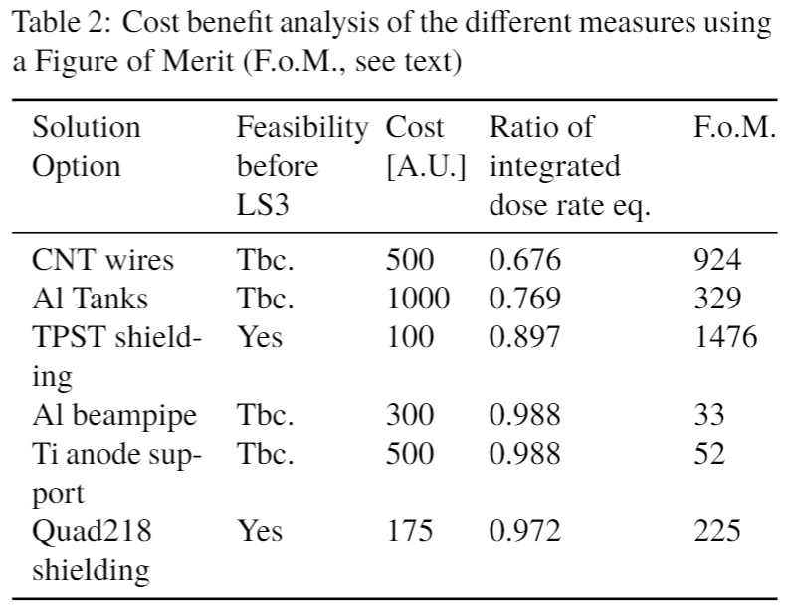
Cost-Benefit analysis [5]
Conservative estimate:
Scattered particles off ZS septa same as for the reference case with WRe wires
F.o.M. = (Integrated measurement – integrated measurement * local reduction factor) /cost
→
F.o.M. = (Saved integrated residual dose rate exposure) /cost
TPST shielding is the most cost-effective solution alternative
CNT wires and Al Vacuum tanks are the most efficient at reducing residual radiation exposure throughout the extraction region

Slide 16
Conclusions
CNT wires and Al vacuum tanks are the most efficient at reducing residual radiation exposure throughout the extraction region.
Al6061 for non baked tanks and AL2219 for bake tanks appear suitable vacuum tank materials.
TPST shielding is the most cost-effective measure.
Alternative to low Z anodes: use hollow electrodes, deflectors → maybe 3D printing ?
Notes:
sheet metal work is these days not a widely available skill anymore with the widespread use of CNC milling machines

Slide 17
References for further reading
M. Tomizawa, “ Slow extraction at J-Parc”, GSI Slow extraction workshop 1-3- June 2016, Darmstadt
C. Theis and H. Vincke, "ActiWiz - optimizing your nuclide inventory at proton accelerators with a computer code", Health Phys., vol 4, pages 228 - 232, 2014.
D. Björkman, "First RP results of the ZS material inventory using the LSS2 FLUKA model”, CERN, Geneva, Switzerland, 1 Aug. 2018. https://indico.cern.ch/event/744318/
D. Björkman, "LSS2 material inventory and shielding suggestion based on the LSS2 FLUKA model”, CERN, Geneva, Switzerland, 21 Nov. 2018. https://indico.cern.ch/event/774574/
D. Björkman et al., “ALTERNATIVE MATERIAL CHOICES TO REDUCE ACTIVATION OF EXTRACTION EQUIPMENT”, IPAC 2019, Melbourne Australia
C. Germain et al., “Technical developments of the CERN electrostatic program”, 2nd Int. Symp. On Insulation of High Voltages in Vacuum, p.279 -291, Boston (1966).
C. Geyer, “Da electrostatische Septum des Heidelberger Testspeicherrings TSR”, Max-Planck_Institut fuer Kernphysik, Heidelberg, 1988
M. Thivent, “Developpements liés à la construction des déflecteurs Electrostatiques:, PS/PSR/Note 83-8, 1983
A. Mamun et al., “TiN coated aluminum electrodes for DC high voltage electron guns”, Journal of Vacuum Science & Technology A 33, 031604 (2015)
V. Nagalsaev, “Requirements, Design and Challenge of slow extraction for the Mu2E experiment at Fermilab”, GSI Slow extraction workshop 1-3- June 2016, Darmstadt
J. Borburgh, “ZS HW modifications”, SLAWG #5: SE loss reduction brainstorming 1/9/2016, https://indico.cern.ch/event/562757/
J. Borburgh, “Activation reduction due to different septum tank materials”, SLAWG #7: P.o.t. scaling, septa materials and activation reduction prioritisation, 28/9/2019, https://indico.cern.ch/event/570165/
D. Björkman, "Progress on the LSS2 FLUKA model", CERN, Geneva, Switzerland, 5 Apr. 2017. https://indico.cern.ch/event/621754/
D. Björkman and L.S. Esposito, "Optics and loss proﬁle of the LSS2 FLUKA model”, CERN, Geneva, Switzerland, 4 Jan. 2018. https://indico.cern.ch/event/687186/

Slide 18
Back up slides

Slide 19
Low Z tanks, supports
 | Inox 304 | Al (6061) | Ti-A6-V
Young’s modulus [GPa] | 200 | 69 | 120
Yield strength [MPa] | 200 | 120 | 760
Density [Mg/m³] | 7.85 | 2.7 | 4.43
Global RP hazard evaluation (operation) 1 week* | 0.89 | 0.29 | 1.04
Global RP hazard evaluation (waste) 1week* | 1.84 | 0.36 | 0.92
Global RP hazard evaluation (operation) 20 years* | 0.78 | 0.26 | 0.77
Global RP hazard evaluation (waste) 20 years* | 1.00 | 0.18 | 1.38
Present steel ZS tank 6 mm wall thickness. Would end up with 10 mm in Al and < 6 mm in Ti (buckling not considered).
RP risk (Actiwiz): long term Ti similar to steel but worse for waste; Al alloy most suitable.
*ActiWiz data, see actiwiz.cern.ch

Slide 20
ActiWiz radiological hazard factors
To establish the radiological hazard factors the following approach was used:
Operational hazard factor: the volume of each topology (tank volume) is multiplied by the compound risk factor.
Waste hazard calculation: a normalised hazard factor is calculated based on the weight of the anode and the tank ratio.

Slide 21
Global radiation hazard for activated materials as waste
First estimates obtained using ActiWiz, for various combinations of tank/anode materials.

Slide 22
Aluminium alloys for tank
Al 6061
easy to machine, easily weldable, most commonly used general-purpose alloy,
compatible with vacuum applications,
Al 6000 series looses strength when heated up: not recommended for bake-able tank.
Al 2219
Strong, alloyed with copper,
More difficult to weld than other Al alloys,
Susceptible to stress corrosion cracking, increasingly replaced by 7000 series (alloyed with zinc),
Can be used for bake-able application.
Al 5083
Strong, alloyed with magnesium,
More difficult to weld than Al 6061,
5083 retains strength after welding. It has the highest strength of the non-heat treatable alloys, but is not recommended for use in temperatures in excess of 65°C.

