Slide 1
Mu2e Electrostatic Septa Volumetric Exchange of FC-40 Dielectric in High Radiation Environments
Matthew Alvarez
June 20, 2019

Slide 2
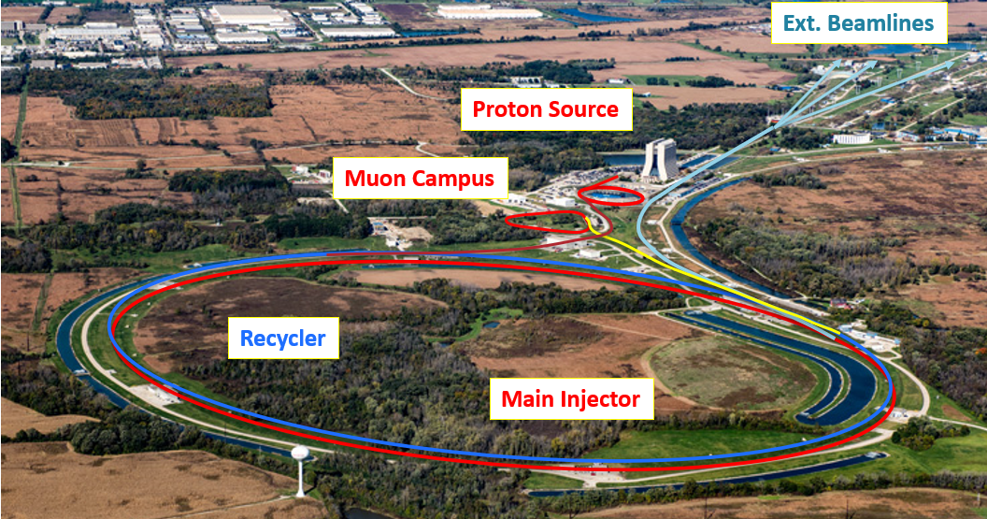
Outline
Introduction
Background
Mechanical Design of HVF
Test Setup
Results

Slide 3
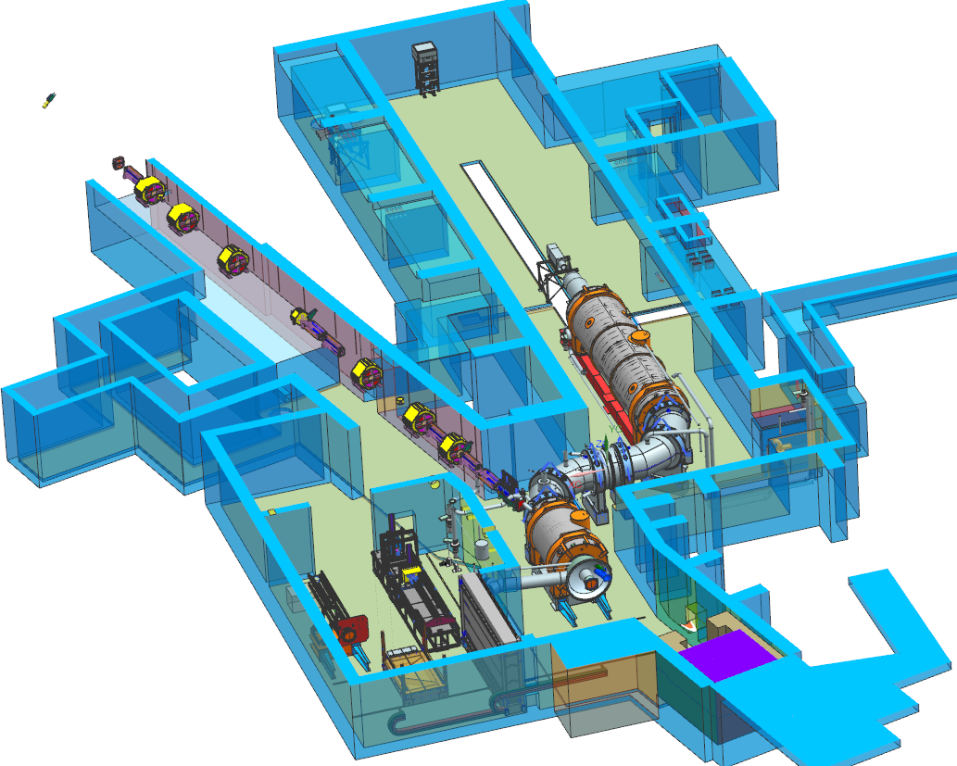
Introduction
Mu2e Experiment
8GeV Proton Beam needed to observe Muon to Electron Decay.
Requires Septa to deliver beam from the storage ring.
Mu2e proposes to measure the ratio of the rate of the neutrinoless, coherent conversion of muons into electrons in the field of a nucleus, relative to the rate of ordinary muon capture on the nucleus:
Mu2e TDR, arXiv:1501.05241

Slide 4
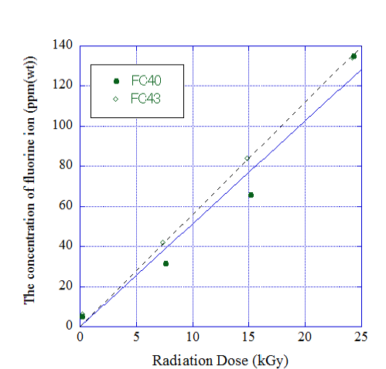
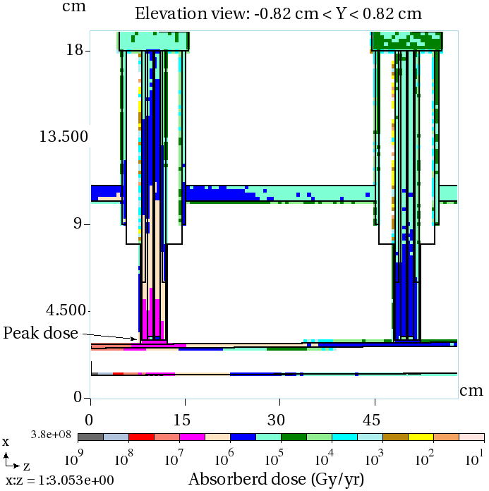
Background
JPARC Test Results
Electrostatic Septa
100kV nominal voltage is used to extract the beam for the Mu2e experiment.
MARS simulations show
HVF sees 1e7Gy/yr
High radiation was observed during extraction near the septa in the AP-30 region.
Radiation exposure of the HVF indicate likely breakdown of the FC-40 insulating capabilities.- Voltage Instabilities)
Creates toxic gases.
5 ppm/hr

Slide 5
Background
5PPM/hr of Fluorine ions generated
Free fluoring ions can recombine into hydrofluoric acid and Perfluoroisobutlylene (PFIB)
Very dangerous when inhaled or in contact with your skin. Therefore, it is bad for the equipment.
What is the danger level for humans?
3ppm in air according to National Research Council Subcommittee on Acute Exposure Guideline Levels.
We need to mitigate this by having an FC-40 Recirculating HVF with chemical filters.

Slide 6
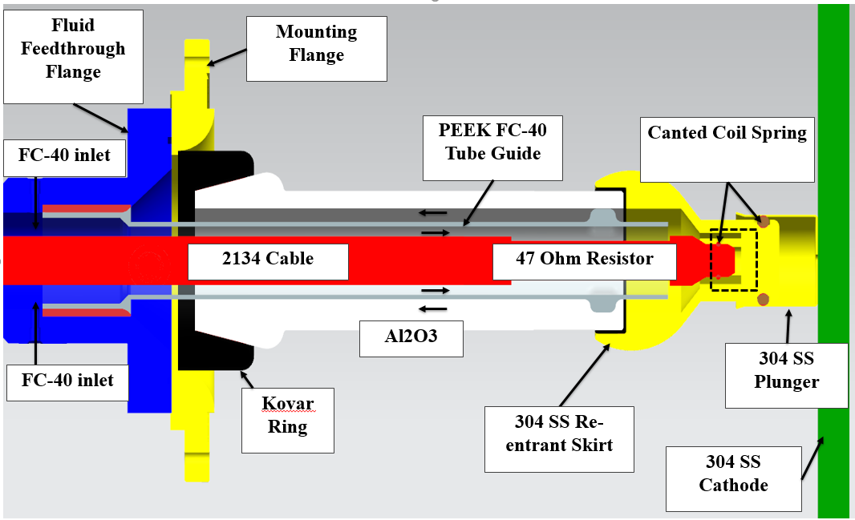
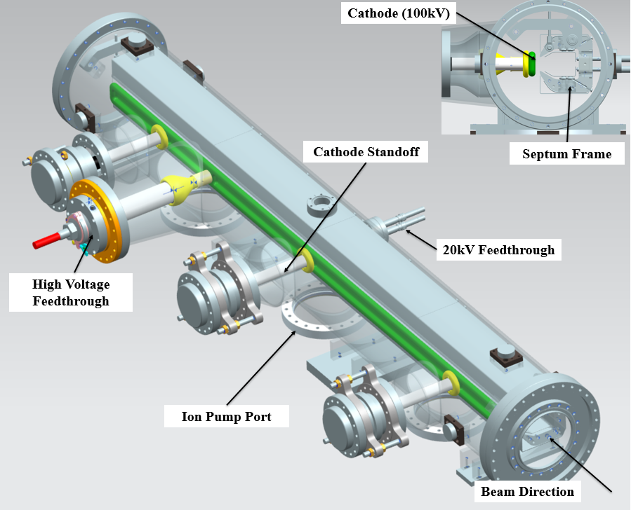
Mechanical Design of HVF
Recirculating FC-40 through the HVF

Slide 7
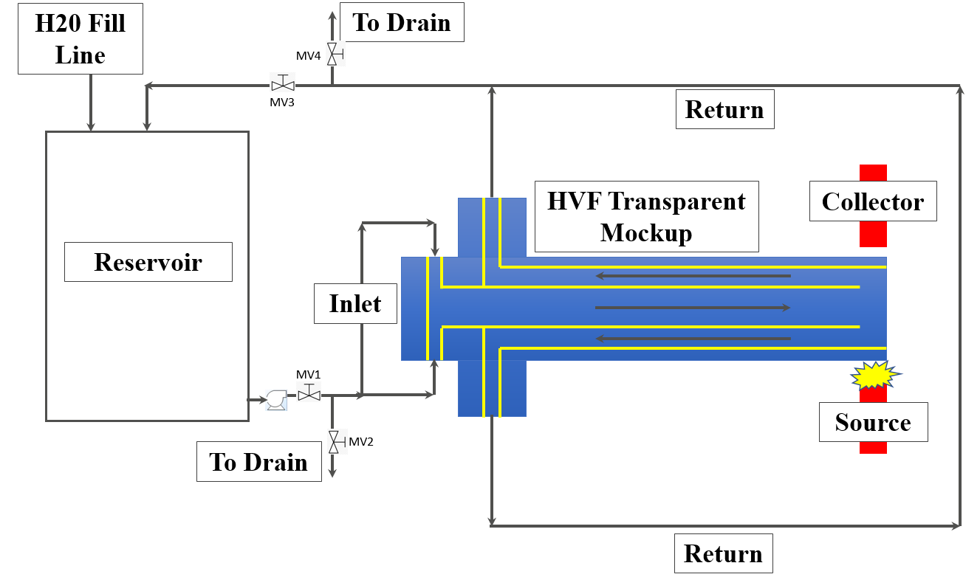
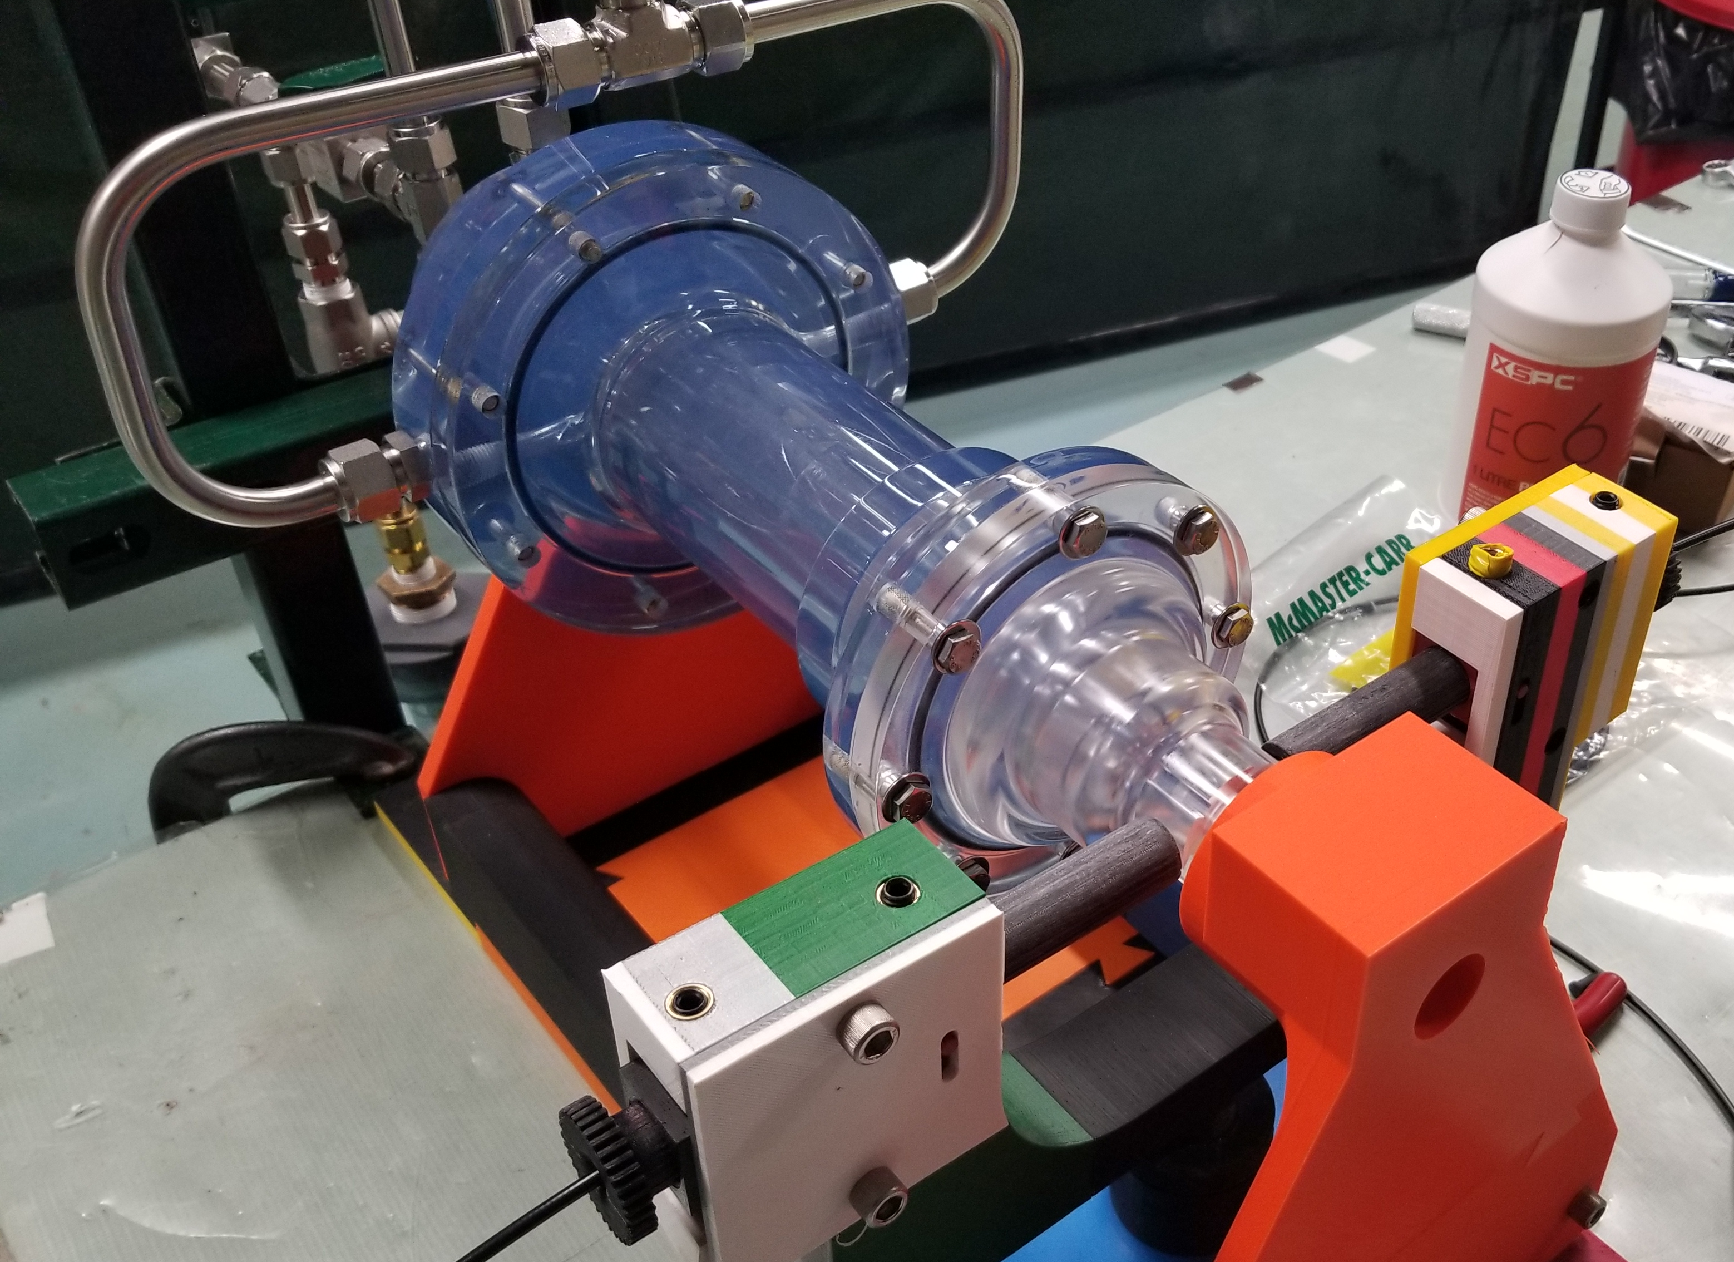
Test Setup
Water as the working fluid
StellarNet Portable Black-Comet-SR Spectrometer (190nm-850nm)
1.9LPM flow rate (0.5GPM)
10Hz sample rate (for 15s) measured 350nm to 846nm wavelengths

Slide 8
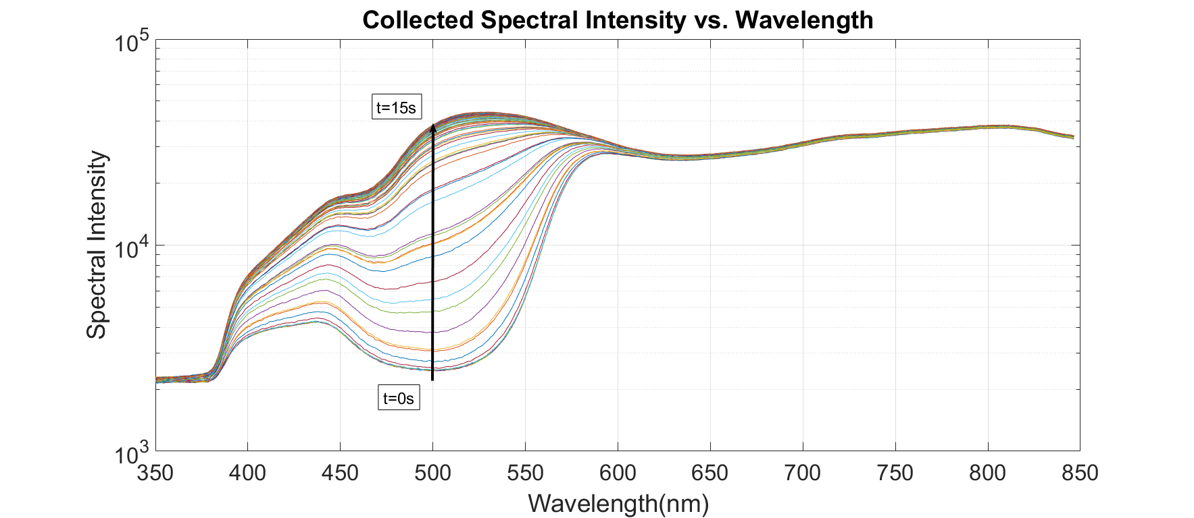
Results: Raw Data Spectral Intensity
Low spectral intensity (SI) observed due to the dye absorbing the light. Note: The mockup was filled with dyed water first then purged.
More light passes through the region of interest therefore increasing the SI

Slide 9
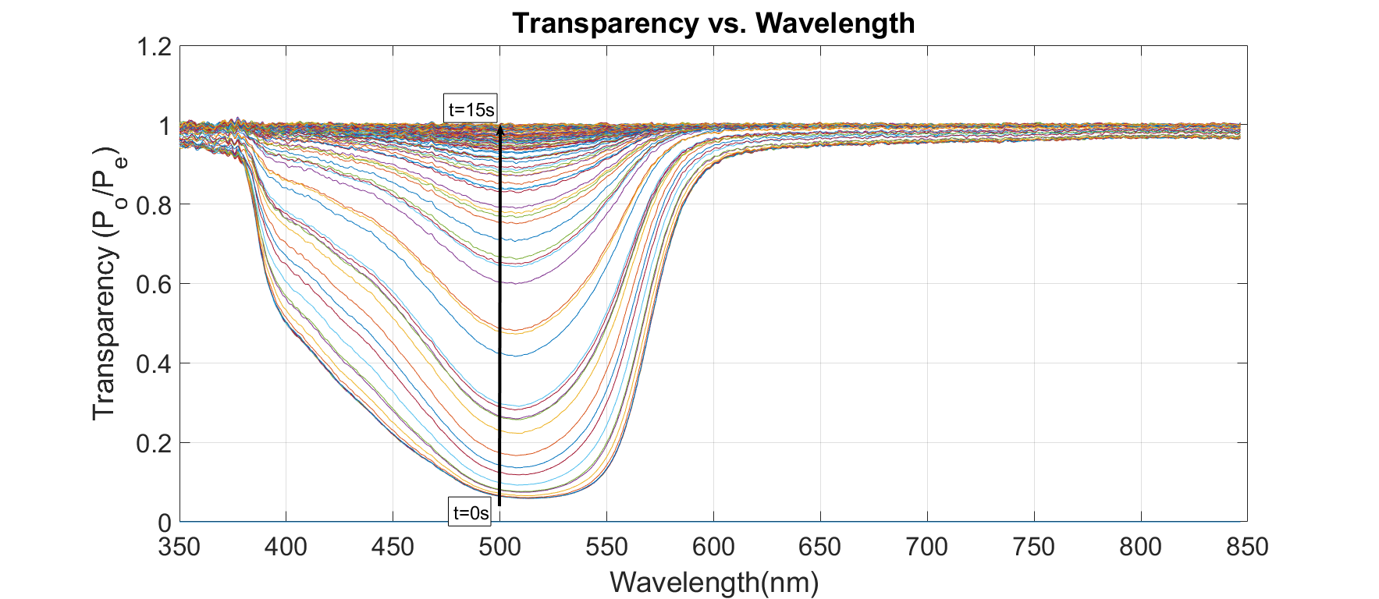
Results: Transparency
Spectral Transparency (ST)- ratio of collected light to emitted light
ST nears 1-> region becomes more transparent

Slide 10
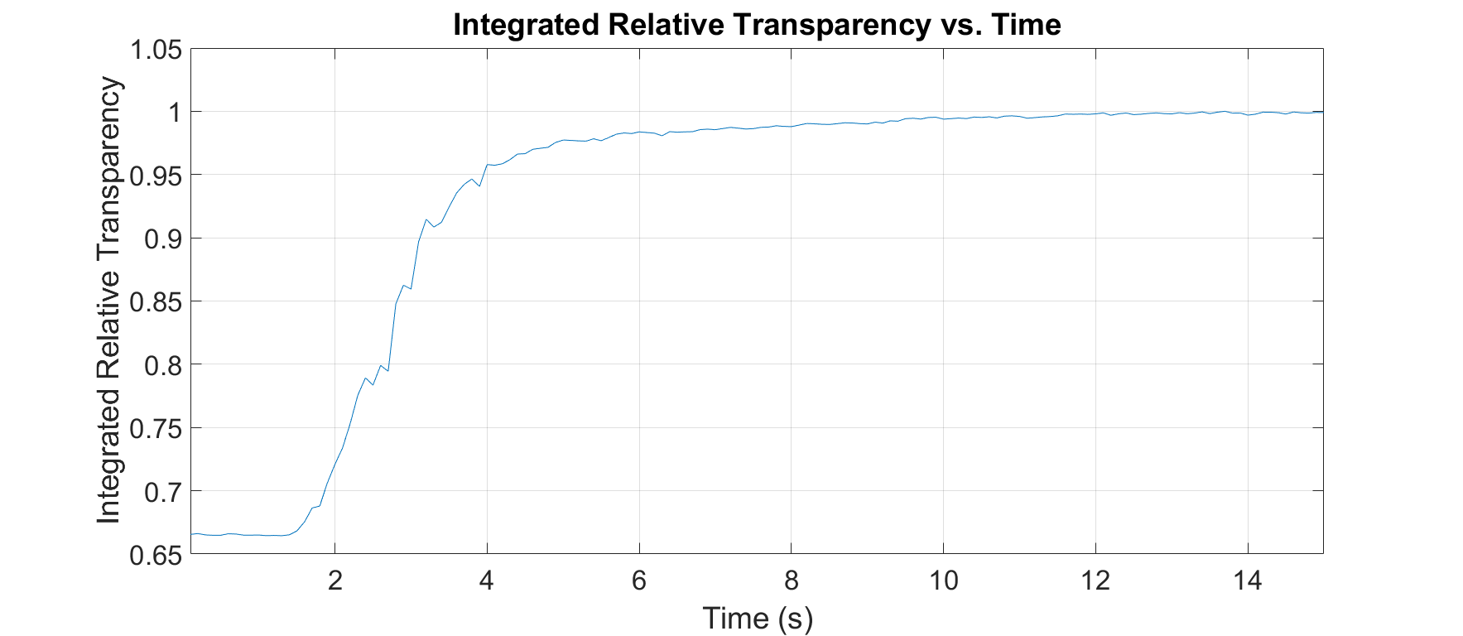
Results: Integrated Relative Transparency
Time to exchange volume=~10s
Integrated each time step which contains spectral intensities for each wavelength from 350nm to 846nm to get one number.
150 points show in figure above. (0.1s sample rate)
It takes 10s to exchange the volume given an incoming flow rate to the feedthrough of 1.9LPM
Or 3.2 exchanges per liter of incoming water.

Slide 11
Results: Integrated Relative Transparency
6 exchanges per minute of operation @ 1.9LPM
3.2 exchanges per liter of incoming water
360 exchanges per hour

Slide 12
Conclusion
Water test was successful
Measured 6 volume exchanges per minute or 360 volume exchange per hour of operation at 1.9LPM
3.2 exchanges per liter of incoming fluid
360 exchanges per hour is greater than the Fluorine ions generated on an hourly basis (5PPM/hr) when exposed to radiation.
The fluorine ion production of the entire system will be investigate further to see if it is below 3PPM (Hazardous to humans and likely equipment) given 1.9LPM flowrate.
Test the setup with FC-40 to estimate the volume exchange of the region.
Link to Paper: https://ipac2019.vrws.de/papers/wepmp044.pdf

