Slide 1
ICFA Mini-Workshop on Slow Extraction Workshop: Engineering Session Summary
Matthew Alvarez (FNAL), Yoshitsugu Arakaki (JPARC), Bruno Balhan (CERN), Jan Borburgh (CERN), Noah Curfman (FNAL)
July 24, 2019

Slide 2
Outline
Septum Wire Deflection Under High ES Field
Frame Adjustment Bar Test
CNT Wire Inspection and HV Testing
Recirculating HVF Water Test
Alternative Material Choices to Reduce Activation of Extraction Equipment
Motion System Selection

Slide 3
Septum Wire Deflection Under High ES Field - CERN

Slide 4
Wire deflection measurement setup
Under vacuum ZS equipped with upstream flange viewport.
Optical system installed to allow observation of the wire due to the electrical field; cross hair aligned on the wire centre.
Displacement could not be measured directly due to the angle between the wire array and the line of sight.
Using the radial displacement system of the anode, the anode position was manually adjusted to line up the wire with the previously set cross hair of the theodolite.

Slide 5
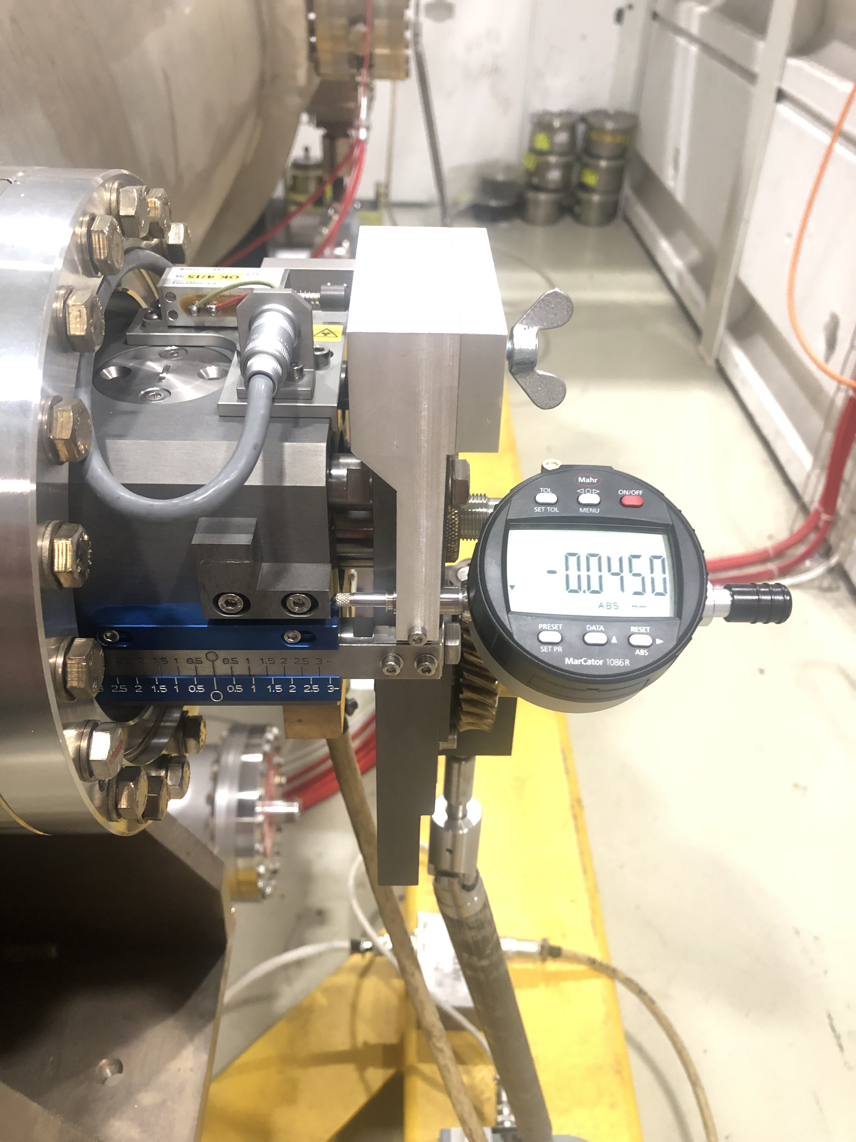
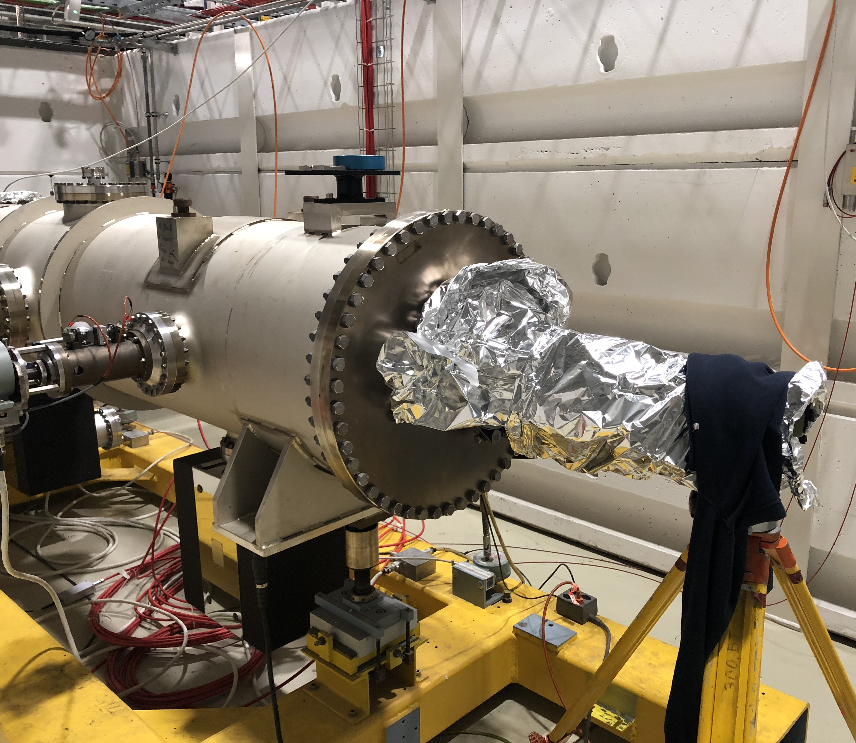
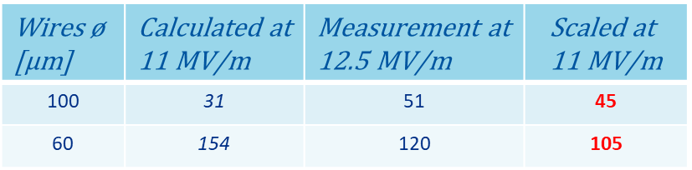
Wire deflection measurement
Wires 󠄍ø [µm] | Calculated at 11 MV/m | Measurement at 12.5 MV/m | $$\text{Scaled} \text{at}\text{ 11 }\text{MV}\text{/}\text{m}$$
100 | 31 | 51 | 45
60 | 154 | 120 | 105

Slide 6
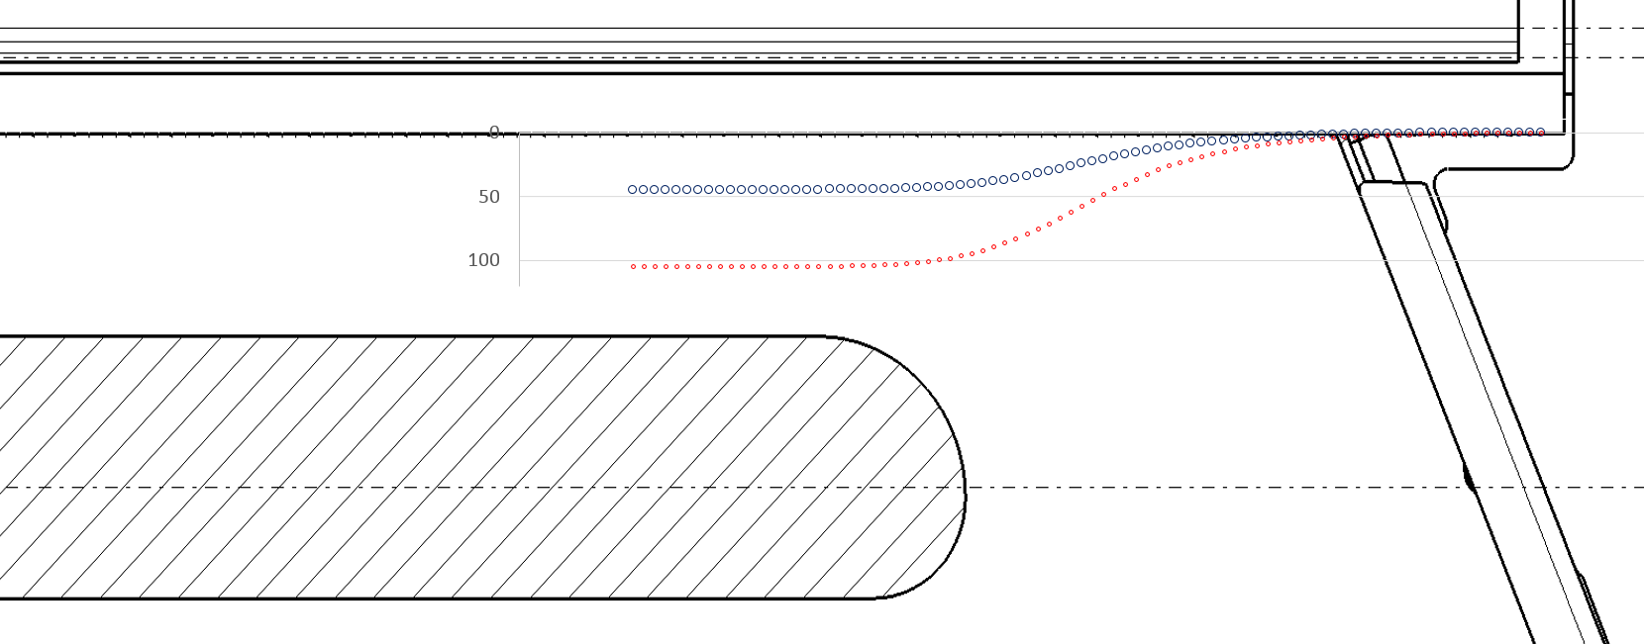

Derived deformation along Z
80 mm
Derived upstream wire deformation along Z at nominal field.

Slide 7
Conclusions
Septum straightness measured at construction better than 20 µm.
Wires being deflected towards cathode due to E-field.
ZS tank alignment survey does not take into account the offset.
Analytic calculation of wire deflection was done; wire deflection directly proportional to the spring load.
Diameter of the wire not really taken into account in the formula, not intuitive. Too simplified?
Measurement of the deflection done; more deflection than anticipated.
Fluka simulations show that the varying wire deflection at the extremities of the anode do not influence the extraction efficiency too much.

Slide 8
Alternative Material Choices to Reduce Activation of Extraction Equipment-CERN

Slide 9
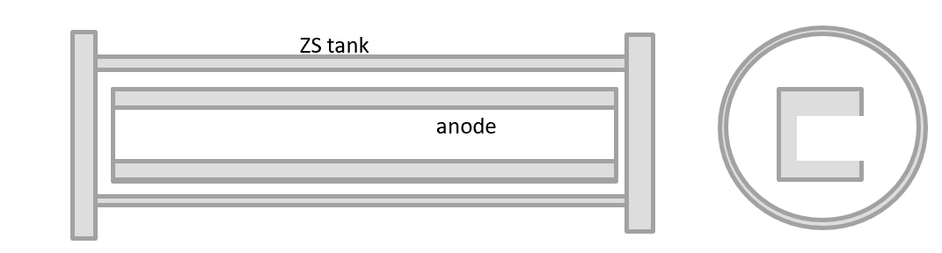
Activation in operation for various tank/anode material combinations
First estimates obtained using ActiWiz [2].

Slide 10
Measuring and Maintaining Septum Frame Rail Straightness (MI-52 Septum)-FNAL

Slide 11
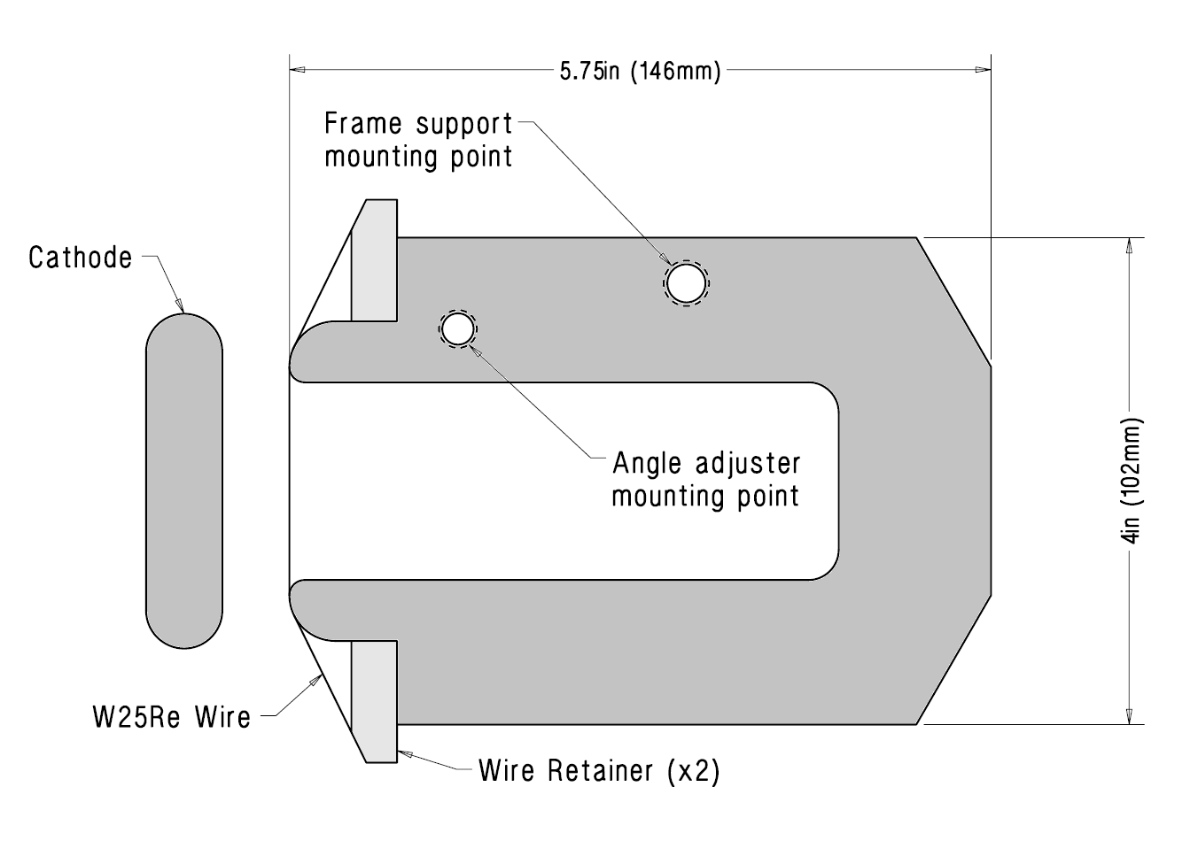
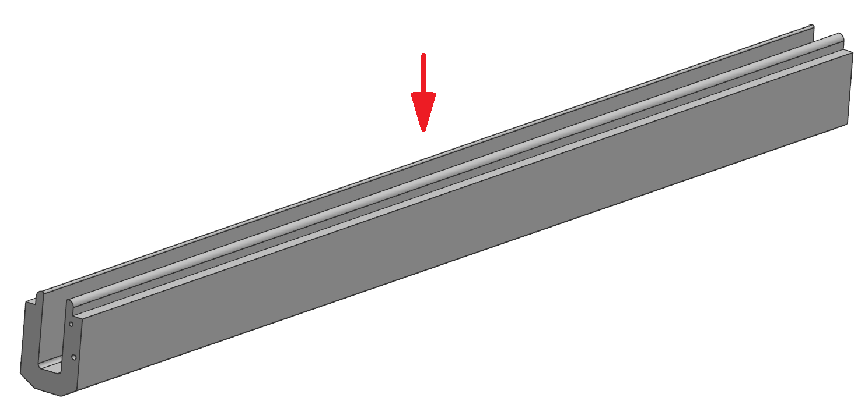
MI-52 Electrostatic Septa
12ft. (3.7m) in length
0.004in (.1mm) W25Re Wires under 2.9N of tension
0.1in (2.54mm) wire spacing
Intentionally bowed 0.006” (0.15mm) out of true
-100kV cathode

Slide 12
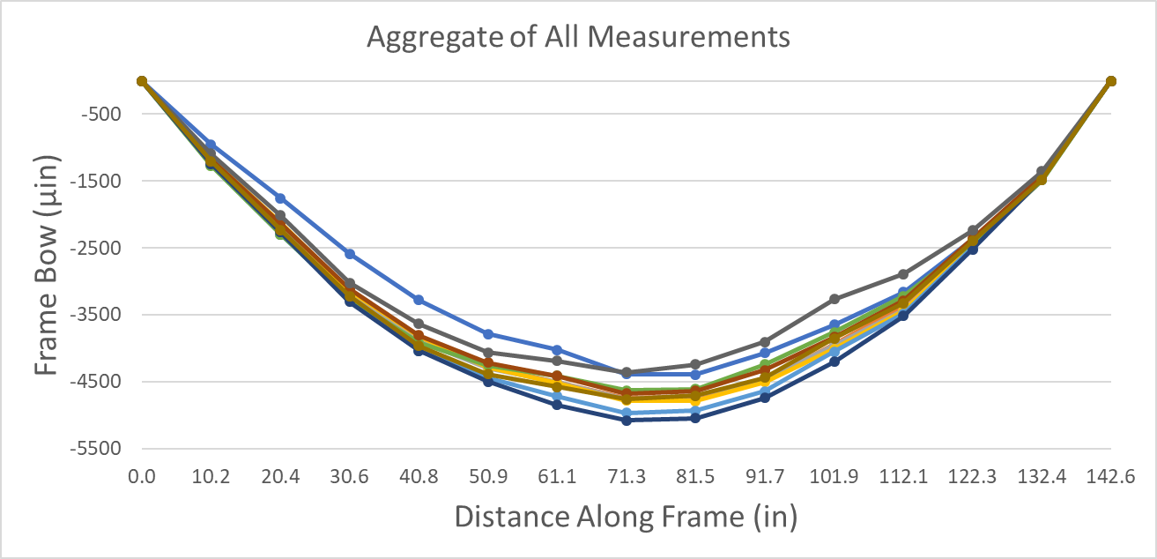
Initial Measurement Results
Frame is 0.0047” (4700μin) bowed out of true
Stabilized conditions would improve measurement quality
  Prohibitively expensive to achieve at this time

Slide 13
Effect of Wire Retainer Bolt Torques

Slide 14
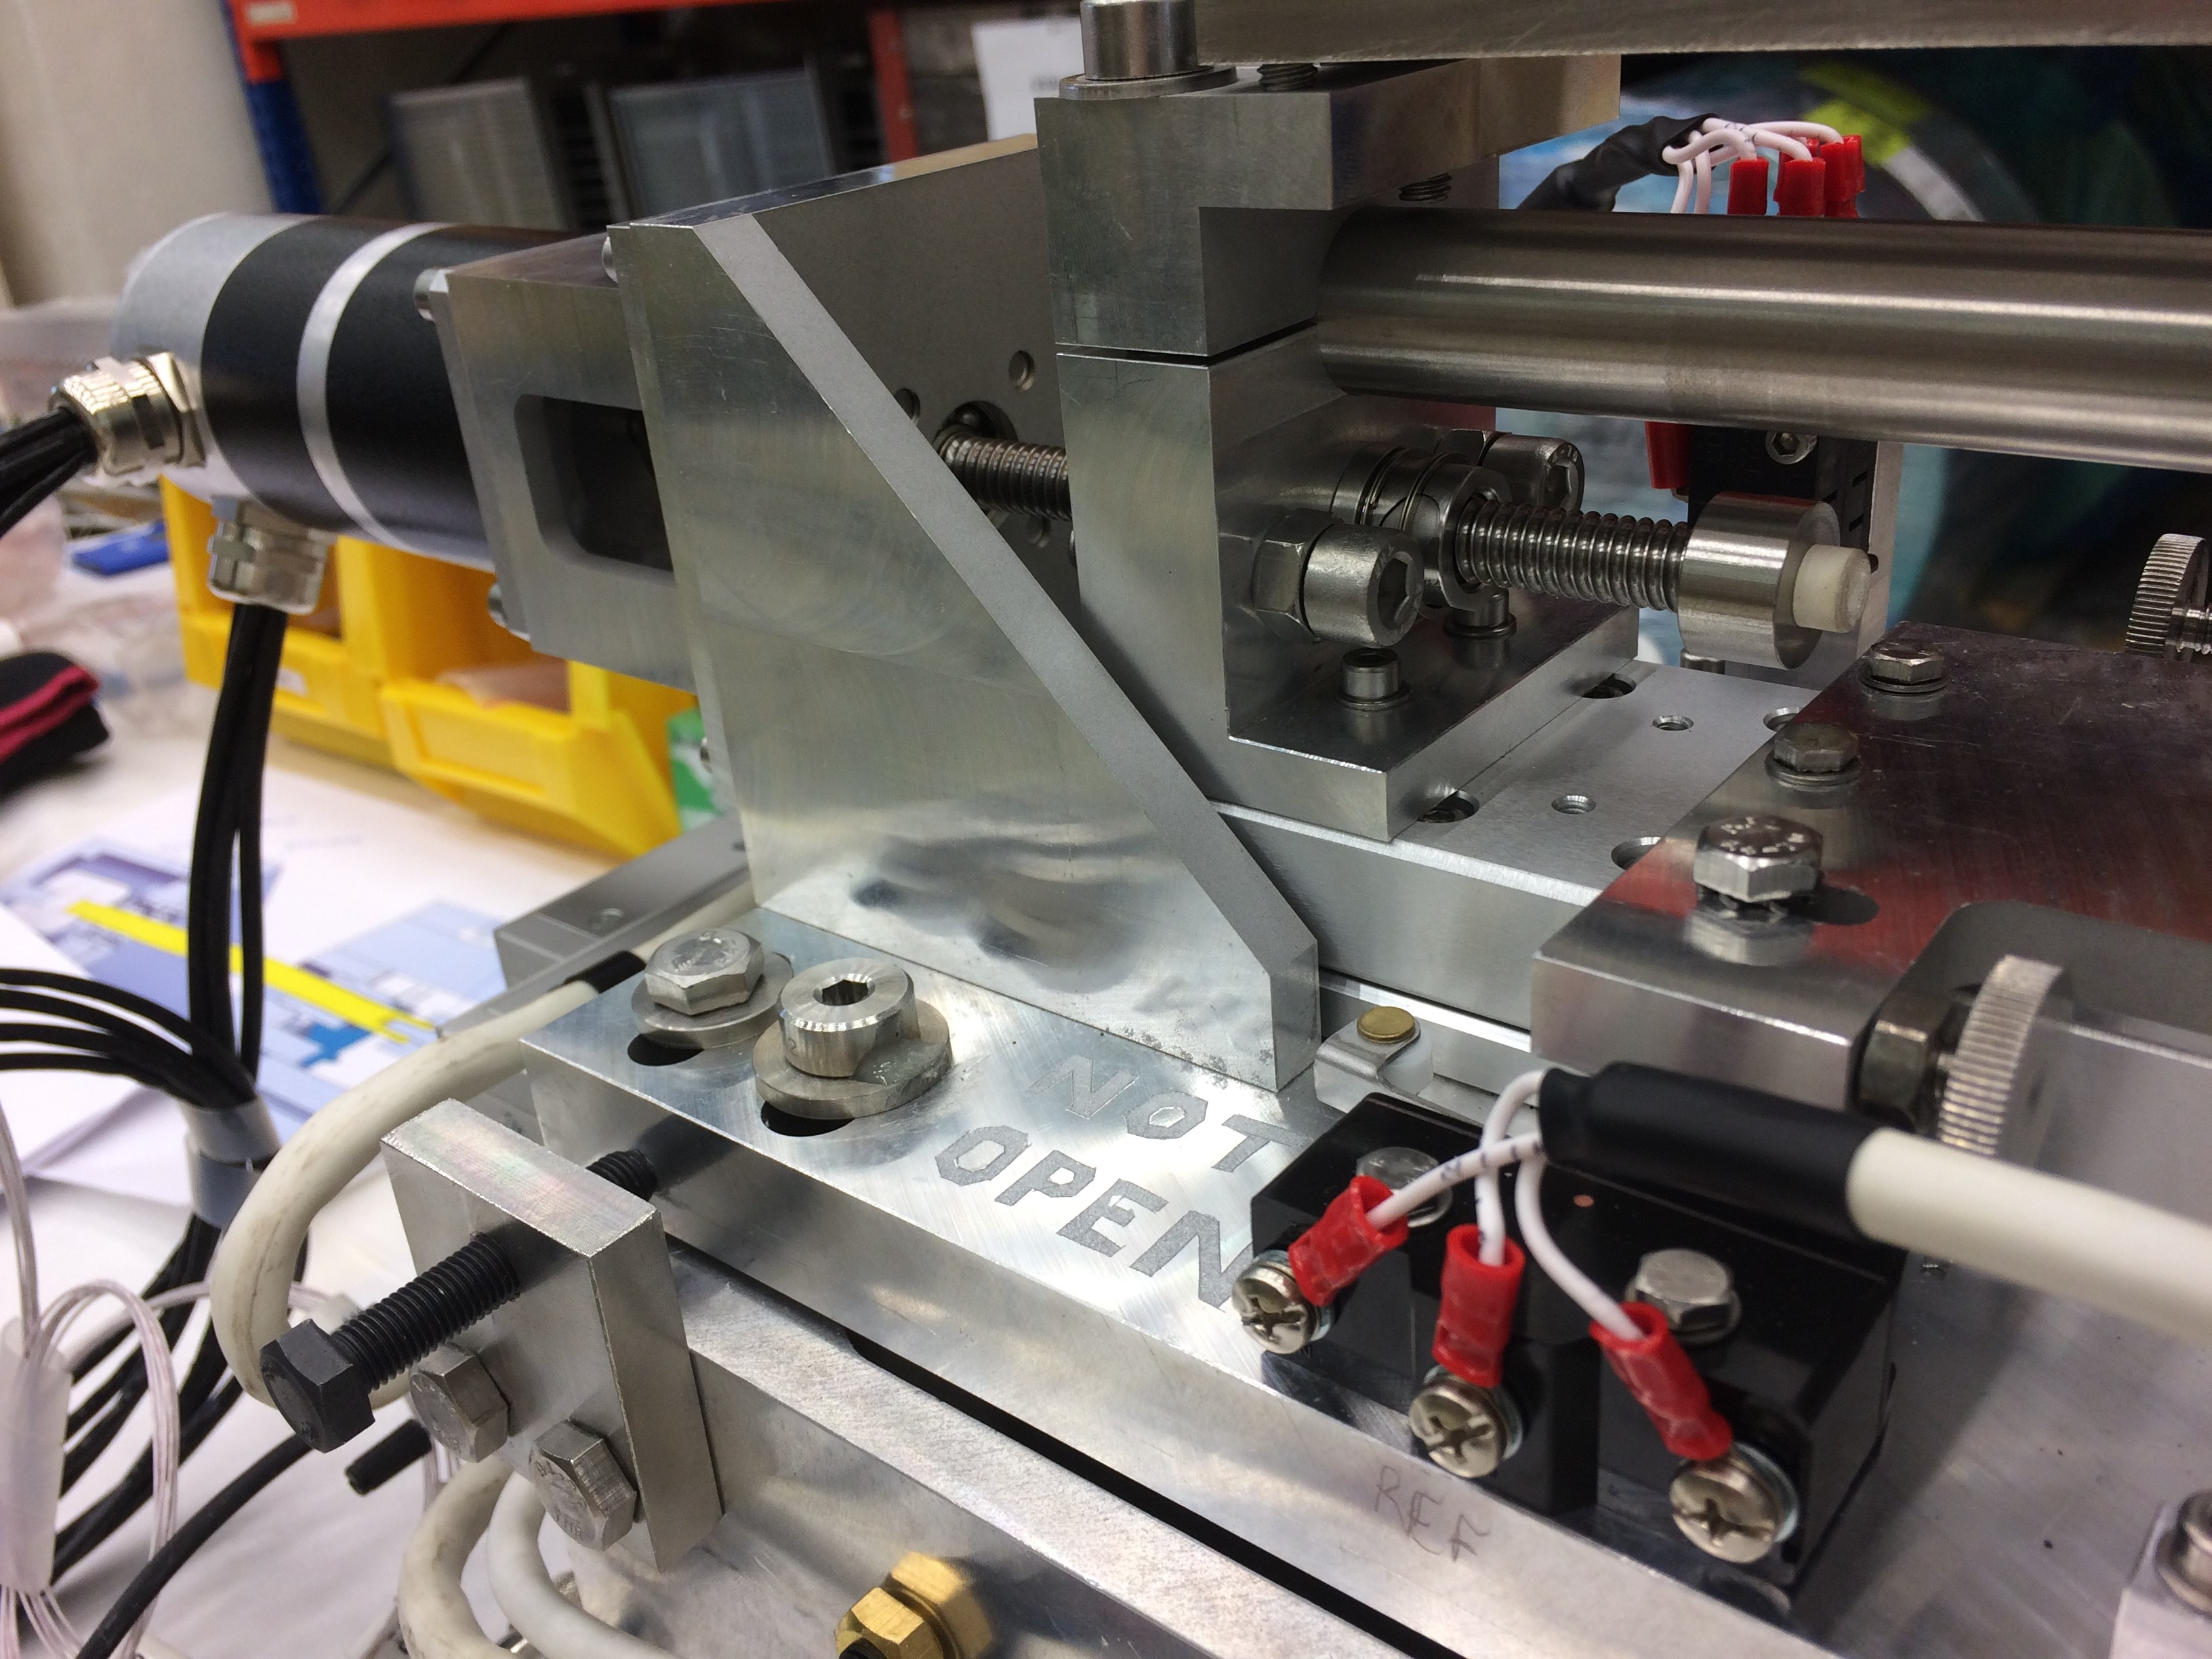
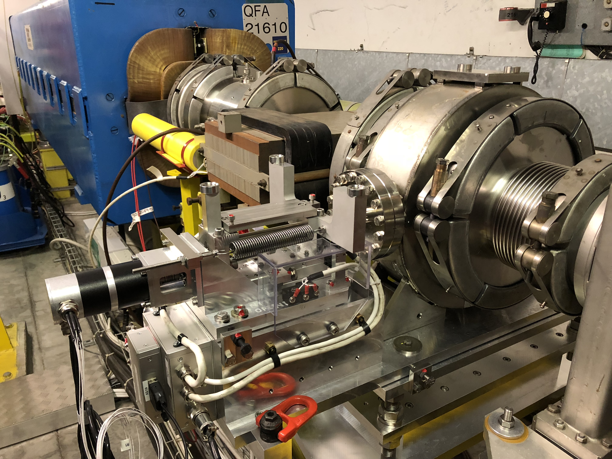
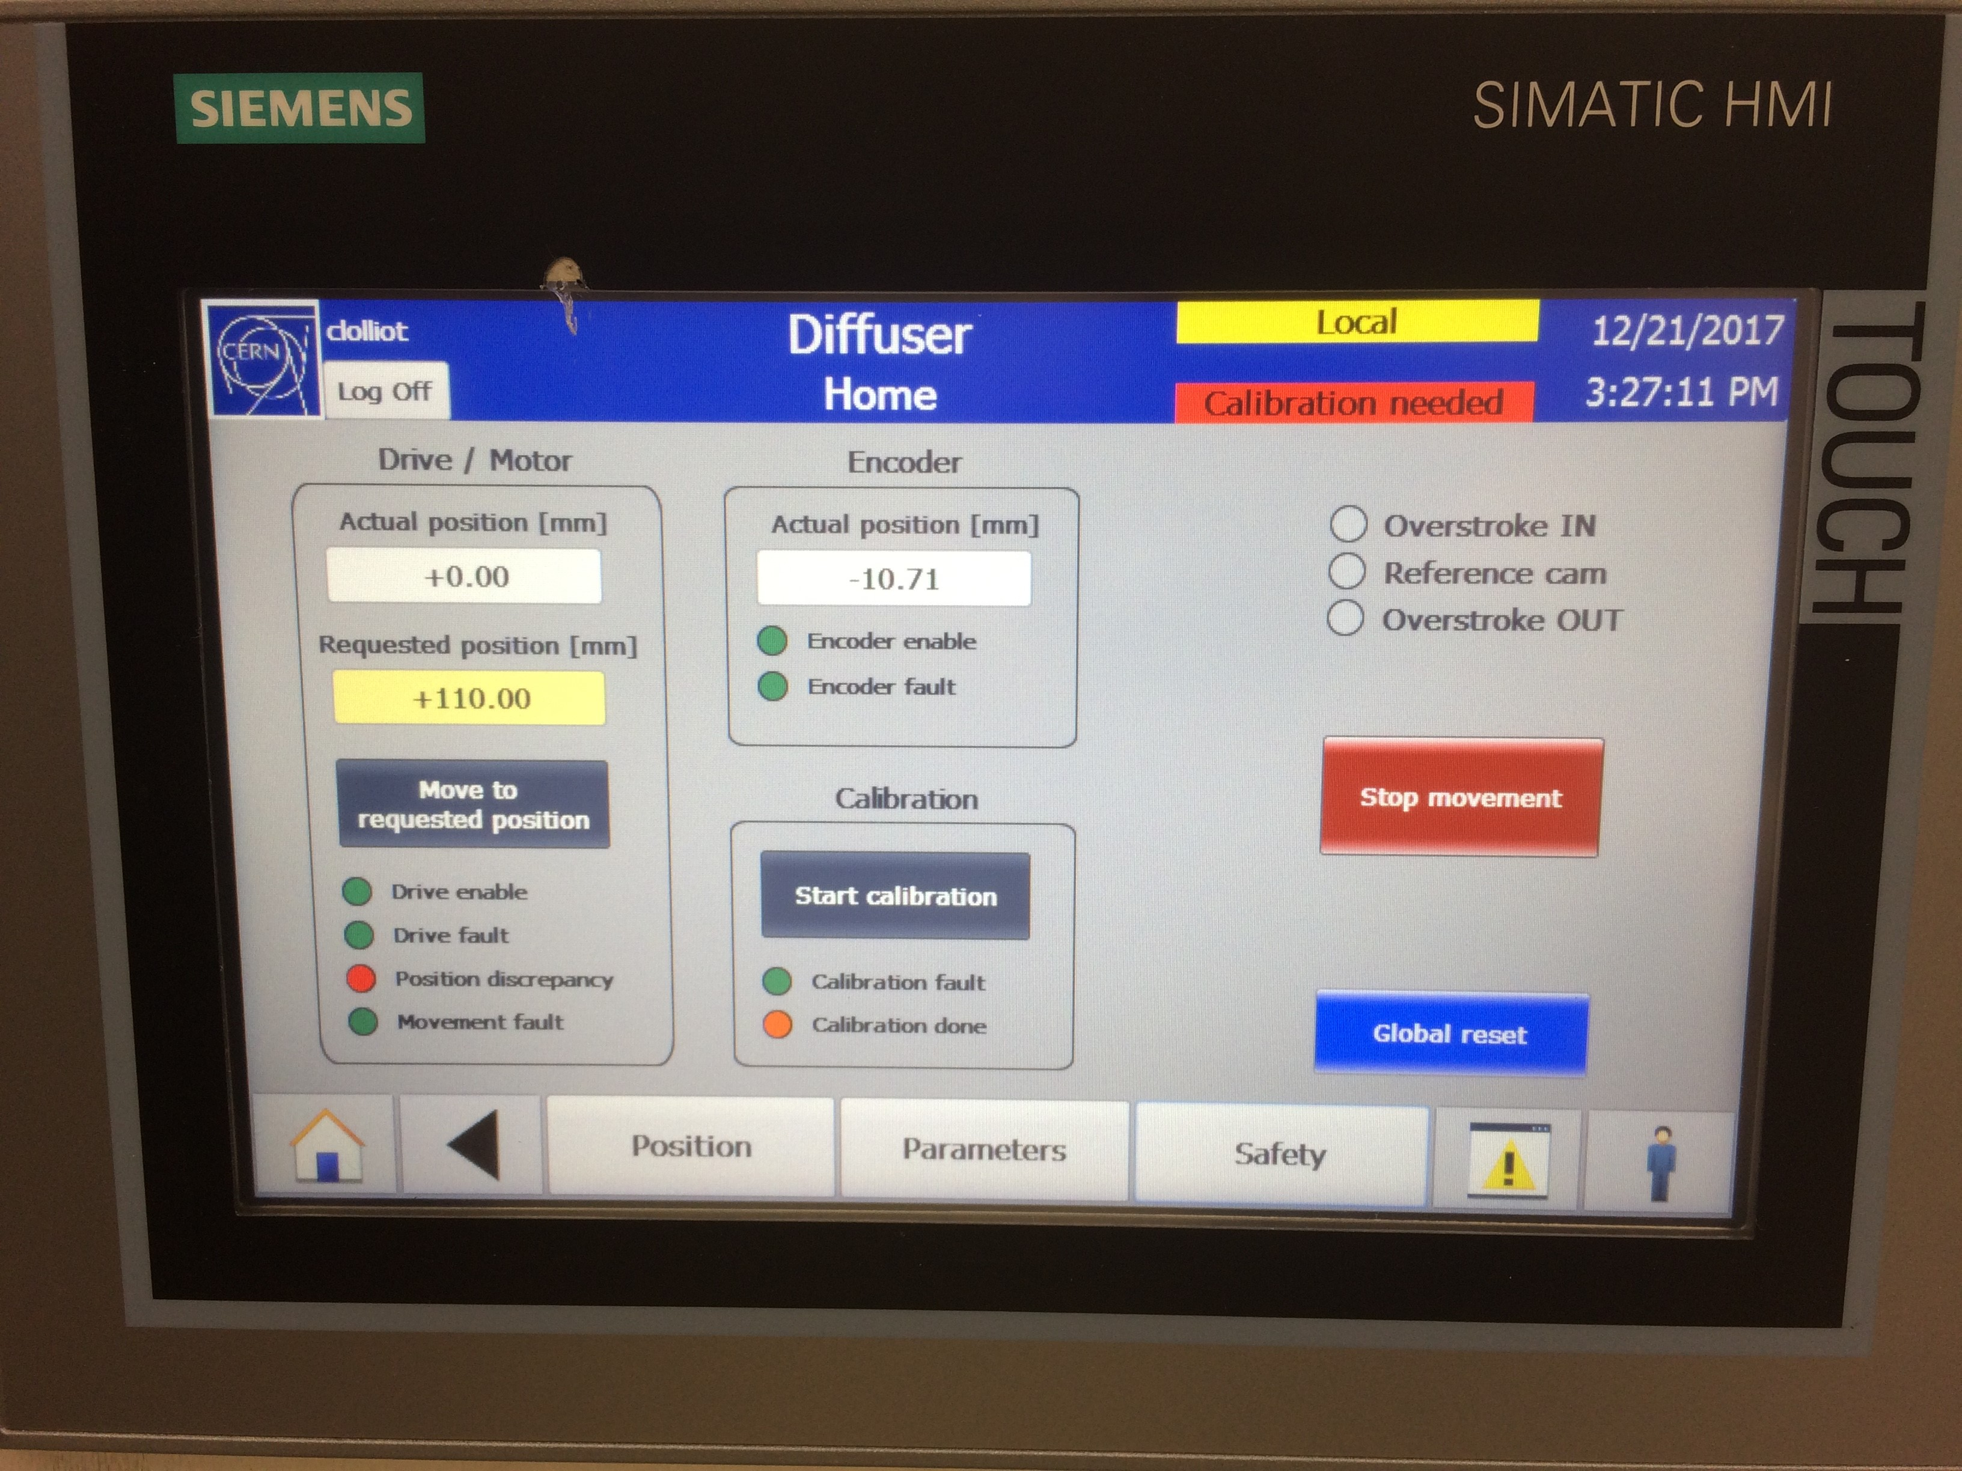
Stepping motor system (SPS diffuser)

Slide 15
Stepping motor system features
Precise resolver/motor combination
Ball screw back-lash compensated by vacuum force. Linearity n.a.
Position step size 5 µm
Mechanical position with respect to tank mid-plane
Needs possibly regular calibration
Minimal torque available when not powered
Max. torque available limited
Absolute system precision dominated by calibration system
Notes:
Regular calibration: to be confirmed when used in operation over longer periods

Slide 16
JPARC ESS Foil and Rail Flatness

Slide 17
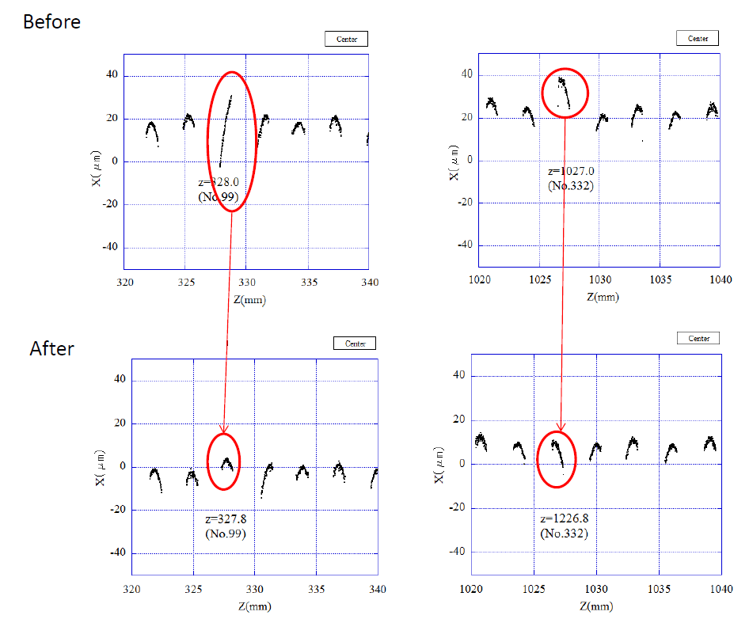

Slide 18
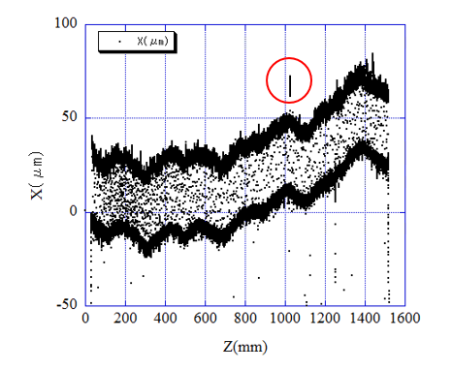
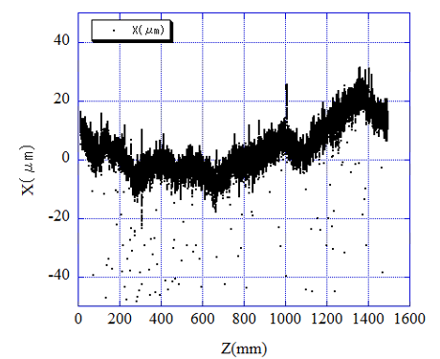
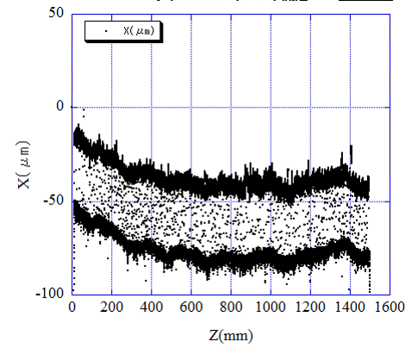
Floating (Small dust might be caught between ribbon and surface of yoke)
Upper side
Ribbons
Surface of the yoke
Twisted
Center
Down side
The difective ribbons were exchanged to new one.

Slide 19
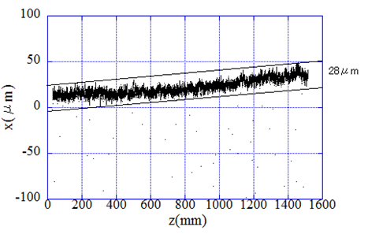
Result of alinement error of the ribbons seen from standard
Upper side
Titanium ESS1
Center
Down side
The effective thickness of the ribbons are 30+28=58μm

Slide 20
Frame Adjustment-FNAL

Slide 21
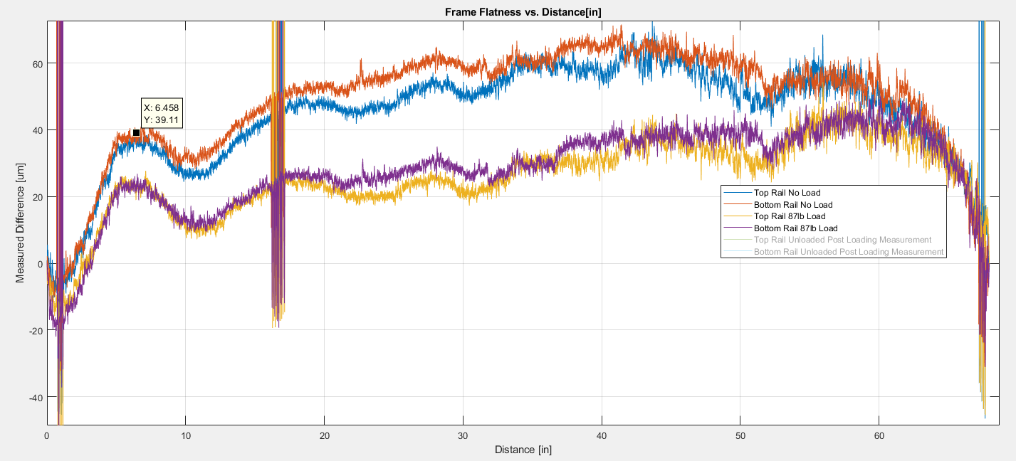
Frame Adjustment
Frame has a convex curvature relative to the optical head
Strong back/ Adjustment bar capable of flattening the profile of the frame by 30um with 40kg (87lb) load
Optical head
Frame
F=43lbs
F=43lbs
Unistrut Channel

Slide 22
CNT Wire Investigation and Preliminary HV Testing-FNAL

Slide 23
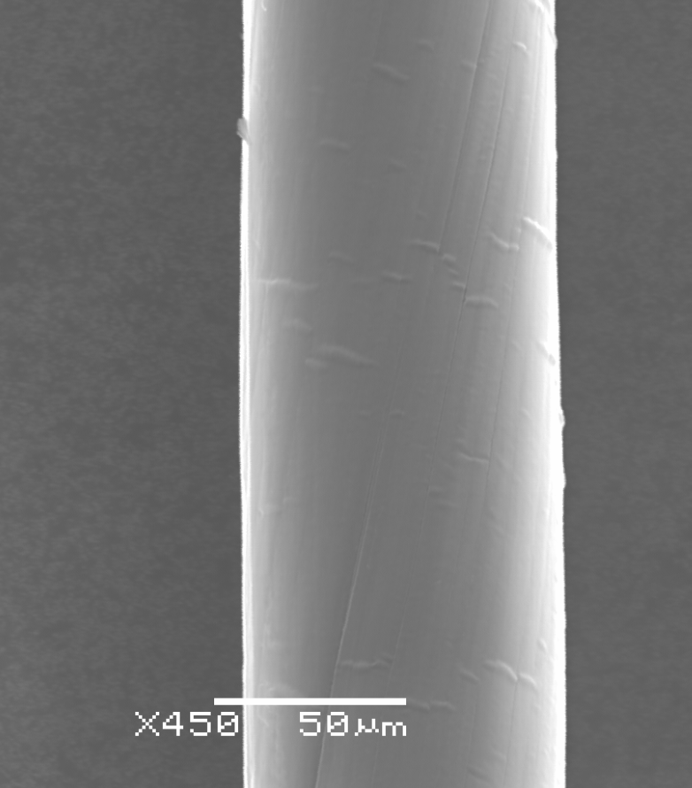
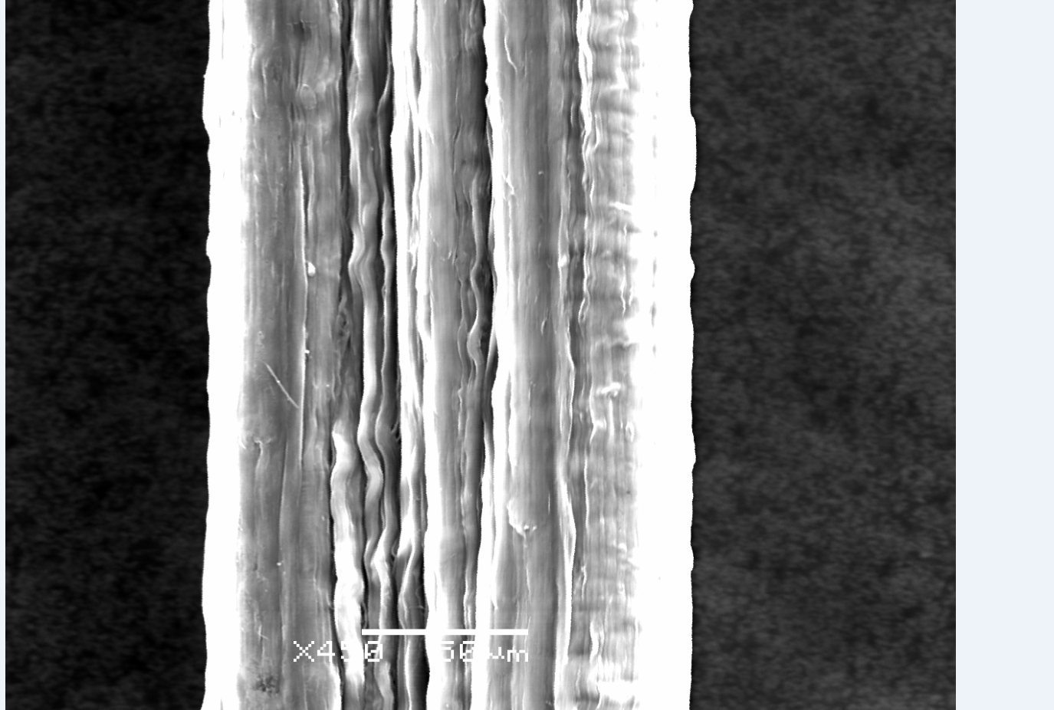
DexMat vs. JPARC CNTs
Smoother Surface
Easy to Cut with Scissors
Round Profile
  Dia. 76-80um
Breaking Load 3.3N~3.5N
Course Surface
Required wire Snips to cut the wire
Elliptical Profile
100 um ±30um
Breaking Load: 6.45 ± 1.87N
JPARC CNT using SEM
DexMat CNT using SEM

Slide 24
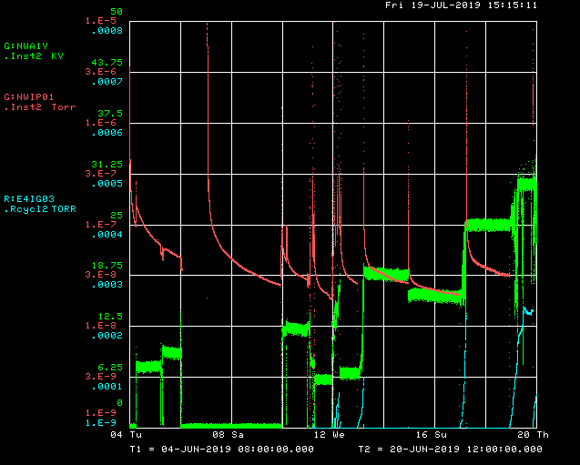
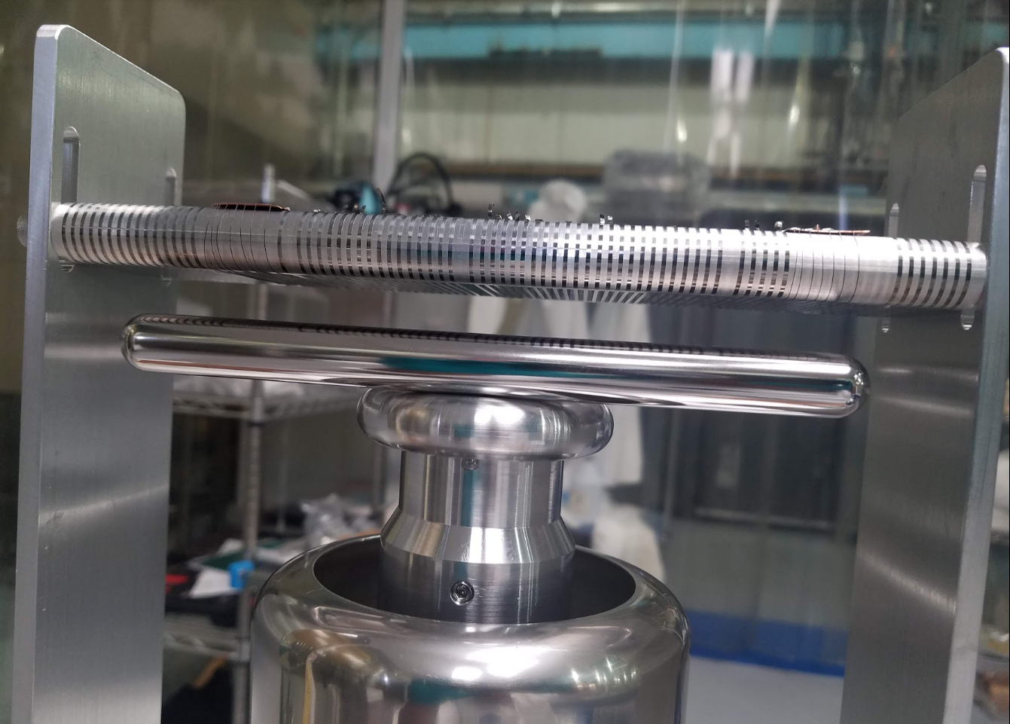
High Voltage Testing of DEXMAT CNTs

Slide 25
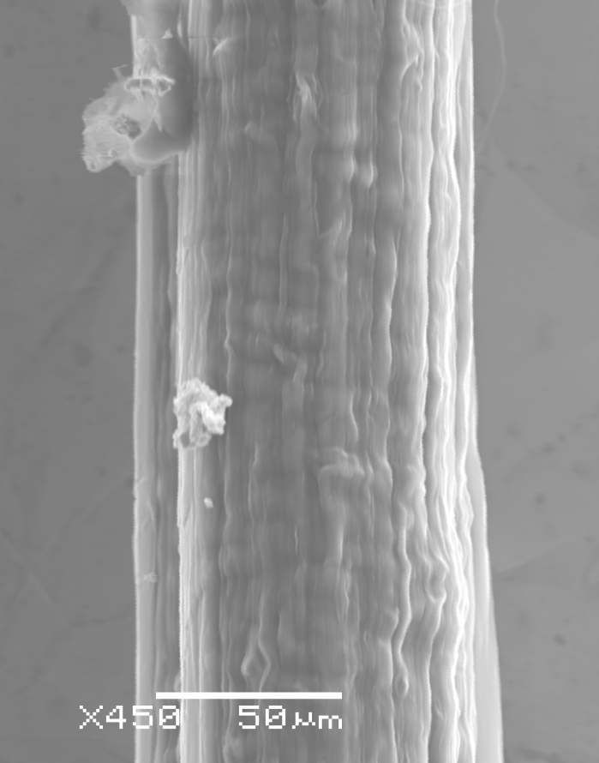
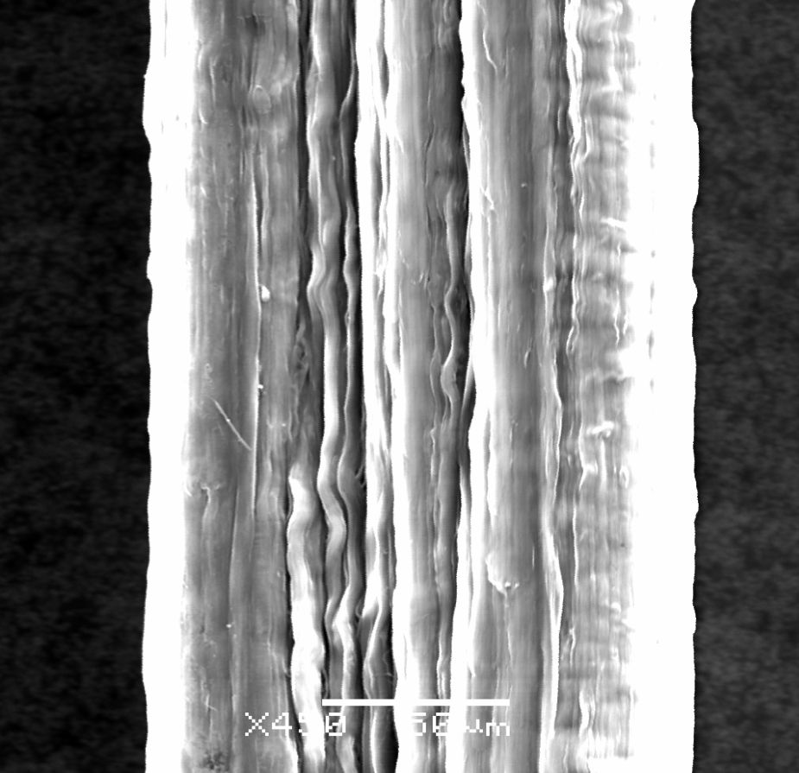
High Voltage Testing of DEXMAT CNTs
CNT wires did not allow me to reach 100kV
Knowing that the CNTs had a coarse profile and potential whiskers, we conditioned the CNTs by spoiling vacuum (5e-5 torr to 5e-4 torr)
  We achieved 33kV over
Currently we do not see any difference between HV CNTs vs. new wires….will investigate the CNTs tested in HV soon.

Slide 26
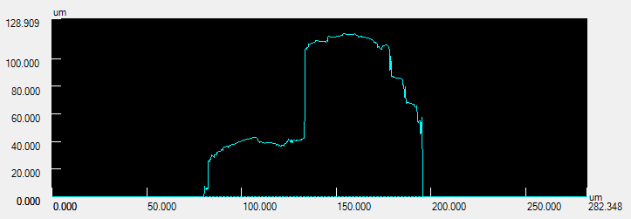
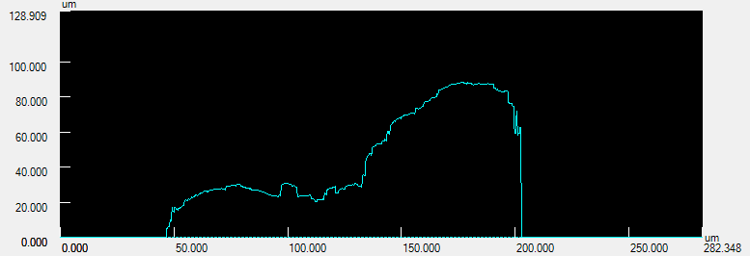
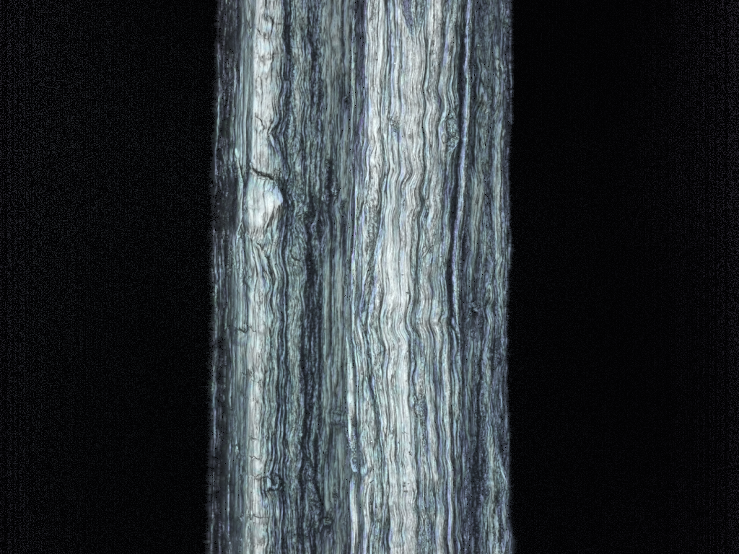
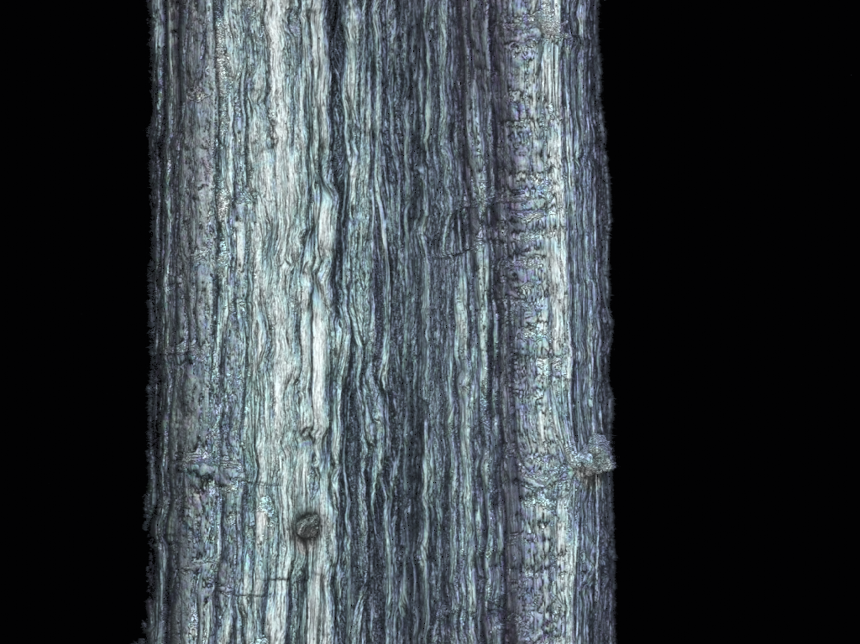
CNT Wires in HV Environments
HV Test Wire
New Wire

Slide 27
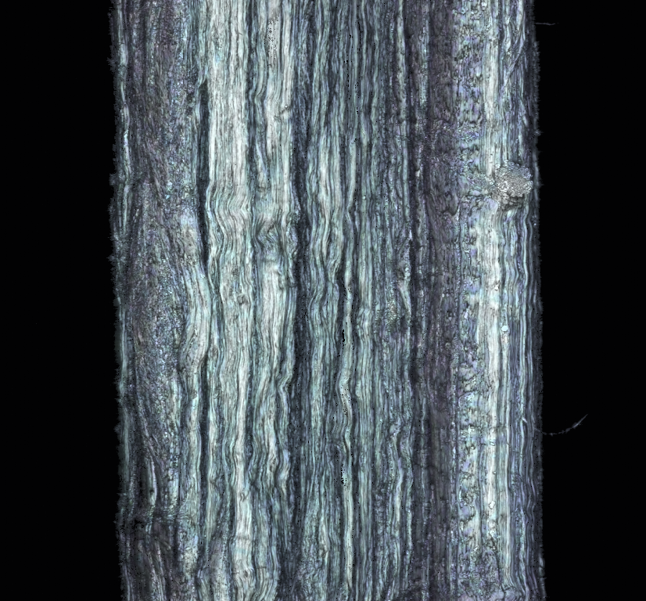
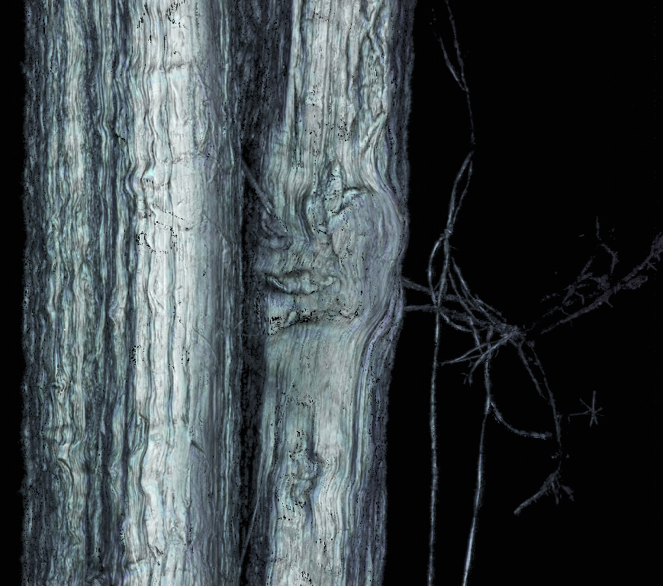
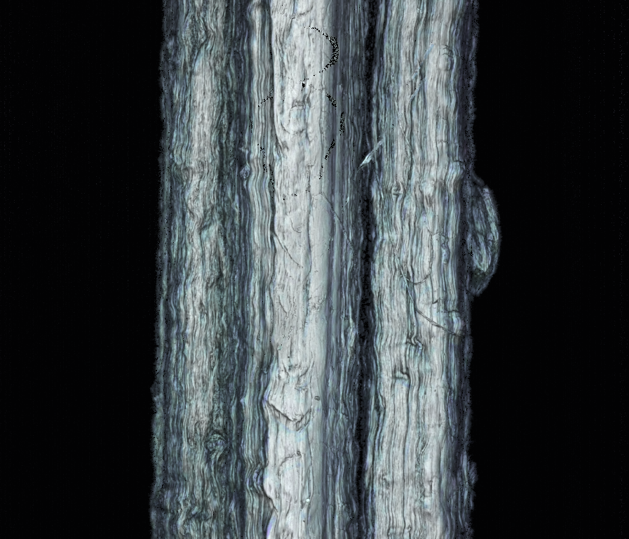
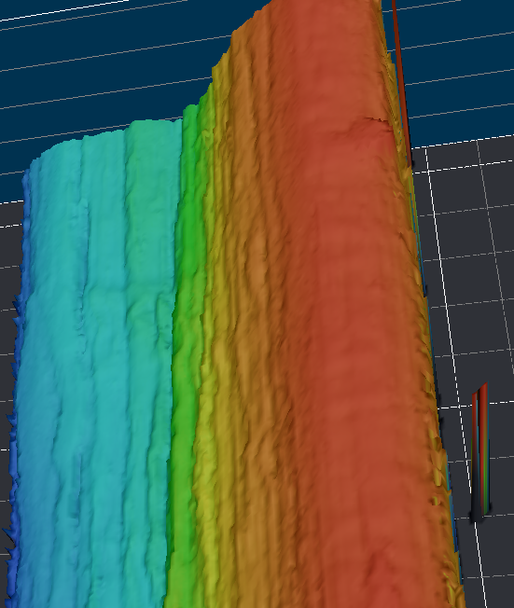
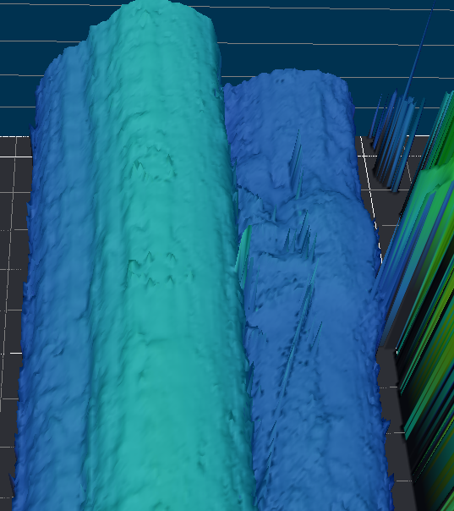
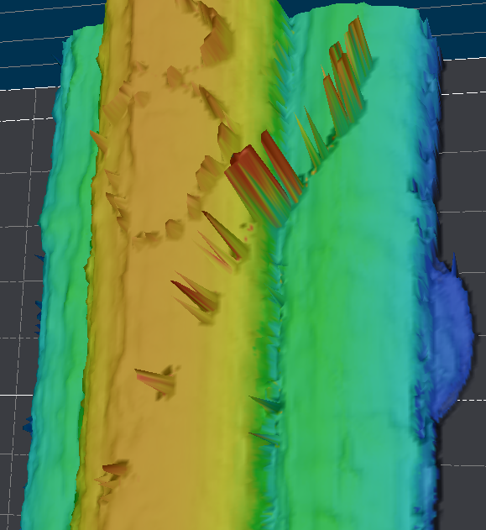
CNT Wires in HV Environments

Slide 28
Recirculating HVF Water Test-FNAL

Slide 29
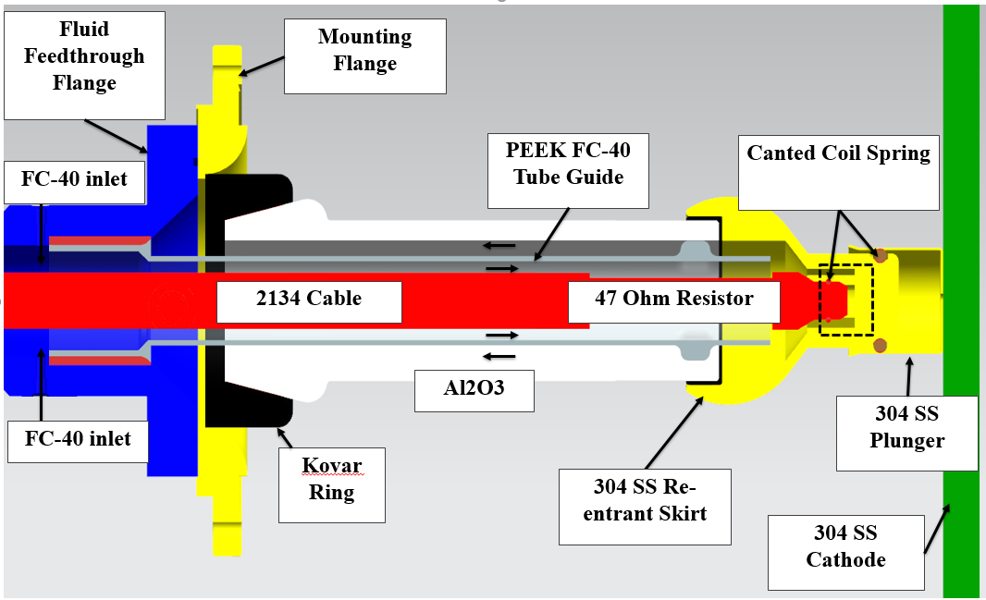
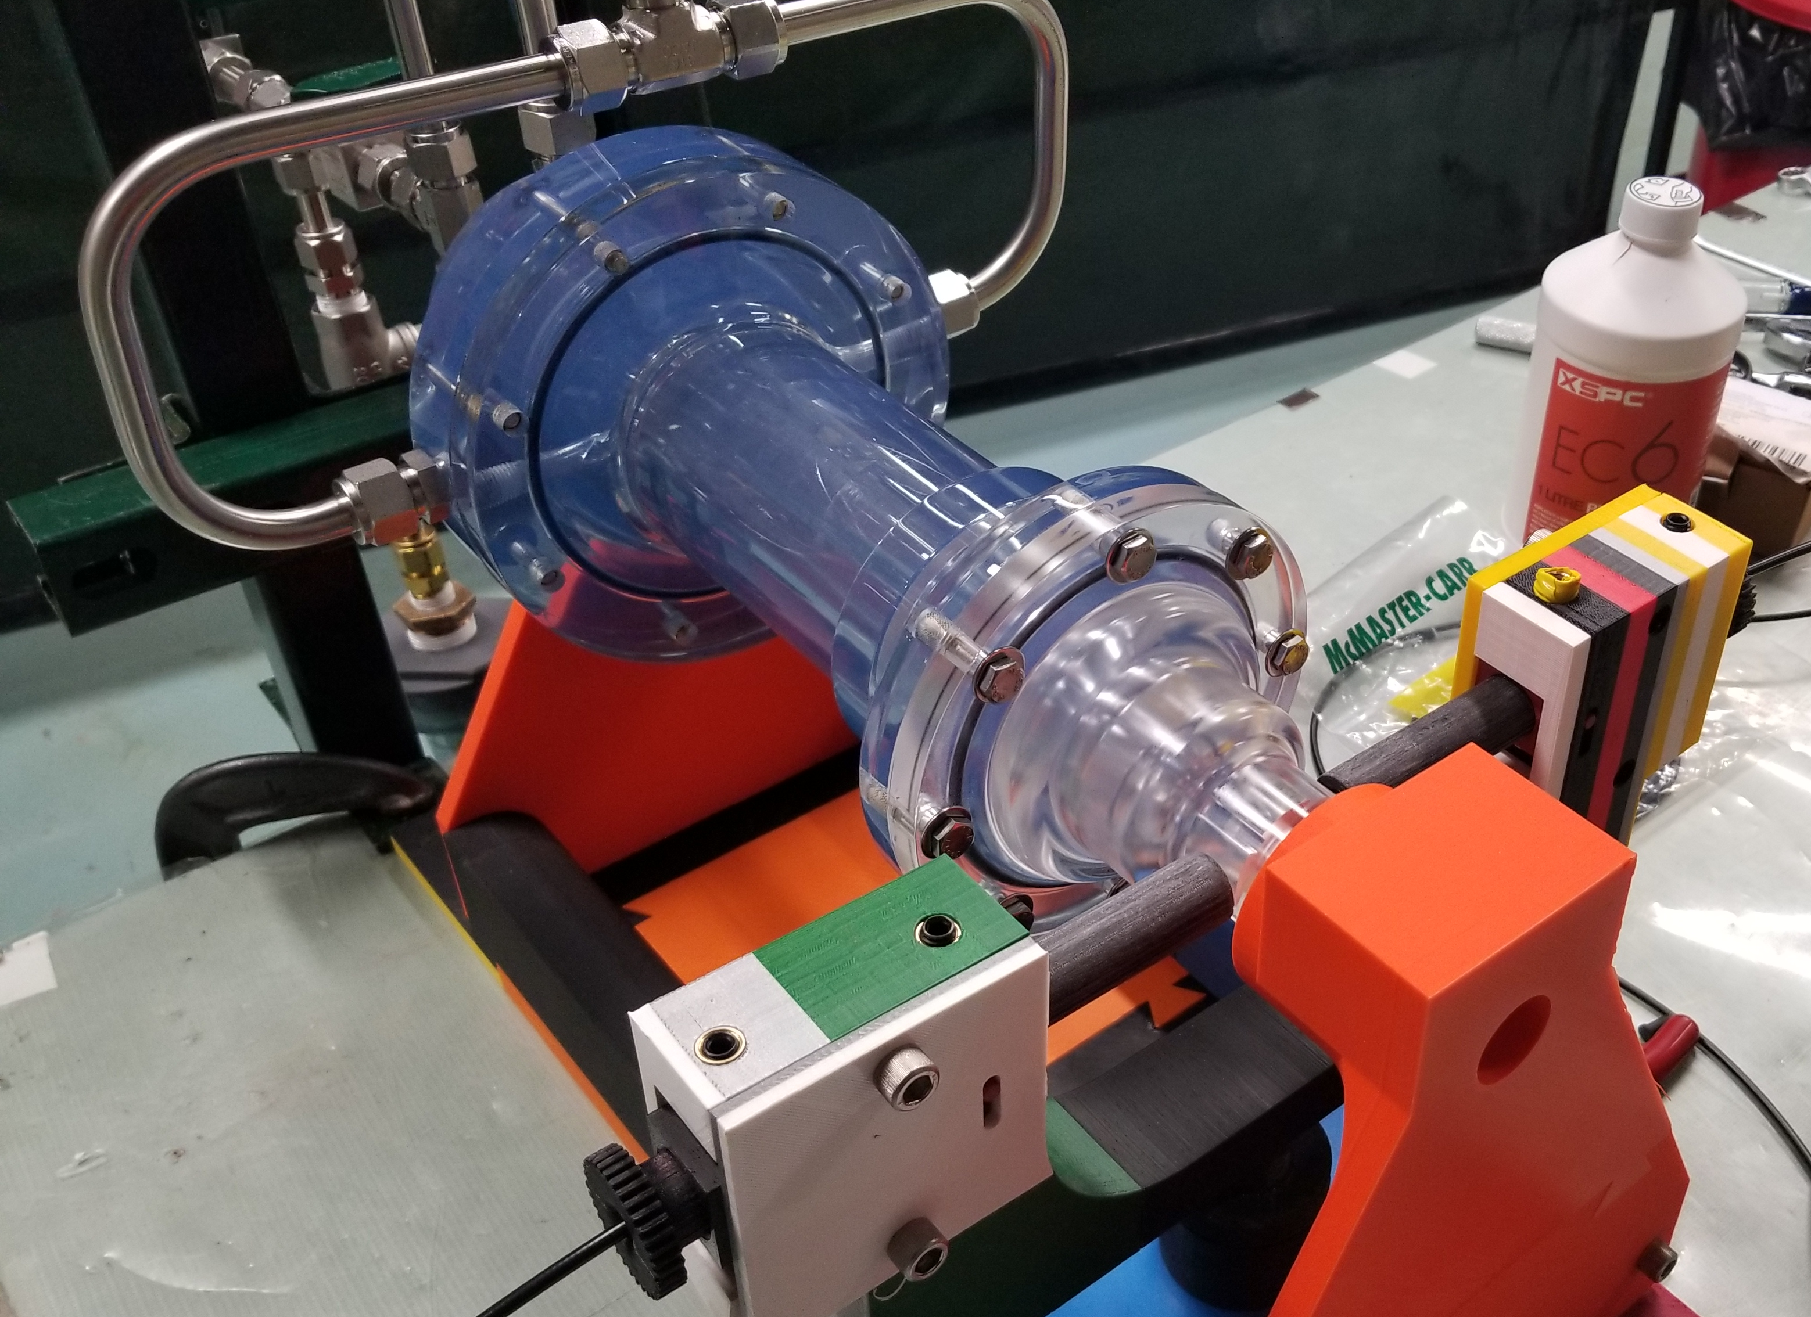
HVF- Water Test
We create 5ppm/hr of fluorine ions that recombine into HF and PFIB.
We found that it takes 10s to exchange the volume to achieve a relative transparency of 1.
3.6 volume exchanges per liter of incoming water

