Slide 1
Broken Wires in the Main Injector at Fermilab
Denton Morris
Slow Extraction Workshop
23 July 2019

Slide 2
Electro-Static Septa’s Worst Nightmare?
“The septa broke a wire.”
“It’s shorted.”
And if that’s one of the worst things to hear,
how about hearing it again in a few weeks,
and a few months again?

Slide 3
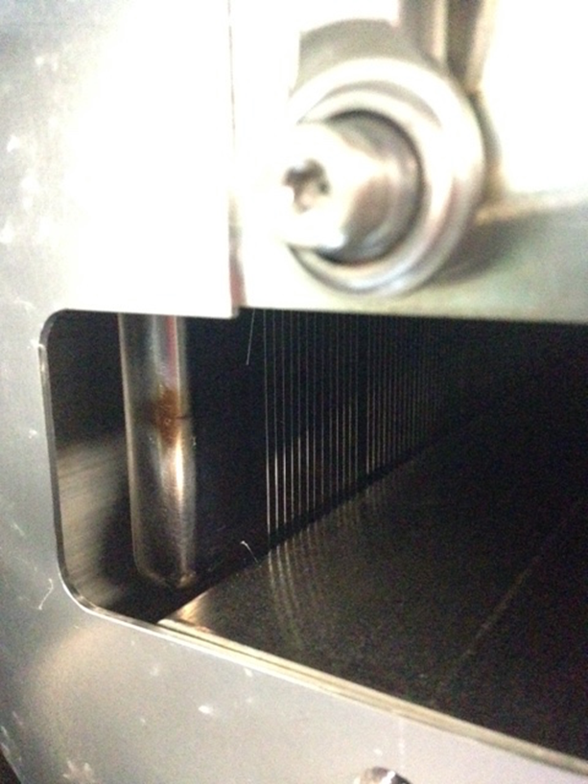
Broken Septa Wires in the Main Injector
NSFW

Slide 4
Septa Tank Configuration

Slide 5
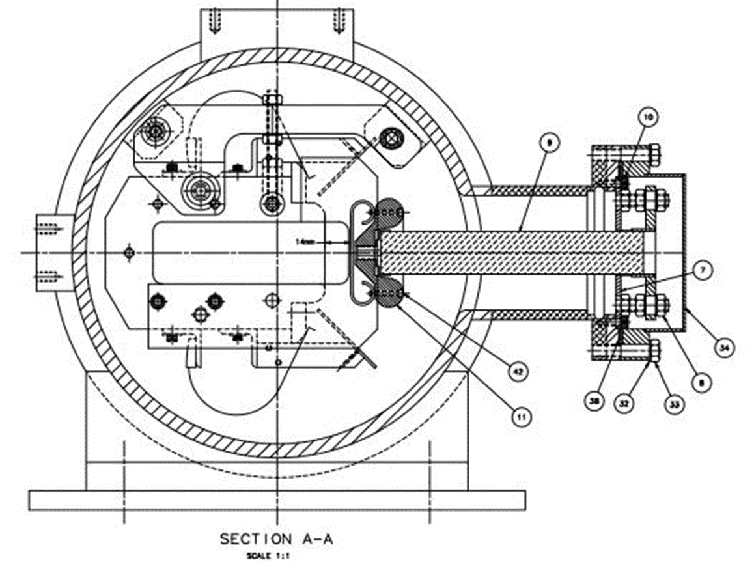
Fermilab Main Injection Exraction Septa
Extraction Septa:
Two 3m tanks
Wire plane is 0.1 mm Tungsten-Rhenium wire
Installed under 300 grams tension
1440 wires per tank spaced 2.5 mm apart
Cathode runs -100 Kvolts
Wire plane to cathode = 14 mm

Slide 6
The (First) Call
11 December 2013
First broken wire that shorted to the cathode in 14 years
Removed the wire (upstream wire, upstream tank)
Noticed a few other wires had broken, but retracted properly
Early 2015
Same situation
Removed the wire
Noticed a few other wires had broken, but retracted properly

Slide 7
More Calls
A few months later the third call. Is it time to worry?
State of our spares:
One 0.1 mm spare (in storage for 20+ years)
Two 0.05 mm spares that have never been tried with beam

Slide 8
Inspection Of A Wire From The First Failure

Slide 9
Broken Wire

Slide 10
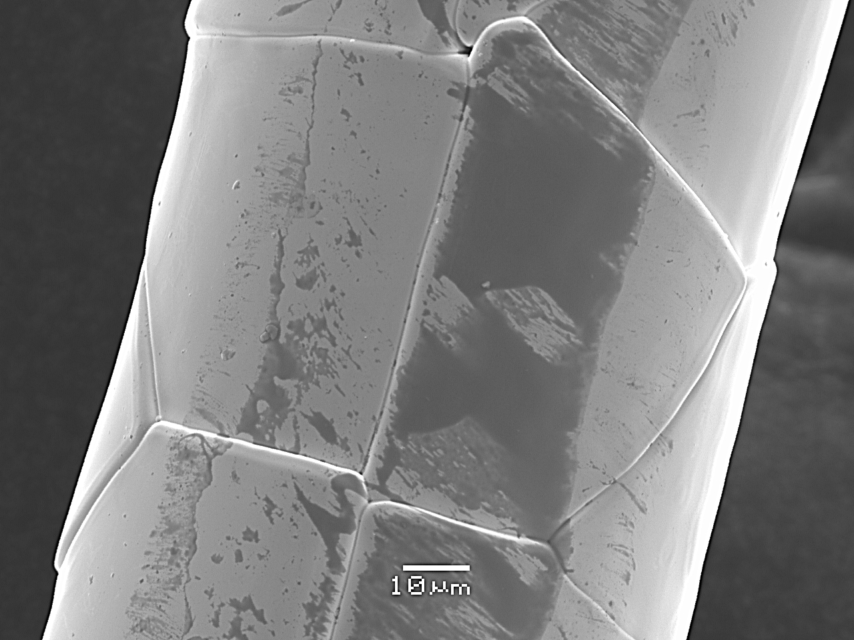
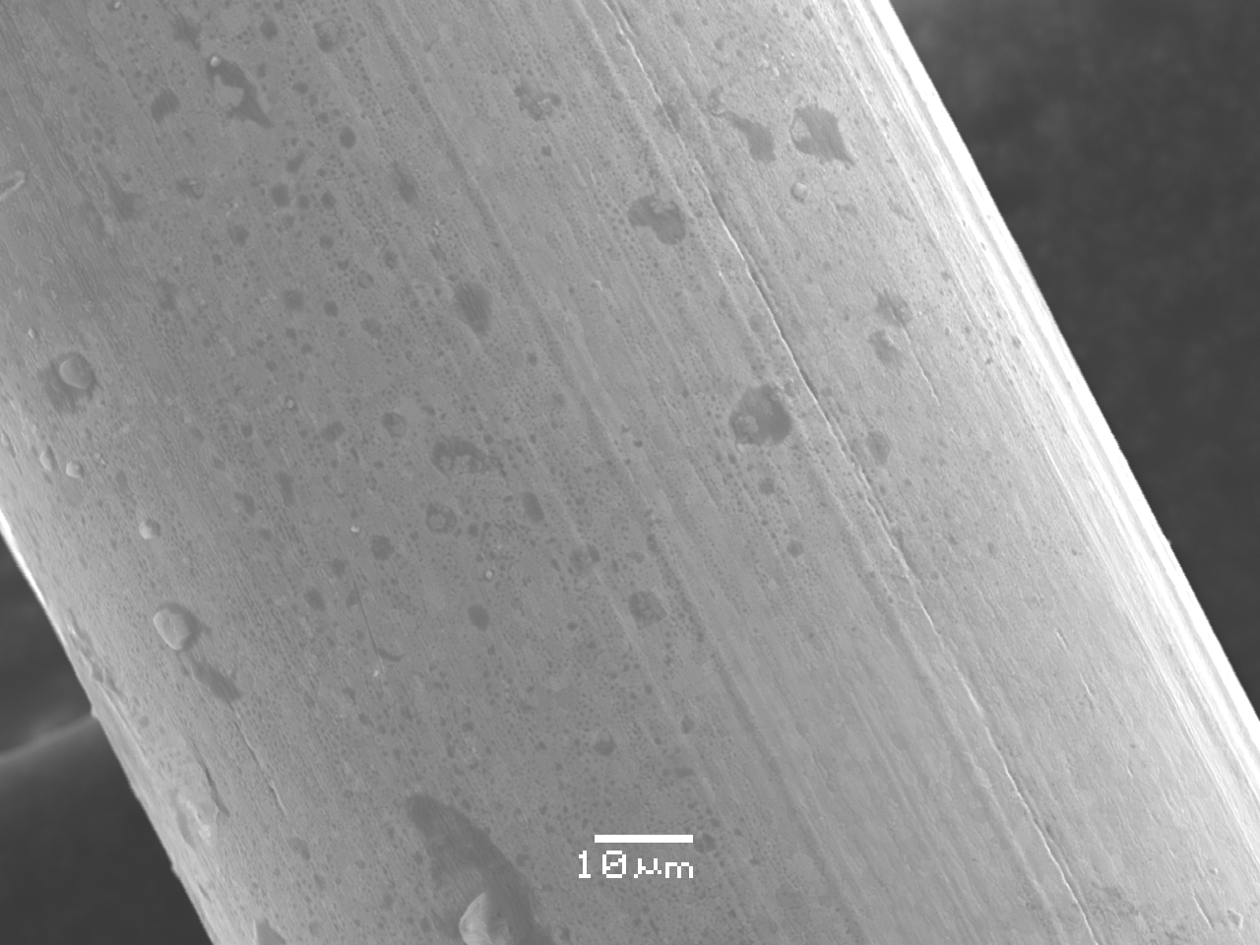
Broken Wire Versus Unexposed Wire
Septa Failure
February 2016
10
Denton Morris | MI Septa Failure Analysis
22-July-2019

Slide 11
Broken Wires in the Main Injector Septa
Opted to change out our leading septa and preplace it with our only 0.1 mm spare.
Replaced the broken wires by hand and conditioned the repaired septa to -100 KV.
December 2016: Three shorted wires within 1 month.
We eventually replaced the upstream septa with a 0.05mm
spare and ran it for several month prior to scheduled maintenance. Upon inspection it had many failed wires.
Now it’s personal.

Slide 12
Causes?
Metal migration?
Beam degradation from slow extraction?
Wires over tensioned?
E field changes due to broken wires?
Beam energy deposition during high intensity NUMI cycles?
Resonance heating from high intensity beam?
Corrosion?
Other?

Slide 13
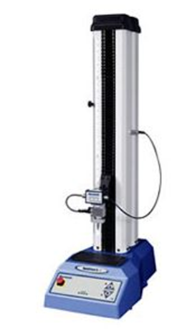
Tensile Strength
Conveniently we have a tensile strength test station.
Cold-worked Tungsten-Rhenium has about 2.25 times the tensile
strength as un-worked.
Three tests on unused 2 mil septa wire
#1 – 458,940 psi
#2 – 436,314 psi
#3 – 492,998 psi
Unworked Tungsten (75%) Rhenium (25%) alloy has a tensile strength
Of ~200,000 psi. (~300 gm-N)

Slide 14
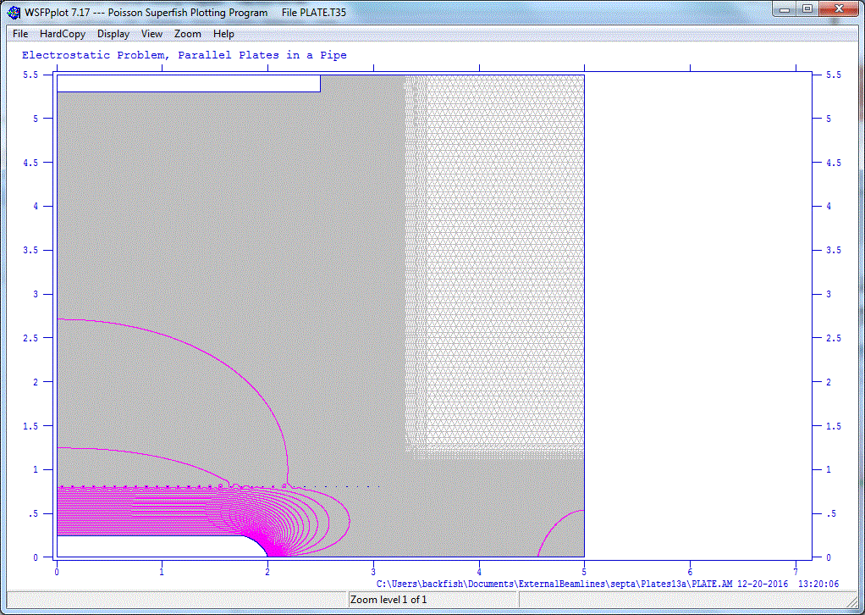
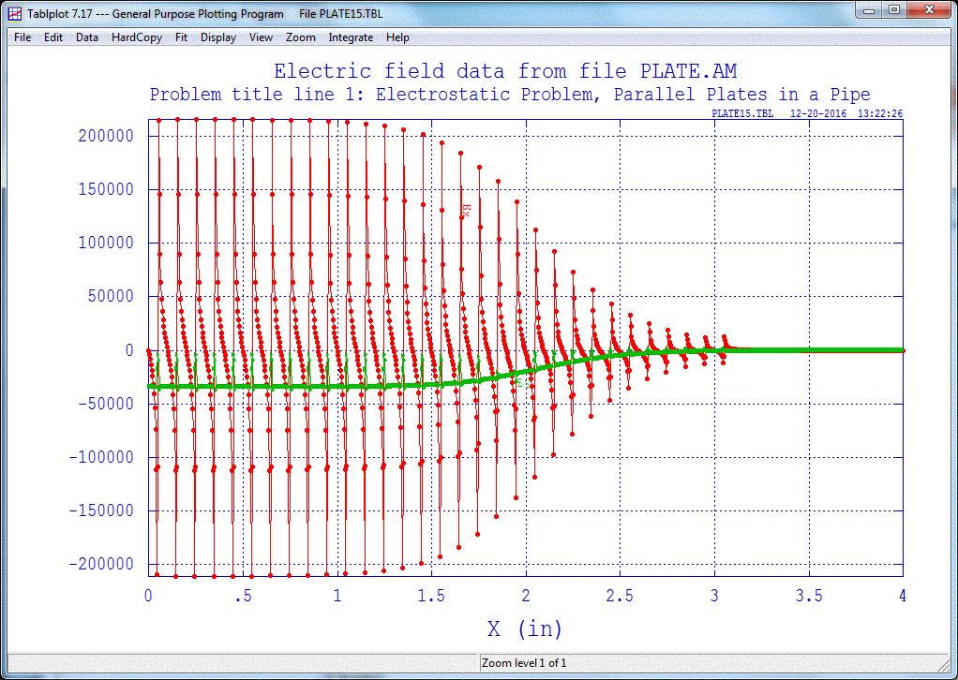
E-Field Changes
14
Denton Morris | MI Septa Failure Analysis
1/3/17

Slide 15
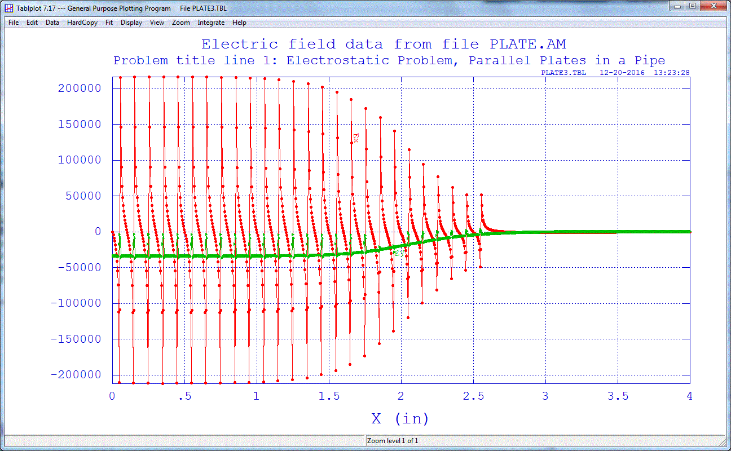
E-Field Changes
15
Denton Morris | MI Septa Failure Analysis
1/3/17

Slide 16
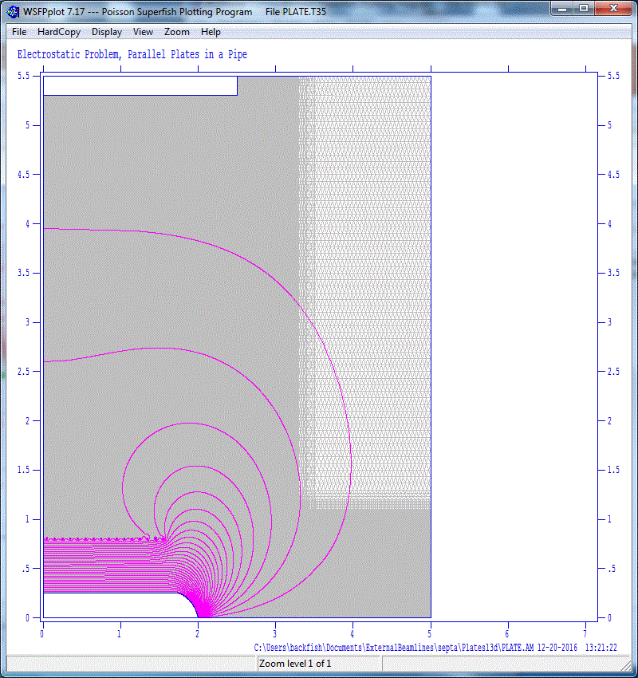
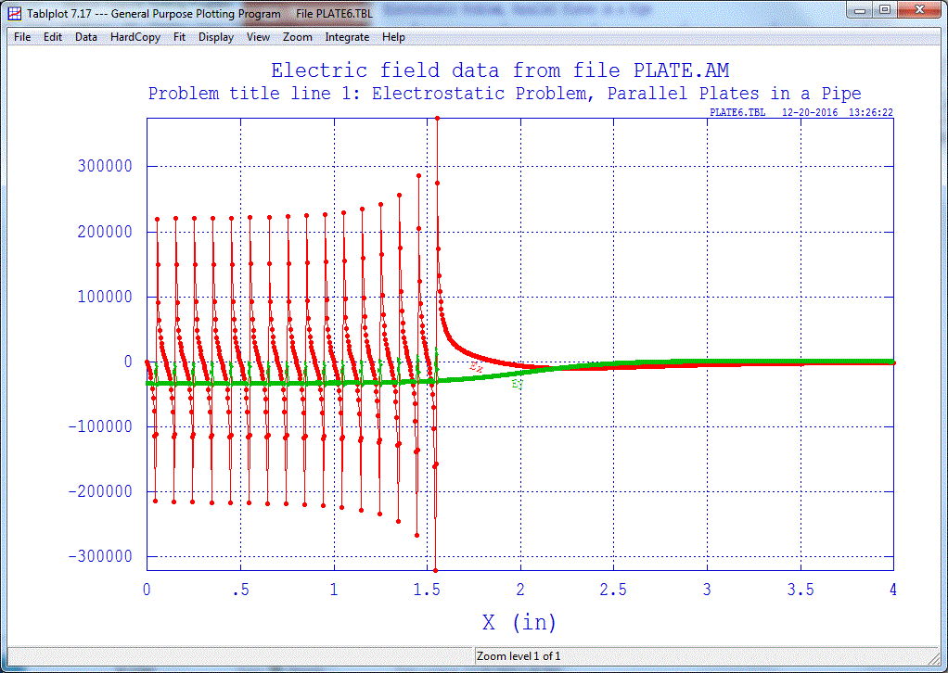
E-Field Changes
16
Denton Morris | MI Septa Failure Analysis
1/3/17

Slide 17
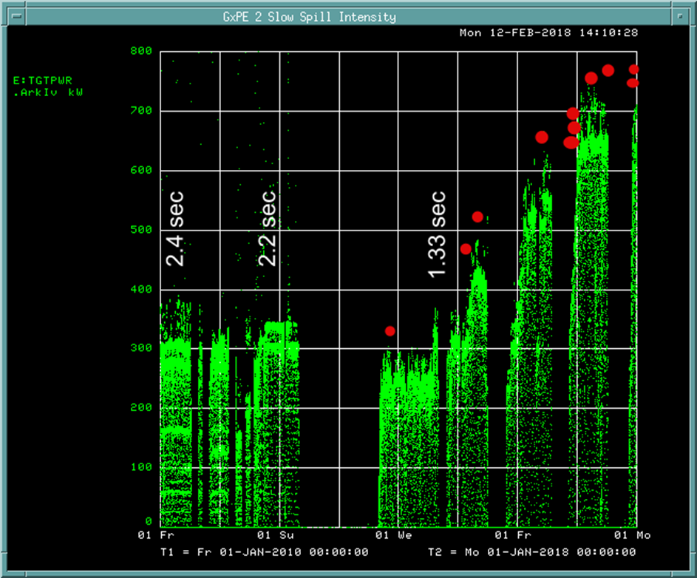
Running Conditions

Slide 18
Running Conditions
Logged Beam Position Data
shows no position changes
on cycles before wires broke.

Slide 19
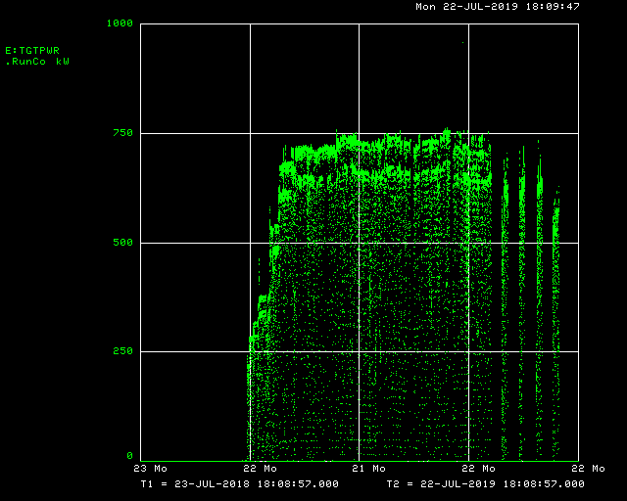
Resonant Affects in Septa Tanks?
Rob Ainsworth will present on this topic.
(Hint: Maybe, but for the last year we’ve run and record power on the NUMI cycles and no broken wires.)
NUMI beam:
>5e13 ppp
120 GeV
1.33 second rep rate
750KW peak
SX beam:
Max 1e13
120 GeV
One cycle per minute

Slide 20
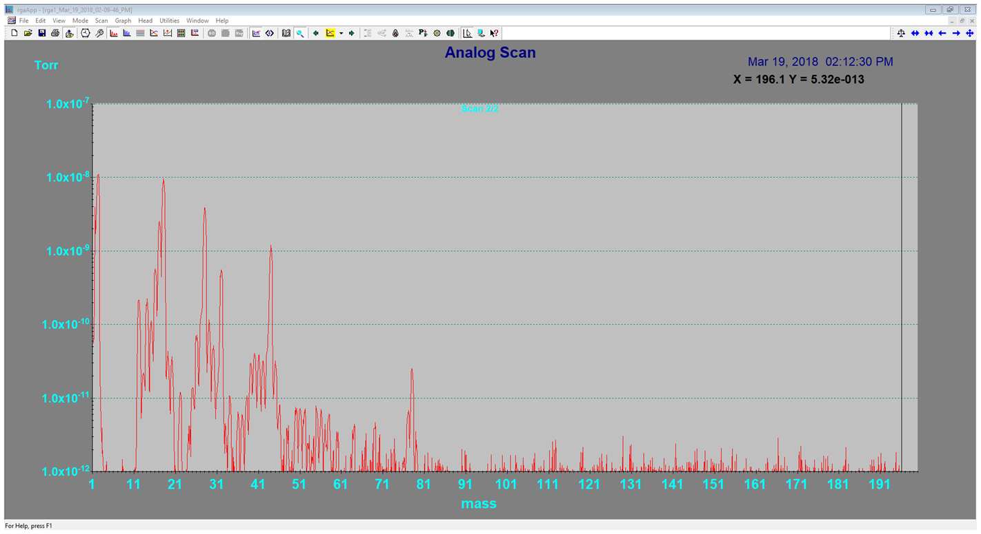
Corrosion

Slide 21
Corrosion
69
100
119
131
150*
*RGA error beyond 142 AMU

Slide 22
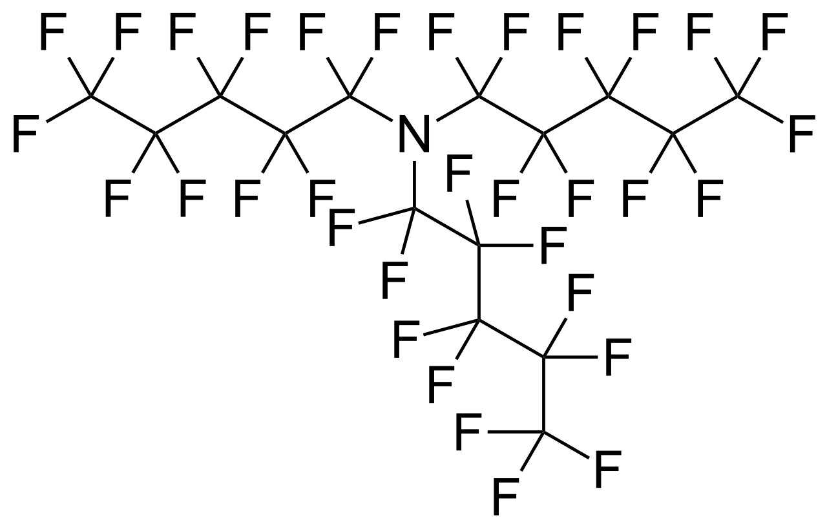
Corrosion Results
RGA scans show unusual peaks,
often separated by 12 and 19 a.u. ???
Fluorine and Carbon.
How does Fluorine get in our vacuum?
Fluorinert 40, Fluorinert 77, Fluorinert 770…
These are commonly used for cooling and electrical insulation.
We use Fluorinert to cool our fast kicker magnets in the tunnel.
One pair of those magnet are located 1 m upstream of our septa.

Slide 23
Solution?
We removed the kickers in close proximity to the septa that use
Fluorinert and baked the local components to remove any traces
from the septa systems. We also installed an additional RGA near
other kickers at a different location, to monitor for Fluorinert.
Even though leak checks of the removed kickers showed no leaks,
the RGA measurements showed no more traces of Fluorine.
We have had no shorted wires in over one year, even with the
machine beam intensity increasing.
Silver lining…

Slide 24
Conclusions?
We have zero data points since removing the Fluorinert
Good enough for me!
We are still working to understand the nature of the wire failures and the wire damage we’ve observed.
In the process of relearning how to build spare septa.

Slide 25
Lessons Learned
Documentation and archiving knowledge is useful
We had no information regarding the manufacturing process used during production of the Tungsten-Rhenium wire and did not know what it’s tensile strength was.
Intermittent failures need to be tracked to better understand possible cause and effect issues.
Push for long term maintenance plans regardless of costs and resource requirements
Then you can blame management.
Anecdotal information can be very important
A technician commented that during the first septa repair he polished the re-entrant cones on the cathode because they had areas of corrosion on the aluminum surface.
Information Transfer – Employees don’t last forever

