Slide 1
Remaining questions to discuss:
Quick overview of the Engineering sessions 10-15 min
Analytical models for non-linear dynamics
Channeling: projection for lower energy
Darmstadt: did anybody use smearing of ripples by the transit time spread?
COSE extraction
Diffuser results: projections to other cases
Spill Quality
Spill Regulation System: looking for the collaboration
RFKO FM modulation: looking for commercial solutions?
93% SDF at CERN: compare with the higher BW data?
Radiation hardness and Machine Protection:
Beam passing through the septum plane doesn’t get extracted

Slide 2
Analytical comparison with high order mapping model

Slide 3
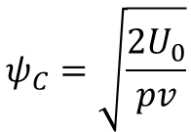
Crystal Shadowing
Critical angle
$$ψ_{C}=\sqrt{\frac{2U_{0}}{pv}}$$
Dechanneling length – doesn’t take into account MS?
22cm @ 450 GeV
15mm @ 30 GeV
3.9mm @ 8 GeV
What happens when circulating beam emittance gets larger – larger angular spread in horizontal.
Is the vertical beam scattered? Or does channeling work (partially) for the vertical?

Slide 4
Smearing ripples with transit time spread
A
Counts
Small S
A_{β}
extr.
beam
Time
$$\overline{T_{tr}}$$
stable
beam
Convolution
∆T_{tr}
Transit time spread
δ${ ε}_{Q}$(t)
Δp
Counts
At small sextupole strength, tune ramp starts closer to resonance (to maintain spill length)
Sextupole strength ($S )$and distance to resonance are NOT independent parameters
Transit time mean and spread are inversely proportional to distance to resonance ${(ε}_{Q}$)
B
$$\overline{T_{tr}}$$
${(ε}_{Q})$
Delay and smoothing!
Counts
∆T_{tr}
Time

Slide 5
COSE Concept
Separatrix change is consequence of moving resonance to select particles to be extracted via their momenta
COSE: keep resonance fixed and scale machine settings according to momentum to be extracted.
→ normalized strengths stay constant; fields change with momentum (or Bρ)
In many ways similar to betatron core
Difference: momentum of extracted beam not constant
V.Kain
Change in angular spread of extracted beam should mean the transport optics need to be adjusted, given new initial phase space definition. Is the change too small for this to be noticed?
Did anything in the transport to targets change (larger or smaller losses, new splitter positions, etc.)
k_{n}: constant

Slide 6
RFKO

Slide 7
Diffuser
1. How different is circulating beam emittance between low intensity and high intensity? Could the lower effectiveness (10%) be the result of a larger angular distribution (due to larger angular spread in separatrix arm from initially larger horizontal emittance.)
2. If vertical emittance was larger, could there have been a vertical scattering effect that caused more losses for larger emittance than smaller emittance?

Slide 8
High frequency SDF

Slide 9
Questions to J-PARC?
JPARC
Low Q’, Duty factor typically 50-55%. Would spill quality be improved with higher Q’ and COSE?
For measured 99.5% what is ES thickness needed from simulation?

Slide 10
PIMMS
PIMSS family machines
Empty bucket channelling to stabilise spill improves SDF from 0.1 to 0.7 (0.9?)
CNAO air-core quad in FF is not reproducible. Use by injecting HF ripple, and in FB to suppress ripple below 1 kHz. Why so difficult to reproduce?

Slide 11
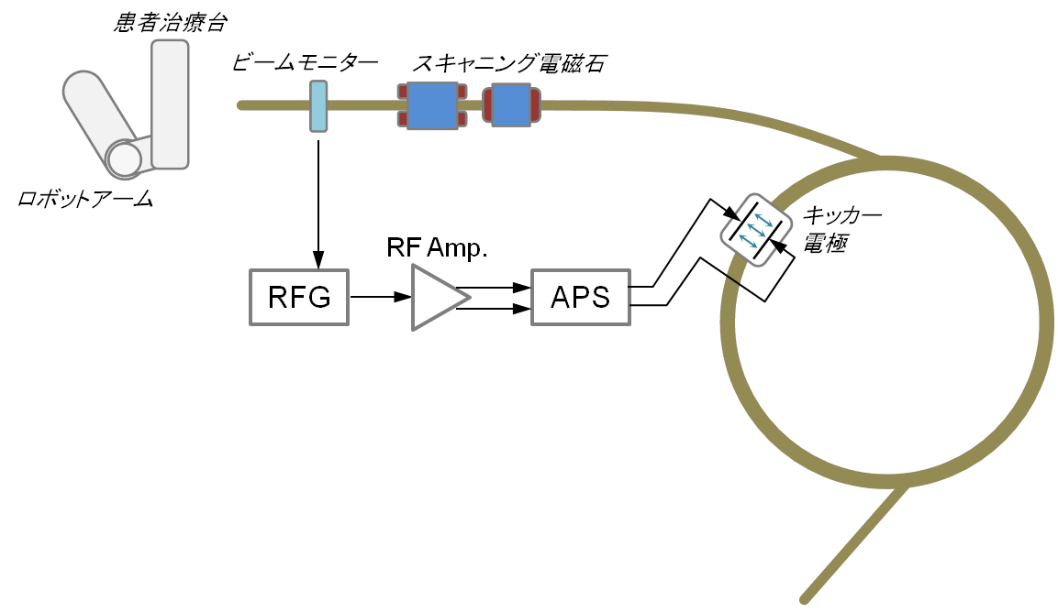
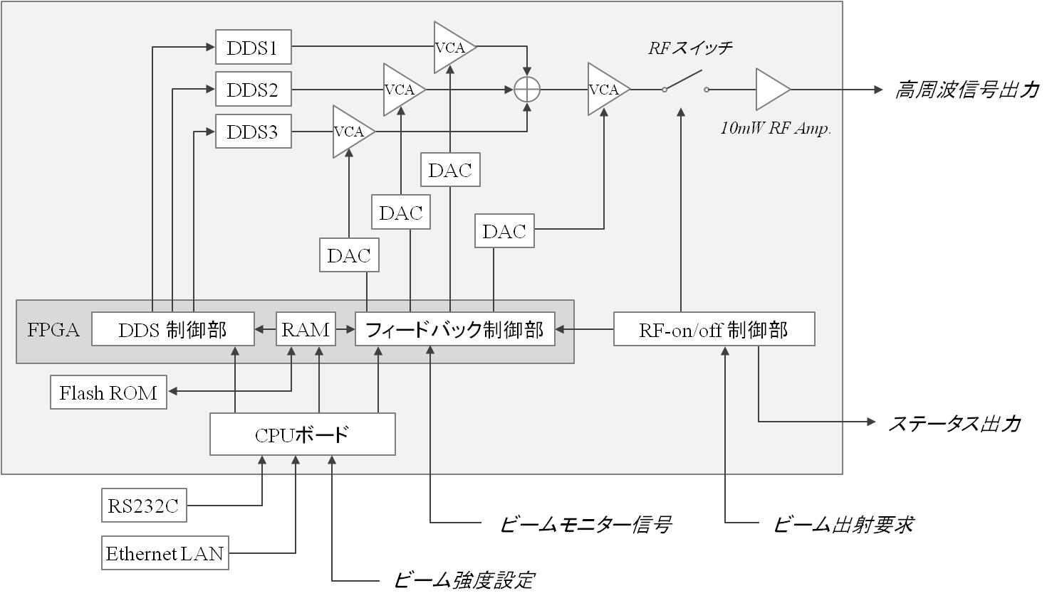
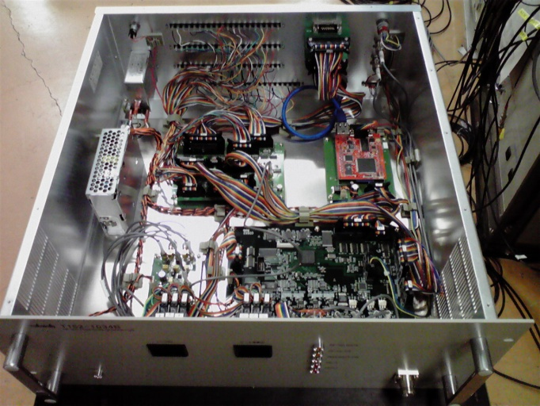
New Spill-Control System
高周波信号発生器
Robotic Coach
RF Signal Generator
K.Noda
Beam Monitor
Scanning Magnet
3 waves synthesizer applied with DDS
Amplitude feedback modulation with 10kHz-period
Intensity control trough PI-control
RF-Signal Output
Feedback Control
Status Output
Beam Monitor Signal
Beam ON Request
Beam Intensity Input

