Slide 1
A compact, low-field, broadband mode launcher for X-band DLA structures
Yelong Wei*, Alexej Grudiev
CERN, European Organization for Nuclear Research
Email: yelong.wei@cern.ch
1

Slide 2
Outline
Research progress on the dielectric disk accelerating (DDA) structures operating at TM02 π-mode
Design of a compact, low-field, broadband mode launcher
Tolerance studies
Geometry sensitivity
Sensitivity for corner defects
Summary & Outlook
2

Slide 3
Outline
Research progress on the dielectric disk accelerating (DDA) structures operating at TM02 π-mode
Design of a compact, low-field, broadband mode launcher
Tolerance studies
Geometry sensitivity
Sensitivity for corner defects
Summary & Outlook
3

Slide 4
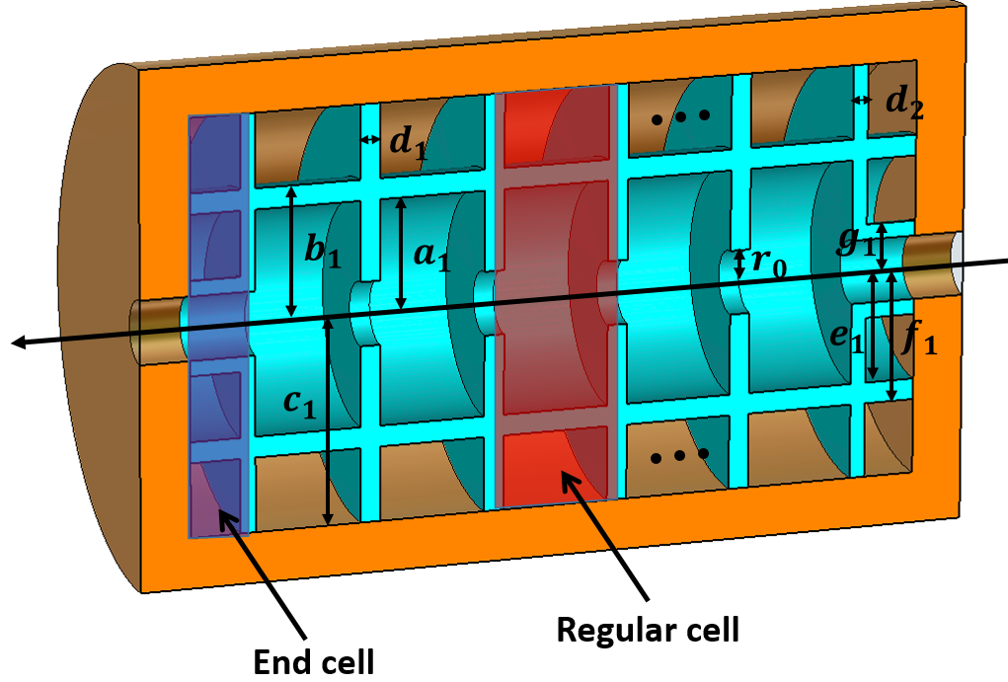
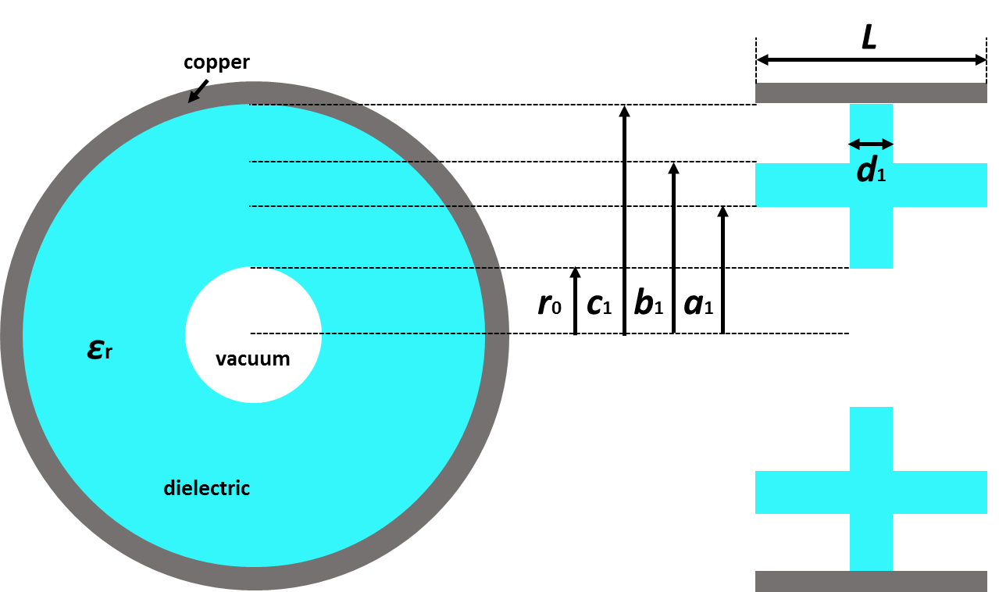
DDA Structures-TM02 π-mode
High order mode operation reduces the wall power loss;
The electromagnetic fields can be controlled by dielectric parts;
High power efficiency.
D. Satoh, et al. Phys. Rev. Accel. Beams 19, 011302 (2016)
4

Slide 5
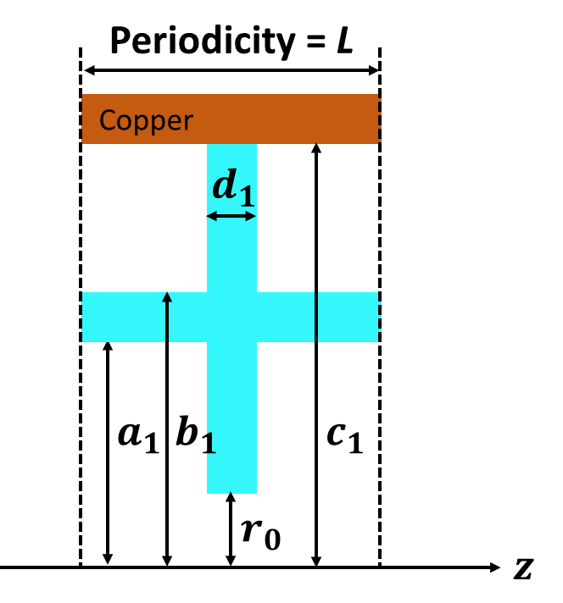
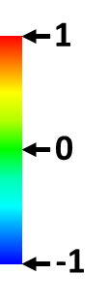
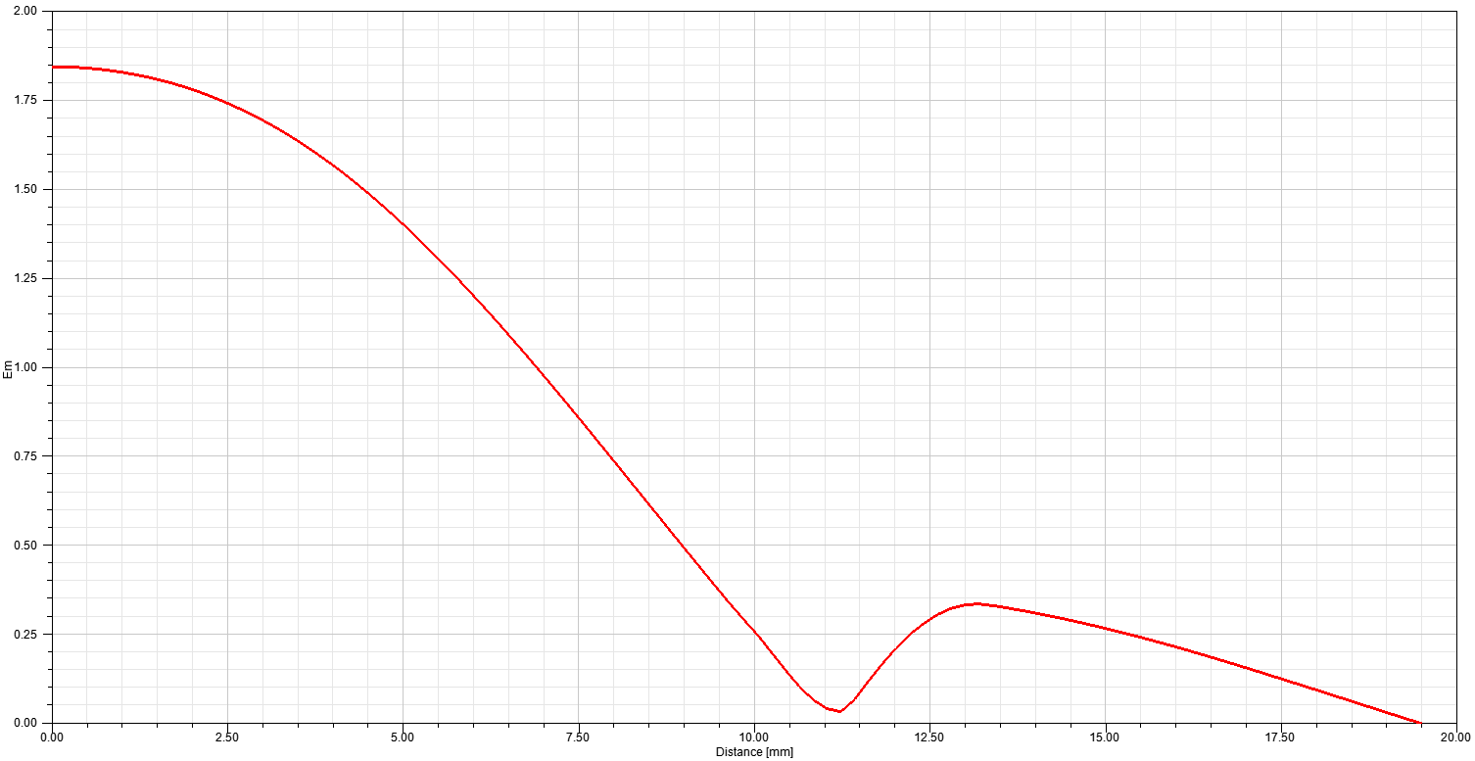
Regular cell (original-type)
Longitudinal electric fields
Transverse magnetic fields
Most of the RF energy is stored in the vacuum region;
The total RF loss including both the wall loss on the conducting cylinder and dielectric loss in the DDA structure can be drastically reduced, thereby resulting in both an extremely high quality factor and a very high shunt impedance at room temperature.
Electric energy density
Magnetic energy density
5

Slide 6
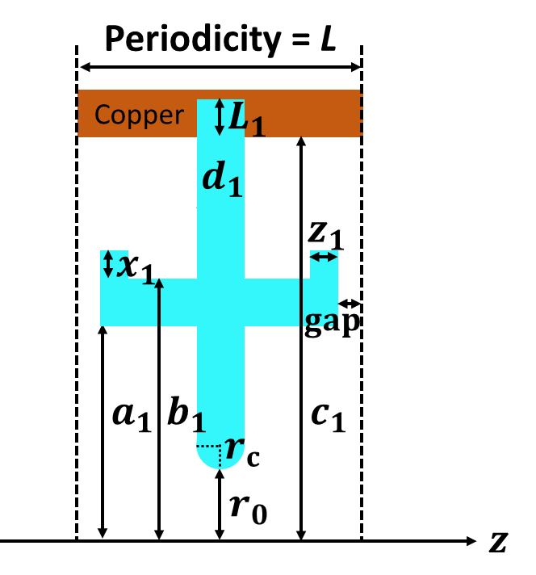
Further optimization and consideration (modified-type)
Optimum parameters | Original | Modified
Dielectric constant εr | 9.64 | 9.64
Dielectric loss tangent δ | 6E-6 | 6E-6
Inner radius r0 [mm] | 3.15 | 3.15
Outer radius c1 [mm] | 20.5 | 20.5
a1 [mm] | 11.10 | 11.10
b1 [mm] | 13.16 | 13.50
d1 [mm] | 2.0 | 2.0
L1 [mm] |  | 5.0
x1 [mm] |  | 0.9
z1 [mm] |  | 0.7
Structure period length L [mm] | 12.50 | 12.50
Phase advance | 180° | 180°
Acceleration mode | TM02 π-mode | TM02 π-mode
Frequency [GHz] | 11.9969 | 11.9949
Unloaded Q0 | 134542 | 112639
r’/Q0 [Ω/m] | 6089 | 5488
r’ [MΩ/m] | 819 | 618
Fillet the dielectric corner with a radius of $r_{c}=$ 1.0 mm to reduce the $E_{p}$/$E_{a}≈$ 2.0 ;
Add a gap between ceramics for evacuation with a gap of 0.25 mm;
Add a dielectric $L_{1}$ to improve thermal contact.
6

Slide 7
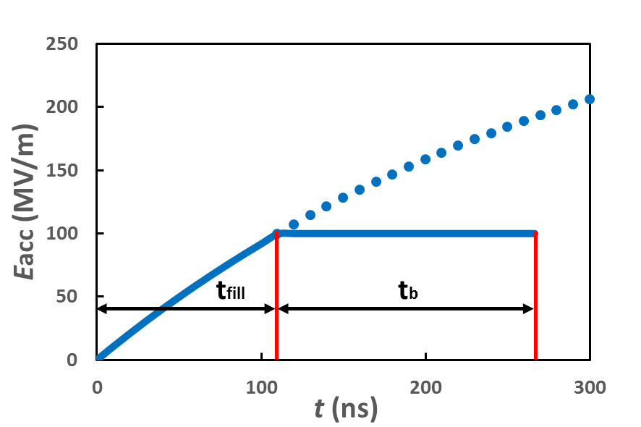
RF to beam efficiency for CLIC main linac
$$P_{dis}=\frac{V_{acc}^{2}}{r^{′}NL}=0.1526 MW$$
$$τ=\frac{2Q_{0}}{ω\left(1+β\right)}=303.83 ns$$
$$N_{2π/3}^{CLIC−G}=26$$
$N_{π}^{DDA}=$18
$$P_{b}=V_{acc}I_{b}=1.4875 MW$$
$$E_{acc}^{Unload}=\sqrt{\frac{P_{0}r^{′}}{NL}}=327.8 MV/m$$
$$N=1$$
$$L=12.5 mm$$
$$E_{acc}^{Load}=100 MV/m$$
$$P_{0}=P_{dis}+P_{b}=1.640 MW$$
$$β=\frac{P_{0}}{P_{dis}}=10.746$$
$$V_{acc}=NLE_{acc}^{Load}=1.25 MV$$
$$E_{acc}=E_{acc}^{Unload}\left(1−e^{−\frac{t}{τ}}\right)$$
RF properties | CLIC-G (26 regular cells, damped) | Original DDA (1 cell) | Modified DDA (1 cell)
Dielectric loss tangent δ |  | 6E-6 | 6E-6
Acceleration mode | 2π/3 | TM02 π-mode | TM02 π-mode
Shunt impedance r’ [MΩ/m] | 92 | 819 | 618
Peak input power [MW] | 61.3 | 1.64 | 1.69
Loaded gradient $E_{acc}^{Load}$ [MV/m] | 100 | 100 | 100
Filling time $t_{fill}$ [ns] | 67 | 110 .6 | 135.8
$t_{b}$ [ns] | 155.6 | 155.6 | 155.6
RF to beam efficiency | 28.5% | 53.0% | 47.0%
Design of the CLIC main linac accelerating structure for CLIC Conceptual Design Report, Proceedings of LINAC2010, A. Grudiev, W. Wuensch.
7

Slide 8
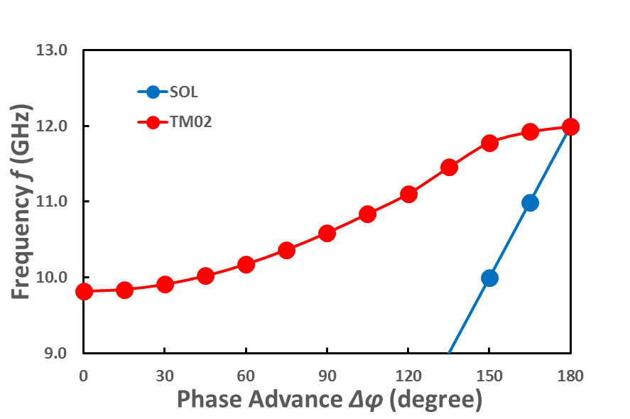
Considerations on the maximum number of cells
Reference: Nagle, Knapp and Knapp, 1964 and 1968
$$f=\frac{f_{r}}{\sqrt{1+k\cos{∆φ}}}$$
$$f_{r}=\frac{\sqrt{2}f_{π}f_{0}}{\sqrt{f_{π}^{2}+f_{0}^{2}}}=10.7442 GHz$$
$$k=\frac{f_{π}^{2}−f_{0}^{2}}{f_{π}^{2}+f_{0}^{2}}=0.198$$
Bandwidth $BW=f_{r}k=2.17 GHz$
To avoid mode overlapping: $N<\sqrt{\frac{Q_{π}π^{2}k}{4}}=256$; $N<\frac{Q_{π/2}πk}{2}=39221$
The frequency separation for modes: $∆f_{N−1,N}^{π}=f_{r}\frac{{kπ}^{2}}{{4N}^{2}}=21 MHz$; $∆f_{N−1,N}^{π/2}=f_{r}\frac{kπ}{4N}=6.7 MHz$
;
Maximum number of cells can be 255
8

Slide 9
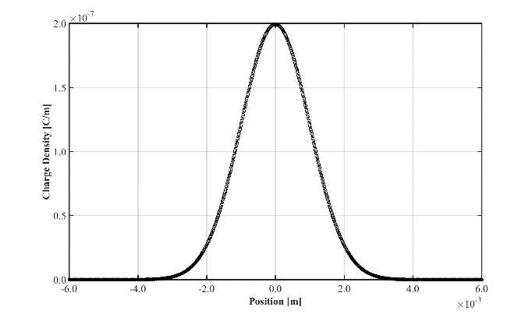
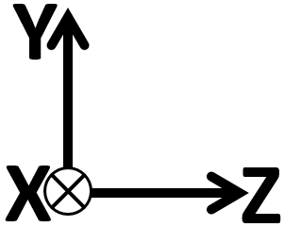
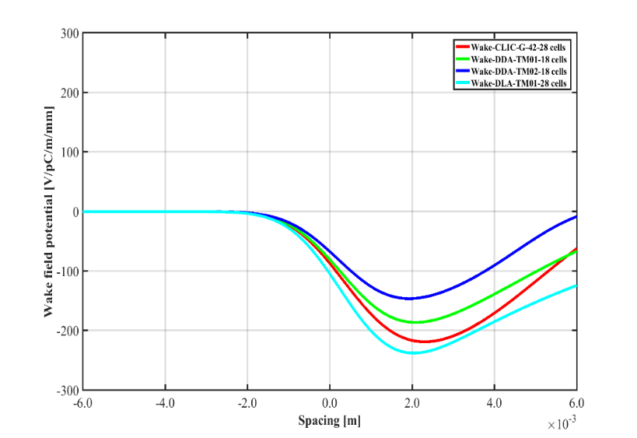
Short-range Wakefields
Charge Density
CLIC-G-42
DLA-TM01
DDA-TM01 (Standing Wave)
DDA-TM02-original (Standing Wave)
DDA-TM02 structure shows lowest short range Wakefields: abour 2/3 of the CLIC-G
CLIC-G: 28*8.332 ↔ DDA TM02-π: 18*12.5, so the number of regular cell is 18, no end cells are included;
Convergence studies: dx = dy = dz = 0.05 mm;
Bunch charge Q = 1.0 nC, bunch sigma = 1.0 mm, offset = 0.5 mm.
CLIC-G
DLA-TM01
DDA-TM01
9

Slide 10
Outline
Research progress on the dielectric disk accelerating (DDA) structures operating at TM02 π-mode
Design of a compact, low-field, broadband mode launcher
Tolerance studies
Geometry sensitivity
Sensitivity for corner defects
Summary & Outlook
10

Slide 11
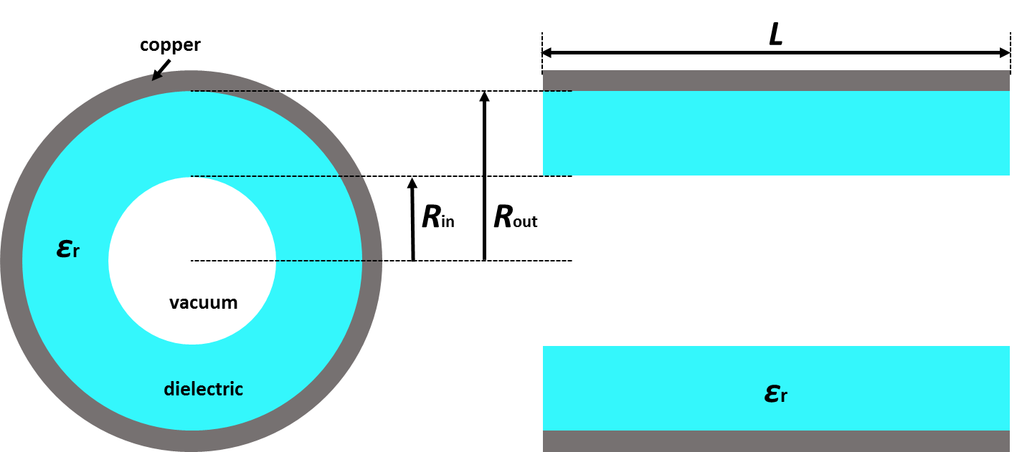
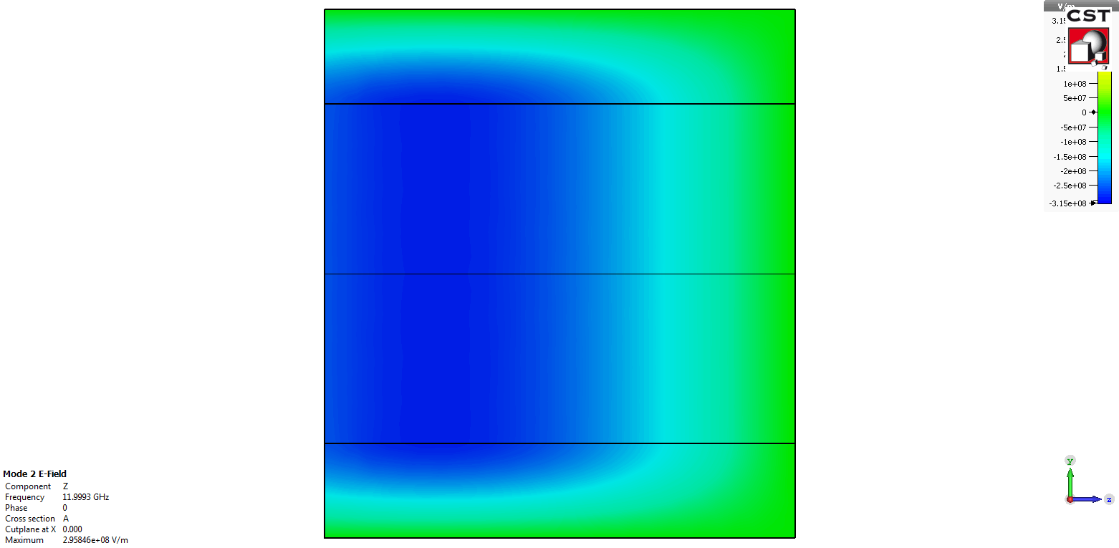
An X-band DLA structure
 | CLIC-G iris structure (undamped) | MCT-16
Dielectric constant $ε_{r}$ |  | 16
Dielectric loss tangent $δ$ |  | 0.0001
Structure length [mm] | 8.33 | 8.33
Phase advance | 120° | 120°
Inner radius $r_{1}$ [mm] | 3.15 | 3.0
Outer radius $r_{2}$ [mm] |  | 4.675
Frequency [GHz] | 11.9943 | 11.9984
Unloaded $Q_{0}$ | 7245 | 2468
$r^{′}/Q_{0}$ [Ω/m] | 15924 | 9489
$r^{′}$ [MΩ/m] | 115 | 23
$v_{g}$/c | 0.018 | 0.068
$E_{s}$/$E_{a}$ | 2.4819 | 1.069
$E_{s}$/$E_{a}$ [dielectric] |  | 1.0
Power required to generate 100 MV/m [MW] | 45.0 | 287
Longitudinal Electric fields
11

Slide 12
An X-band mode launcher for DLA structures
DLA structure material? One more slide about DLA structure design is needed
$ε_{r}=16.0$, loss tangent δ = 0.0001;
$R_{in}=3.0$ mm, $R_{out}=4.675$ mm;
Working frequency $f_{0}=11.9980$ GHz
21.9 mm
Matching section????
Using existing design of the X-band mode launcher for metallic prototypes (Converting TE10 mode into TM01 mode)
Output circular waveguide has a diameter of 21.9 mm
12

Slide 13
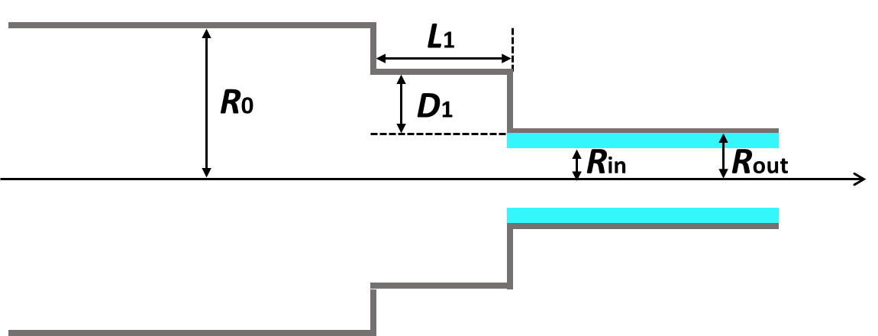
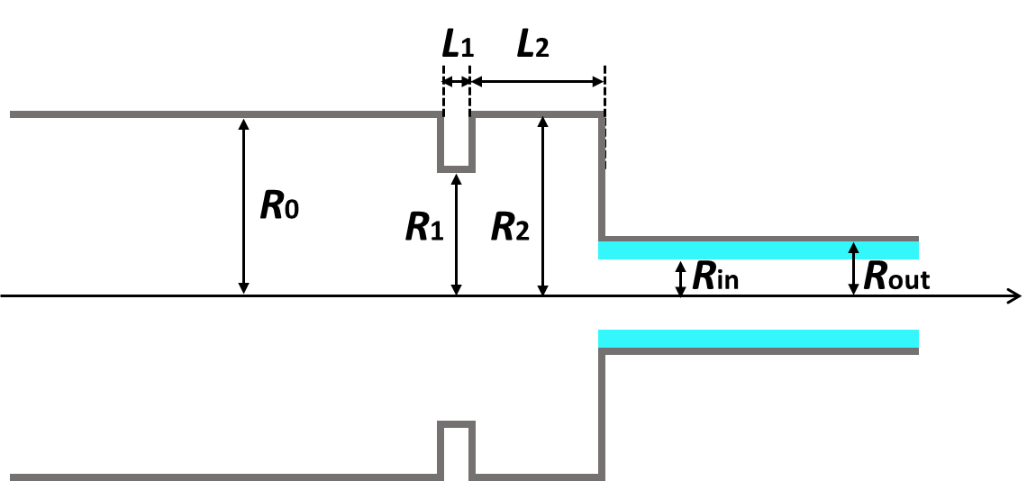
Standard methods for matching between a DLA structure and a circular waveguide
Circular waveguide has a radius of $R_{0}=10.95$ mm;
DLA has a inner radius $R_{in}=3.0$ mm and outer radius $R_{out}=4.675$ mm;
Two methods are being used:
Quarter wavelength waveguide;
A matching cell.
(1) Quarter wavelength waveguide
(2) A matching cell
13

Slide 14
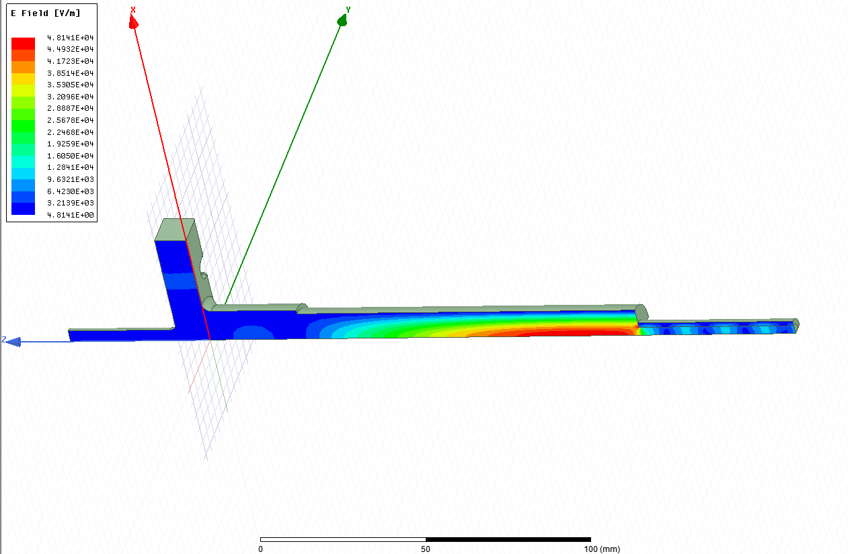
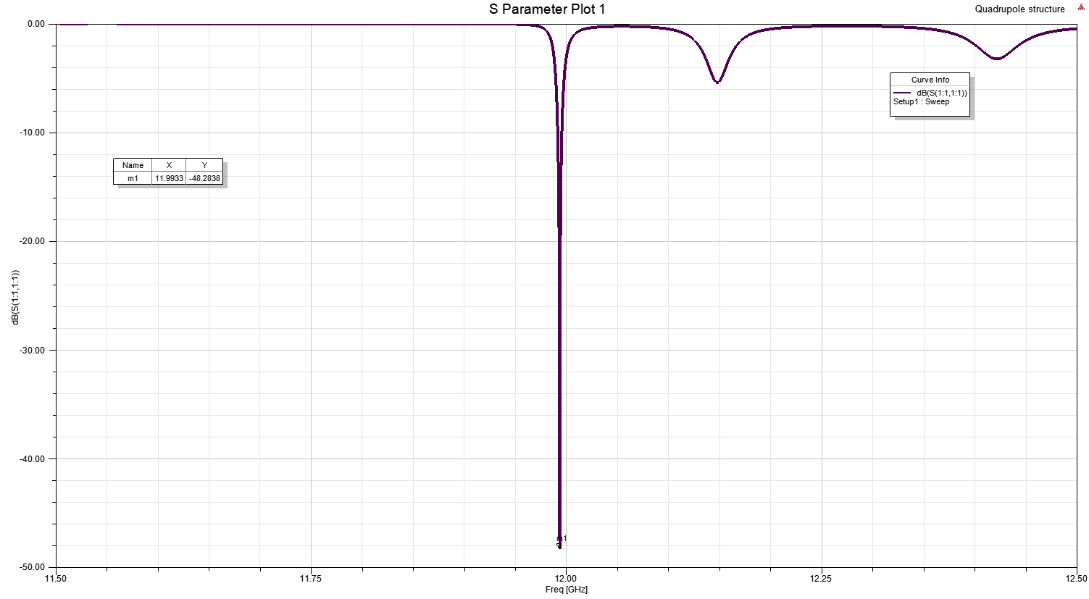
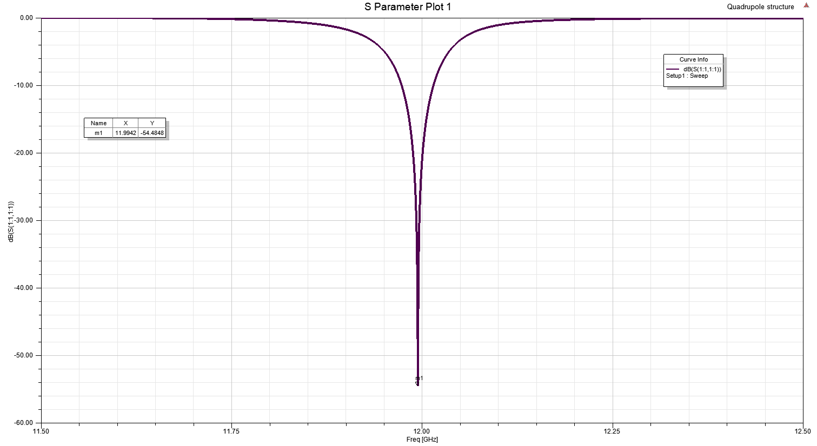
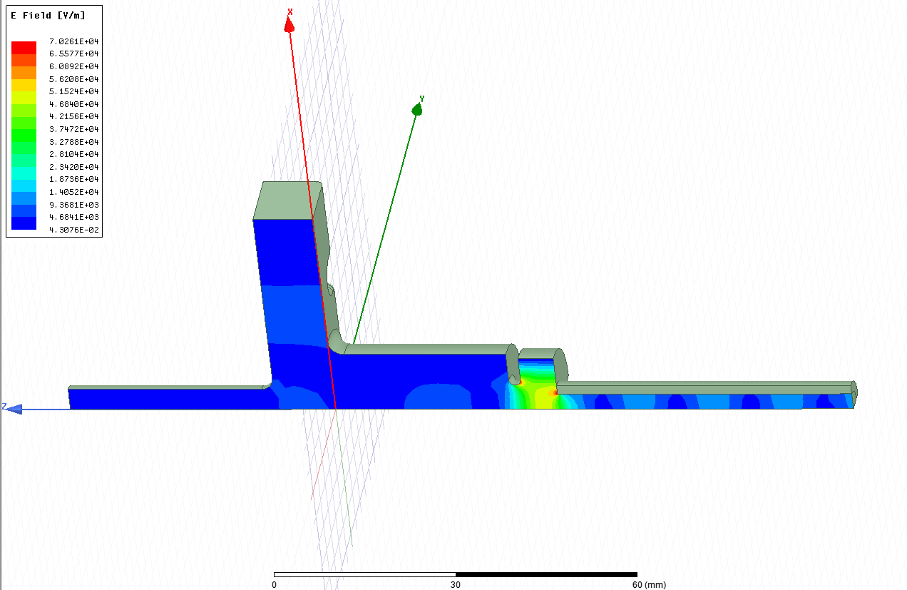
S Parameter Simulation
Good S11 can be achieved;
Further simulation studies are needed to reduce the maximum field in the matching sections.
f = 11.9933 GHz
S11 = -48 dB
f = 11.9942 GHz
S11 = -54 dB
14

Slide 15
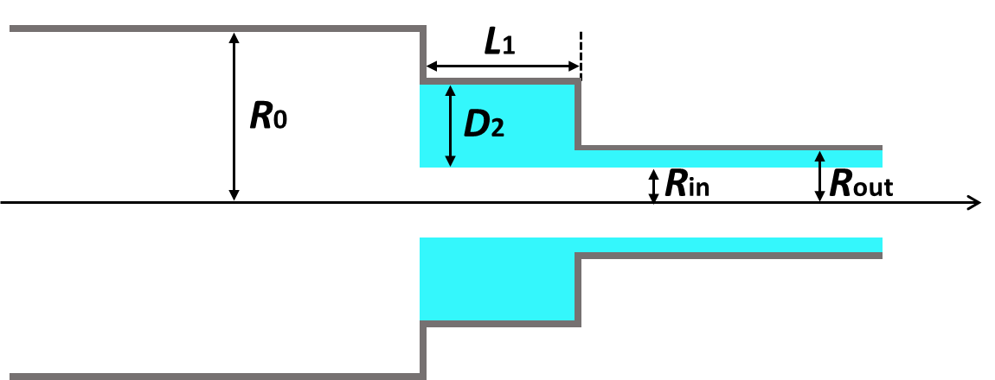
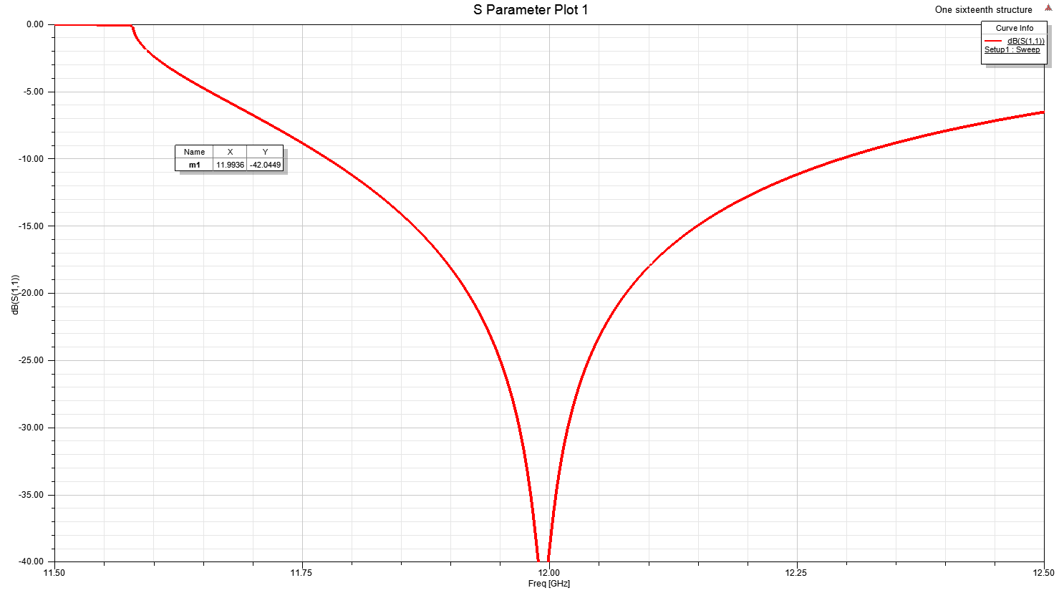
Adding dielectrics into matching section
L1 = 1.82 mm, D2 = 3.135 mm;
The maximum field in the matching section is lower than in the DLA, but still pay special attention to the fields in the corners.
Bandwidth is much larger and it is limited by the waveguide cut-off frequency
f = 11.9936 GHz
S11 < -42 dB
15

Slide 16
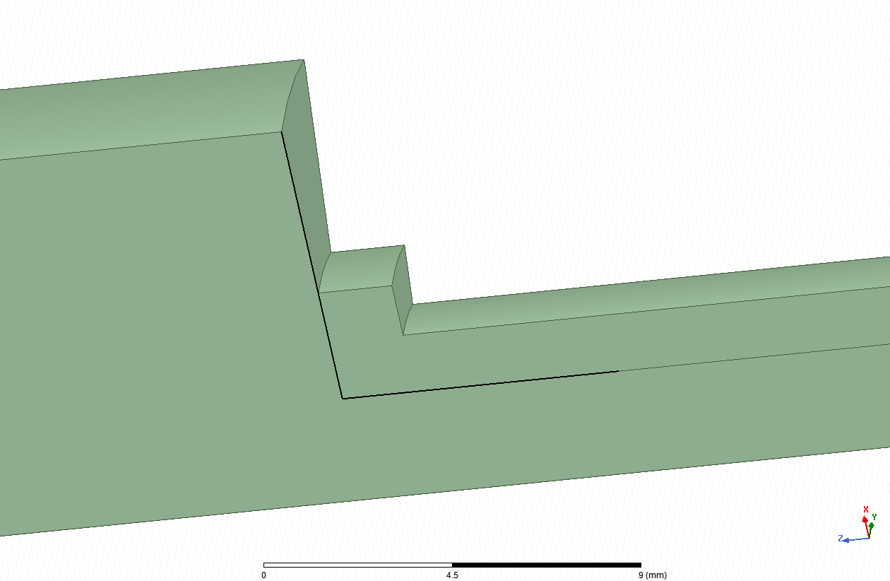
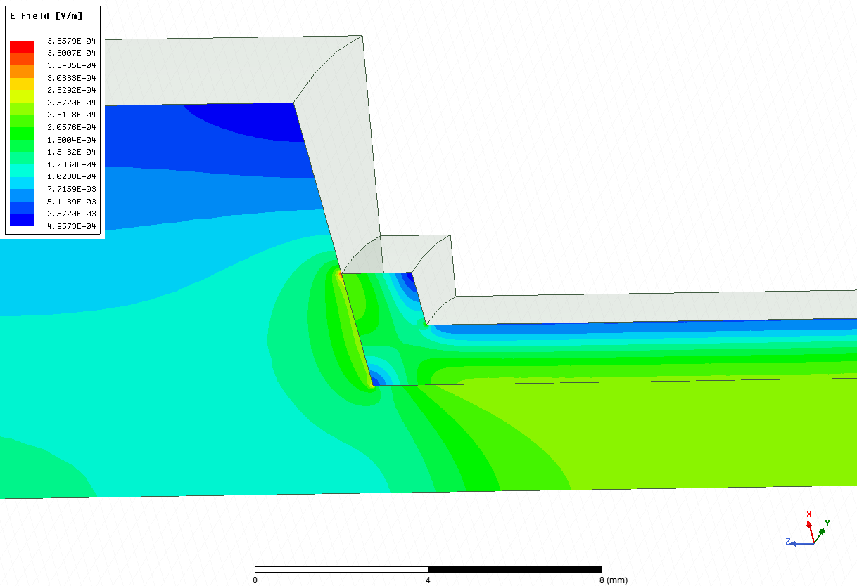
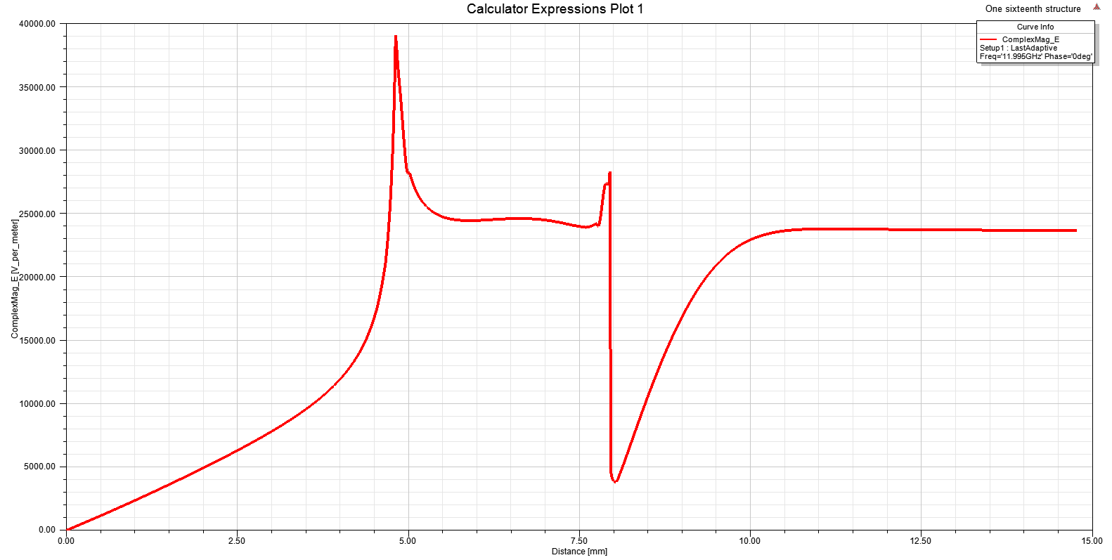
Electric fields in the corners
Corner 1
Corner 3
Corner 2
There are two peak fields in the corner 1 and dielectric corner 2, respectively;
We need to reduce these two peak fields;
16

Slide 17
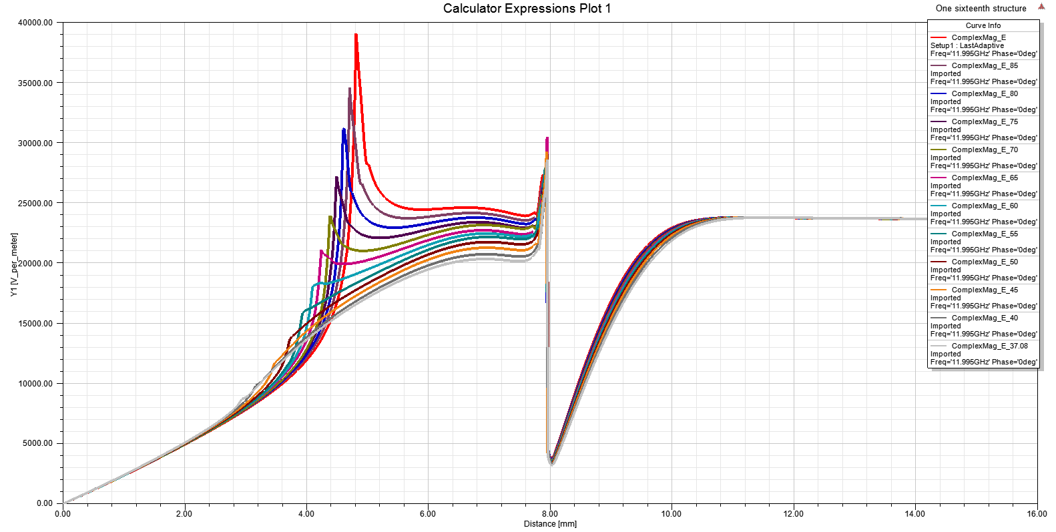
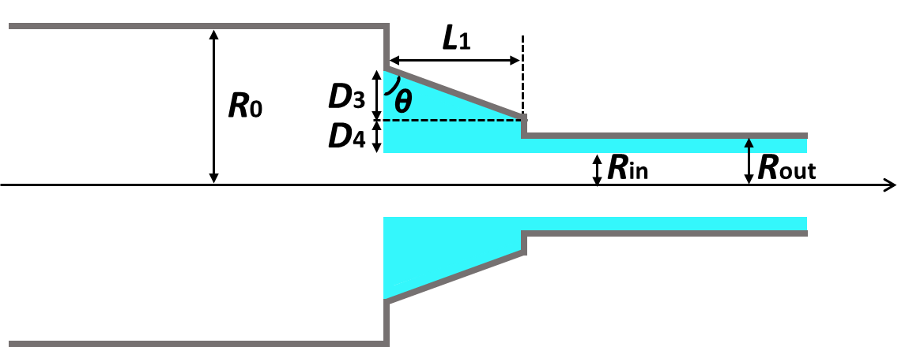
Adding a skew angle θ for Corner 1
90°
85°
80°
75°
70°
65°
60°
55°
50°
45°
40°
37.08°
For each skew angle, it is perfectly matched with a S11 < -40 dB;
The peak fields in the corner 1 are decreased with a smaller skew angle θ;
When $θ={70}^{0}$, the peak fields in the corner 1 equal to the accelerating fields in the DLA structure; ${70}^{0}$ is a critical skew angle;
$θ={60}^{0}$ is chosen for the following optimization.
17

Slide 18
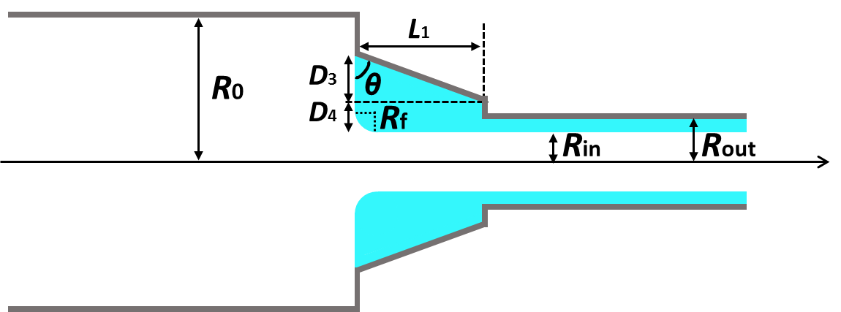
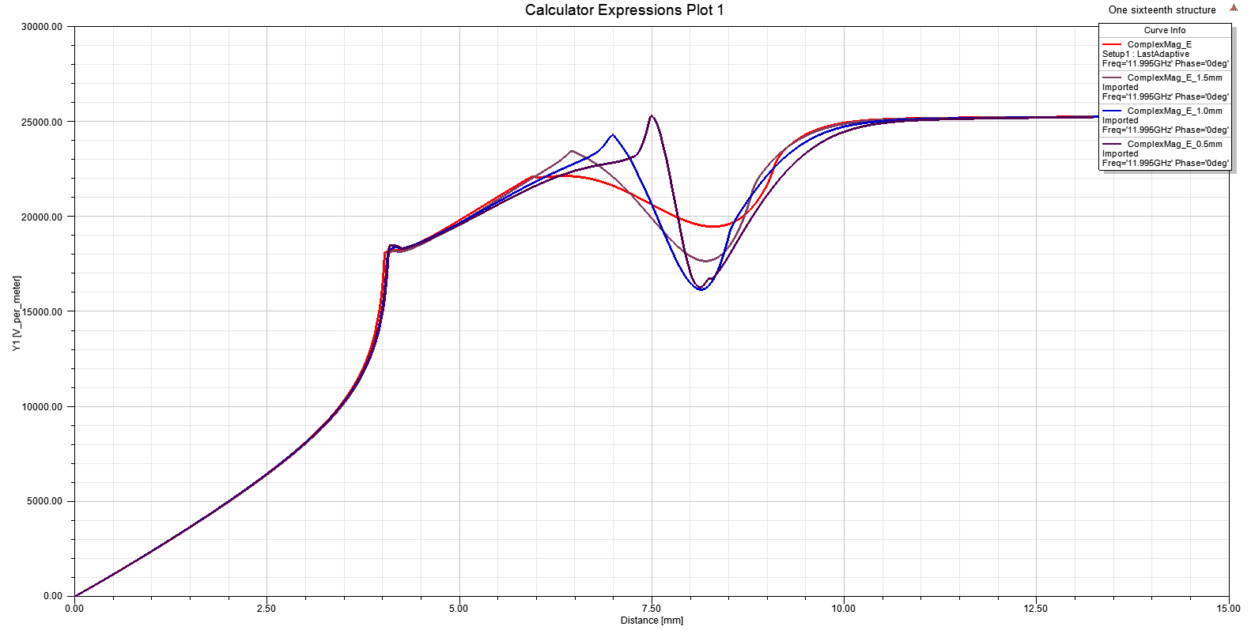
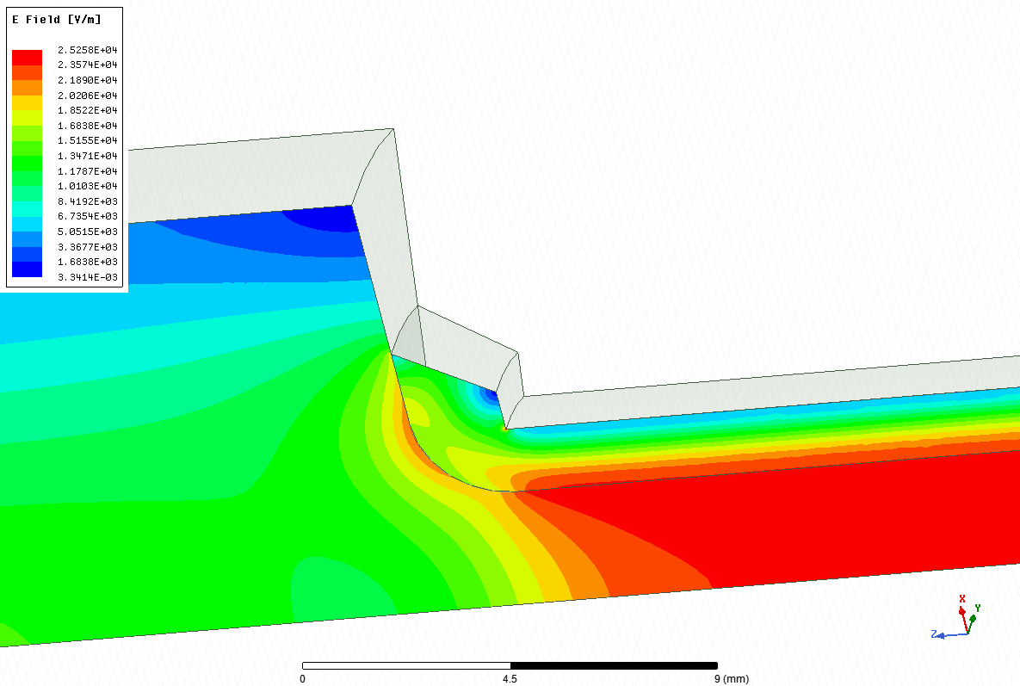
Fillet Corner 2 at a skew angle of 60°
$R_{f}=$ 0.5 mm
$R_{f}=$1.0 mm
$R_{f}=$1.5 mm
$R_{f}=$ 2.0 mm
$R_{f}=$ 2.0 mm
For each curve, it is perfectly matched with a S11 < -40 dB;
The peak fields in the corner 1 are decreased with a larger fillet radius $R_{f}$;
$R_{f}=$ 2.0 mm is chosen for the following optimization.
Corner 3
18

Slide 19
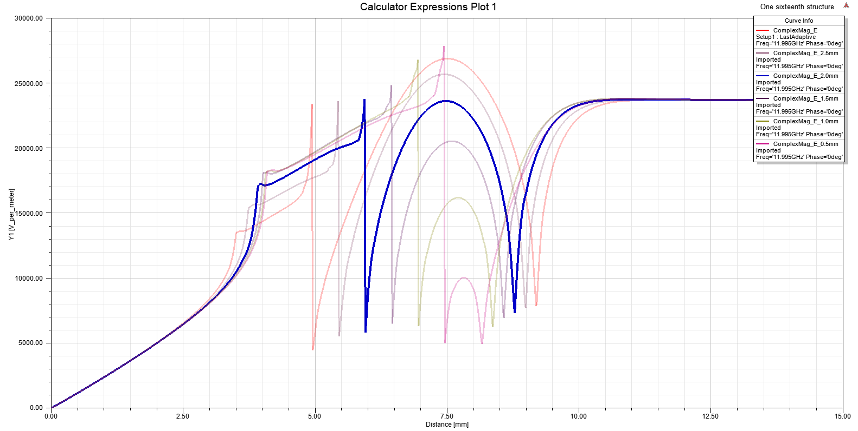
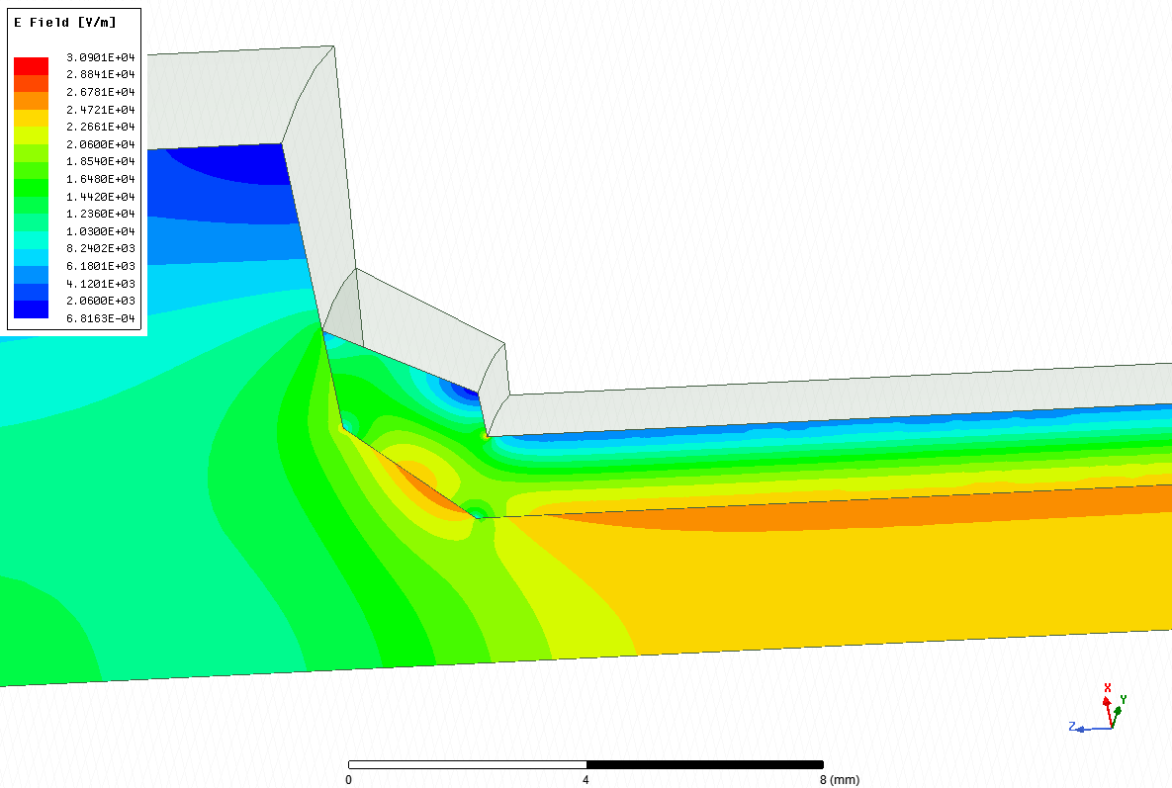
Chamfer Corner 2 at a skew angle of 60°
$R_{c}=$ 1.5 mm
$R_{c}=$ 1.0 mm
$R_{c}=$ 2.0 mm
$R_{c}=$ 2.5 mm
$R_{c}=$ 0.5 mm
$R_{c}=$ 3.0 mm
$R_{c}=$ 2.0 mm
For each curve, it is perfectly matched with a S11 < -40 dB;
Only when $R_{c}=$ 2.0 mm, the peak fields in the corner 2 equal to the accelerating fields in the DLA structure.
19

Slide 20
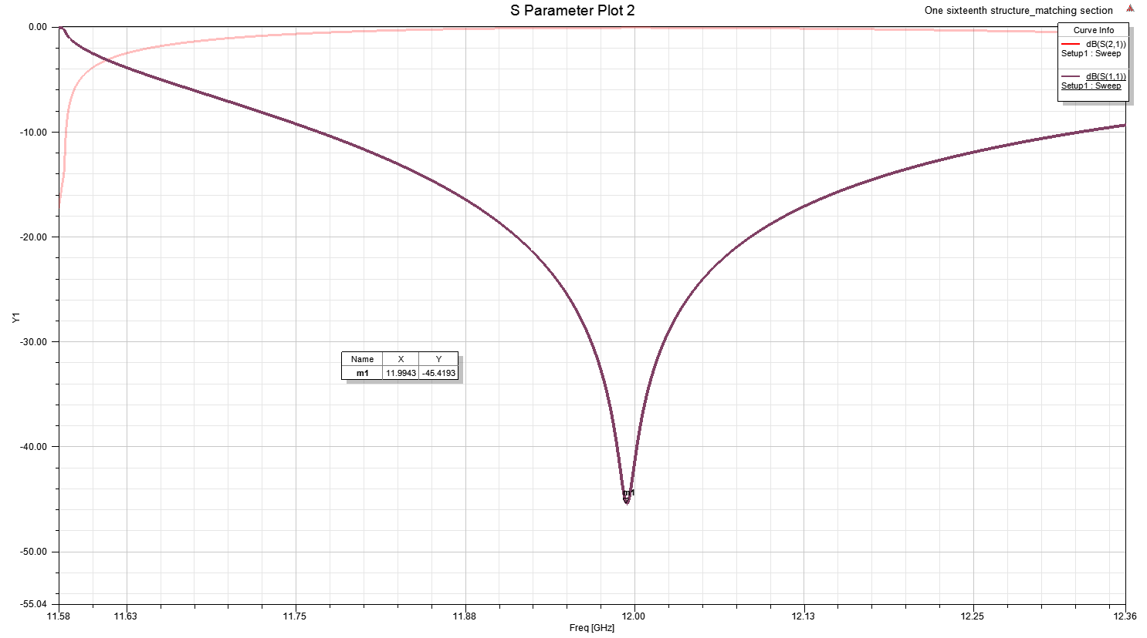
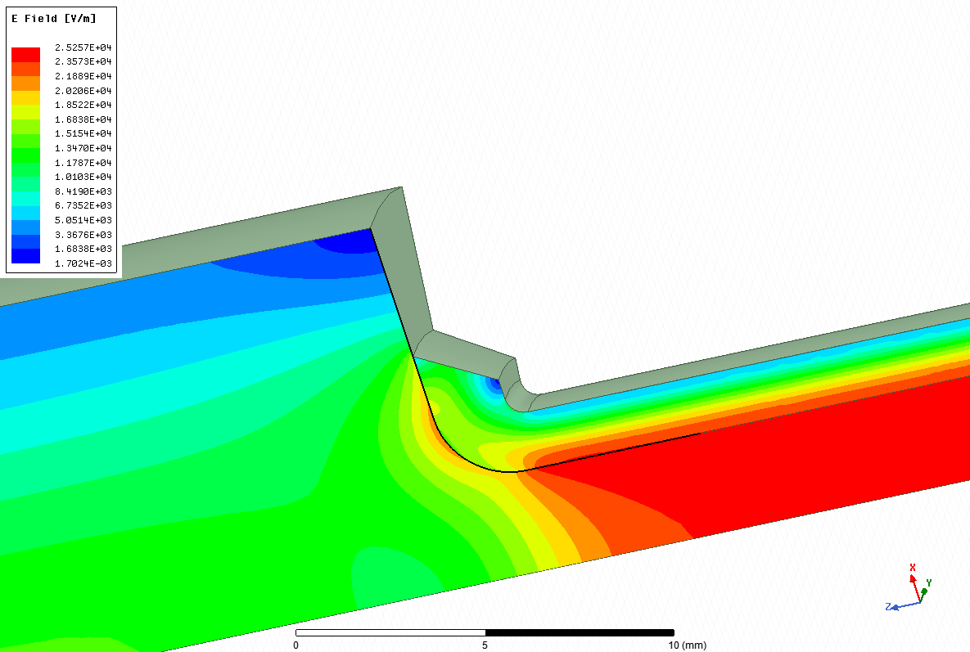
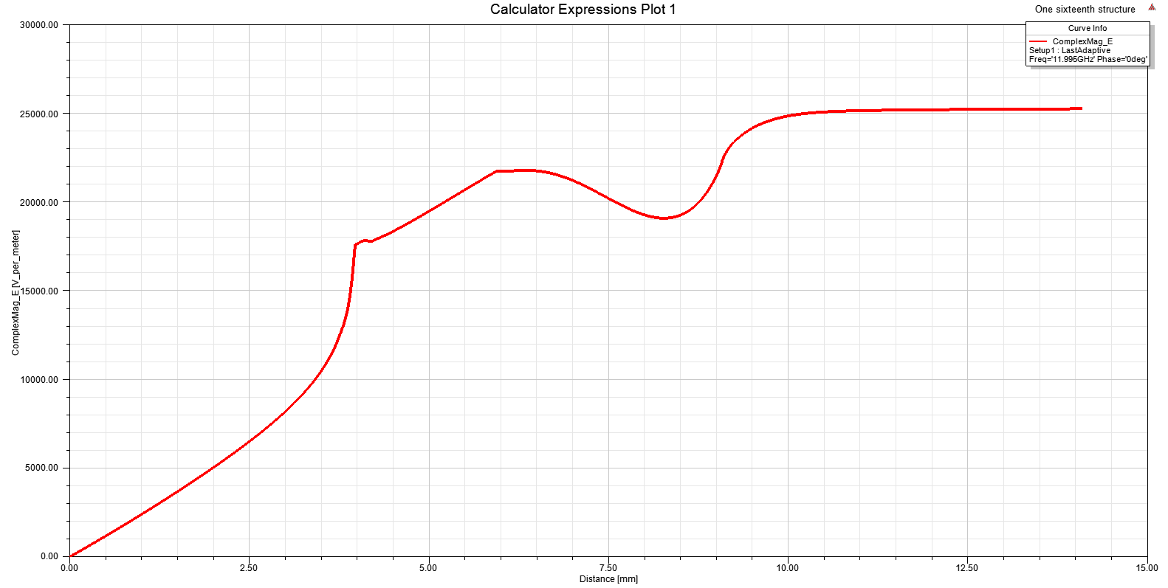
Skew angle θ = 60°, Fillet Corner 2 with a radius $R_{f}$ = 2.0 mm
f = 11.9943 GHz
S11 = -45.4 dB
Fillet Corner 3 with a radius of 0.5 mm;
The peak fields in the Corner 1, Corner 2 and Corner 3 are greatly reduced so that the maximum fields are located in the DLA structure;
For S11 < -30 dB, the bandwidth $∆$ = 12.0216 GHz -11.9680 GHz = 53.6 MHz;
For S11 < -20 dB, the bandwidth $∆$= 12.0855 GHz -11.9131 GHz = 172.4 MHz
20

Slide 21
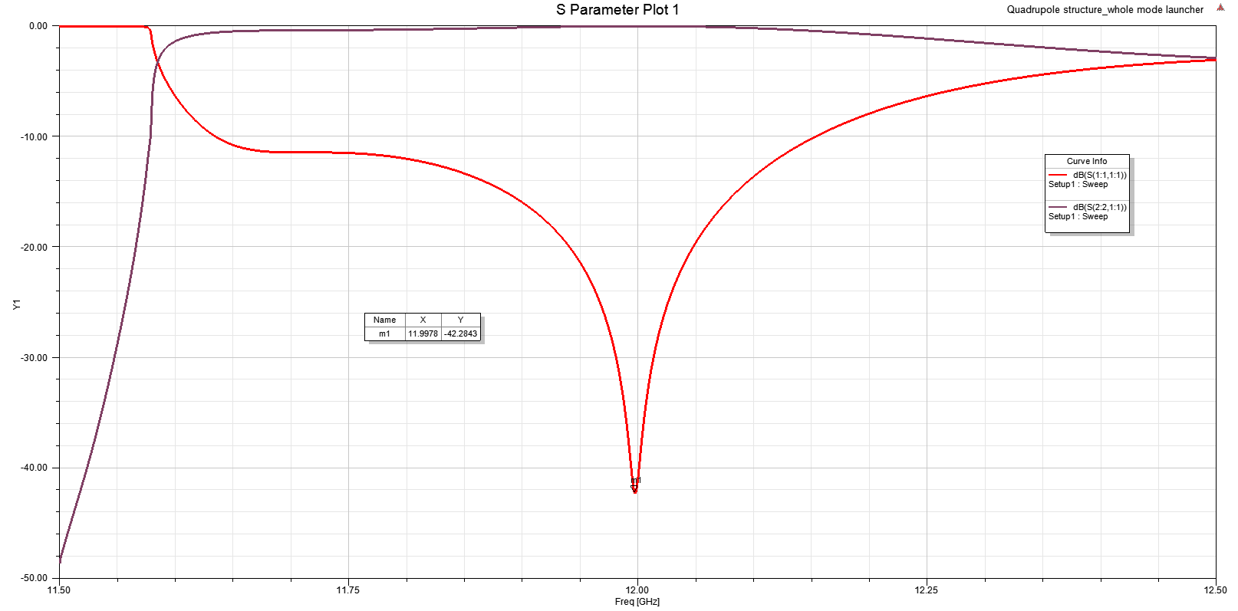
Whole X-band mode launcher
f = 11.9978GHz
S11 = -42.3 dB
Input power from klystron (Peak power: $100$ MW, repetition rate: 100 Hz, pulse width: 100 ns), the average power is 1 kW.
The power loss in dielectrics is 32 W for a DLA with length of 10 cm; The power loss in surface copper is 1.87 W.
21

Slide 22
Outline
Research progress on the dielectric disk accelerating (DDA) structures operating at TM02 π-mode
Design of a compact, low-field, broadband mode launcher
Tolerance studies
Geometry sensitivity
Sensitivity for corner defects
Summary & Outlook
22

Slide 23
Geometry Sensitivity
$R_{0}$is not taken into account because it is a geometry form existing prototype.
f = 11.9950 GHz | $S_{11}≤−30$ dB | $S_{11}≤−25$ dB | $S_{11}≤−20$ dB
$L_{1}=2.075$ mm | [-0.008, +0.006] mm | [-0.014, +0.012] mm | [-0.024, +0.023]
$D_{4}=2.780$ mm | [-0.020, +0.015] mm | [-0.033, +0.028] mm | [-0.056, +0.053] mm
$$θ={60}^{0}$$ | [-${2.0}^{0}$, +${2.6}^{0}$] | [-${3.6}^{0}$, +${4.4}^{0}$] | [-${6.7}^{0}$, +${7.6}^{0}$]
$R_{f}=2.0$ mm | [-0.041, +0.048] mm | [-0.078, +0.080] mm | [-0.150, +0.133] mm
$R_{m}=0.5$ mm | [-0.062, +0.052] mm | [-0.120, +0.092] mm | [-0.190, +0.159] mm
$R_{out}=4.675$ mm | [-0.006, +0.009] mm | [-0.011, +0.015] mm | [-0.019, +0.029] mm
$R_{in}=3.0$ mm | [-0.008, +0.006] mm | [-0.015, +0.011] mm | [-0.028, +0.019] mm
Dielectric constant $ε_{r}=16.0$ | [-0.077, +0.078] | [-0.135, +0.144] | [-0.242, +0.268]
$S_{11}$ is most sensitive to $L_{1}$, $R_{out}$, and $R_{in}$;
$S_{11}$ is least sensitive to $D_{4}$, $θ$, $R_{f}$, $R_{m}$, $ε$;
Really depends on the fabrication tolerances and dielectric material.
23

Slide 24
Outline
Research progress on the dielectric disk accelerating (DDA) structures operating at TM02 π-mode
Design of a compact, low-field, broadband mode launcher
Tolerance studies
Geometry sensitivity
Sensitivity for corner defects
Summary & Outlook
24

Slide 25
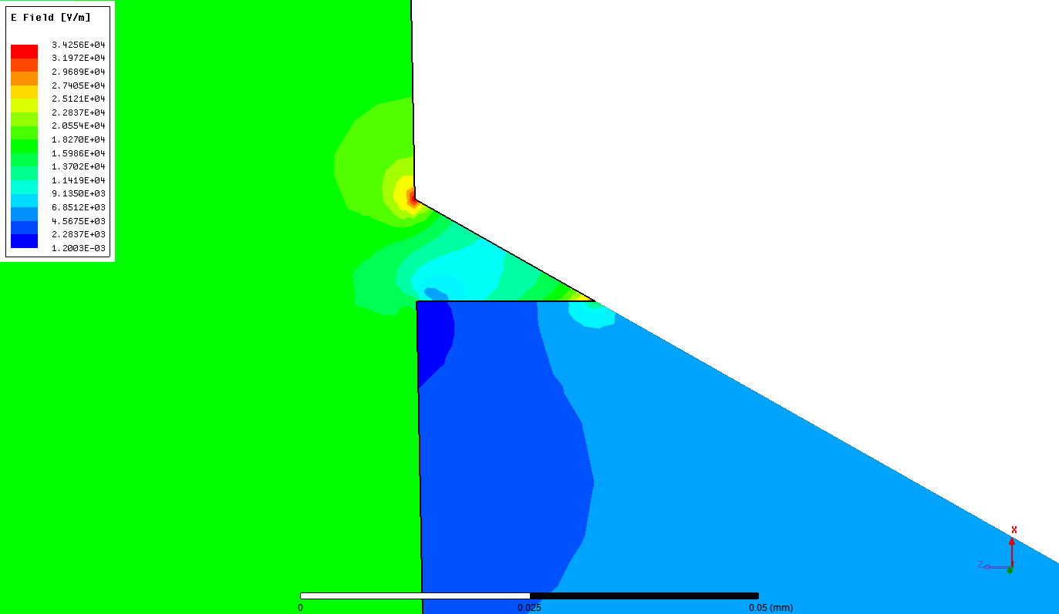
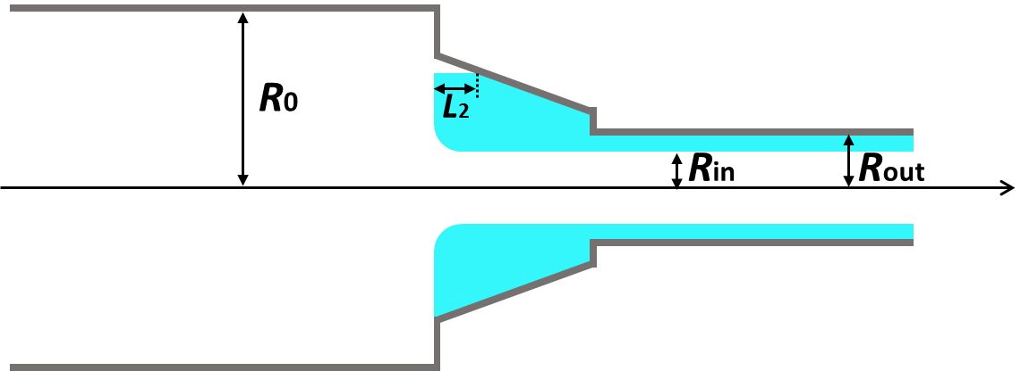
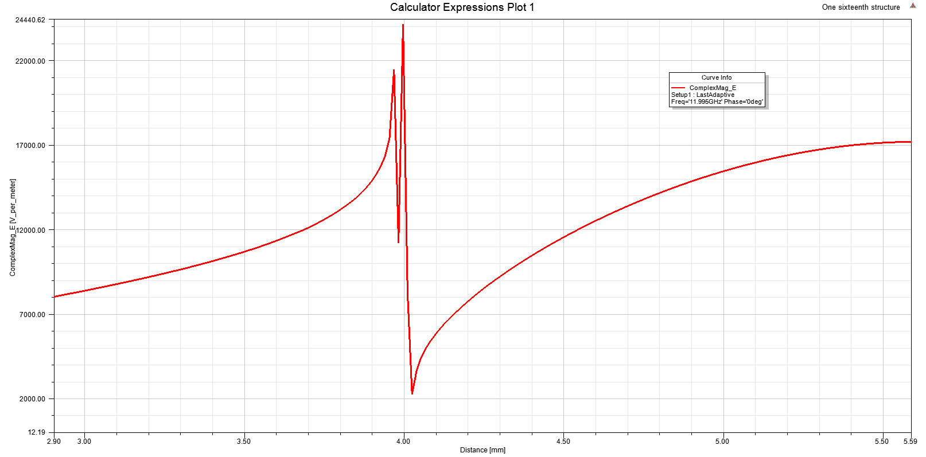
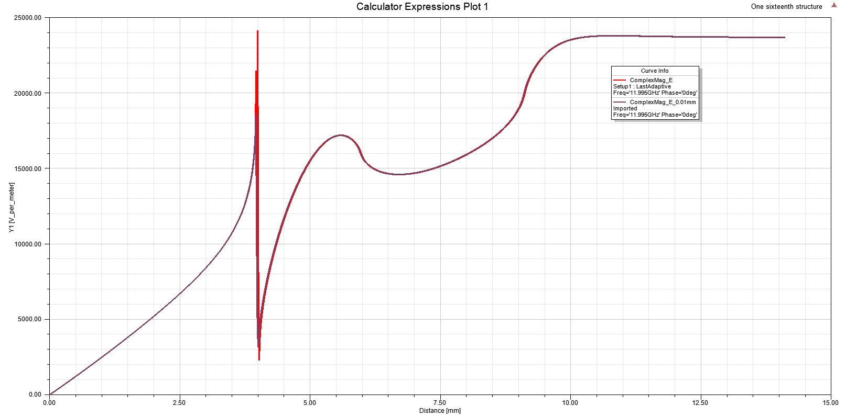
Sensitivity for corner defects
$L_{2}=$ 0.02 mm
$L_{2}=$ 0.02 mm
$L_{2}=$ 0.01 mm
$S_{11}$ < -40 dB for both $L_{2}=$ 0.01 mm and 0.02 mm at frequency of 11.9950 GHz;
So $L_{2}=$ 0.02 mm can still be accepted in the practical fabrication in consideration of electric fields.
25

Slide 26
Summary & Outlook
DDA structures operating at TM02 π-mode structure:
Extremely high quality factor and shunt impedance: Q0 = 134542, r’ = 819 MΩ/m for original-type and Q0 = 112639, r’ = 618 MΩ/m for modified-type;
High RF-to-Beam efficiency of $\sim$50%;
The number of acceleration cells can be up to 255 due to high bandwidth;
Low short-range wakefields.
A compact low-field, broadband mode launcher has been designed:
The maximum fields are located in the DLA structure;
Good reflection coefficient with S11 < -40 dB has been achieved;
Geometry sensitivity has been carried out.
Further optimization and wakefield studies on DDA TM02 π-mode structure;
Collaboration with ANL researchers for the fabrication studies of the DLA prototypes.
26

