Slide 1
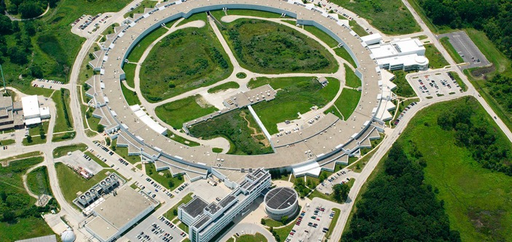
Overview of Accelerator at Argonne
erhtjhtyhy
John byrd
Director, Accelerator Systems Division
Director, Argonne Accelerator Institute
Advanced Photon Source
AWA Workshop
August 21-23, 2019

Slide 2
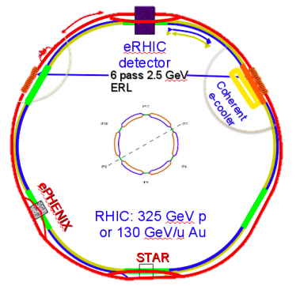
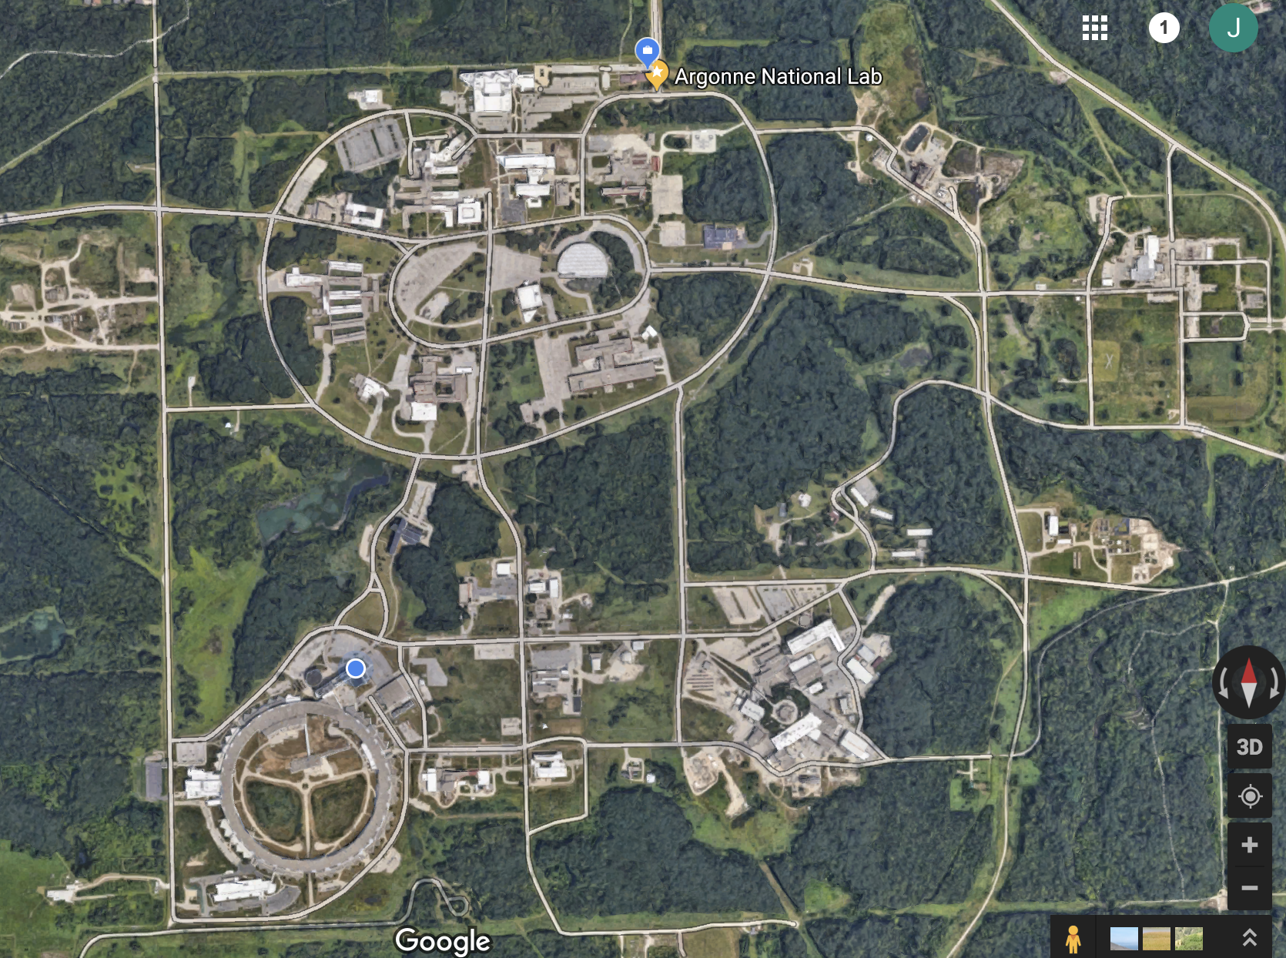
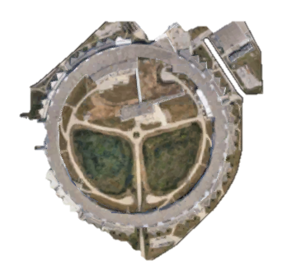
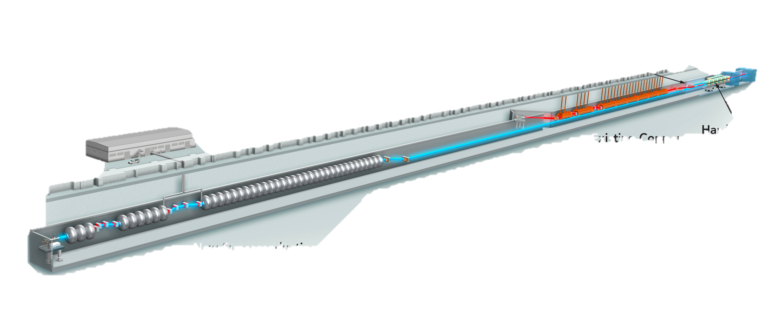
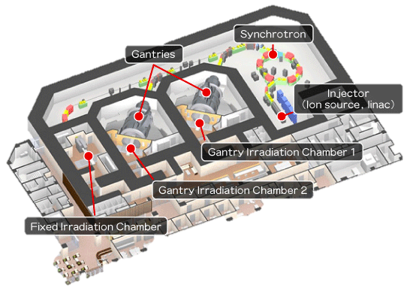
Welcome to Argonne!
The definition of a “green field site.”
Electron-ion Collider
Linear Collider Test Facility
or
Isotope Production
2nd APS
Full energy Linac for APS-U injection AND FEL
(MaRIE Test
Facility)
Hadron Therapy
Center

Slide 3
Overview
Selected “tasting” of accelerator activities at Argonne
Advanced Photon Source and the $0.815B Upgrade
RF Conversion from Klystrons to Solid-State
Linac Extension Area (aka The return of LEUTL!)
Linac Refurbishment
Development of Superconducting Undulators
Cavity-Based XFELs

Slide 4
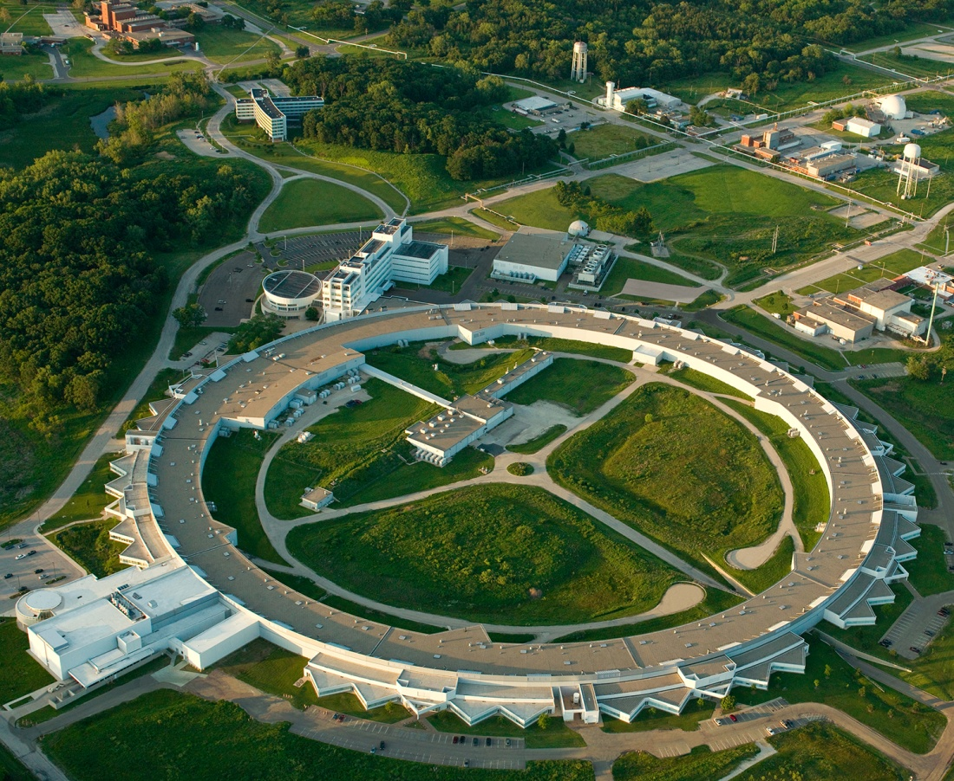
APS Accelerator Complex
7 GeV, 100 mA, 46 ID, 21 bend magnet BL,
3 fill patterns
Linac: S-band, 0.38 GeV, 30 Hz
Booster: 0.38-7 GeV, 2 Hz
PAR: 0.38 GeV, 2 Hz, 1-4 nC
Linac Extension
Area
The APS Upgrade (APS-U) will replace the main storage ring but keep the radio-frequency (rf) system. Injector systems will be reused and require increased performance.

Slide 5
APS Upgrade

Slide 9
APS-U will keep the US at the forefront of light sources

Slide 14
Accelerator R&D Initiatives

Slide 15
Potential conversion of APS RF source from klystron to Solid-state
With the vanishing number of vendors of MW-class tubes, the ageing APS HV infrastructure, we are pursuing a path towards modular solid-state rf sources combined to reach ~200 kW units.
Review held at APS in Aug 2018 to advise on RF conversion plan. Committee supported SSPA conversion with many valuable suggestions.
ASD RF Group SSPA concept using combiner cavity

Slide 16
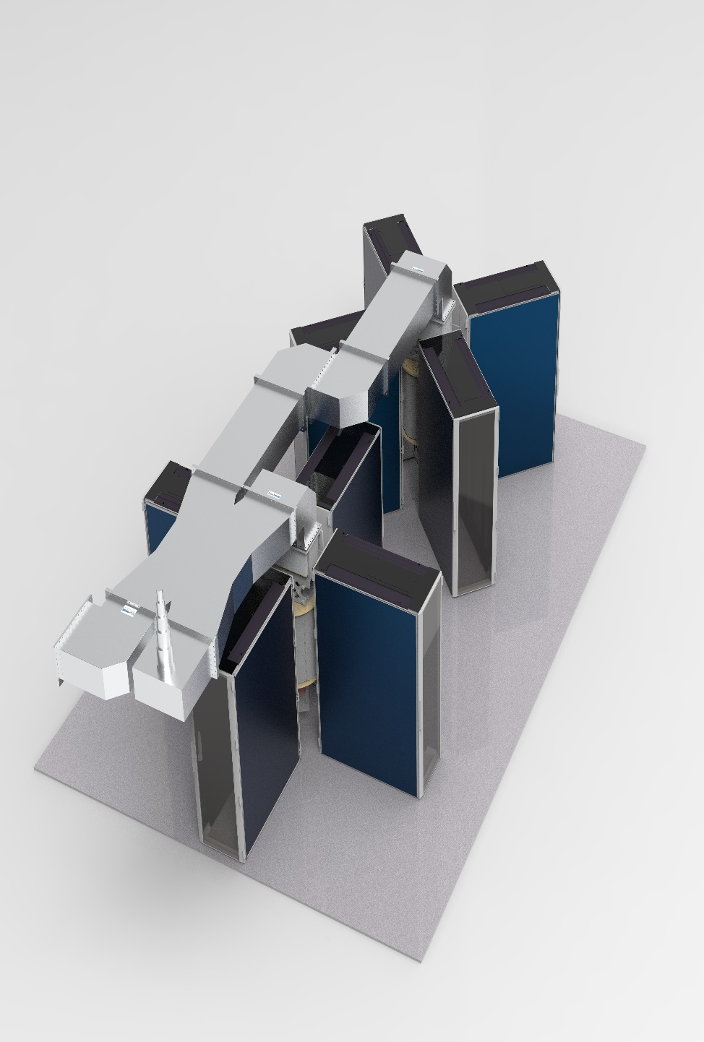
SSPA conversion is currently in the demonstration phase
200 kW unit
Commercial 30 kW unit expected in July 2019. Tests complete by end of 2019.
Next step is to install a 200 kW unit on a single cavity in APS and run 6-12 mos. before darktime.
Conversion of entire storage ring expected to cost $20-30M with strong dependence on bulk $/Watt.
Klystrons are slowly phased out as new SSPA units added. We plan for our current stock of tubes to last until then.
Upgrade plans for booster RF also under consideration.
Combining cavity 2
Combining cavity 1

Slide 17
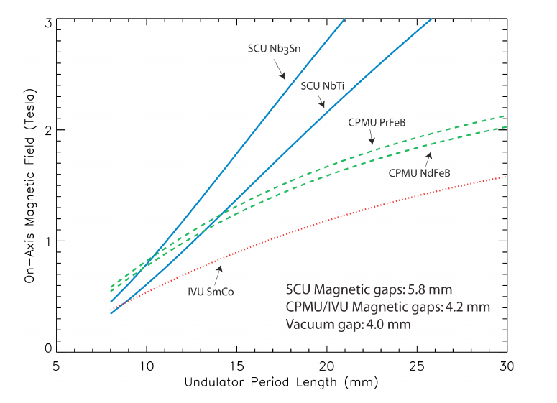
Magnetic field of various insertion device technologies
Motivation for Superconducting Undulators
A superconducting undulator (SCU) is an electromagnetic undulator that utilizes superconducting coils for generating magnetic field.
Superconducting technology-based undulators outperform all other technologies in terms of peak magnetic field and, hence, energy tunability of the radiation
Superconducting technology opens a new avenue for insertion devices
Calculated tuning curves for SCUs and for hybrid undulators.
Calculated on-axis magnetic fields of two cryogenic permanent magnet undulators (CPMUs), two superconducting undulators (SCUs) and on in-vacuum undulator (IVU) for a vacuum gap of 4.0 mm for period length from 8 mm to 30 mm.
E. Moog, R. Dejus, and S. Sasaki, “Comparison of Achievable Magnetic Fields with Superconducting and Cryogenic Permanent Magnet Undulators – A Comprehensive Study of Computed and Measured Values”, ANL/APS/LS-348, 2017.

Slide 18
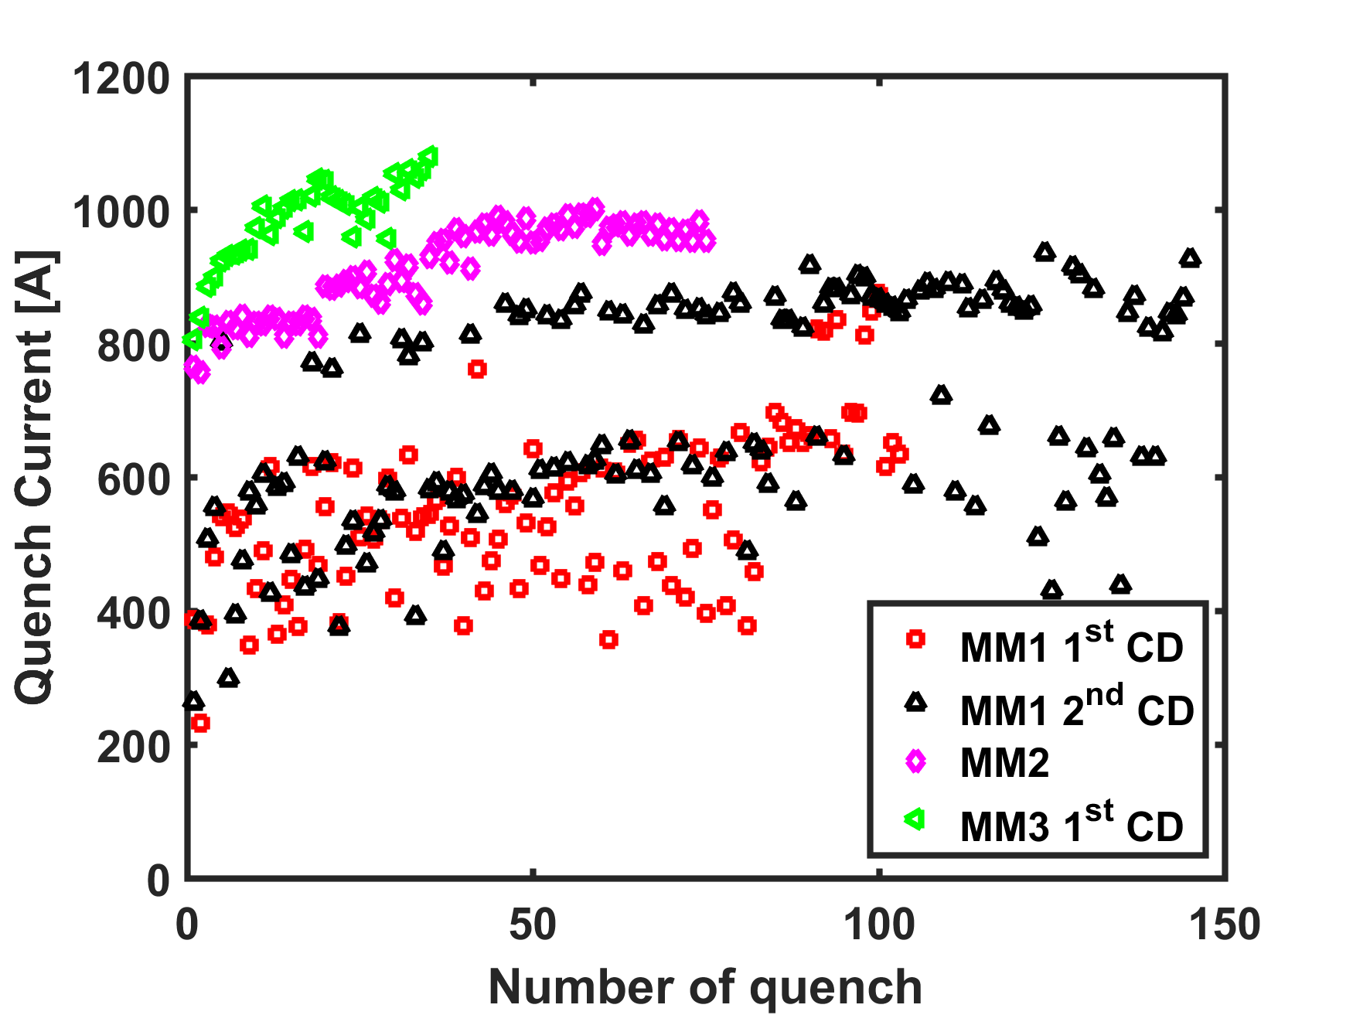
R&D on Nb₃sn undulator
Training of short models
DOE has funded 3-year project, Efim Gluskin is the PI
Goal: Develop, build and install on the APS ring a two-magnet Nb₃Sn undulator (in a long cryostat) a year before the APS-U ‘dark time’ starts.
Collaboration with FNAL, LBNL and SLAC.
Plan:
  R&D phase – build and test short magnet models
  0.5-m long prototype
  Full scale magnet and cryostat
  Undulator assembly, test, installation on the APS ring.
For comparison: max training current of NbTi conductor is about 650A.
Based on magnetic measurements of magnet model #3:
the Nb₃Sn undulator will generate about 25% higher magnetic field than the NbTi one
18

Slide 19
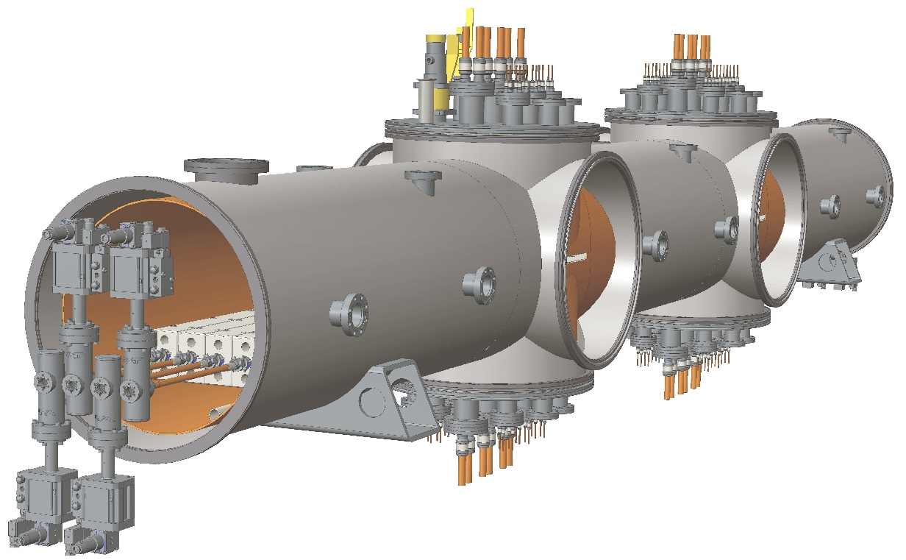
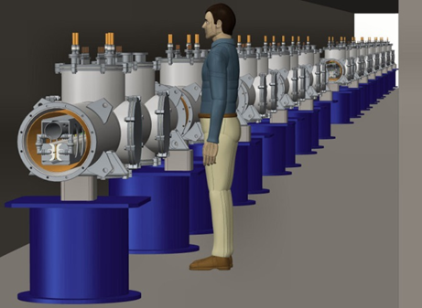
SCUs for FELs
Superconducting undulators should become a baseline for future FELs.
Several FEL undulators in one cryostat is a possibility.
4 FELs
Possible LCLS SCU line
A cryomodule with four FELs
Alignment quad
Undulator segments (3)
Phase shifters (3)
Focusing quad
BPM
1.5 m
Beam
direction
15 cm
15 cm
70 cm
x & y position control
x & y position control
Courtesy of J. Fuerst, APS
5.5 m
FEL SCU cryomodule concept

Slide 20
Cavity based x-ray FEL (CBXFEL)
Achieve longitudinal coherence via an optical resonator at x-ray energies
Undulator
e-beam
X-rays
Two proposed schemes:
  Regenerative Amplifier FEL (SLAC)
    Requires only a few passes in optical cavity. Results in higher peak power ultrashort pulses.
  X-ray FEL Oscillator (Argonne)
    Requires long buildup of x-rays in cavity. Results in 2-3 order magnitude brightness increase over LCLS-II.

Slide 21
Proposal to build cavity and install in LCLS and test concept on LCLS-I
Use two-bunch beam pulse in CuRF linac to test effect on 2nd bunch
Total budget: $12.6M
ANL: $7.0M
Key Argonne Personnel: Kwang-Je Kim (PI), Yuri Shvyd’ko (co-PI), Deming Shu (co-PI), Marion White (PM), Ryan Lindberg, Lahsen Assoufid, Xianbo Shi

Slide 22
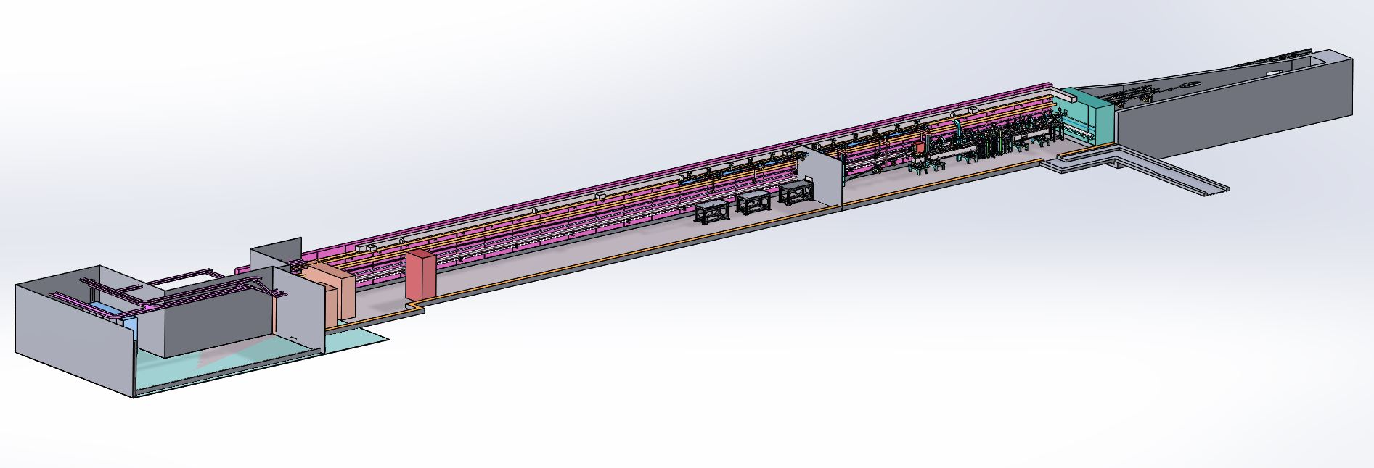
LEA: Linac Extension Area
booster
Chicane
RG2
RG1
PCG
L5 L4
L2
LEA
wall
375 ~ 500 MeV
LINAC
150 MeV
6 MeV
PAR
17m
53m
An existing radiation enclosure of ~ 53 m long;
The LEA beamline will utilize the first ~ 17 meter of the tunnel;
The end of the tunnel will serve as a S-band RF test stand.

Slide 23
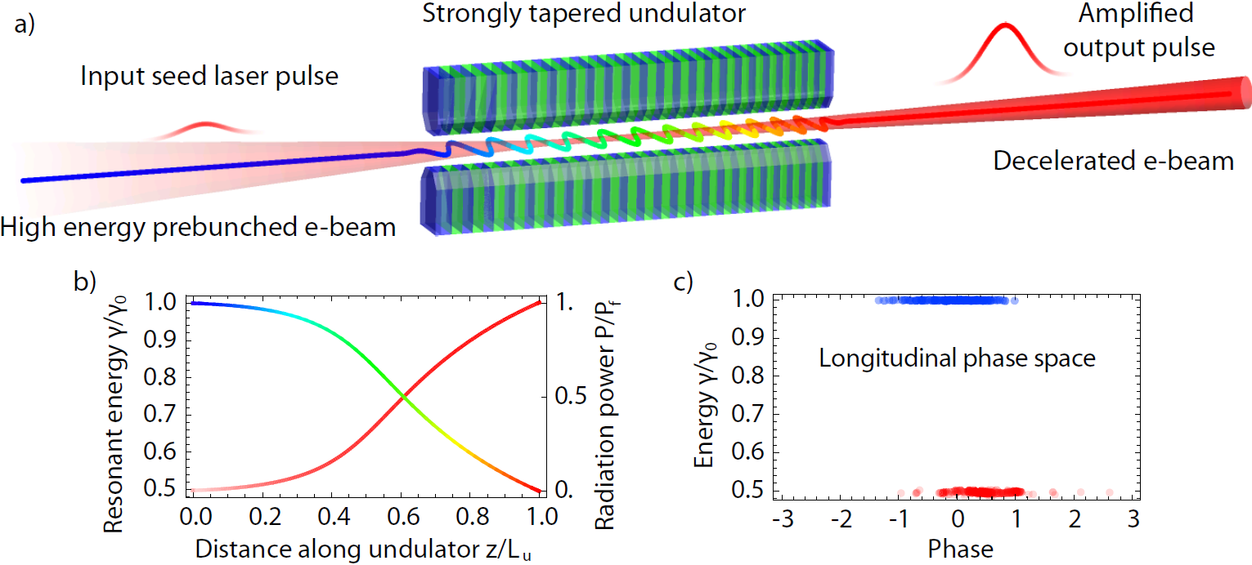
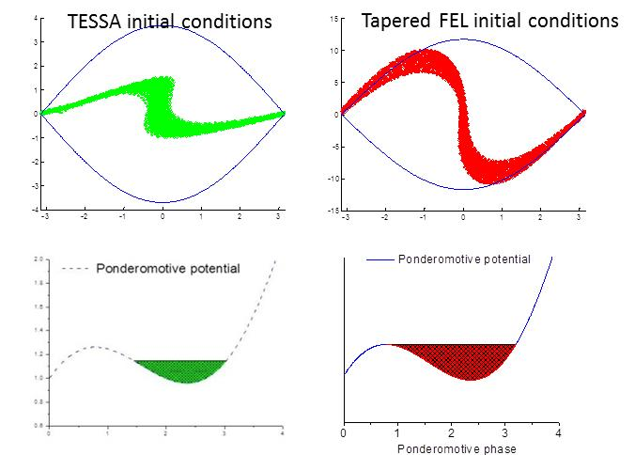
Proposed LEA Experiment: Tapering Enhanced Stimulated Superradiant Amplification (P. Musumeci, UCLA)
Modern SASE FELs only extract a small fraction (0.1%) of the electron beam energy.
How can we get higher x-ray pulse energy from FELs?
We can extract a large fraction of the energy from an electron beam provided:
  A high current, microbunched input e-beam
  An intense input seed
  Gradient matching to exploit the growing radiation field.
IFEL deceleration
Duris et al. NJP (2015)
Notes:
After the success of this experiment we started thinking what happens if we do the experiment in reverse. Obviously the dynamics here is time-invariant so if we flip all th eparticle directions it will bepossible to reverse the interaction. That is inject a high energy beam and decelerate it down to half of its energy. Where did the energy go? Since there are no medium, no boundaries, the energy can only go back into the laser, so we would be able to extract half of the energy in the e-beam and give it to the radiation. This is what started us formulating the TESSA concept. The main ingredients are a high current microbunched beam, a high intensity seed and a properly tapered undulator.
Many times I have been asked what is the difference between a inverse inverse free electron laser and a free electorn laser. Of course the equations are the same. The best way to understand it is in the initial conditions.

Slide 24
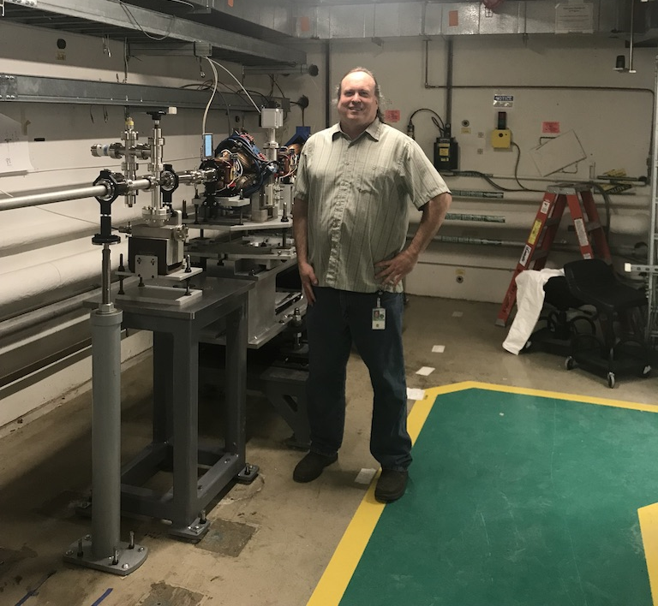
Linac Extension Area Beamline installed
First phase of new beamline for accelerator R&D
First phase of LEA beamline has been installed in B413.
All magnets and stands reused from previous LEUTL beamlines.
Next phase is adding cabling from power supplies and diagnostics.
Total cost <$60k (minus infrastructure improvements).
First beam no earlier than Spring 2020.
Jan 3 2019. LEA beamline is installed.

Slide 25
High brightness, high repetition rate Electron sources are needed
25% longer linac
Applications for XFEL injectors and UED/UEM
Covered on Friday Talk
The next phase for XFELs is to increase rep rate and energy reach.
Lower emittance (i.e. higher brightness) is needed to allow lasing at higher energies.
This is achieved with higher electric field gradients at the photocathode AND 100% DF.
This is a strong case for SRF guns.
Another emerging application is time-resolved electron diffraction and microscopy using very similar technology.
Argonne is an ideal place to contribute to this effort.

Slide 26
Summary
The most sophisticated electron storage ring in the world (APS-U) has just received CD-3 approval and will be installed and commissioned in 2022-3.
  Numerous leading edge developments in accelerator technology and beam physics.
Funding for several high priority BES accelerator R&D projects is now funded
  Nb3Sn SCUs
  CBXFEL
  SRF photogun
We are working to leverage the 500 MeV APS linac and available tunnel space for a unique accelerator R&D tool that would be highly complementary to the AWA facilities. N.B. This is a politically sensitive subject and we do not have guidance from DOE how to operate such a tool.
Argonne is fully engaged in the present golden age of accelerator development. Please come join us!

