Slide 1
Quick Survey of Microwave Dielectric Structures and Current Projects
Chunguang Jing on behalf of collaboration (Euclid and AWA)
Euclid TechLabs, 365 Remington Blvd., Bolingbrook, IL 60440, USA
8/21/2019

Slide 2
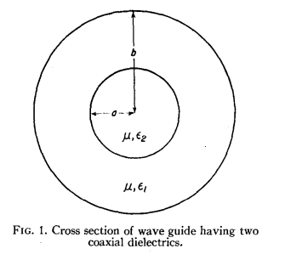
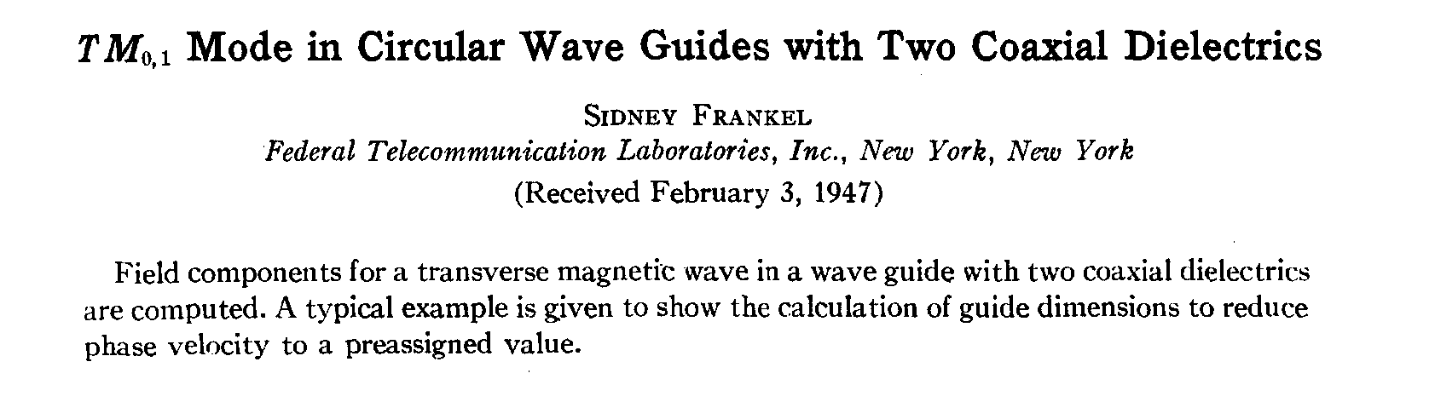
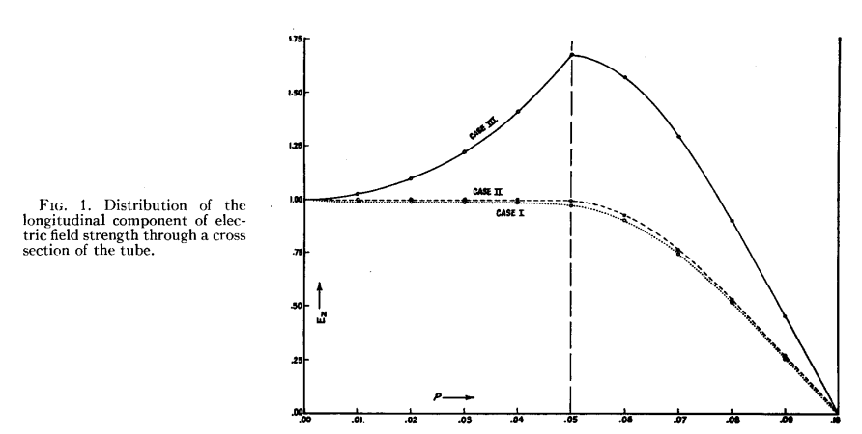
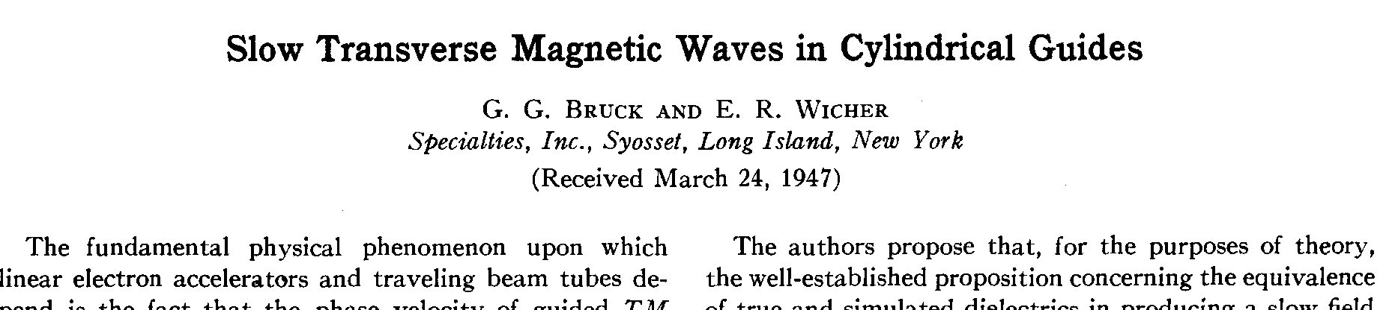
History: the starting era (1947-1960)
Theoretical papers (1947---)
Experimental Work(1948-1958)
Research Group | Scientists | References | Research Scope
Atomic Energy Research Establishment (AERE), UK | R.B. R.-Shersby-Harvie, etc. | 1. R.B. R.-Shersby-Harvie, Nature, 162 (1948) 890. 2. R.B. R.-Shersby-Harvie,etc., Proc. I.E.E. B., 104 (1957) 273. | Constructed and Tested a 4MeV Traveling wave Dielectric Disk Loaded Accelerator. Beam Acceleration. Discovered Multipactor in DLA.
Queen Mary College, Uni. of London, UK | G.B. Walker, etc. | 1. G.B.Walker and N.D.West, Proc. I.E.E. C., 104 (1957) 381. 2. G.B.Walker and E.L.Lewis, Nature, 181 (1958) 38. | Constructed and Tested Dielectric Disk Loaded Wavguide Cavities. Tested Dielectric Breakdown.
IIT, USA | G.I. Cohn and G.T. Flesher | 1. G.T.Flesher and G.I.Cohn, A.I.E.E. C., 70 (1951) 887. 2. G.I.Cohn and G.T.Flesher, IIT Report, 2 (1952). | Constructed and Tested a Quartz Tube Based Dielectric Loaded Accelerator.
www.euclidtechlabs.com

Slide 3
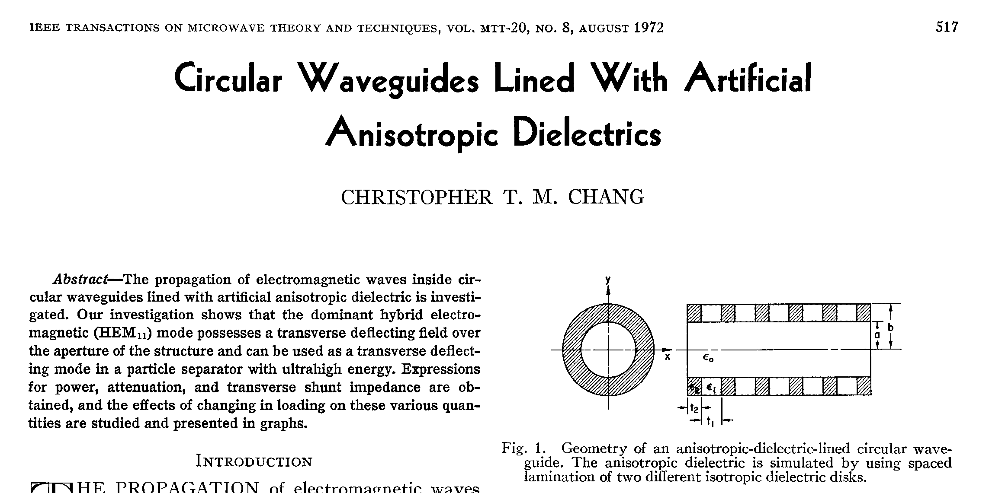
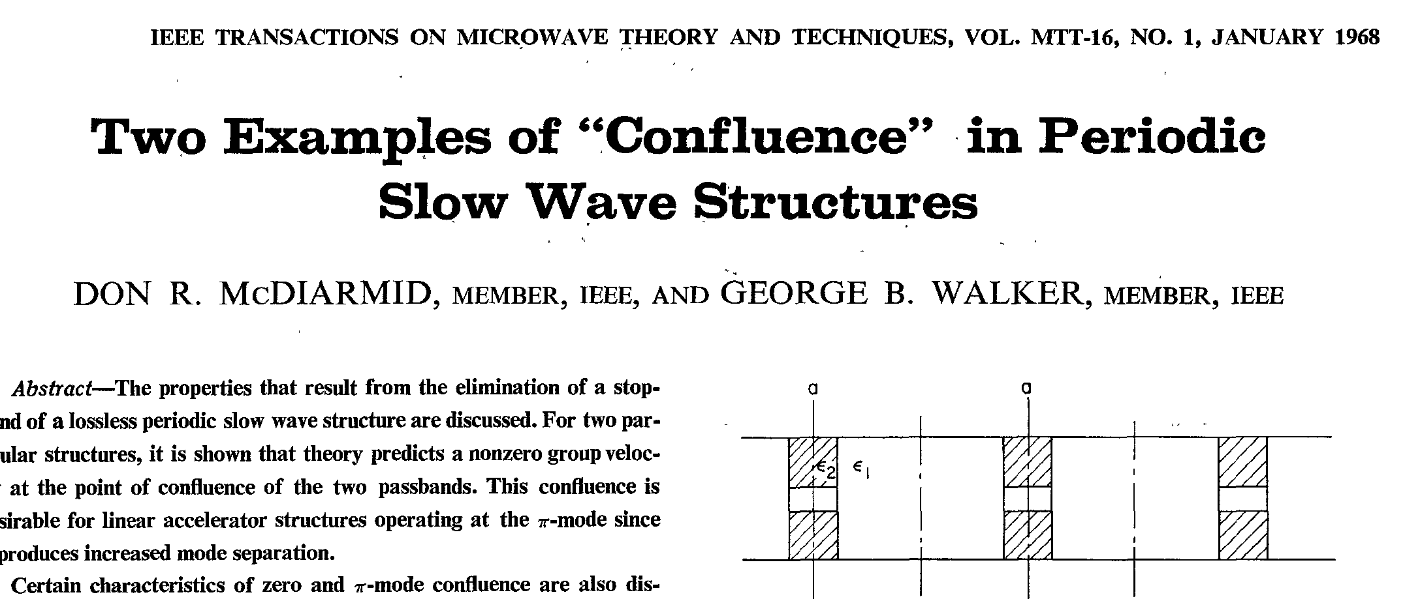
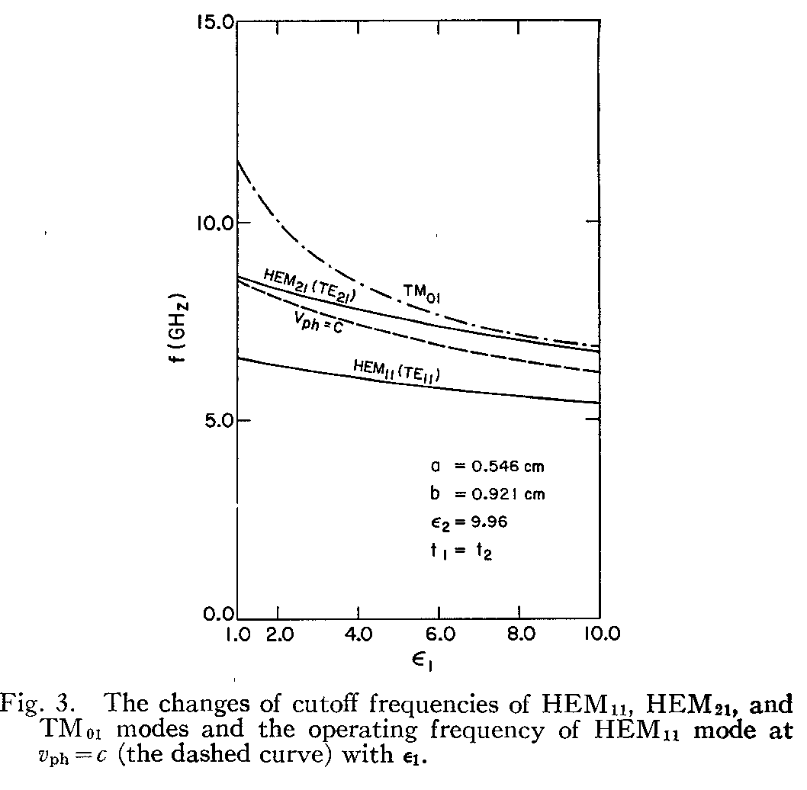
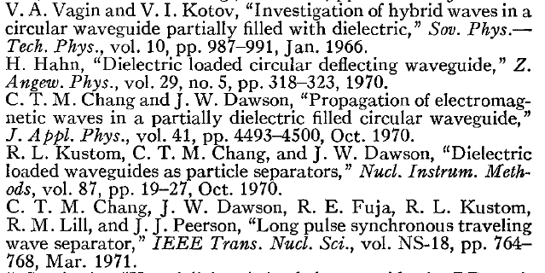
History: waiting years(1960-1985)
www.euclidtechlabs.com

Slide 4
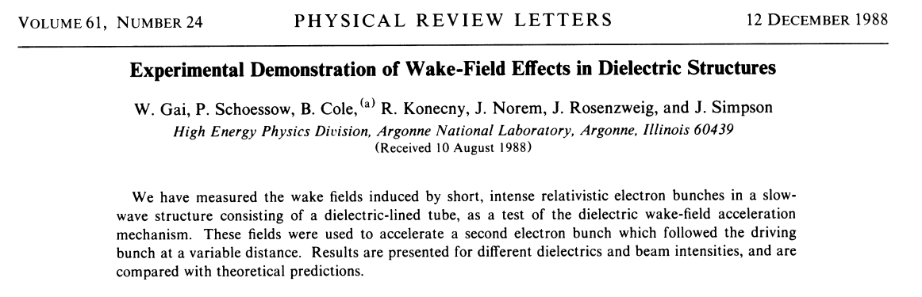
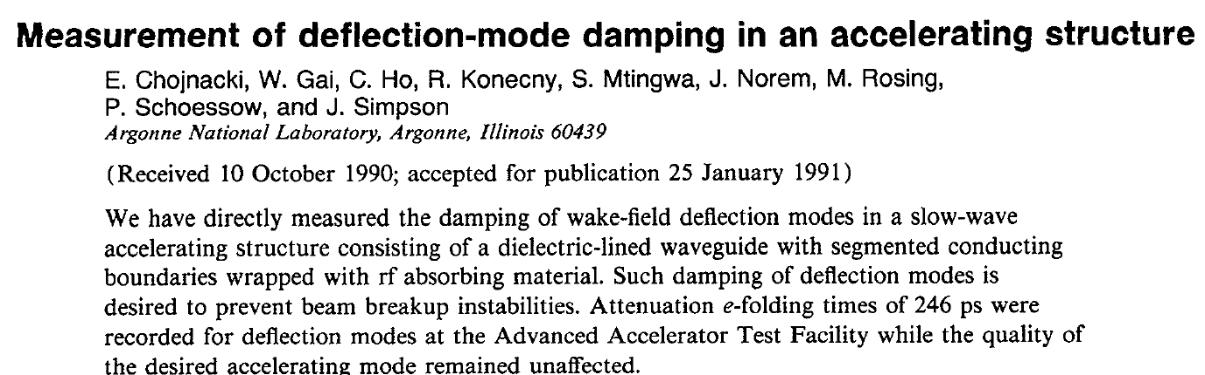
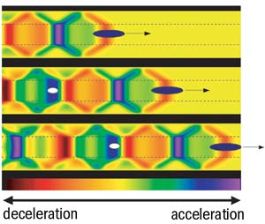
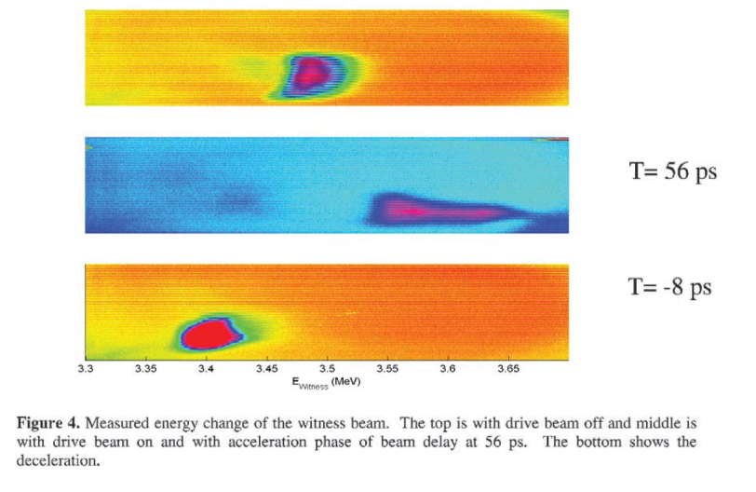
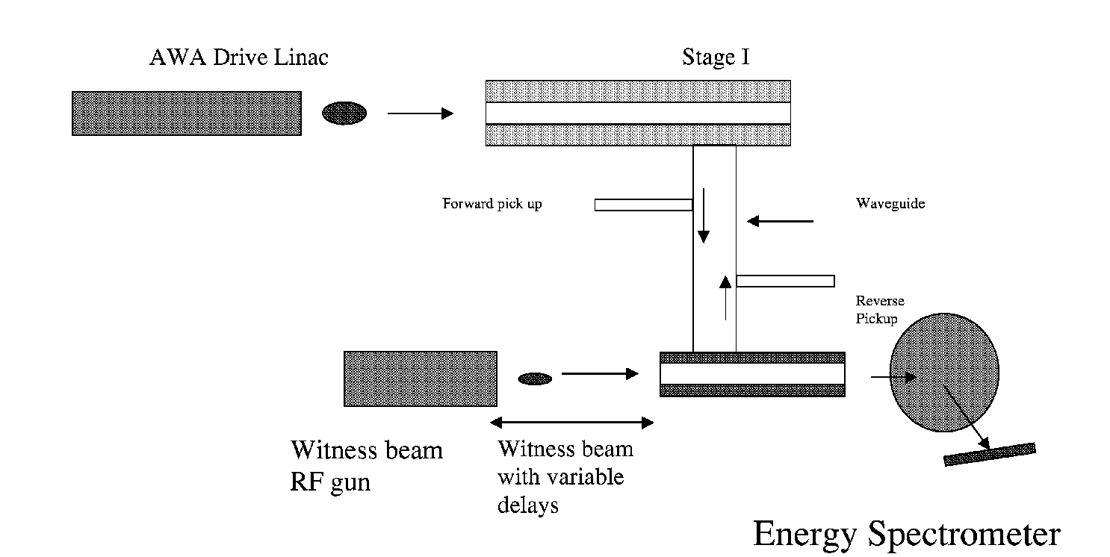
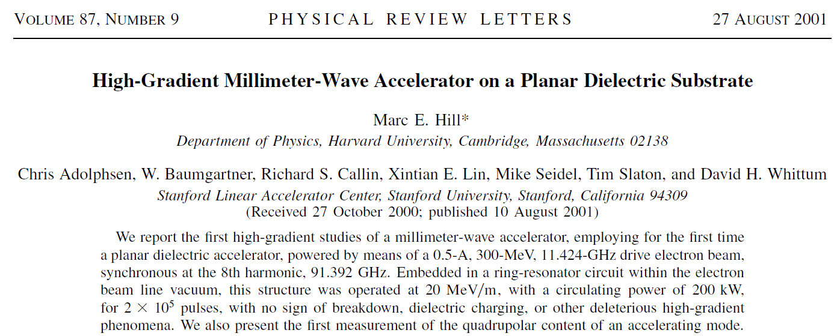
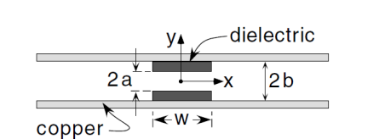
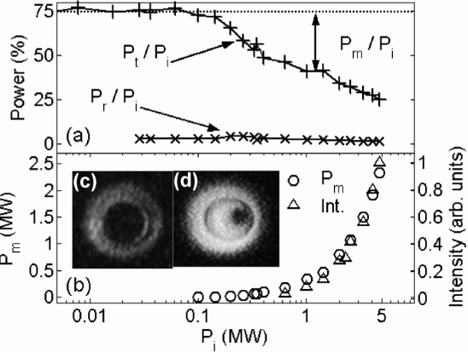
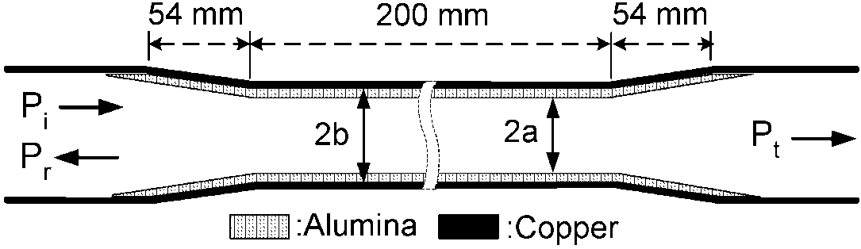
History: the reviving era (1988-present)
www.euclidtechlabs.com

Slide 5
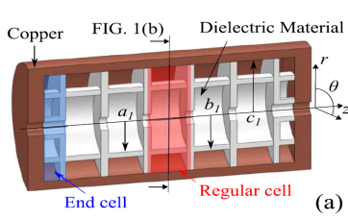
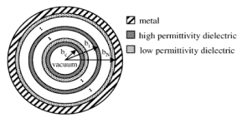
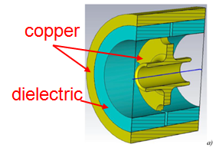
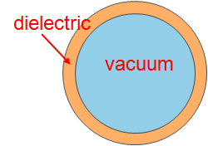
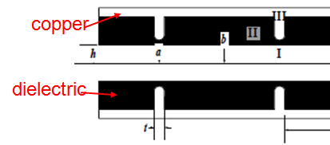
Variety of Dielectric Accelerator Structures
Variety of dielectric structures | Pros | Cons
Dielectric-loaded accelerator [7] | Most developed structure High group velocity, low surface fields | Moderate r/Q Weak points: tapered section
Dielectric-assisted accelerator [6] | Very high shunt impedance Low group velocity Prototype fabricated | No high group velocity optimization yet Current prototype is clamped together, and may not hold high gradient Weak points: high surface fields at joint of copper and dielectric
Disk-Ring hybrid accelerator [8] | High group velocity Various parameters for optimization | Moderate r/Q No prototype yet Weak points: high surface fields at joint of copper and dielectric
Hybrid dielectric accelerator [9] | Low surface fields, high r/Q Prototype reported | Low group velocity May be difficult to fabricate dielectric piece with desired shape Weak points: joint of copper and dielectric
Multilayer dielectric accelerator [10] | Higher r/Q than DLA High group velocity Low surface fields | Hard to eliminate the gap between dielectric layers Weak points: joint of layers
www.euclidtechlabs.com

Slide 6
Euclid/AWA/NRL DLA work over years
Dielectric Accelerator
Time | Structures | facility | Achievement
2001 ~2015 | 11.4GHz external powered Dielectric accelerators | NRL Magnicon, 20MW, 200ns | Multipactor suppression: different coating techniques, surface geometrical perturbations, external solenoid field, etc.
2005 ~2007 | X-band dielectric wakefield structures | AWA 15MeV beamline | Single bunch high charge wakefield excitation. 100MV/m, ~5ns; high transformer ratio collinear; tunable DWA, etc.
2015 ~2017 | 26GHz short pulse dielectric accelerator | AWA 70MeV beamline | Short pulse TBA, 50MeV/m
2017 | 11.7GHz short pulse dielectric accelerator (no test yet) | AWA 70MeV beamline | Short pulse TBA
www.euclidtechlabs.com

Slide 7
Euclid/AWA DPETS work over years
Dielectric PETS
Time | Structures | facility | Achievement
2006~2008 | 7.8GHz DPETS | AWA 15MeV beamline | 50MW, 10ns
2009 | 26GHz DPETS | AWA 15MeV beamline | 20MW, 10ns
2013 | 11.4GHz DPETS | SLAC ASTA klystron | 40MW, 50ns, 100ns
2014 | 12GHz DPETS | AWA 15MeV beamline | Transverse wake damping
2016~2017 | 26GHz DPETS | AWA 70MeV beamline | 50MW, 10ns
2017 | 11.7GHz DPETS | AWA 70MeV beamline | >200MW, 10ns
www.euclidtechlabs.com

Slide 8
Euclid/AWA current work---Dielectric Disk Accelerator
2019 HEP SBIR Phase1

Slide 9
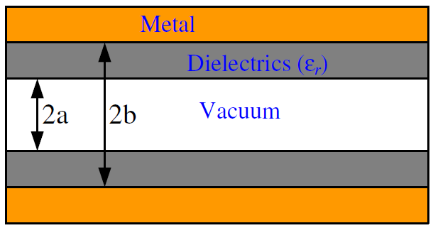
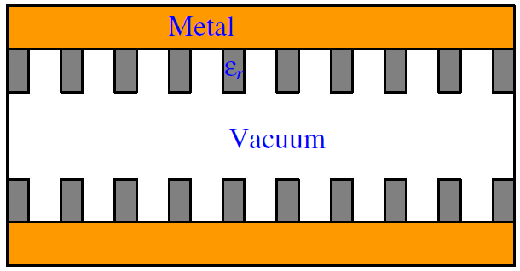
Dielectric disk accelerator
DLA
DDA
Comparison with DLA
- More optimization parameters: working mode, disk thickness
- High shunt impedance
Comparison with metallic disk-loaded structure
- More optimization parameters: dielectric constant
- High group velocity due to coupling through the disk
C. Jing, Rev. Accel. Sci. Tech.., vol. 9, 127-149, 2016

Slide 10
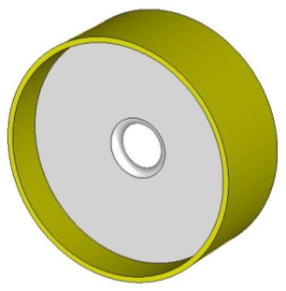
Dielectric disk accelerator
Optimization of rf to main beam efficiency in AFLC
- Main beam: 0.5 nC/bunch, 13 GHz separation, 186 bunches
DDA candidates
AFLC
Fix mode at 2π/3
Fix disk thickness at 0.5 mm
Additional advantages
- Standard deform tuning by side-wall tuners
- Can be applied in constant gradient and long structures

Slide 11
Dielectric disk accelerator
A detailed comparison with DLA for AFLC (26GHz)
 | Dielectric-loaded | Dielectric-disk
Aperture diameter | 3 mm | 3 mm
Outer diameter | 4.99 mm | 9.23 mm
Dielectric thickness | 1 mm | 0.5 mm
Dielectric constant | 10 | 50
Loss tangent | 1x10⁻⁴ | 5x10⁻⁴
v_{g} | 0.11c | 0.16c
r/Q | 21.8 kΩ/m | 32.5 kΩ/m
Q | 2295 | 6431
r | 50.0 MΩ/m | 208.8 MΩ/m
Input power | 1.22 GW | 0.96 GW
η_{rf-main} | 27 % | 39 %
Beam loading | 15.1 % | 16.8 %
E_{max} | 363 MV/m | 660 MV/m

Slide 12
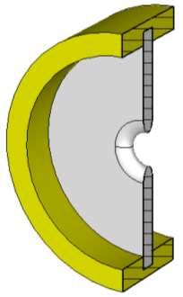
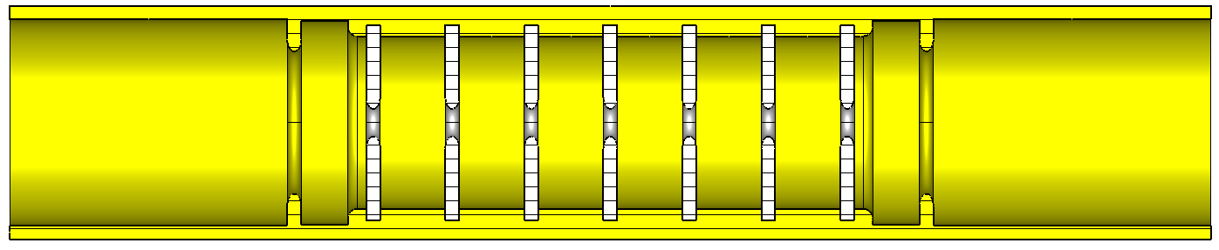
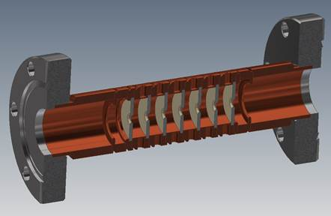
Dielectric disk accelerator
Prototype I
- X-band 6 dielectric disk cells + 2 matching cells
- 8 tuning pins per cell
- Goal: demonstrate fabrication and tuning

Slide 13
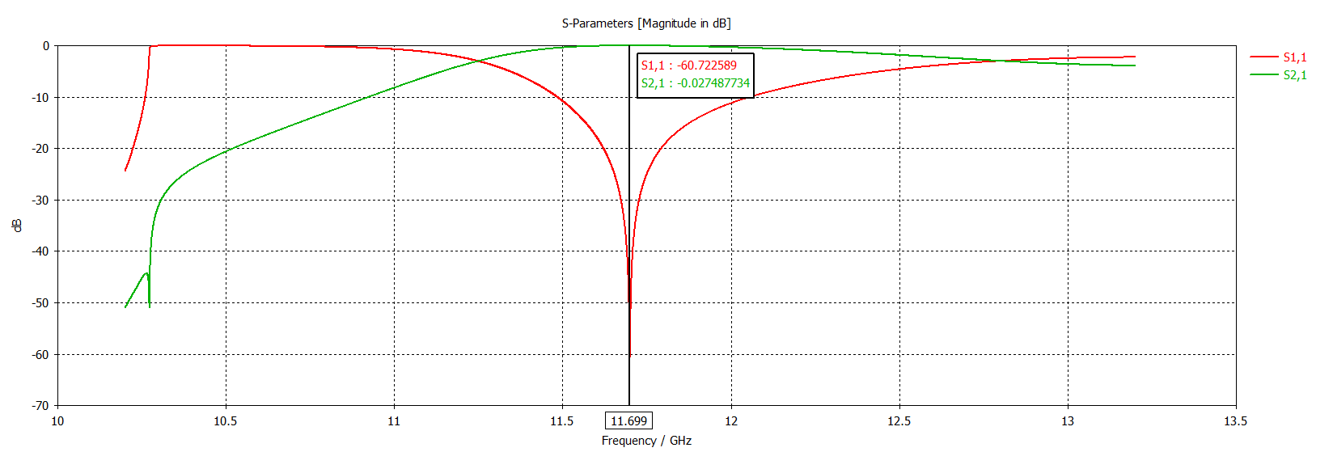
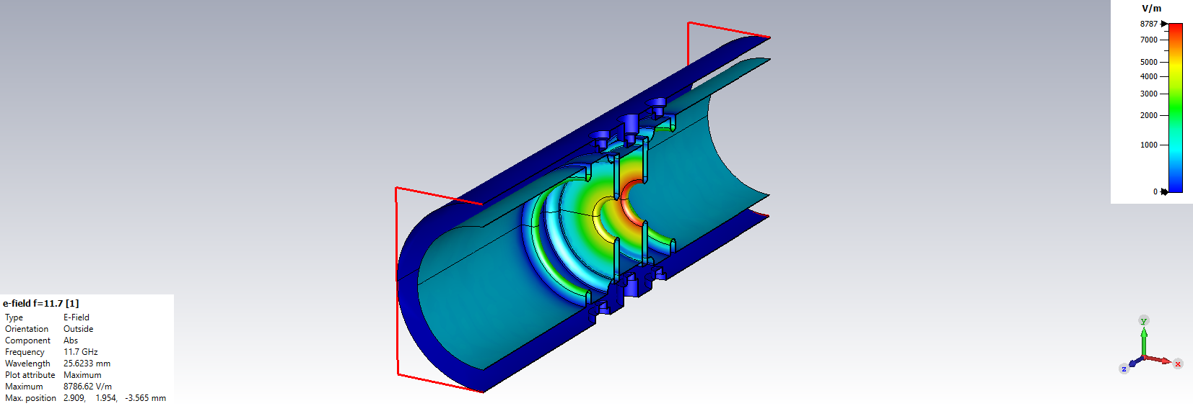
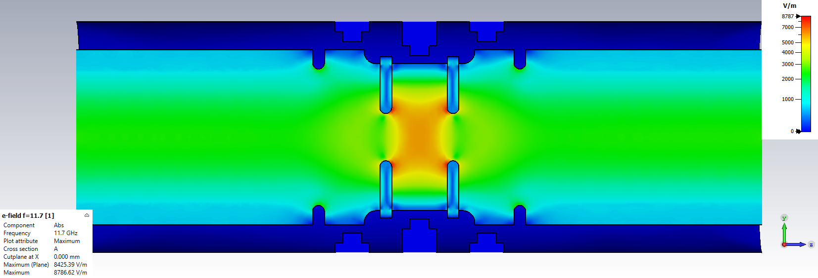
Single Cell DDA Prototype
1 Dielectric disk + 2 matching cell structure simulated
Each set of 4 tuners allows ± 3 MHz range
173.4 MV/m peak field on dielectric surface at 200 MW input power

Slide 14
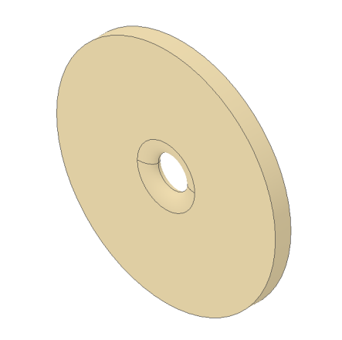
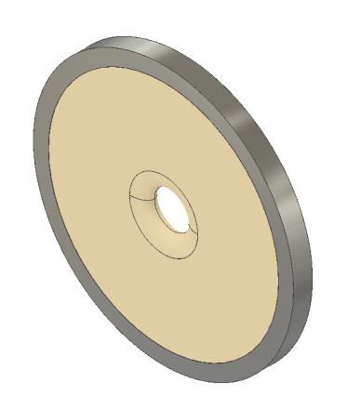
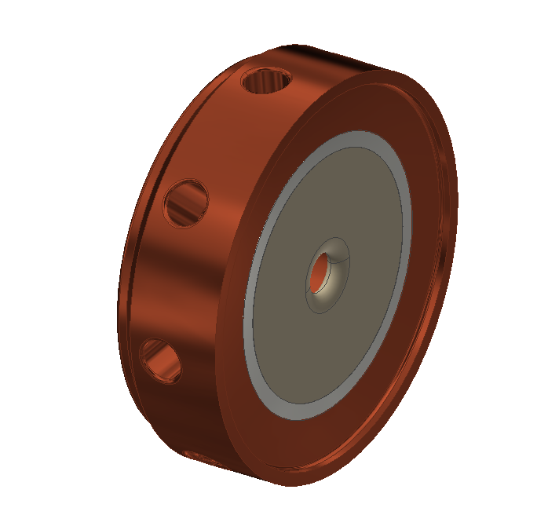
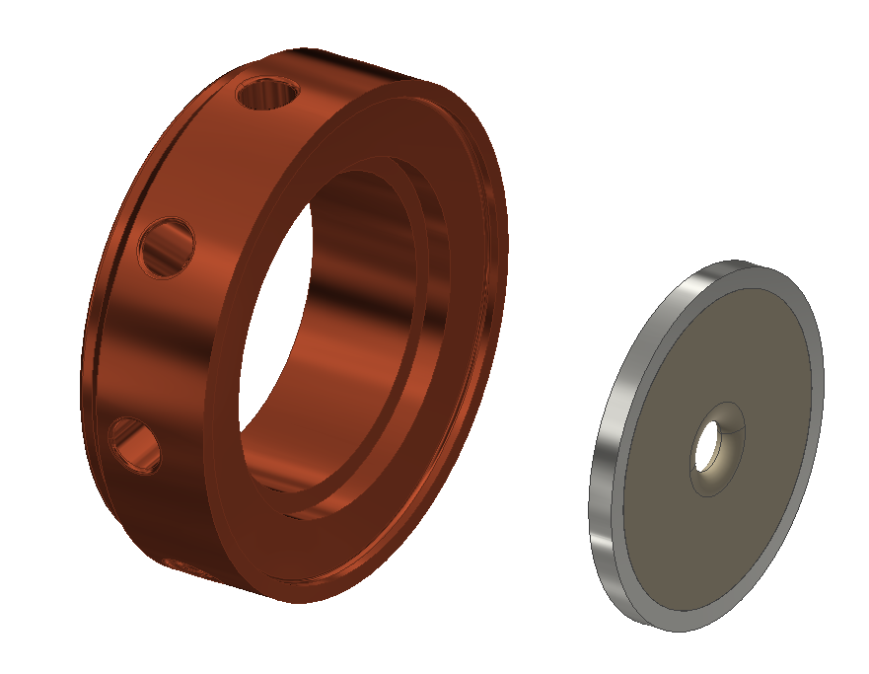
Dielectric disk accelerator
Fabrication
Dielectric disk
Metalized
dielectric disk
Tuner
Groove
for disk
Single cell
Copper tube

Slide 15
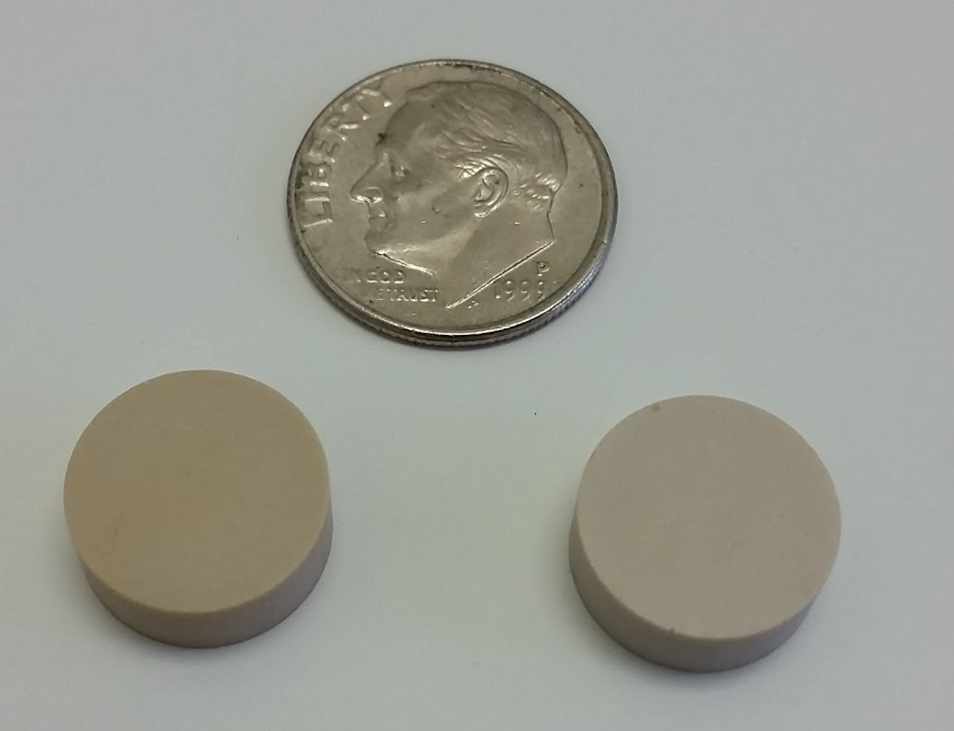
Dielectric Material & Brazing
D-50 dielectric (Ba-Ti) to be used
Samples from manufacturer tested
  𝛜_{r} = 50.14 ± 0.35, tan 𝛅 = 8.00E-5 ± 0.32E-5
Metallization and subsequent brazing to copper structure are difficult
Manufacturer does thick film silver
Positive feedback from potential brazing vendors for metallization-brazing processes
Sample coupons from manufacturer to be sent to brazing vendors for process testing

Slide 16

Remarks
Development of RF dielectric accelerator has been making steady progress over years. With more researchers participate, we expect to have a breakthrough sooner or later.
AWA is an ideal and critical platform for the dielectric accelerator development and test. We enjoy our collaboration over the years.

Slide 17

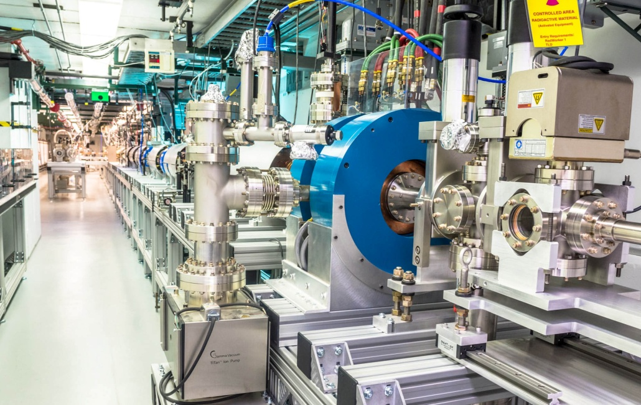
Acknowledgments
Numbers of DoE SBIR Projects.
Fully support from AWA
www.euclidtechlabs.com

