Slide 1
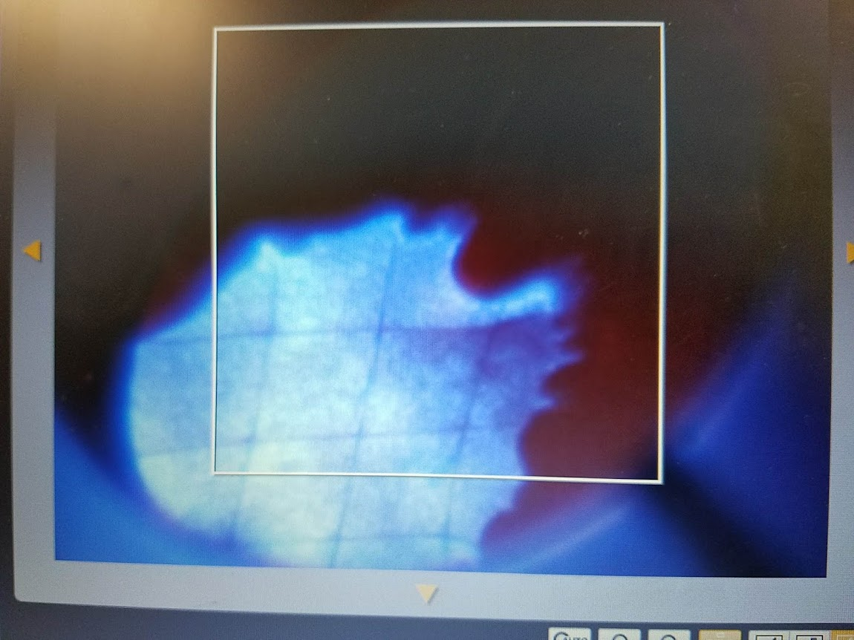
Brazeless Accelerator R&D
Sergey Antipov
Euclid Techlabs LLC

Slide 2
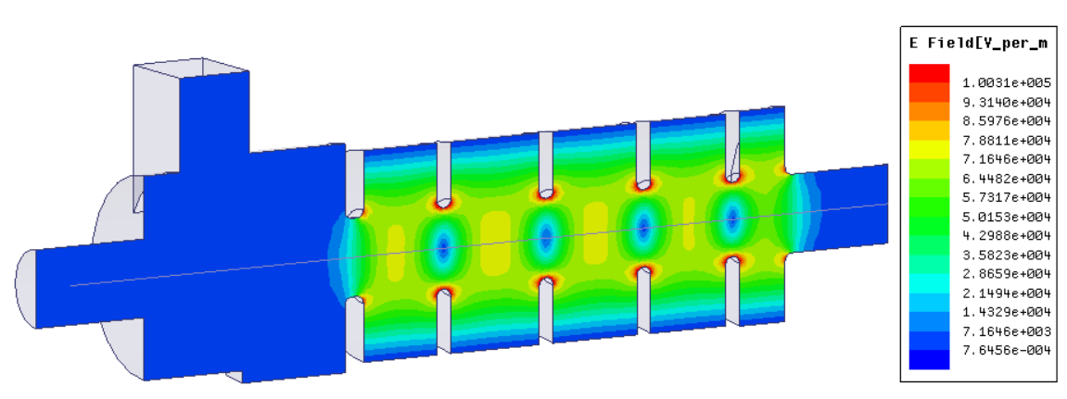
Introduction
Phase I SBIR grant from DOE – DNN (PM Dr. Donald Hornback)
Based on Euclid’s Patent US9913360B1
9 month project duration
RF Design of 1 MeV accelerator
Mechanical design
Full fabrication
Microwave tuning
… High power conditioning to designed gradient of 12 MV/m!
Notes:
Shortest development cycle in PI – SA 15 years experience. Dealing with multiple vendors with their lead times, especially brazing

Slide 3
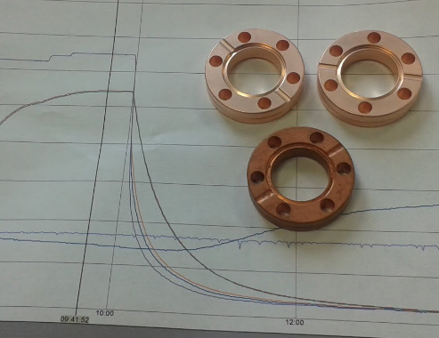
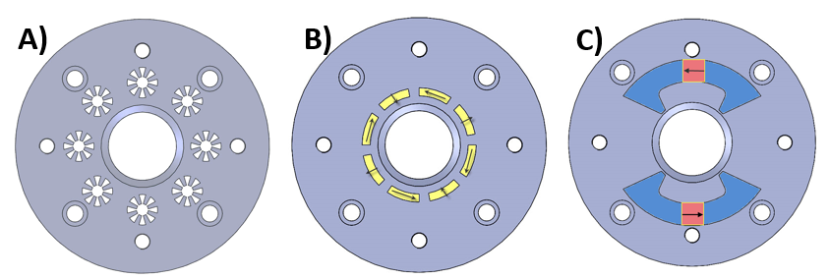
Brazeless accelerator benefits: cost + flexibility
Additional embedded features in brazeless assembly. A) Efficient heat spreader channel cooling. B) Halbach array magnetic optics. C) Traditional permanent magnet quadrupole
Conflat – like technology + batch copper plating
Structure cost ~ $20K
Copper plating is robust
Notes:
Take time to explain the assembly
Take time to explain benefits like exotic cooling, built in magnets, etc.

Slide 4
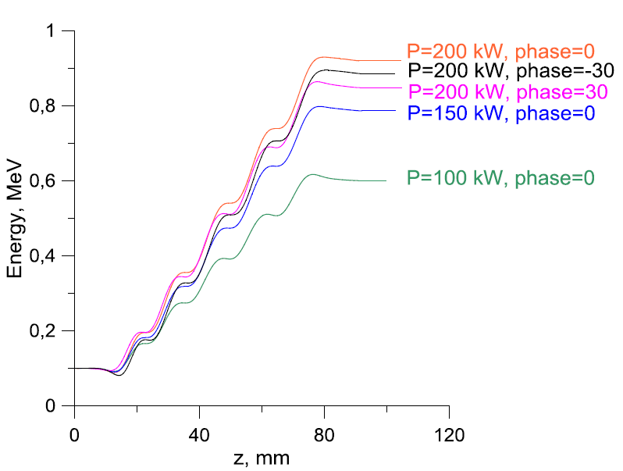
1 MeV Standing wave accelerator
1 MeV
9 GHz
π - SW
12 MV/m
200kW

Slide 5
Engineering
1 MeV, ~9 GHz, π – SW, 12 MV/m, 200kW
partikelaccelerator
Notes:
Lego accelerator
Ikea accelerator: partikelaccelerator, röntgenmaskin – if gamma ray production

Slide 6
Initial microwave testing and tuning
Transmission
After plating
Before plating
1 MeV Brazeless accelerating waveguide prototype
Notes:
Shift due to undercompression [if asked]. Good place to point out, that we don’t care to have exact frequency – magnetron is broadband

Slide 7
Initial microwave testing and tuning
Field balance tuning
Reflection
initial
final
Notes:
Field balance tuning is done by honing stainless steel structure.
Same process as refurbishing car engine cylinders
Thin copper plating does not change field balance.
After all said and done – S11 with excellent coupling

Slide 8
High power test
reflection \
transmission monitoring
pump
2.5e-7 HPa achieved
magnetron
RF tract
copper plated brazeless structure

Slide 9
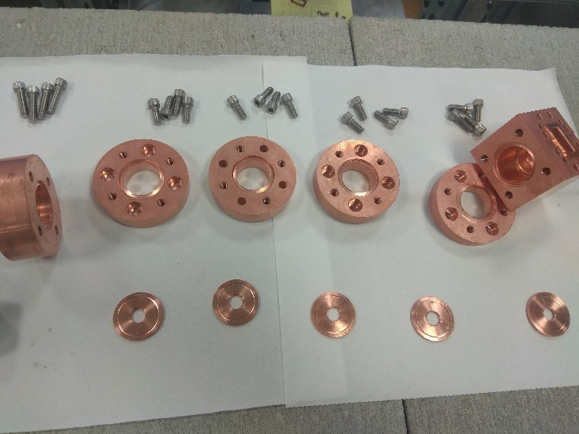
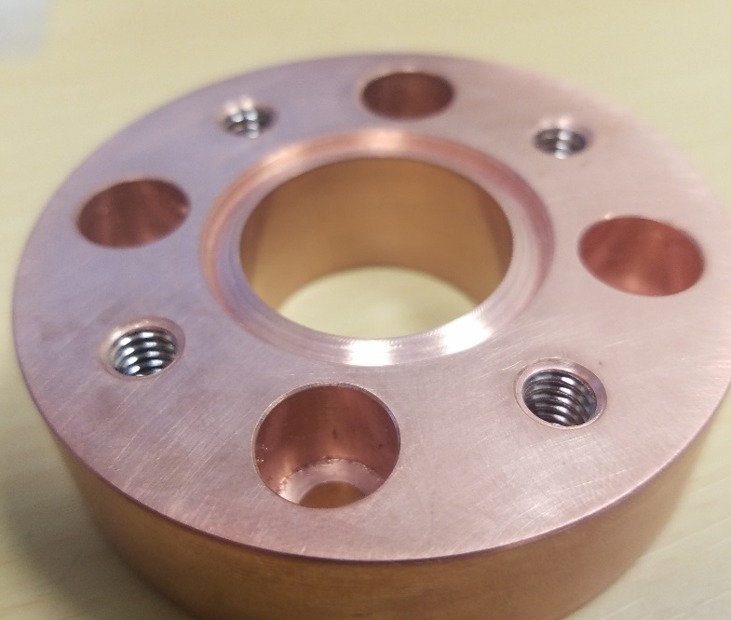
BRAZELESS SPLIT BLOCK
CONDITIONED TO 12 MV/m

Slide 10
BRAZELESS SPLIT BLOCK IDEA

Slide 11
1 MEV BRAZELESS SPLIT BLOCK

Slide 12
1 MEV SPLIT BLOCK DESIGN

Slide 13
1 MEV SPLIT BLOCK TESTING

Slide 14
Brazeless Power Extractor at the AWA

Slide 15
INDEPENDENT CELL + WAVEGUIDE COMBINER
*Low Loaded Q=225 for short pulse wakefield
e-beam

Slide 16
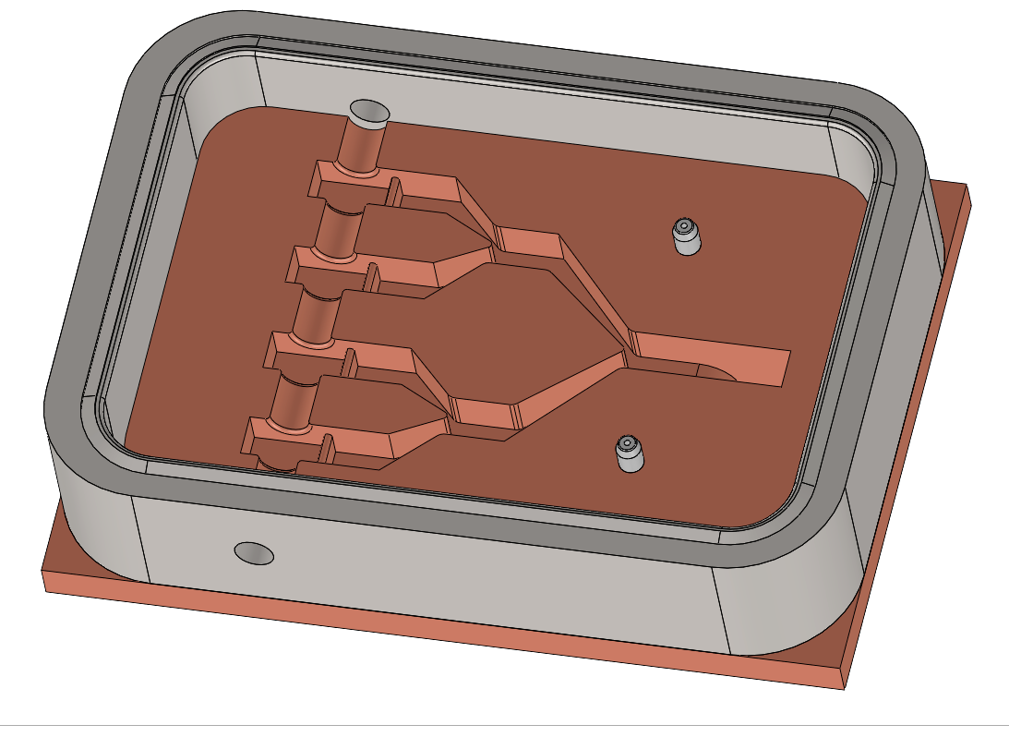
BRAZELESS SPLIT BLOCK ENGINEERING
e – beam
SS – knife edge
Copper bottom half
1.33 CONFLAT

Slide 17
Power extraction simulation

Slide 18
Double-cell power extractor
e-beam
e-beam

Slide 19
Power extractor performance parameters
Parameters | Q=25 nC | Q=50 nC
RF Frequency | 11.7 GHz | 11.7 GHz
Q-factor | 220 | 220
Bunch train frequency | 11.7/9 GHz | 11.7/9 GHz
Bunch length | 1.2 mm | 1.8 mm
Max. surface E-field | 530 MV/m | 1030 MV/m
Max. surface H-field | 1.23 MA/m | 2.38 MA/m
Pulsed temperature rise | 65° | 240°
Shunt impedance 1 cell/4 cells | 88 kΩ/325 kΩ | 88 kΩ/325 kΩ
Pulse duration | 10 ns | 10 ns
Output power (4 cells) | 240 MW | 900 MW

Slide 20
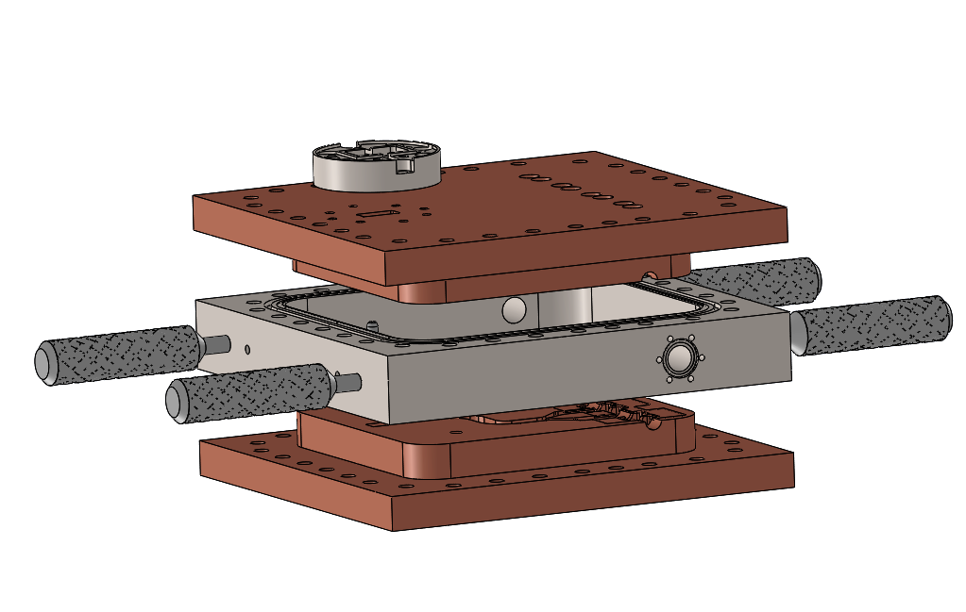
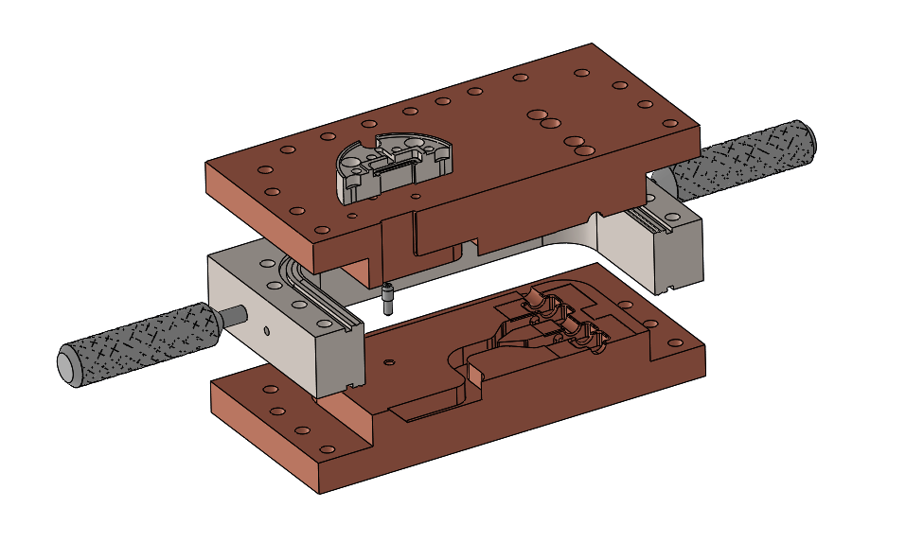
Engineering of the split block

Slide 21
Summary
Brazeless split block^{new} – high gradient brazeless technology!
Power extractor for the AWA (11.7GHz, 10ns, 900MW) designed
Structure is being fabricated
Looking forward to test at the AWA !
Acknowledgement
Funded by DOE SBIR Phase II
AWA Staff
My group at Euclid:
Sergey Kuzikov
Pavel Avrakhov
Edgar Gomez
Ed Dosov
Collaborator
Alexander Vikharev IAP (Russia)

