Slide 1
Experiments with Metallic Metamaterial Structures for Wakefield Acceleration
Xueying Lu, Julian F. Picard, Michael A. Shapiro, Ivan Mastovsky, Richard J. Temkin
Massachusetts Institute of Technology (MIT)
Manoel Conde, John G. Power, Jiahang Shao, Eric E. Wisniewski,
Maomao Peng, Gwanghui Ha, Jimin Seok,
Argonne National Laboratory (ANL)
Chunguang Jing
Euclid Techlabs LLC
August 21, 2019
AWA Needs and Opportunities Workshop
Lemont, IL

Slide 2
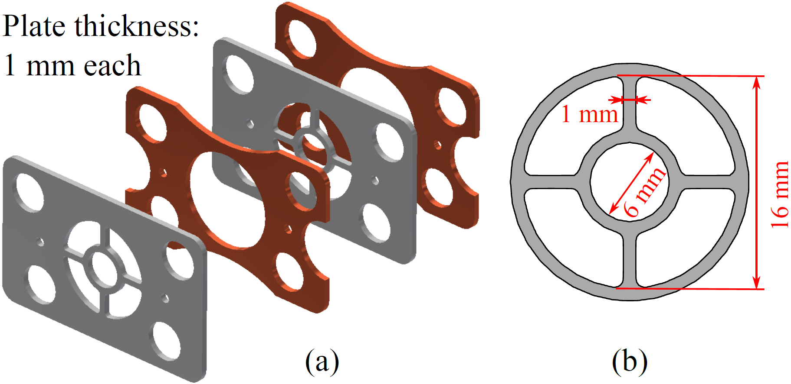
Outline
Introduction
Metamaterial Design and Theory
Stage I Experiment
Stage II Experiment
Conclusions

Slide 3
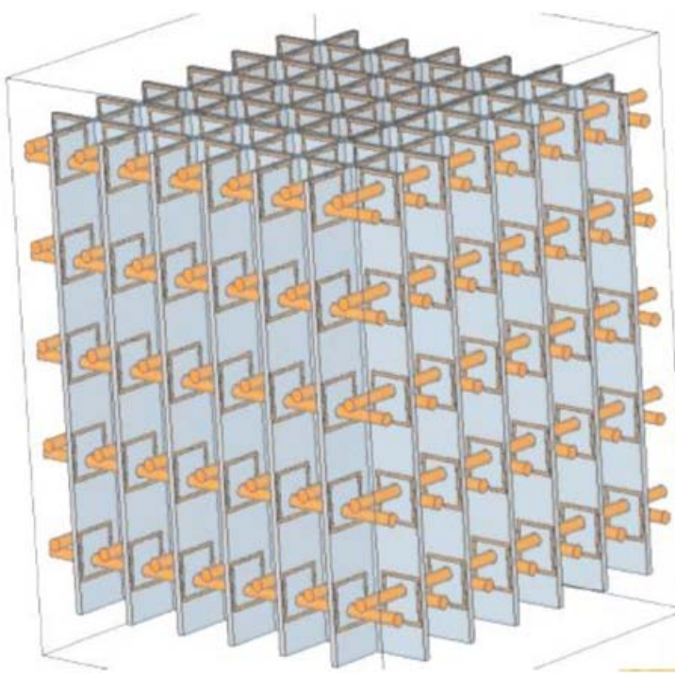
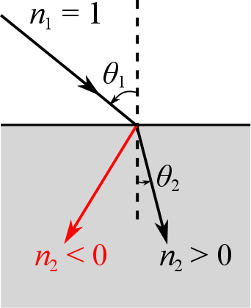
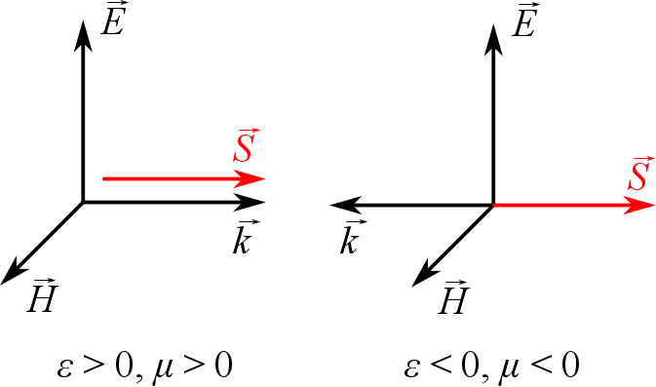
Metamaterials
Metamaterial (MTM):
An artificial material with a subwavelength structure
Exhibits properties not usually found in natural materials
Especially a negative refractive index : simultaneous ε, μ < 0
Metamaterial with split ring resonators on dielectric boards*
Left-handed materials
Negative refraction
* S. Antipov et al., J. Appl. Phys. (2008)

Slide 4
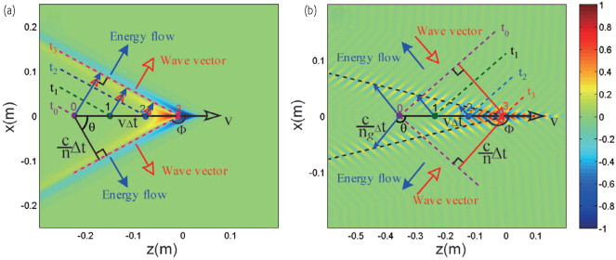
Reversed Cherenkov Radiation
Cherenkov Radiation
Electron velocity exceeds wave phase velocity
ε, μ > 0
Wave vector and energy flow parallel
Reversed Cherenkov Radiation
ε, μ < 0
Wave vector and energy flow anti-parallel
Hongsheng Chen and Min Chen. "Flipping photons backward: reversed Cherenkov radiation." Materials Today 14.1-2 (2011).

Slide 5
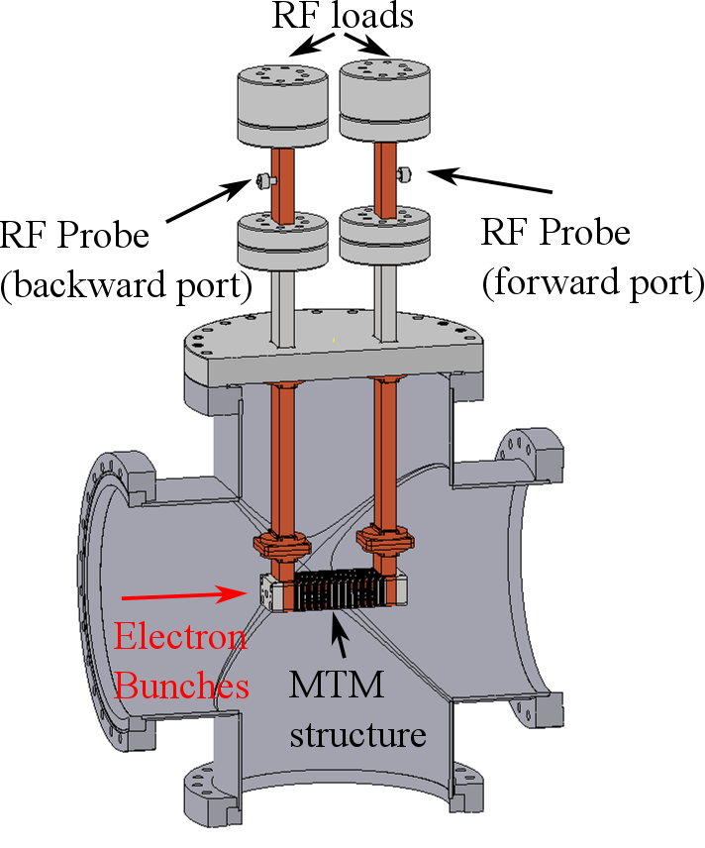
Motivation
Science:
Verify reversed Cherenkov radiation in a metamaterial structure from a direct measurement
Application:
High power microwave generation for wakefield acceleration in both collinear and two-beam acceleration regimes
All-metal structure to survive high RF power

Slide 6
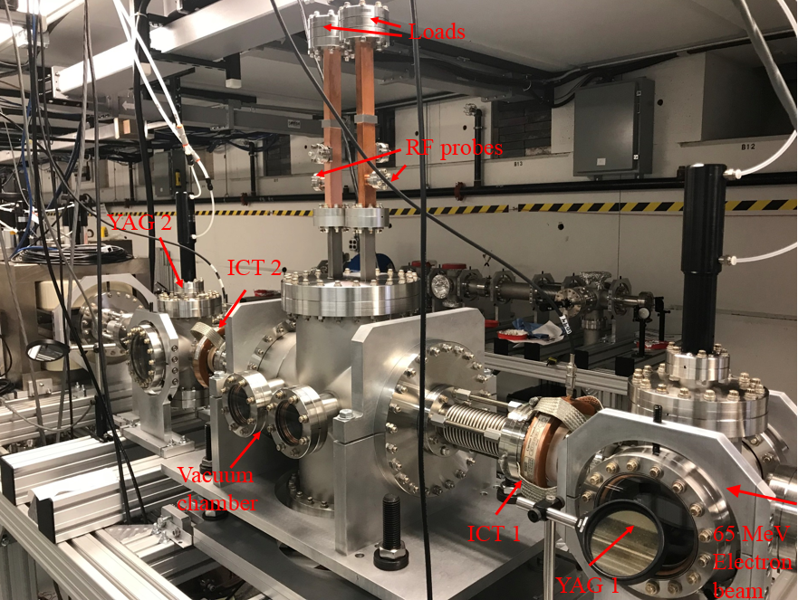
Experimental Setup at AWA
Diagnostics:
ICT (Integrating current transformer): Bunch charge
YAG screen:
Bunch transverse size
RF probes:
Output microwave

Slide 7
Outline
Introduction
Metamaterial Design and Theory
Stage I Experiment
Stage II Experiment
Conclusions

Slide 8
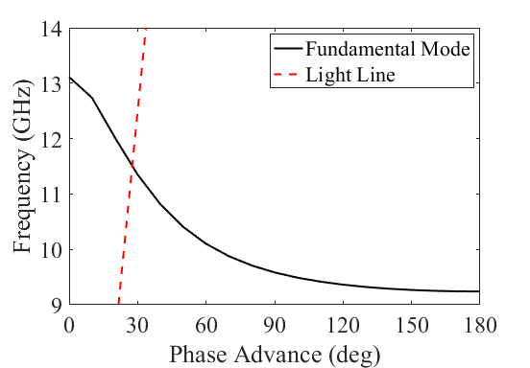
Wagon Wheel Structure Unit Cell
Wagon wheel structure
Periodic subwavelength structure
Period: 2 mm
Free space wavelength at 11.42 GHz: 26 mm
Negative group velocity
Fundamental mode: TM mode
Interaction frequency: 11.42 GHz
Cutoff frequency of an empty waveguide: 14.2 GHz
Dispersion Curve
Copper
Stainless steel

Slide 9
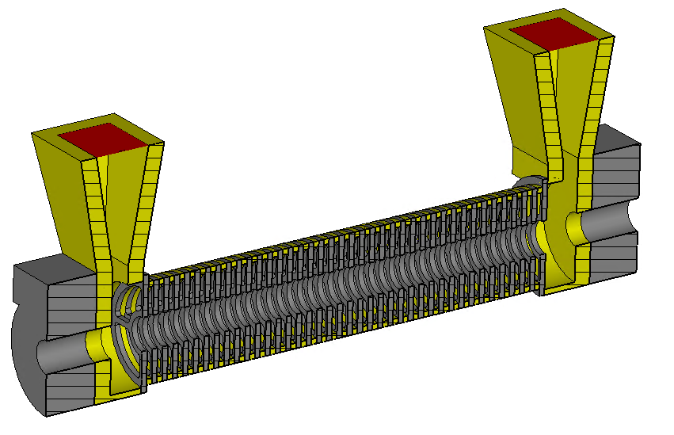
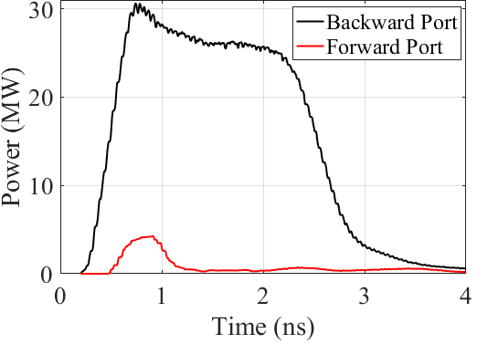
CST Simulation
Forward Port
CST Wakefield solver, single bunch
45 nC, σ_{z} = 1.2 mm
26 MW steady state in the backward port
Much lower power in the forward port
Reversed Cherenkov radiation
Analytical theory:
= 25 MW
Backward Port
Beam
Simulation

Slide 10
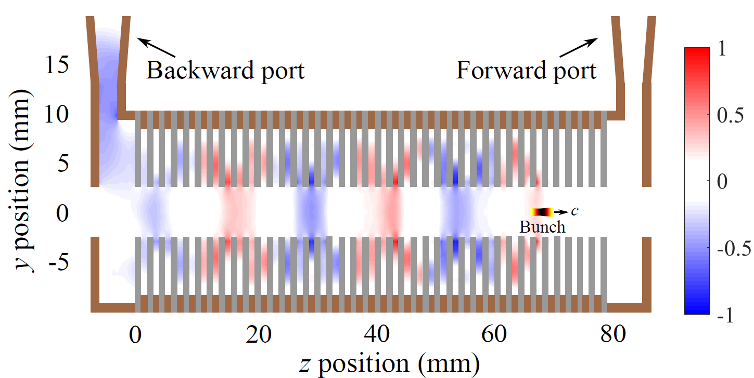
Electric Field Structure
“Artificial dielectric” structure with all metal
Similar “bouncing feature” of the electric field in the wagon wheel structure and a dielectric tube
Very easy to tune the effective dielectric constant with the huge parameter space in the metamaterial design
Wagon
Wheel
Dielectric tube

Slide 11
Advantages of Wagon Wheel Structure
Rugged all-metal structure
Enhanced beam-wave interaction
Large beam aperture => low shunt impedance, high group velocity
Small beam aperture => high shunt impedance, low group velocity
MTM with negative group velocity: High group velocity and high shunt impedance at the same time
Structure | Beam aperture (mm) | Group velocity | r/Q (kΩ/m) | Output power¹ (MW)
Wagon wheel | 6 | -0.158 c | 21 | 25
Alumina-loaded tube | 6 | 0.106 c | 10 | 13
¹ Output power is calculated for a single 45 nC drive bunch.

Slide 12
Outline
Introduction
Metamaterial Design and Theory
Stage I Experiment
Stage II Experiment
Conclusions

Slide 13
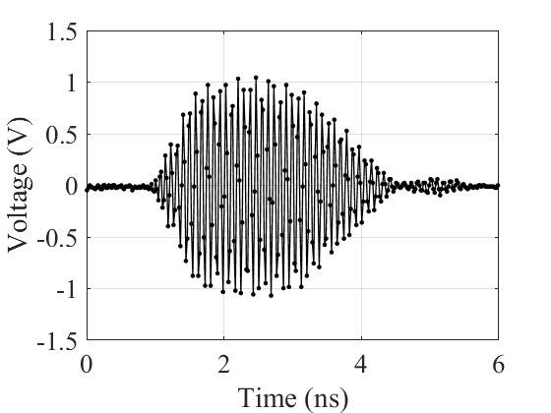
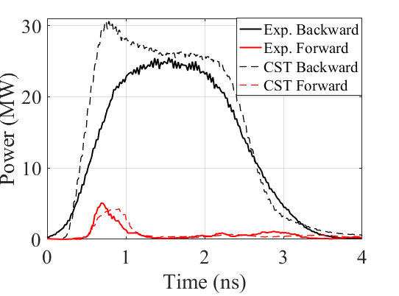
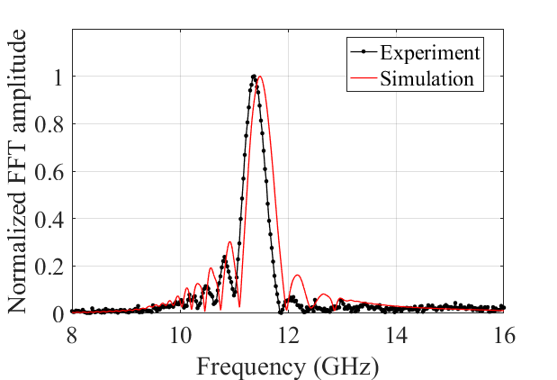
Single Bunch Experiment
High RF power from a single 45 nC bunch
Experiment: 25 MW
Simulation: 26 MW (steady state)
Analytical theory: 25 MW
Reversed Cherenkov radiation verified
Coherent radiation at 11.4 GHz
Backward port has much more power
100 GSa/s, 16 GHz BW scope
Lu et. al., PRL 122, 014801 (2019).

Slide 14
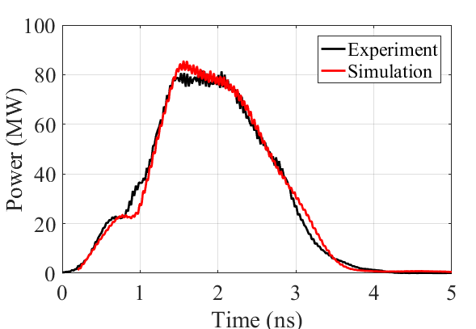
Stage I Highest Power Shot
Two bunches with a total charge of 85 nC
80 MW extracted RF power
50 MV/m decelerating electric field
75 MV/m available accelerating gradient for a possible witness bunch

Slide 15
Outline
Introduction
Metamaterial Design and Theory
Stage I Experiment
Stage II Experiment
Conclusions

Slide 16
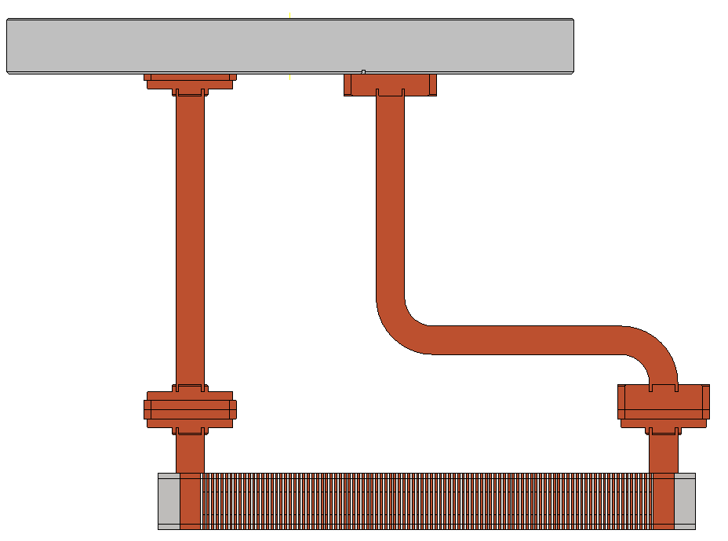
Stage II Experiment: Design
Design goal: achieve higher RF power / gradient from a train of 8 bunches with a rep rate of 1.3 GHz
Longer structure: 100-cell structure (20 cm long), 11.7 GHz
Higher total charge in the bunch train: > 200 nC
To Output Ports
8-bunch Train

Slide 17
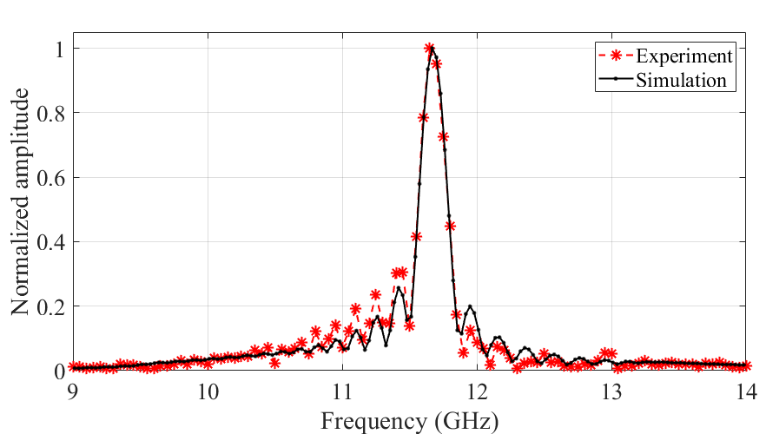
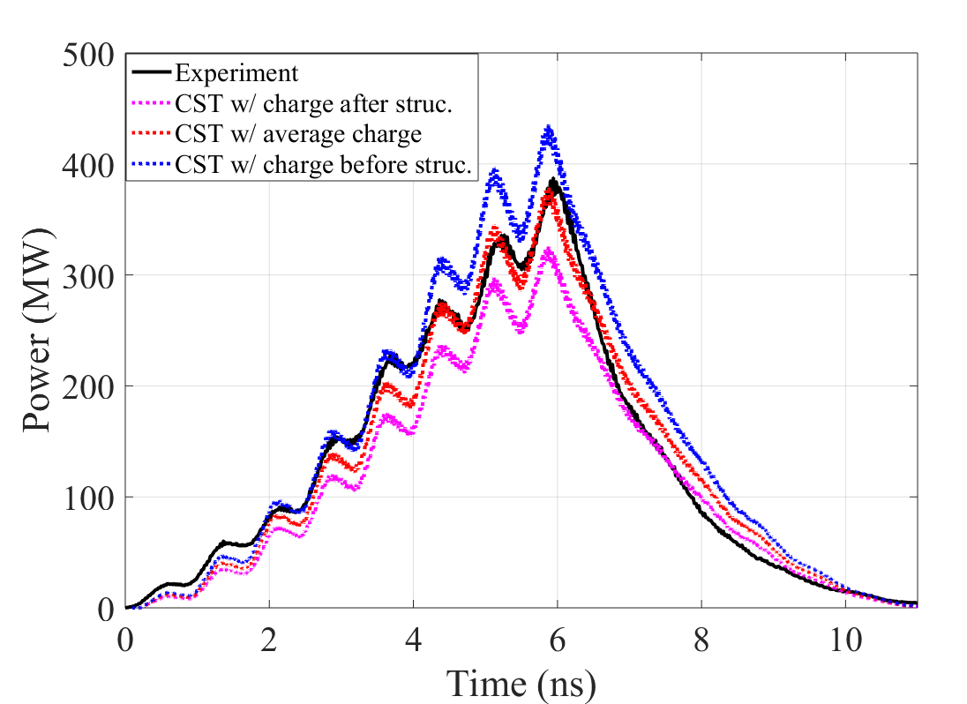
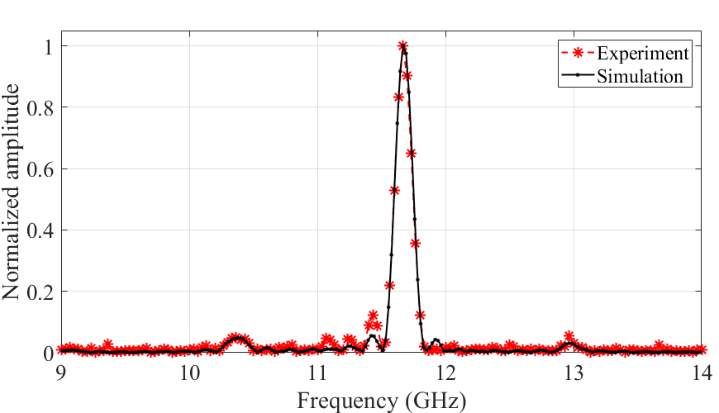
Stage II Experiment: Preliminary Results
RF pulse shape and frequency spectrum agree well with beam simulations.
Highest power is estimated to be 380 MW peak from 224 nC in 8 bunches
110 MV/m gradient
1-bunch spectrum
8-bunch power
8-bunch spectrum

Slide 18
Conclusions
Two wagon wheel metamaterial structures at X-band have been tested at the Argonne Wakefield Accelerator as power extractors.
Reversed Cherenkov radiation has been verified in a metamaterial structure with a negative group velocity.
High microwave power was generated, in agreement with analytical theory and CST simulations.
Stage I (40-cell structure): Two bunches, 85 nC, 80 MW, 50 MV/m decelerating gradient, 75 MV/m accelerating gradient
Stage II (100-cell structure): Eight bunches with a total charge of 224 nC, estimated peak power of 380 MW
Wagon wheel structure has unique advantages for wakefield acceleration
Rugged all-metal structure, no dielectrics
Enhanced beam-wave interaction

Slide 19
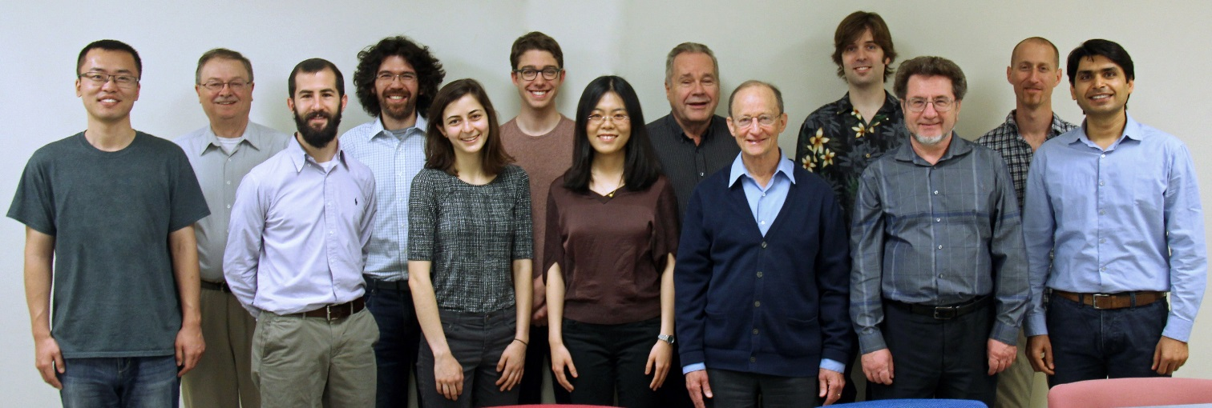
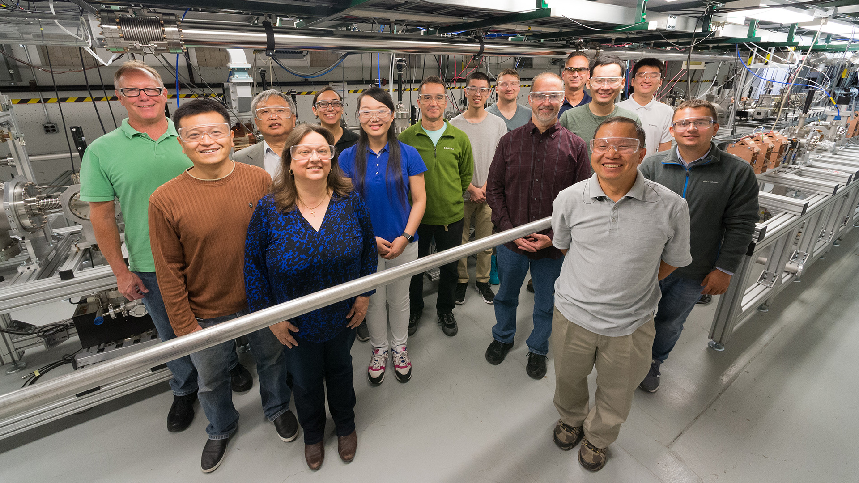
Acknowledgement
MIT
ANL
Funding agency:
MIT: U.S. Department of Energy, Office of Science, Office of High Energy Physics under Award Number DE-SC0015566.
ANL: U.S. Department of Energy, Office of Science under Contract No. DE-AC02-06CH11357.

