Slide 1
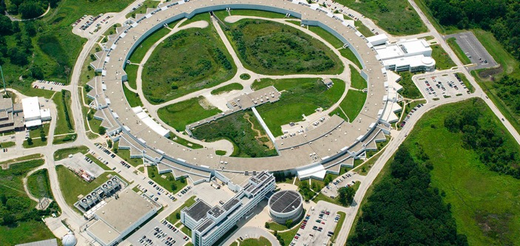
Potential for a new program in Ultrafast Electron diffraction/Microscopy at Argonne
erhtjhtyhy
John byrd
Director, Accelerator Systems Division
Director, Argonne Accelerator Institute
Advanced Photon Source
Briefing to Jim Murphy
4 June, 2019

Slide 2
High brightness photoinjectors are a enabling accelerator Technology
Basis for all Free Electron Lasers; several new applications
Beam brightness is current/unit phase space area
Gun
Beam brightness proportional to electric field at cathode (E^{n}, n>1)
Pulsed RF guns can achieve high fields but are limited to low duty factor (0.1%) and low rep rate (0.1-1 kHz)
Future science needs are driving high repetition rates (LCLS-II) and RF guns with 100% duty factor (aka CW operation.) The most promising option is an SRF gun that has not yet been demonstrated.

Slide 3
High brightness, high repetition rate Electron sources are needed
25% longer linac
Applications for XFEL injectors and UED/UEM
The next phase for XFELs is to increase rep rate and energy reach.
Lower emittance (i.e. higher brightness) is needed to allow lasing at higher energies.
This is achieved with higher electric field gradients at the photocathode AND 100% DF.
This is a strong case for SRF guns.
Another emerging application is time-resolved electron diffraction and microscopy using very similar technology.
Argonne is an ideal place to contribute to this effort.

Slide 4
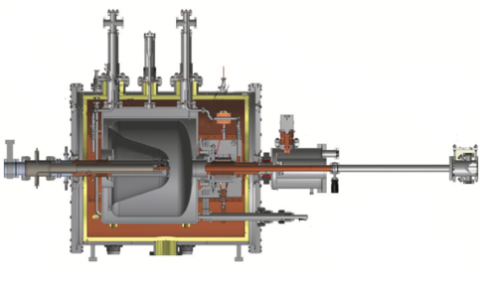
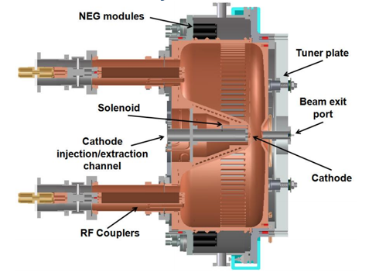
The next step is high repetition rate
High brightness, high rep-rate (~MHz) e-guns have been under development for the past decade for LCLS-II
Superconducting gun
Normal conducting gun (LBNL)
SLAC is not able to divert attention from LCLS-II for a new SRF gun project. DOE/BES has contacted ANL and other labs with SRF capability for expressions of interest to adopt this gun. We are making a strong proposal to bring it to Argonne.

Slide 5
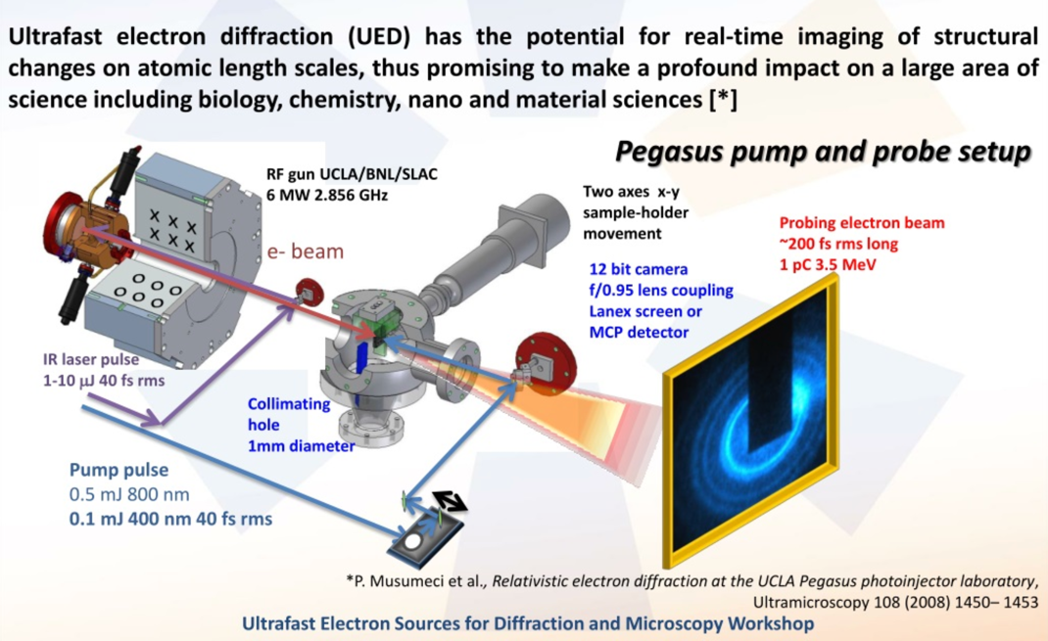
Ultrafast electron diffraction/microscopy (UED/UEM)
Leverages development of high brightness e-guns over past 3 decades

Slide 6
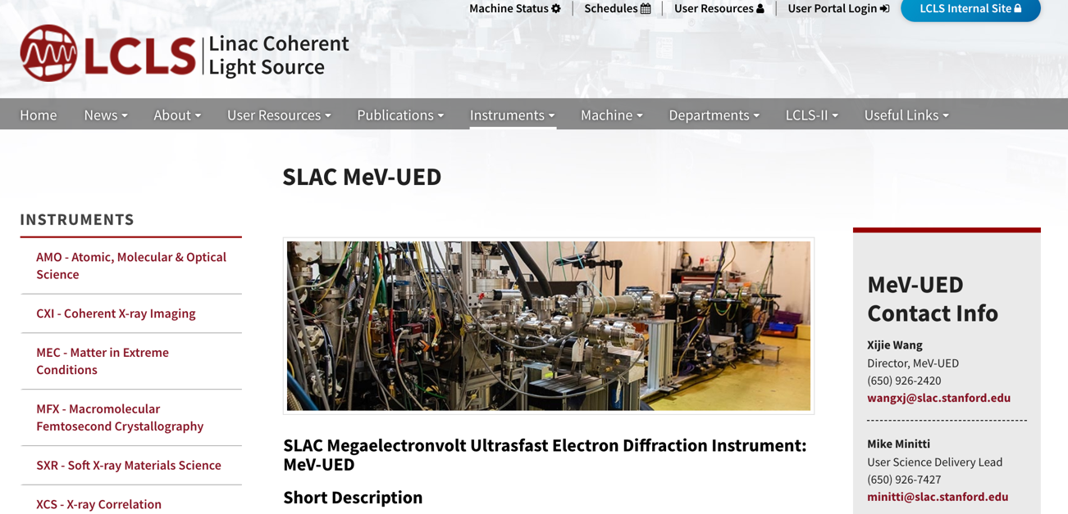
A new program in UED has just begun at SLAC using a pulsed electron gun

Slide 7
KEY Argonne personnel
PHYSICS Division-Accelerator Development Group
  Mike Kelly (lead), Jerry Nolen, Brahim Mustapha
Argonne Wakefield Accelerator
  Manoel Conde (lead), John Power
Advanced Photon Source
  John Byrd (lead), Michael Borland, Yin-e Sun, Mike Fisher(formerly UWisc)
Northern Illinois University
  Phillippe Piot
Science applications
  Linda Young (CSD), Ilke Arslan (CNM)
Argonne Management
  Kawtar Hafidi-ALD Physical Sciences and Engineering
  Stephen Streiffer-ALD Photon Sciences
  Paul Kearns-ANL Director

Slide 8
Why Argonne?
ANL has all the necessary technical infrastructure, capability and expertise to demonstrate the full capability of the existing gun.
  Complete SRF processing and testing facilities
  “Spare” cryoplant with 60W capacity at 4K, upgradeable to >100W
  World-class SRF team engaged in R&D for several DOE projects
  Strong expertise in laser-driven PC guns and photocathodes
  Excellent capability in modeling electron beam dynamics
  Excellent support for beam diagnostics and electromechanical installation
ANL has a vision for transforming a successful gun demonstration into a scientific tool that complements existing ANL and DOE programs
  The gun has tremendous potential as a future high rep-rate UED/UEM source with time resolution from 10s of picoseconds to sub-psec. This is highly complementary to the time-resolved TEM capability already under development at ANL.
  This gun design is also a candidate for a high-brightness source for LCLS-II HE

Slide 9
gun to be sited in existing SRF test bunker in Dynamitron building
ATLAS
SRF development test area

Slide 10
gun to be sited in existing SRF test bunker in Dynamitron building
Existing cryoplant is used for SRF R&D. Not used for ATLAS ops.
Existing cryoplant has 60W capacity at 4K. An additional compressor could be added to bring capacity >100W. Estimated cost $250k.
Compatible with DOE-mandated He recovery program.
200 MHz cavity similar to other SRF devices tested in bunker.
Space outside bunker for RF system, controls, laser hutch.
Bunker walls are removeable to allow for full beam transport line to be installed.
CAD rendering of gun in existing bunker. Walls are moveable to allow for extending beamline.

Slide 11
gun to be sited in existing SRF test bunker in Dynamitron building
Liquid helium refrigerator & shielded test cave – At least 6 months/year access for next two years
RF/LLRF systems at 200 MHz
Cryomodule assembly area & access to SRF chemistry, clean facilities

Slide 12
Beamline commissioning: Overall plan
  Gun commissioning
    shipment of Gun/cryostat/RF system/beam transport/drive laser from SLAC
    installation of gun in physics test bunker and cooldown
    installation of cavity low level RF control -testing with low power RF
    pulsed cavity conditioning to higher power
    CW high power operation
  Drive laser
    construction of interlocked laser hutch next to bunker
    installation and commissioning of laser system
    laser transport to gun over bunker wall
    focus laser on photocathode
    Characterize beam directly from gun
  Beam transport
    Remove back bunker wall and install beamline
    Operate beamline with building interlocked
    Characterize gun performance (emittance, energy, charge , bunch length)

Slide 13
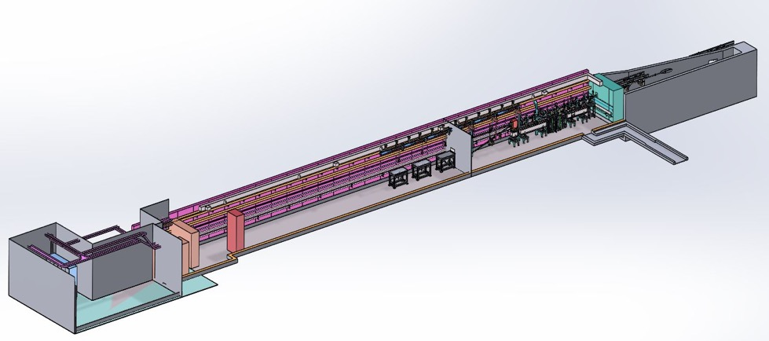
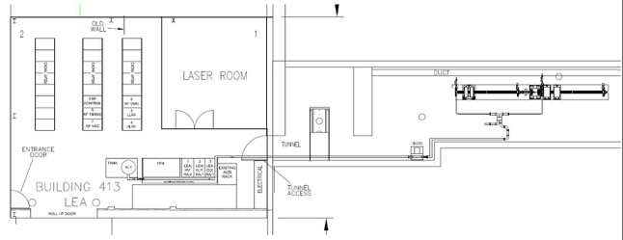
Vision for future UED/UEM experiments
APS Linac Extension Area (LEA) is available. Lacks cryoplant.
LEA is one potential location to site a UED/UEM experiment.
  53 m tunnel downstream of APS linac. Former LEUTL area.
  Existing interlocked area approved for accelerator operations
  Room for RF and controls
  Dedicated laser room
  Space for cryoplant in HVAC area
17m
53m

Slide 14
Strawman Gun commissioning schedule (2 yrs)
Detailed schedule dependent on APS-U BLS cryomodule. APS-U has priority with 50% time commitment of cryoplant.
Gun testing
  ANL Pressure systems safety review – early Summer 2019
  Shipment to ANL - summer 2019
  Order new compressor – fall 2019
  Installation of cryomodule into test bunker - calendar 2019 (1 month)
  Initial cooldown and 4 K testing – early 2020 (1-2 months)
  Installation of new compressor – spring 2020
    no significant downtime expected
  Installation of laser, hutch, and laser transport to cathode (spring 2020)
  Additional 4 K cooldown and testing – calendar 2020 and beyond
    No significant competition for He refrigerator or bunker in FY21-22
  Characterization of PC beam at <10 pC
Beamline Testing
  Installation (summer 2020)
  Commissioning and beam characterization (Fall 2020-Summer 2021)

Slide 15
Argonne contributions to SRF gun demonstration
Subject to final approval by ANL Director
M&S
  Liquid helium refrigerator & shielded test cave – At least 6 months/year access for next two years
  RF/LLRF systems at 200 MHz
  Cryomodule assembly area & access to SRF chemistry, clean facilities
  Support shipping entire gun systems from SLAC to ANL
  Provide additional compressor to bring cryoplant capacity to >100W
  Provide laser hutch to house PC drive laser
Effort
  Provide support for one postdoc (PHYS)
  Provide ~1 FTE/yr support for electromechanical installation and maintenance (APS). This includes Mike Fisher, original engineer from UWisc, who now works at APS. APS would also support beam physics modeling studies.

Slide 16

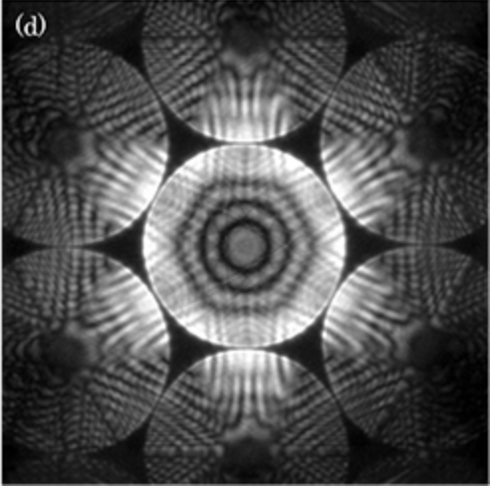
Artemis: the Argonne Transmission Electron instrument for ultrafast science

Slide 17
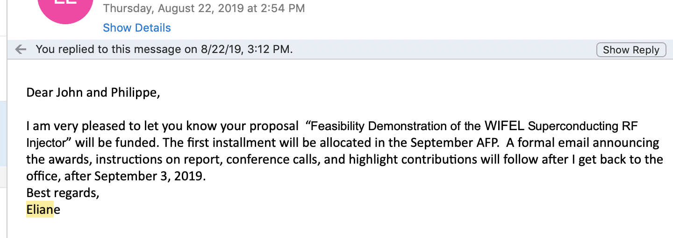
News flash
Project funded!
Funds arrive in September 2019. ANL has already contributed $100k LDRD and $263k towards improvements in the existing R&D cryoplant.

