Slide 1
Multipactor Studies of 17 GHz Metallic Structures
Haoran Xu, Michael Shapiro and Richard Temkin
AWA Needs and Opportunities Workshop
Argonne National Laboratory
08/22/2019

Slide 2
What is Multipactor?
Multipactor is an avalanche of free electrons on a surface exposed to radio-frequency (RF) electromagnetic fields in vacuum.
It is caused by secondary emission of electrons from surfaces struck by electrons that have been accelerated by the applied RF field.
Electrons with E ~100s eV are found at the side wall of the structure
The SEE curve is affected by air exposure, bakeout, coatings, plasma processing, laser treatment, accelerator processing

Slide 3
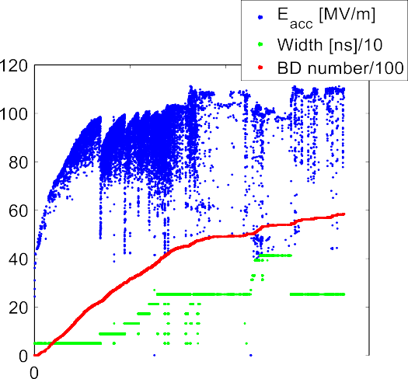
Why Study Multipactor?
What is the role of multipactor in breakdown and outgassing?
Sample calculation of electron multipactor at the side wall of the MIT high gradient 17 GHz structure
Multipactor affects accelerator structure processing
Do we need 600 million shots to process a high gradient structure?
Pulse No. *10⁸
From Wu et al., PR AB (2017)

Slide 4
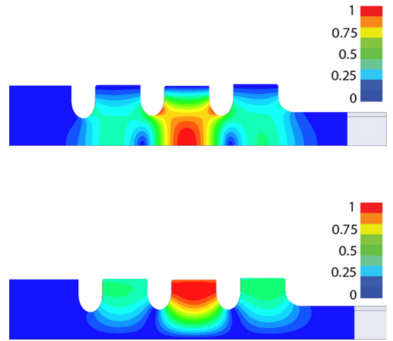
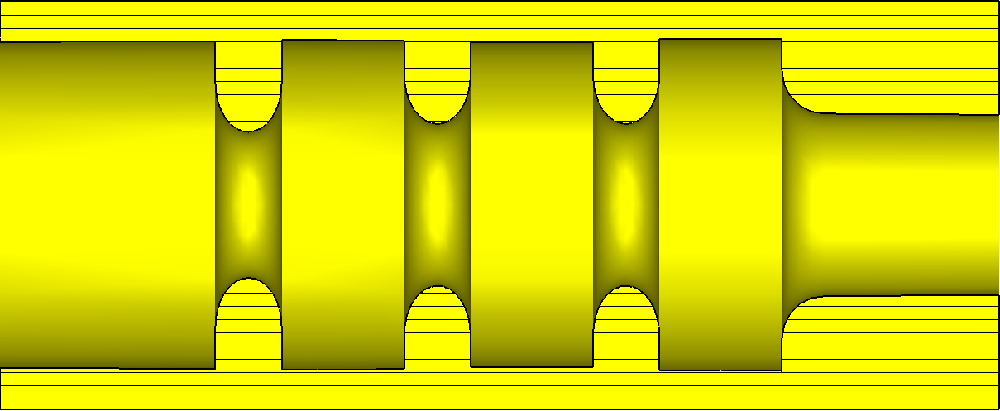
MIT-DLWG 17 GHz Structure
17 GHz standing wave disk loaded waveguide (DLWG) test structure
Side Wall
central cell
input coupling cell
output coupling cell
15.12 mm
Electric field amplitude
5.68 mm
Magnetic field amplitude

Slide 5
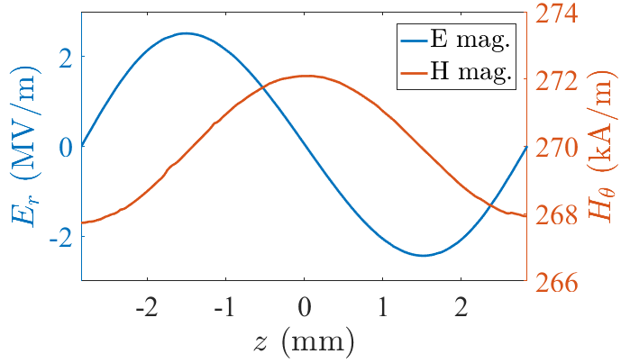
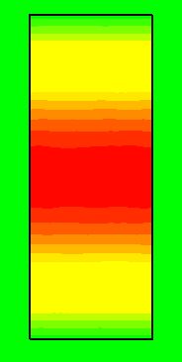
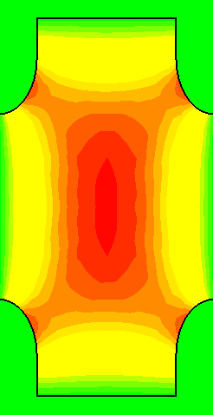
Multipactor is Caused by Nonzero E_{r} at the Side Wall
Pillbox cavity: no E_{r} component.
Accelerator cavity (E_{g} = 72 MV/m)
The small E_{r} at the side wall excites electrons in the hundreds of eV energy range causing the multipactor discharge.

Slide 6
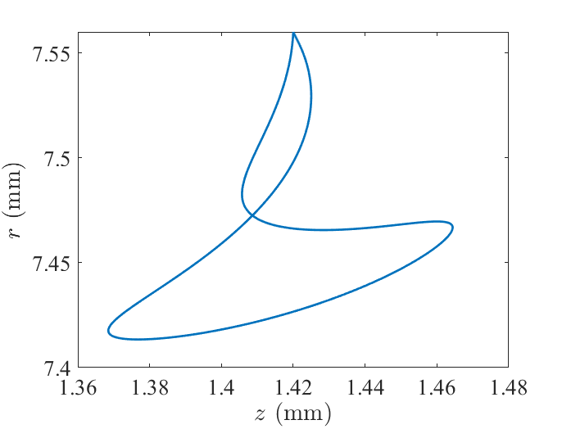
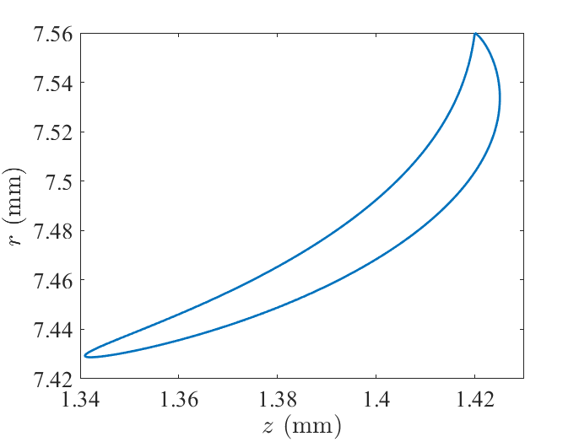
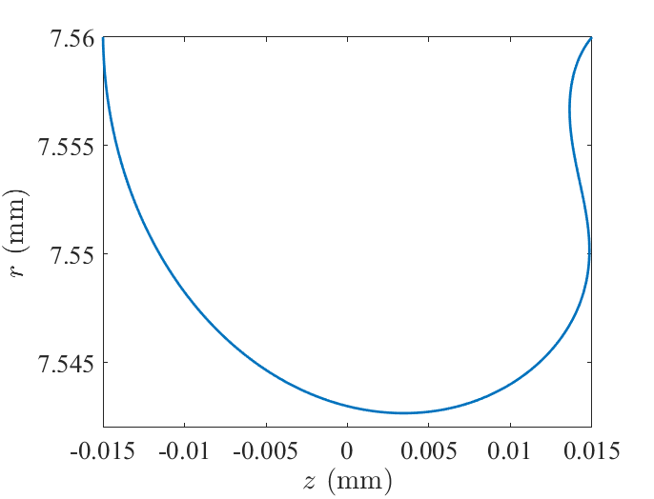
Multipactor Modes
Modes are defined by the number of rf periods (N) per cycle.
Radial extent of the trajectories is small, < 0.2 mm
N = 2
N = 1
N = 0.5
$$E_{g}=45 MV/m$$
$$E_{g}=72 MV/m$$
$$E_{g}=250 MV/m$$

Slide 7
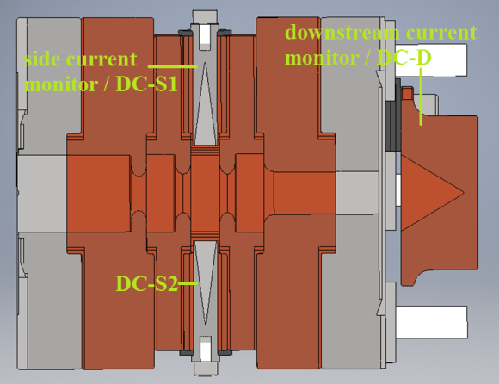
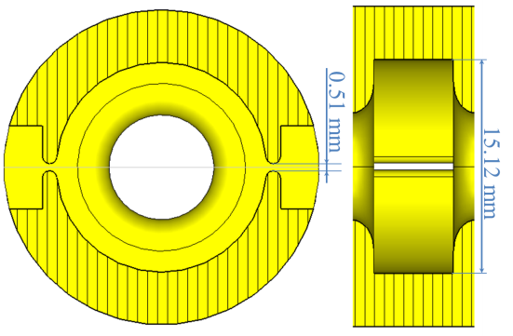
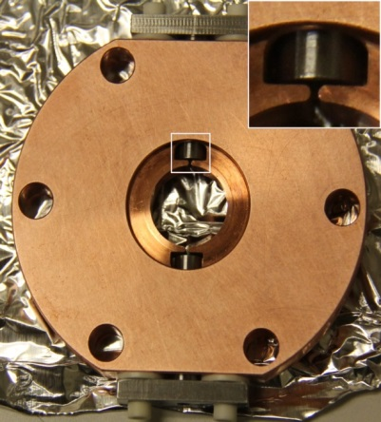
Monitor for Measuring the Side Dark Current
Standing wave single cell structure with side slits for dark current extraction
Two side current monitors
Structure assembly
Central cell design
Central cell plate

Slide 8
MIT 17 GHz Accelerator Lab
*
*
* Haimson Research Corp.

Slide 9
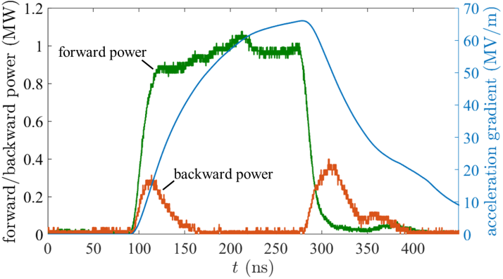
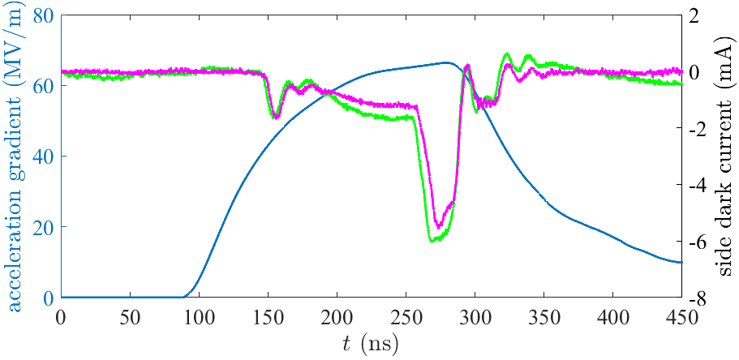
Experimental Identification of N=1 and N=2 Modes
Forward/backward power and calculated gradient
N = 2
E_{g} ~ 42 MV/m
N = 1
E_{g} ~ 70 MV/m
Side dark current shows equal emission on two sides
Peaks in the traces correspond to N=2 and N=1 modes
Note the “burn through” effect
Peaks are reduced with processing
H. Xu, M. A. Shapiro and R. J. Temkin, Phys. Rev. – Accel. Beams 22, 021002 (2019).

Slide 10
What is the Effect of the Multipactor Electron Cloud?
Will the electron cloud detune the cavity frequency?
Multipactor electron cloud is modelled by a dielectric layer.
$$ω_{p,e}^{2}=\frac{n_{e}e^{2}}{ε_{0}m_{e}}$$
$ε_{r}=1−\frac{ω_{p,e}^{2}}{ω^{2}}$;
l
0.15 mm
72 MV/m gradient, N = 1 multipactor trajectory on the side wall.
Electron cloud layer with density n_{e}, permittivity $ε$_{r}. and thickness l

Slide 11
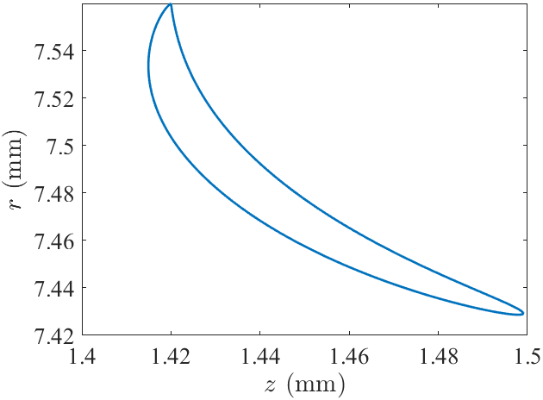
Layer Thickness Estimate at 17 GHz
Method 1: calculation of the electron multipactor trajectory size.
Method 2: CST PIC simulation.
Example: At 72 MV/m and 17 GHz, N=1 multipactor electron cloud thickness ~0.15 mm by both methods.
Trajectory calculation
CST calculation

Slide 12
Frequency Detuning of 17 GHz Accelerator Cavity
Δω/ω ~ (n_{e}/n_{c})*(l/R)³
Frequency detuning:
where n_{e} is the electron cloud density
n_{c} is the cutoff density
l is the cloud thickness
R is the cavity radius
At 17 GHz, l = 0.15 mm, R = 7.58 mm
Frequency detuning is small, Δω/ω << Q⁻¹
Predict negligible detuning effect at 17 GHz

Slide 13
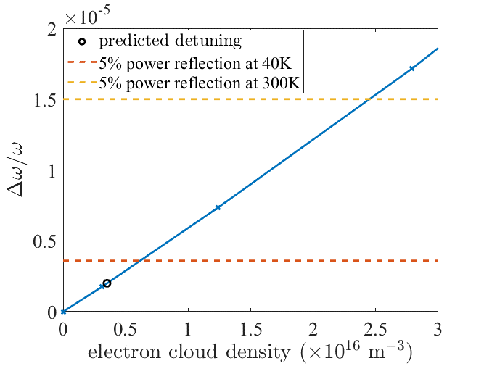
Frequency Detuning of 2.856 GHz Cryo Cavity
2.856 GHz standing wave cavity
Q₀=8.5×10⁴ at 40 K
n_{c} = 1x10¹⁷ m⁻³
l = 0.9 mm
Conclusion: Frequency detuning by multipactor may cause power reflection in a copper cryo cavity

Slide 14
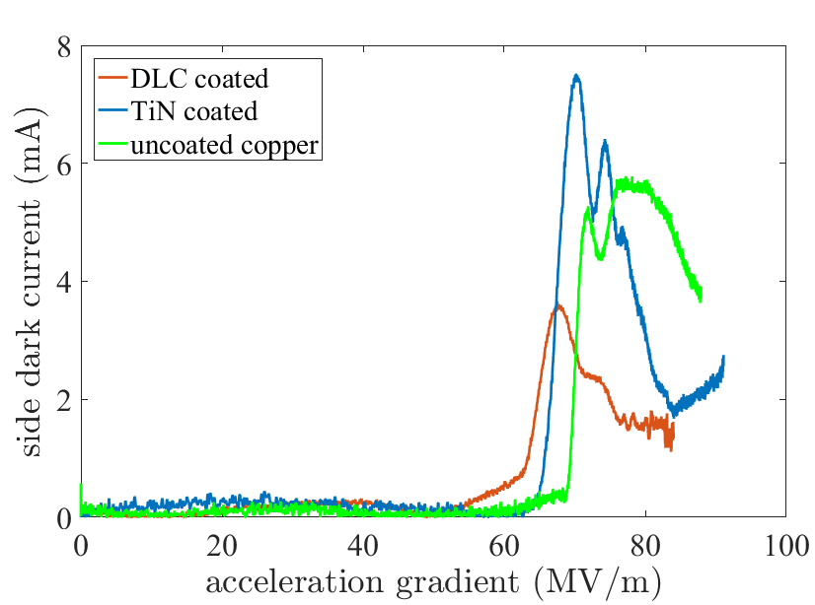
Coated Sidewalls – Multipactor Mitigation
Diamond-like carbon (DLC) and titanium nitride (TiN) coatings were applied on the side walls of the central cell for two different high power tests.
All structures showed the N=1 mode after processing to 2x10⁵ pulses
N = 1

Slide 15
Conclusions
Completed theoretical and experimental studies of multipactor at the side wall of a high gradient accelerator structure.
Measured the N=2 multipactor (~ 42 MV/m) and the N=1 mode (~72 MV/m) using a side wall current monitor, in good agreement with theory
Showed that the multipactor electron cloud does not detune a room temperature cavity but may be an issue in cryo cavities.
Tested DLC and TiN coatings on the side wall to reduce the multipactor intensity.

Slide 16
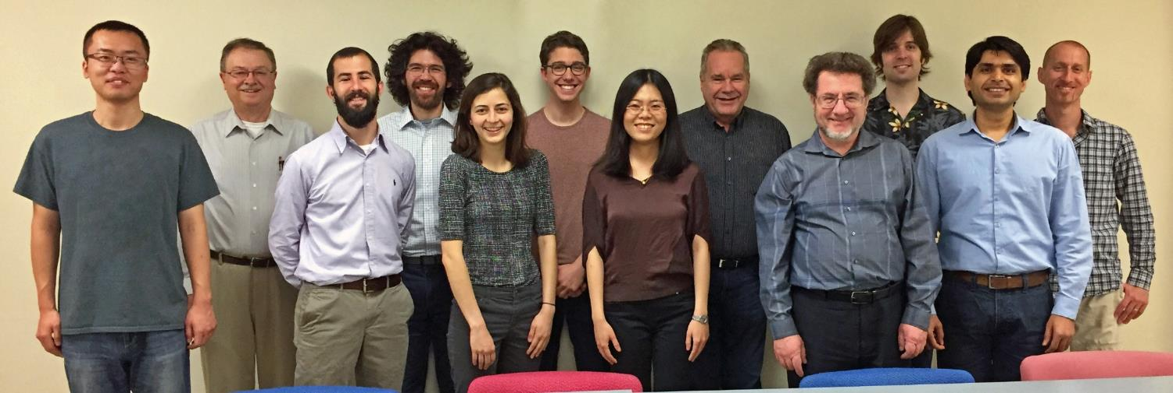
Acknowledgements
(Left to Right) H. Xu, P. Woskov, J. Stephens, A. Soane, H. Hoffmann, J. Picard, X. Lu, I. Mastovsky, M. Shapiro, S. Schaub, S. Jawla, G. Rosenzweig

