Slide 1
Charge Particle Detection by Detuning of a Microwave Resonator
Sergey Antipov
Euclid Techlabs

Slide 2
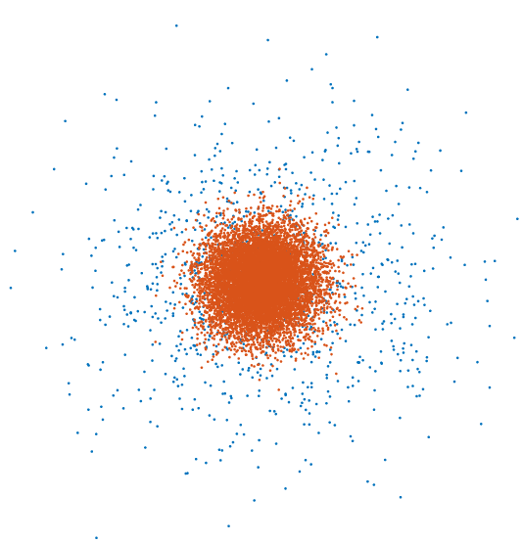
Concept: diamond beam halo monitor
limited by the damage threshold of these materials
Resonator
Main beam
scan
scan
Halo
scan
scan
Diamond wire / blade
Tungsten/carbon wire
Intercepts charge
Diamond: radiation hard material with excellent thermal properties
Change in resonator
properties = halo signal

Slide 3
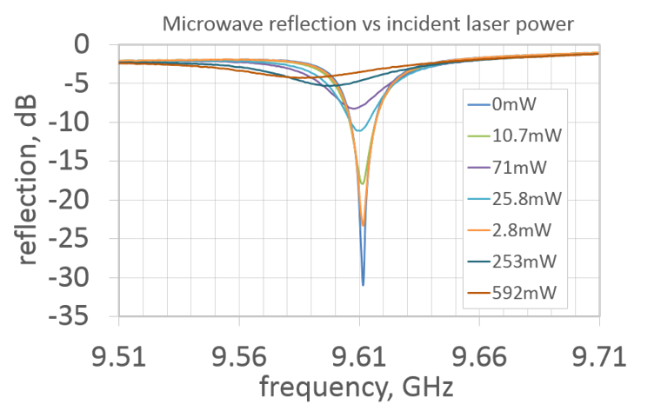
Example: green laser peak power measurement using silicon in a resonator
Resonator
silicon
515nm laser
S11 measurement (reflection)

Slide 4
Measurement considerations
Non-linear measurement
Sensitive element – dependent
Time-domain measurement
Retuning of the cavity
Sensitivity
Correlation of signal to charge
Scanning patterns

Slide 5
Diamond membranes
We are ablating diamond to produce thin 10-20 um membranes (drum heads).
We also can polish diamond to few-nm Ra roughness

Slide 6
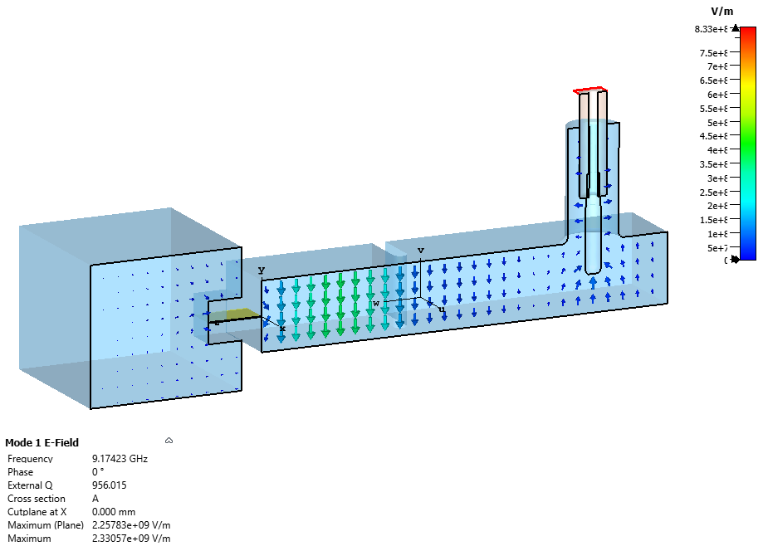
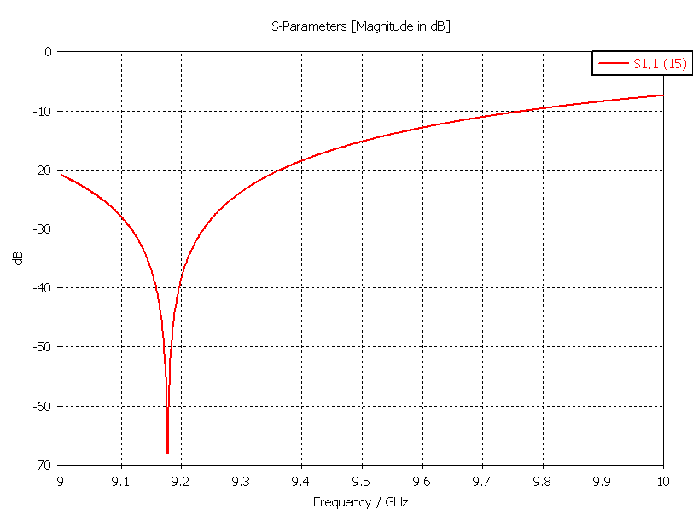
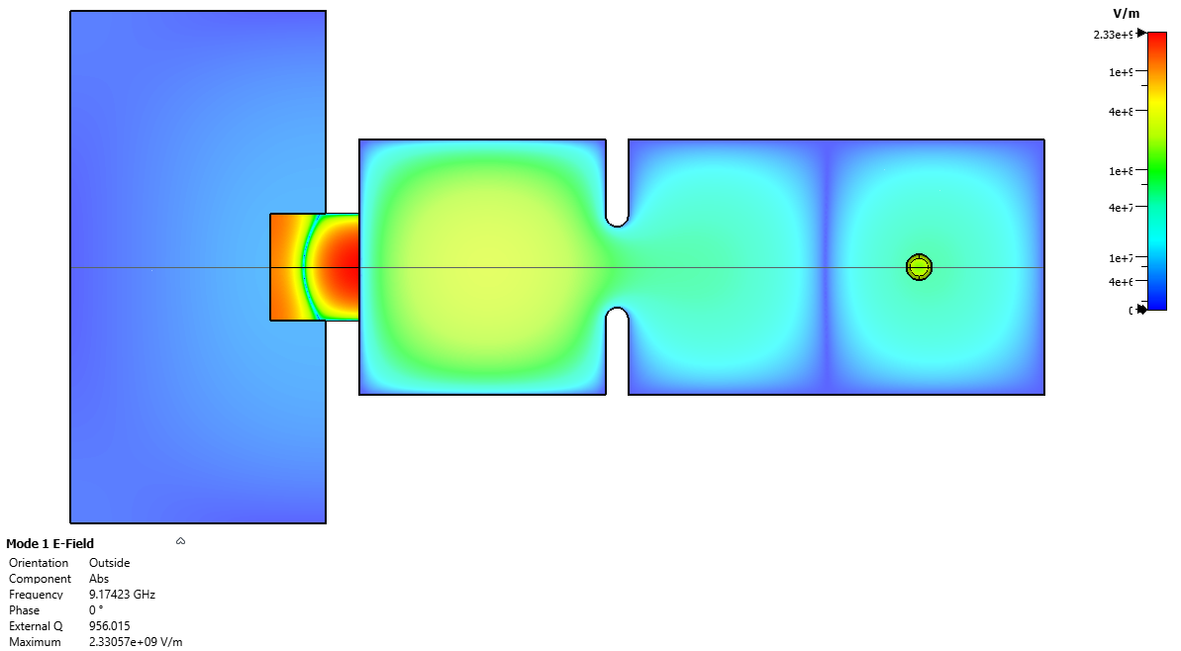
Halo Measurement Resonator Design 9.2 GHz

Slide 7
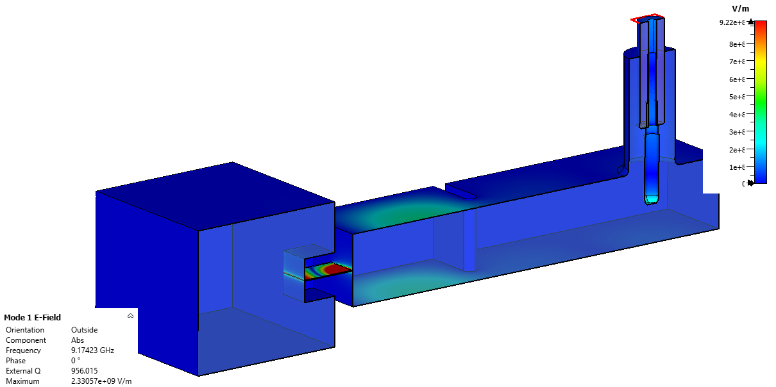
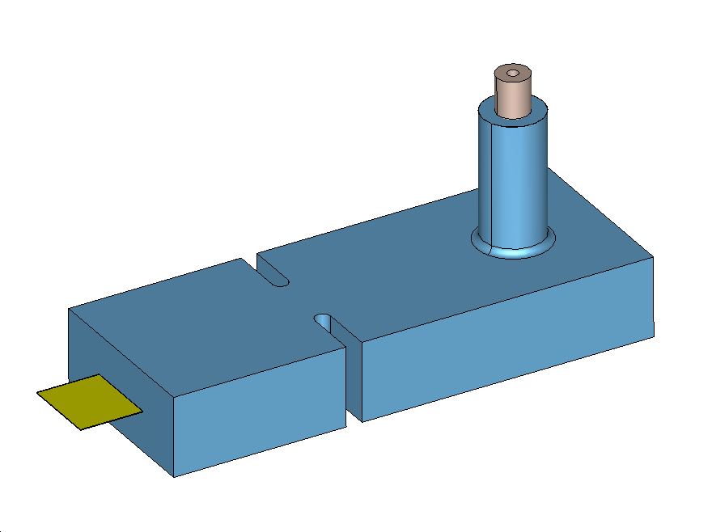
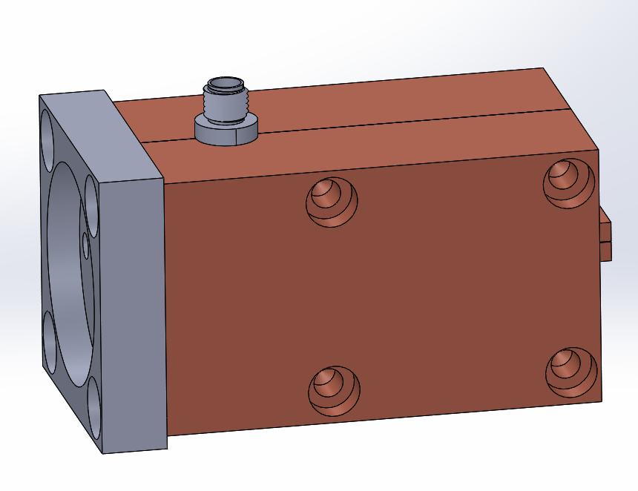
Engineering design

Slide 8
Insides: All – UHV vacuum compatible
UHV kapton sma cable inside (accuglass)
UHV sma connector (accuglass)
UHV sma feedthrough (accuglass)
Aluminum adaptor
Copper cavity
Huntington linear actuator
Vented screws, vacuum relief, etc..
In-vacuum RF cable is a problem!

Slide 9
“Simplified” resonator – no scanning

Slide 10
“Simplified” resonator fabricated and tested

Slide 11
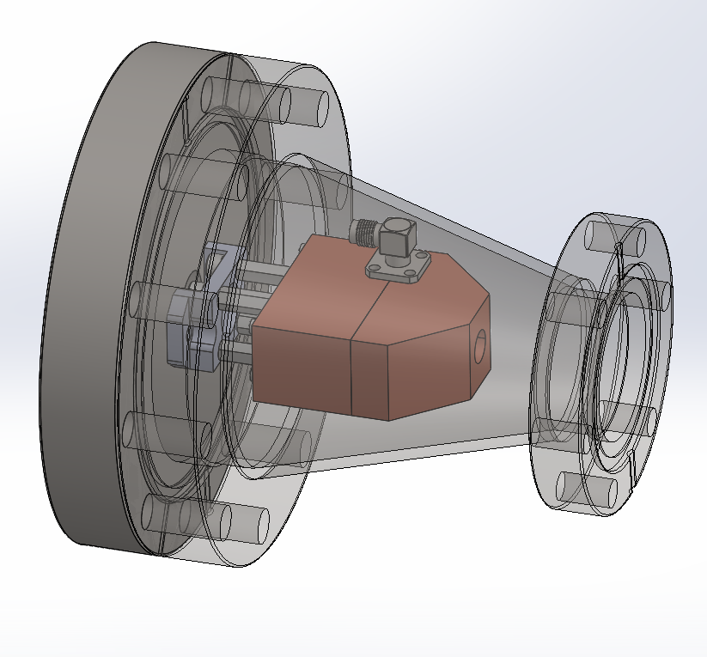
“Simplified” resonator fabricated and packaged
The plan is to have a simple preliminary measurement

Slide 12
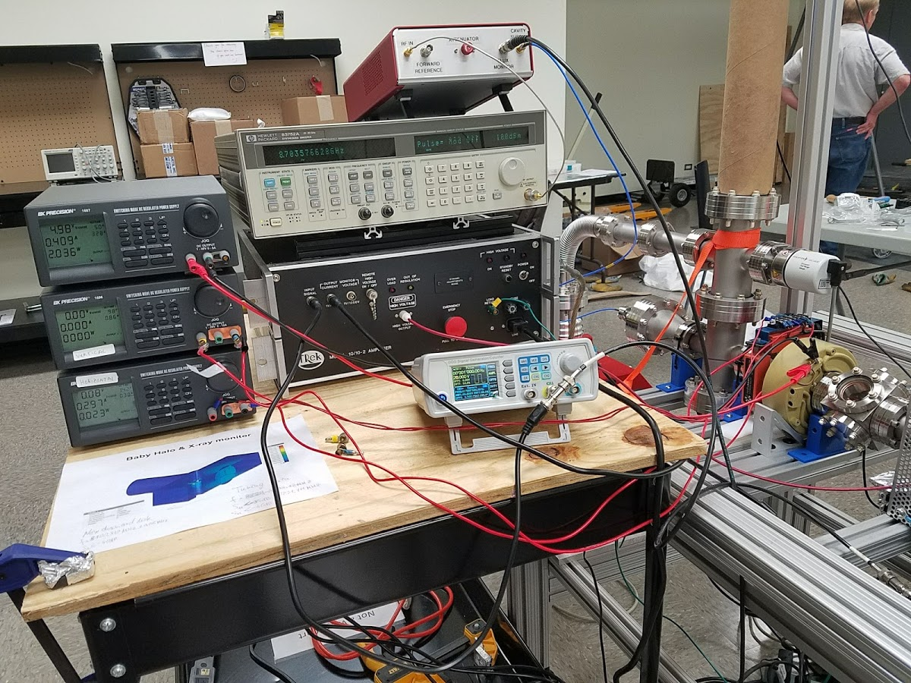
Controller (RF Box)

Slide 13
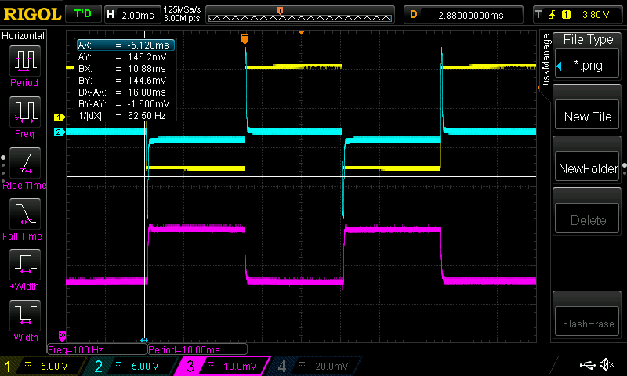
Baby Halo Monitor test result (beam energy 10 keV; beam current 4.6 uA; RP 100 Hz)
DC gun Voltage DC gun Current Halo Monitor signal

Slide 14
Fluorescence on diamond
S. Antipov, S. Stoupin measured at 1BM APS, 2015
For example, a 15-micron-thick diamond screen will transmit 90% of the x-ray flux at 5 keV.
At 8 keV, a very comfortable 60-micron thickness can be used.
~50 um diamond beam position monitors are commercial product

Slide 15
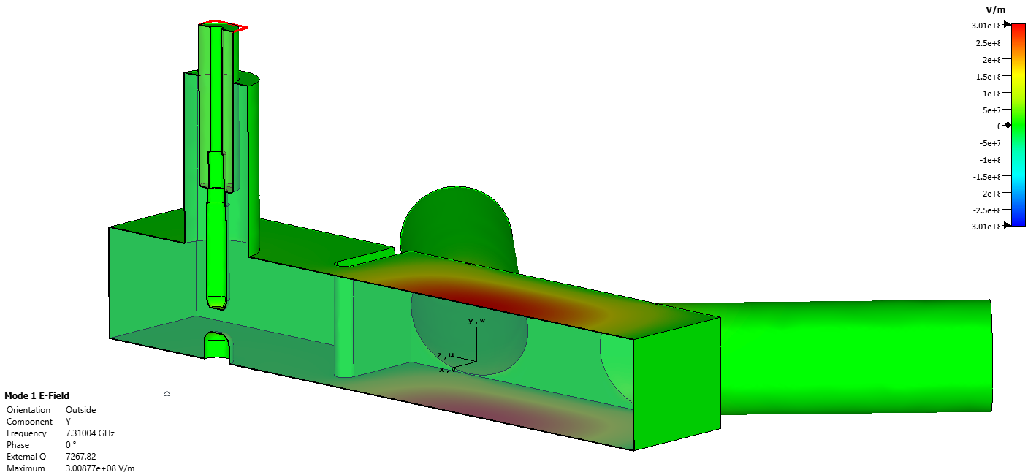
Microwave resonator design

Slide 16
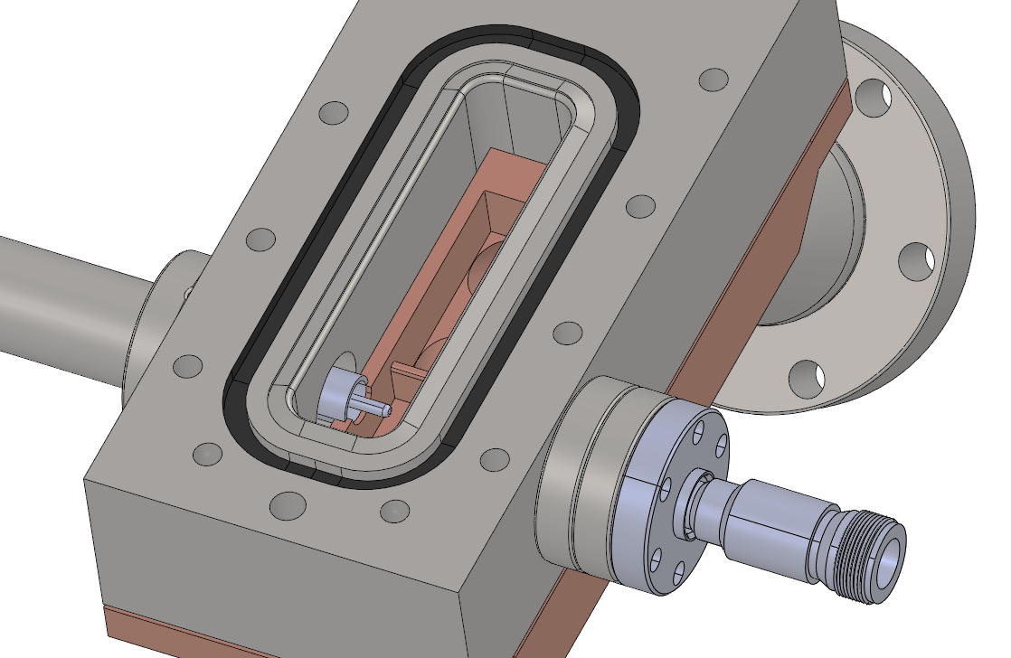
Engineering: UHV design!
diamond

Slide 17
Overall device for experiment at CHESS
No experiment due to CHESS schedule

Slide 18
Fabricated device
Replace stainless steel part with 3D printed plastic one for bench tests (to preserve knife edge)

Slide 19
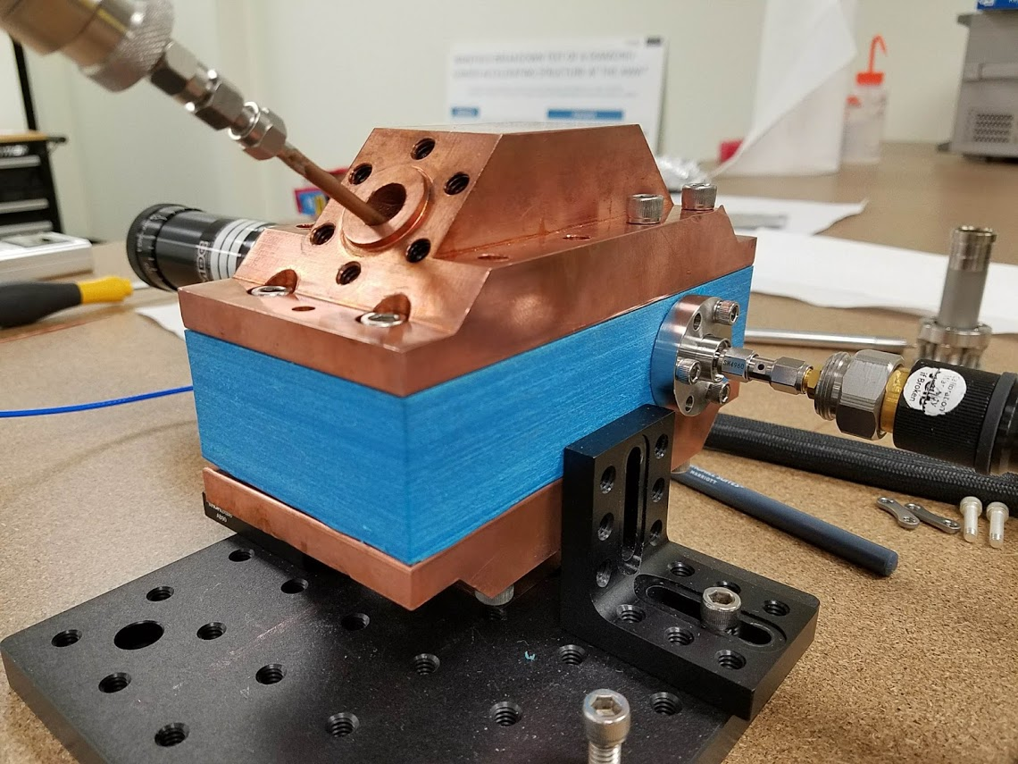
Bench testing
Measurement at the AWA-ACT?

Slide 20
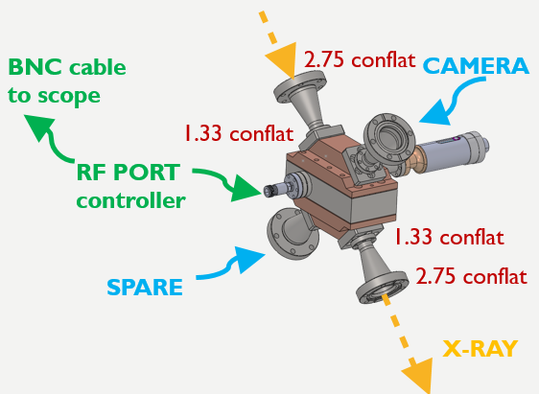
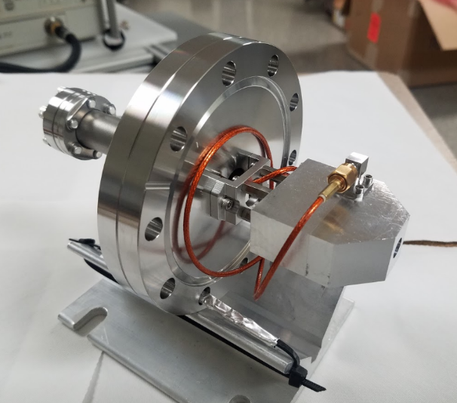
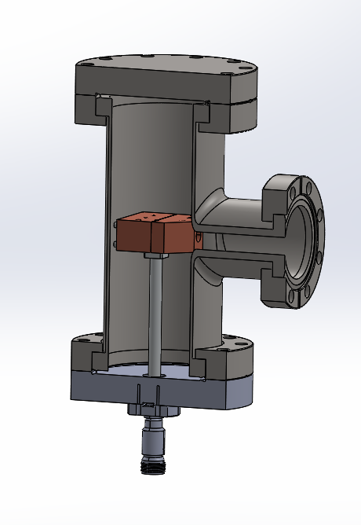
Testing at the AWA: two options
“Baby” resonator ~ Faraday Cup
Simple, easy
End of beamline
Available in UHV configuration
X-ray resonator
More involved,
Dedicated installation (blocking beam)
Flourescence + beam measurement = publication – worthy
Ready in split block form

Slide 21
Summary
Acknowledgement
Beam measurement via resonator detuning
Faraday cup configuration
BPM + charge measurement
Scanning for halo measurement
Funded by DOE SBIR Phase I
AWA Staff
My group at Euclid:
Sergey Kuzikov
Pavel Avrakhov
Edgar Gomez
Ed Dosov
Ernie Knight
Collaborator
Alexander Vikharev IAP (Russia)

