Slide 1
An Iris Diaphragm Beam Halo and Profile Detector
Ao Liu, on behalf of the project workforce,
Euclid Techlabs, LLC
Project funded by DOE SBIR program under contract DE-SC0019538

Slide 2
Outline
Motivations and introductions
Concept of the iris diaphragm detector
Design of the system
Test results at the AWA ACT beamline
Next steps

Slide 3
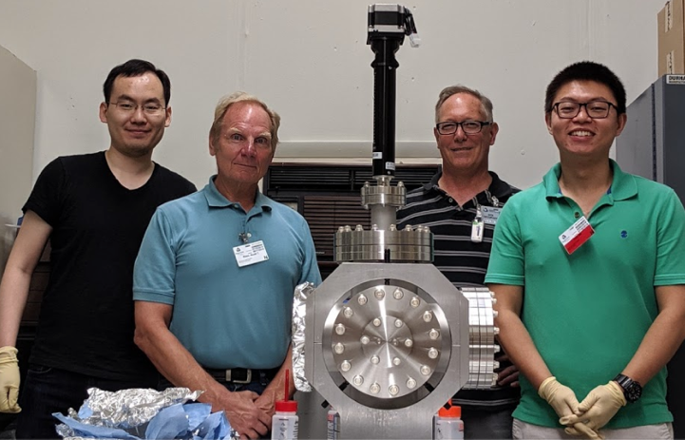
First things first
Sincere thanks to all AWA personnel for helping in accommodating, assembling, scheduling and conducting the 2-day experiment:
Special thanks to Jiahang Shao, Eric Wisniewski and Wanming Liu for their hard hands-on work and providing useful tools, even during the weekend.

Slide 4
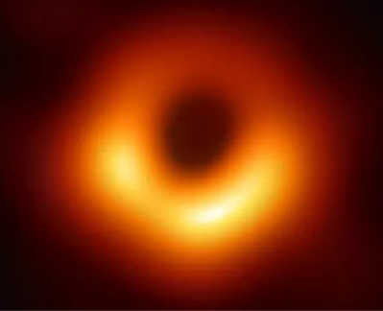
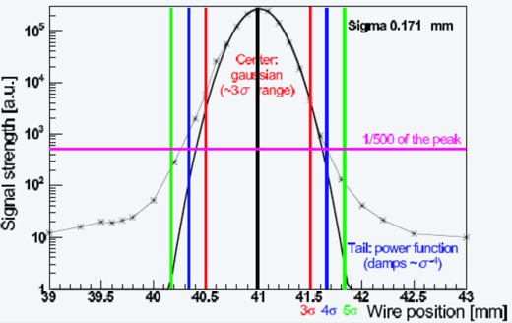
Motivations
Beam halo is an unwanted component of the beam distribution that
Occupies typically outer and larger space of the beam core;
Leads to potential beam loss in an undesired manner;
Exists in both transverse and longitudinal distributions;
Has an “arbitrary” definition: non-Gaussian distribution up to a certain cut-off.
Image: Event Horizon Telescope
Not necessarily like this!
More like this!
Beam halo-induced hazard examples:
Beam loss in undulators: change field of permanent magnets (such as LCLS-II)
Residual activation in a proton machine (such as Main Injector of Fermilab)
Need a good monitoring method to control loss!
Image: IHEP ATF

Slide 5
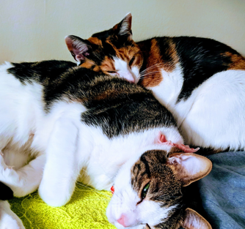
Halo background knowledge
Halo structures can be formed by
Dark current formed in RF cavities;
Beam-gas coulomb scattering, Intra-beam scattering, Bremsstrahlung, etc.
Halo accompanies the beam core and some have similar energy as the core (also no clear boundary)
Depends on formation mechanism
Beam halo structures have been measured with various kinds of techniques
Wire scanner;
Gas jet monitor;
Synchrotron radiation light + Digital Micromirror Array mask; light + charge injector device (CID); Beam loss monitor;
Image: Event Horizon Telescope
Halo
Core
Invasive to
Non-invasive

Slide 6
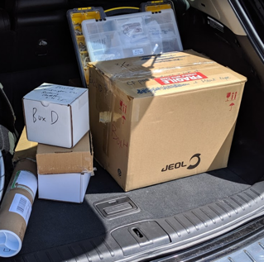
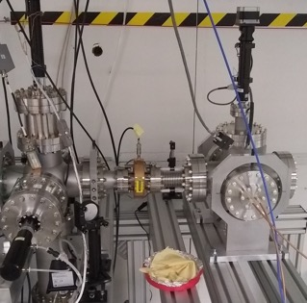
Concept of the iris diaphragm detector
Now, imagine…
A halo detector that allows the user to freely control the degree of “invasion”
and works as a beam profile monitor
and works as an adjustable collimator
Version alpha
before and after assembly
and is compact enough to fit in the trunk

Slide 7
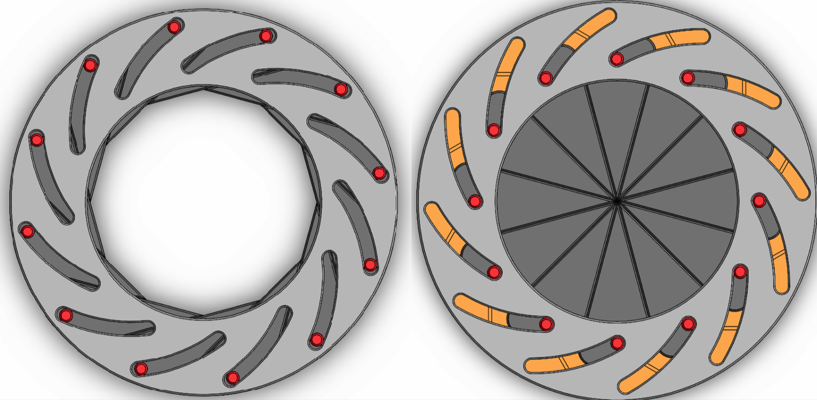
Inspiration and challenges
The iris diaphragm detector was inspired by
An actual iris diaphragm for the camera lenses!
The counter geometrical structure for a halo is a hollow aperture
Great! So what are the challenges?
Q: How to obtain signals? A: The most direct measurement of the charge: collect and output current.
Q: OK, how to address the beam-invasion problem? A: The iris opens to be non-invasive, closes to be invasive.
Q: How do you control it? A: Using a UHV-compatible linear actuator or piezoelectric actuator (depending on the travel and accuracy needed)
Q: How many iris blades needed? A: Customizable, depends on how finely the distribution needs to be mapped.
Q: How are signals between blades isolated? A: Ceramic or non-conductive coating

Slide 8
Version alpha
Version alpha enables the proof-of-principle tests of the concepts that the full-version of iris diaphragm detector is built upon.
The design was done to accomplish tests for:
~ 1 MeV electron beam bombarding the iris blades at various thickness made of different materials, i.e. different stopping power: penetrating or fully stopping;
Current signal extraction from the blades using coax cables;
Ceramic insulation of signals from conductors;
Vacuum compatibility of cables, actuators, ceramics at low-UHV;
Demonstrate the low-cost, high-mobility, simple-configuration compact design
Fit the whole apparatus in one 6” CF six-way cross.
It could be even smaller if without YaG screen to see where the beam is!

Slide 9
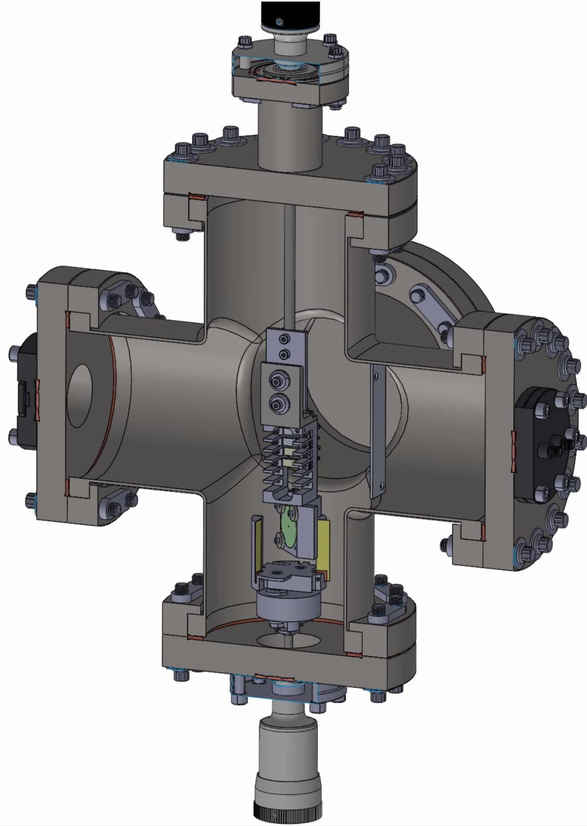
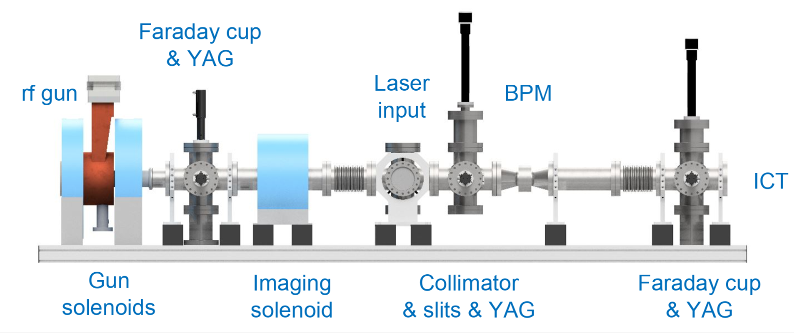
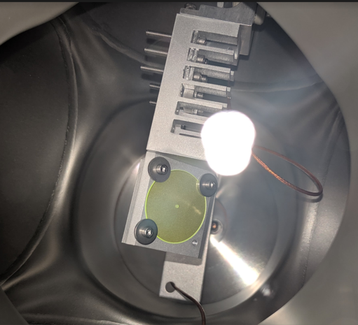
Version alpha details
Connect after
ICT
here
YaG and W
holder insulated
from adapter
YaG
Cable guide
contactor
insulated
from
holder
contactor
(mounts to rotary feedthru)

Slide 10
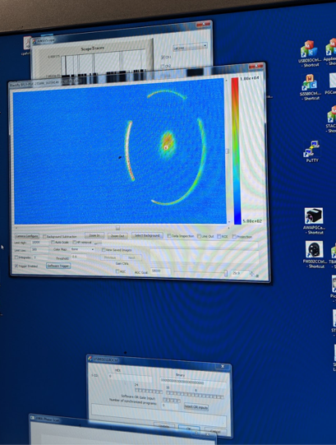
Version alpha tests at ACT
Honored to be the first beam-based physics experiment (other than testing the beam generation itself) ever done on ACT!
During the precious two-day time window, all the test objectives were accomplished
Some difficulties were encountered: laser instability due to pending upgrade; beam position and intensity instability; energy uncertainty.
Additions of more beam diagnostics and manipulation, e.g. spectrometer, quads, correctors, apertures, etc. on the ACT will be of great help to open up more opportunities to many more physics experiments!

Slide 11
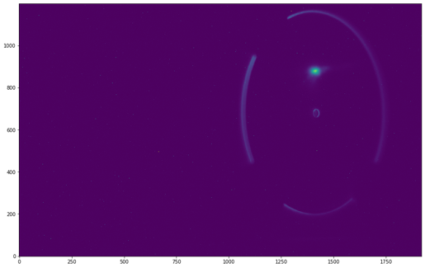
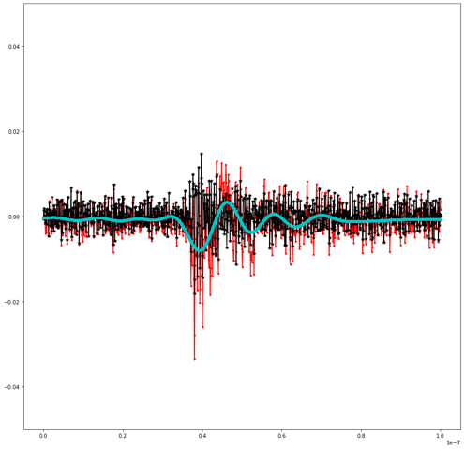
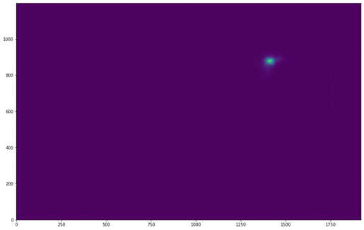
Data analysis for version alpha tests
Filter out YaG screen edge and use integrated beam brightness on YaG when beam is too weak to be sensed by ICT;
Apply LP and HP signal filters on the blade holder signal to extract the relative beam current strength

Slide 12
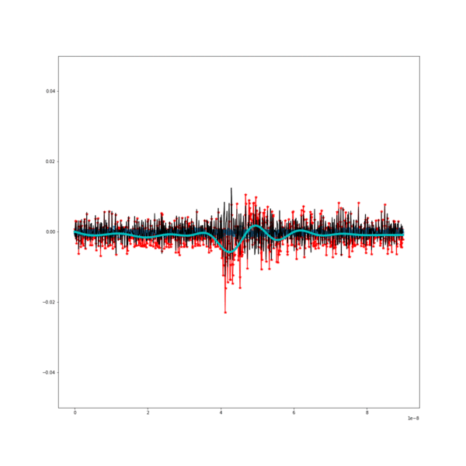
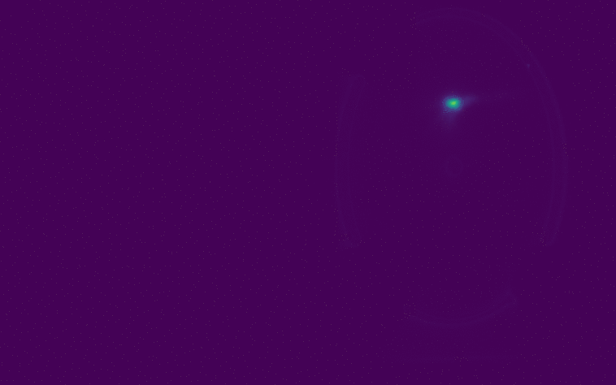
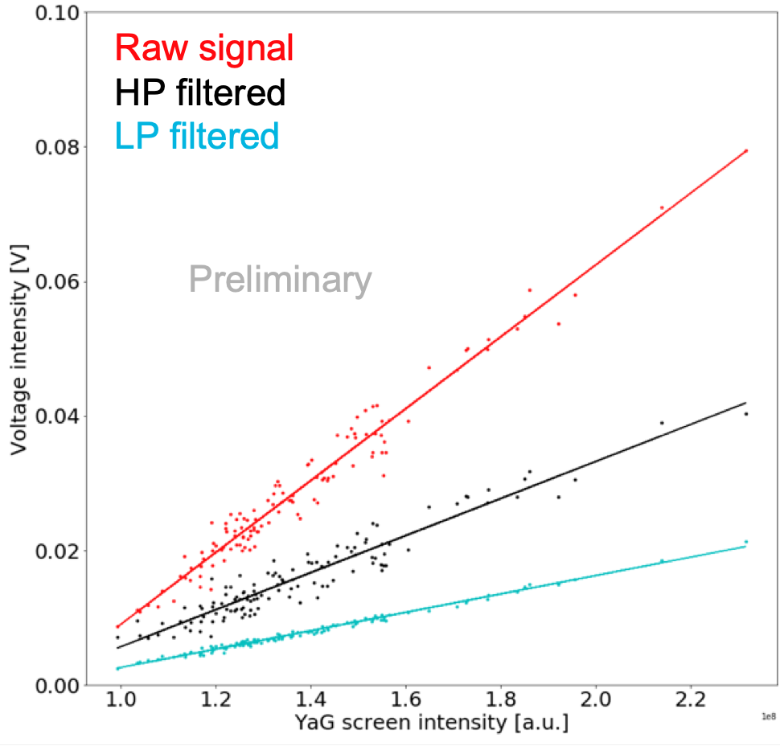
Data analysis preliminary results – low intensity no ICT
Data group 1: ACT aperture in, beam position more stable but intensity weaker; ICT signal too weak.
LP-filtered signal is the most robust against noises, but all three signals show dependence on intensity

Slide 13
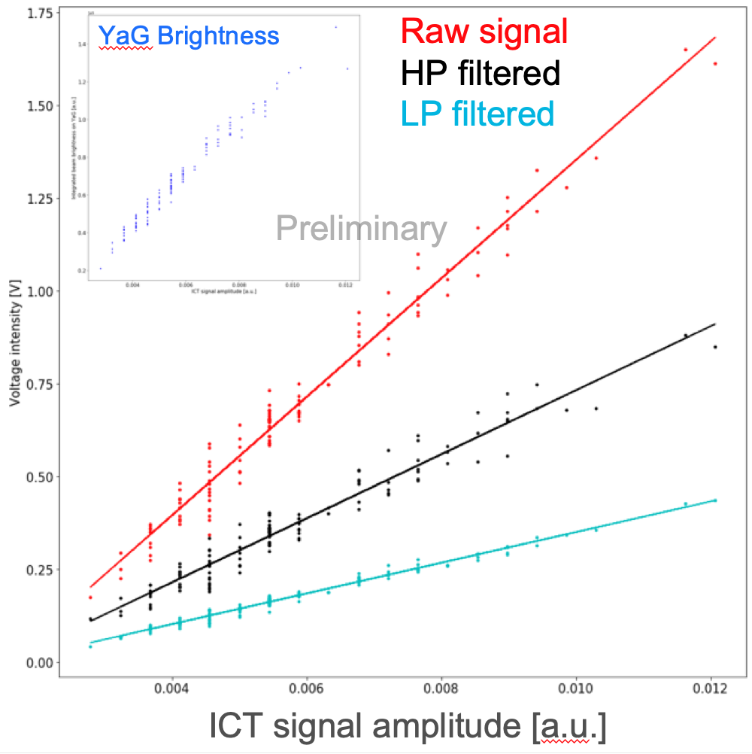
Preliminary analysis results – high intensity with ICT
Holder
Contactor
Data group 2: ACT aperture out, beam position less stable but intensity stronger; ICT signal available, using YaG as the collector
Measured both the holder and contactor (not touching) at the same time: LP filtered contactor signal is less affected by the noise

Slide 14
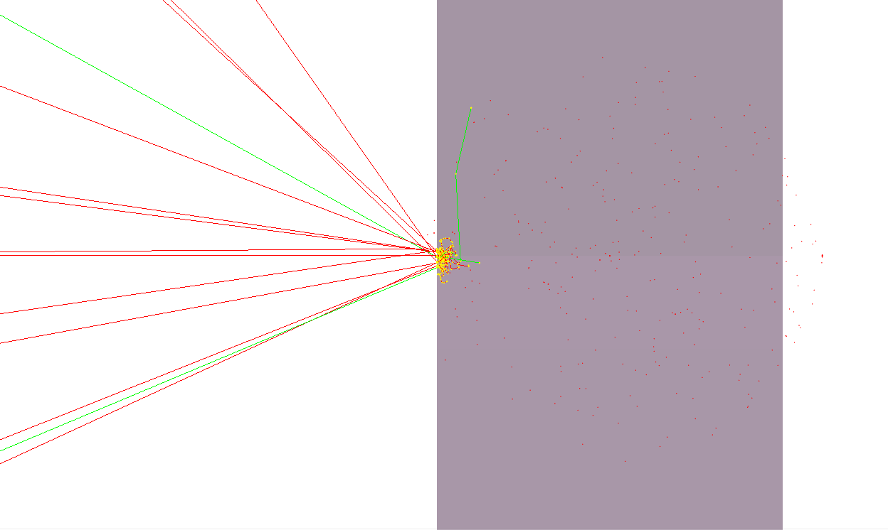
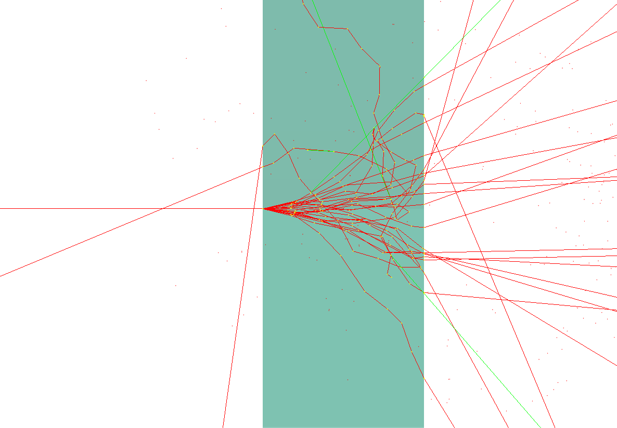
High intensity with ICT cont’d – theoretical charge deposition
Electron deposition pattern in Tungsten, left, and Aluminum, right (1.5 MeV incident e⁻)

Slide 15
High intensity with ICT cont’d – data for different blades
Clear signal strength difference from two stacks of metal plates: different stopping power;
Beam does not need to be fully stopped in the blade;
Noise removal continued to be effective by doing LP filtering.

Slide 16
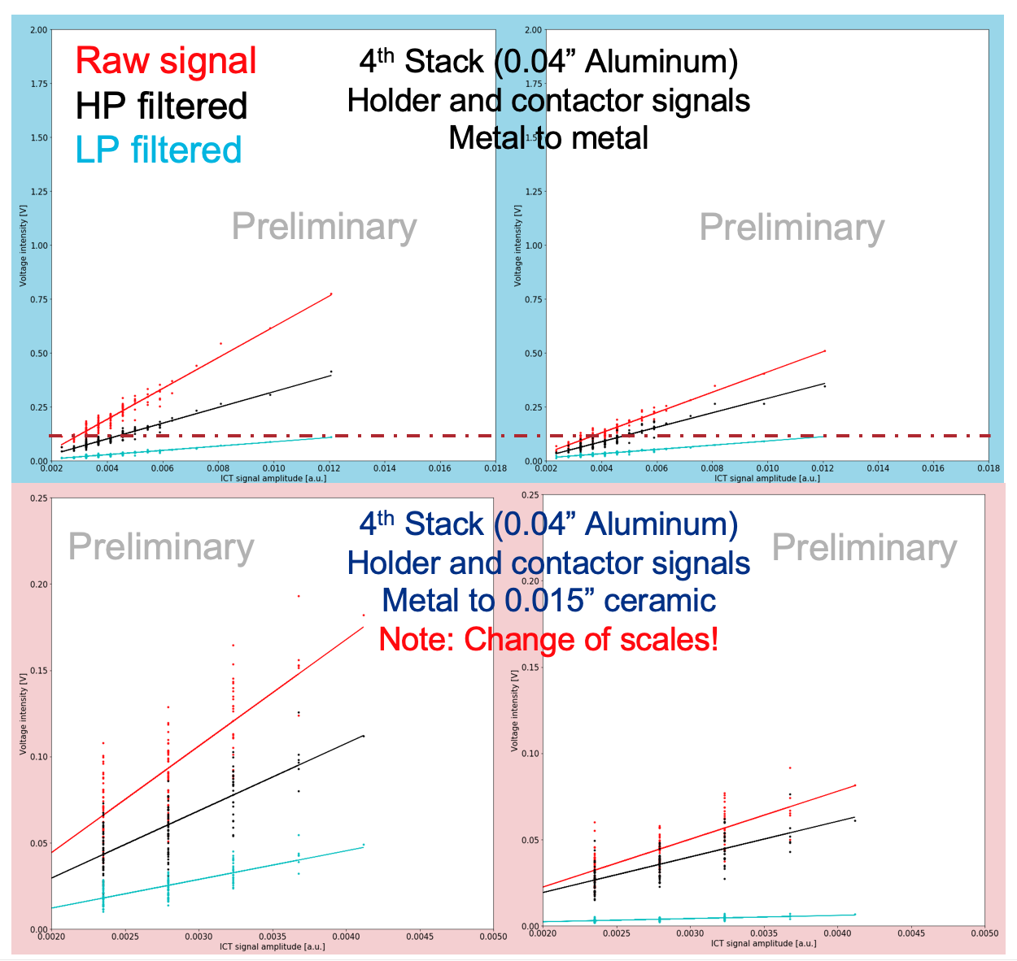
Ceramic insulation
Beam intensity dropped down at the later stage of the data-taking, ICT strength almost faded away.
However,
The LP filtered signal from the contactor indicates it drew ignorable current from the holder. i.e. signals do not cross-talk.
In the full-version, ceramic thickness can be increased to further eliminate cross-talk.

Slide 17
Version beta (finalizing design and to be fabricated)

Slide 18
Thank you!
Looking forward to do more systematic studies at AWA in Phase II !
Euclid Techlabs:
Scott Ross
Chunguang Jing
Alexei Kanareykin
Yubin Zhao
AWA:
Jiahang Shao
Eric Wisniewski
Wanming Liu
Gwanghui Ha
Manoel Conde
John Power
Scott Doran

