Slide 1

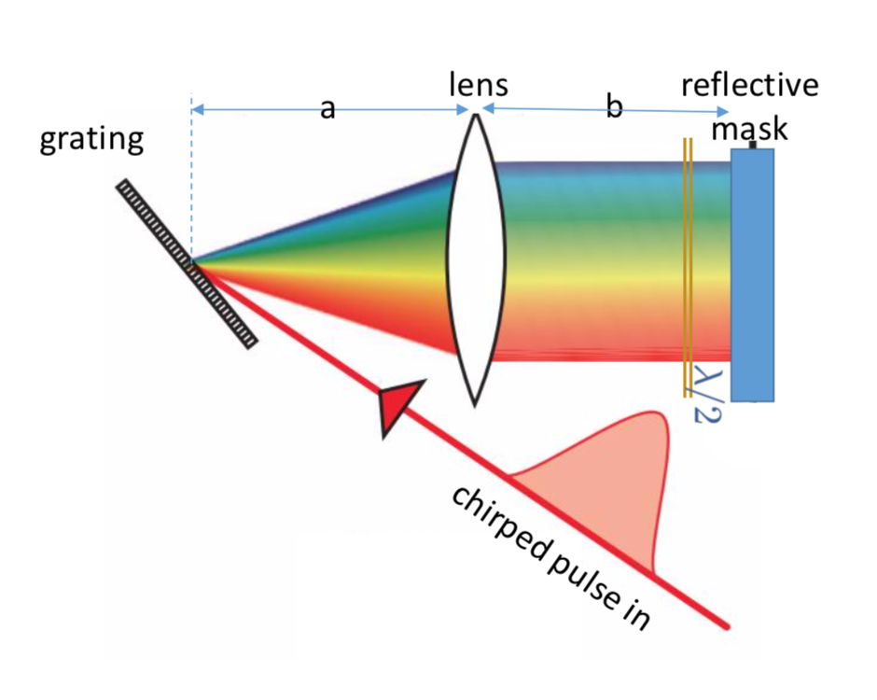
Ultrashort Laser Pulse Shaping and Characterization for Tailored Electron Bunch Generation
AWANOW
drhgfdjhngngfmhgmghmghjmghfmf
Tianzhe Xu
Northern Illinois University
08/22/19
Lemont, IL

Slide 2
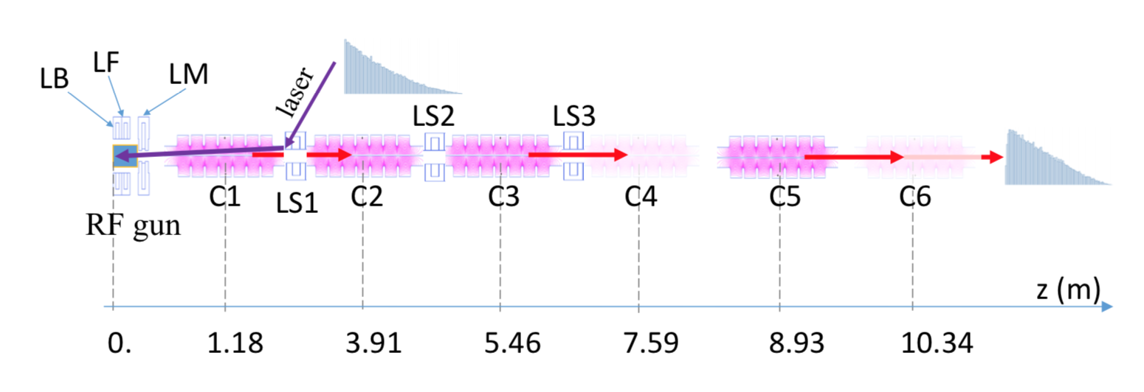
Photocathode Laser Shaping
AWA beamline (drive)
Ability to generate longitudinally ramped electron bunches right out of photoinjector
Ample flexibility and great simplicity
Can be combined with DEEX and other shaping methods
Laser Pulse Shaping
Electron Beam Dynamics
Laser Pulse Measurement
Electron Beam Measurement

Slide 3
Pulse SHaping

Slide 4
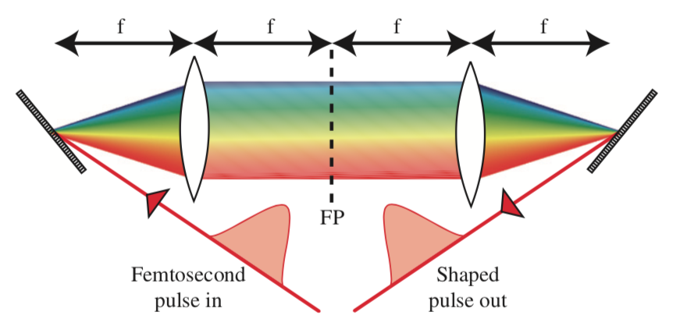


Shaping a chirped pulse
Disperse spectral components with grating
Spectral components are spatially separated
A digital mask is placed in the Fourier Plane (FP) to modulate the phase/amplitude of different spectral components
Linearly chirped pulse: a linear correlation between $t−ω$ components
Easier for spectral mask design
$${\tilde{E}}_{out}\left(ω\right)=M(ω){\tilde{E}}_{in}(ω)$$

Slide 5
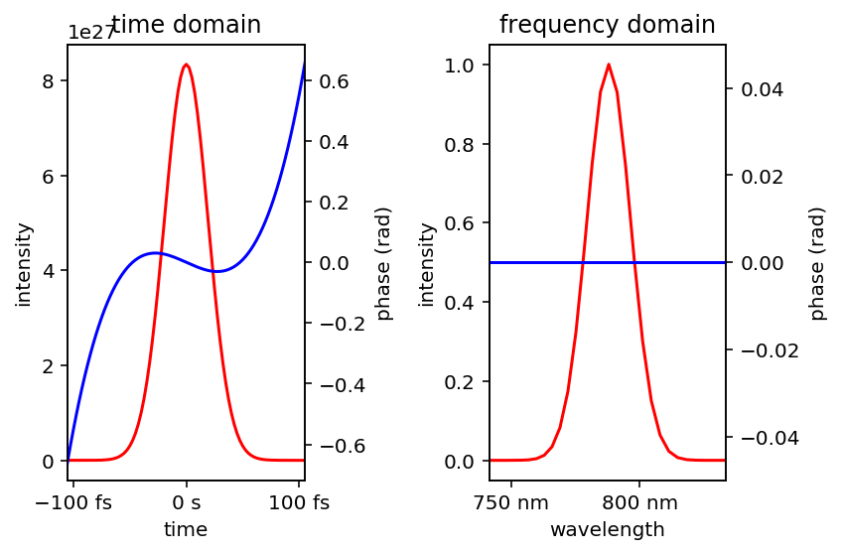
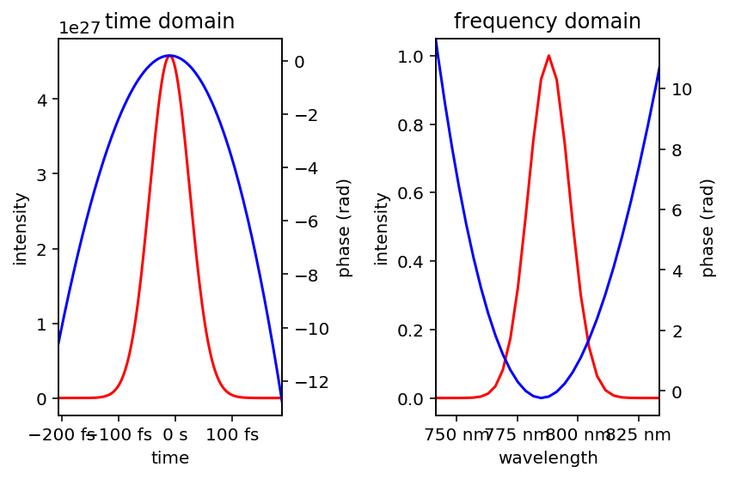
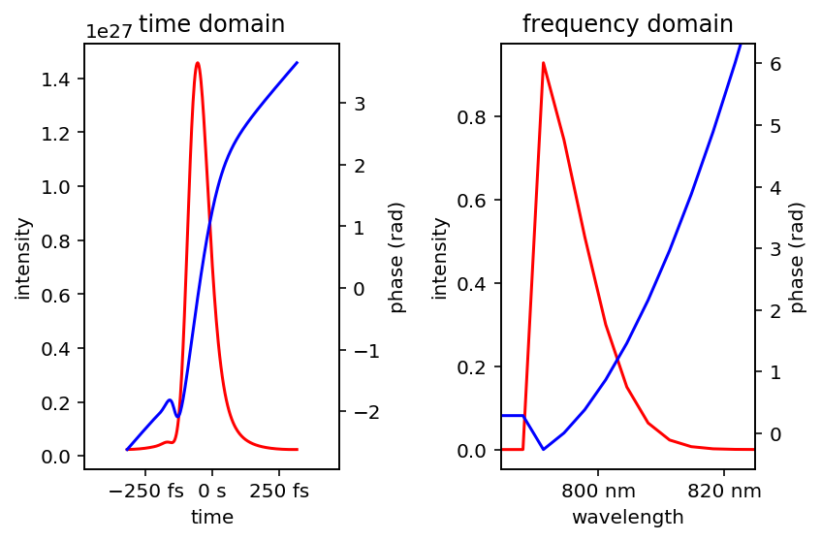
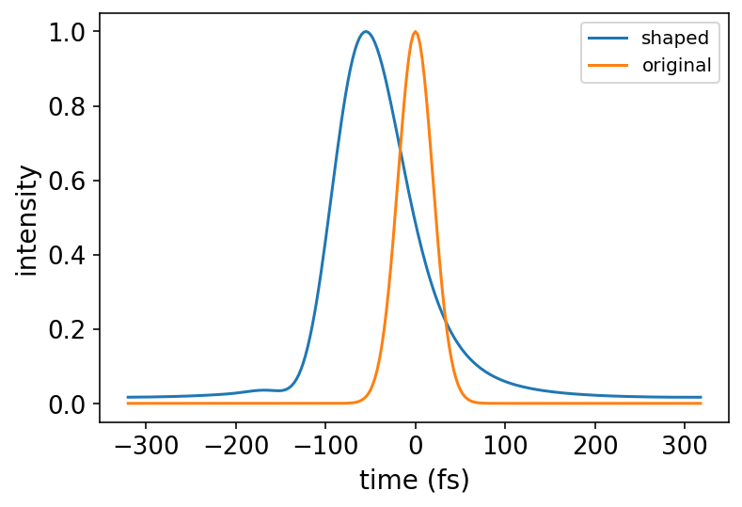
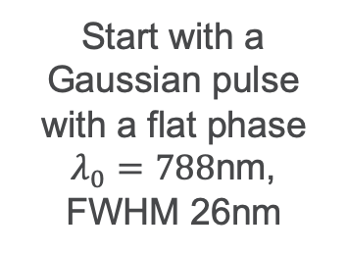
Shaping In the Frequency Domain
Start with a Gaussian pulse with a flat phase
$λ_{0}=788$nm, FWHM 26nm
Introduce the chirp
(2cm BK7 glass,
chirp not exactly linear)
Shape spectrally with a digital mask
(Heaviside function)

Slide 6
Pulse characterization

Slide 7

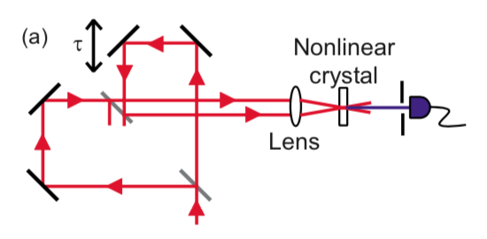
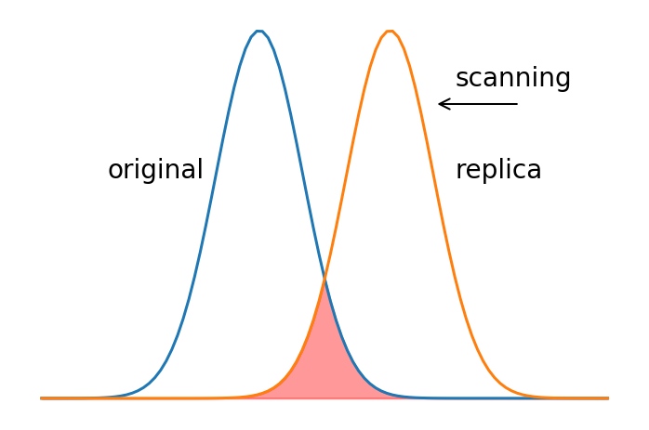
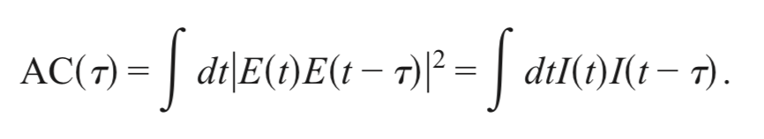
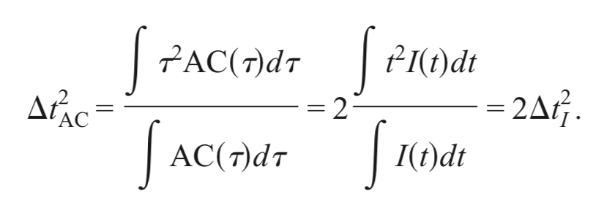
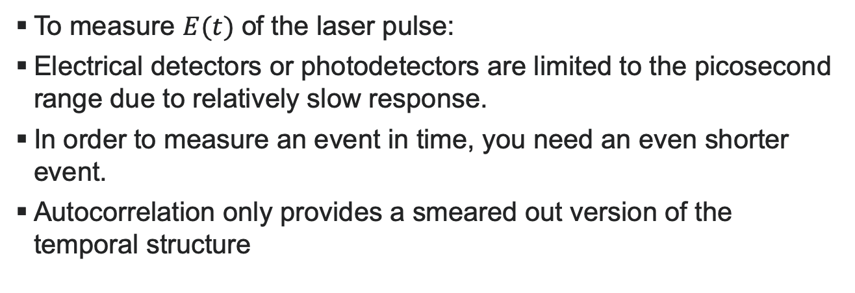
Intensity Autocorrelation
To measure $E(t)$ of the laser pulse:
Electrical detectors or photodetectors are limited to the picosecond range due to relatively slow response.
In order to measure an event in time, you need an even shorter event.
Autocorrelation only provides a smeared out version of the temporal structure
RMS pulse duration given by:
Notes:
Different from Interferometric autocorrelation

Slide 8
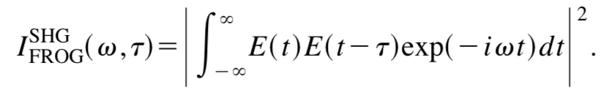
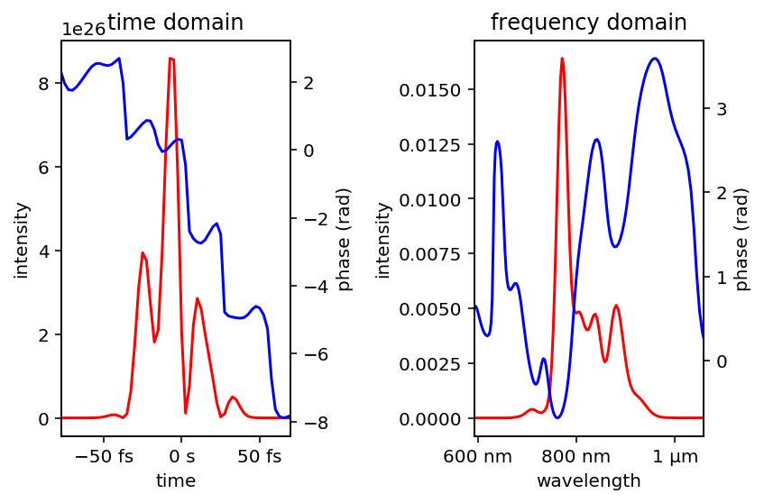
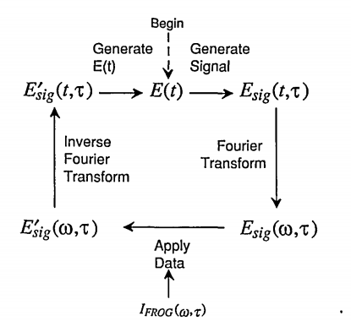
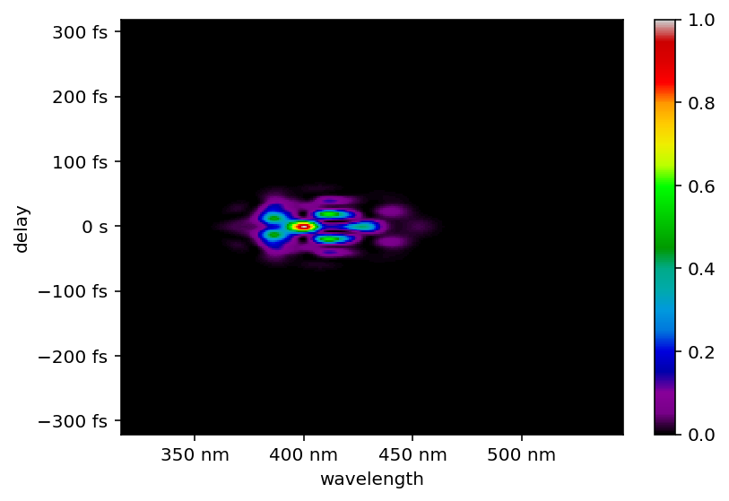

Frequency-Resolved Optical Gating (FROG)
FROG simply involves spectrally resolving the signal beam of an autocorrelation measurement.
SHG-FROG trace of a randomly generated pulse

Slide 9
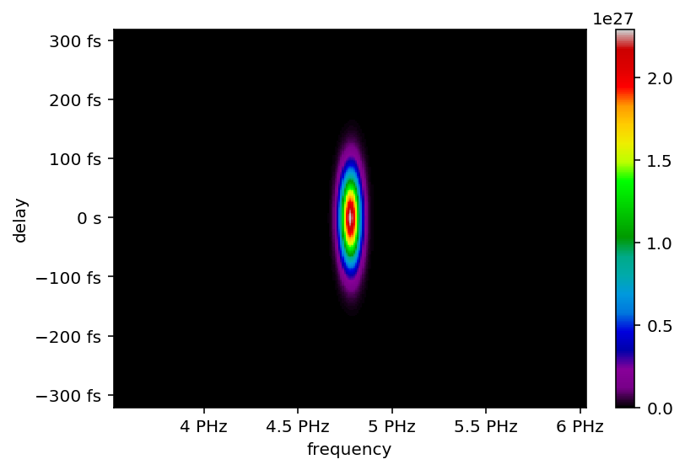
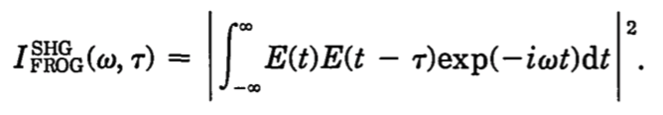
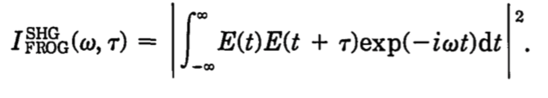
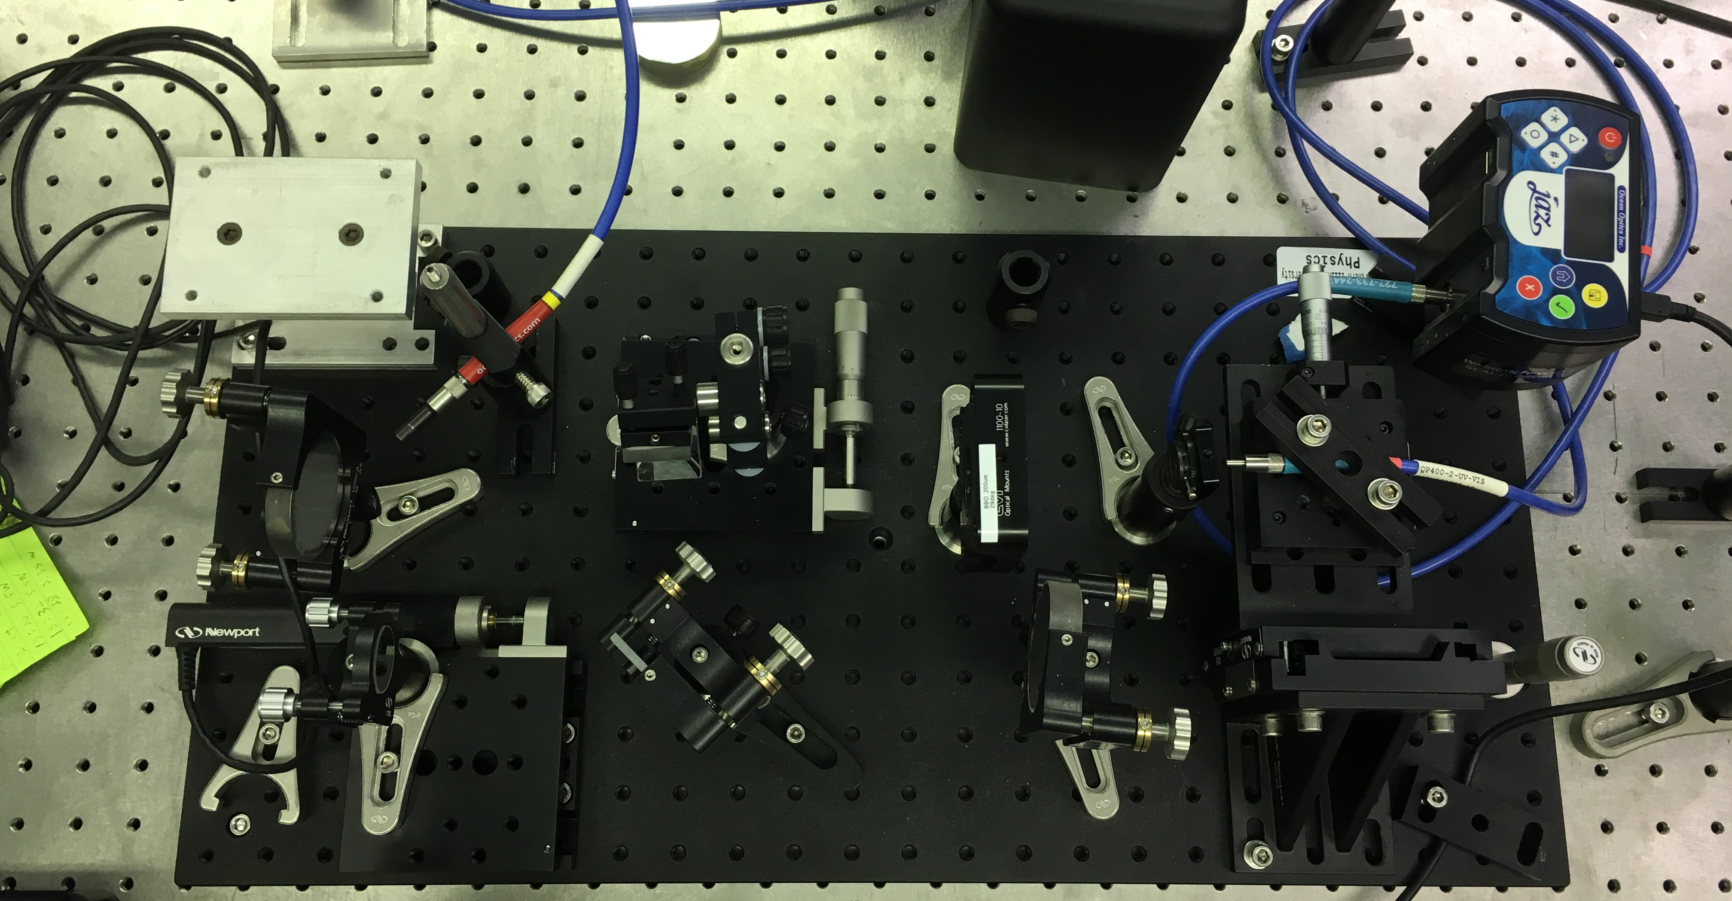

SHG-FROG diagnostics at AWA
Symmetric
FROG trace!
A change of variable $t^{′}=t−τ$
Spectrometer
Autocorrelator
Next step:
PG-FROG
needed after the compressor
to characterize the chirp

Slide 10
Layout (Laser, shaper and FROG)

Slide 11
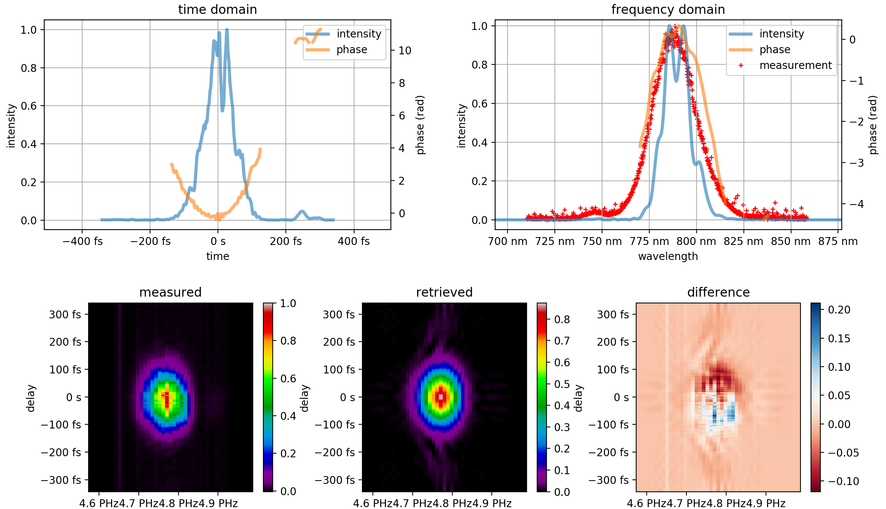



Retrieved Pulse from FROG
FWHM ~ 82 fs
$$ω$$
$$ω$$
$$ω$$

Slide 12
BEAM DYNAMICS of tailored BUNCHES

Slide 13
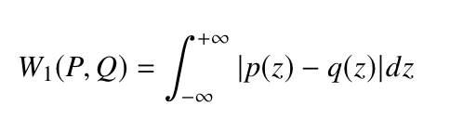
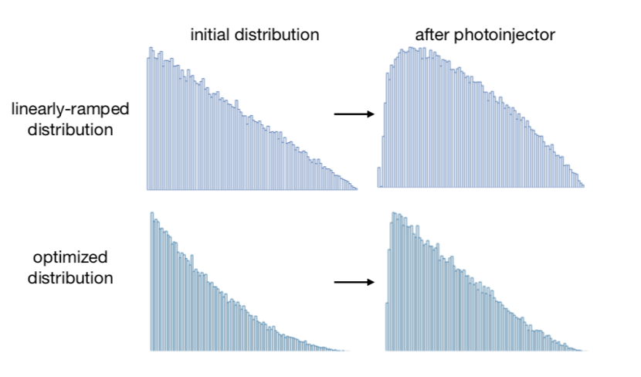
Pre-compensation of initial bunch shapes
Wasserstein distance:
for a quantitative comparison of simulated and target bunch shapes
Then perform multi-objective (shape, emittance) optimization in IMPACT-T

Slide 14
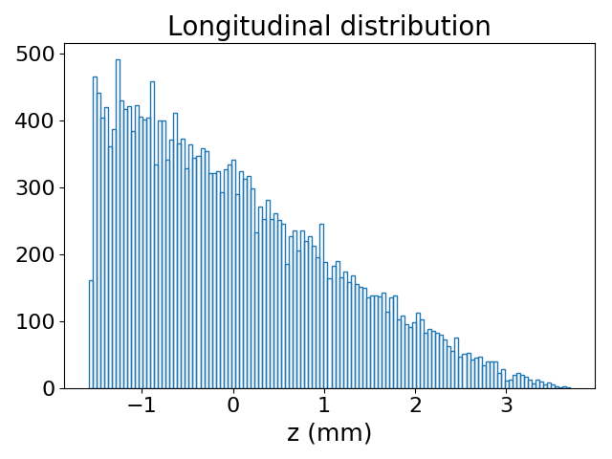
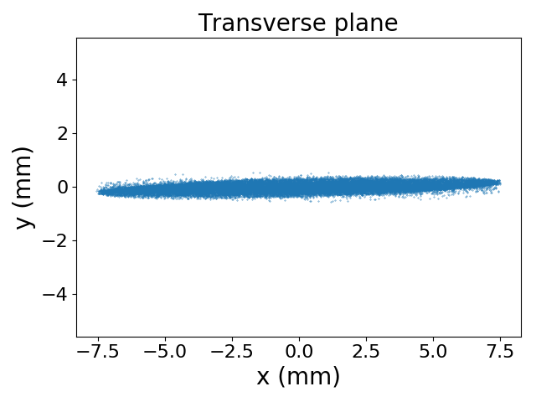
Transversely Flat and Longitudinal Shaped Beam for High-Efficiency Wakefield Acceleration
IMPACT-T simulation of a 1nC bunch
Longitudinal Ramped Bunch
Higher Transformer Ratio
Transversely Flat Bunch
Transverse Wakefield Suppression

Slide 15
LONGITUDINAL PROFILE MEASUREMENTS

Slide 16
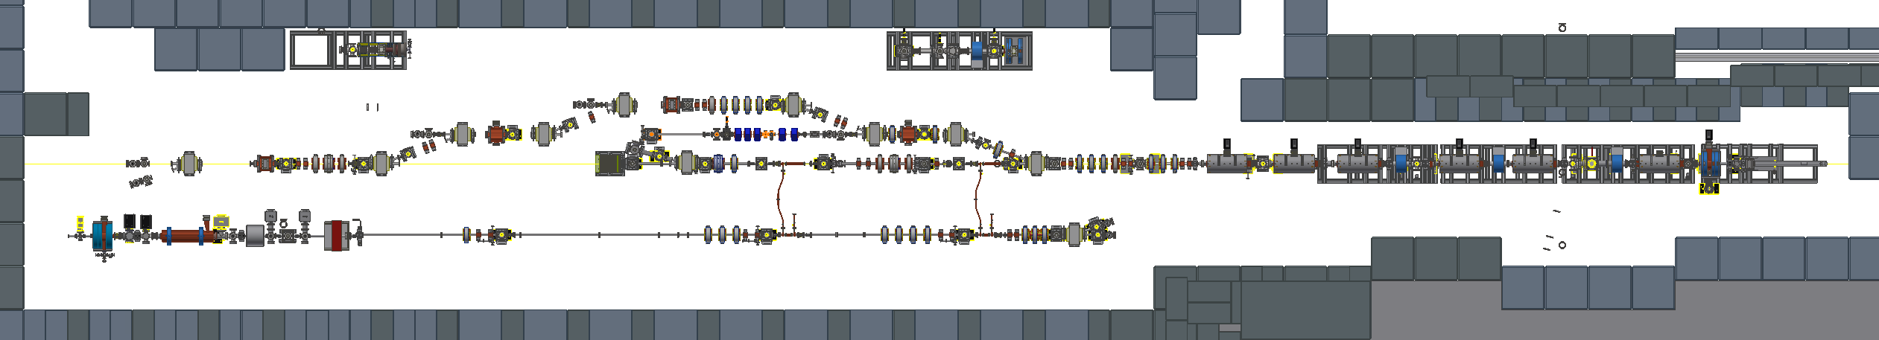
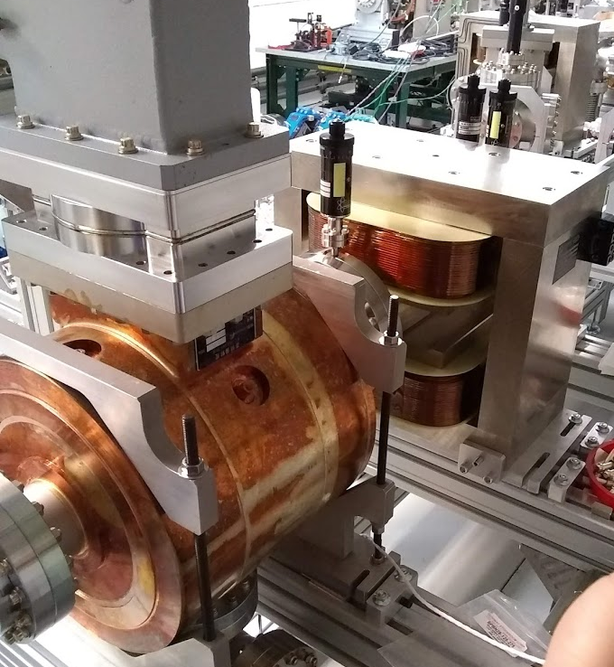
Longitudinal Profile Measurement at AWA
Shaper, SHG-FROG
Laser room
TDC
PG-FROG(for UV), Compressor, Tripler

Slide 17
Future Work
2019
  PG-FROG for full characterization of UV pulse
  Laser shaper set-up with SLM or DMD
2020
  Longitudinal profile measurement of shaped beam
  Flat beam + Laser shaping

Slide 18
Acknowledgements
Philippe Piot (NIU& ANL)
Nils C. Geib (University of Jena)
John Power, Manoel Conde, Wanming Liu, Scott Doran, Gwanghui Ha, Eric Wisniewski, Jiahang Shao, Charles Whiteford (AWA)

Slide 19
Thanks For your ATTENtion

Slide 20
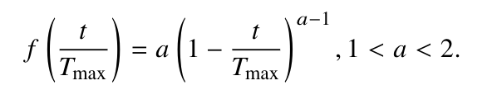
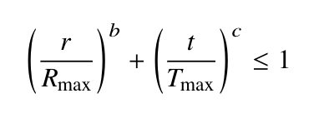
Spatio-temporal shaping
Temporal distribution:
Spatio-temporal correlation:
Initial laser x-z distribution
final bunch (3nC) x-z distribution

