Slide 1
EUCLID/AWA COLLABORATIVE WORK ON ADVANCED WAKEFIELD ACCELERATOR DEVELOPMENT
Alexei Kanareykin,
Euclid Techlabs LLC
On behalf of Euclid Techlabs/AWA collaboration
AWA Needs and Opportunities Workshop
August 21-23, 2019, Argonne National Lan, Lemont IL

Slide 2

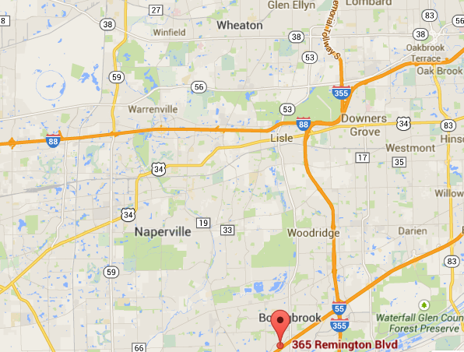
Euclid Techlabs LLC
Euclid TechLabs LLC, founded in 1999 is a company specializing in the development of advanced materials and new designs for beam physics and high power/high frequency applications. Additional areas of expertise include dielectric structure based accelerators, pulsed electron microscopy, and "smart" materials technology and applications.
Fermilab
IARC
2 offices: Bolingbrook, IL (lab) and Gaithersburg MD (administrative).
Tight collaborations with National Labs: Argonne, Fermi, CERN, BNL, JLab.
Actively participate in Accelerator Stewardship DOE Program
Euclid Techlabs
Argonne
www.euclidtechlabs.com

Slide 3
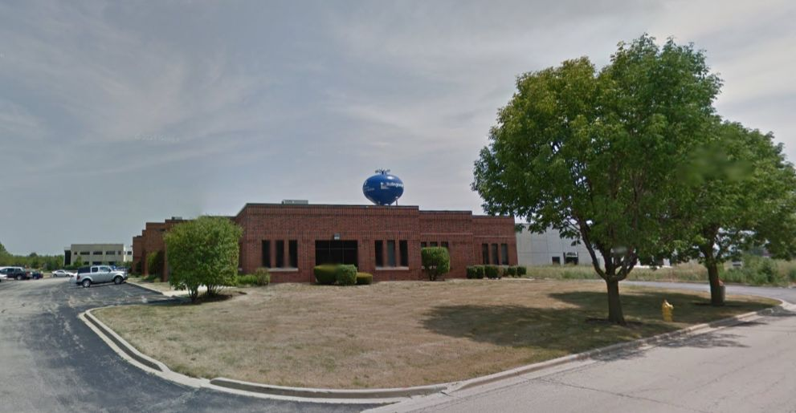
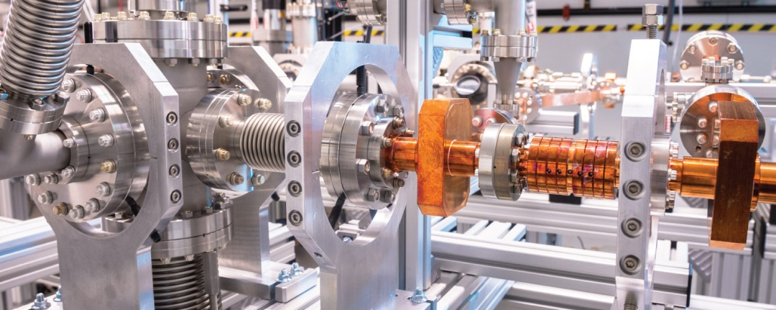
LAB FACILITY IN BOLINGBROOK IL
Compact electron accelerator test facility (bunker)
Time resolved TEM beamline
Clean room/magnetron sputtering (TiN, copper, dielectrics)
Field Emission cathode DC test stand
Femtosec laser
RF lab
…other beam physics related equipment - www.beamphysics.com
15 PhDs,
22 staff total
11,000 sq ft - total
2,000 sq ft – office
9,000 sq ft - lab
2 locations: Chicago IL and Maryland/DC
ANL/AWA accelerator, ANL/CNM - cathodes, ANL/APS- diamond based X-ray optics
Jlab and Fermi: SRF tests

Slide 4
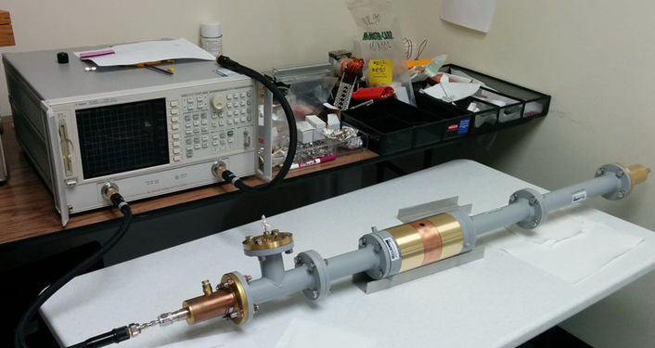
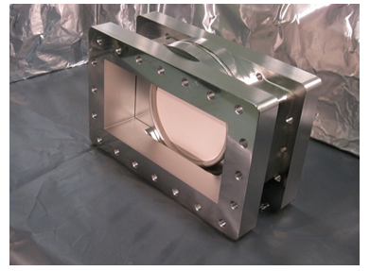
Key Euclid’s technologies:
Ultra-compact low energy accelerator (dielectric based)
Stroboscopic pulser for Transmission Electron Microscope
Electron guns for accelerators: Photo-, thermo-,
field emission (FE)- and (new !) SRF guns.
Ferroelectric based fast tuner.
UNCD based FE cathodes.
Accelerator components (RF windows, couplers…)
Other beam physics instrumentation.
5 GHz kicker for TEM, BES/NIST
Fast ferroelectric 400 MHz tuner successfully tested at CERN
L-band RF window
for AWA ANL

Slide 5

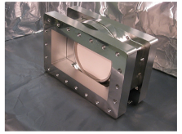
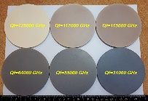
How we collaborate ?
AWA/Euclid, funded by HEP/SBIR
Ideas, Projects, Proposals
Beam test,
High power,
Paper…
Materials,
Technology
Design,
Prototype
Fabrication,
Cold Test
Commercialization ?
Other project funded by
HEP, BES, NP, NIH, DHS …
Product ? Never directly … HEP is fundamental science !

Slide 6
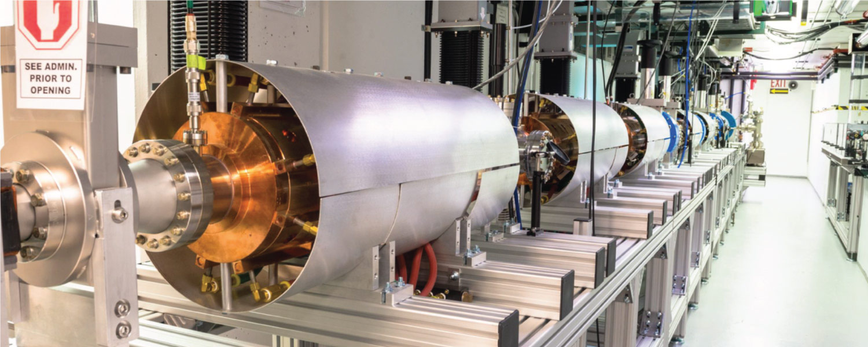
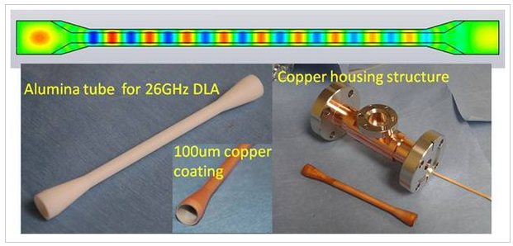
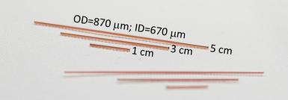
History: Research on Dielectric Wakefield Accelerating structures, since 2001
designs: 7-26 GHz
scalable to THz
Experiments with DWFA were done by Euclid Techlabs at Argonne,
Externally powered dielectric structure: Naval Research Lab
Brookhaven, SLAC

Slide 7
Transformer Ratio Enhancement for Collinear Wakefields
Scheme I---Single
Triangular Bunch
Reference: Bane et. al., IEEE Trans. Nucl. Sci. NS-32, 3524 (1985)
Scheme II---Ramped
Bunch Train
W
+
ρ
(z)
TR=3.4
z
W
-
d
d
d
Reference: Schutt et. al., Nor Ambred, Armenia, (1989)
Theory
Experiment
C. Jing et al., PRAB 14, 021302 (2011)
B. Jiang et al., PRAB 15, 011301 (2012)
K. L. F. Bane, SLAC-PUB-3662 (1985)
V.Tsakanov, EPAC 88), Rome, Italy, 1988, 1040

Slide 8
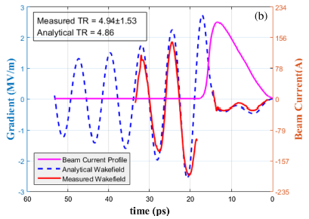
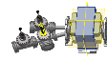



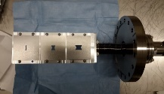
Highest Measured Transformer Ratio
R @ 122 GHz
4.65 (measured)
4.51 (wake fcn)
R @ 131 GHz
4.94 (measured)
4.86 (wake fcn)
Train
Triangle
Rectangle
Trapezoid
z
z
z
z
5 nC / 48 MeV
y
y
y
y
AWA Group, C.Jing of Euclid Techlabs
Train
Triangle
Rectangle
Trapezoid
Q. Gao et al., PRL 120, 114801 (2018)

Slide 9
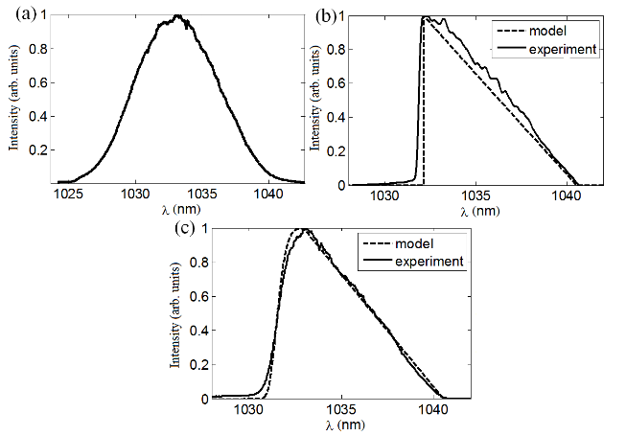
Laser Pulse Shaping Method for TR Increase
The method that relies on the extraction of shaped bunches directly from the photocathode of a photoinjector, where it provides full flexibility of bunch shape in the transverse bunch particle distribution as well.
SBIR HEP, 2018
F. Lemery and P. Piot. Phys. Rev. Accel. Beams 18, 081301 (2015).
Configuration used for the pulse-shaping simulations using a S-band rf gun (a). A temporally shaped laser pulse (b) is optimized to result in a photoemitted electron-beam with current profile (c).
I Kuzmin, …A.Kanareykin et al. Laser Physics Letters, V.16, N1, 2018
A.Kanareykin, AAC’2018, Breckenridge, CO, 12-17 August 2018

Slide 10
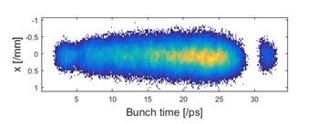
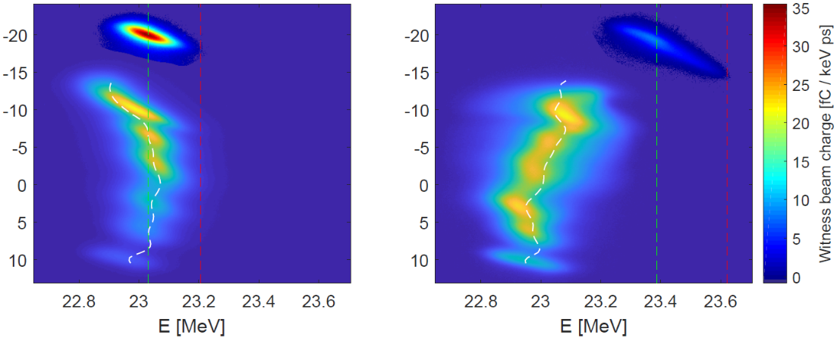
Laser Pulse Shaping Method for TR Increase,, DESY, Zeuthen, Germany
G. Loisch et al. NIM-A, 2018
To achieve flexible temporal shaping of the laser pulse a Šolc fan filter type of configuration was employed. In the PITZ laser pulse shaper the initial 0.7 ps long (RMS) Gaussian laser pulse is split into 14 quasi-pulses that are individually delayed and coherently added to form a longitudinal laser profile of tunable shape and a length of 20 ps (measured as the delay between first and last pulses.
Time [ps]
No Plasma
n_{p} ~ 2x10¹³ cm⁻³
TR=4.6
→ G. Loisch et al., Phys. Rev. Lett. 121, 064801 (2018)

Slide 11
What is next?
Gwanghui Ha. Talk at AAC, 2018.
AWA activities for high transformer ratio
Transformer ratio
EEX shaping
demonstration
Triangular, DWFA, 10
Triangular, DWFA, 5
CWA demo module
with R=5
RBT, DWFA, 3.4
RBT, DWFA, First demo
Triangular, PWFA, 6, 100 MeV/m
Triangular, DWFA, 3.5
2008
2013
2018
2023
2028

Slide 12
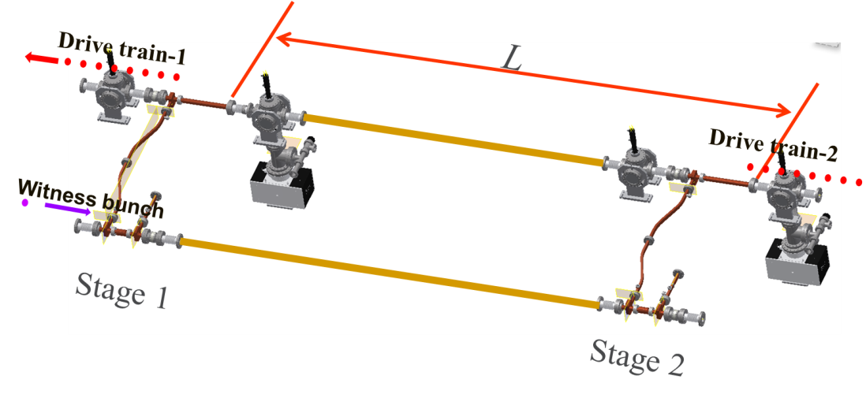
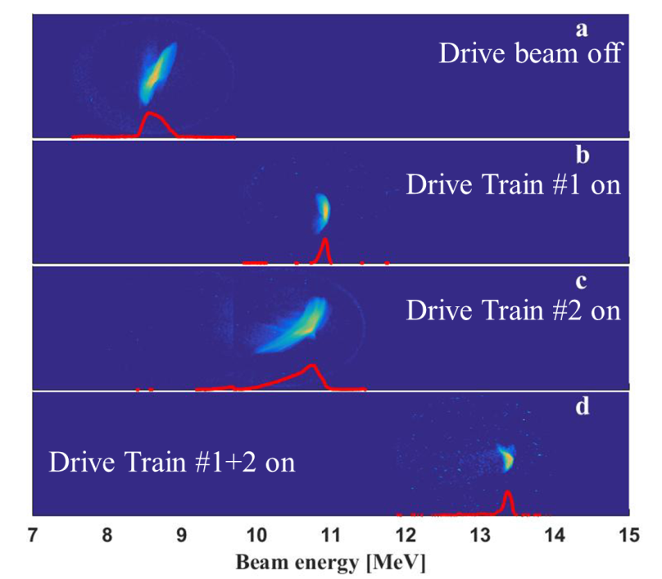
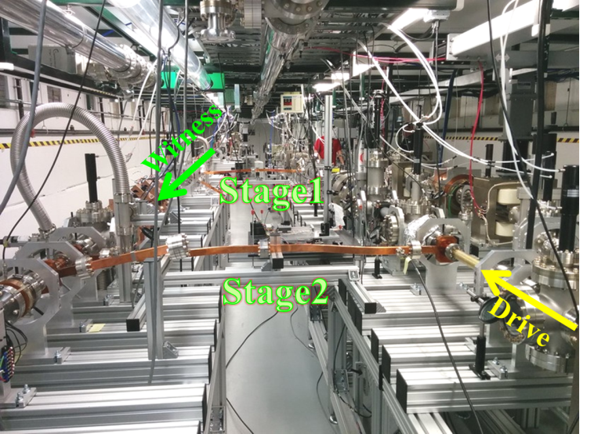
Staging Demonstration at AWA (2017)
11.7 GHz metallic iris loaded structures
70 MeV/m
C. Jing et al., Nucl. Instr. Meth. in Phy. Res. A 898, 72-76 (2018)

Slide 13
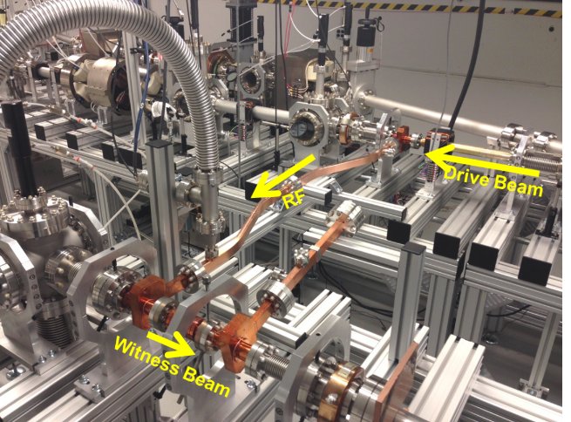
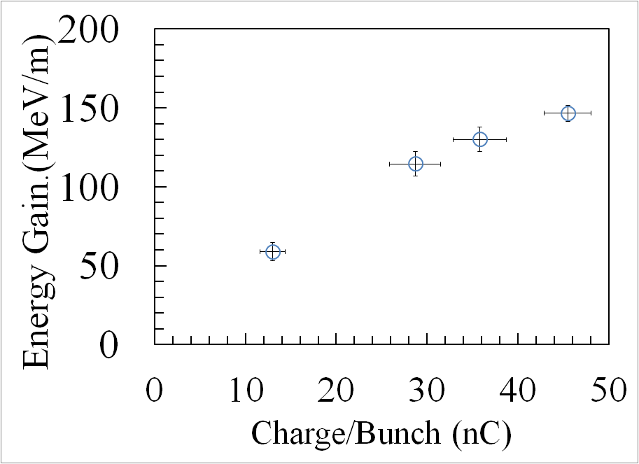
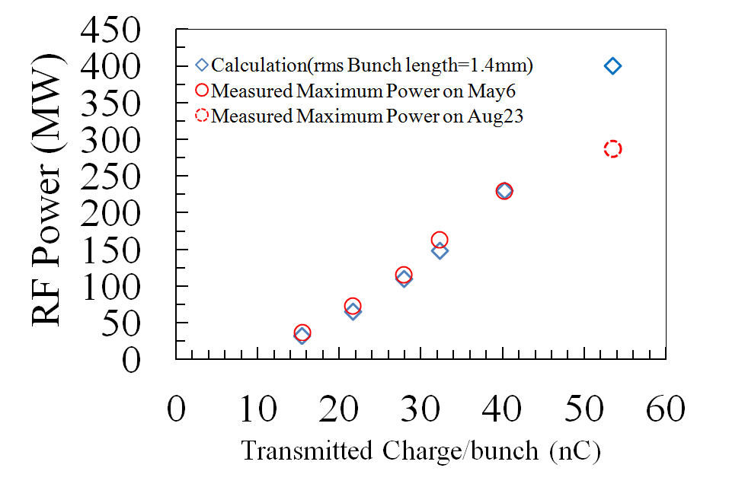
Two-beam acceleration experiment (2017)
11.7 GHz metallic iris loaded structure
300 MW
150 MeV/m
C. Jing et al., Nucl. Instr. Meth. in Phy. Res. A 898, 72-76 (2018)

Slide 14
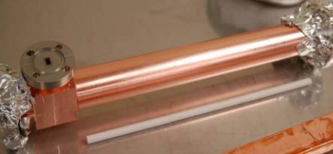
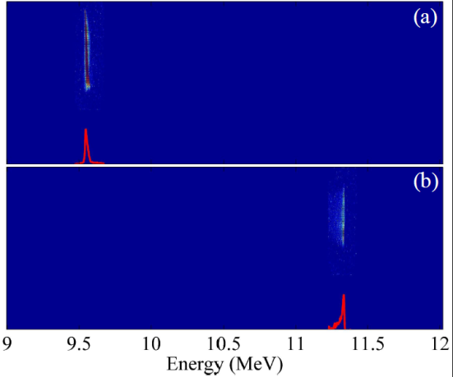
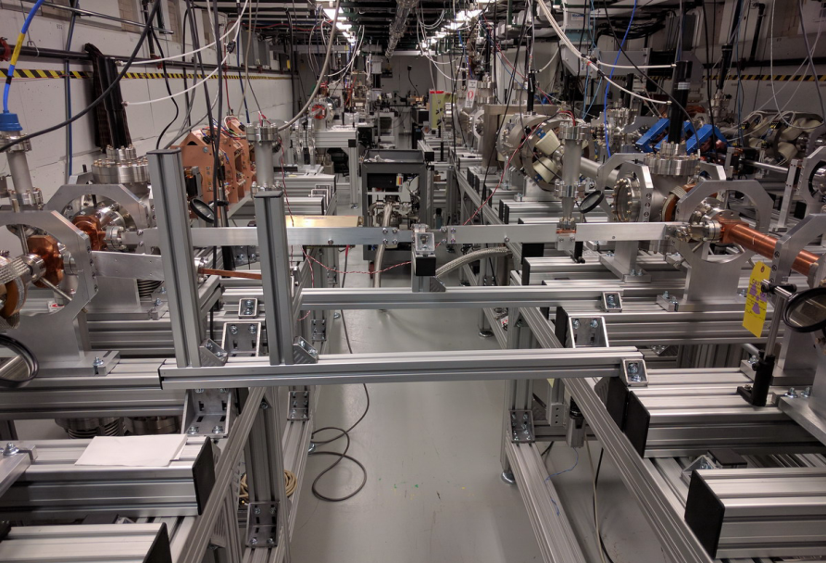
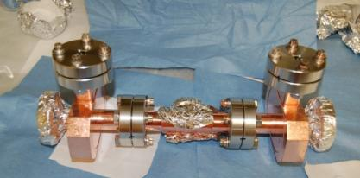
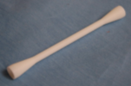
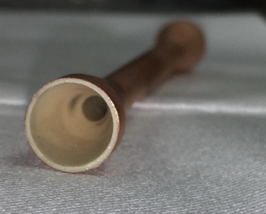
The 26 GHz Full Dielectric Short Pulse TBA Test (2018)
DPETS
ID=7mm, L=30cm
DLA
55MW rf power output were measured.
1.8MeV witness energy gain, eqv. to 54MeV/m gradient.
Note: RF power/gradient is lower than the ideal case due to the combination of RF loss in the waveguide, miss-match of the phase advance, and inefficient rf coupling, etc.
ID=3mm, L=10cm

Slide 15
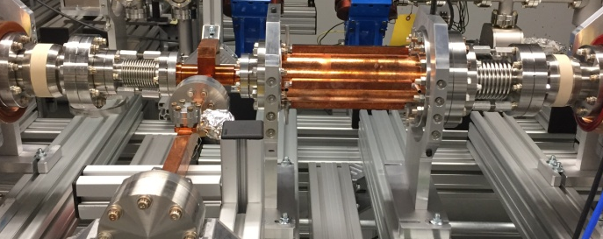
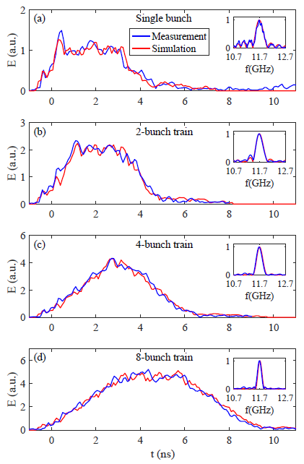
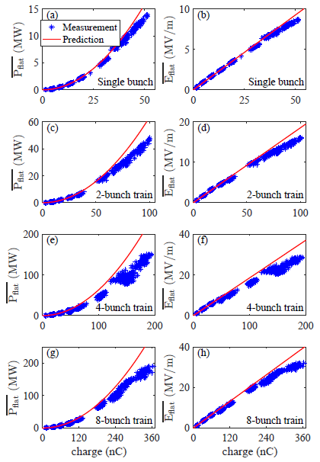
The 11.7GHz Dielectric PETS (2018)
High power test
200 MW generated with 8-bunch train, total 360 nC
No rf breakdown observed
Possible factors for reduced power:
1. Bunch length
2. Launching phase
3. Multipacting in rf
pickup
J. Shao, C. Jing, E. Wisniewski, et al., submitted to PRAB

Slide 16
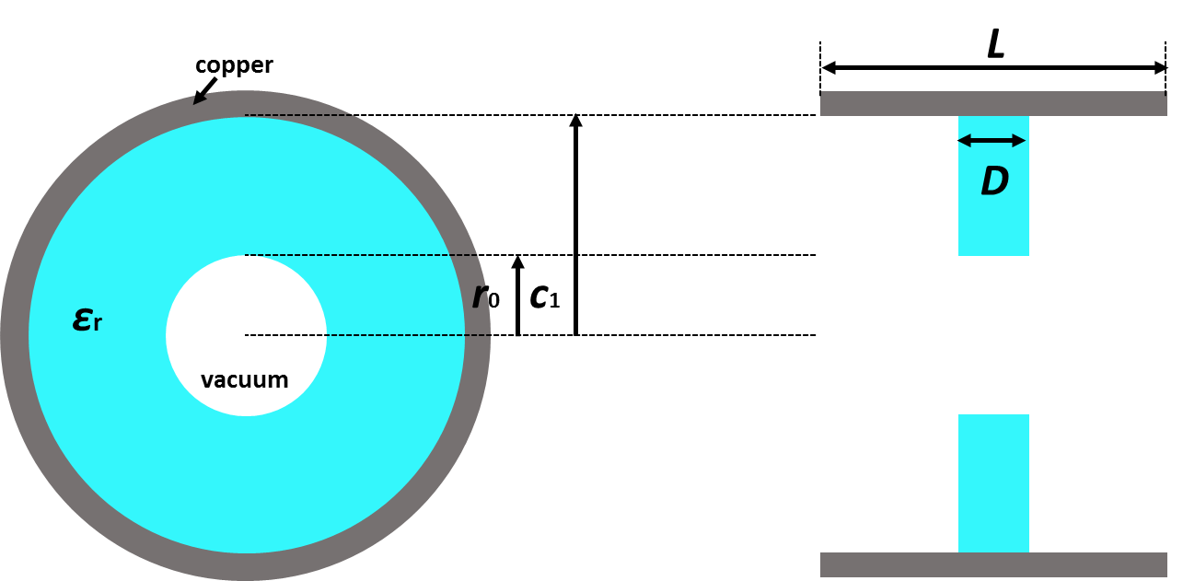
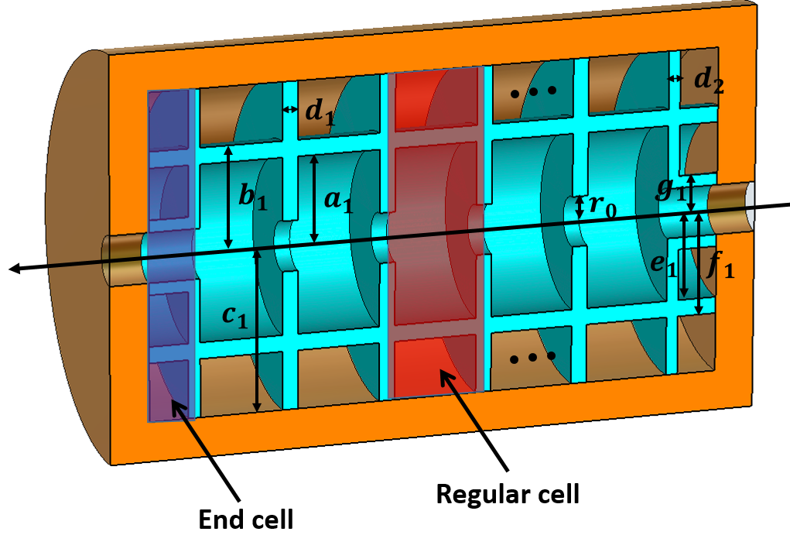
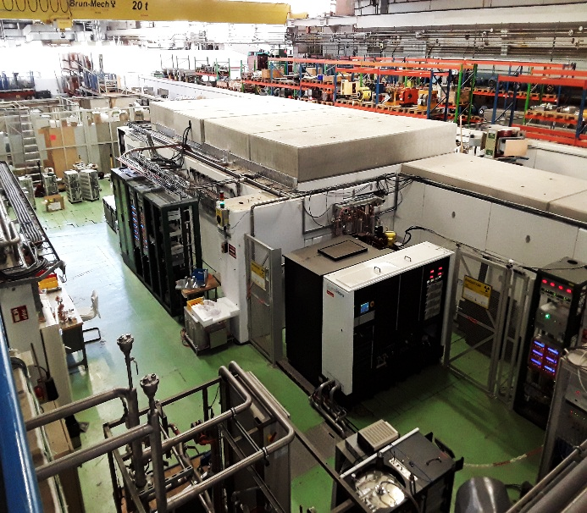
Dielectric Disk Accelerator (DDA) Collaboration with CERN (12 GHz)
One can adjust r0, c1, D and εr to get the desired frequency of 12 GHz.
Such a structure has a periodicity L which can be used to slow down the group velocity of accelerating mode.
The group velocity for a DDA TM01-mode structure gradually decreases to 0;
The phase shift generate a low group velocity
High order mode operation reduces the wall power loss;
The electromagnetic fields can be controlled by dielectric parts;
High power efficiency.
12 GHz structure to be fabricated by Euclid/AWA and tested at CERN
Talk by Yelong Wei, CERN

Slide 17


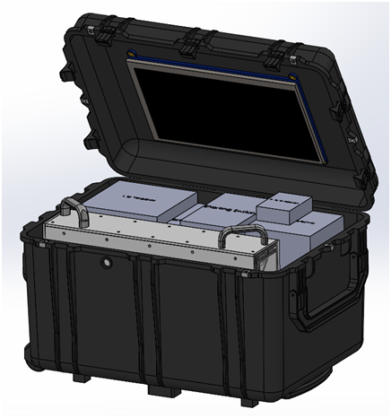
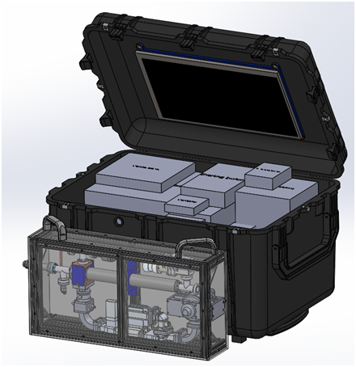
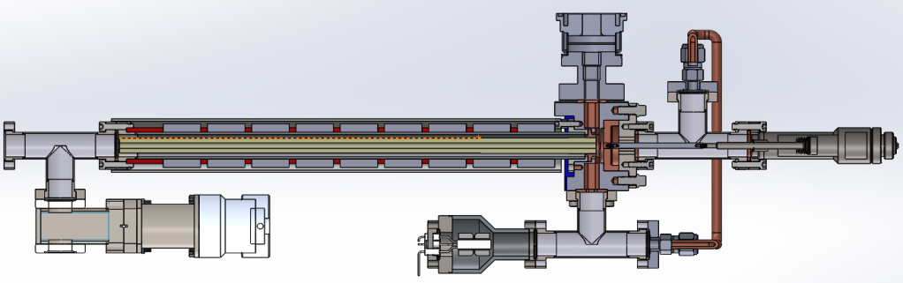
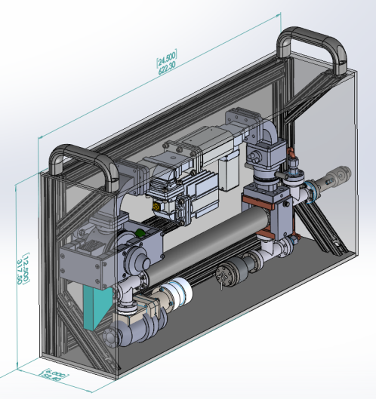
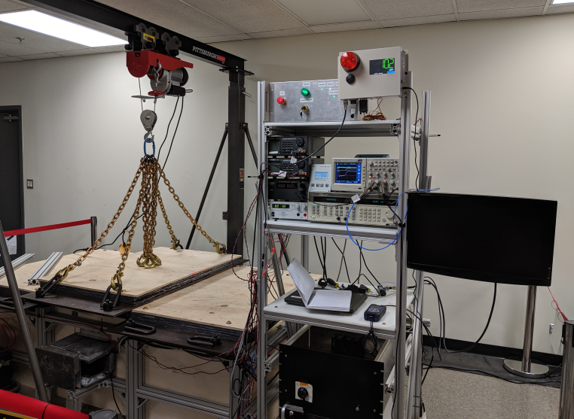
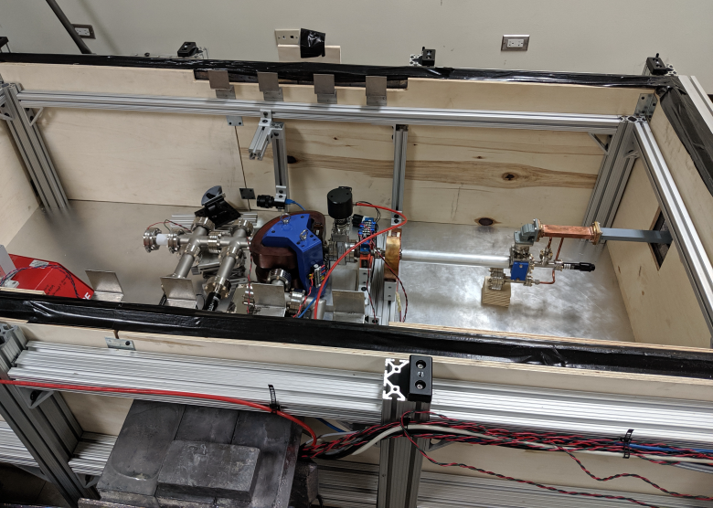
The Accelerator in a Suitcase for Isotope Replacement and for Active Interrogation Systems
Description:
  The project is to demonstrate a 1 MeV dielectric accelerator based suitcase X-ray source and also produce a cost-effective and compact medium energy (~4 MeV) design. Till present, the 1MeV dielectric accelerator is ready for assembling and bench test. Expected output: (prototype in 2019)

Slide 18
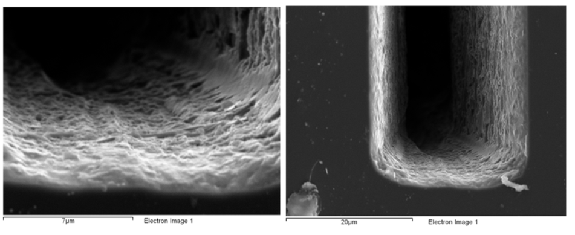
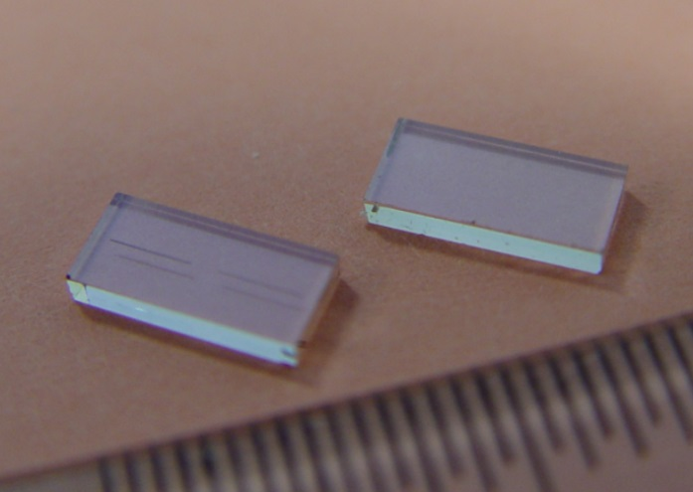
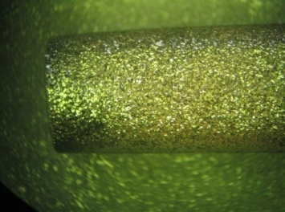
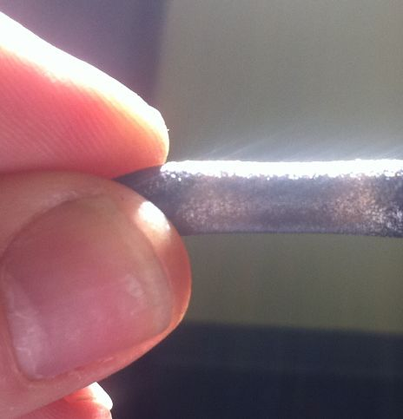
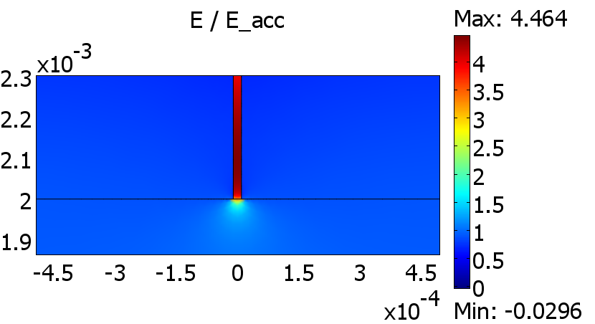
Diamond Structure High Gradient Test at AWA
50nC → 250 MV/m
35 GHz diamond polycrystalline structures
S.Antipov et al. Diamond and Related Materials, 2014.
factor 4.5 field enhancement

Slide 19
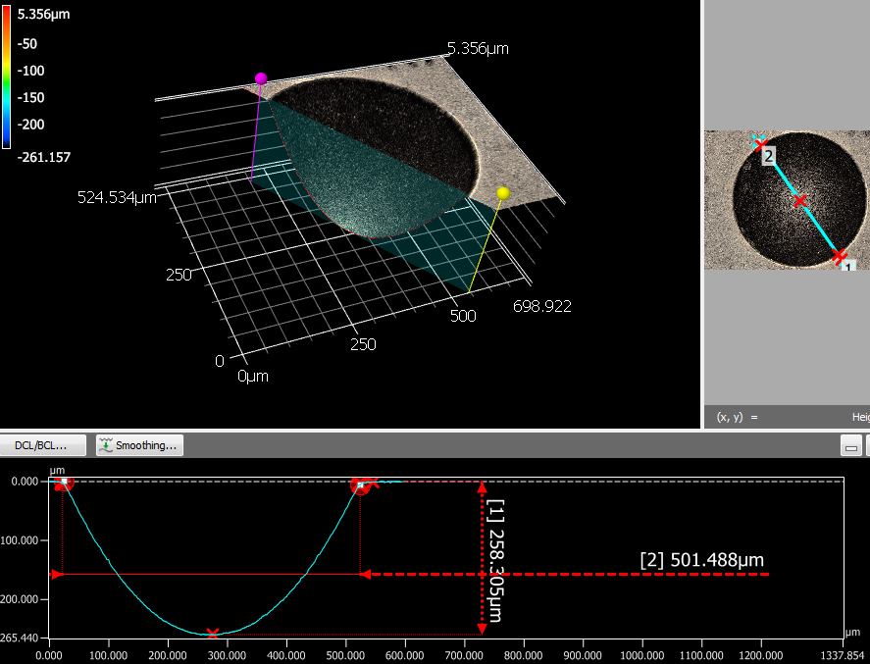
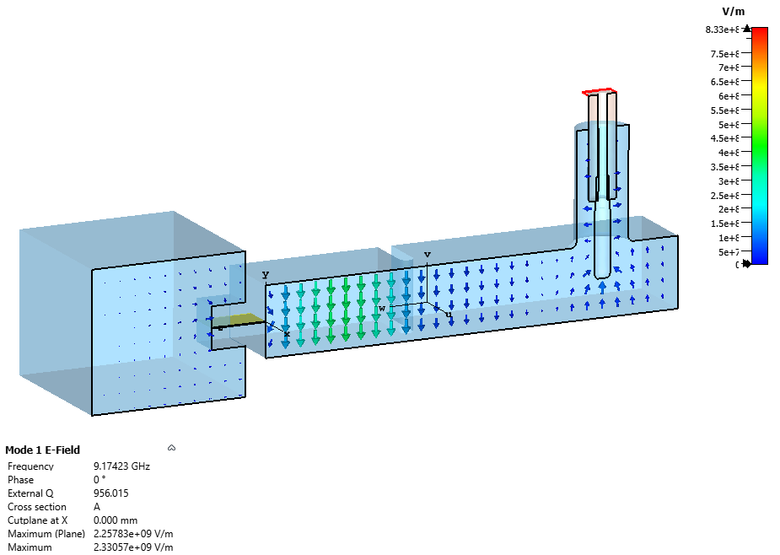
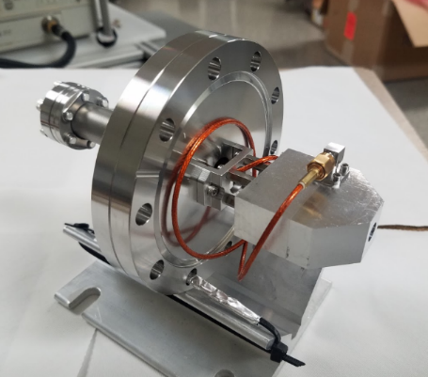
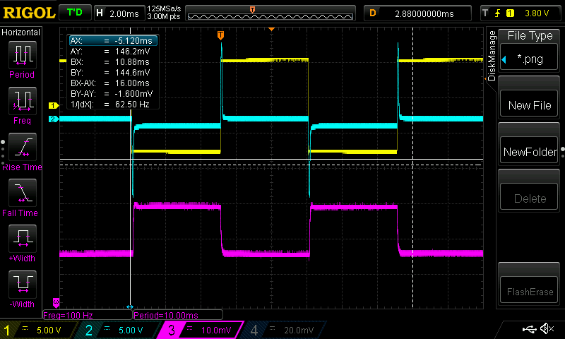
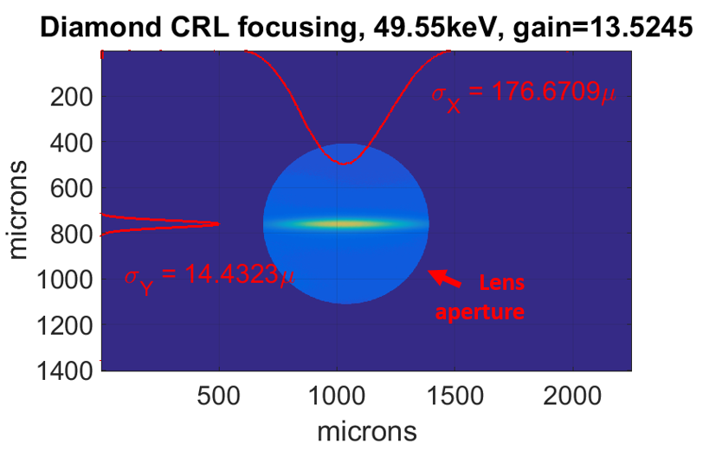
Diamond X-Ray Lens
Diamond Beam Halo Monitor, AWA
S.Antipov
S.Antipov
X-Ray Optics Group (APS)
Laser ablation of diamond for x-ray lens
Electrodeless measurement of the charged particle-induced conductivity in the diamond
Measurement: resonator detuning due to beam interception in active element
Diamond scraper for halo sensing
Laser power measurement with silicon switch
DC gun Voltage DC gun Current Halo Monitor signal

Slide 20



ACT AWA TEST OF AN IRIS DIAPHRAGM DETECTOR
Euclid is developing an iris diaphragm detector (PI: Ao Liu, # SC0019538) for beam profile and halo measurements. A very cost-effective, highly-compact, efficient direct measurement apparatus.
Version alpha experiments at ACT test the charge current collection ability of blades with different stopping power and thickness, checks the ceramic plate insulation, vacuum compatibility, signal extraction, etc.
(version alpha)
Linear
feedthru
adapter
YaG and W
holder insulated
from adapter
YaG
Cable guide
Proof-of principle done, AWA
Version Beta to be tested!
contactor
insulated
from
holder
holder
(mounts to rotary feedthru)

Slide 21




Laser ablation of copper for 250 GHz corrugated waveguide
Brazeless Power Extractor for AWA
S.Antipov
S.Antipov
Soft x-ray FEL facility with an array of collinear wakefield accelerators:
8 bunches 50nC → 11.7 GHz, 10ns, 900 MW
Courtesy of A. Zholents (APS)

Slide 22



Traveling Wave Gun, funded by HEP 2019
Breakdown decreases with reduction of the RF pulse length. To mitigate the breakdown problem and enable large charges to be generated in a high gradient field at the cathode, Euclid Techlabs proposed to develop an ultra-high gradient electron gun fed by a very short RF pulse.
Power extractor installed in the AWA beam line to be used for the TW Gun prototype testing.

Slide 23


UNCD Field Emission Cathodes
S.Baryshev, Phase II NP, 2015-2018
In collaboration with E.Simakov, LANL
High Quantum Efficiency UNCD Photocathode.
SRF Test BNL
S.Baryshev, Phase I, BES, 2014
K. Quintero et al. APL, 2014
G.Chen et al. , APL, 2019

Slide 24



History: Tunable Ferroelectric-Based Accelerator
ε(E) for ferroelectric dielectric composite
NONLINEAR CERAMIC
US patent 7,768,187
US patent 8,067,324

Slide 25

Fast Tuner Testing, CERN 2019
Direct observations of the frequency shift caused
by the FE-FRT made with the signal analyser.
The first ever FE-FRT test with a superconducting cavity has been performed and successfully demonstrated frequency tuning. The timescale in which the FE-FRT is able toshift the cavity frequency across the entire tuning range was measured to be < 50 𝜇s, this is significantly faster than any other cavity tuning device. A maximum frequency tuning of ≈ 12 Hz was observed with an applied voltage of 3 kV, this could easily be increased by coupling more power to the tuner.
A case study of an FE-FRT applied to PERLE show RF power could be reduced by a factor of ≈ 15.
PERLE- Powerful Energy Recovery LINAC, Orsay

Slide 26


Phase II 2016 Ferroelectric Tuner results

Slide 27

Ceramic with Increased DC Conductivity
The main innovation: a new low-loss microwave ceramic material with a increased DC electrical conductivity and low loss tangent. The electrical conductivity will drain the field-emission induced charge away. The low loss tangent will allow realizations of high efficiency RF power transmission.
We developed technology for sintering Mg,Ti oxide materials providing lower loss tangent ceramics in the GHz frequency range, and exhibiting 2–3 orders of magnitude increased conductivity (10² –10³ times).
We observed and studied the interesting new phenomenon of abnormal ~10⁴ conductivity increase of the developed MgTi ceramic in the 25⁰C–100⁰C temperature range, while the loss tangent variation at 100⁰C did not exceed a 20% change compared to the room temperature value.
Motivated by dielectric structure development for AWA, funded by NP for RF windows application

Slide 28

DC 200 kV BEAM CHARGING TEST OF CERAMIC
DC beam test using TEM DC gun:
We are currently carrying out beam tests on the developed ceramic. Using the 200-keV DC gun available at the Euclid lab facility, we are exposing two types of ceramics to the DC beam: the standard MgTi ceramic and our new (Mg,Ti) ceramic with increased conductivity. The goal of the ongoing experiments is to quantitatively study the charging – discharging mechanism of the MgTi.
DC 200 kV electron beam for charging testing

Slide 29



Beam Charging Test Results
The beam images at the downstream YAG, which were captured at different times. T=0 second represents the turn-on time of the DC beam: with the regular ceramic sample beam disappeared in 15 sec, with the new MgTi ceramic it is stable in hours…

Slide 30


100 MHz - 10 GHz Stroboscopic Solution for Ultra-Fast Electron Microscopy
Funded by BES PII and PIIA,
Currently is installed at BNL,
and is being commissioned
Commercial contract with NIST, installed and operational
First presentation of the Strobo -
TEM at M&M Conference, Portland OR

Slide 31

Commercialization
Two periods:
2003-2014 - spinoff from Argonne Wakefield Accelerator group (DOE SBIR)
2014- now - commercialization of advanced material technologies and TEM.
11 patents +5 currently in progress
Fast Ferroelectric Based Tuner
- Phase II 2016 Nuclear Physics
Tuner is purchased, installed and tested in 2019 by CERN, SRF’2019 invited talk by CERN. 80MHz – new project !
Latest Noticeable Contracts:
NIST (2016-2018) – “Time Resolved TEM”
GWU (2017) – “UNCD Emission Chamber”
UMD (2016-2018) – “Single Crystal Diamond FET”
SJTU (2016-2019) – “Photoinjector”, “Thermionic Gun”
JEOL, Inc. installation at the US facility, then BNL and NIST
www.euclidtechlabs.com

Slide 32

Summary
Our collaboration is…
researchers,
ideas, and projects,
materials and technologies,
design and prototyping,
beam or high power testing,
.. and commercialization, if we are really, really lucky….

Slide 33
Acknowledgments
DOE, Office of Science High Energy Physics:
L.K.Len, Ken Marken, John Boger, Eric Colby
DOE Office of Science, Basic Energy Science,
Eliane Lessner
DOE, Office of Science Nuclear Physics:
Michelle Shinn, Manouchehr Farkhondeh
Argonne National Laboratory, HEP,
Manoel Conde, John Power and AWA Group

