Slide 1




Transverse wakefiled suppression using
Flat-shape Beam in Planar Structure.
Flat Beam collaboration
Presenter:
Stanislav Baturin
Enrico Fermi Institute
The University of Chicago
08/22/2019

Slide 2
Outline
Theoretical framework
Current experimental effort at Argonne AWA, preliminary experimental results and near future plans.
Notes:
1 …To the wakefieds concepts
2 … ??? Simple calculation of the wakefields

Slide 3
Theoretical framework
Notes:
.. concepts

Slide 4
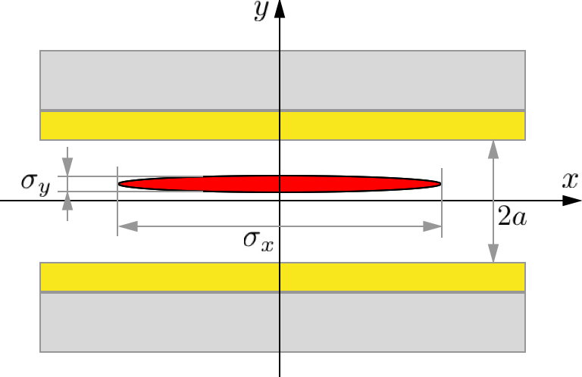
Flat beams. Motivation.
Wake potential could be reduced by introducing flat beam in a planar structure
Ultimately for in finitely flat beam there is no traverse wakefield
For a beam of finite transverses dimensions transverse wake can be suppressed more then longitudinal

Slide 5
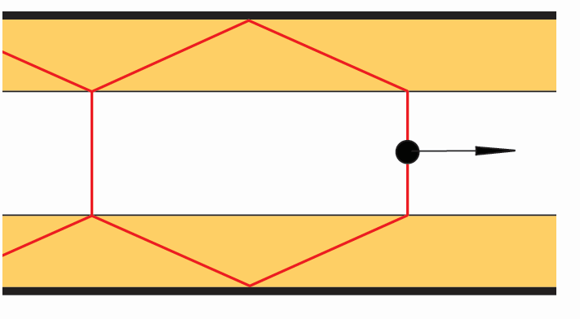
Relativistic Gauss Theorem
S.S. Baturin, A.D. Kanareykin. PRL
113, 214801, 2014
Shock wave front
Reflection
c
vacuum
Self field + radiation

Slide 6
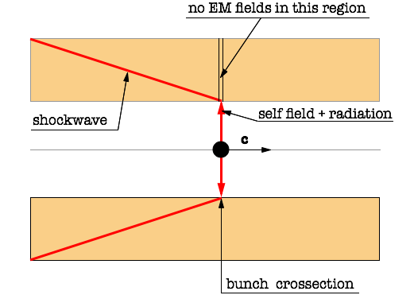
Conformal mapping approach
S.S. Baturin, A.D. Kanareykin. Phys. Rev. Accel. Beams 19, 051001 (2016)
Boundary condition: source term is canceled
by the radiation term on the vacuum material interface.

Slide 7
Limiting wake in a planar structure
S.S. Baturin, G. Andonian and J. Rosenzweig
Phys. Rev. Accel Beams 21(12):121302, (2018)

Slide 8
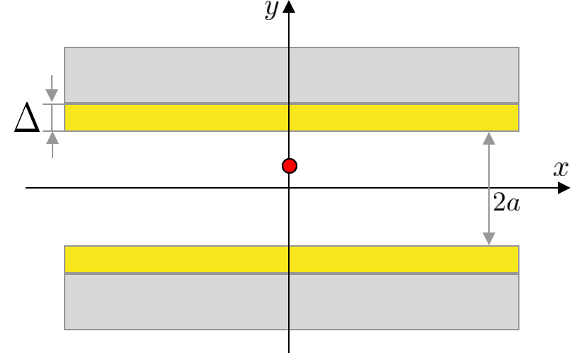
Explicit formulas
S.S. Baturin, G. Andonian and J. Rosenzweig
Phys. Rev. Accel Beams 21(12):121302, (2018)

Slide 9
Structure of the transverse wakefield
Y- component of the transverse wake
Longitudinal wake
S.S. Baturin, G. Andonian and J. Rosenzweig
Phys. Rev. Accel Beams 21(12):121302, (2018)

Slide 10
Wake decrease rates

Slide 11
Wake decrease rates

Slide 12
Experimental studies
Notes:
.. concepts

Slide 13
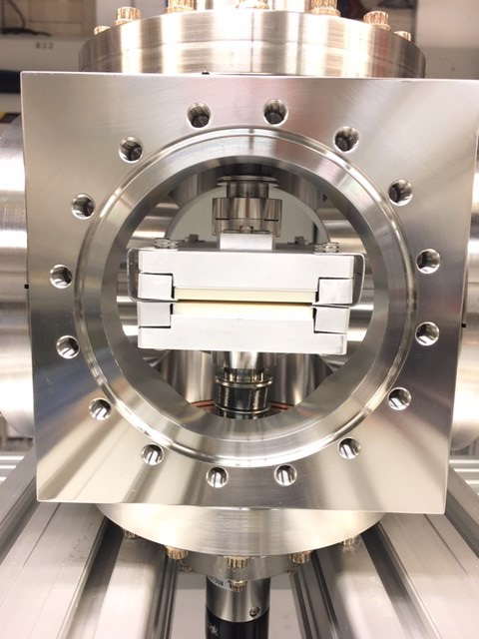
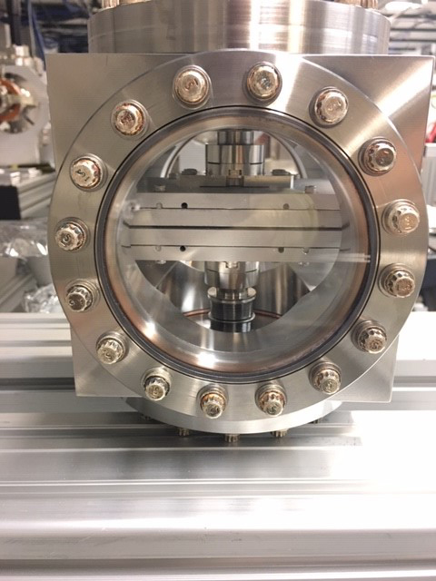
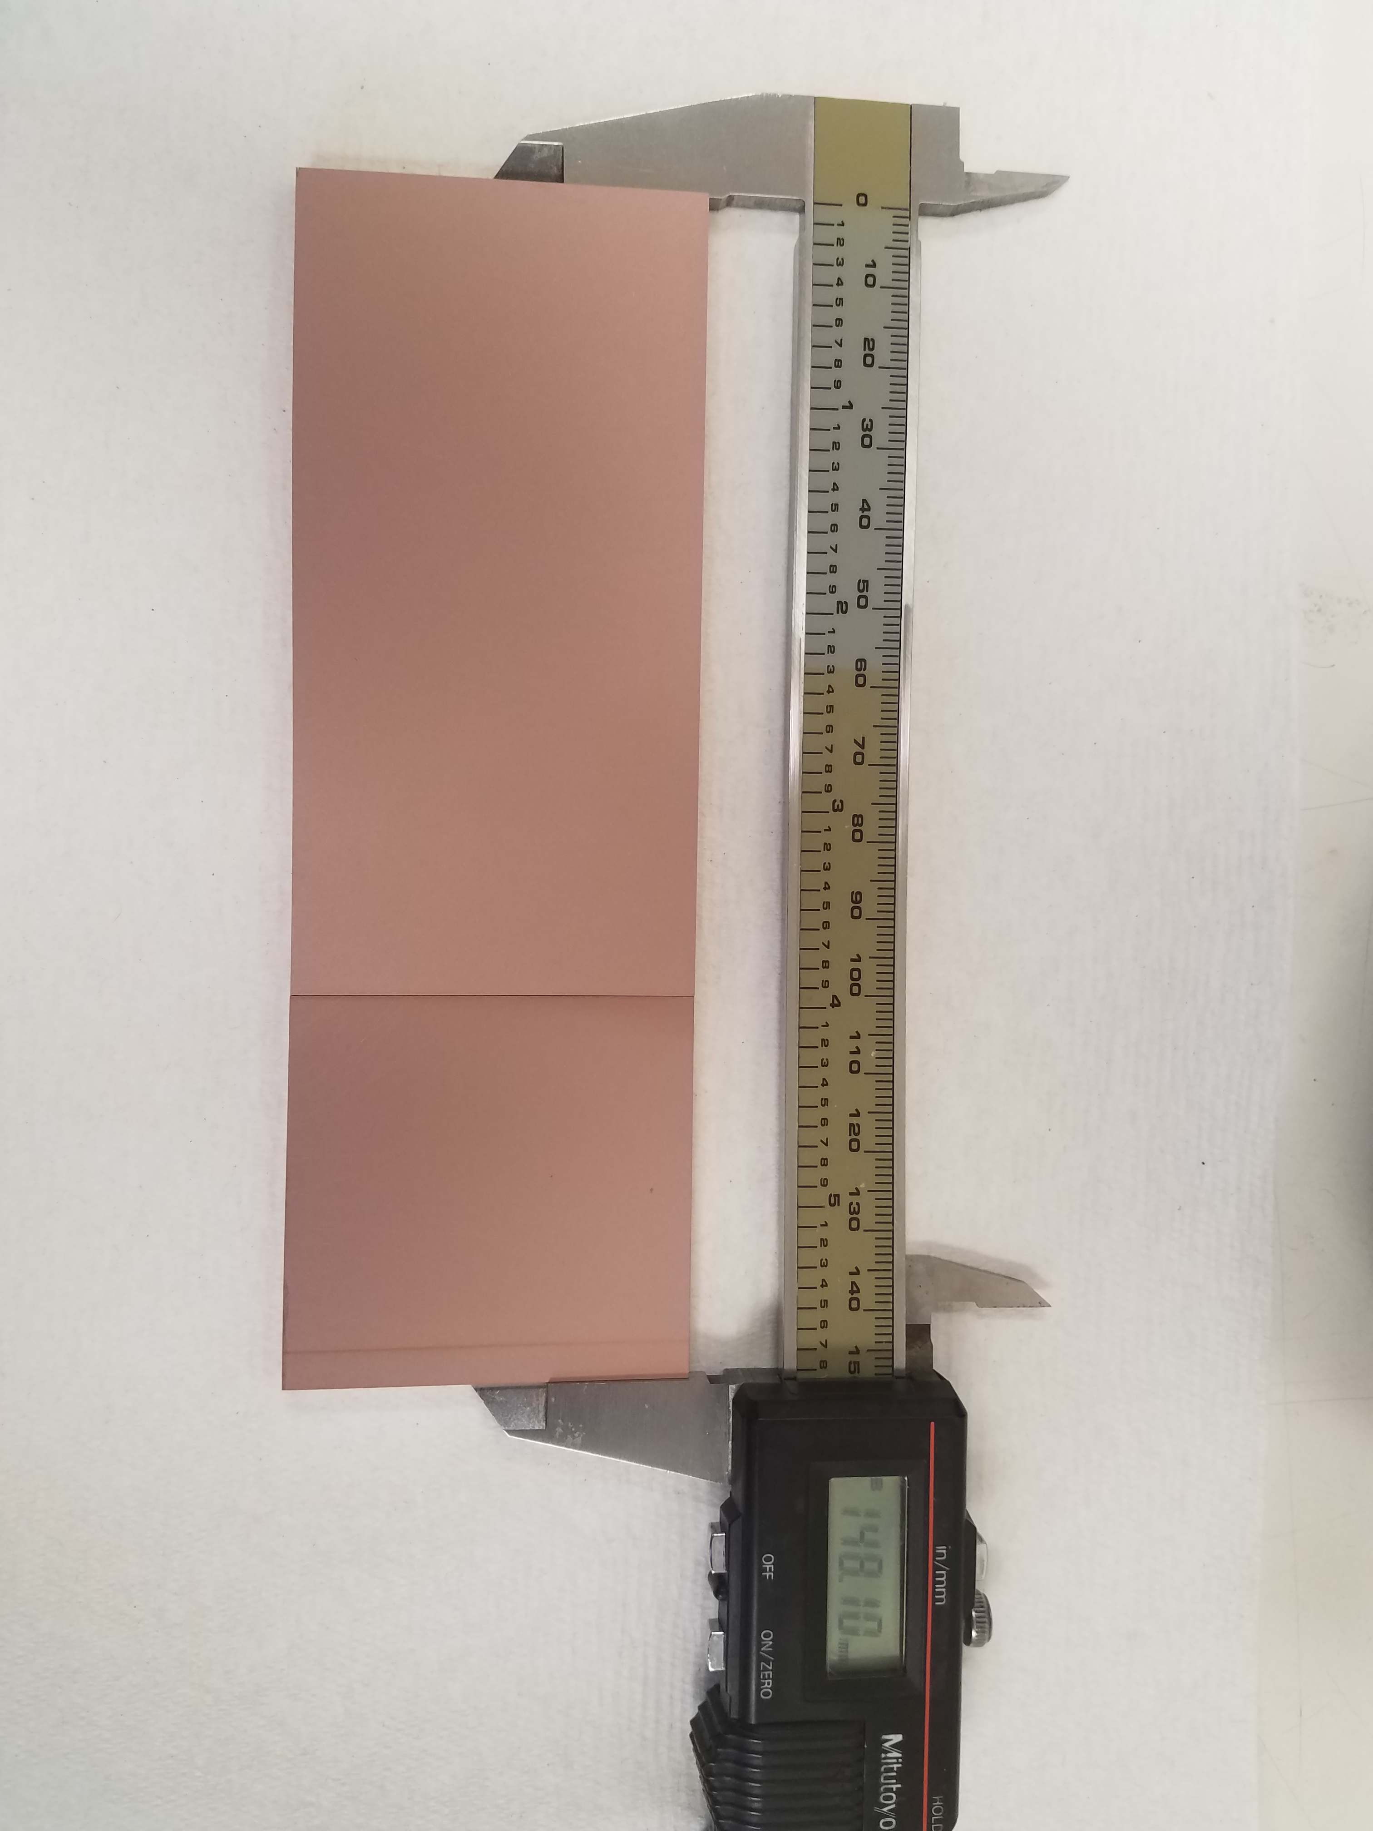
Thick dielectric structure
Al2O3
15 cm
5 mm
5 cm
Notes:
We may measure this two curves.

Slide 14
Tradeoff curves measurement
Notes:
We may measure this two curves.

Slide 15
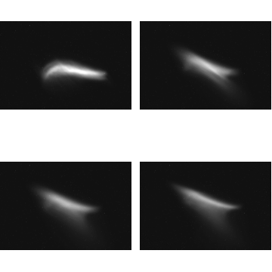
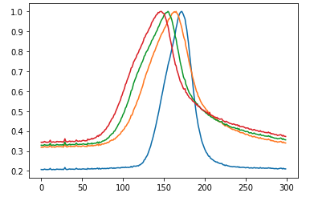
Tradeoff curves measurement (preliminary results)
Transverse projection of the beam after the structure
centered
80 um displacement
no structure
Beam centered
160 um displacement
80 um displacement
240 um displacement
160 um displacement
No structure
Notes:
We may measure this two curves.

Slide 16
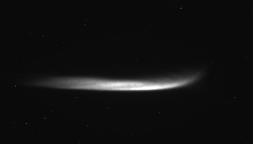
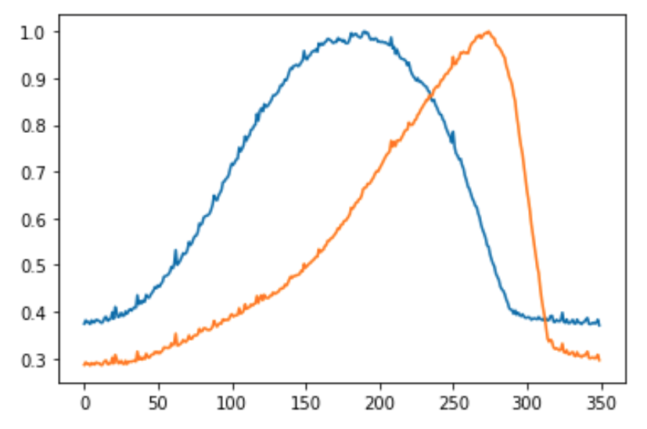
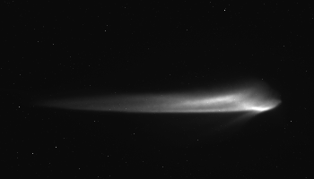
Tradeoff curves measurement (preliminary results)
no structure
Structure in, beam centered
No structure

Slide 17
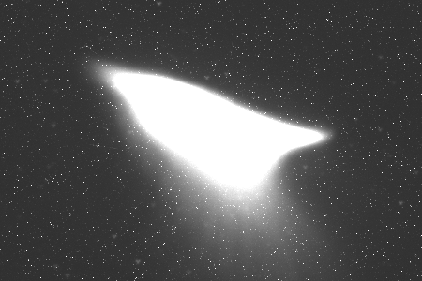
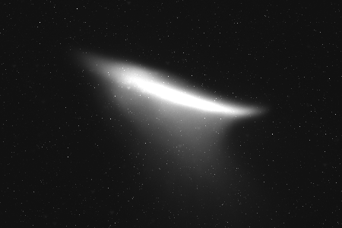
Transverse structure of the wake (skew wake)

Slide 18
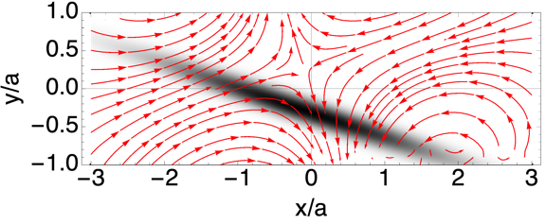
Transverse structure of the wake (skew wake)

Slide 19
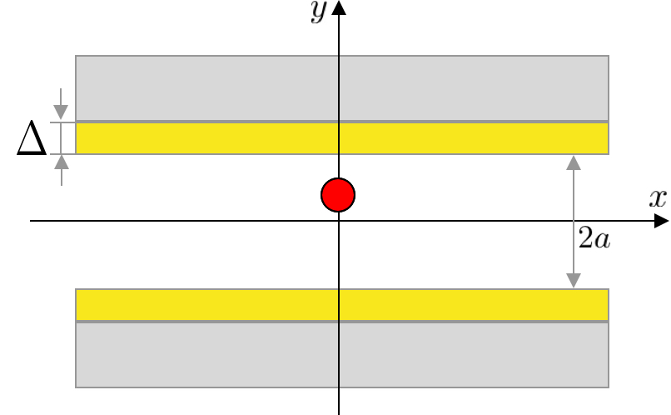
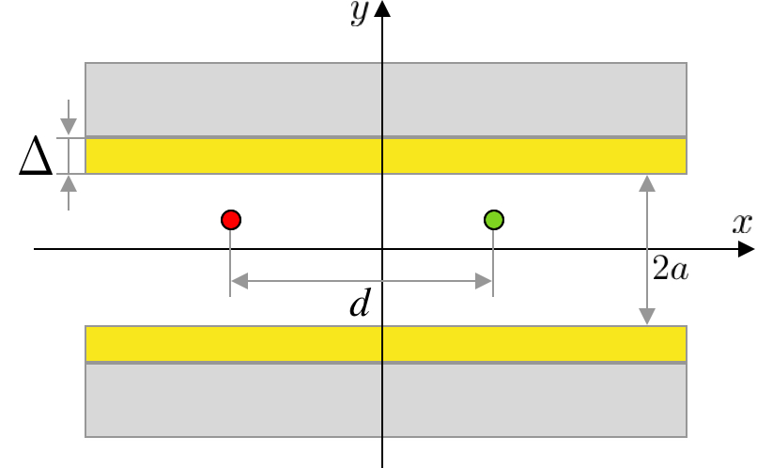
Two-beam injection
Y- component
of transverse wake
Y- component
of transverse wake
Longitudinal wake
Longitudinal wake

Slide 20
Experimental proposal
Minimum of the kick
Notes:
We may measure this two curves.

Slide 21
Drivers and whiteness generation
Notes:
We may measure this two curves.

Slide 22
Conclusion
We have observed skew wake effect caused by a tilted beam
We have collected the data for the tradeoff curves and in the stage of the data analysis and additional simulations
New experiment on two beam injection and 3D wakefield mapping is under active development
Developed techniques of beam injection and new inside on wakefield structure may be extended beyond dielectric structures.
Notes:
We may measure this two curves.

Slide 23
Flat beam collaboration
Tianzhe Xu, Philippe Piot
Northern Illinois University
Walter Lynn, Gerard Andonian, James Rosenzweig
University of California LA
Jimin Seok, Gwanghui Ha, Eric Wisniewski, Jiahang Shao, Scott Doran, John Power, Manoel Conde
Argonne National Laboratory (AWA)
Stanislav Baturin
The University of Chicago, Enrico Fermi Institute
Supported by
US DOE Grant No. DE-SC0017648
U.S. NSF under Award No. PHY- 1549132, the Center for Bright Beams
and under Award No. PHY-1535639

