Slide 1
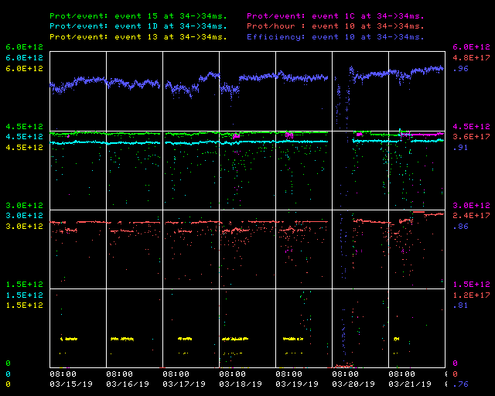
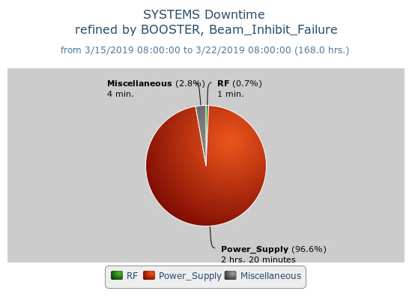
Booster Operations 03/15/19 – 03/22/19
F
M
Tu
W
F
Sa
Su
Th
F
Capture/Transition Issues
Collimator Studies
NOKD issues
Access, BRF21 installed
Downtime:
2 hours 25 minutes for the week
NOKD issues 2hours 18 minutes
MP02 crowbar trip 2minutes
Minor RF Trip 1 minutes
023/high field losses 4 minutes
Proton Source Studies
This week:
Beam to BnB $1D ~4.3E12 94%, ~7.00E16 P/hr
Beam to Numi $15 ~4.3E12 94%
Beam to SY $13s as requested
Beam to Muon $1Cs as requested
Dedicated beam studies performed on Wednesday
Longitudinal & Transverse Damper Adjustments & Tuning
Special Event this week
Japan-U.S. beam physics collaboration meetings
We enjoyed visit from several KEK J-PARC personnel
Linac & Booster + Studies performed together
Pending Requests:
During good opportunity, ~15 minutes or so to allow Controls to install/adjust BMIN module in Mac Room for new Booster event triggering. Will require NO TCLK generated during this time (includes FAST/IOTA areas)!

