Slide 1
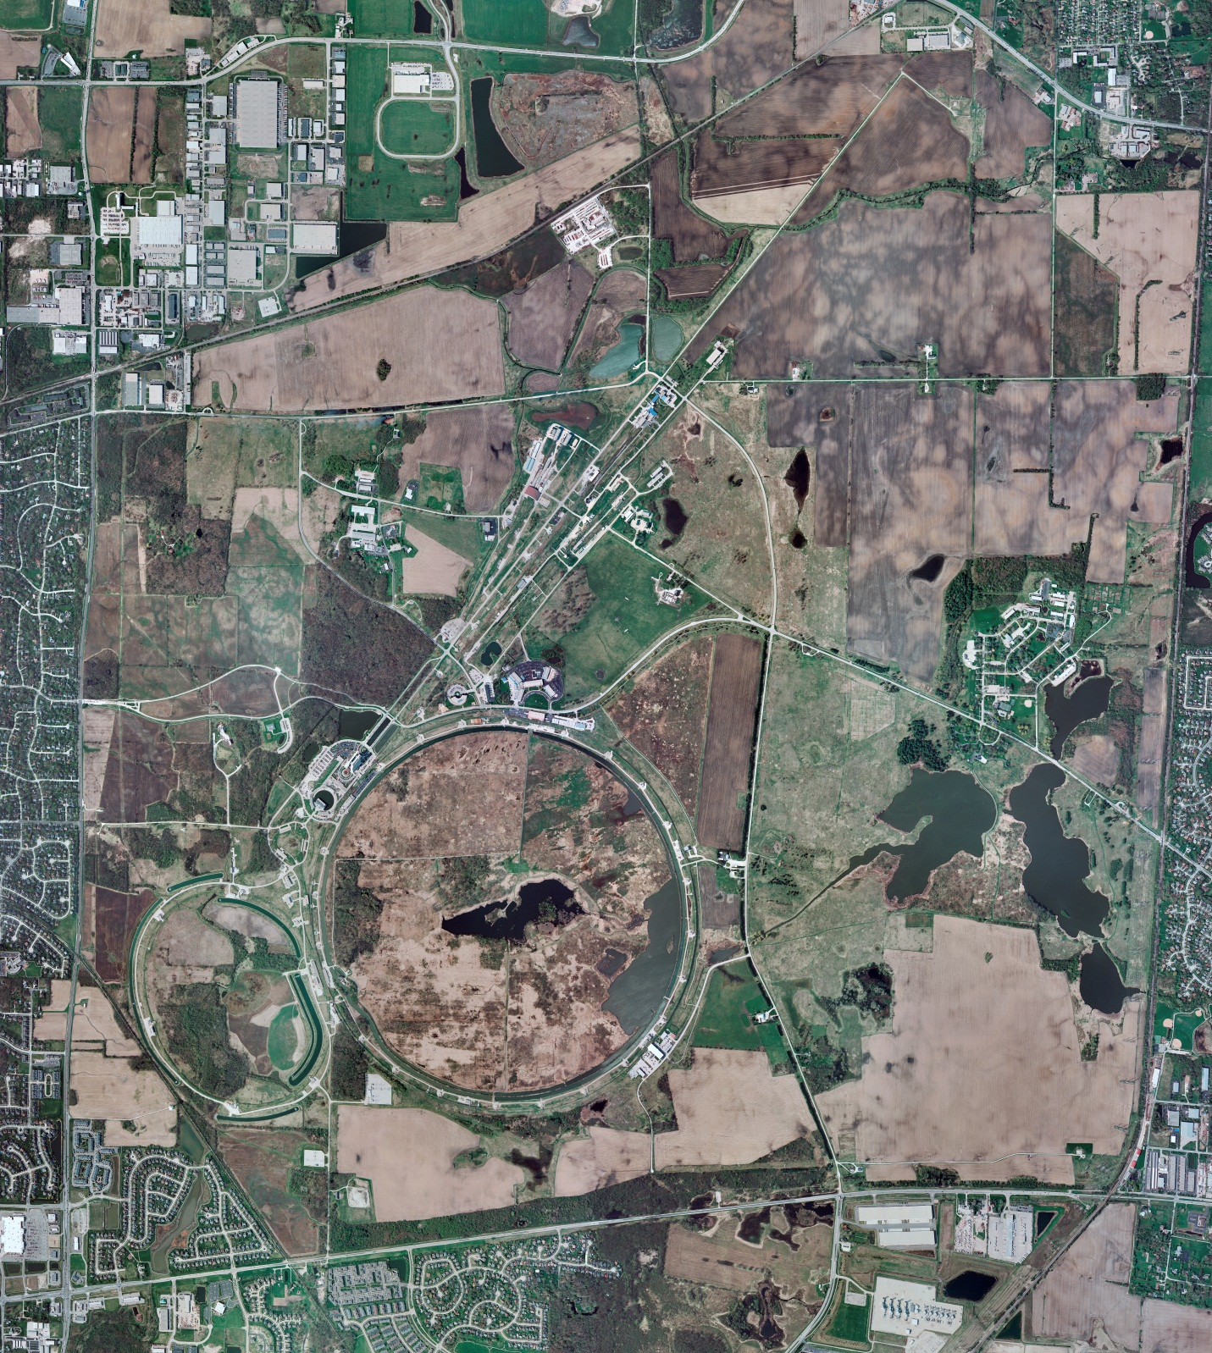
Helium Cryogenics
Status 3/22/2019 J.Makara
CMTF: Linde SCP cold at 5 K and operating on four comprs.
CMTS1 CM16 cooldown in progress, to be filled today, and expecting testing this weekend.
MCTF: Warm, shut down, isolated; LN2 system still online only for Purifier compr and its oil removal skid bakeout completed; Purifier warmup & regeneration in progress; restart activities to start next week.
MDB/HTS: at RT
MDB/STC: at RT
MDB Magnet: at RT
NML/FAST: Lab-B North/South comprs online with North Fridge running fine; South Fridge was shut down last night due to cryo leak at control valve stem to be addressed today.
CC1/CC2/CM: cold at 2 K
MTA: shut down and isolated at RT; physical disconnection in progress.
IB1: Cold and operating test stands
HAB: BA compr/Fridge purification in progress with cooldown anticipated next week.
STF: at RT, isolated, and under LOTO
Muon Campus: A0 comprs (3) online with cryogenic system cold at 5 K, including g-2 magnet with occasional powering.
MISC:

