Slide 1
FAST Facility Department – Week of 03/22/2019
Access/Maintenance Activities:
Undulator Manipulations & M4R SL Station Work
Edge Radiation Station Installation / Removal
x107/x118 Controls
IOTA BPM/Damper pre-Amps
Gas sheet beam profile monitor measurement
Studies:
Single-Electron Tomography in IOTA
Edge Radiation (M4R & M4L SL Interference)
Undulator Radiation (Requires IOTA Undulator)
IOTA (Anti)Damper
IOTA High-Charge Response
Low Emittance Lattice in IOTA
HEA / IOTA Mode Switching Studies

Slide 2
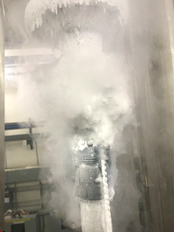
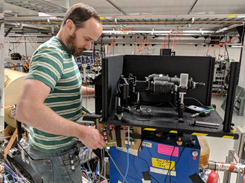
FAST Facility Department – Near Term
Access/Maintenance Activities (Monday):
Sump PM in NML Rad Fence Area
Studies:
Friday (3/22) Recover from Cryo Valve issues
08:00 - 12:00 — Nonlinear lattice Studies 12:00 - 18:00 — IOTA Low-Emittance Lattice Studies 18:00 - 02:00 — Wakefields / y-t Studies in LE Linac Saturday / Sunday Undulator Studies
Nonlinear Lattice
Mode-switching Studies
LE Linac emittance scans & phase scans
UV Laser QE measurement

Slide 3
FAST Facility Department – Next Week
FINAL WEEK OF RUNNING SRF/IOTA UNTIL SUMMER 2019 (for OSC)
Current Studies: A Brief Summary
Single Electron Tomography
Edge Radiation (DONE-ish)
Undulator Radiation
Nonlinear Lattice Measurements
Low-Emittance Lattice
(Anti)Damper
IOTA/HEA Mode Switching
Parasitic Cryomodule HOM measurements
Magnetized beam studies (DONE!)
Short Range Wakefield / E-t / y-t
Emittance and RF Phase/Energy Scans
IOTA
HE e-Injector
LE e-Injector

Slide 4
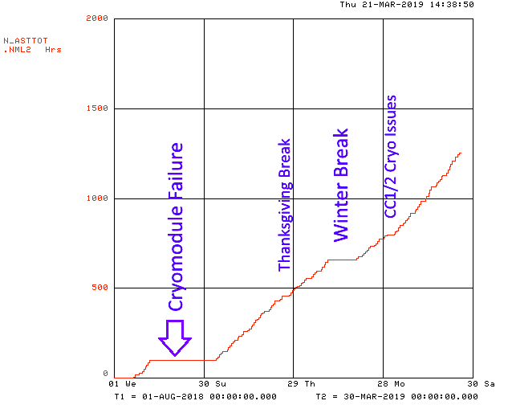
FAST Facility Department – Run Summary

