Slide 1
Friday 9:00
2019-03-22

Slide 2
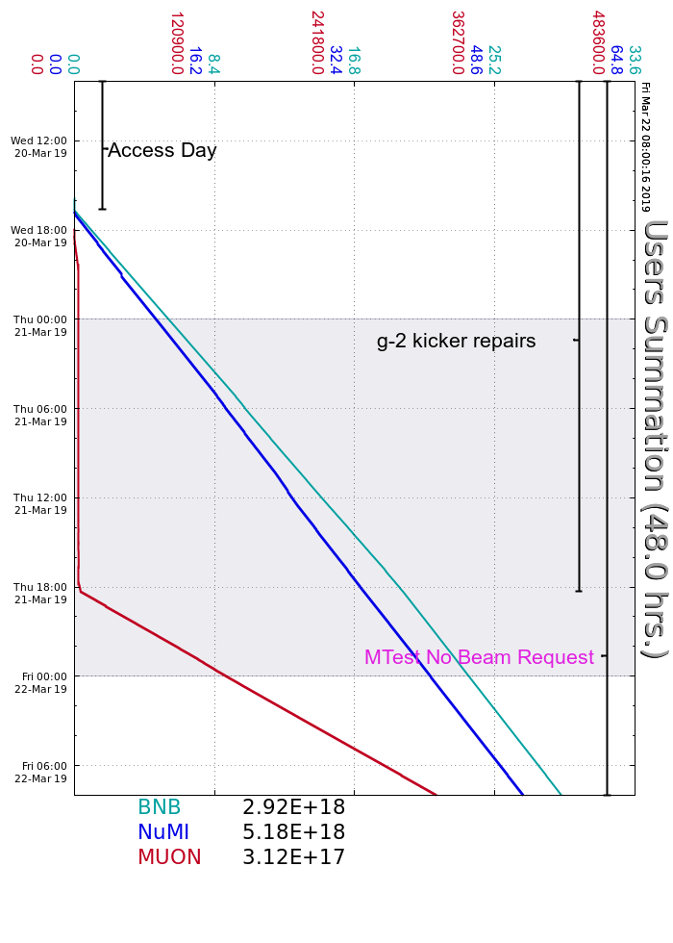
Wednesday
Booster Studies & Access Day
Interlocks replaced MINOS Safety system PLC PS
Ops re-secured
MI20L PS filter breaker trip, experts recovered
Beam to users by 16:45
MIRF2 SSD LCW flow fault, ran without overnight
Thursday
I:LAM61 turned itself off, reset without issue
Techs recovered MIRF2
LRF1 Cavity head pressure dropped, techs repaired
Established beam to g-2 by 18:15, 2 batch @ 1.333s
Many R:KPS5A timing error trips
Inhibited beam but did not trip any permits
Friday
I:LAM61 turned itself off again, reset without issue
Current Conditions
Beam to NuMI, BNB and Muon
SY120 beam available on request

