Slide 1
IOTA Experiment: Single-Electron Tomography
Aleksandr Romanov
FAST/IOTA Collaboration Meeting and Workshop on High Intensity Beams in Rings
10 June 2019

Slide 2
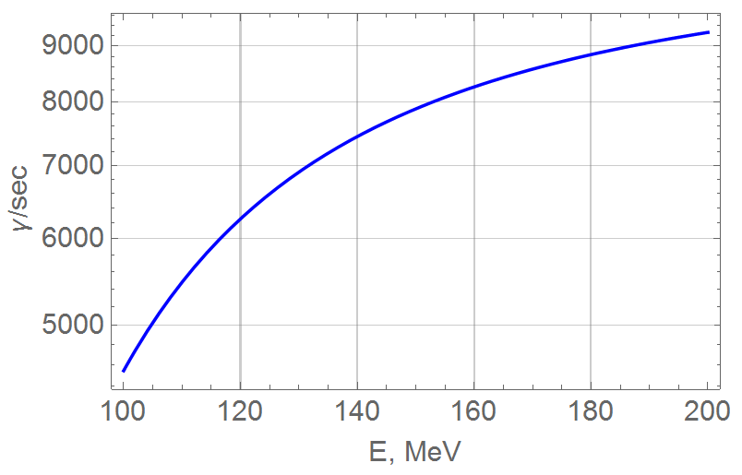
Synchrotron radiation
Number of photons per electron, emitted within acceptance angle for 550±20 nm over 1 second
Transmission of the optics is ~70%

Slide 3
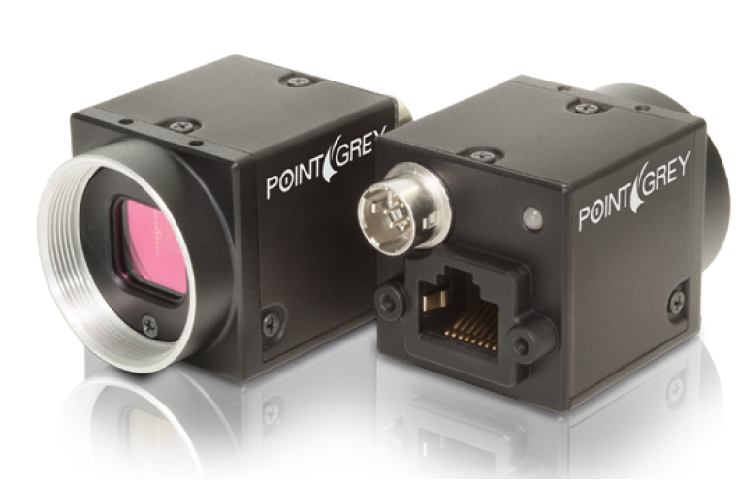
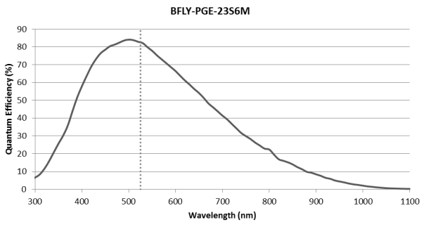
Cameras characteristics
IOTA is equipped wit 8 PoE cameras BFLY-PGE-23S6M-C from Point Grey (now Flir)
Exposure Range: 0.019 ms to 32 seconds
Sensor: Sony IMX249, CMOS, 1/1.2“
Sensitivity Threshold (γ): 9.5
Saturation Capacity (e-) 33106
Rsolution: 1920 x 1200
Pixel Size: 5.86 μm
ADC: 12-bit
QE: 83%

Slide 4
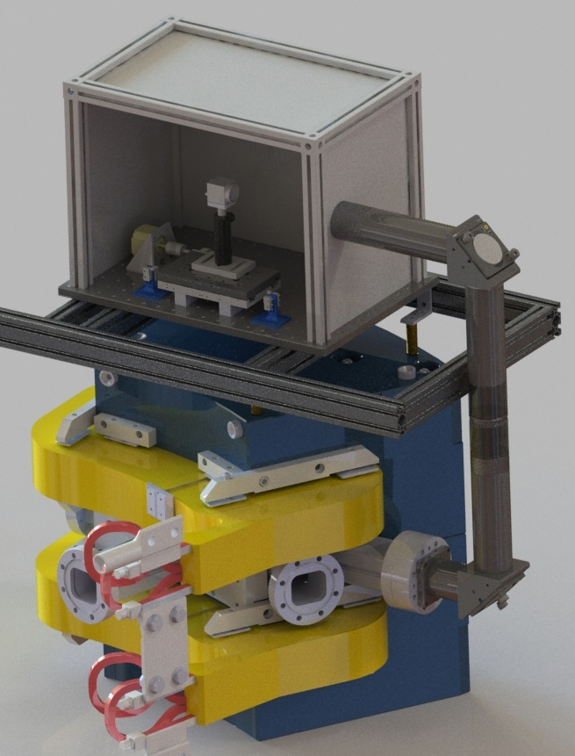
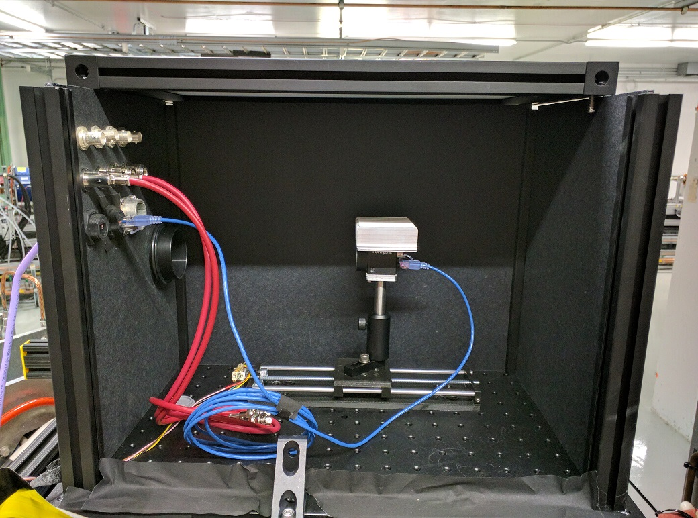
Synclight stations optimization
8 synchrotron light stations with cameras
Irises were removed to open aperture
Had to motorize top and bottom mirrors for transmission optimization
Passive heatsinks added to cool cameras for lower noise
Installed stepper actuated focusing stages for all cameras
Iris & lens
N. Kuklev

Slide 5
Single electron injector
x
x
Block laser with shutter to get only dark current
Insert several OTR foils in LE and HE lines
Decrease last injection quadrupole to stretch phase volume and distort incoming trajectory

Slide 6
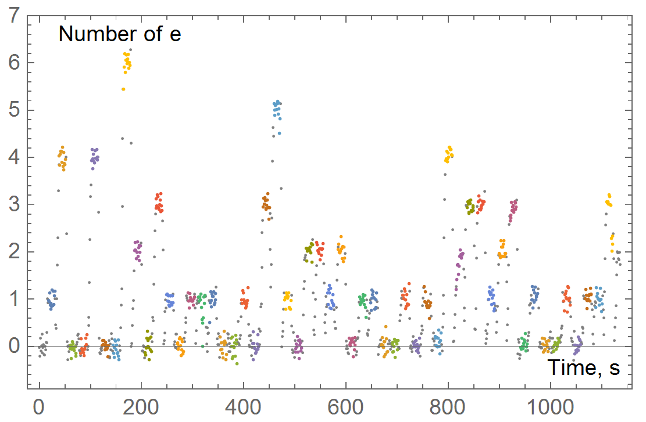
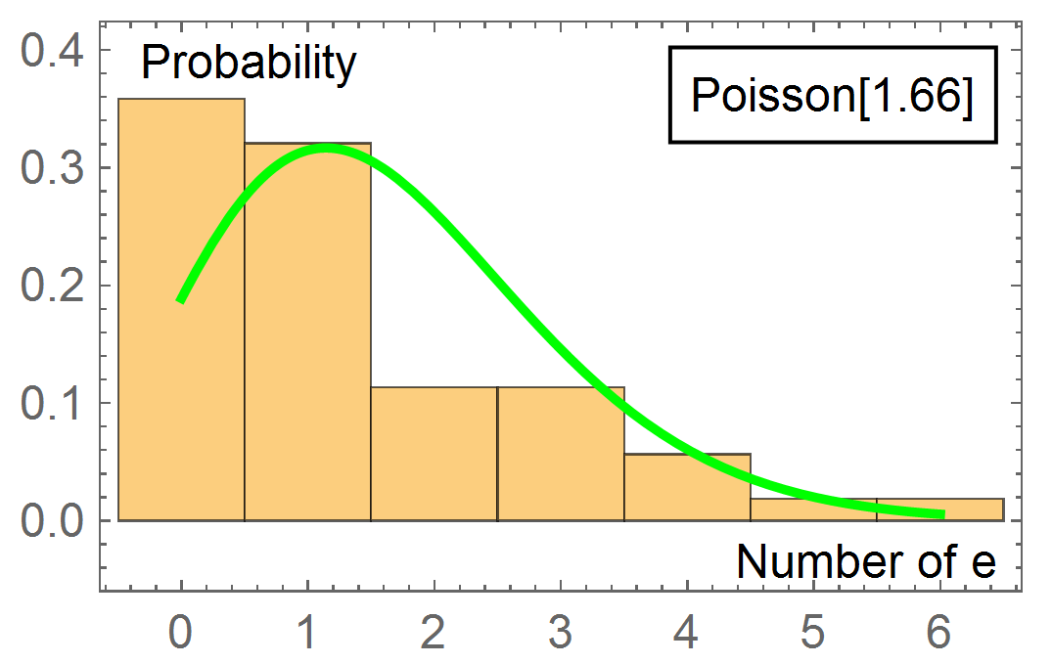
Single electron capture probability
To test selected method of intensity attenuation 53 injections were done with interval of 21 seconds
Resulting probability of single electron injection: 32%
For purely Poisson distribution maximum probability is 36.8%

Slide 7
On-line image processing
Two steps are done to reduce noise level
Dark frame subtraction
Partial line’s average is subtracted, basing on the dark side of the frame
Median filter found to be very efficient during offline processing
Two regions of interest (ROI) are specified:
ROI that is stored on the hard drive for the future processing
ROI for the number of electrons estimation for on-line diagnostics

Slide 8
Synchronization
All cameras have to be triggered simultaneously
Two types of triggers are available
Software trigger
Hardware trigger
Software trigger was used
Provided synchronization of about 1 ms which is enough for 100-1000ms exposure times
Hardware triggers weren’t wired

Slide 9
IOTA configurations
Base lattice for the nonlinear studies of the octupoles string and DN type magnets was used as the most understood
Two lattice regimes were used
Nominal configuration with fully coupled transverse motion and equal emittances
Decoupled by moving betatron tunes off the diagonal. Fractional tunes were 0.28 in the horizontal plane and 0.31 in the vertical
Several quantities of the electrons were recorded
1,2 and 3 electrons for 3D tomography
180e and 30e decays for low-intensity life-time measurements

Slide 10
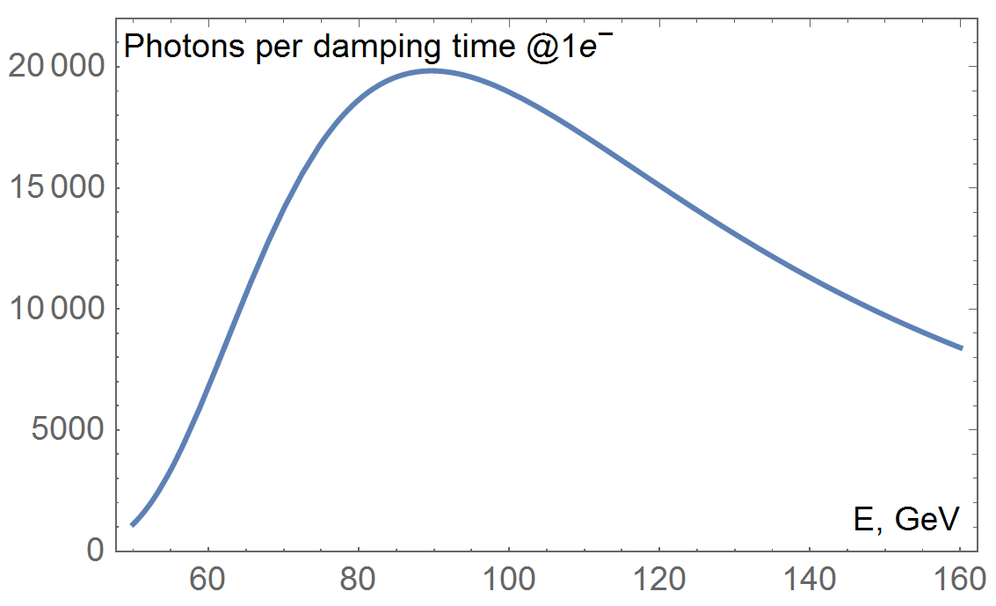
Single electron in IOTA
Real time footage from M2R camera after specially developed noise cancellation algorithms

Slide 11
Tomography method
Coordinate of the electron at turn n can be presented as
$$X_{n}=\sum{a_{i}(n)Y_{i}e^{2πi {(ψ}_{i}+n ν_{i})}},$$
here $Y_{i}$ are eigenvectors of the turn-matrix at the location of a monitor, $ν_{i}$ are betatron tunes and $a_{i}(n)$ are mode amplitudes that typically have slow dependence on n.
For the IOTA at 100 MeV characteristic time of the amplitudes change (inverse decrements) are (6.7,2.4,0.9) s. Therefore for the frame rate of 1.3 fps amplitudes remain roughly the same.

Slide 12
Tomography method
Model image can be obtained from$X_{n}$ averaged over the quick changing phase in the exponents and convoluted with point spread function of the optical system.
For the case of negligible transverse coupling, 2D images can be substituted with 1D projections.
SVD-based inverse problem solver will be used to fit model projections to measured.

Slide 13
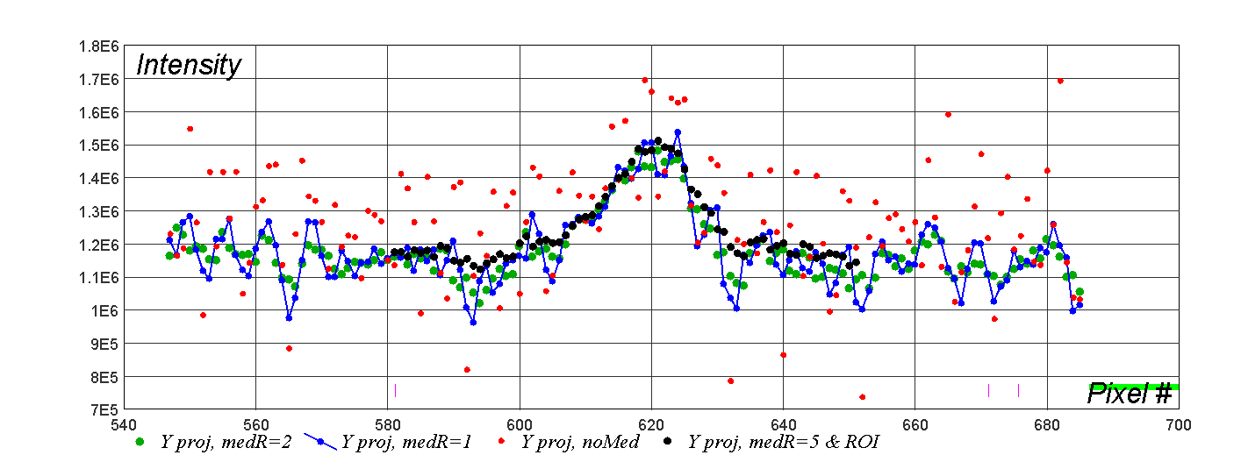
Projections: median filtering and framing
X
Y

Slide 14
Summary
Proper filtering gives significant reduction of the noise
Analysis to be continued…
About 50 000 frames from each available camera were recorded over 3 night shifts

