Slide 1
FAST/IOTA Collaboration meeting
Sergei Nagaitsev (Fermilab)
June 10, 2019

Slide 2
Welcome to the 7th FAST/IOTA collaboration meeting
FAST is a Fermilab “Facility for Accelerator Science and Technology”
Not a DOE Users Facility
The IOTA ring is a component of FAST, like the electron linac and the proton injector.
The IOTA research collaboration:
Formally registered with the Fermilab Users Office
Not fully formed yet: doesn’t have an elected spokesperson, by-laws, or a formal “authors list”.
Presently (informally) led by Giulio Stancari, who advises Alexander Valishev (Assoc Division Head for Accel S&T)
The IOTA research and operations are funded mostly by HEP GARD (Accel and Beam Physics thrust) and by Accel Test Facility Ops

Slide 3
Fermilab GARD org chart
Fermilab Director
Office of the CRO
Joe Lykken, CRO
Sergei Nagaitsev, Head of Accel Science Programs (GARD Lead)
Office of the CTO
Sergey Belomestnykh, CTO
(Accel Test Fac Ops Lead)
GARD Test Facility Ops
GARD thrusts:
Accelerator and Beam Physics (FAST/IOTA)
Advanced Accel Concepts (FACET-II, BELLA, AWA, FAST)
SRF
HF Magnets
Targets

Slide 4
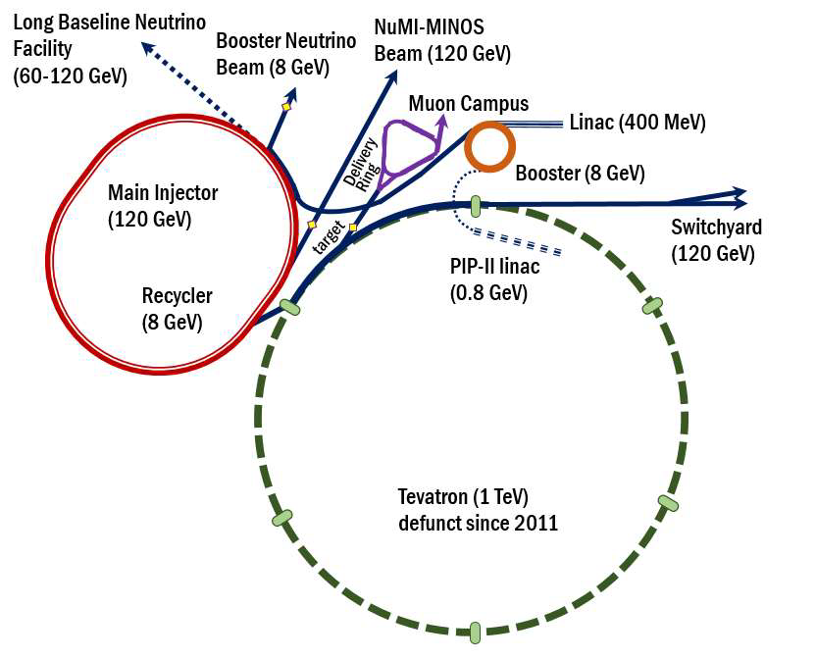
Accelerator and beam physics thrust (PI: Alexander Valishev)
Of particular interest to FNAL and HEP:
Mitigation of beam losses at high-intensity:
Booster, Recycler and MI are intensity-limited by losses (~1 W/m).
Mitigation of instabilities in high-brightness beams:
Fast instabilities which can not be suppressed by external dampers, e.g. an “electron cloud” instability (observed in the Recycler)
Beam cooling
Future colliders
Quantum limits/properties of beams

Slide 5
IOTA/FAST Facility: a center for Acc. and Beam Physics
IOTA/FAST establishes a capability at FNAL, unique in the world, to address frontier topics in Accelerator and Beam Physics
The only dedicated facility for intensity-frontier accelerator R&D; ranked as top facility (“Tier 1”) for acc. & beam physics thrust by recent GARD review (Jul 2018)
~30 Collaborating institutions
Nat. Lab Partnerships: ANL, BNL, LANL, LBNL, ORNL, SLAC, TJNAF
Many opportunities for R&D with cross-office benefit in DOE/SC

Slide 6
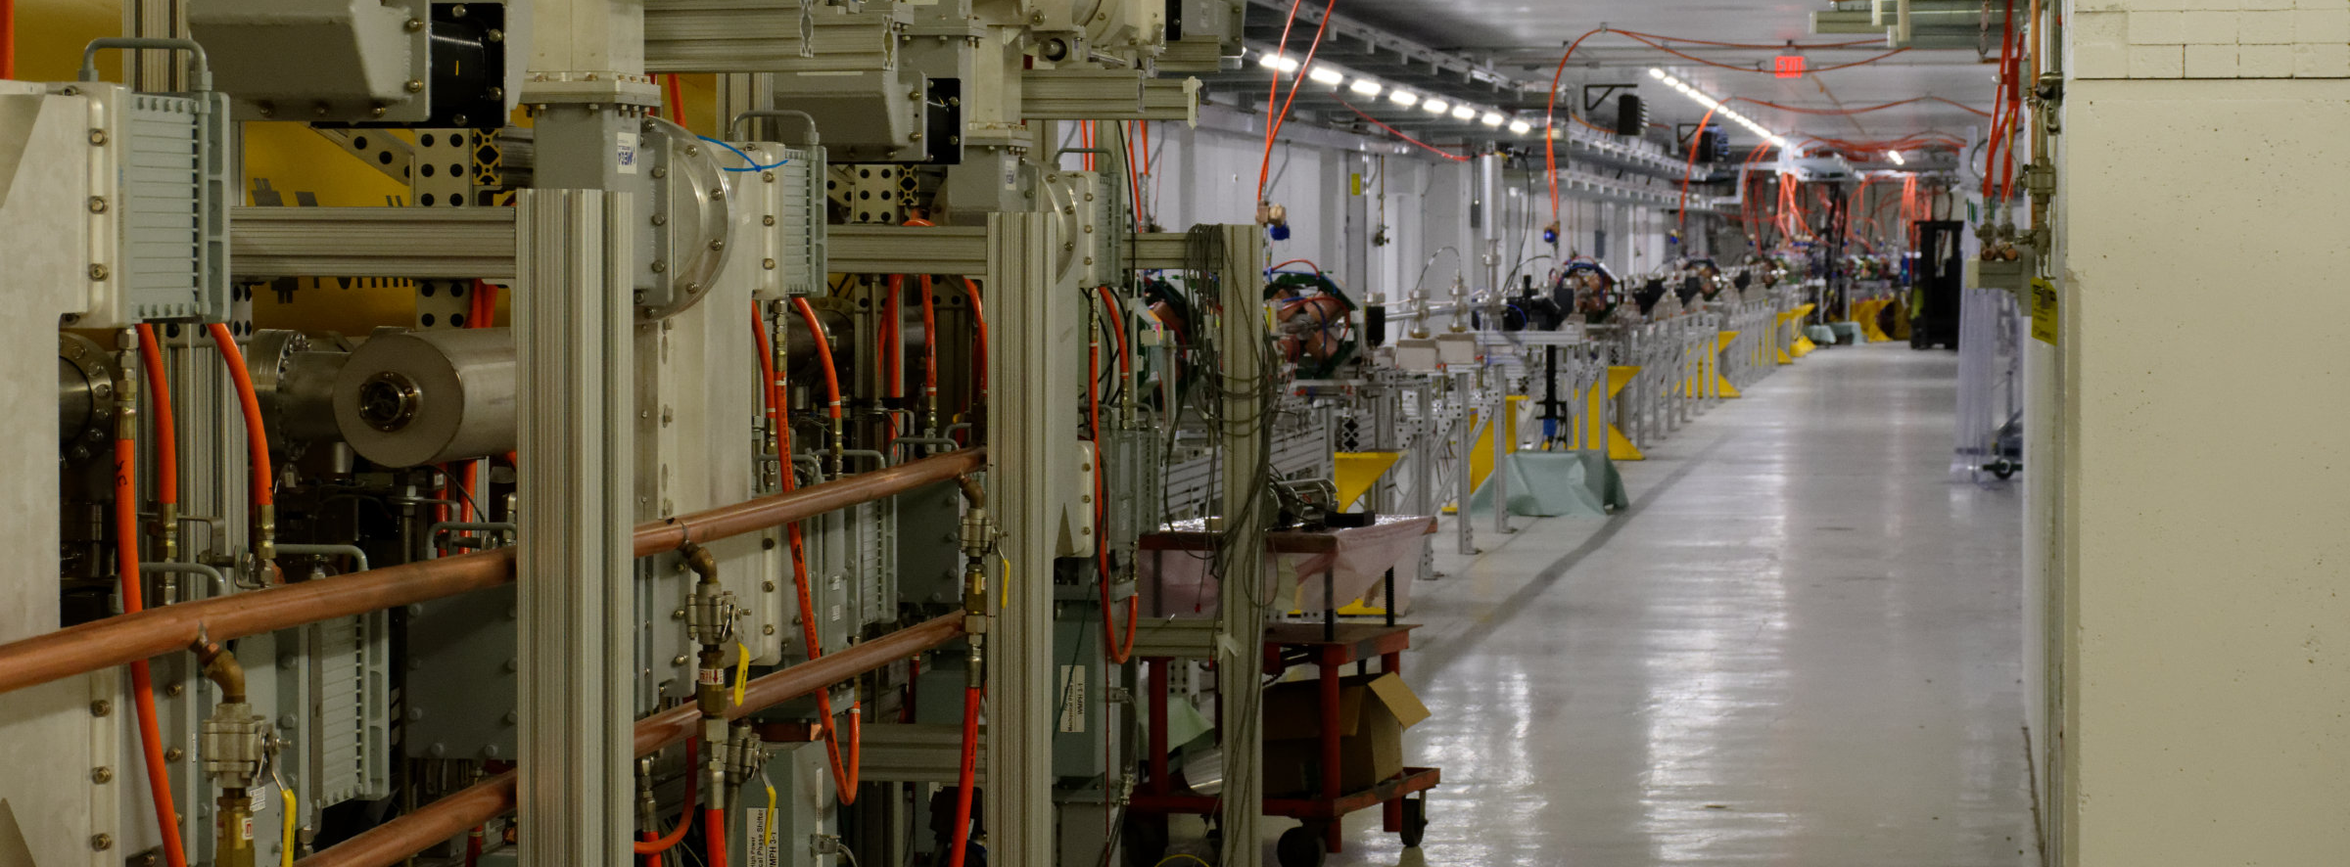
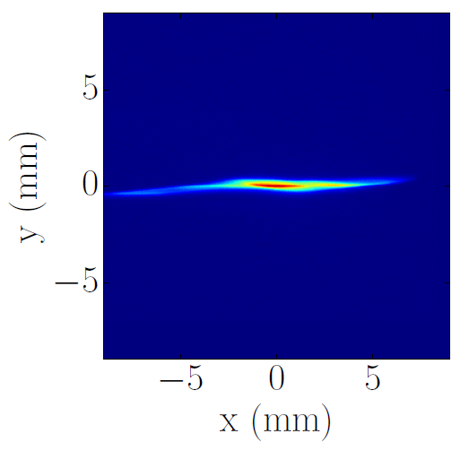
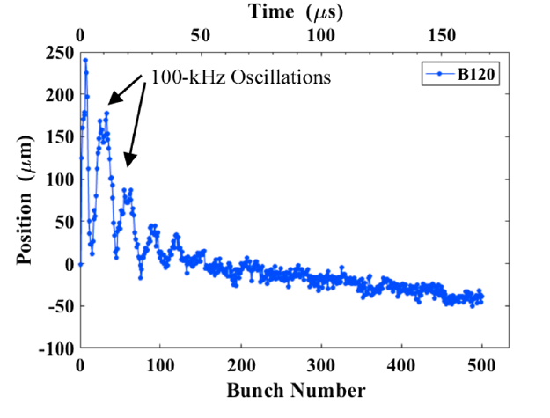
FAST injector has successfully met design goals
Commissioned to full design energy of 300 MeV; ~90% up-time eff.
World-record beam acc. by ILC-type CM: >31.5MV/m (~250MeV gain)
Successful beam delivery to IOTA
Active & expanding scientific program with new results in:
HOM excitation in SRF cavities & effects on beam emittance
Advanced beam diagnostics using synchrotron radiation
Machine learning algorithms for optimization of accelerator controls
4D phase-space tomographic reconstruction of the beam
Flat-beam transformations of high-intensity magnetized beams
Flat-beam
transformation
Multi-bunch
HOM effects
Adv. Beam
diagnostics
Tomographic reconstruction of 4D phase space

Slide 7
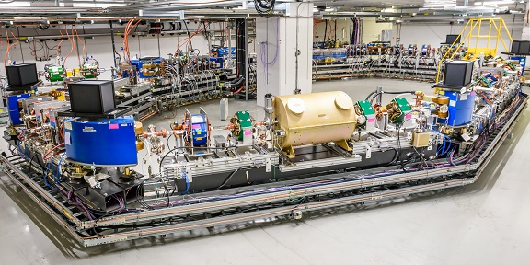
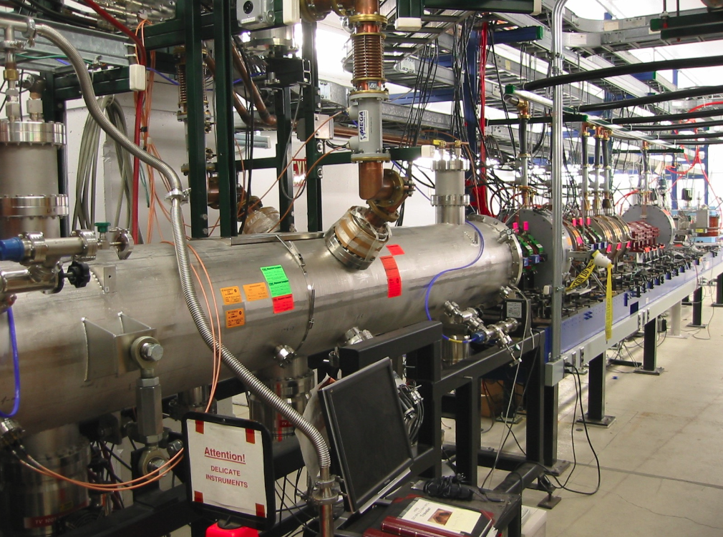
IOTA successfully constructed and commissioned
Commissioned with electrons at 47 MeV and 100 MeV; design charge achieved ~100pC
Proton injector being completed in FY20; available for start of proton science program in FY’21
IOTA proton injector

Slide 8
Accelerator Science at IOTA/FAST
IOTA Ring – priority research focused on high-intensity proton rings, driven mostly by Fermilab
Nonlinear Integrable Optics
Optical Stochastic Cooling
Space-charge compensation
Suppression of coherent instabilities
FAST e- Linac and IOTA – opportunities concurrent with main IOTA program, driven mostly by external partners
Radiation generation
High average current experiments (ILC-like electron beams)
Collaboration with the FACET-II team
EIC R&D
Quantum science: single and few-electron experiments
Near-term, high-impact
science with electrons
High-impact
science with protons

Slide 9
Nonlinear Integrable Optics
connects to instability mitigation, space-charge effects, dynamic aperture, beam-beam effects, LHC
PI’s: A. Valishev, S. Nagaitsev

Slide 10
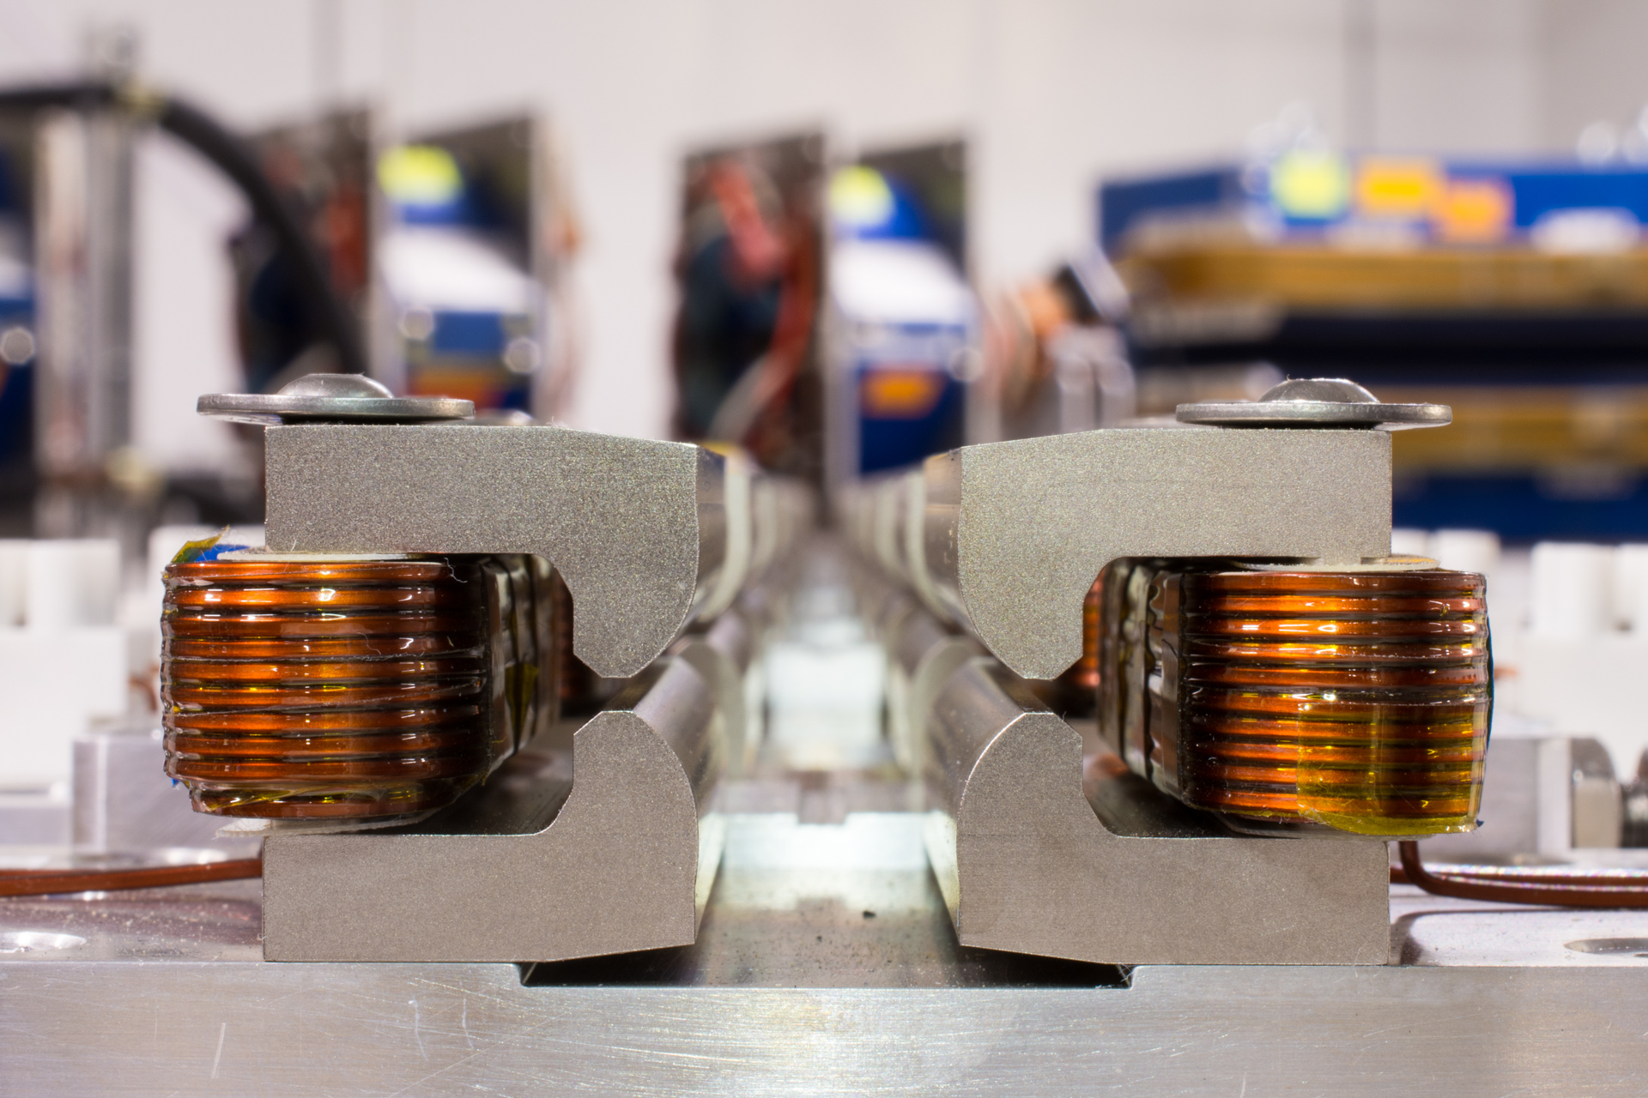
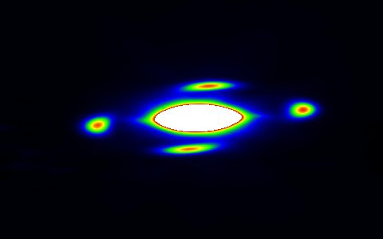
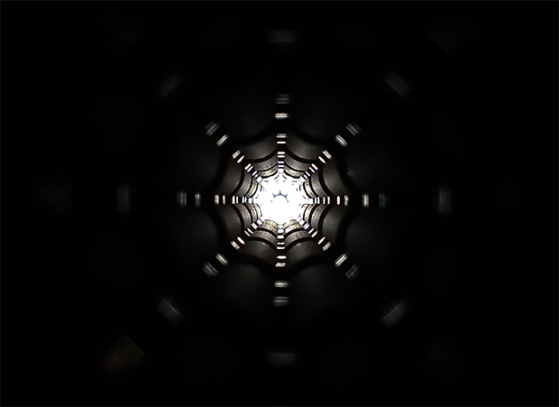
Specialized nonlinearity may transform how we focus beams
$$x”+K_{x}\left(s\right)x=S\left(s\right)x^{2}+O\left(s\right)x^{3}+⋯$$
Nonlinear terms are unavoidable, can be intentional/unintentional, and can help/harm the beam
Specially designed nonlinear magnets (or space-charge potentials) can establish additional integrals of motion that greatly enhance stability and enable higher-intensity operation
May be a critical enabling technology for next-gen. intensity-frontier facilities
IOTA NL mag. string
4-th order resonance
in IOTA ring (3/2019)
IOTA octupole string

Slide 11
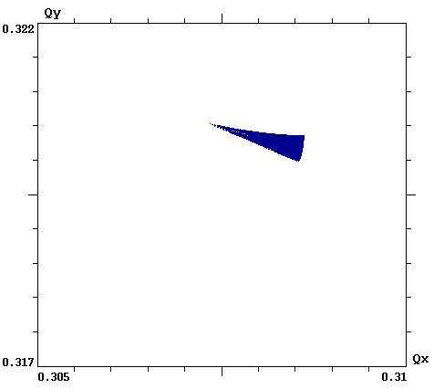
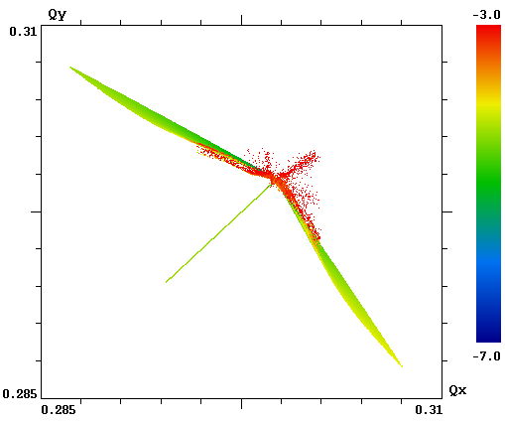
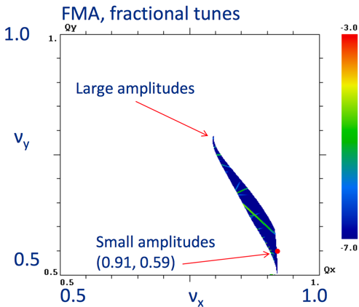
NIO could yield important benefits for future HEP machines
Reduced chaos in single-particle motion: e.g helpful for space-charge suppression
Strong immunity to collective instabilities via Landau damping: provides for higher beam current and brightness
Low cost: brighter beams produce a cascade of cost savings throughout the design, engineering and construction of accelerators
LHC
IOTA w/ Oct.
IOTA w/ NL mag.
ΔQ = 0.001
ΔQ = 0.025
ΔQ = 0.25
Fig. of merit is “tune spread” (ΔQ): the spread in oscillation freq. for beam particles

Slide 12
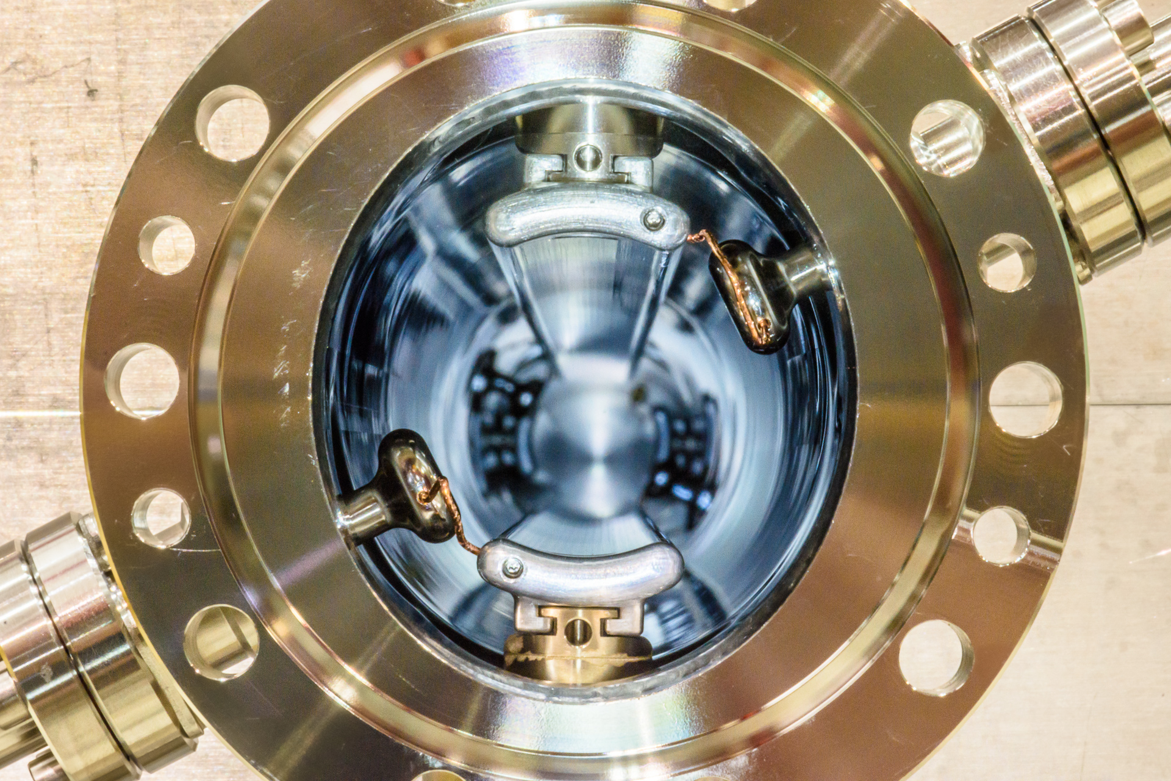
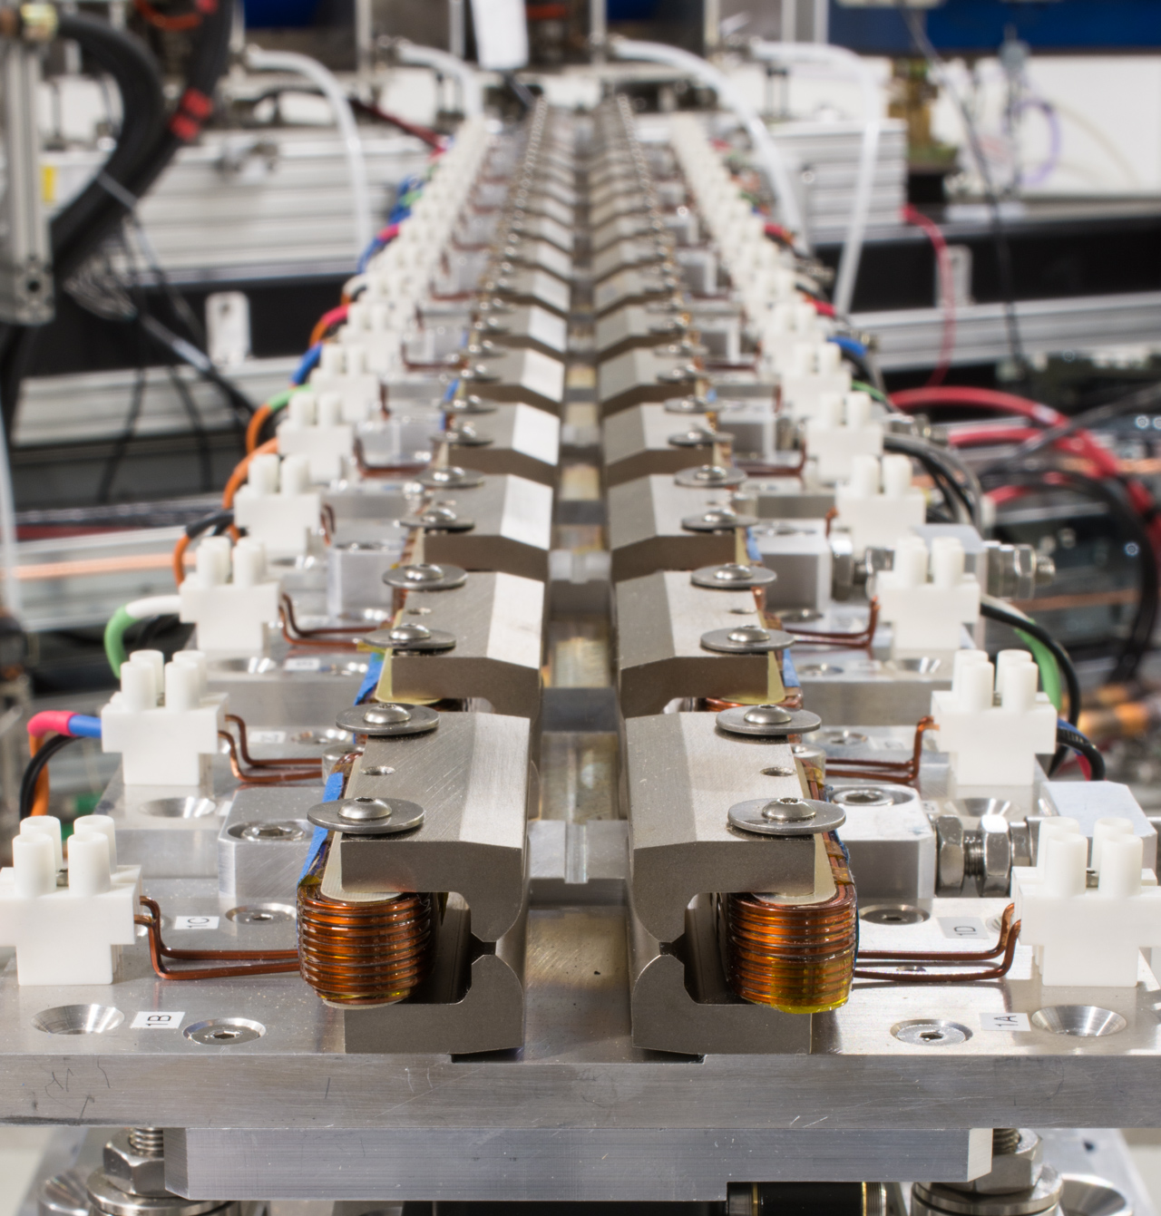
IOTA is purpose-built to explore the NIO concept
Phase I with electrons: 2018-2021
Probe chaos and beam dynamics for NIO systems
Octupole string as NIO element
IOTA NL magnet as NIO element
Phase II with protons: 2020-2022
Study NIO systems in high-intensity regime
Study space-charge compensation methods in NIO systems
IOTA stripline kicker
Goal: Reduce beam losses and improve immunity to coherent instabilities for bright beams
IOTA NL mag. string

Slide 13
Space-charge compensation and electron lenses
connects to LHC, space-charge effects, beam-beam-effects
PI’s: G. Stancari, V. Shiltsev

Slide 14
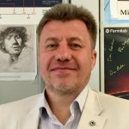
IPAC 2019
The Nishikawa Tetsuji Prize for a recent, significant, original contribution to the accelerator field, with no age limit.
Prof. Vladimir SHILTSEV
“For his original work on electron lenses in synchrotron colliders, his outstanding contribution to the construction and operation of high-energy, high-luminosity hadron colliders and for his tireless leadership in the accelerator community.”

Slide 15
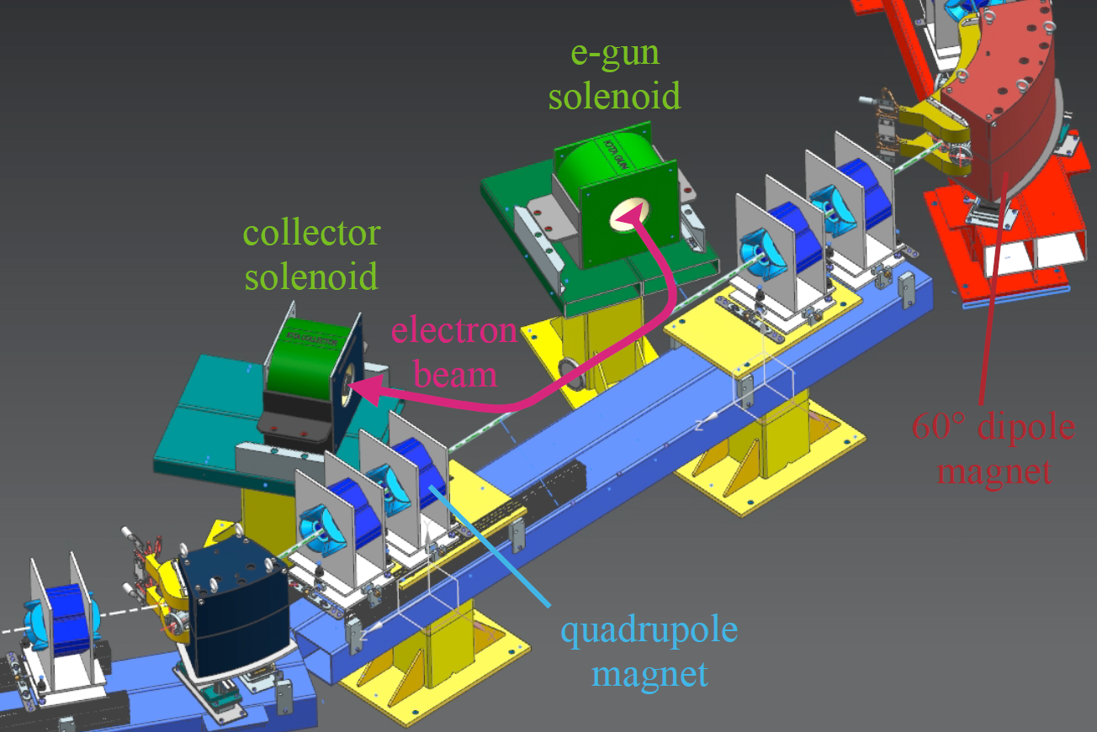
Electron lens is a versatile research tool for IOTA
Research with stored electrons:
Novel nonlinear element for integrable optics (using space charge)
Research with stored protons:
Space-charge compensation and Landau damping
Electron cooling: extending performance of IOTA for space-charge studies; cooling studies in a NIO lattice

Slide 16
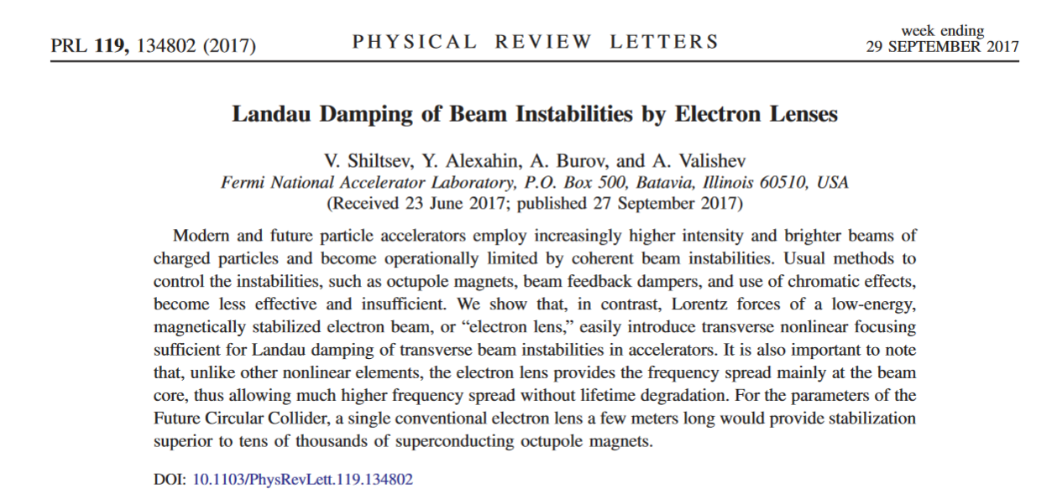
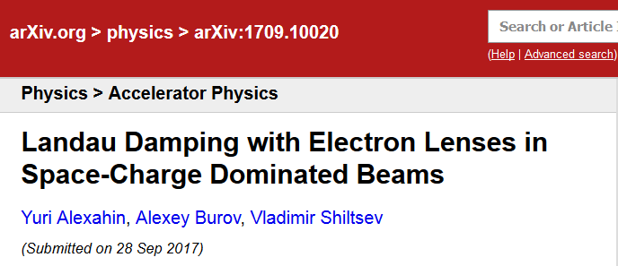
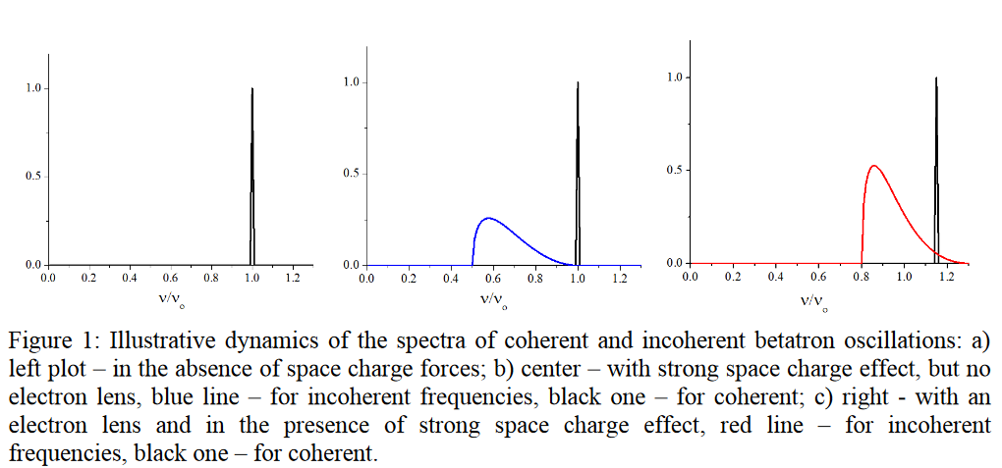
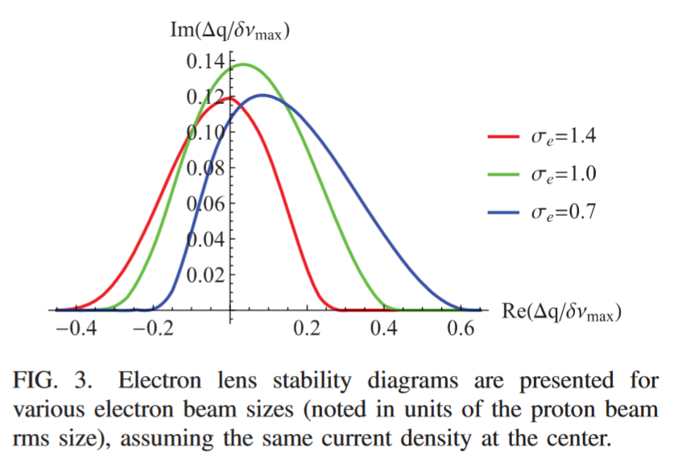
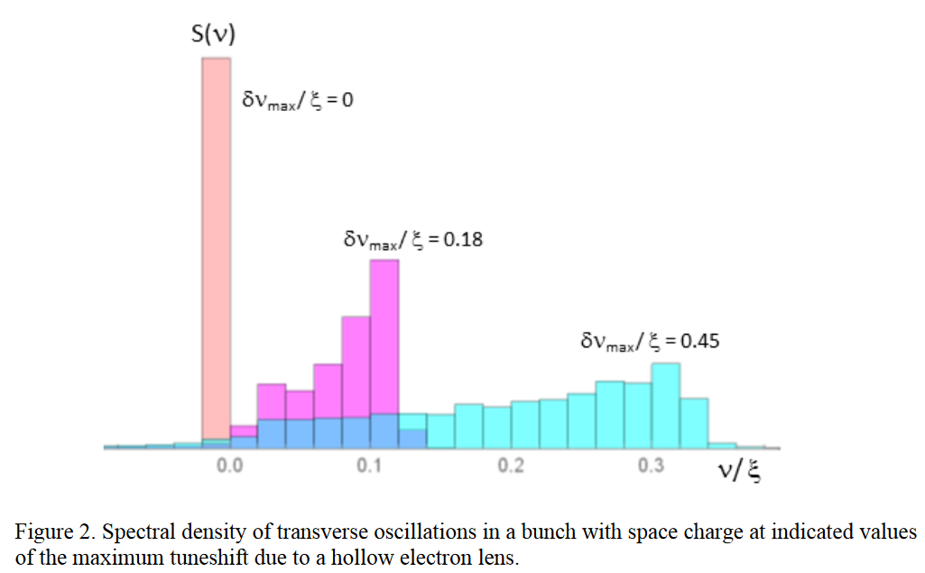
Landau Damping with Electron lenses
“…For the parameters of the Future Circular Collider, a single conventional electron lens a few meters long would provide stabilization superior to tens of thousands of superconducting octupole magnets.”

Slide 17
Photons and Quantum Science
connects to future FELs and to QIS
PI’s: S. Nagaitsev, G. Stancari,
T. Shaftan (BNL), Z. Huang (SLAC)

Slide 18
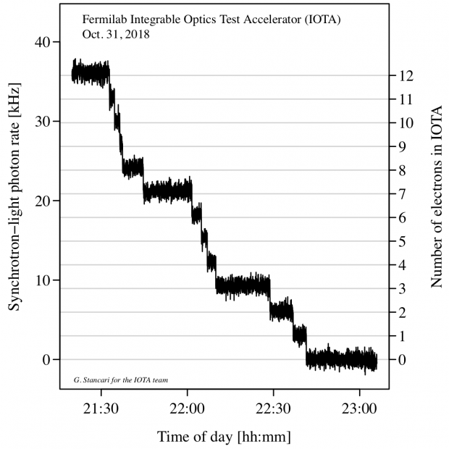
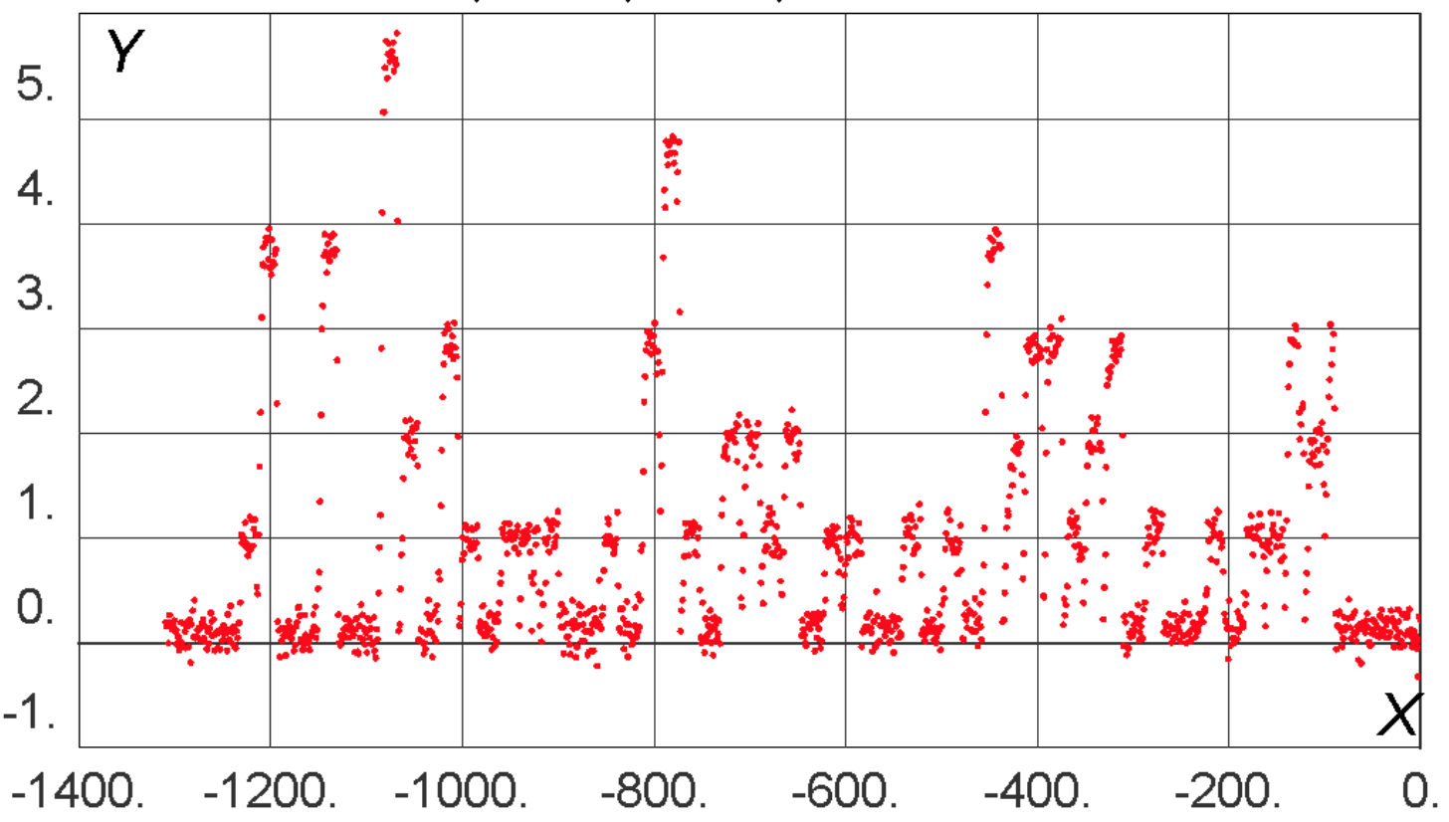
IOTA presents unique opportunities in QS
IOTA demonstrated storage of a single relativistic electron for long periods of time (~10 minutes).
High particle energy (100 MeV) enables observation of SR emission
This opens the way to a wide variety of quantum experiments
Nov. 2018: A one-day Workshop on Single-Electron experiments in IOTA – 30 participants from U.Chicago, LANL, SLAC, ANL, Princeton, RadiaBeam, BNL, UC Berkeley, Fermilab
PMT count rate
Discrete steps from loss
of single electrons
single e- beam
injection every 20 s
Number of Electrons in IOTA
Time (s)

Slide 19
Optical Stochastic Cooling
connects to future colliders, EIC, light sources, quantum science
PI’s: J. Jarvis, V. Lebedev, S. Chattopadhyay

Slide 20
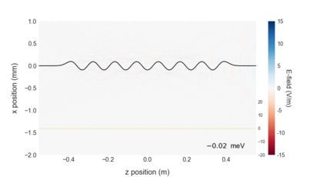
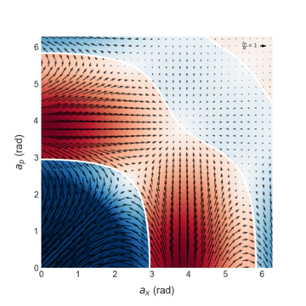
OSC extends the SC principle to optical bandwidth
2
1
4
Energy exchange in kicker
5
3
Wavepacket generated
Particle delayed in bypass
Wavepacket amplified and focused
Corrective kick applied
Cooling accumulates over many passes
Cooling vs. betatron and
synchrotron amplitudes
10³ – 10⁴ increase in cooling rate over SC and extension into an energy range where no operational cooling solutions exist
A.A.Mikhailichkenko, M.S. Zolotorev, Phys. Rev. Lett. 71 (25), p. 4146 (1993)
M. S. Zolotorev, A. A. Zholents, Phys. Rev. E 50 (4), p. 3087 (1994)

Slide 21
FAST science program
connects to the EIC
PI’s: P. Piot

Slide 22
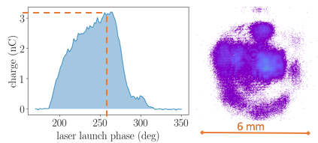
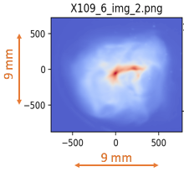
High-Charged Magnetized Beams at FAST-IOTA
Northern Illinois Center for Accelerator
and Detector Development
2018/19 Run: High-charge magnetized beam
Production of high-charge (3.2 nC) magnetized beam [up to 7 nC produced!]
characterization of magnetization
Transport + manipulation over long beamline including use of locally non-symmetric optics
Next Run: High-current magnetized beams → understanding halo
Explore halo formation in magnetized beam using a long-dynamical range diagnostics (Jlab LDRD)

Slide 23
In conclusion…
IOTA/FAST is a unique R&D facility and the only one in the world dedicated to the future of intensity-frontier research:
Electrons and protons, linac and rings -- concurrently
The IOTA science program explores a wide variety of fundamental topics in accelerator and beam physics
IOTA also constitutes an excellent platform for technological developments that may be vital for realizing next-gen. facilities
Significant opportunities for cross-office benefit inside DOE; draws heavily on FNAL’s heritage in cooling and beam dynamics
As an operational SRF accelerator, FAST cuts across GARD thrusts as a valuable tool for studying SRF technology and its interaction with an intense beam; attracting significant interest from global partners

