Slide 1
Fermilab Power Upgrade: Scenarios and Challenges
Jeffrey Eldred
FAST/IOTA Collaboration Meeting 2019
June 10th 2019

Slide 2
2
2
Fermilab High Power with
Rapid-Cycling Synchtron (RCS)
2
Jeffrey Eldred | Fermilab Power Upgrade: Scenarios and Challenges
Notes:
2
2
2
2
2
2

Slide 3
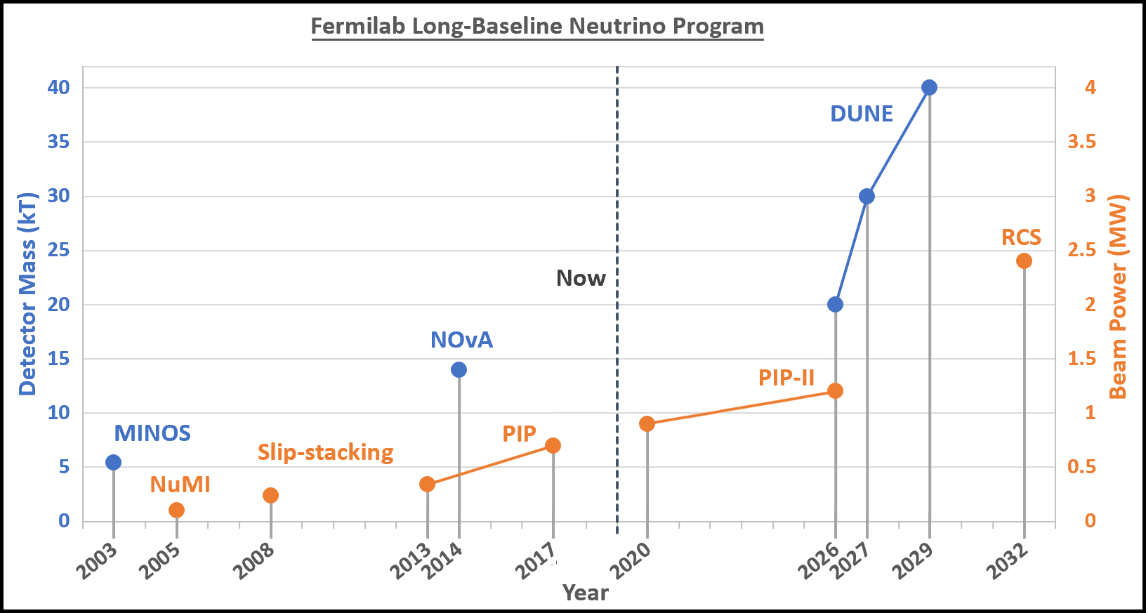
3
Beam Power and Detector Size
DUNE Interim Design Report calls for 2.4 MW by 2032.
3
Jeffrey Eldred | Fermilab Power Upgrade: Scenarios and Challenges
Notes:
3
3
3

Slide 4
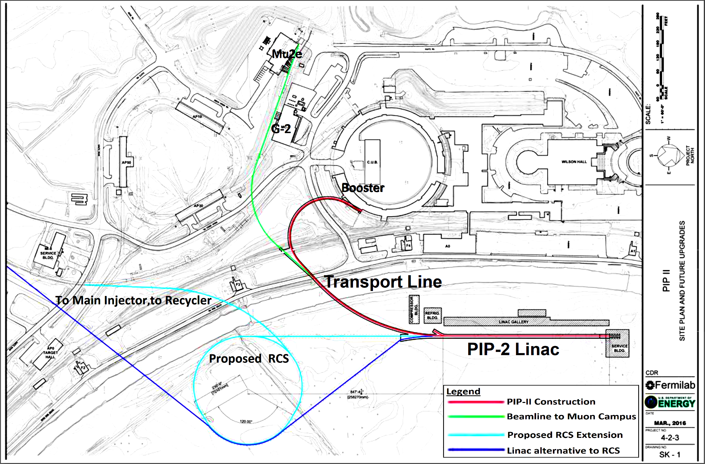
4
4
“ PIP-III ” : Replace Booster with RCS and/or Linac
(Linac and RCS not to scale)
4
Jeffrey Eldred | Fermilab Power Upgrade: Scenarios and Challenges
Notes:
4
4
4
4
4
4

Slide 5
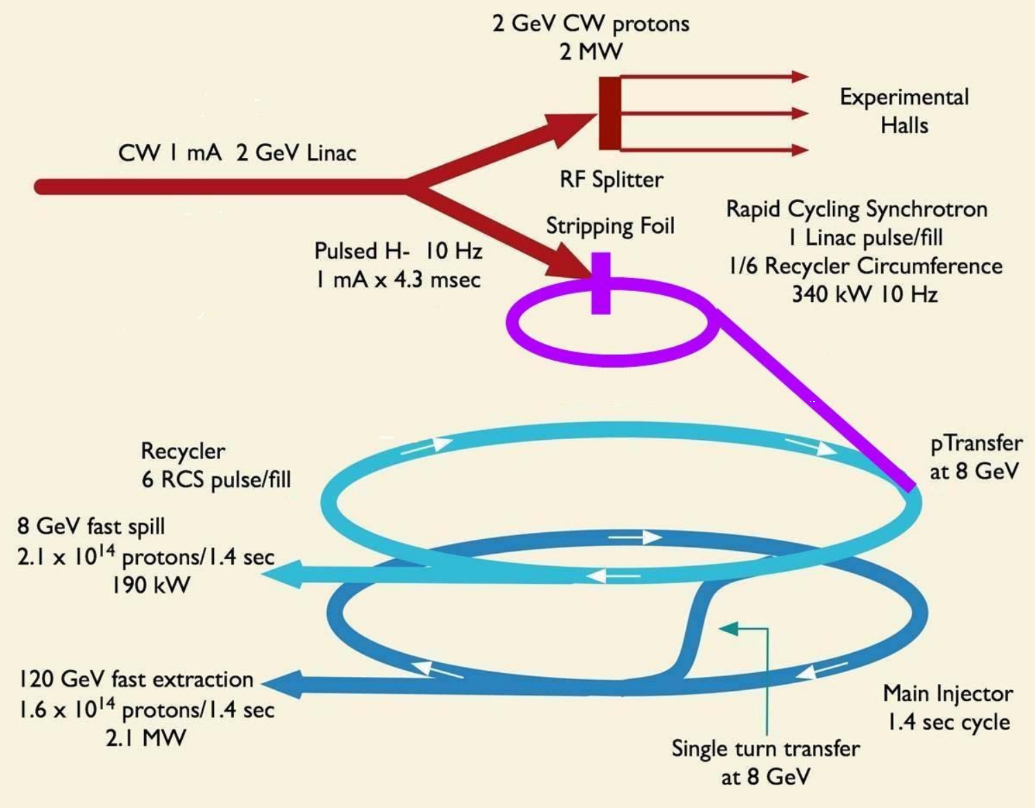
5
Project X ICD-2 Proposal, 2010:
2 GeV Linac
+ New RCS
= 2.1 MW
5
Jeffrey Eldred | Fermilab Power Upgrade: Scenarios and Challenges
Notes:
5
5
5

Slide 6
6
Our Recent Design Study
Fermilab internal LDRD-grant 2016-2019:
“A comprehensive investigation…rapid cycling synchrotron for high-intensity beams”
JINST paper: arXiv:1903.12408 (Eldred, Lebedev, Valishev)
Poster for User’s Meeting this Wednesday
- An active conversation at Fermilab!
6
Jeffrey Eldred | Fermilab Power Upgrade: Scenarios and Challenges
Notes:
6
6
6

Slide 7
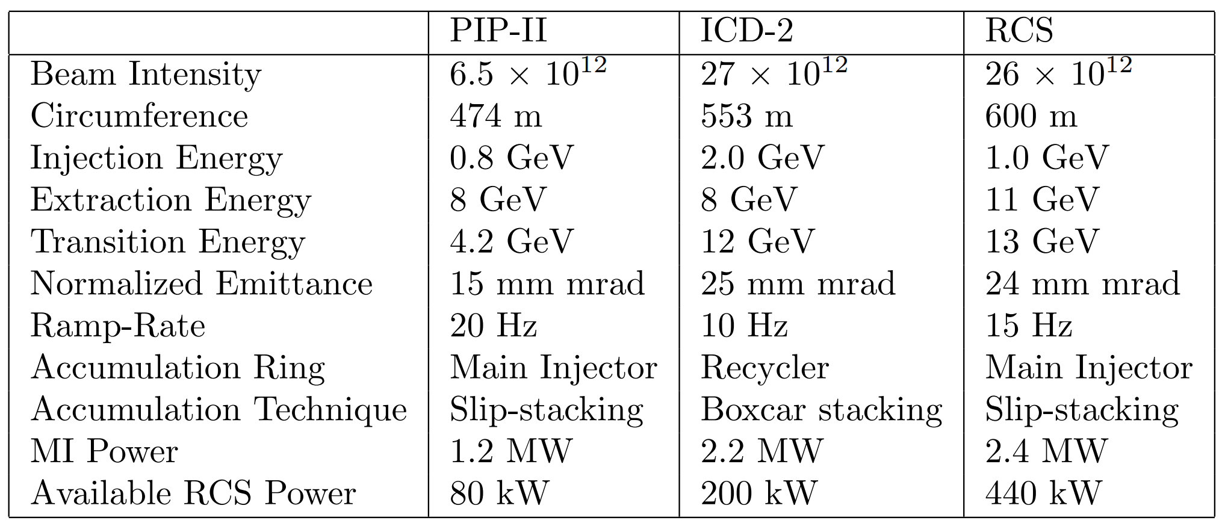
7
Parameter Table for Proposed Rings
7
Jeffrey Eldred | Fermilab Power Upgrade: Scenarios and Challenges
Notes:
7
7
7

Slide 8
8
ICD-2 vs. our Fermilab RCS proposal – Pros and Cons
2.4 MW Beam Power for DUNE
- high-power neutrino targets → more beam to DUNE
Less stress on Main Injector
- higher RCS energy → smaller emittance, less space-charge
Larger RCS Laslett Tune-shift
- aggressive collimation → following J-PARC precedent
- higher superperiodicity → smaller tune-shift per period
- advanced technology→ IOTA technology for intense beams
440 kW Available RCS Power at 11 GeV
- Is this something experiments can use?
Slip-stacking Accumulation
8
Jeffrey Eldred | Fermilab Power Upgrade: Scenarios and Challenges
Notes:
8
8
8

Slide 9
9
Some Other Scenarios
With a new 11-GeV Storage ring to replace the Recycler,
higher beam power is possible.
- caveat: LBNF target hall rated for 2.4~MW.
With even greater RCS intensity, slip-stacking is not necessary.
What are the ultimate space-charge limits for modern machines?
9
Jeffrey Eldred | Fermilab Power Upgrade: Scenarios and Challenges
Notes:
9
9
9

Slide 10
10
10
Challenges for RCS Design
10
Jeffrey Eldred | Fermilab Power Upgrade: Scenarios and Challenges
Notes:
10
10
10
10
10
10

Slide 11
11
Space-charge Tune-Shift Limit
“Space-charge Tune-shift” from beam self-field can be used as a generic proxy for intensity of space-charge forces.
- relativistically-adjusted figure for space-charge density.
- true tune-shift would incorporate image charges.
After PIP-II, painted injection like most high-power proton facilities.
Painted injection means emittance can be varied and we can shrink the beam until we encounter a space-charge limit.
Laslett Tune-shift:
11
Jeffrey Eldred | Fermilab Power Upgrade: Scenarios and Challenges
Notes:
11
11
11

Slide 12
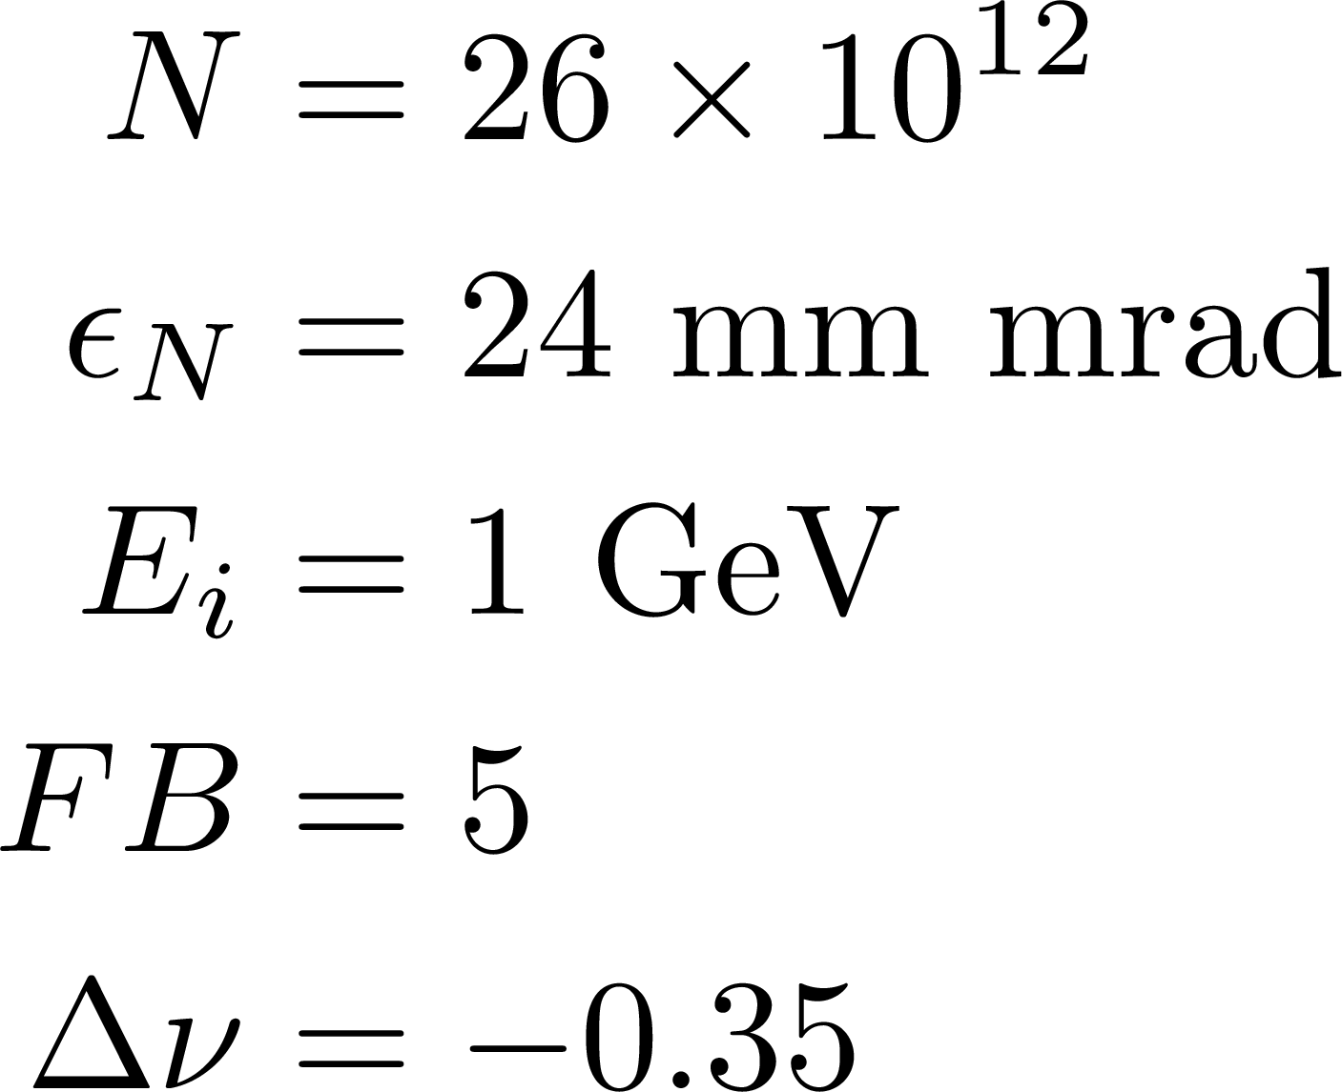
12
J-PARC Precedent for Tune-shift, Power, Collimation
The J-PARC RCS shows intensity of 83e12 protons, 1 MW extracted beam power, -0.30 tune-shift, 0.1 tune-shift per super-period.
Hotchi et al. PRAB 2017.
Collimators at 3σ aperture of the beam.
Total ring acceptance factor of 1.5 on collimator acceptance.
We can adopt the same strategy at a much smaller aperture.
RCS with -0.35 tune-shift,
-0.044 tune-shift per super-period.
with 2nd harmonic cavities, ~0.24 tune-shift.
Parameters:
Laslett Tune-shift:
12
Jeffrey Eldred | Fermilab Power Upgrade: Scenarios and Challenges
Notes:
12
12
12

Slide 13
13
Eddy Currents in Vacuum Chamber
Vacuum chamber radius a: 2.5 cm
Ramp rate: 15 Hz
Peak Dipole Field: 1.2 T
Vacuum chamber heating power by eddy currents
1.28mm Steel-316: 108 W/m
0.45mm Inconel-625: 33 W/m
Conservative air cooling estimate of convective cooling
heat transfer coefficient 10⁻³ W/cm²/K
1.28mm Steel-316: ΔT = 92 K
0.45mm Inconel-625: ΔT = 21 K
13
Jeffrey Eldred | Fermilab Power Upgrade: Scenarios and Challenges
Notes:
13
13
13

Slide 14
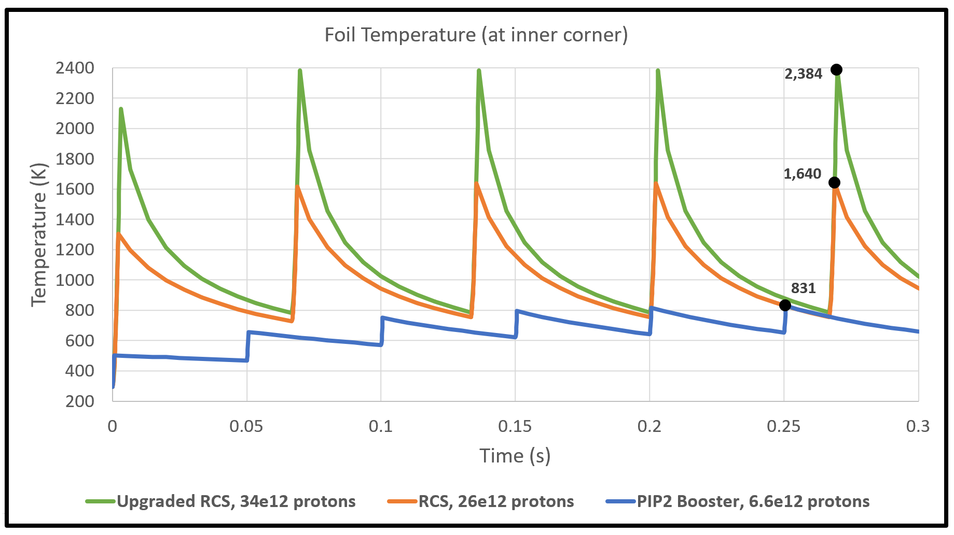
14
H- Foil Heating
(PIP-II Linac is 2 mA, CW-capable)
14
Jeffrey Eldred | Fermilab Power Upgrade: Scenarios and Challenges
Notes:
14
14
14

Slide 15
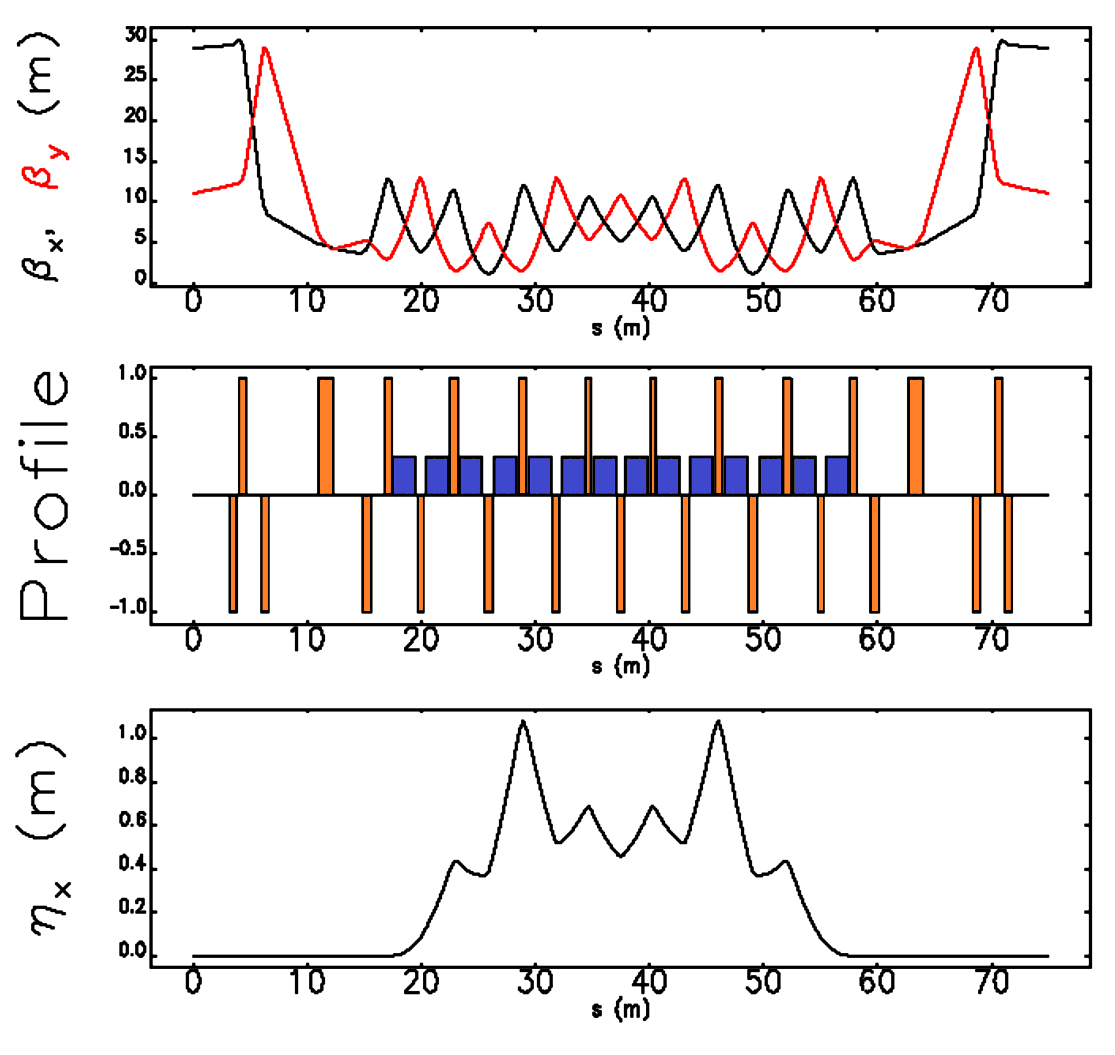
15
Example Lattice Design
8-fold periodicity.
Small betas to large.
Insertion-free drifts.
6.5 m, 2x4.4m
2x2.4 m, 2x1.3m
Adequate injection with 2π/3 collimation.
Length for RF straights.
γ_{T} = 14.3
15
Jeffrey Eldred | Fermilab Power Upgrade: Scenarios and Challenges
Notes:
15
15
15

Slide 16
16
16
R&D for High Power
16
Jeffrey Eldred | Fermilab Power Upgrade: Scenarios and Challenges
Notes:
16
16
16
16
16
16

Slide 17
17
IOTA Technologies
Nonlinear integrable optics:
Provides incredible nonlinear focusing without the usual loss in dynamic aperture. Mitigates halo formation and collective effects.
Electron lens:
A versatile particle accelerator device with applications in beam-beam compensation, collimation, nonlinear focusing, and direct space-charge compensation.
- Vladimir Shiltsev IPAC2019 Nishikawa Prize Talk
Both technologies tested at IOTA over the next several years.
For robustness of performance?
Or for upper-bound of performance?
17
Jeffrey Eldred | Fermilab Power Upgrade: Scenarios and Challenges
Notes:
17
17
17

Slide 18
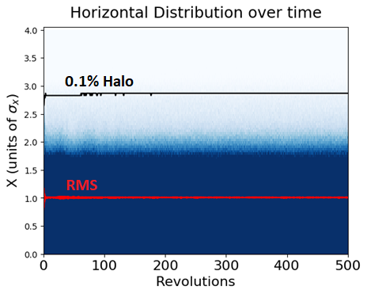
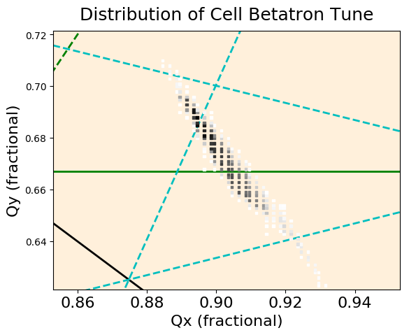
18
Space-charge Simulation of iRCS
Waterbag beam injected with 20% mismatch
Laslett tune-shift of 0.4, equivalent to ~30e12 protons.
Beam also stable under large chromatic effects.
Eldred,
Valishev
IPAC 2018
18
Jeffrey Eldred | Fermilab Power Upgrade: Scenarios and Challenges
Notes:
18
18
18

Slide 19
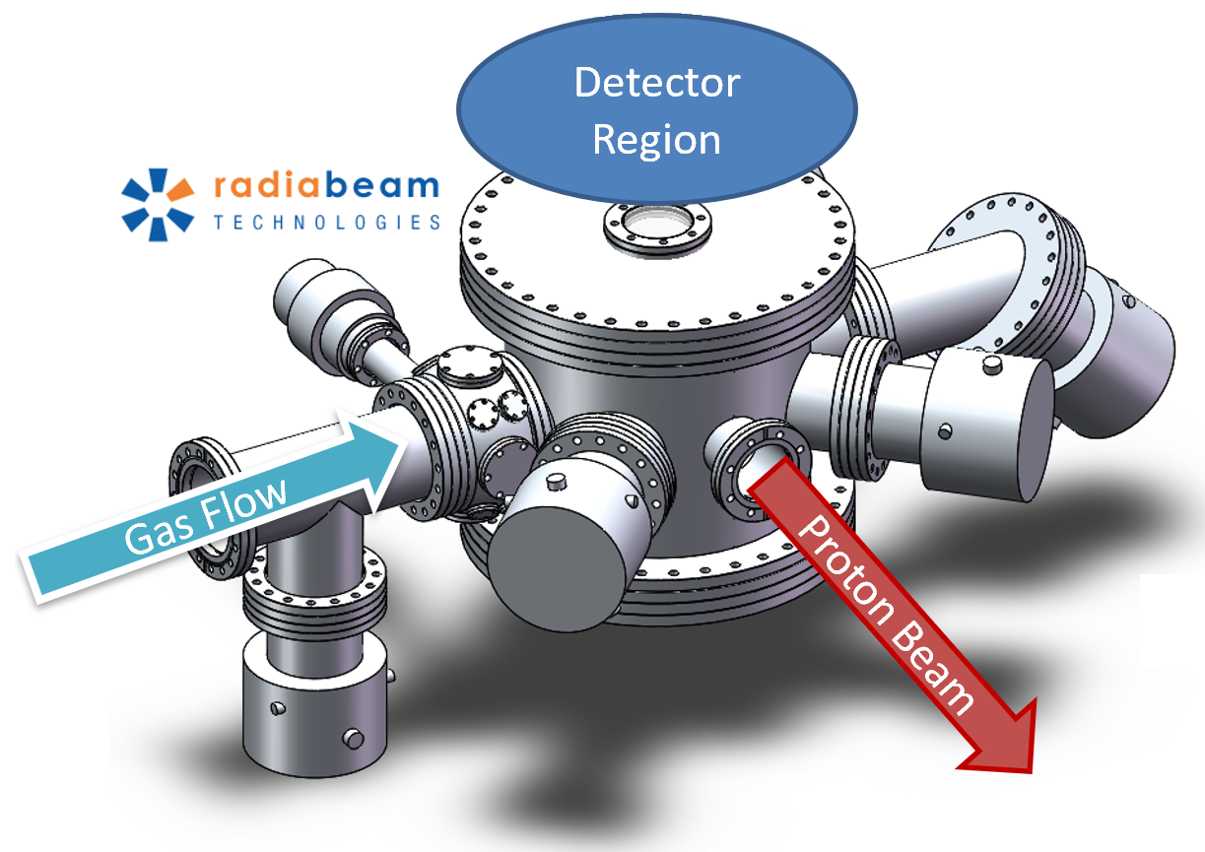
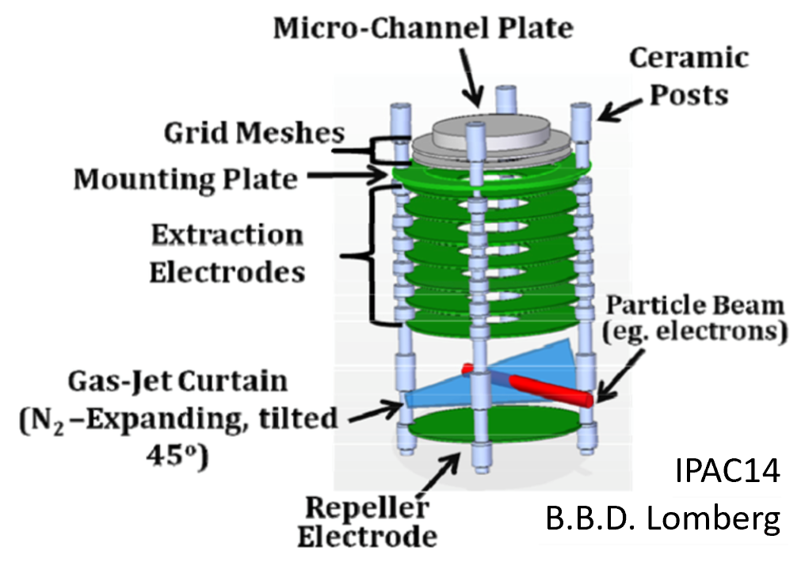
19
Proton Halo Diagnostics
Szustkowski
The relevant losses are often part of the 0.1% beam halo → diagnostics
A gas sheet profile monitor being developed by NIU for proton diagnostics at FAST/IOTA. Halo monitoring for nonlinear intense beams.
Gas pressure is variable → high-dynamic range with turn-by-turn capability.
19
Jeffrey Eldred | Fermilab Power Upgrade: Scenarios and Challenges
Notes:
19
19
19

Slide 20
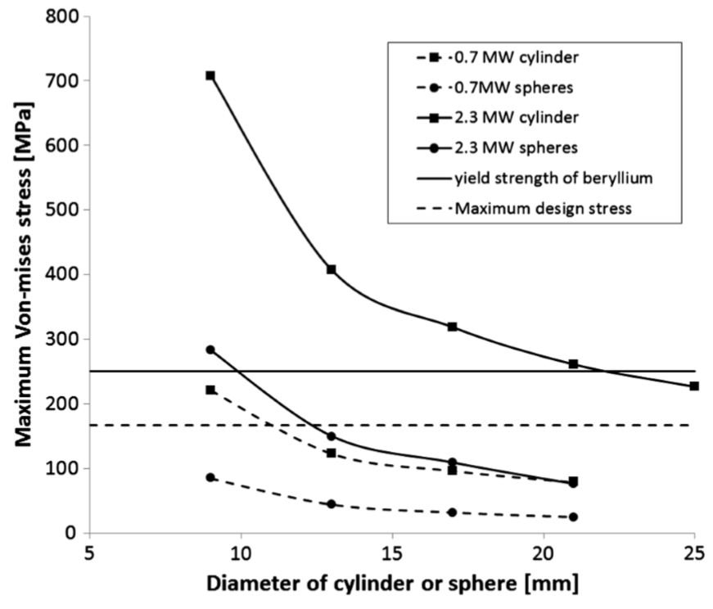
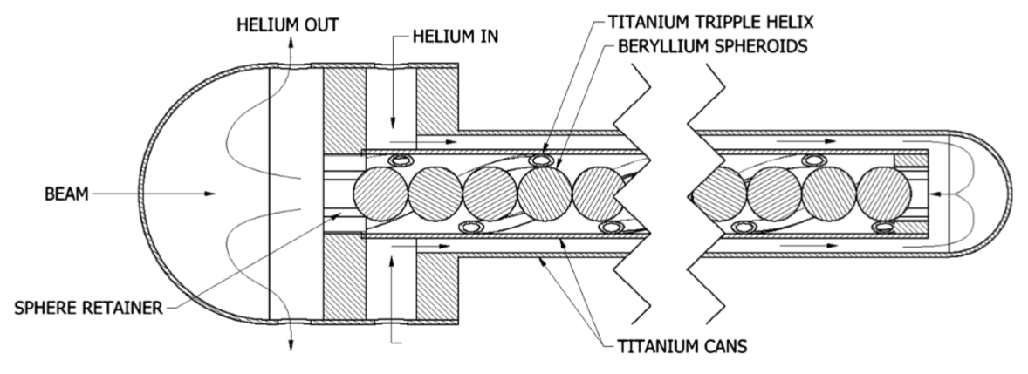
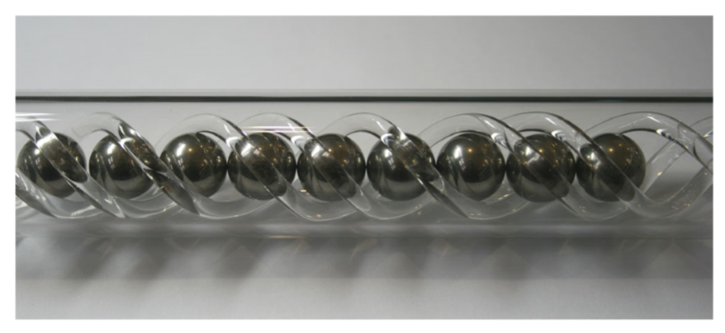
20
High-Power Neutrino Targets
Detailed design of 2.3 MW Be target for neutrino beams.
- assumes 160 x 10¹² proton pulses.
Active area of R&D development – shock test, radiation damage, target design, flux optimization etc.
T. Davenne et al. PRSTAB 2015
20
Jeffrey Eldred | Fermilab Power Upgrade: Scenarios and Challenges
Notes:
20
20
20

Slide 21
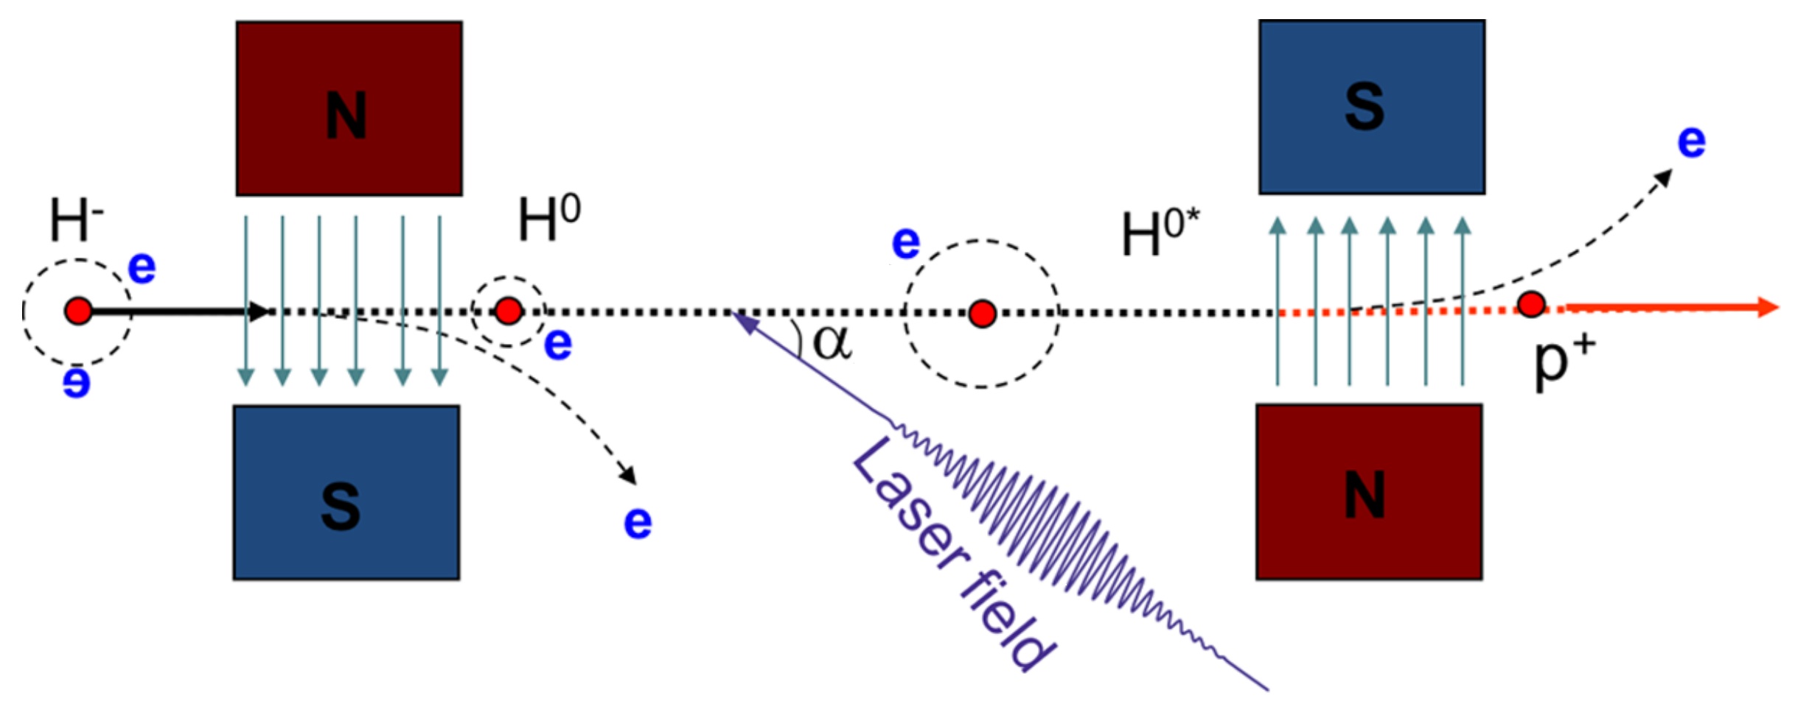
21
H⁻ Laser Stripping
Cousineau et al.
PRAB 2017
SNS demonstrated 95% stripping efficiency of a 1 GeV H⁻ beam with 10 μs macropulse duration using a UV laser at 1 MW peak power.
“[next]… a doubly resonant optical cavity scheme is being developed to realize a cavity enhancement of burst-mode laser pulses.”
With laser-stripping, there is no foil-heating limit on RCS intensity.
No scattering from circulating beam → reduced activation at injection.
21
Jeffrey Eldred | Fermilab Power Upgrade: Scenarios and Challenges
Notes:
21
21
21

Slide 22
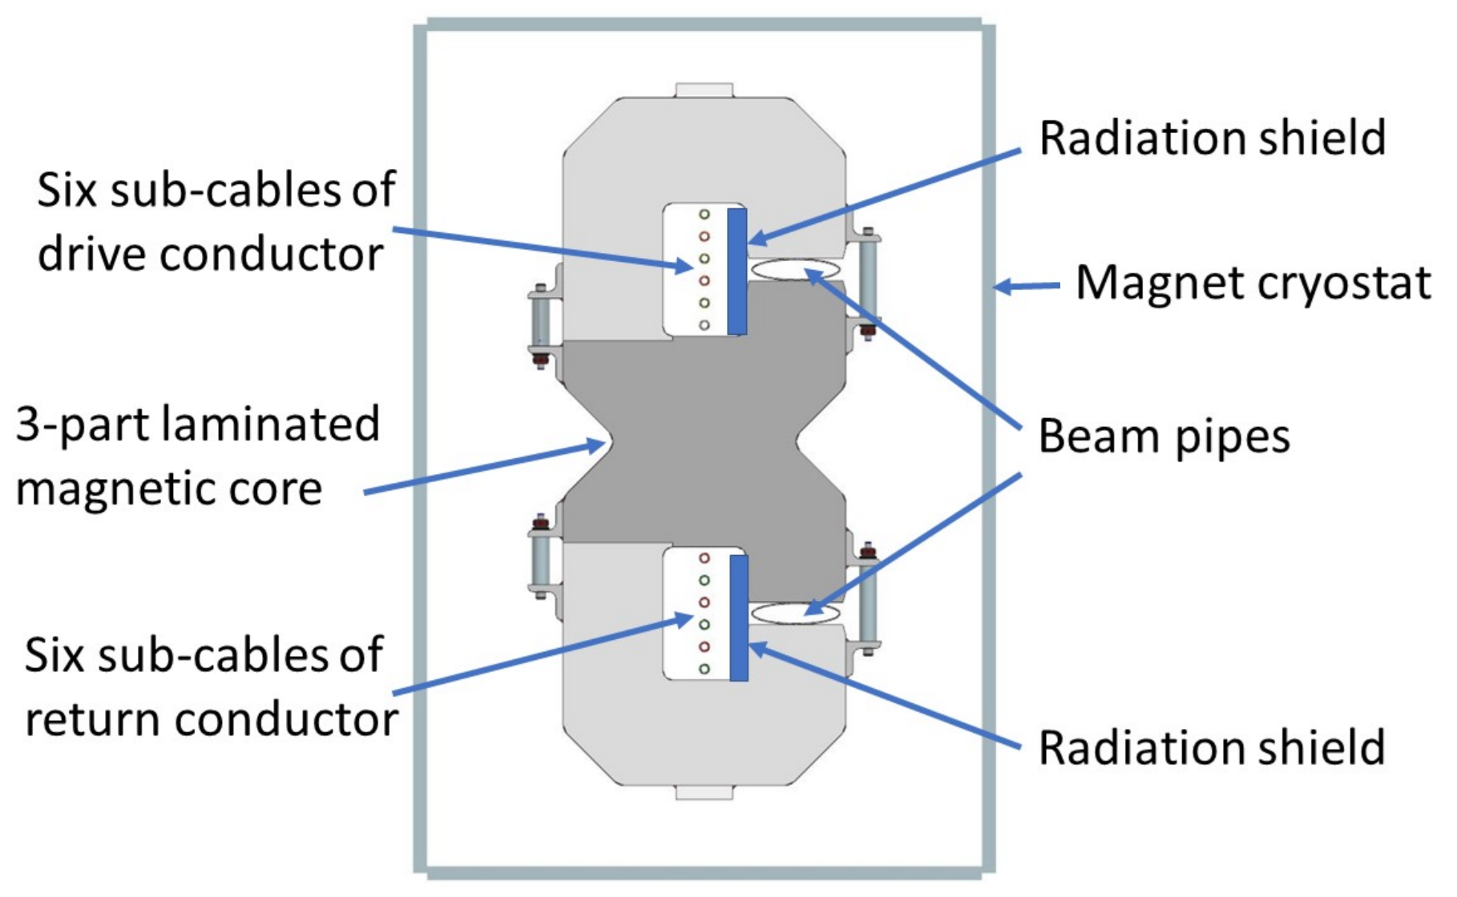
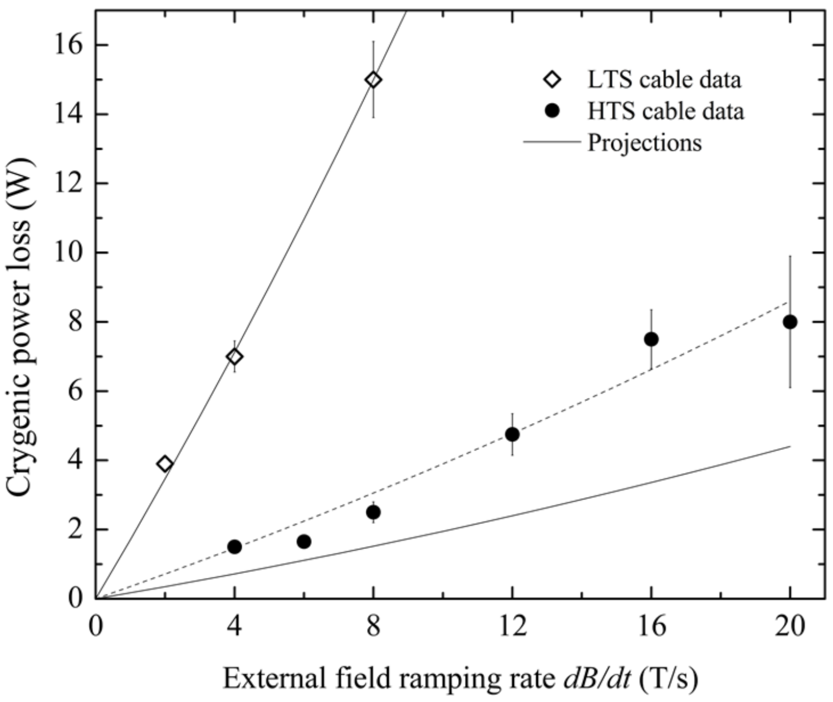
22
Fast-ramping Super-ferric Magnets
Piekarz et al.
NIM A 2019
YBCO-based HTS super-ferric dipole demonstrated >12 T/s.
Super-ferric → Less circum. / energy → less RF power, less intensity
300m, 2x 15e12 protons, 5Hz boxcar stacking, storage ring = 2.4 MW
…or 500m, 2x 28e12 protons, 22 GeV above transition, 7.5Hz, 1.33s
22
Jeffrey Eldred | Fermilab Power Upgrade: Scenarios and Challenges
Notes:
22
22
22

Slide 23
23
Summary
DUNE motivates high-power RCS design at Fermilab.
Challenges
Space-charge
Collimation
Eddy-heating
Foil scattering
Lattice Design
Valuable Accelerator R&D
Integrable Optics
Electron Lens
Halo Monitoring
Neutrino Targets
H- Laser Stripping
HTS Super-ferric Magnets
23
Jeffrey Eldred | Fermilab Power Upgrade: Scenarios and Challenges
Notes:
23
23
23

Slide 24
24
24
Backup
24
Jeffrey Eldred | Fermilab Power Upgrade: Scenarios and Challenges
Notes:
24
24
24
24
24
24

Slide 25
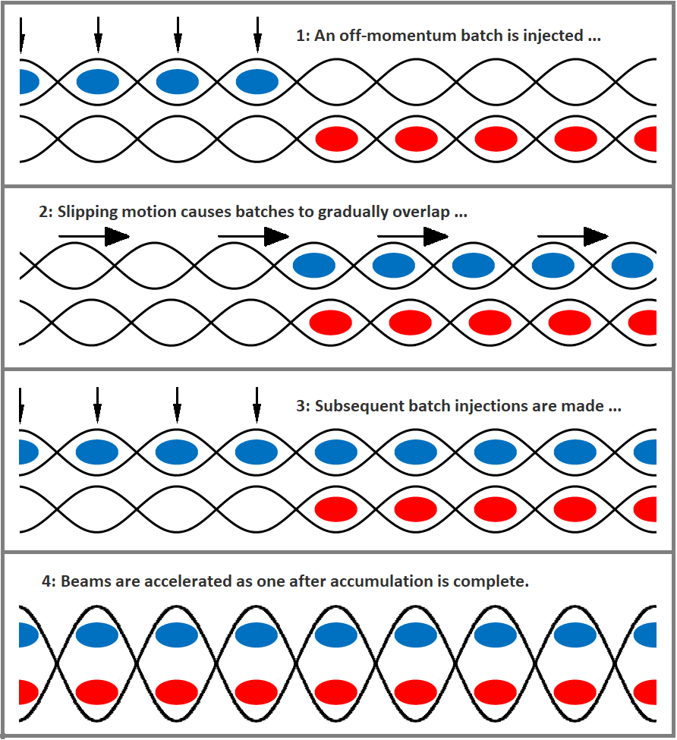
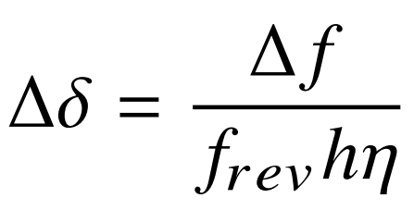
25
Slip-stacking Accumulation
RF frequency separation:
Momentum separation:
25
Jeffrey Eldred | Fermilab Power Upgrade: Scenarios and Challenges
Notes:
25
25
25

Slide 26
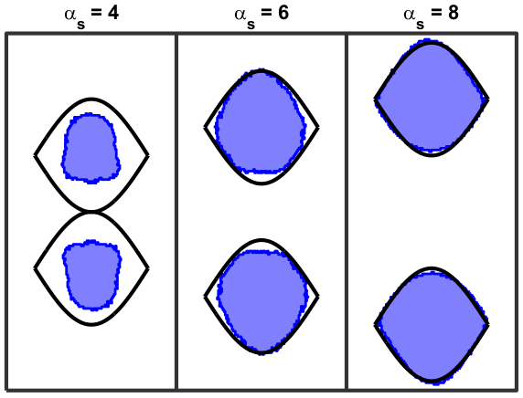
26
Slip-stacking Frequencies
Δf > ~750 Hz
for longitudinal stability
Δf < ~1680 Hz
for PIP-II momentum span
For ~600 m RCS
7 Hz < f_{RCS} < 15 Hz
Eldred, Zwaska PRAB 2016
26
Jeffrey Eldred | RCS for Multi-MW Facility at Fermilab
Notes:
26
26
26

Slide 27
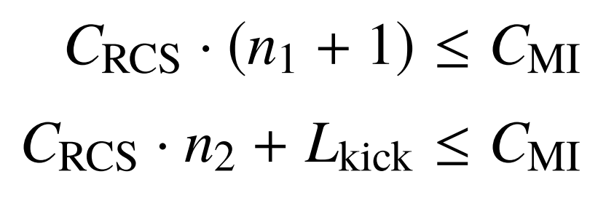
27
Slip-stacking & RCS Circumference
Stacking-Limits:
L_{kick} ~ 300 m or 1μs
or 53 buckets
Even-Batch Slip-stacking:
5
6
7
8
1
2
3
4
Batch-gap
used as kicker-gap
Odd-Batch Slip-stacking
5
6
7
8
9
1
2
3
4
Batch-gap + kicker-gap
27
Jeffrey Eldred | RCS for Multi-MW Facility at Fermilab
Notes:
27
27
27

Slide 28
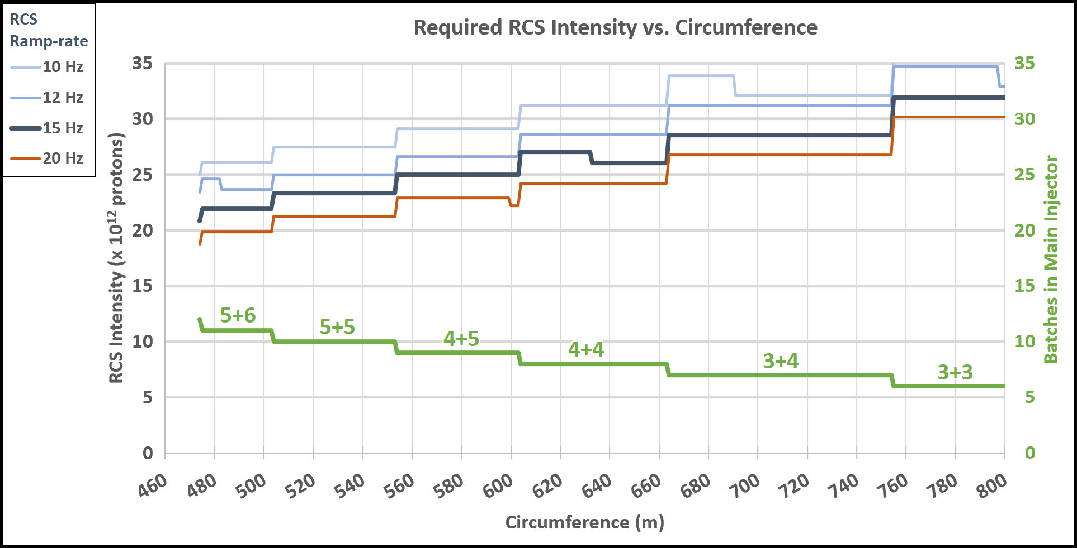
28
Slip-stacking & RCS Circumference
28
Jeffrey Eldred | RCS for Multi-MW Facility at Fermilab
Notes:
28
28
28

Slide 29
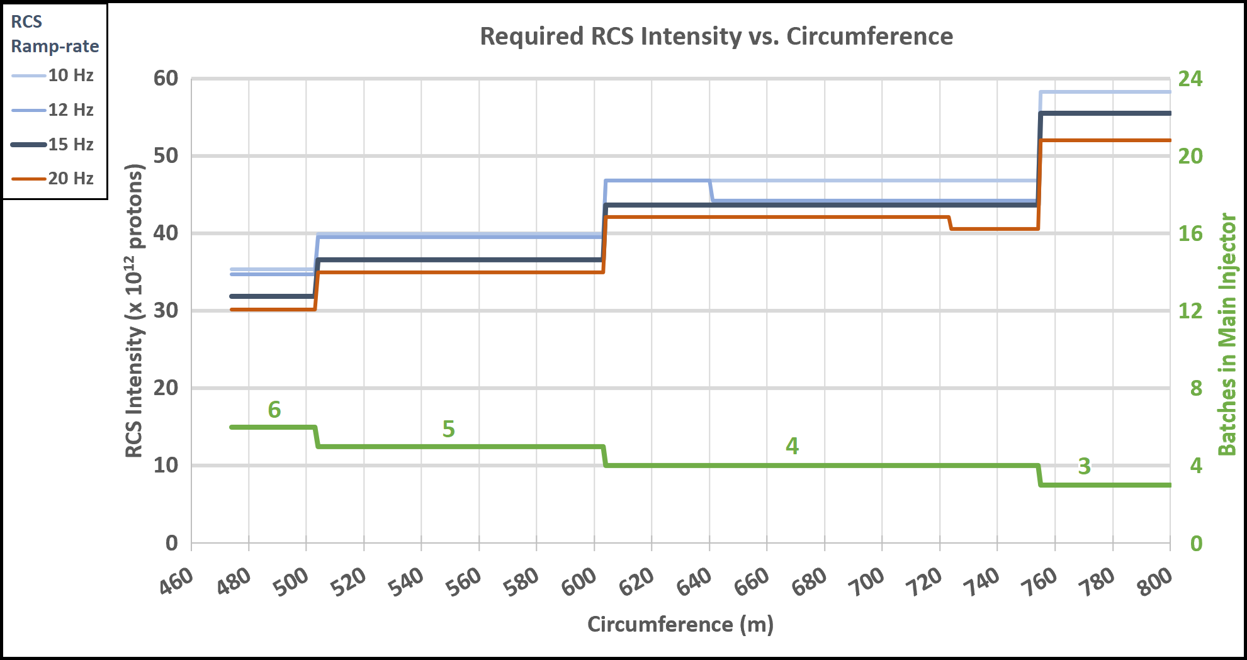
29
Boxcar Stacking & RCS Circumference
Boxcar Stacking requires ~50% more charge
29
Jeffrey Eldred | RCS for Multi-MW Facility at Fermilab
Notes:
29
29
29

Slide 30
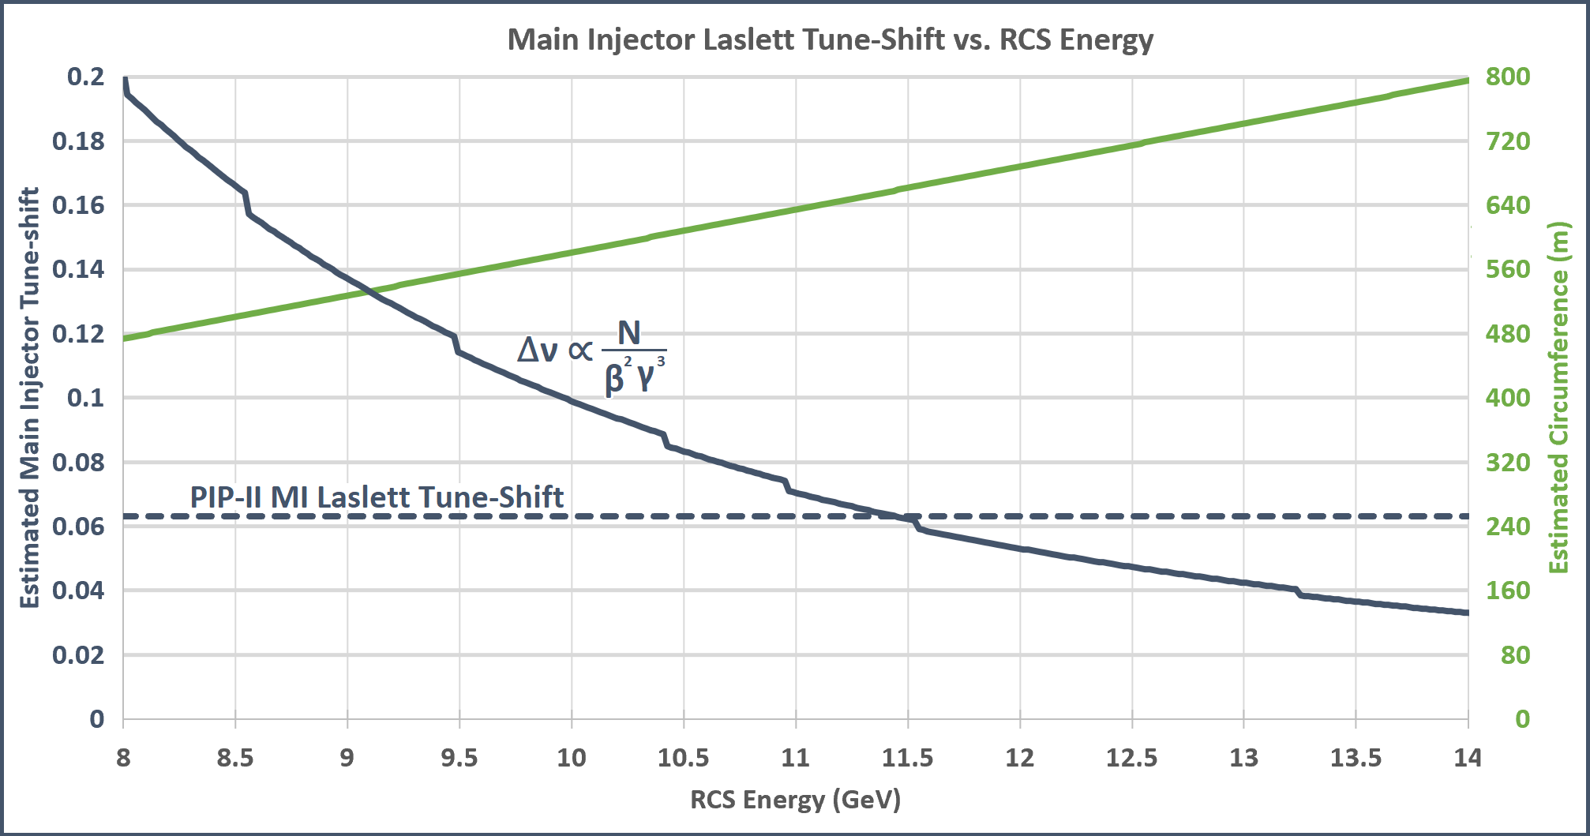
30
RCS Circumference & Main Injector Tune-Shift
30
Jeffrey Eldred | RCS for Multi-MW Facility at Fermilab
Notes:
30
30
30

Slide 31
31
Parameter Table for Efficient Circumferences
Efficient Slip-stacking Circumferences:
(Estimated)
(Estimated)
For MI Tune-shift the RCS energy should be ~11 GeV.
Slip-stacking Frequencies:
600m RCS with 15 Hz ramp: Δf = 1590 Hz
660m RCS with 15 Hz ramp: Δf = 1755 Hz
Δδ ≈ 0.6% ≈ PIP-II
31
Jeffrey Eldred | RCS for Multi-MW Facility at Fermilab
Notes:
31
31
31

Slide 32
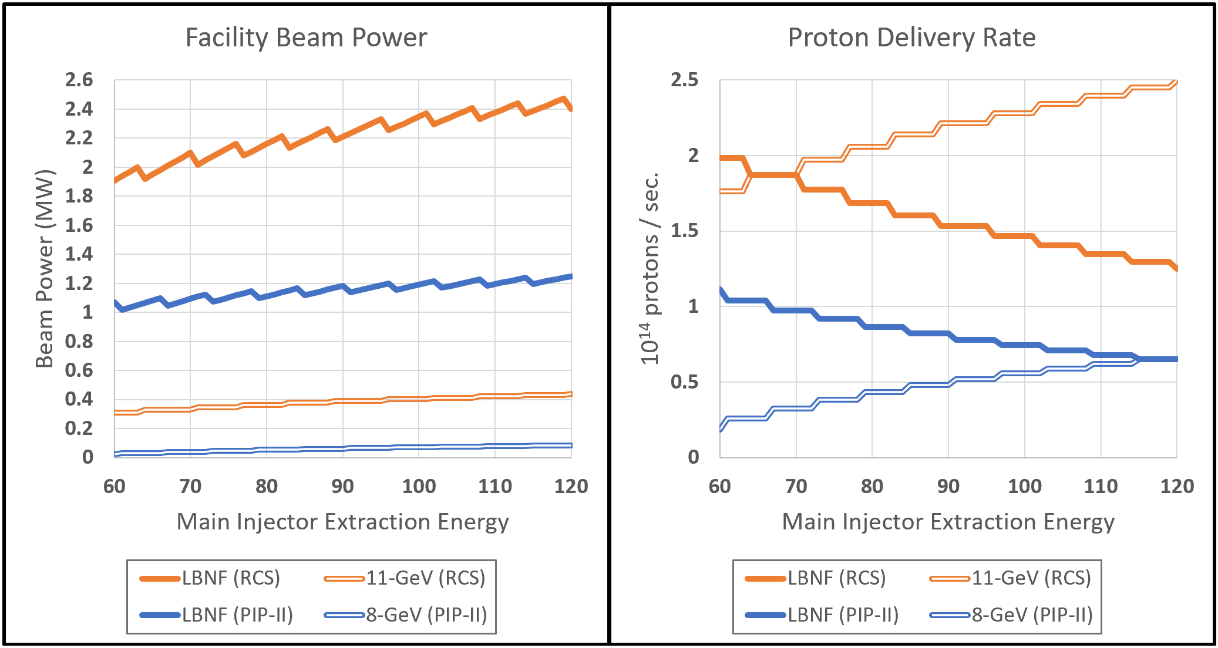
32
Beam Power within 60 GeV to 120 GeV Range
(Assuming Slip-stacking, 11 GeV, 600 m, 15 Hz, 25e12)
32
Jeffrey Eldred | RCS for Multi-MW Facility at Fermilab
Notes:
32
32
32

Slide 33
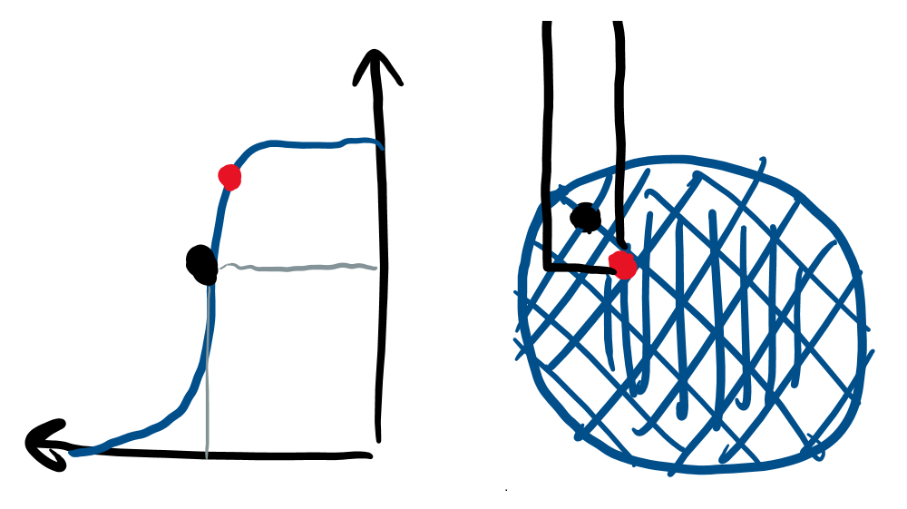
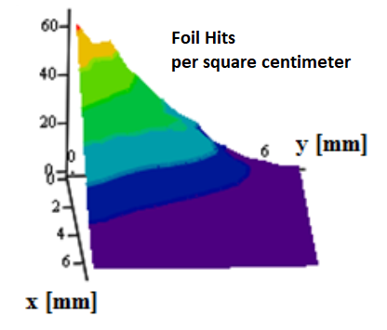
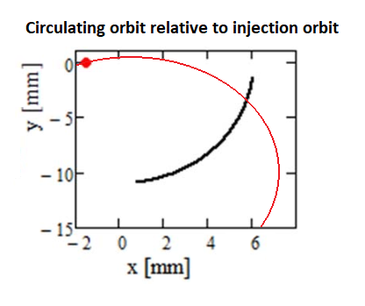
33
Heating associated with H- Foil Painting
Beam Distribution during Injection
Peak Temperature on corner
(PIP-II)
Anti-correlated Painting Injection
Injection painting scheme chosen to:
Minimize foil hits from the circulating beam.
Optimize stability of the beam distribution.
33
Jeffrey Eldred | RCS for Multi-MW Facility at Fermilab
Notes:
33
33
33

Slide 34
34
Limits on Booster at 13e12 protons (or more!)
Some Known Challenges:
Impedance effects from dipole laminations.
Transition-Crossing.
Booster magnets.
Proton Driver Study, 2003 and Project X, 2010:
Both propose multi-MW beam-power in Main Injector by circumventing Booster with an RCS and/or linac.
34
Jeffrey Eldred | RCS for Multi-MW Facility at Fermilab
Notes:
34
34
34

