Slide 1
Fermilab Complex Beam Physics Challenges
Rob Ainsworth
FAST/IOTA Collaboration Meeting and Workshop on High Intensity Beams in Rings
10 June 2019

Slide 2
Outline
Accelerator Complex
Challenges
Beam physics
Operational

Slide 3
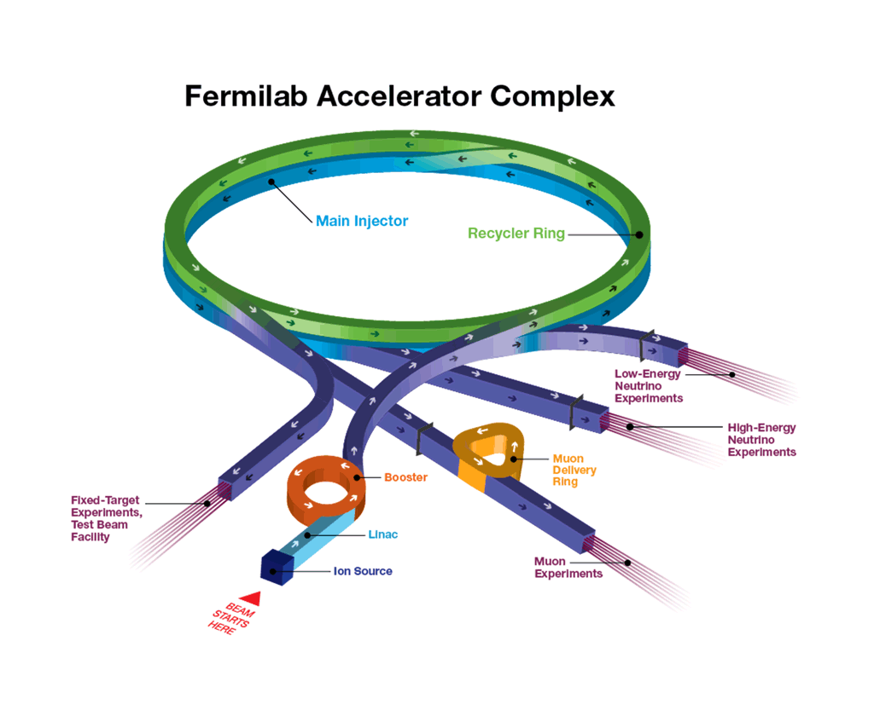
Accelerator complex
H⁻ linac
Booster
h = 84
15 Hz
400 MeV -> 8 GeV
Recycler
h = 588
Slip-stack 12 batches (double bunch intensity)
Main Injector
8 GeV -> 120 GeV

Slide 4
Beam Physics Challenges

Slide 5
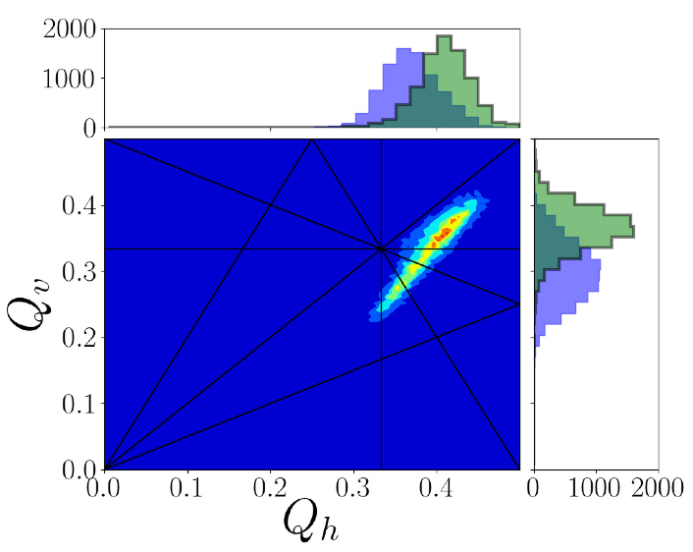
Space charge
Large space charge tune shifts/spreads are expected
Crossing multiple resonances

Slide 6
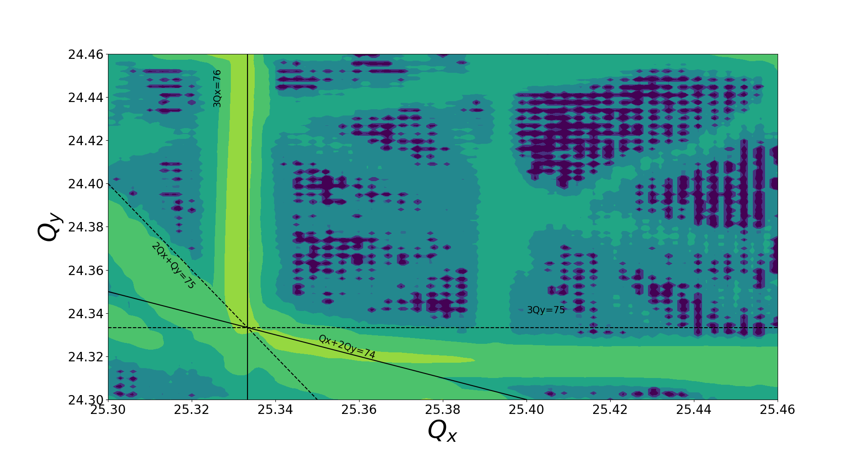
Resonances in Recycler
Current working point

Slide 7
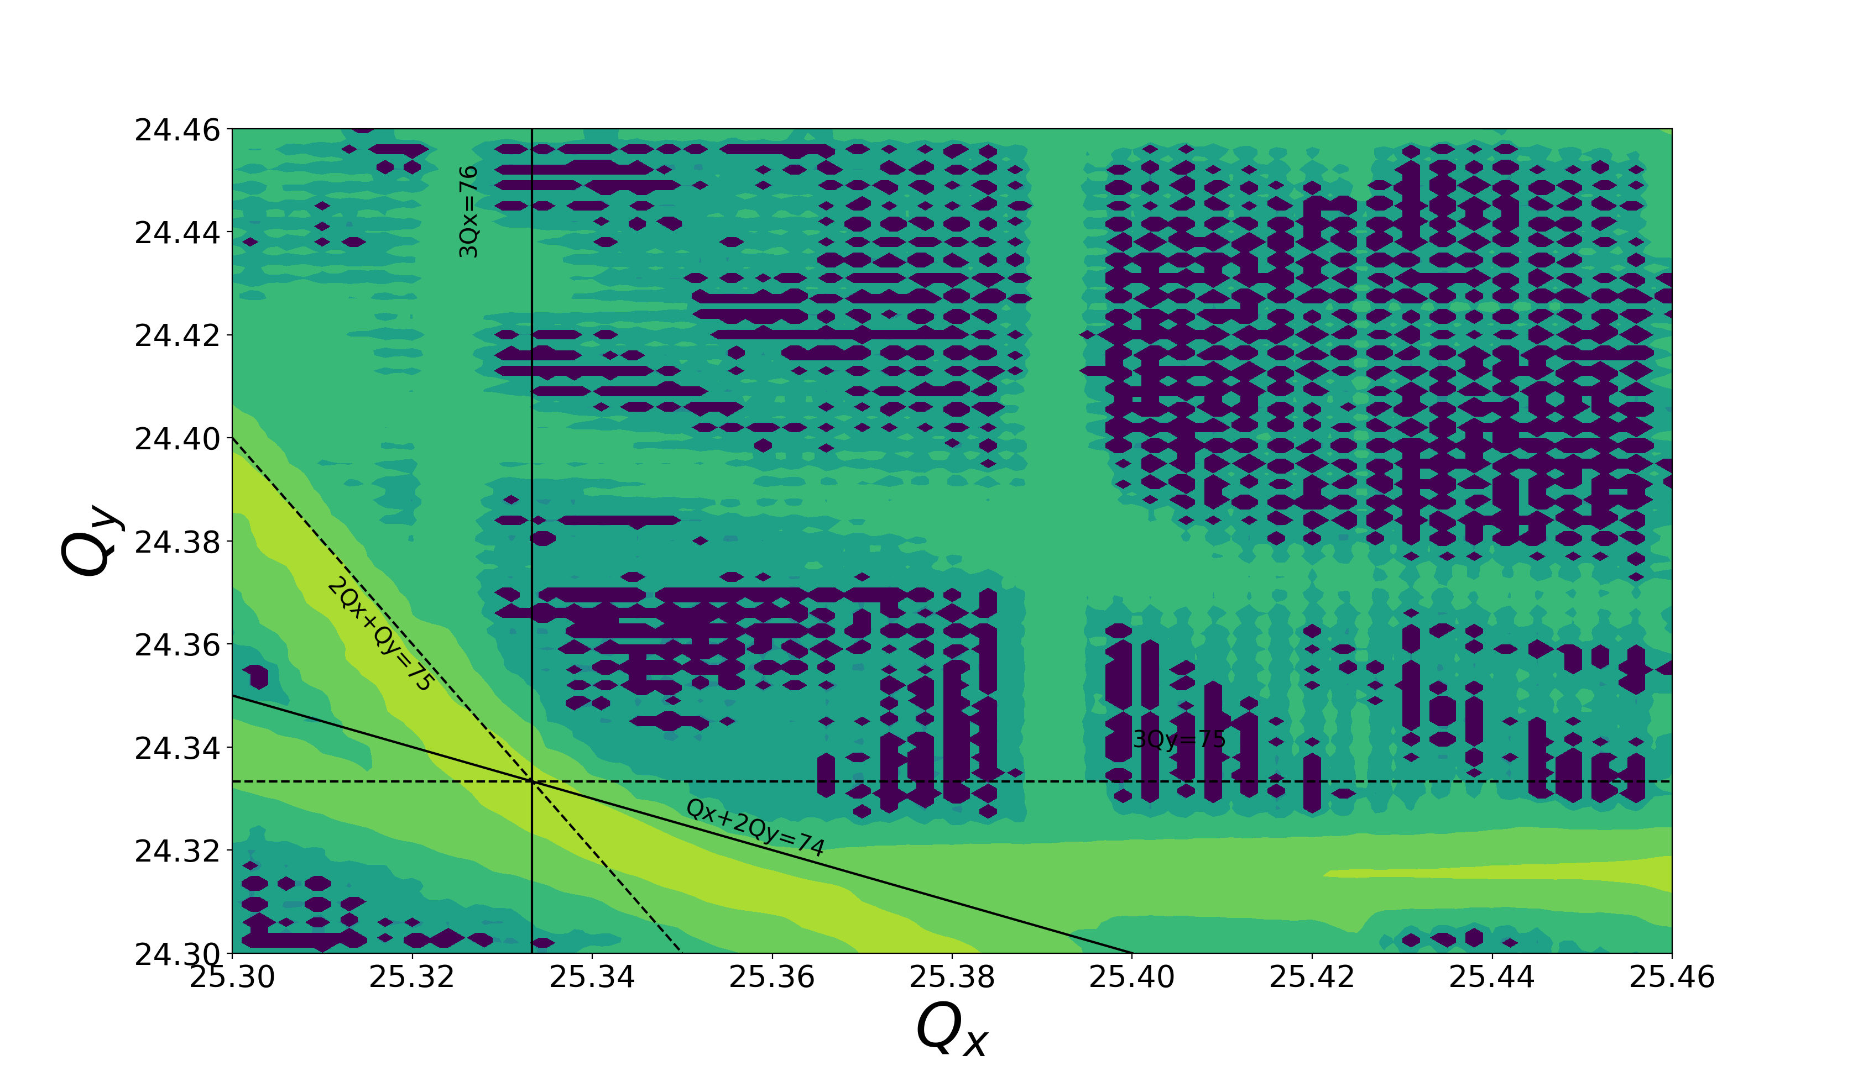
Resonance correction schemes being tested

Slide 8
Resonance correction schemes
Currently implementing resonant correction schemes in the RR
3Qx correction has been demonstrated
Unwanted side effect causes unexplained losses during operational cycle

Slide 9
Impedances
Transverse impedance in RR and MI are dominated by resistive wall
Bunch by bunch dampers protect against coupled bunch instabilities
A different kind of damper is needed for slip-stacking
For slip-stacking, the growth rate for the sum mode (bunches performing the same motion) is much larger than the difference mode [Burov]
A lower bandwidth damper looking at the envelope could be sufficient

Slide 10
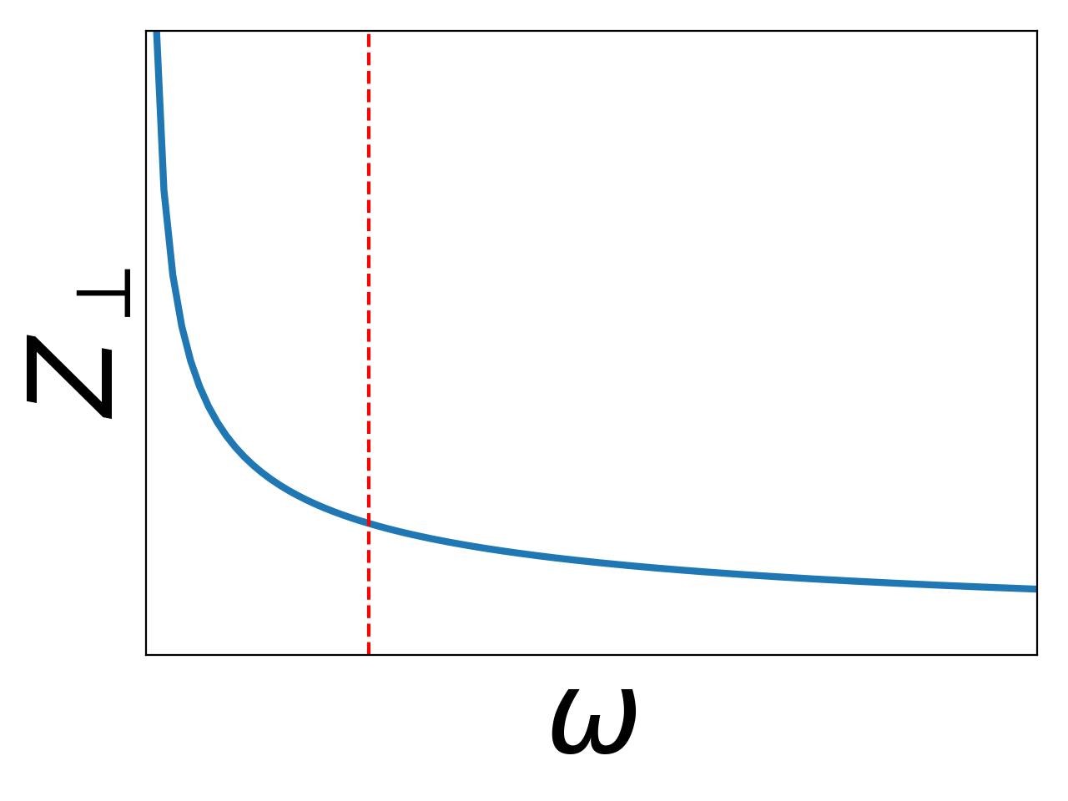
Slip stack damper
The current bandwidth of the damper is 2.5 MHz
To what intensity will this be sufficient to damp?
Can the bandwidth be increased further?
Damper
Landau

Slide 11
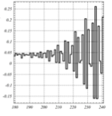
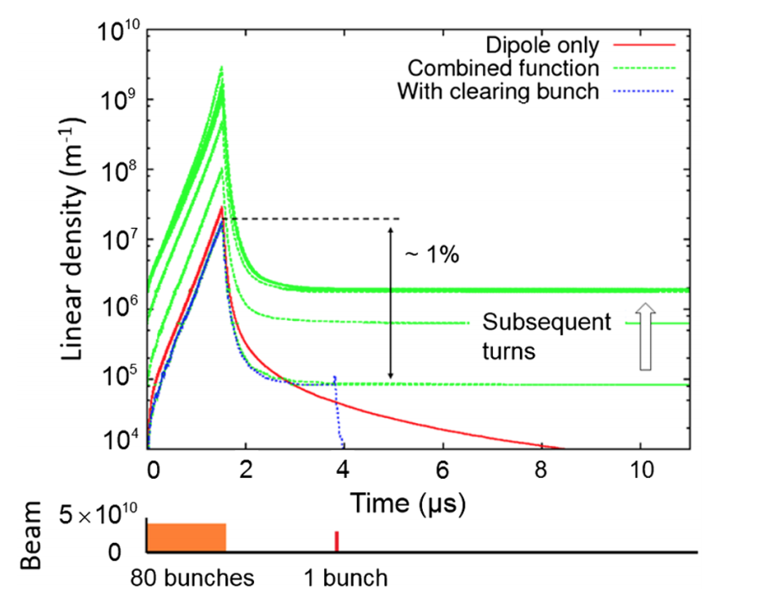
Fast instability - electron cloud
A fast instability was observed in the Recycler but not in the Main Injector
Growth too fast to be stabilized by dampers
Eventually, attributed to electron trapping in the combined function magnets
Instability has been conditioned away for now
At what intensity will it reappear?
Observed on BPMs, growth rate 10-15turns
S. Antipov

Slide 12
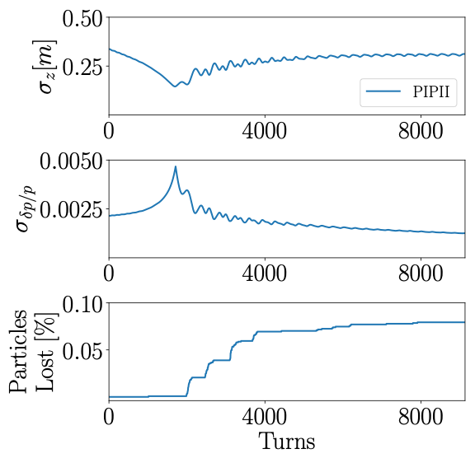
Transition crossing

Slide 13
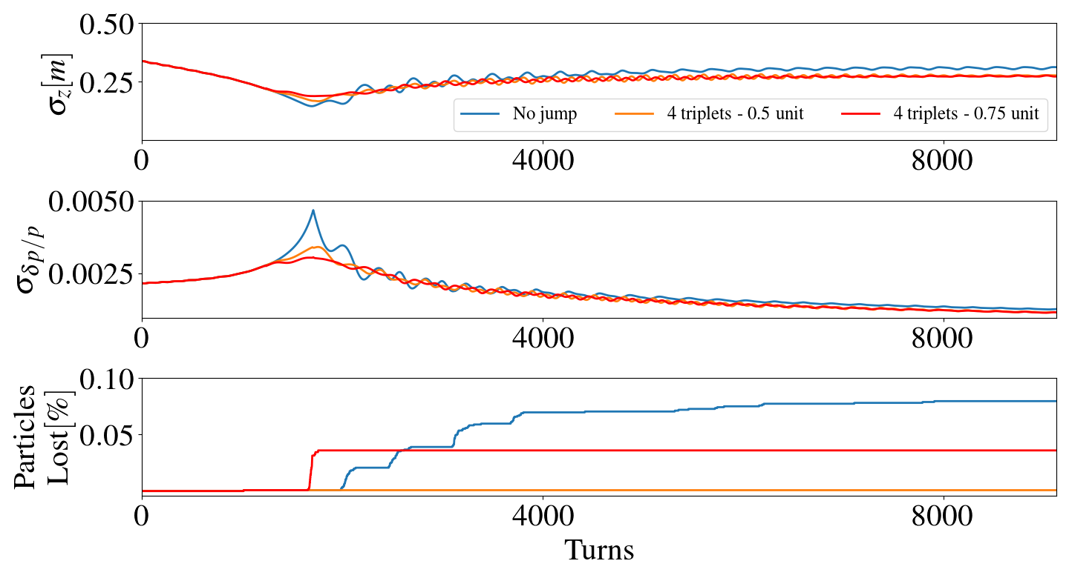
Gamma-t jump
Transverse loss

Slide 14
Transition Crossing
For PIPII, a large dp/p is expected
gamma-t jump is planned
So far simulations only include space charge
Need to add impedances
Will try to measure longitudinal impedance on MI
Compare with simulations

Slide 15
Halo/Tails
As intensity is increased
Tails and halo will become more and more important
Need to understand what generates halo/tails
Currently, only method of measuring tails in collimator scan
Slow
Destructive
Need better diagnostics capable of measuring transverse tails/halo

Slide 16
Operational Challenges

Slide 17
Collimation
For 700 kW operation, access to tunnels is already becoming problematic
High activity in leads to component damage
Loss ion pumps making vacuum worse -> higher losses
MI8 line
Design spec, 1% of 5E12 at 10 Hz
Currently running, ~1% of 4.5 E12 at 15 Hz
Need to add more collimators in MI8 line
MI30 collimators
Inside Main Injector, most take care of longitudinal losses from slip-stacking
Plan to add inserts

Slide 18
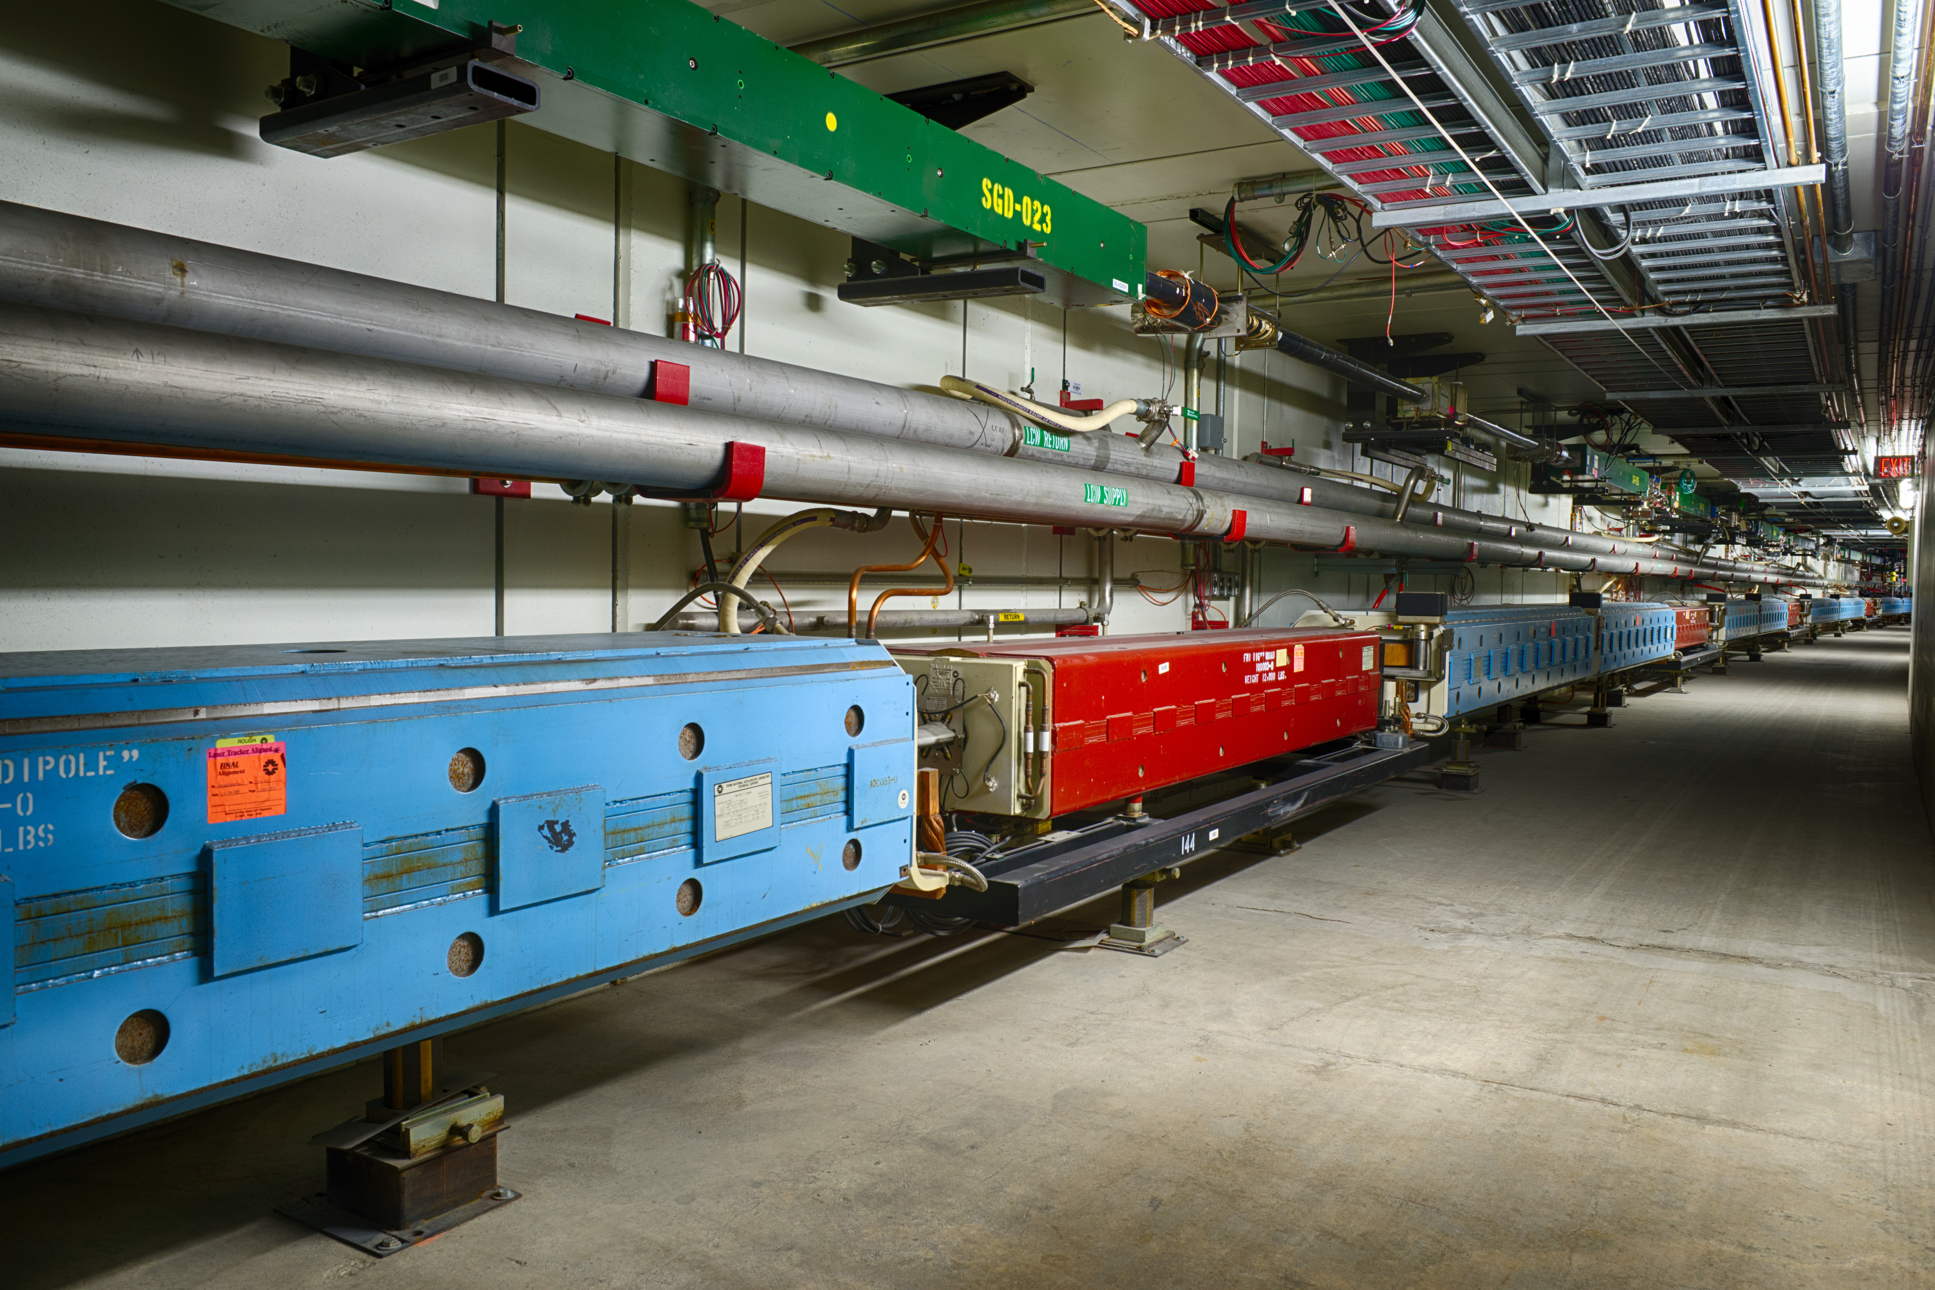
Two machines in the same tunnel
Recycler
Main Injector

Slide 19
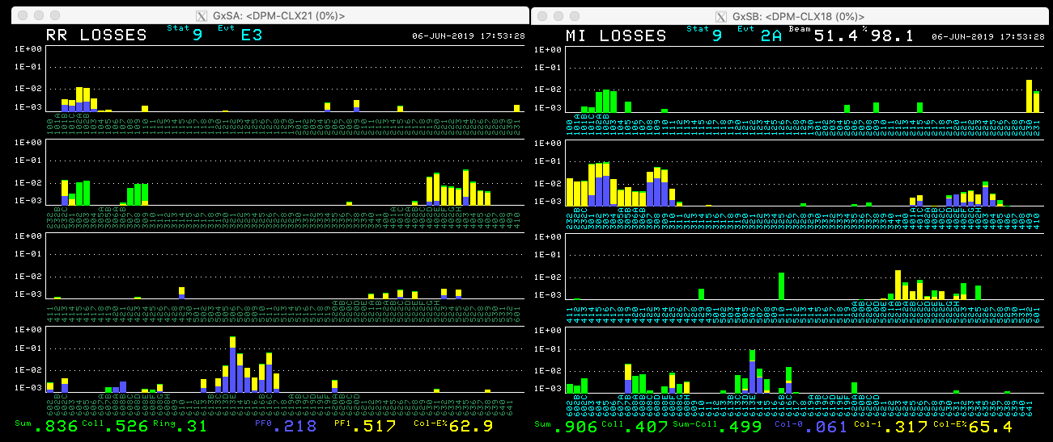
Two machines in the same tunnel
Loss identification becomes more difficult

Slide 20
RF
Power limits
Current limit 54E12 (NuMI target limit). This corresponds to 777 KW with 1.33 sec cycle time.
MI is limited by the available RF power to 62E12 which corresponds to 892 KW with 1.33 sec
Dual PA upgrades will increase this to 1.24E13 (1.784 MW)
Beyond this
New cavities
New PAs
Space requirements become an issue

Slide 21
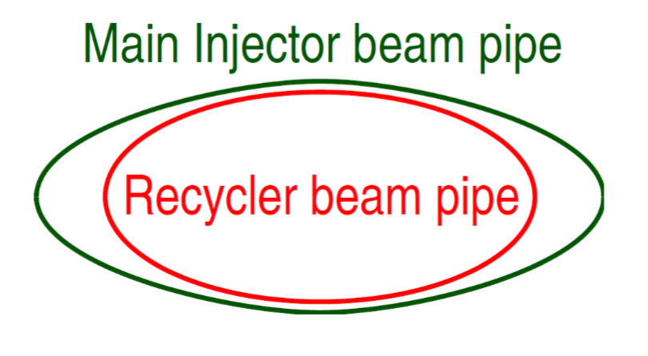
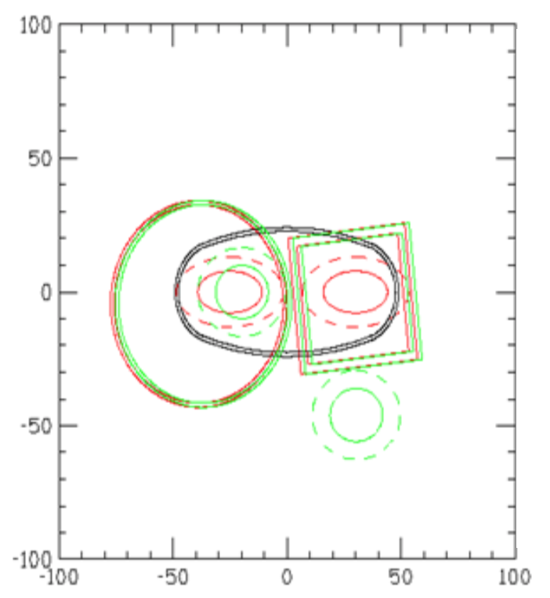
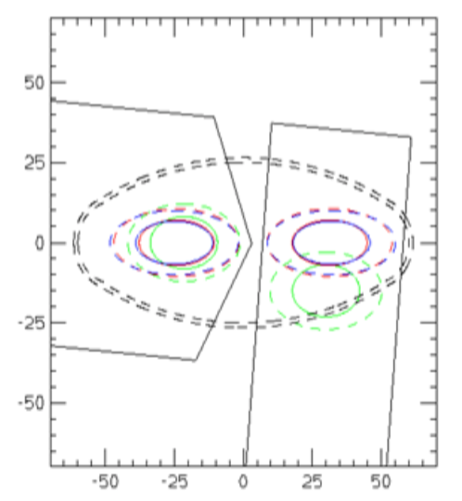
Aperture
RR not designed to be a proton stacker and such apertures are a big problem
Limiting apertures are at lambertson locations
Efforts made to improve apertures in certain areas
Issues still exist particularly at RR to MI extraction
Old
New

Slide 22
Summary

Slide 23
Beam Physics Challenges
Space charge
Tune shifts crossing resonances
Impedances
To what intensity will slip-stack damper work?
Need more bandwidth?
What’s the highest bandwidth before slipping causes a problem
Electron Cloud
Instability may return, what intensity?
Transition crossing
Gamma-t jump will help
Halo
Controlling losses at high power

Slide 24
Operational challenges
Collimation
Tunnel access already difficult at 700 kW
Two machines in the same tunnel
Identifying losses
Space requirements
Apertures
Major loss locations occur at Lambertsons (Transfers)
RR pipe is small
Instrumentation
How measure tails/halo?

Slide 25
Backup

Slide 26
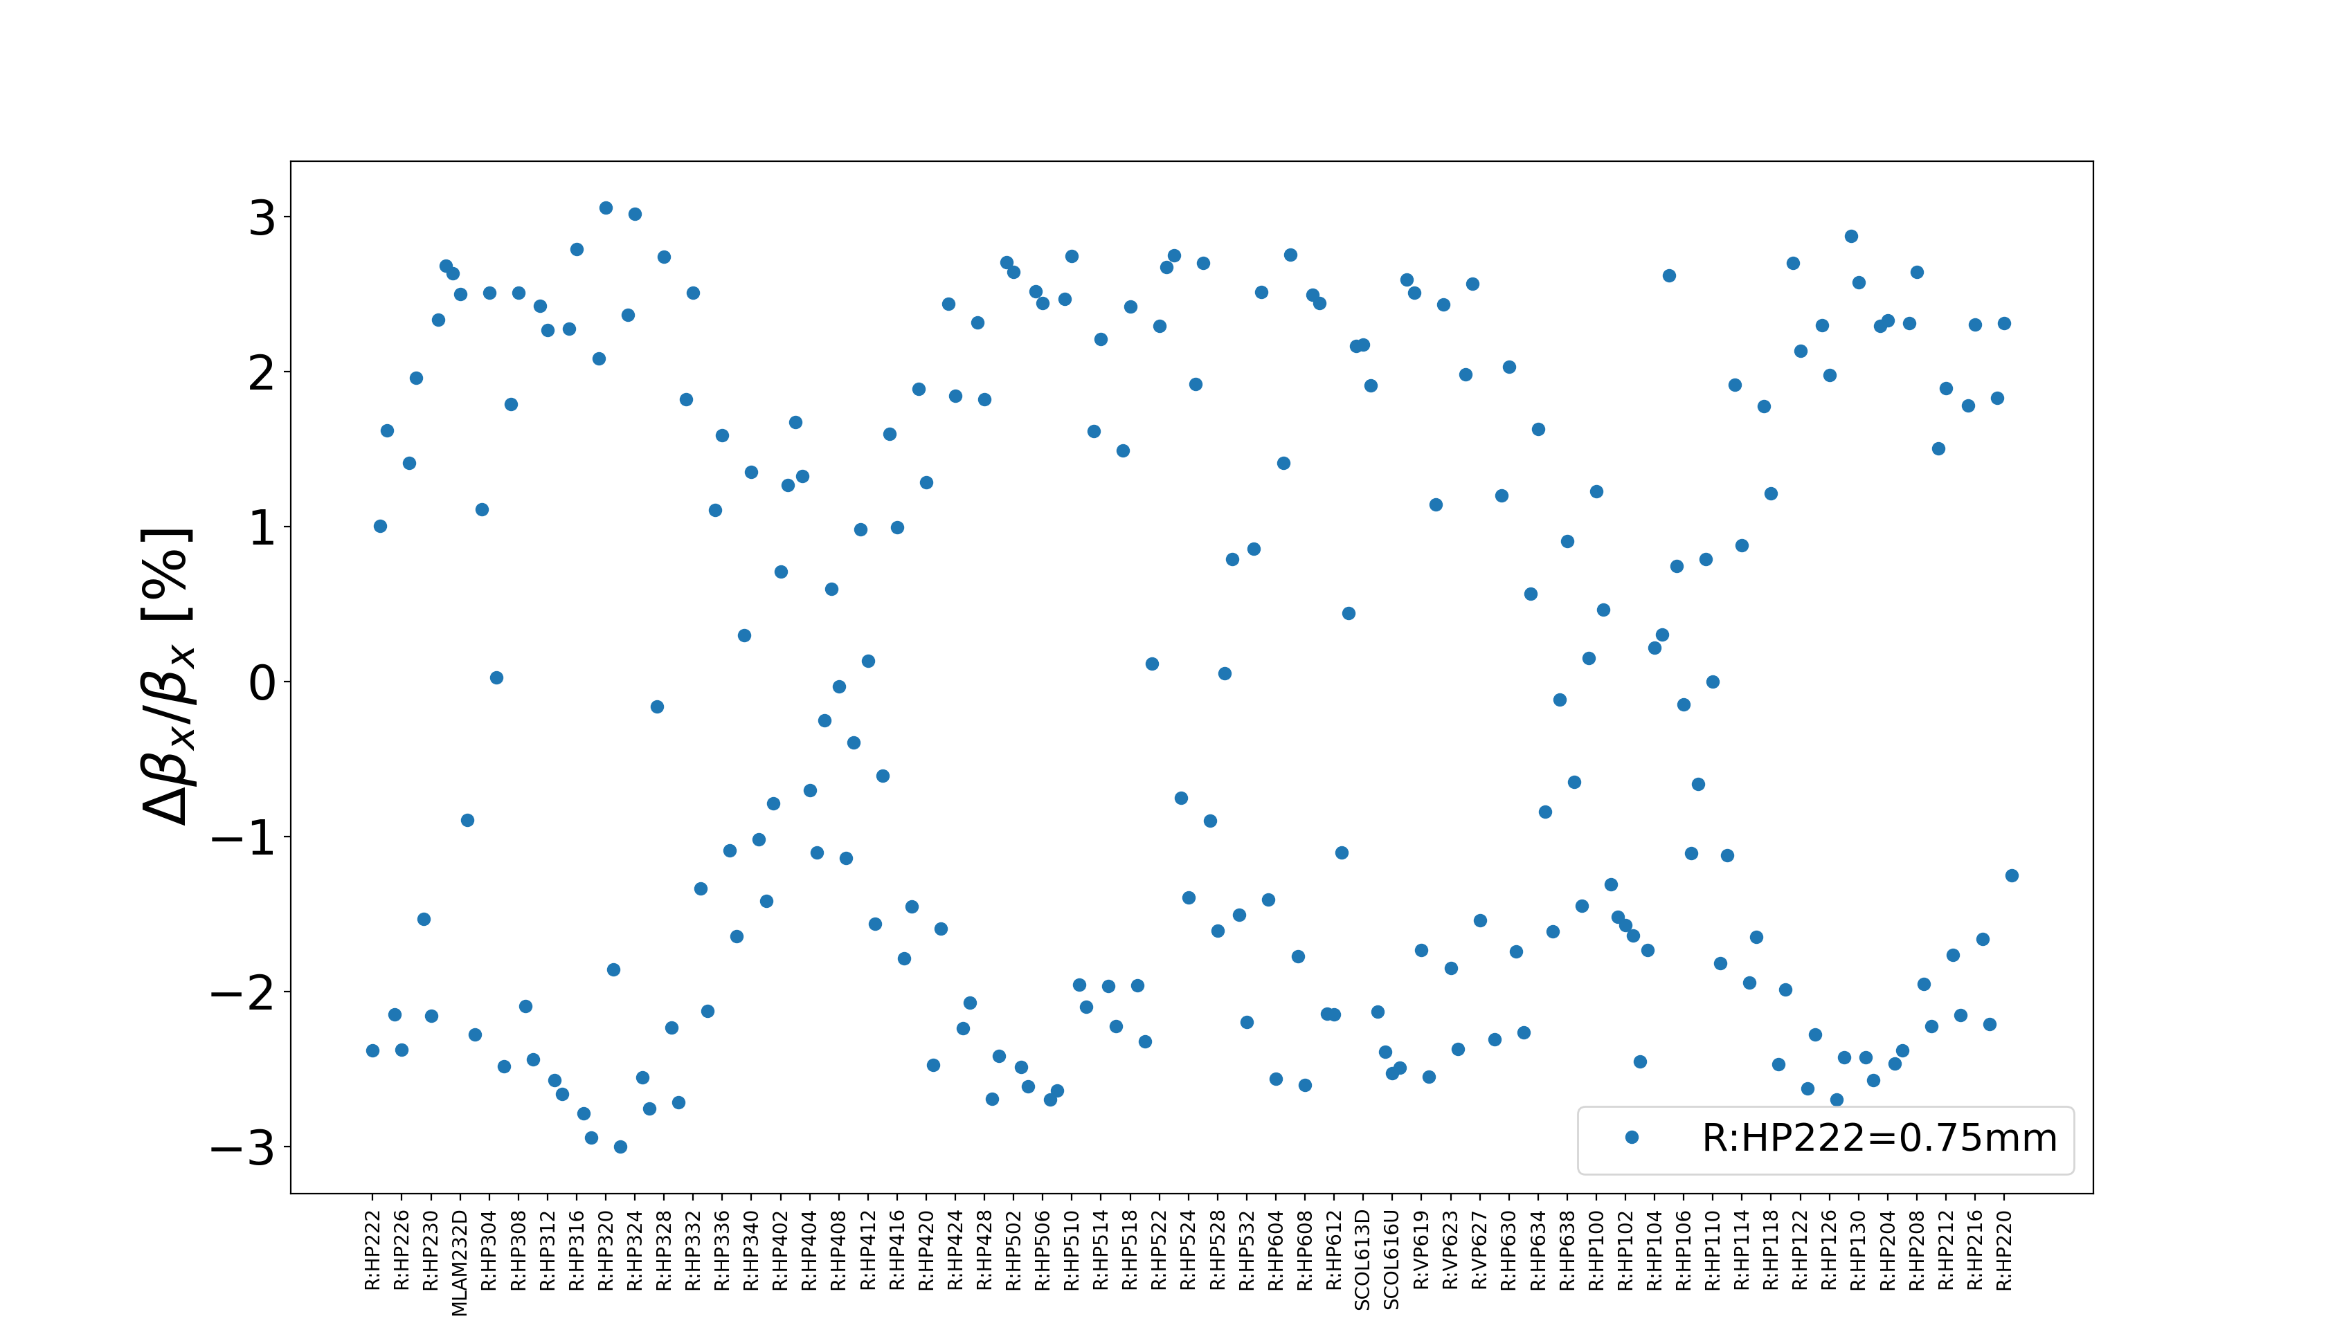
Effect with other sextupole powered

Slide 27
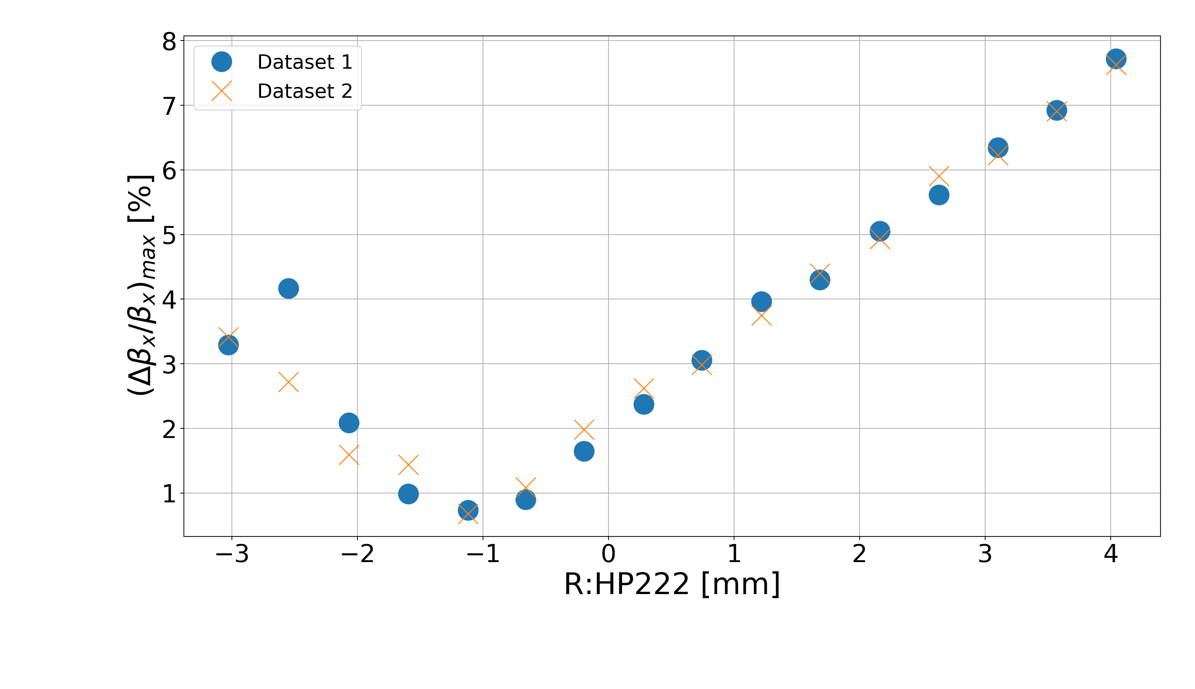
222 bump scan

Slide 28
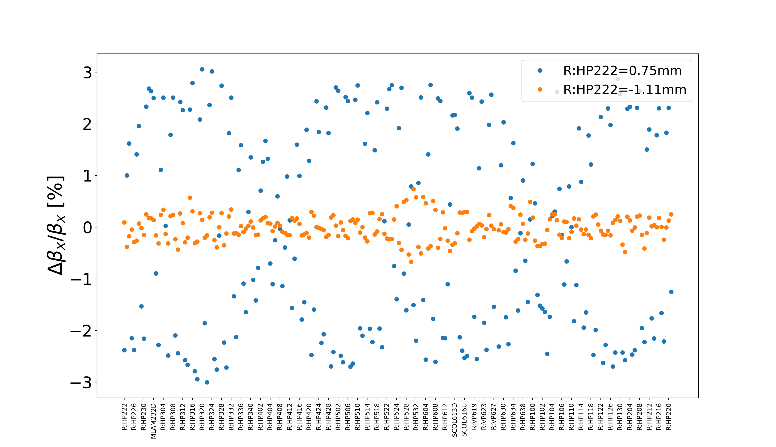
Beta-wave comparison

Slide 29
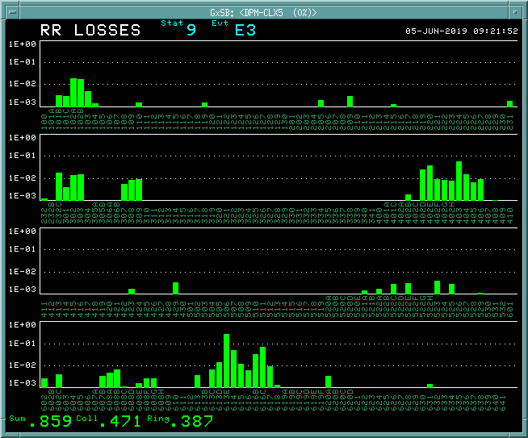
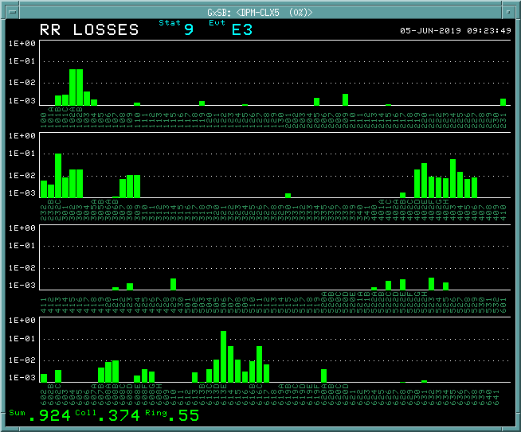
Effect on 6+6
SC222 off
SC222 on at -10A

Slide 30
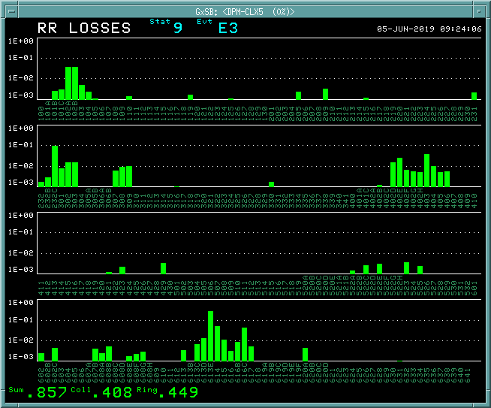
Effect with bump
SC222 on at -10A
SC222 on at -10A, with bump
Loss at 232C unaffected

Slide 31
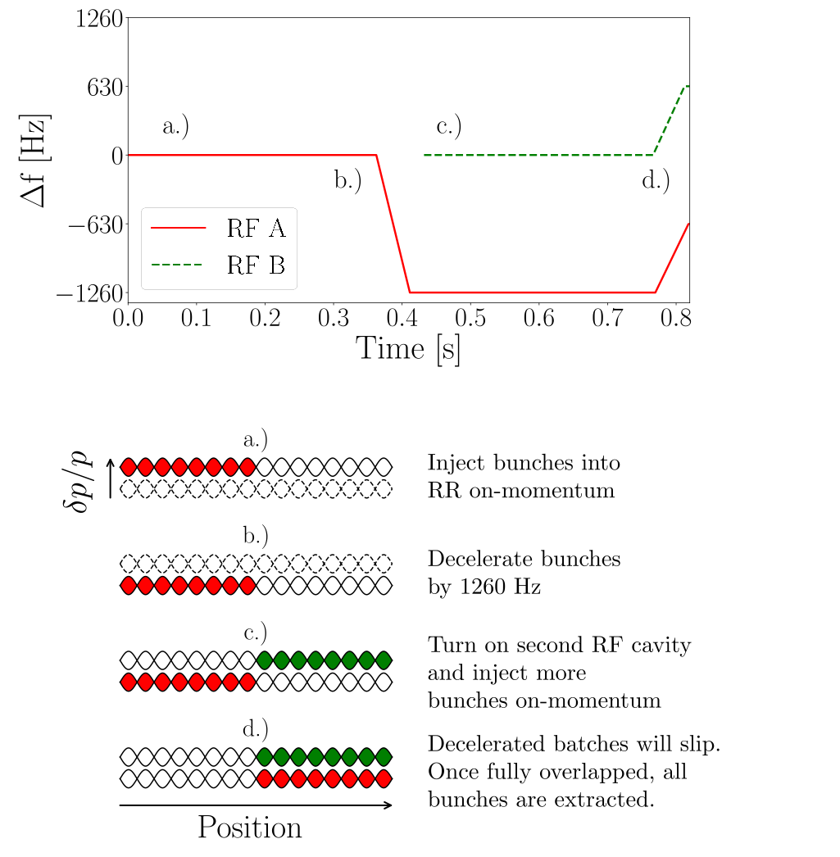
Slip-stacking
Slip-stacking allows us to double the intensity of the bunches in the Recycler

Slide 32
Slip-stacking
Gap clearing kickers fire before every injection sending beam to abort

Slide 33
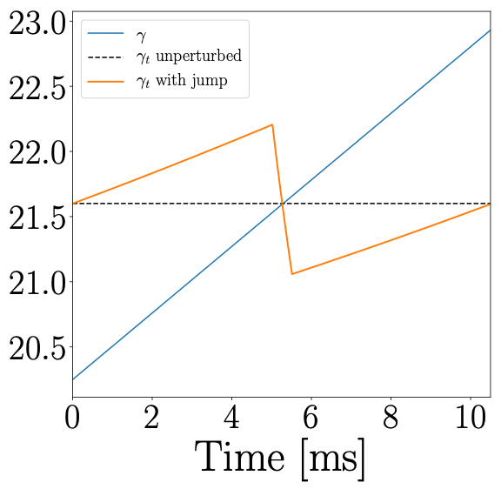
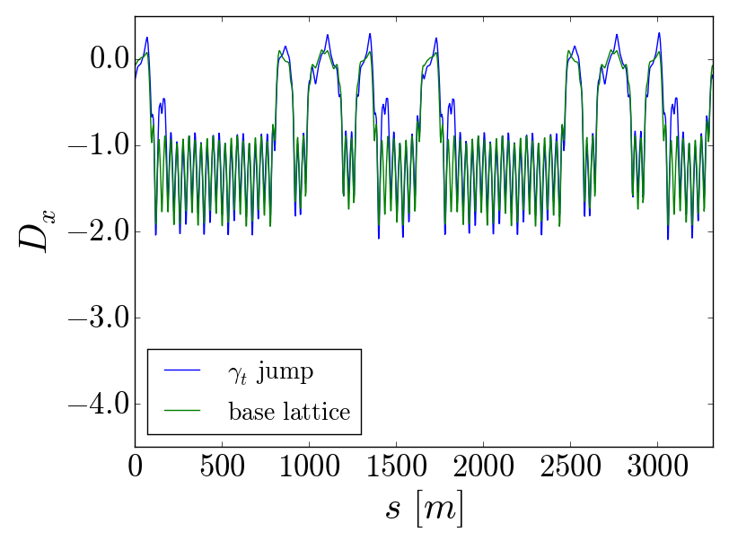
Gamma-t jump
Effectively cross transition quicker using ramped quads
2 quads (0.85 T-m/m) in the arc
1 quad (1.7 T-m/m) in the straight section

Slide 34
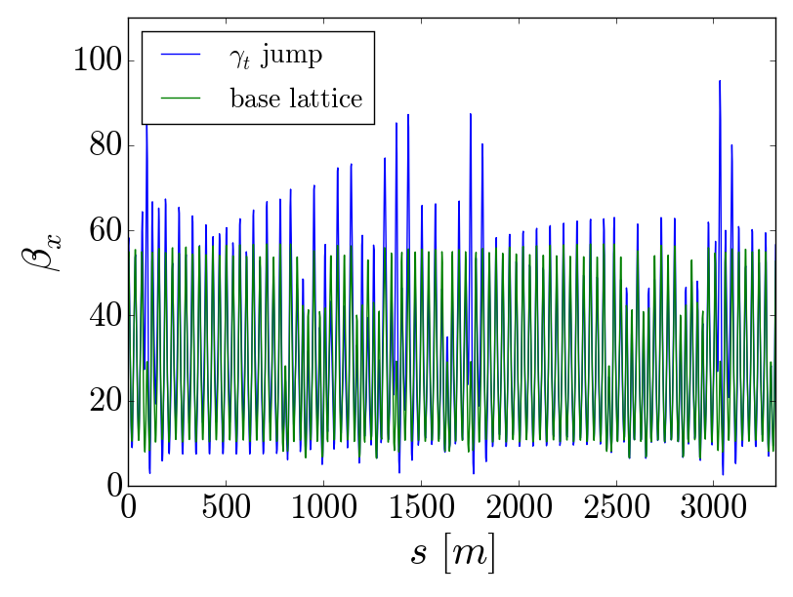
Gamma-t jump
At max of 0.5 unit jump
The quad triplets perturb the lattice
large beta-wave
May have potentially adverse effects on transverse phase space

