Slide 1
IOTA Instrumentation
Nikita Kuklev
IOTA/FAST 2019 Collaboration Meeting
10 June 2019

Slide 2
Motivation
Showcase of existing and potential instrumentation
We have a lot of things
But...if we don’t have it, you can BYOD (bring your own devices)
Most systems are modular and easy to work with - add-ons just slot in

Slide 3
Outline
IOTA ring – geometry and design
Control and readout
Devices
BPMs
Sync-Light – cameras + PMTs
WCM/DCCT/other
BYOD

Slide 4
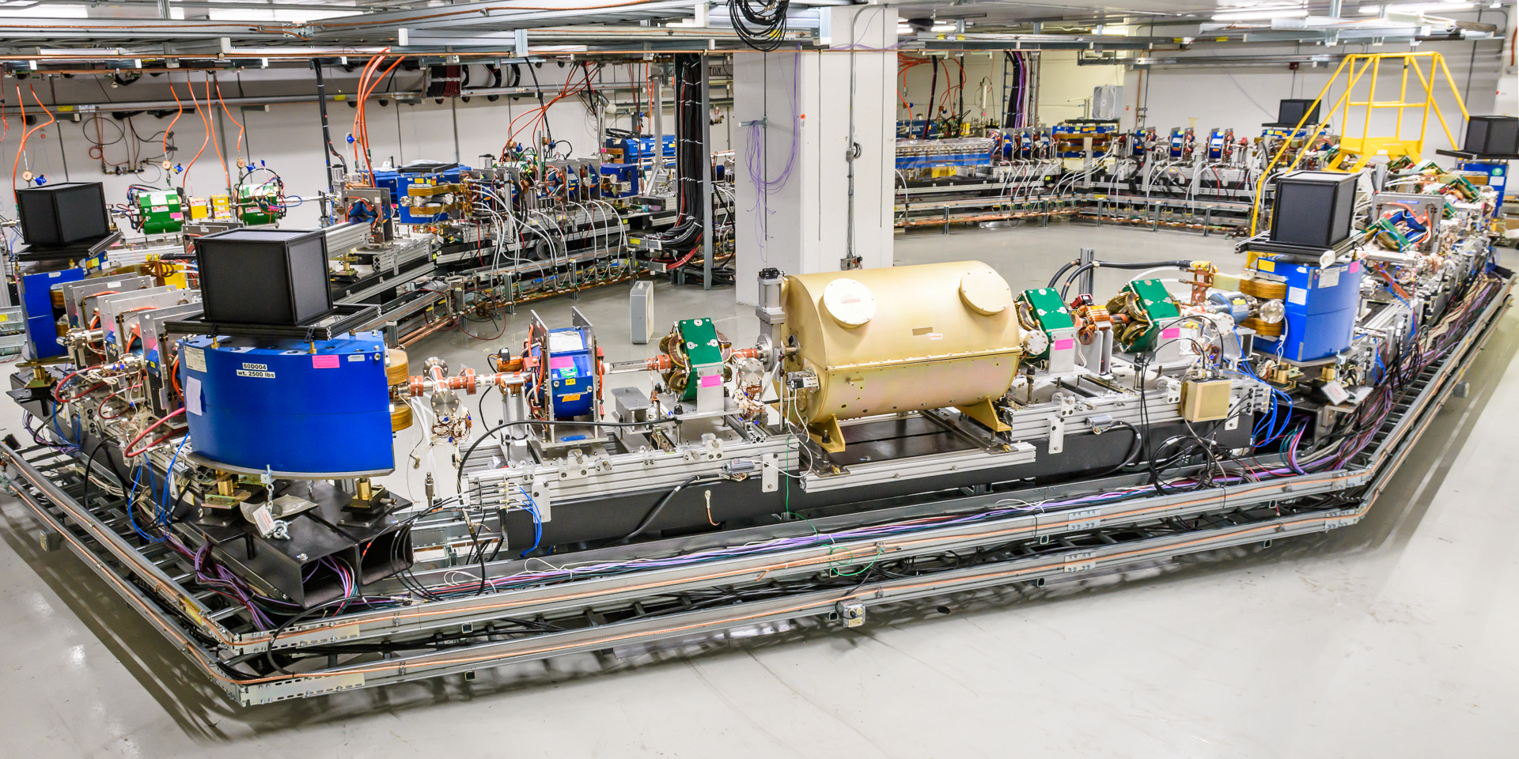
IOTA design
WCM
SL
BPM
DCCT

Slide 5
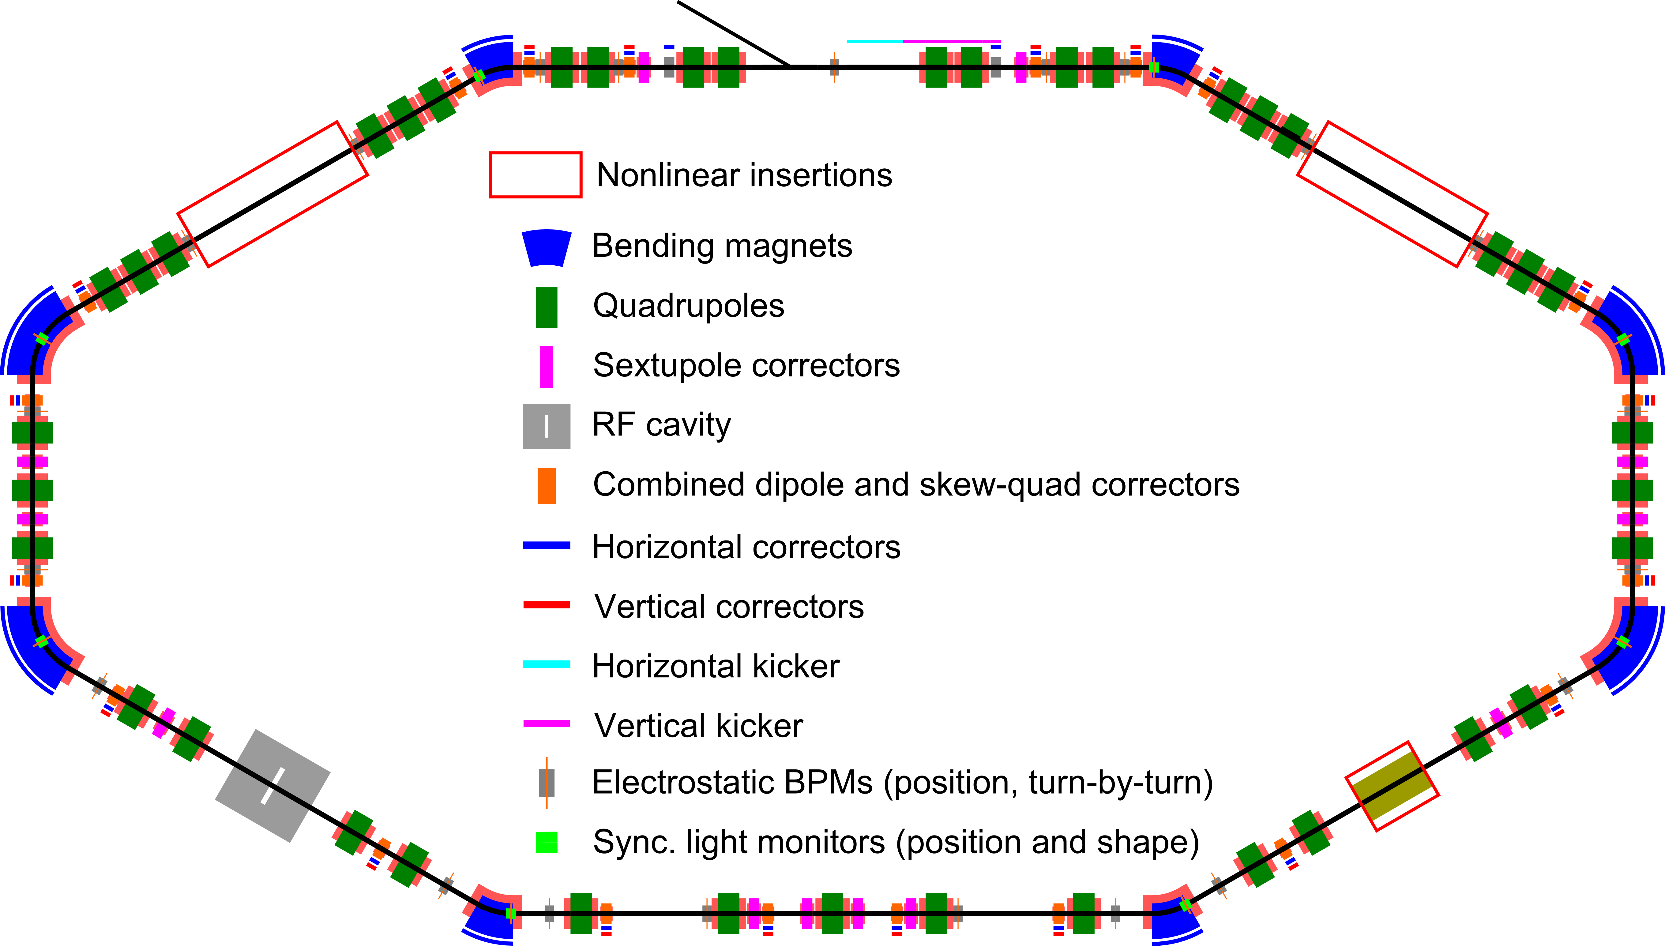
IOTA design
8 bending magnets – 4x30 + 4x60
Vacuum chambers with extra windows
Various drift regions (some have gate valves, easy in/out)
Individually powered magnets (all except main bend)
Variety of extra connections
No need for rad-hard components

Slide 6
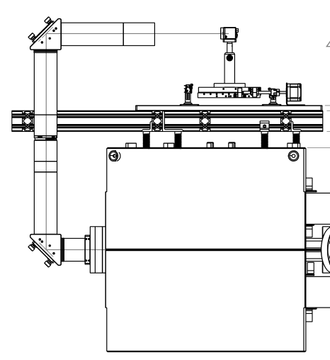
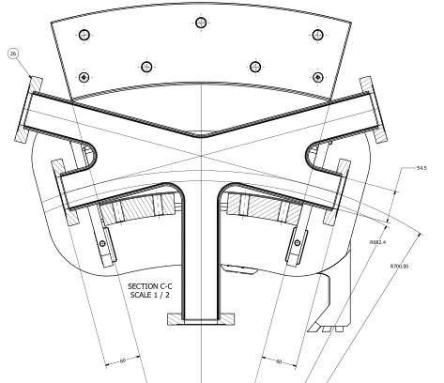
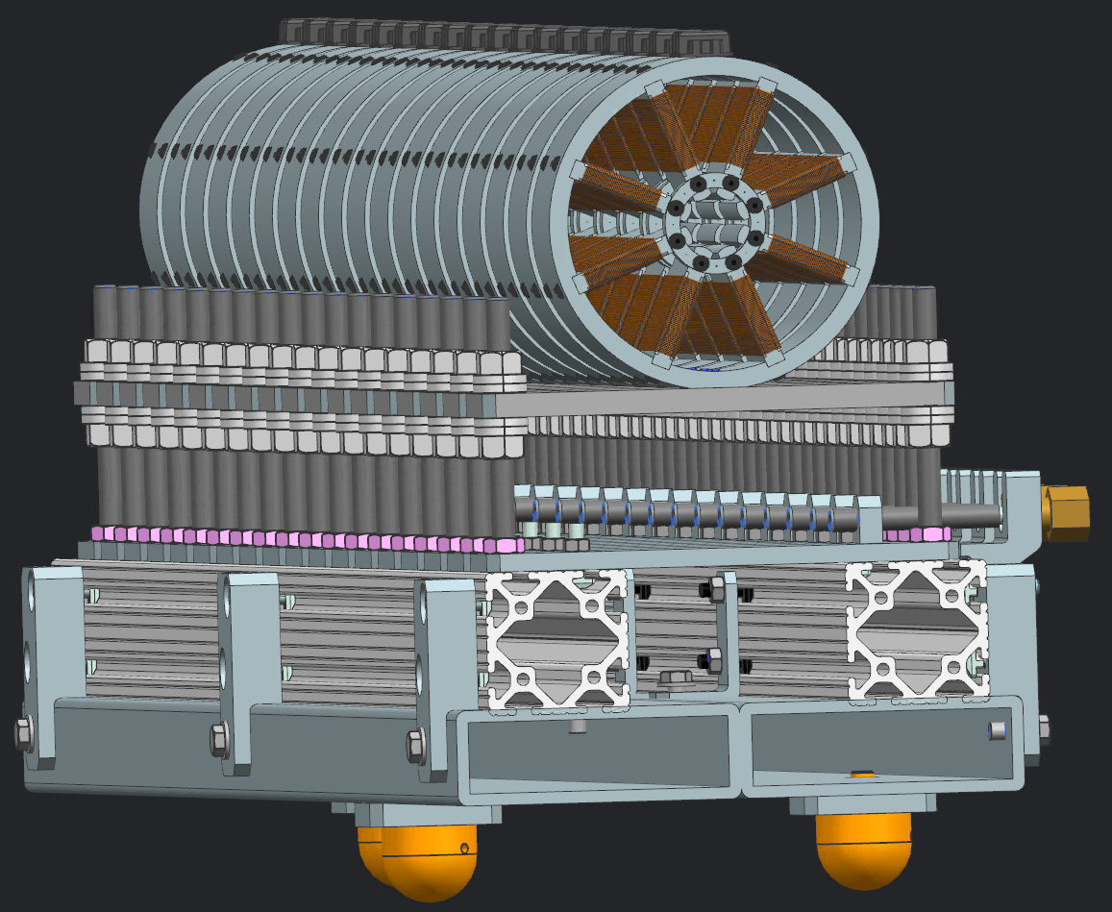
IOTA design
Mechanical design is centrally managed (TeamCenter/NX)
Can provide models for all necessary parts
Oftentimes spares available for testing (even main bends)

Slide 7
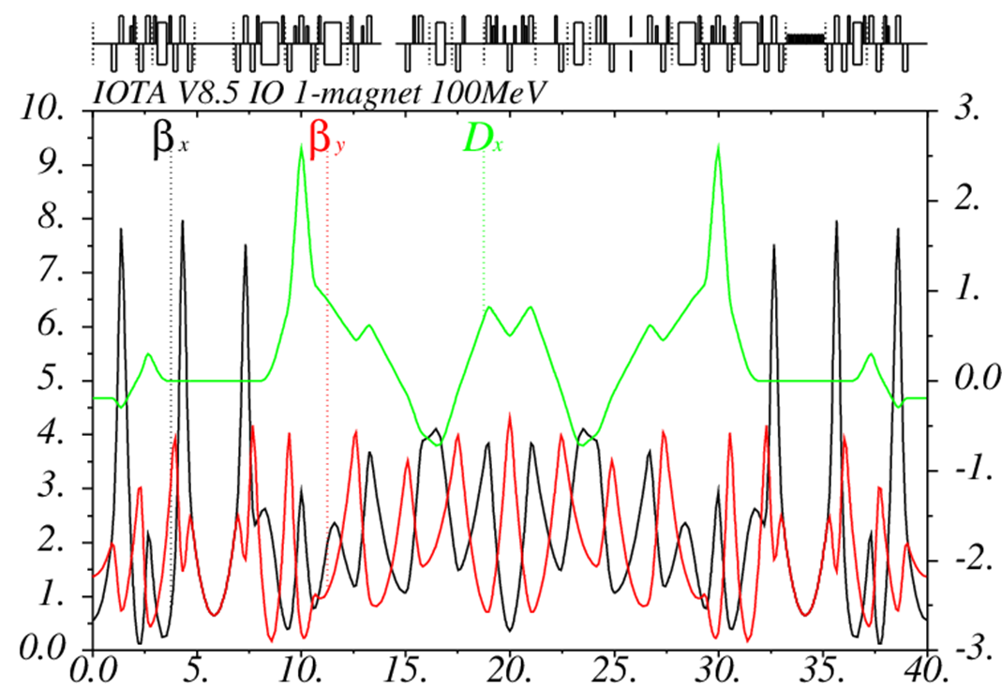
IOTA design
Lattice files in standard MAD-X format (+other)
Central, authoritative repository
Consistent design base + history

Slide 8
Outline
IOTA ring – geometry and design
Control and readout
Devices
BPMs
Sync-Light – cameras + PMTs
WCM/DCCT/other

Slide 9
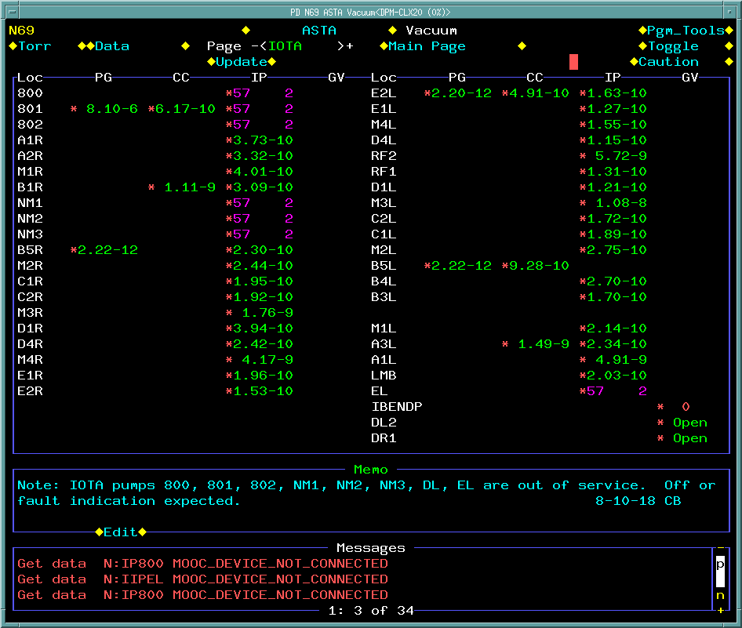
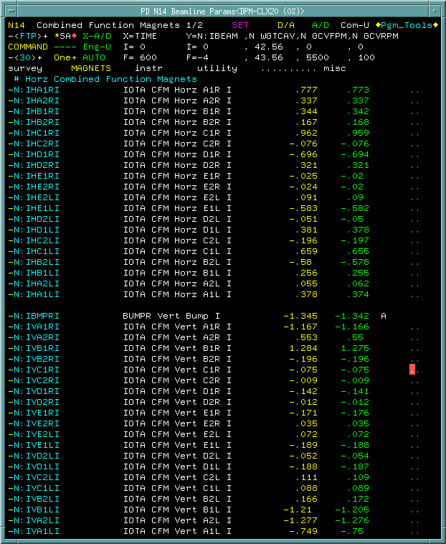
Readout + control
Main control network – ACNET…bit old school
Has a library of devices/drivers (optical flippers, digitizers, etc.)

Slide 10
Readout + control
Do not fear – there are Python and Java wrappers
Masks most ACNET things, and unifies data acquisition
Have been playing with internal EPICS deployments, and can set one up for your devices
Complimentary fire department late night support included

Slide 11
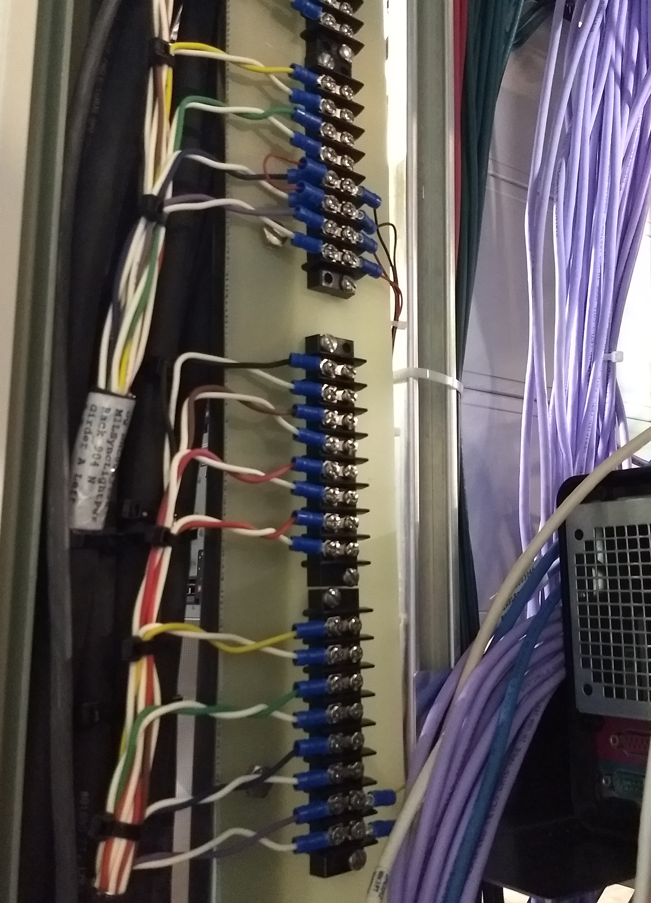
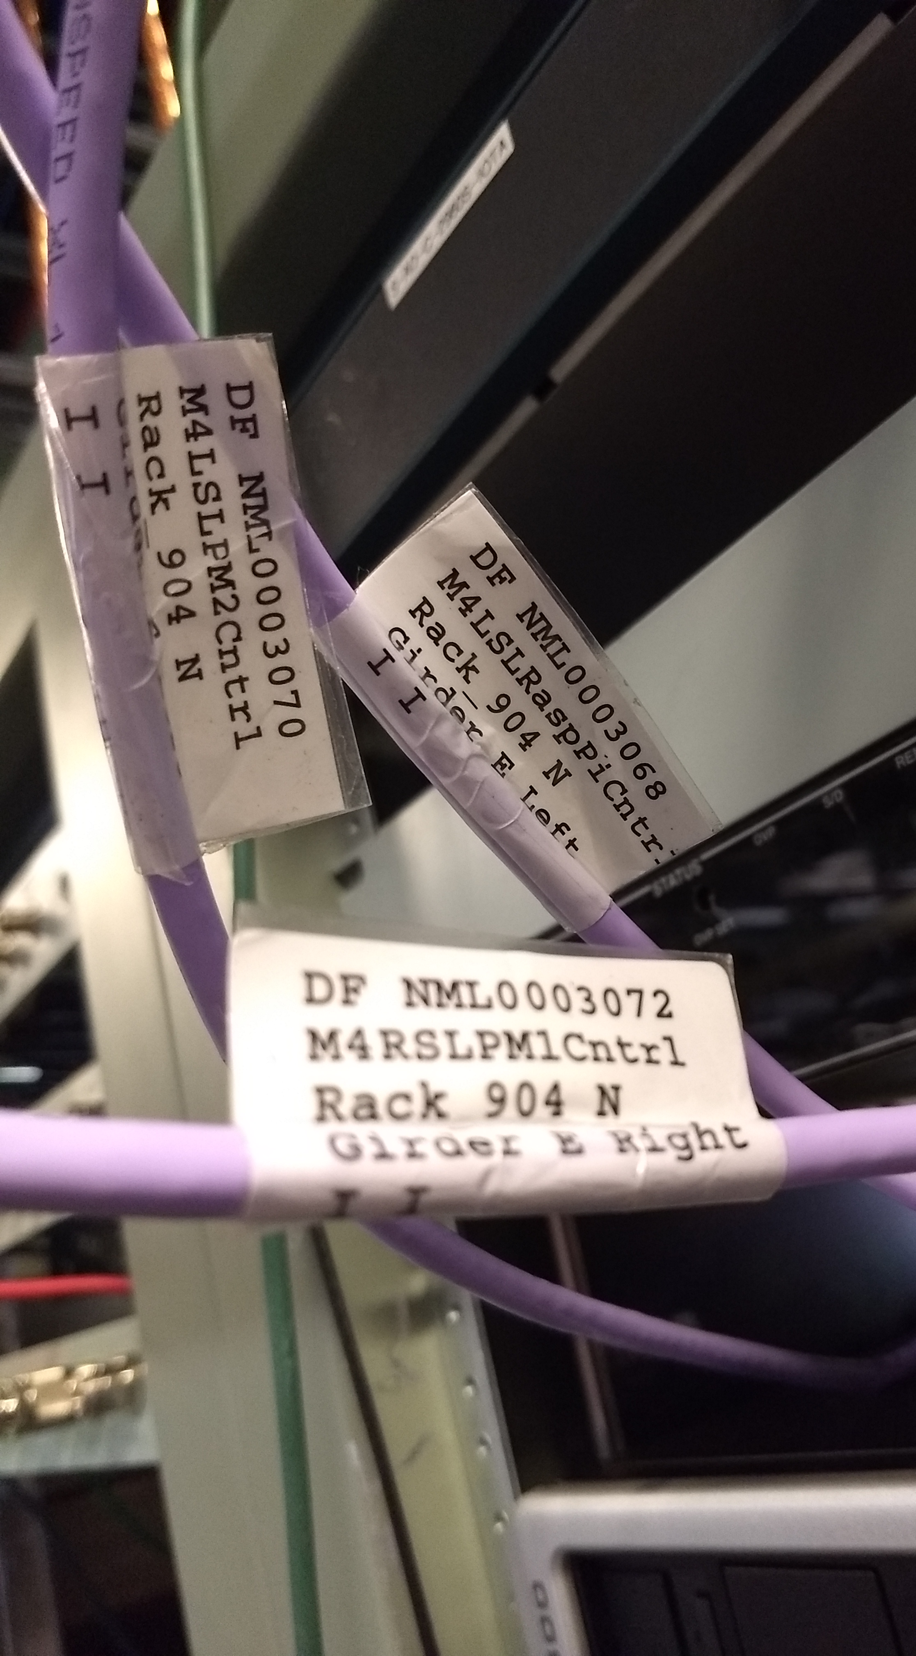
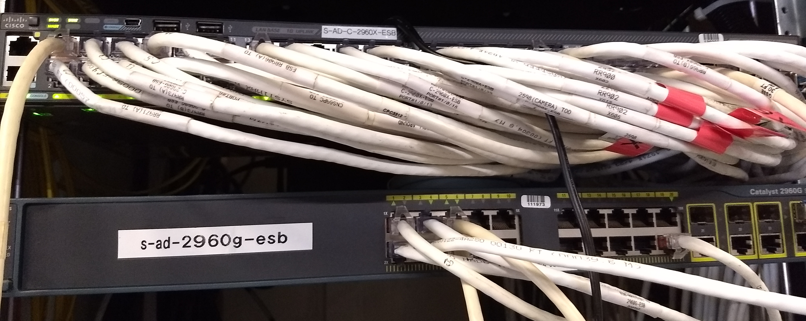
Readout + control
Spare cables of all varieties
Heliax/RG58 (coax)/HV/mystery
Ethernet + PoE + fiber
AC/DC power up to few kW
(Most) are labeled!
Internal network w/ control room access
Can provision devices internally instantly
Or more permanently in a few hours, accessible from anywhere via VPN
Portable networked scopes and digitizers available

Slide 12
Outline
IOTA ring – geometry and design
Control and readout
Devices
BPMs
Sync-Light – cameras + PMTs
WCM/DCCT/other
BYOD

Slide 13
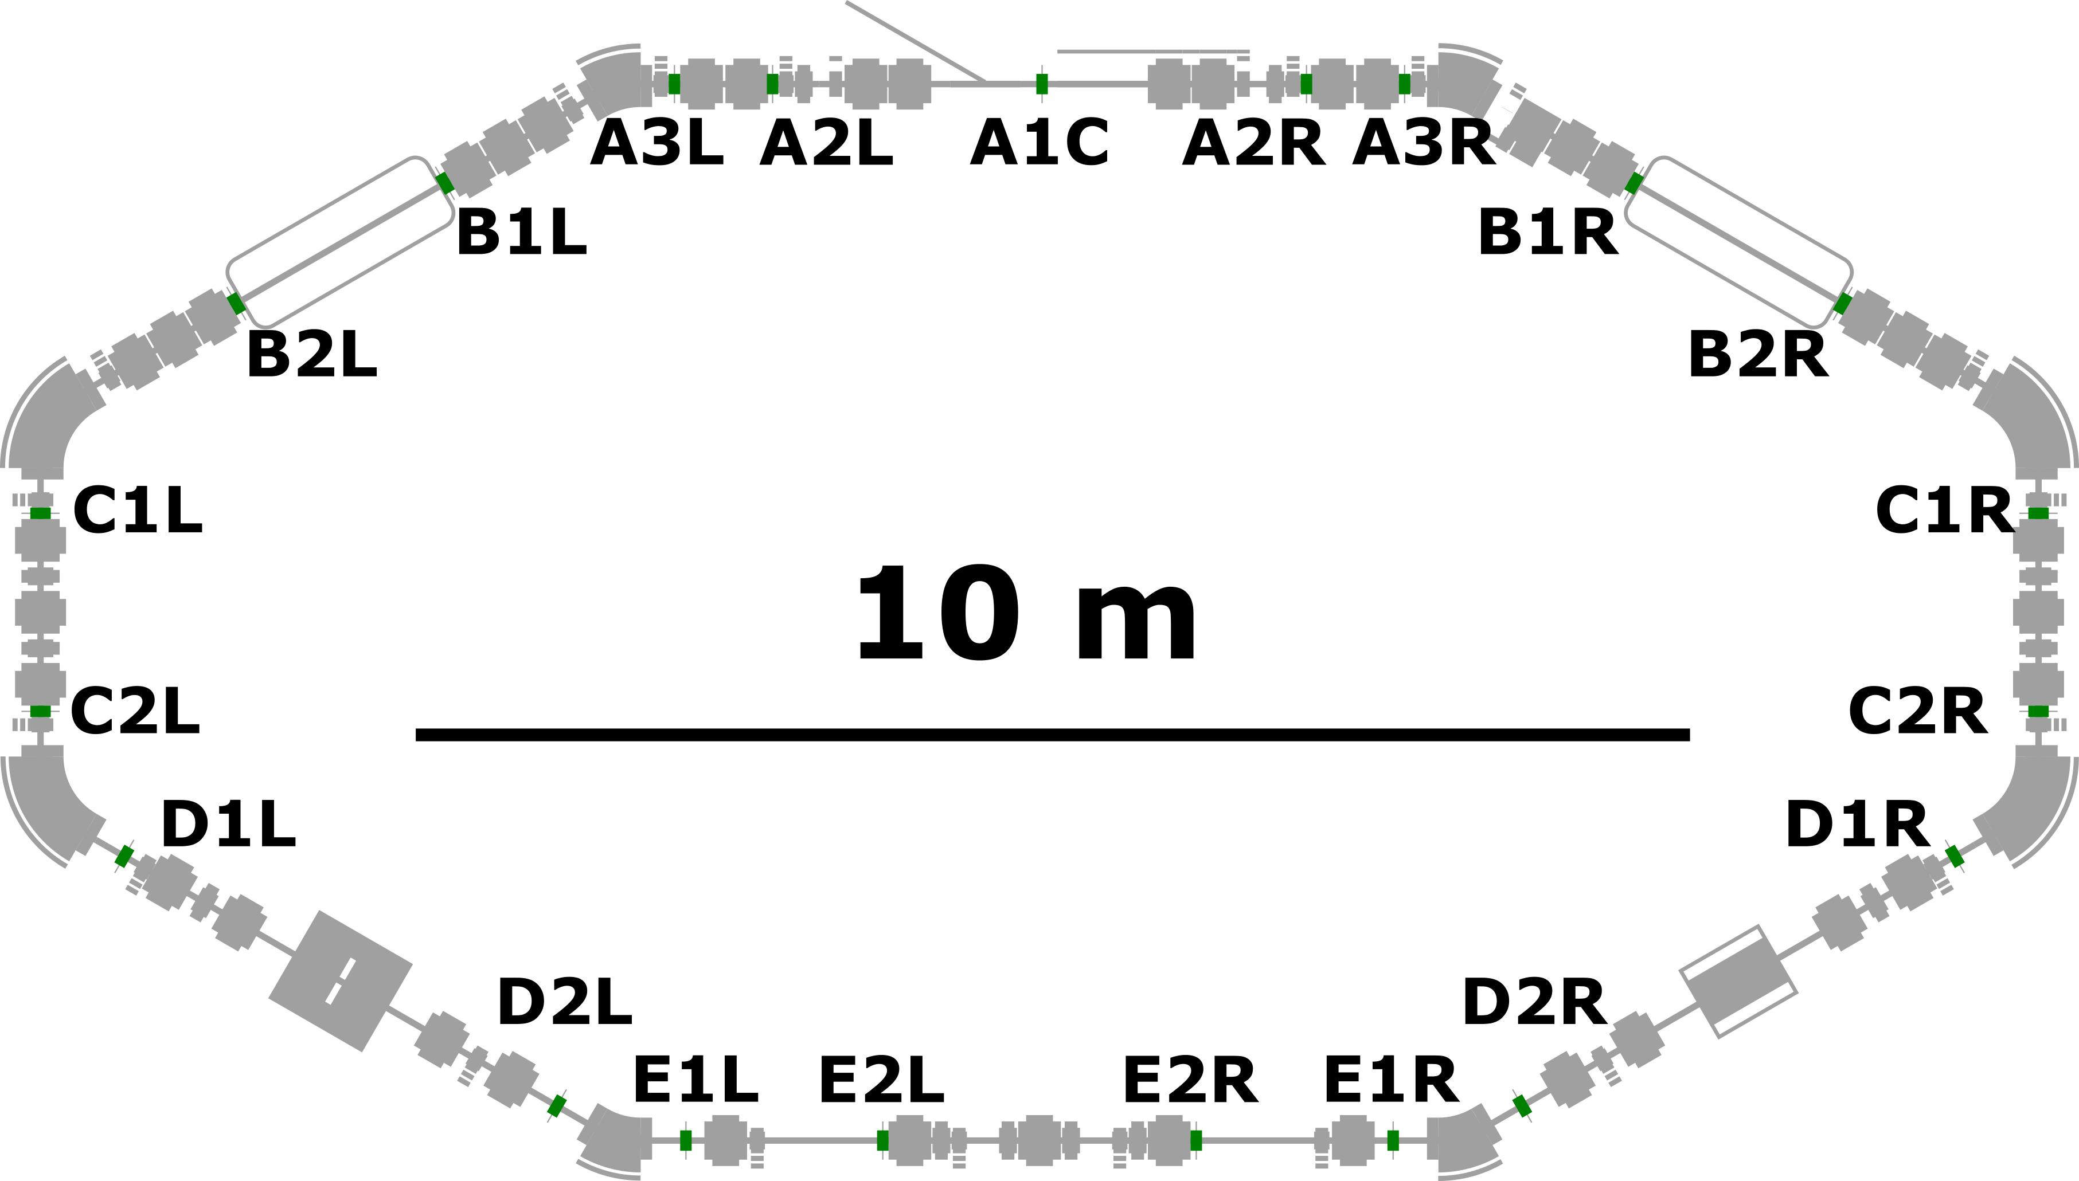
BPMs
21 electrostatic button BPMs
Turn-by-turn or orbit (averaging) modes

Slide 14
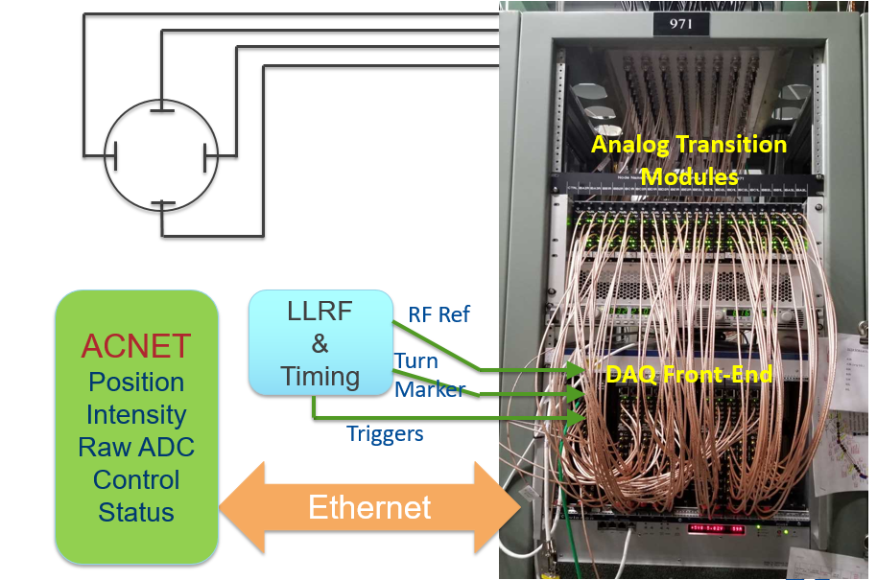
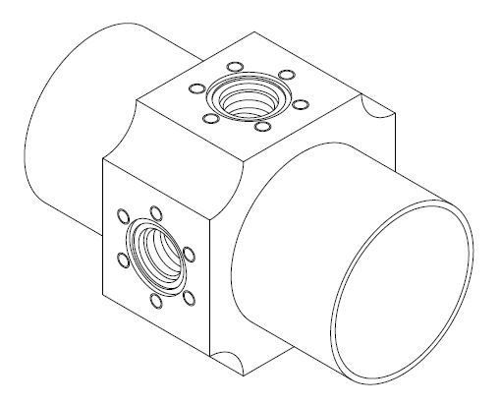
BPMs
Modular design, analog front-end + 250MS/s digitizers
Equivalent to modern commercial ones, like Libera Brilliance+
Can feed/fan out signals to your own readout

Slide 15
BPMs
During run 1, it had a number of quirks
Linearity
Random reboots/hangs
Performance was current/drift dependent
Sufficient for tune measurements, but not LOCO
Many lessons learned, expect major improvements in run 2
Advantage in having experts on site for support

Slide 16
BPMs
Key (upgraded) specs for users:
GigE readout (<<1s)
8k+ turns
<100um TBT
<10um ORM
Good linearity (or high sensitivity)
Fully integrated into control system
‘Just works’

Slide 17
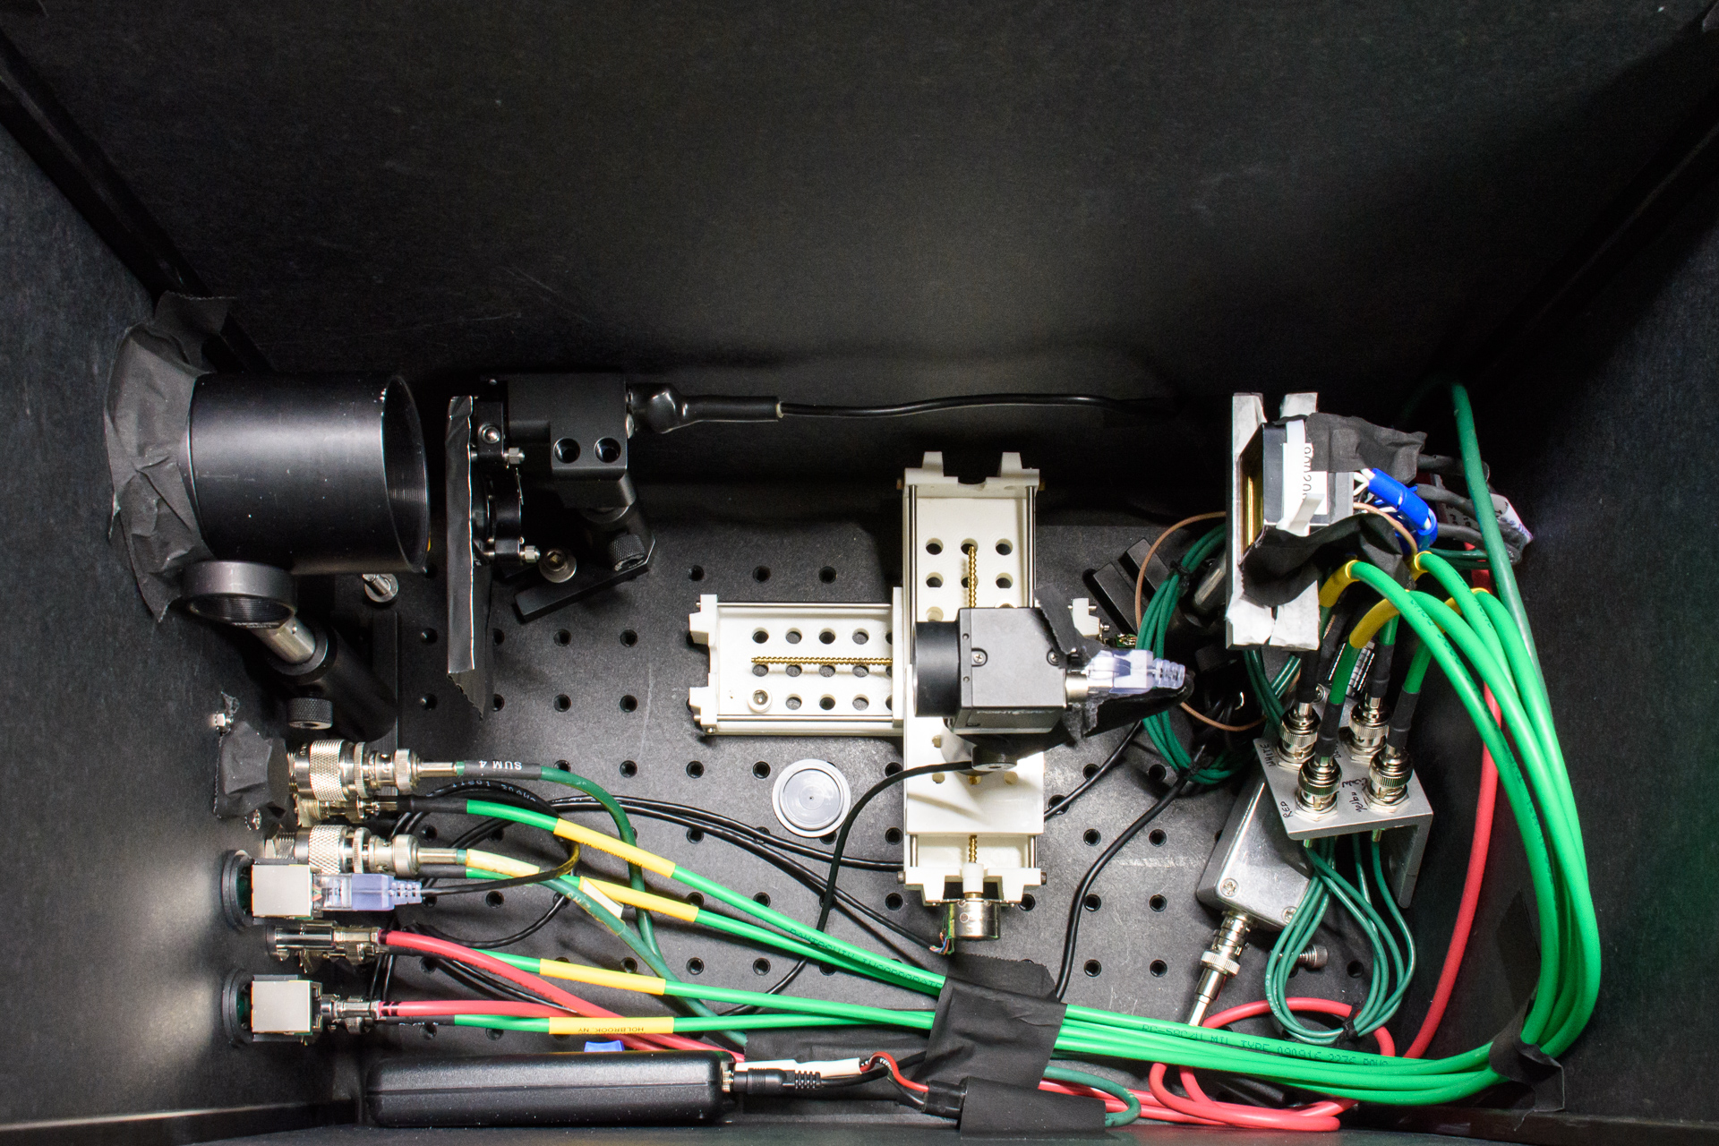
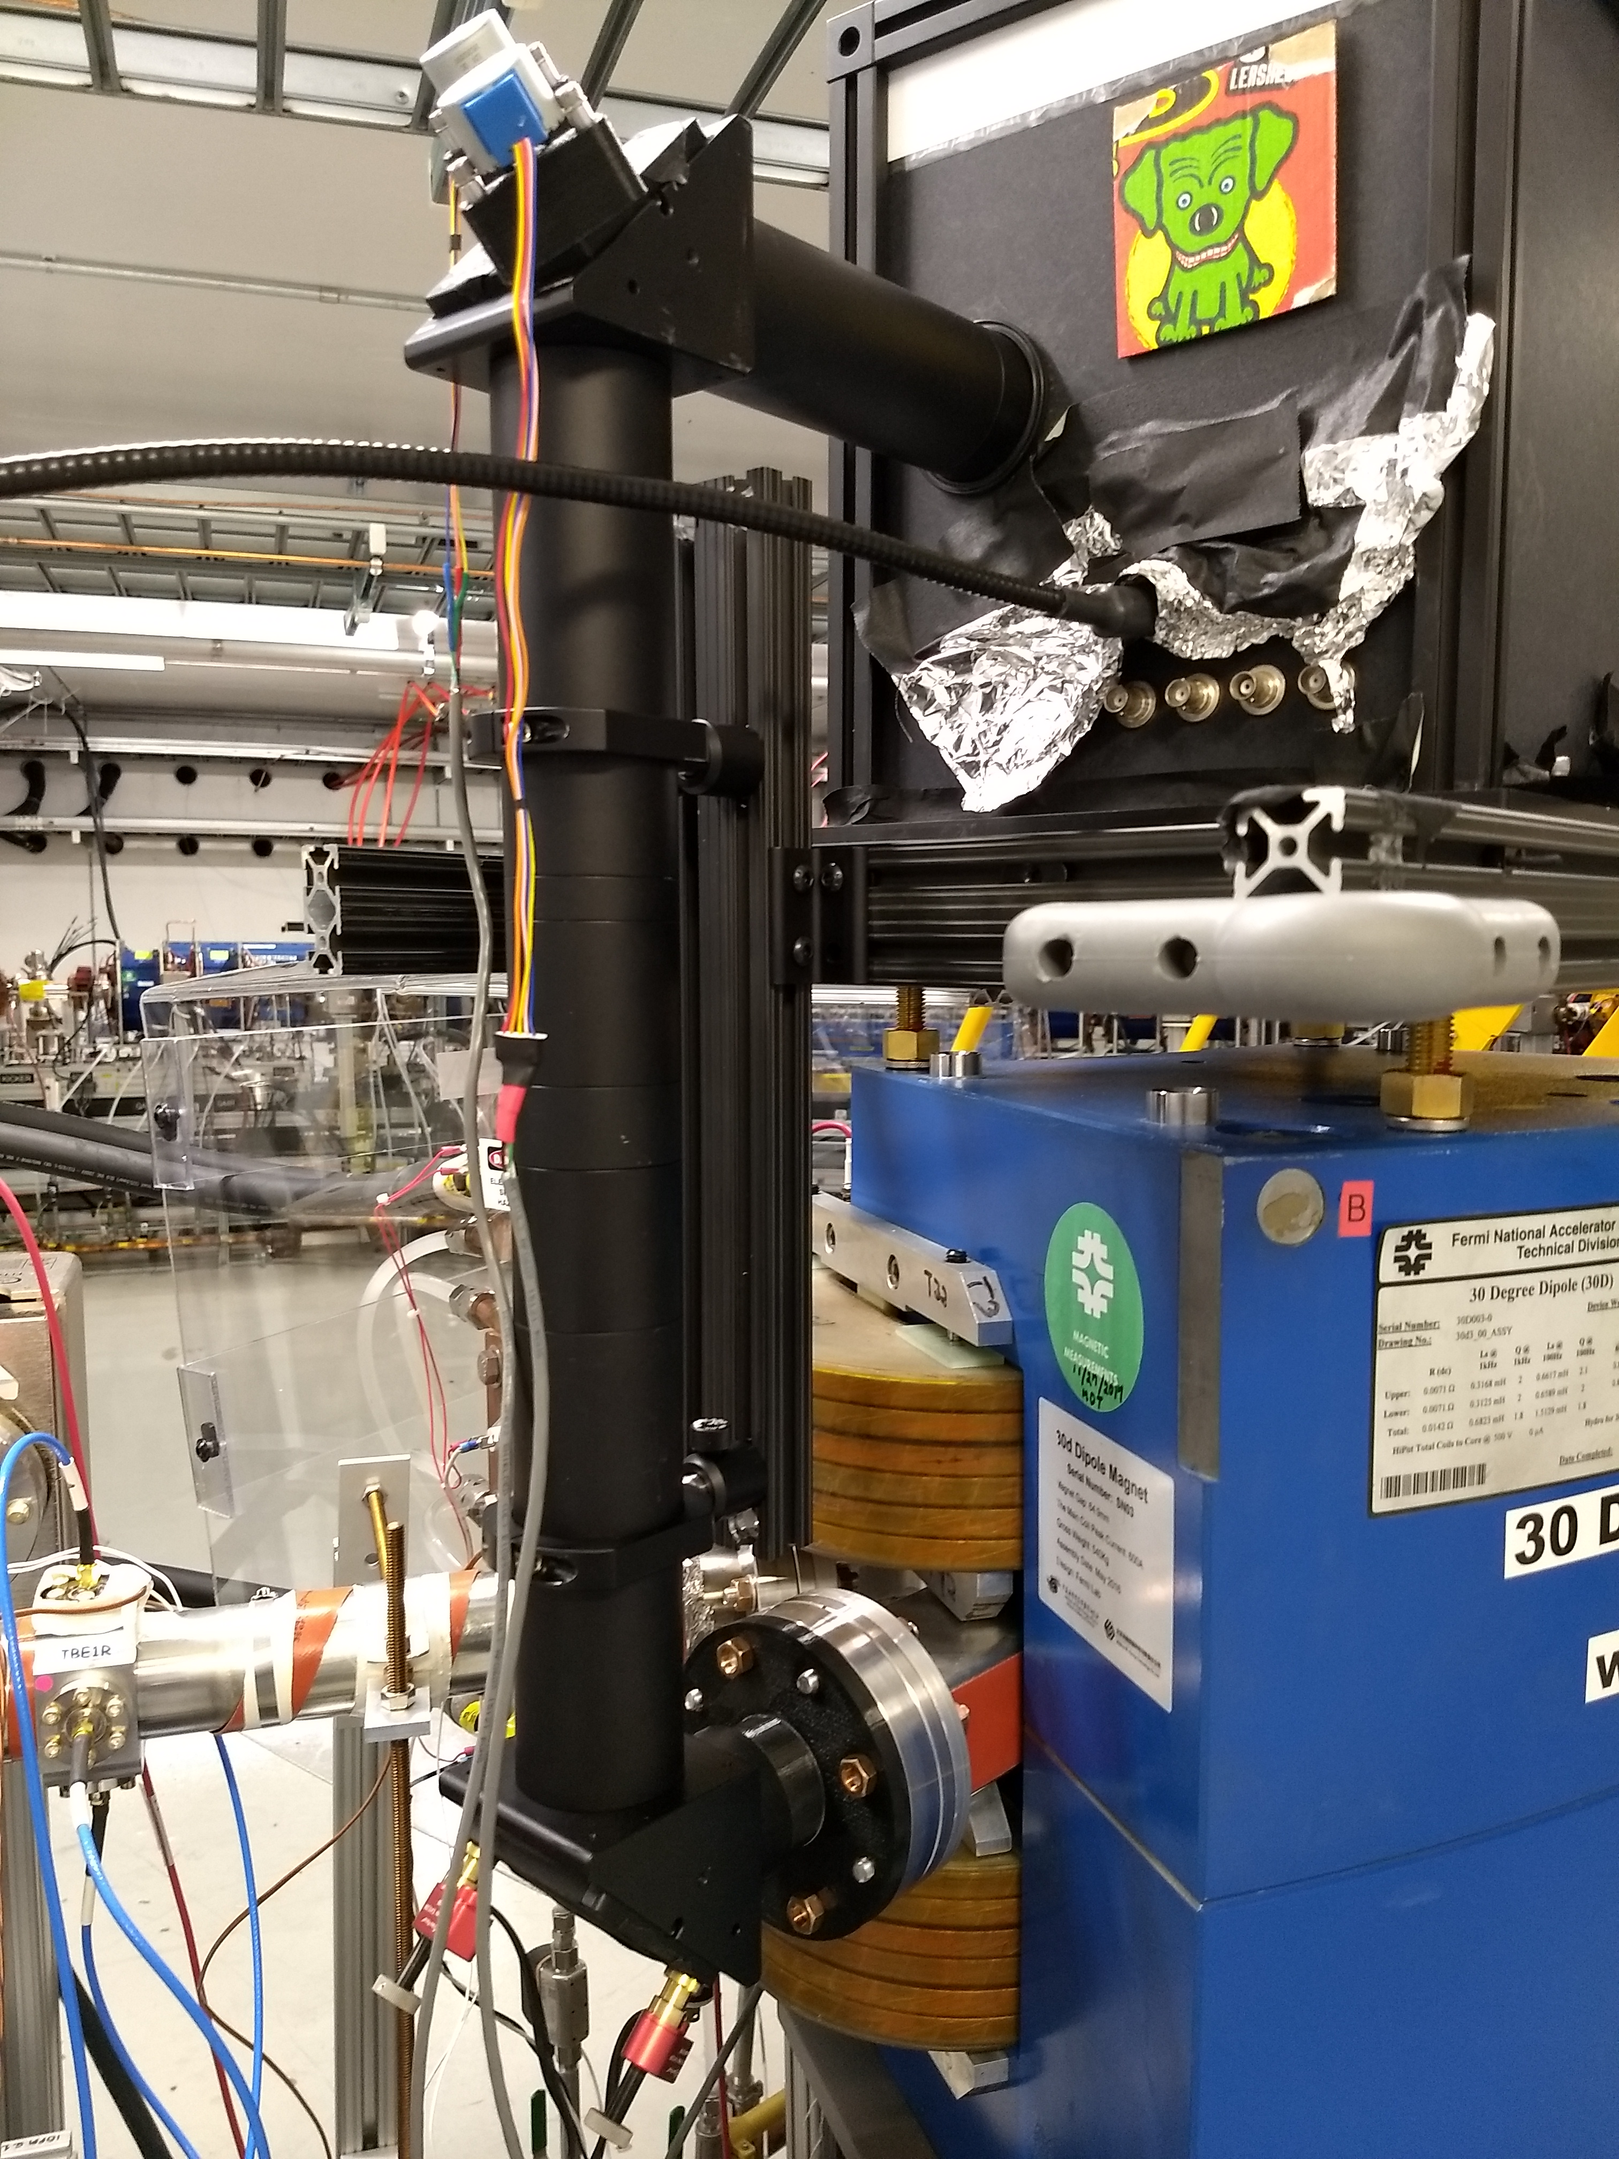
Sync-Light
Each main bend has a base station with optics + camera
A variety of addons are installed – PMTs, diodes, etc.
Many parts custom CNC/3D printed
But all optics and mounting standard
G. Stancari
Multi-anode PMT as a turn-by-turn BPM
Dog is listed as mission critical

Slide 18
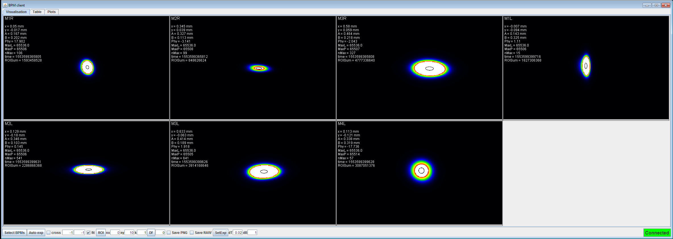
Sync-Light
Live control room readout through DAQ server cluster
Direct to disk saving and remote access
Exquisite precision for orbit measurement, <100nm statistical
Strongest constraints on LOCO

Slide 19
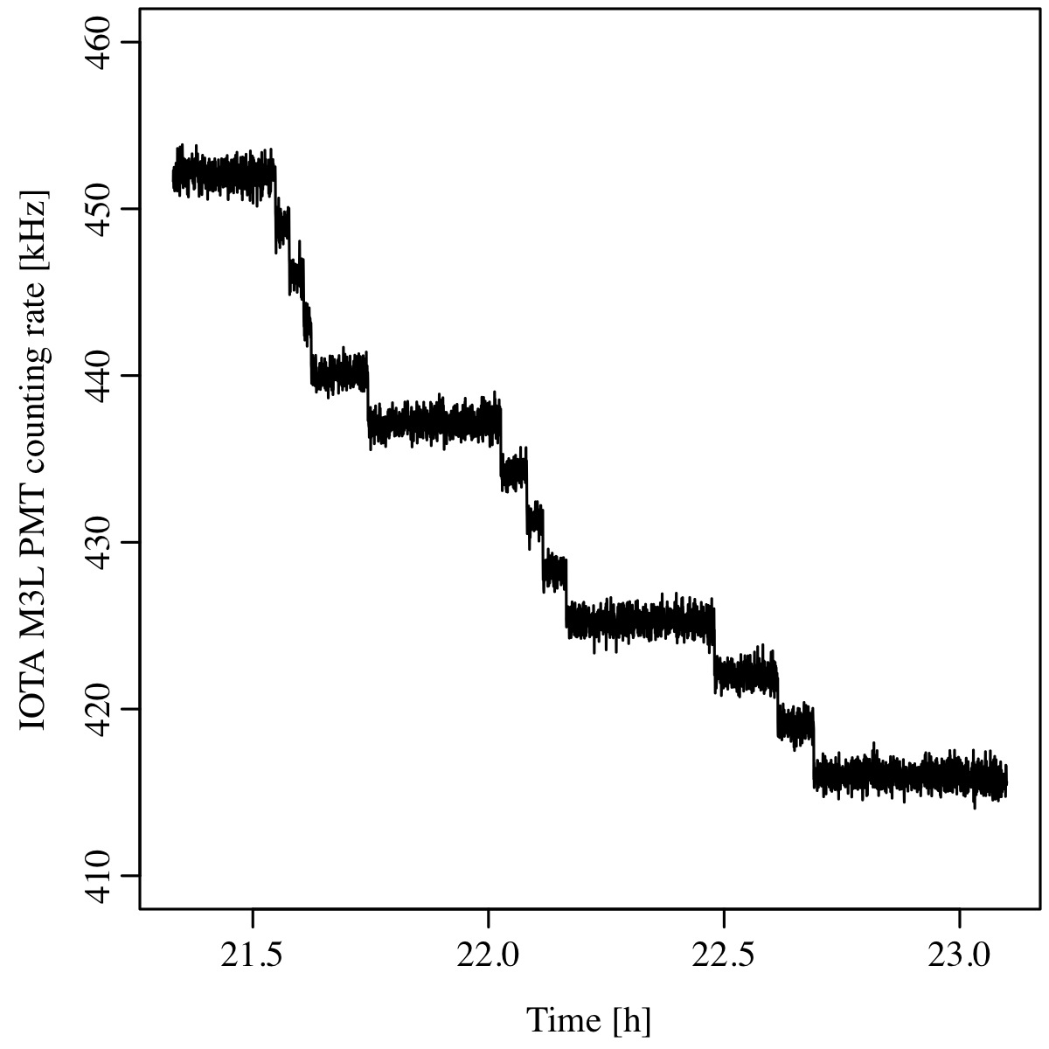
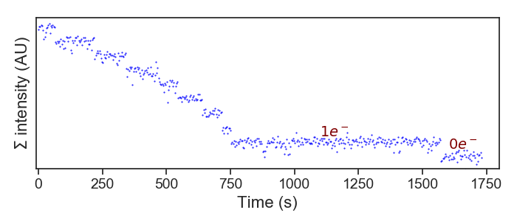
Sync-Light
Dynamic range from mA to single electron
PMT
Camera
G. Stancari
A. Romanov

Slide 20
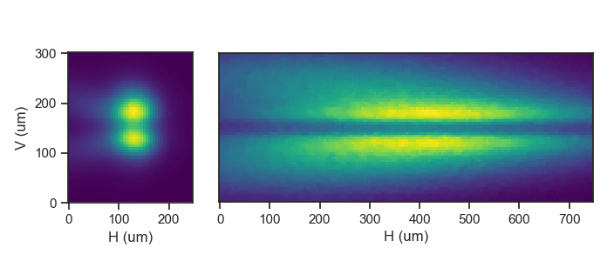
Sync-Light
Extensions to low-emittance beams (slits/polarizers)

Slide 21
Sync-Light
Can focus on different sources (edge interference)
Can use for insert alignment (OSC)

Slide 22
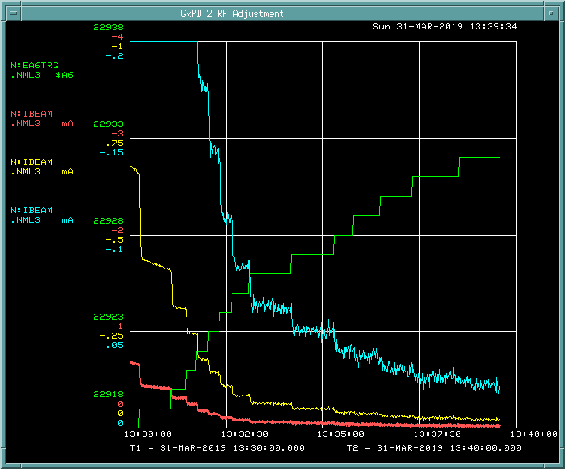
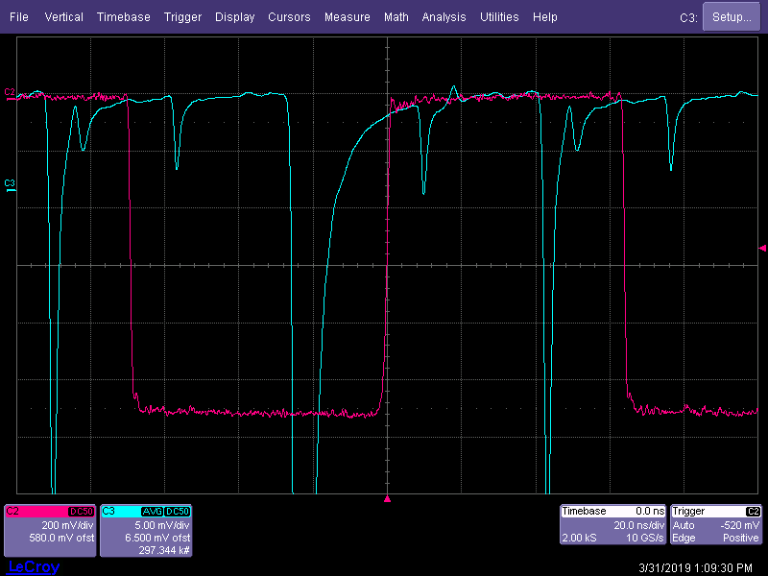
DCCT/WCM/other
DCCT for current measurements
Noisy, improvements in progress
WCM
Can be used for longitudinal profile measurements, finding bucket loading
Beam loss monitors
Never tripped, no hotspots
They silently judge bad injections
50uA current, with 3-5uA noise
Hitchhiker
Main bucket

Slide 23
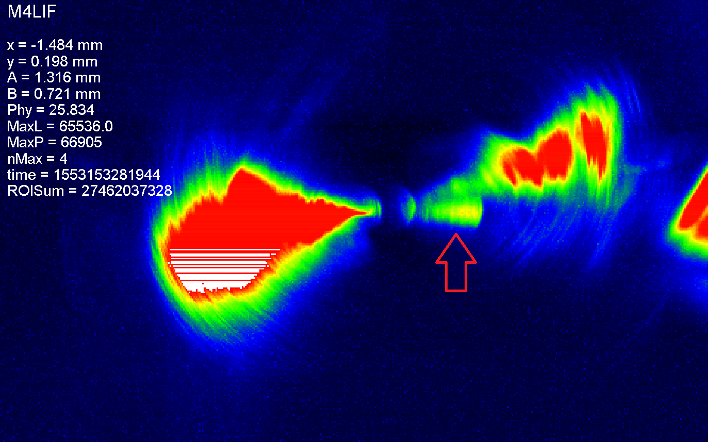
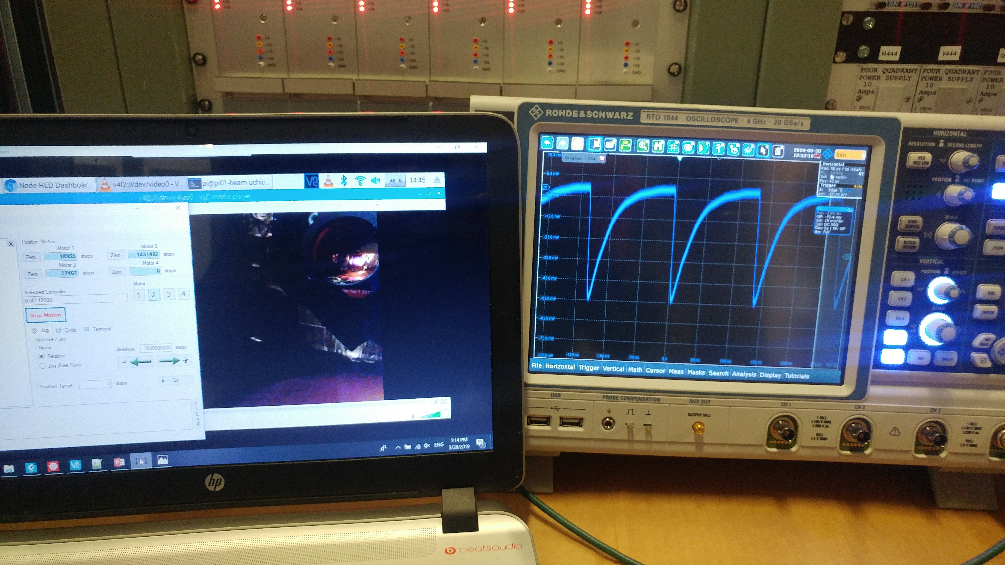
BYOD
Many things can be changed quickly for custom devices
Case studies: edge radiation and undulator fluctuations
Both experiments took over a single SL station
Installed within a day, most prep work beforehand
Easy access for alignment and fixes (~60 mins beam to beam)
“Perhaps we have stared too long at this abyss.”
Brendan O’Shea, SLAC, 2019
I. Lobach

Slide 24
Summary
IOTA is a flexible research ring, with flexible instrumentation
All basic capabilities are there – X/Y/Z profile/TBT position, current, losses, etc.
For custom devices, there is info/models for remote design and simulations, to optimize on-site time for actual data collection
Have an idea? Ask!

