Slide 1
FAST Linac Operation and Capabilities
Dan Broemmelsiek
FAST/IOTA Collaboration Meeting and Workshop on High Intensity Beams in Rings
10 June 2019

Slide 2
FAST Operations Summary
IOTA Commissioning Run Complete…
Studies: A Brief Summary
Single Electron Tomography
Edge Radiation
Undulator Radiation
Nonlinear Lattice Measurements
Low-Emittance Lattice
(Anti)Damper
IOTA/HEA Mode Switching
Cryomodule HOM measurements
Magnetized beam studies
Short Range Wakefield / E-t / y-t
Emittance and RF Phase/Energy Scans
DONE!
DONE-ish
DONE!
DONE!
DONE-ish
DONE!
DONE-ish
DONE!
DONE!
DONE-ish
DONE!
IOTA
HE e-Injector
LE e-Injector

Slide 3
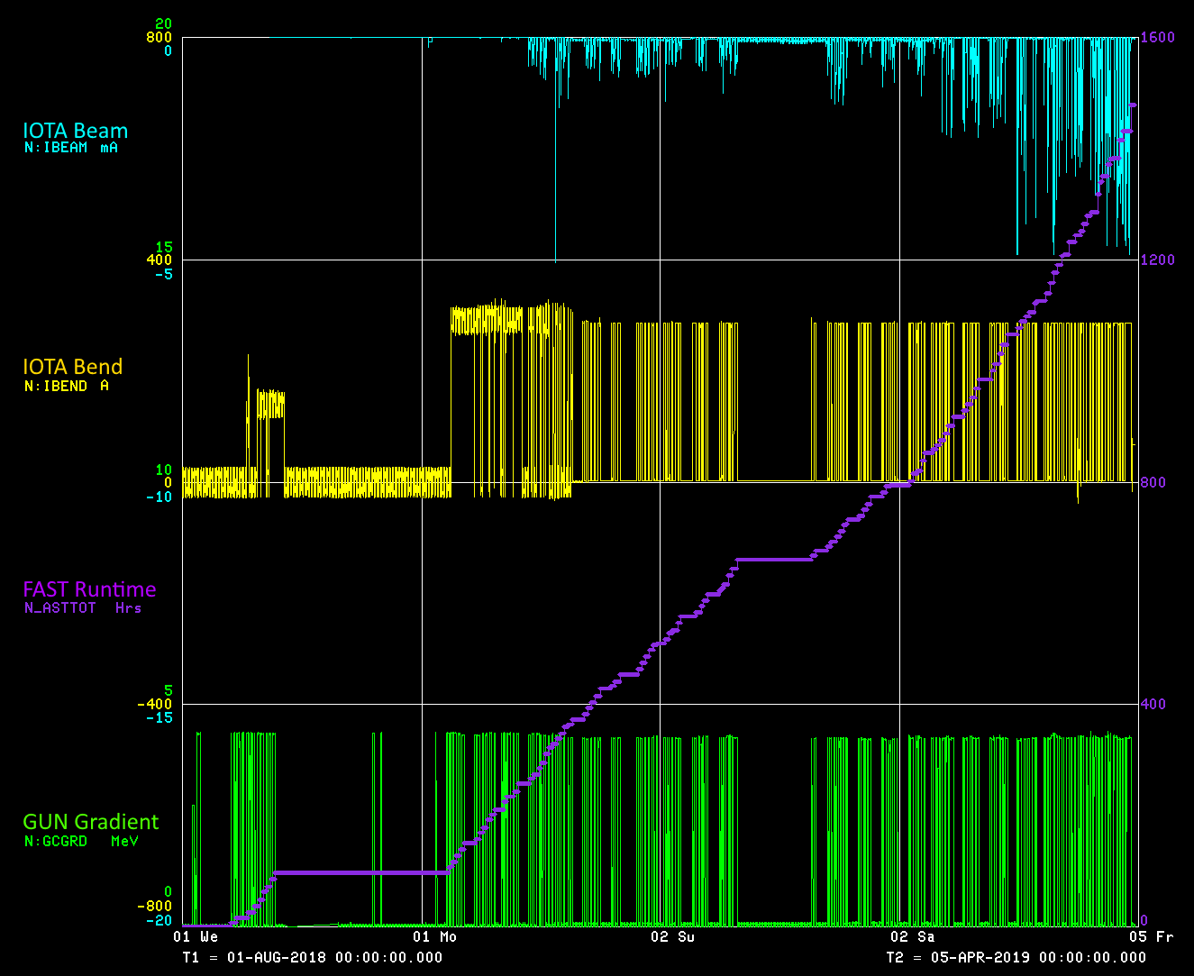
FAST Operations Summary
Total Run Time
1477 Hrs
IOTA Injection
100 MeV
Max IOTA Beam
4.88 mA (e)
Primary Downtime
CM Coldmass
Holiday Break
Cryo Instabilities
CC1 RF Droop
Switch Failure

Slide 4
Capabilities
Laser
Beam
Intensity
Phase space
Beam Energy
Instrumentation
Advanced Beam Configurations

Slide 5
Laser
Laser parameter | Nominal Value | Range | Note
Wavelength | 263nm | N/A
Bunch Length | 3 ps (RMS) | 3-20ps (RMS) | Long pulse is established with pulse stacking. It has been built and tested inside the laser lab.
Micro Bunch Frequency | 3MHz | 0.1~9MHz | Anything less than 3MHz can be realized using ACNET control already. 9MHz or above is possible with some preparation time. Maximum charge will be limited once frequency is above 3MHz.
Macro pulse Frequency | 1Hz | <5Hz | 5Hz laser operation has been tested inside the laser lab. However additional Gun conditioning is needed for the facility. (The higher frequency the longer conditioning time)
Beam size at cathode | 1mm (RMS) | 0.1~1.5mm (RMS) | Beam size is controlled with both Iris and imaging optics. Additional transverse laser shaping is currently in discussion with the adaption of Digital Microarray Device
Micro bunch # within Macro bunch | 10 | <3000 at 3MHz. The maximum duration is 1ms | 1ms pulse at 3MHz is demonstrated inside laser room. Only tested during Gun commissioning stage.

Slide 6
Beam
Beam parameter | Nominal Value | Range | Note
Bunch Charge | 1nC | <3.2 nC | Up to 3nC is demonstrated will <100 bunch operation with 5-year old cathode. We changed to a newer cathode during this shutdown. Bunch charge will also be related to micro bunch frequency once it is more than 3MHz
Beam energy | 100MeV | <300MeV | 300MeV is demonstrated in FY2017
Beam transverse emittance (µm) | 2.11Q^{0.69} | 0.1~100 | C. R. Prokop, et al., Nucl. Instrum. Meth. A 719 17 (2013).
Beam Longitudinal emittance (µm) | 30.05Q^{0.84} | 5~500
Peak Current | 1 | <10
Beam length | 3 ps (RMS) | 0.8~20 (RMS) | Less than 1ps pulse is demonstrated with Chicane compressor in FY2017

Slide 7
Beamline
Beamline | Nominal Value | Range | Note
Low energy | 40MeV | <50MeV | Gun energy is up to 4.2MeV. CC1 and CC2 will provide up to 46MeV. Additional CC1 and CC2 coupler conditioning may be needed for the higher energy
High energy (IOTA related) | 100 MeV | <300MeV | Nominal injection energy for IOTA operation in 2018
 | 150 MeV |  | Designed IOTA injection energy in later runs
 | 300 MeV |  | Demonstrated in 2017 commissioning run.
High energy (To High energy dump) | 100MeV | <300MeV | Demonstrated with switching from high energy to IOTA injection in <5 minutes
 | 300MeV |  | Demonstrated in 2017 commissioning run.

Slide 8
Instrumentation
Beam parameter | Availability | Range | Note
BPM | Whole beamline | 0.05~3.2 nC | Intensity control can be realized with ACNET parameter to keep BPM in the proper dynamic range for various charge.
Beam profile monitor | Whole beamline |  | All beam profile monitor in commissioned during last 2 runs.
HOM | CC1, CC2, CM |  | Commissioned during 2017 and 2018 run
Charge | Whole beamline | 0.001~3.2 nC | Including Toroid, Wall current monitor and Faraday cup. All commissioned.
Emmittance monitor | Low energy beam line | 0.05~3.2 nC | Live beam emittance monitoring with slits is demonstrated during 2017 commissioning. Emittance measurement after CM is done with quads scan
Longitudinal beam shape | Gap monitor | <2 ps (RMS) | Commissioned during 2017 run
 | Streak camera | 1~20ps (RMS)
Beam Energy | Dipole | 20~300MeV | Commissioned during 2017 run. Additional E-T phase space monitoring with streak camera and dipole is installed in 2018.

Slide 9
Advanced Beam Configurations
Beam configuration | Nominal Value | Range | Note
Beam compression with chicane | 1nC | <1 ps (RMS) | Chicane operation established during 2017 commissioning run. Special designed z-slizer is fully installed in 2018
Flat beam operation | 0.25 nC | 0.1~3 nC | Low charge flat beam is commissioned in 2017 run and flat beam with higher energy (through CM) is established. High charge flat beam is commissioned in 2018 in collaboration with Jlab. Halo monitor is going to be installed and commissioned during 2019.
Inverse Compton scattering | 3nC |  | Laser transport from laser to high energy line is designed and partially installed. PMQ is designed and could be ready for installing soon.

