Slide 1
IOTA Nonlinear Integrable Optics Experiment: Landau Damping
Nathan Eddy
Fast/IOTA Collaboration Meeting
10 June 2019

Slide 2
Motivation/Theory
Landau Damping provides damping mechanism via tune spread
Octupoles provide a means to increase tune spread and increase the stable region via Landau Damping
Octupoles introduce strong non-linearities at large amplitudes
  Reduce dynamic aperture and lifetime
  Landau damping sensitive to tails of beam
  Can change chromaticity via feed-down effects

Slide 3
Feedback System Overview
E2L Button
BPM
Horizontal
Kicker
~800ps
32db
A,B
~20ns
BPM
Analog
Module
55db
A
B
Diff
Amp
~Position
Diff
Amp
Phase
Delay
~20ns
Att
20db
1 Turn
Delay
Use horizontal button electrodes on E2L bpm with 32db RF pre-amplifier on each button
BPM analog module based upon RF envelope detector conditions fast doublet into longer pulse – provides 32db of programmable gain control
Implement 1 turn notch filter delay and phase delay with cable
Use one plate of the horizontal strip-line to kick beam

Slide 4
Relevant Parameters
Parameter | Value
RF Frequency | 30.034 MHz
Harmonic Number | 4
Revolution Frequency | 7.508MHz
Revolution Time | 133ns
Ring Circumference | 3997cm
Stored Beam Orbit Tune (ν_{x}) | 5.30
Synchrotron Tune | 50-60kHz
Kicker Cable | 370ns
BPM Cables | 180-270ns
Feedback System (cables, amps) | 125ns

Slide 5
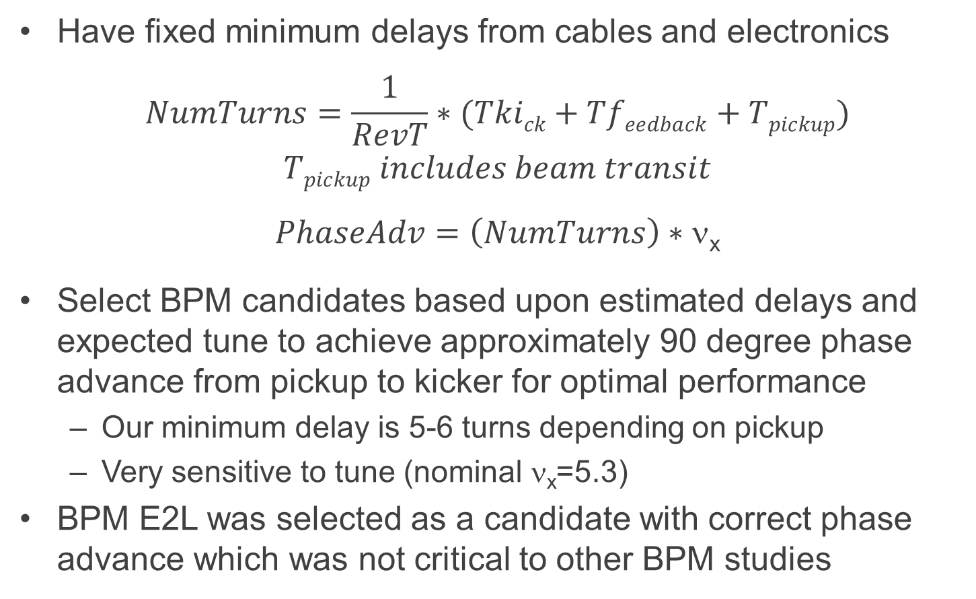
BPM Selection
Have fixed minimum delays from cables and electronics
$$NumTurns=\frac{1}{RevT}∗(Tkick+Tfeedback+Tpickup)$$
$$Tpickup includes beam transit$$
$$PhaseAdv=\left(NumTurns\right)∗\text{n}\text{x}$$
Select BPM candidates based upon estimated delays and expected tune to achieve approximately 90 degree phase advance from pickup to kicker for optimal performance
  Our minimum delay is 5-6 turns depending on pickup
  Very sensitive to tune (nominal ν_{x}=5.3)
BPM E2L was selected as a candidate with correct phase advance which was not critical to other BPM studies

Slide 6
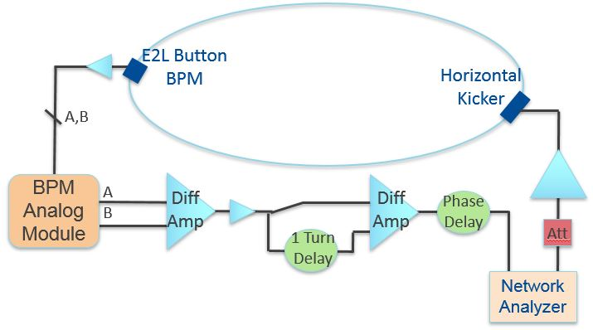
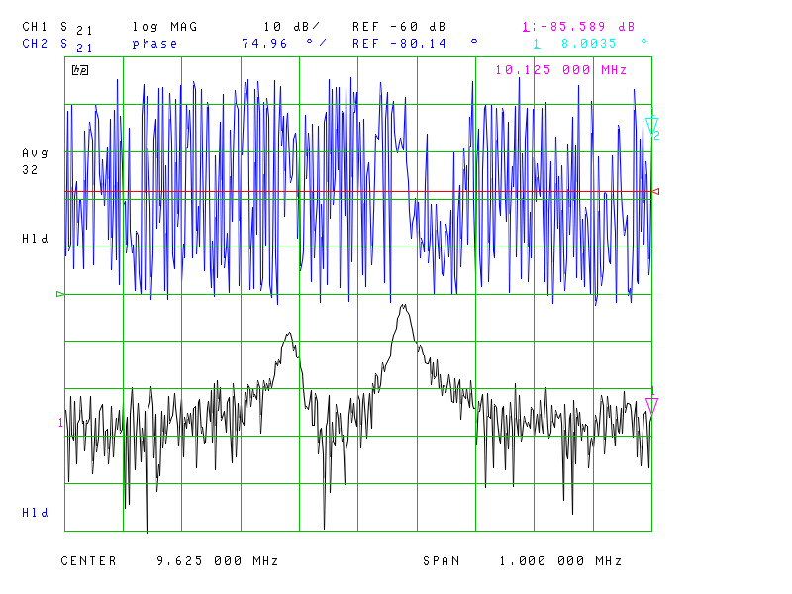
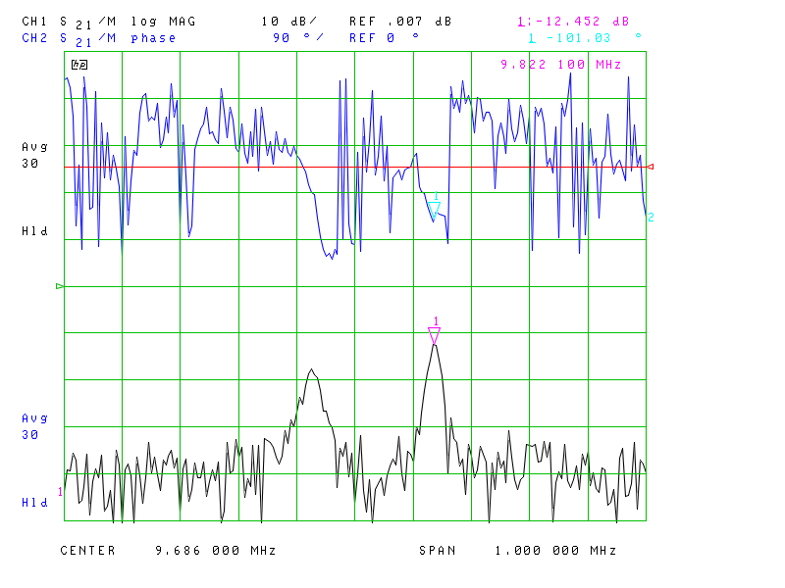
Commissioning – Beam Transfer Function
Before
Pre-amp
After
Pre-amp
Injection Tunes

Slide 7
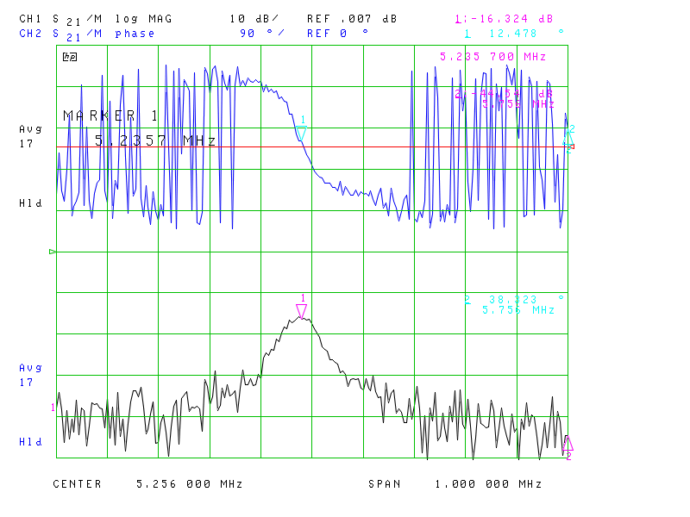
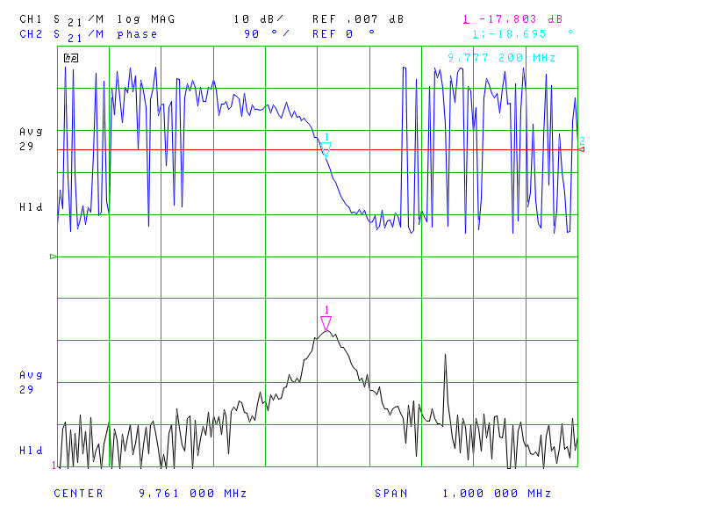
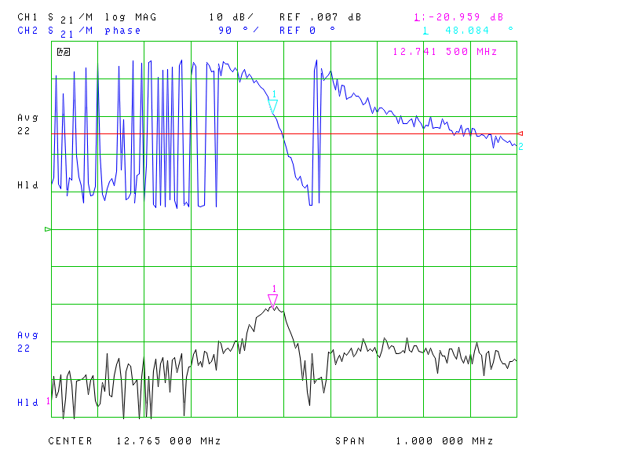
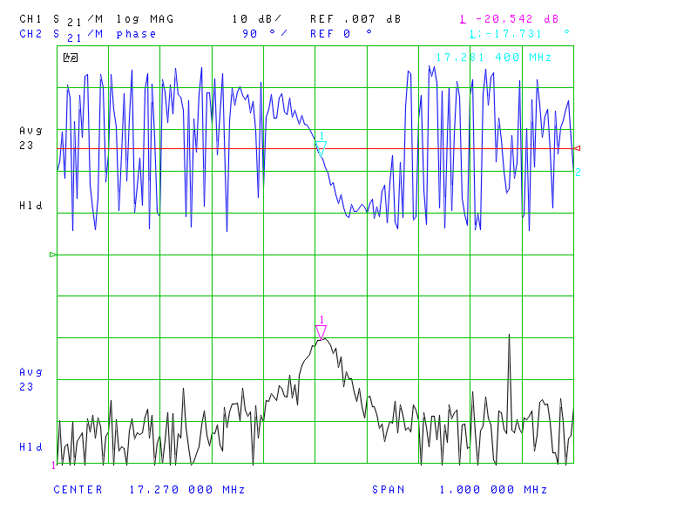
Commissioning – BTF after Phasing for Positive Feedback
1st
Harm
Lower Sideband
Upper Sideband
2nd
Harm

Slide 8
Inducing Instability – Positive Feedback
Instability triggered by changing gain in analog module
Ability to provide relatively controlled instabilities

Slide 9
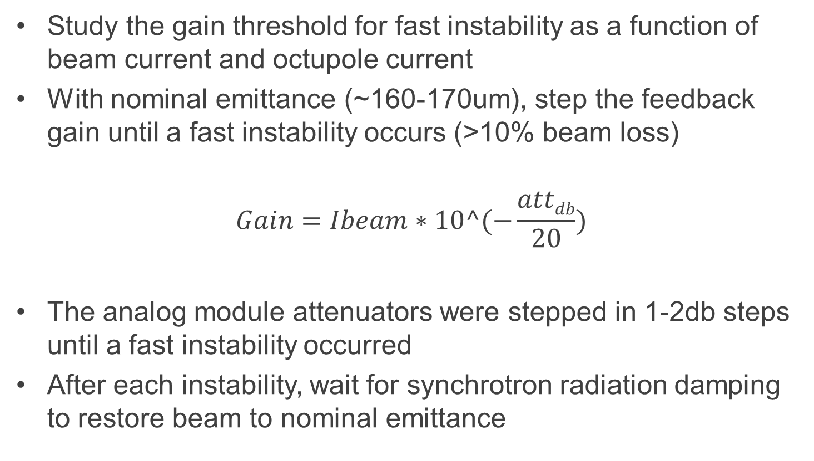
Instability Threshold Study
Study the gain threshold for fast instability as a function of beam current and octupole current
With nominal emittance (~160-170um), step the feedback gain until a fast instability occurs (>10% beam loss)
$$Gain=Ibeam∗10^(−\frac{attdb}{20})$$
The analog module attenuators were stepped in 1-2db steps until a fast instability occurred
After each instability, wait for synchrotron radiation damping to restore beam to nominal emittance

Slide 10
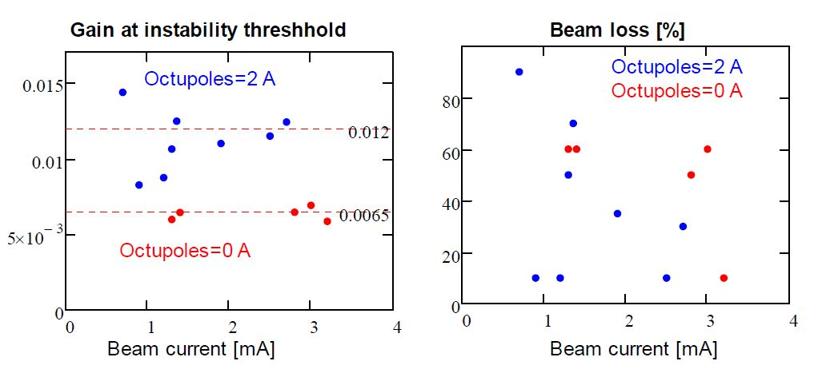
Instability Threshold vs Gain
See approximately factor of 2 increase in the instability threshold with octupoles at 2A as compared with 0A

Slide 11
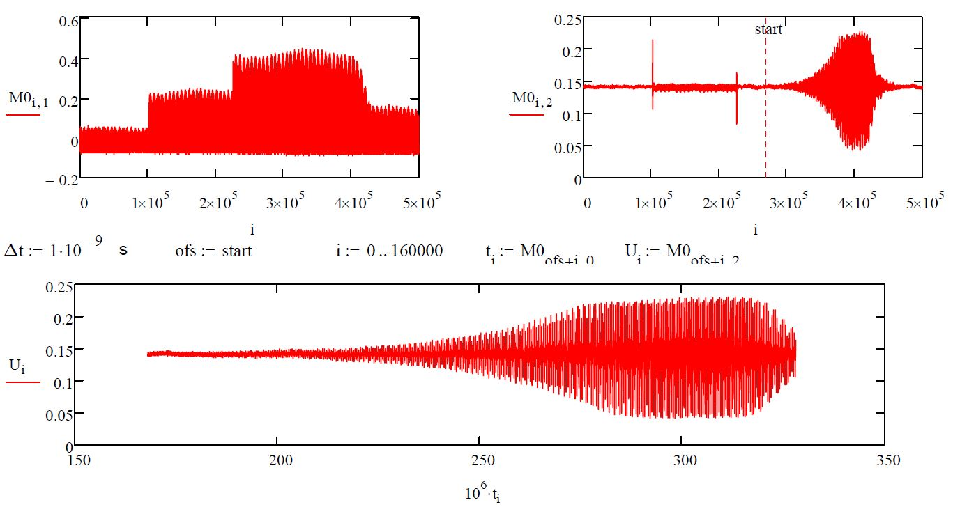
Instability Octupoles 0A
Sum Signal
Kick Signal
Kick Signal Zoom

Slide 12
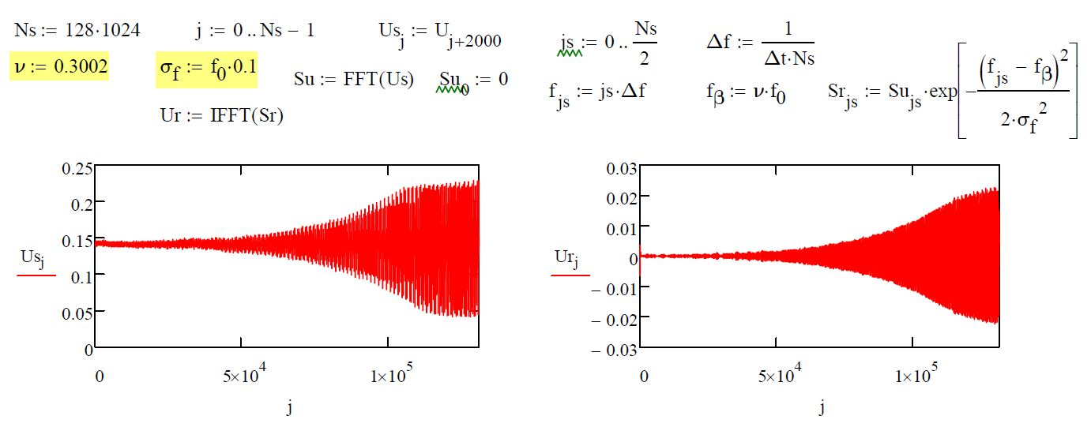
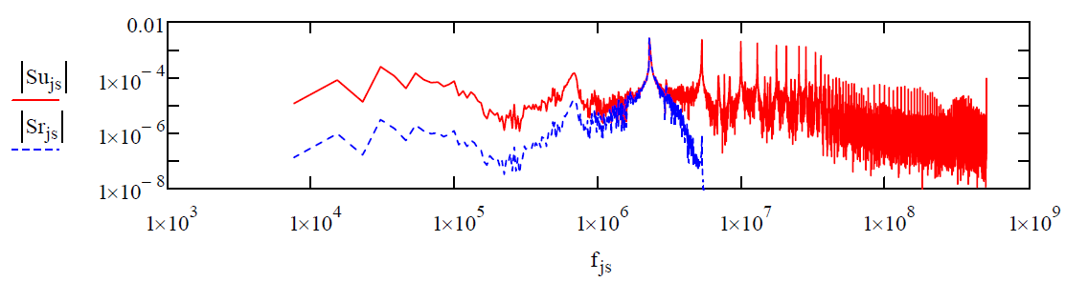
Instability Octupoles 0A – 1st Harmonic

Slide 13
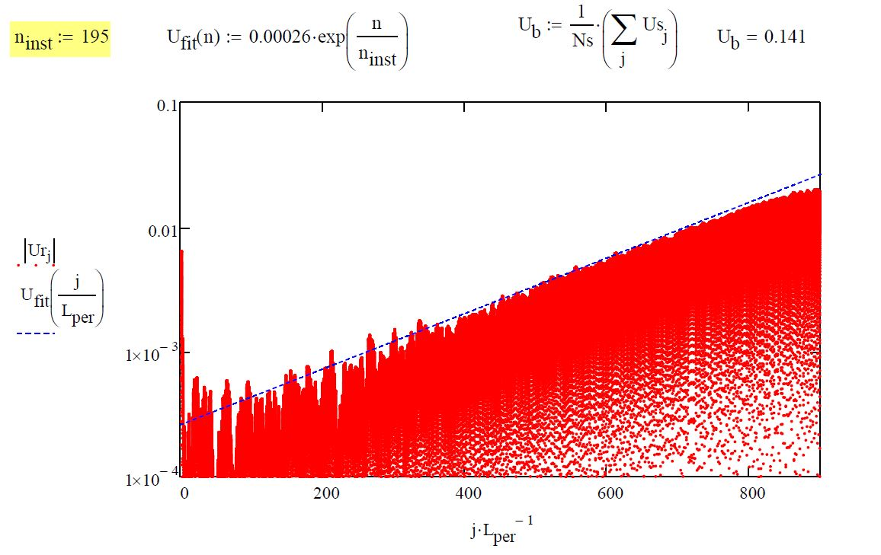
Instability Octupoles 0A – Growth Rate
Growth Rate 195 Turns

Slide 14
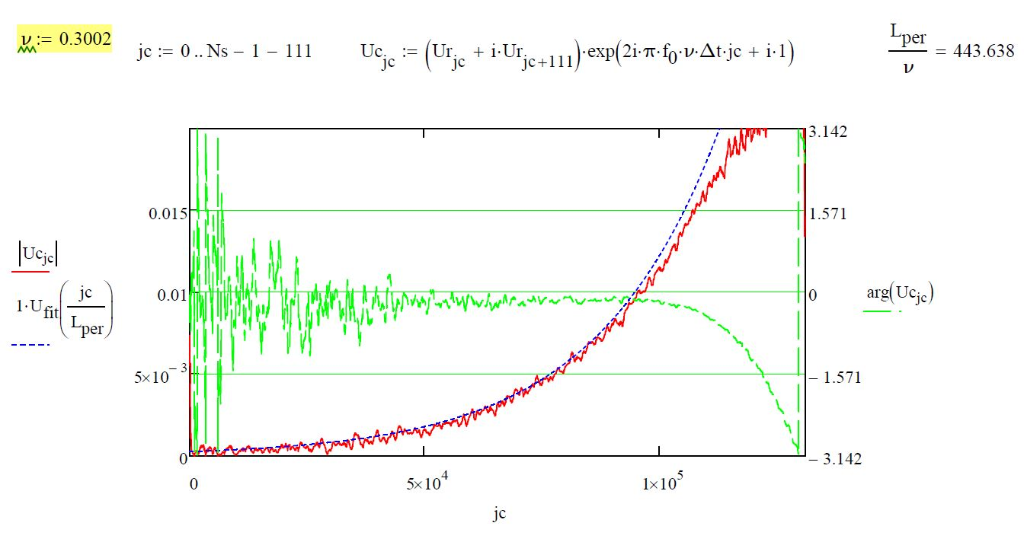
Instability Octupoles 0A – Frequency Analysis

Slide 15
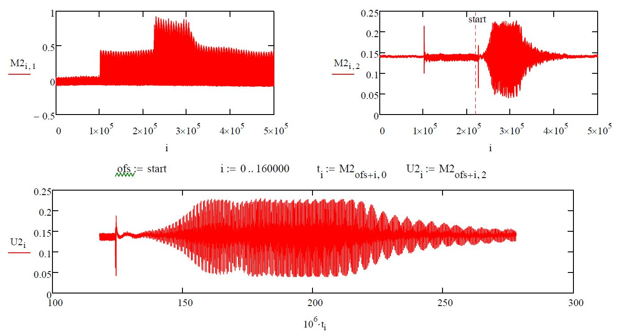
Instability Octupoles 2A
Sum Signal
Kick Signal
Kick Signal Zoom

Slide 16
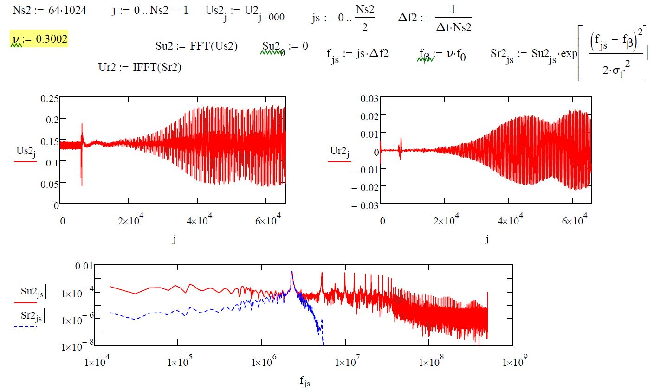
Instability Octupoles 2A – 1st Harmonic
Kick Signal
Kick 1st Harm
All Harm
1st Harm

Slide 17
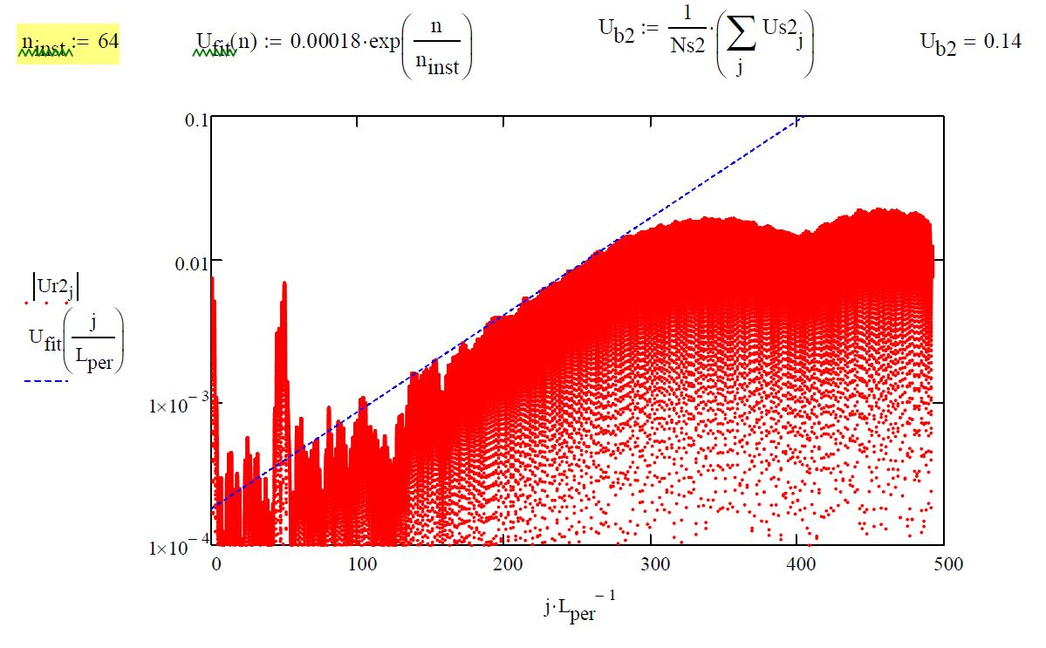
Instability Octupoles 2A – Growth Rate
Growth Rate 64 Turns

Slide 18
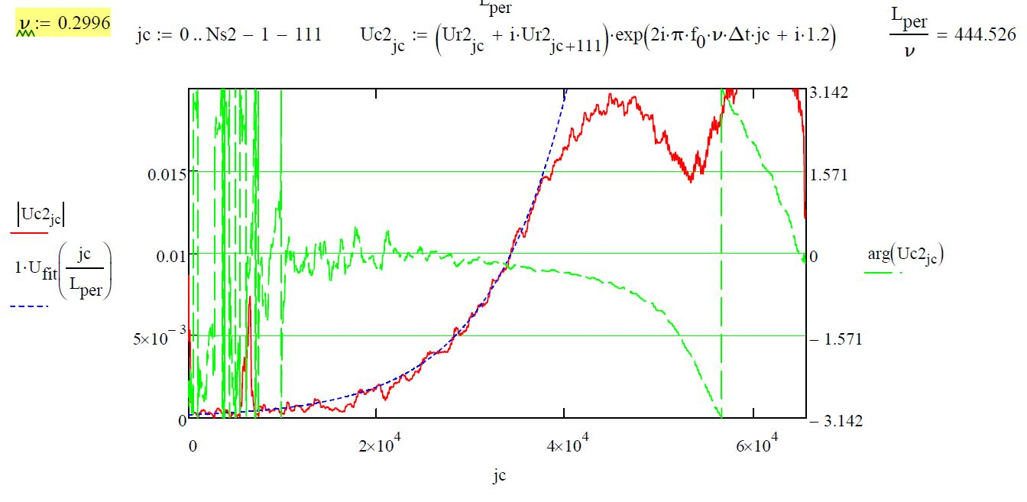
Instability Octupoles 2A – Frequency Analysis

Slide 19
Summary
See the expected effect that the octupoles at 2A increase the stable region by a factor of 2
Analysis of the time domain data of the instabilities shows faster growth rate for 2A vs 0A – this is not currently understood
Plan to implement a digital system which will provide better mechanisms to control the gain and phase to study the instabilities
Can also use BTF measurements to further the study stability diagram and chromaticity

