Slide 1
Opportunities for Crystal Acceleration Research at FAST
Vladimir SHILTSEV , with input from Sergey Striganov
IOTA/FAST Collaboration Meeting and Workshop on High Intensity Beams in rings
June 12, 2019 - Fermilab

Slide 2
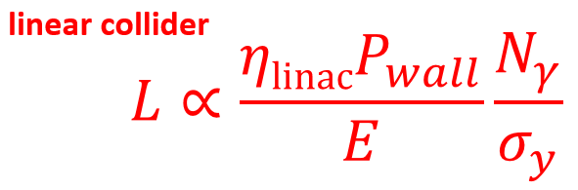
Motivation: “Ultimate” Colliders
Post-100 TeV “Energy Frontier” assumes
  300-1000 TeV (20-100 × LHC)
  “decent luminosity” (TBD)
Surely we know:
For the same reason there
is no circular e+e- collider above
Higgs-F there will be no circular pp
colliders beyond 100 TeV → LINEAR
2. Electrons radiate 100% beam-strahlung (<3 TeV) and in focusing channel
(<10 TeV) → µ+µ- or pp

Slide 3
“Phase-Space” is Further Limited
“Live within our means”: for 20-100×LHC
  < 10 B$
  < 10 km
  < 10 MW (beam power, ~100MW total)
New technology should provide >30 GeV/m @
total component cost <1M$/m ( ~NC magnets now)
SC magnets equiv. ~ 0.5 GeV per meter (LHC)
3. Only one option for >30 GeV/m known now: dense plasma→ that excludes protons→ only muons

Slide 4
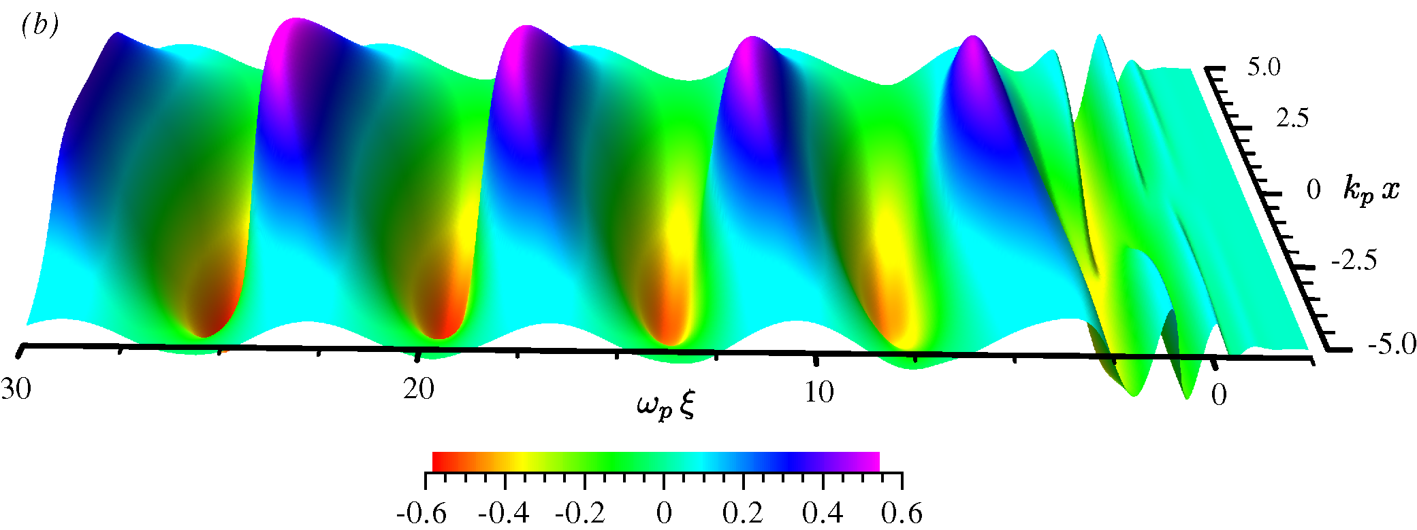
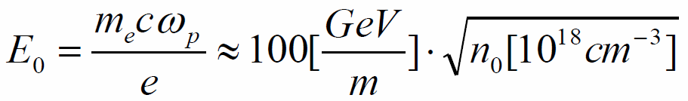
Plasma Waves
Idea- Tajima & Dawson, Phys. Rev. Lett. (1979)
Plasma wave: electron density perturbation
Laser/beam pulse ~ λ_{p}/c
Option A:
Short intense e-/e+/p bunch
Few 10¹⁶cm⁻³, 6 GV/m over 0.3m
Option B:
Short intense laser pulse
~10¹⁸cm⁻³, 50 GV/m over 0.1m
First looks into “Plasma-Collider”: staging kills ! <E>~2 GV/m,ε

Slide 5
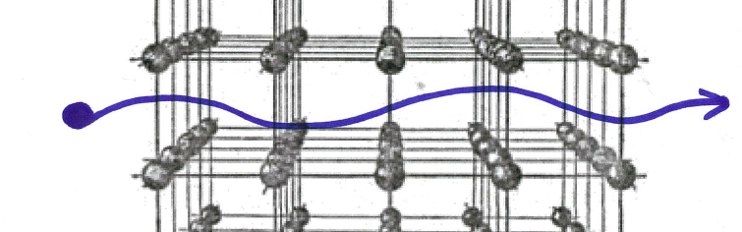
Novelty of the Approach:
Acceleration in Continuous Focusing Channel
10²² cm⁻³ →10 TV/m, λ_{p}~0.3µm
Synchtrotron radiation losses balance energy gain:
0.3TeV for positrons
10 000 TeV for muons (+)
1000 000 TeV for protons
10²⁴ cm⁻³ →100 TV/m, λ_{p}~0.03µm

Slide 6
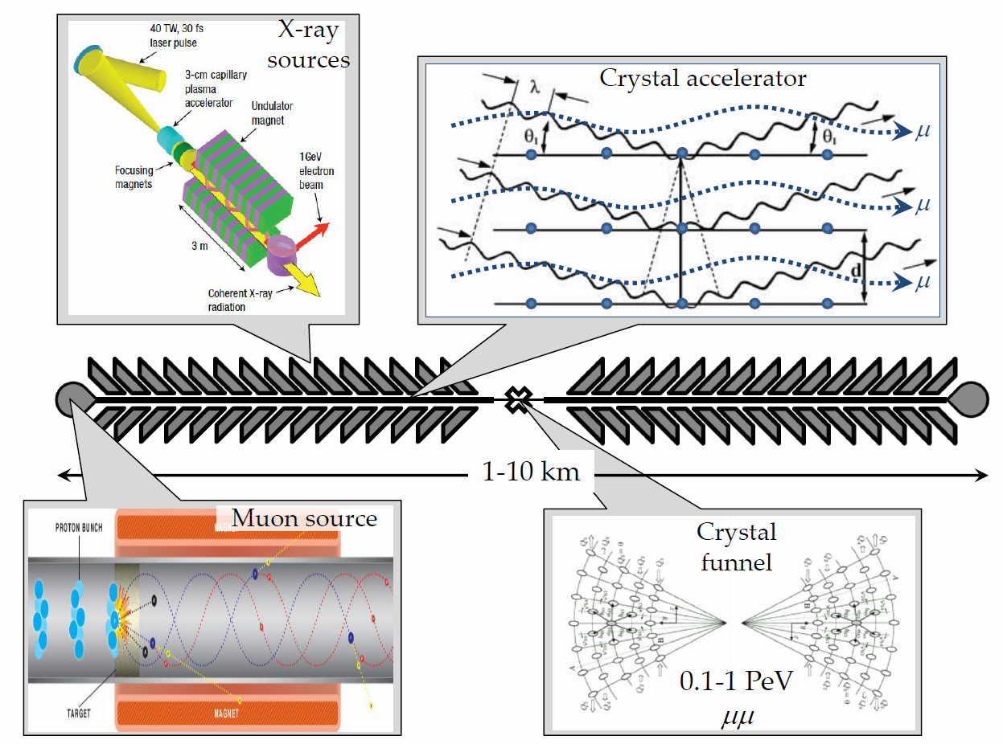
Linear μ+μ- Crystal X-ray Collider
1 PeV = 1000 TeV
n_{μ} ~1000
n_{B} ~100
f_{rep} ~10⁶
L ~10³⁰⁻³²
V.Shiltsev, Physics-Uspekhi 55 (10), 965 (2012)

Slide 7
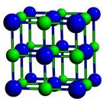

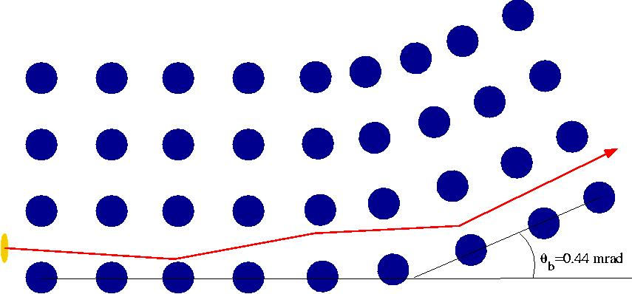
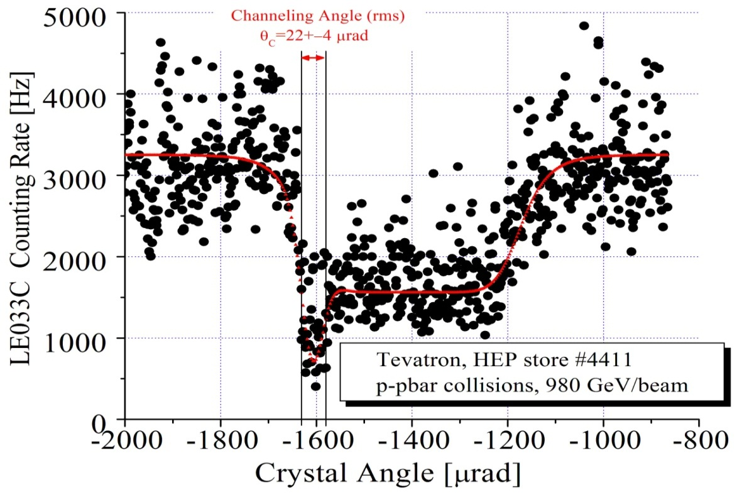
What Do We Know about Crystals?
T980 experiment at Tevatron, N.Mokhov et al JINST 6 T08005 (2011)
Strong inter-planar electric fields ~10V/A=1GV/cm
Very stable, can be used for
  deflection/bending (works)
  focusing (works )
  acceleration (if excited)
~92.5+-5% efficiency
Or l_d ~ 5mm/0.025 < 0.2m

Slide 8
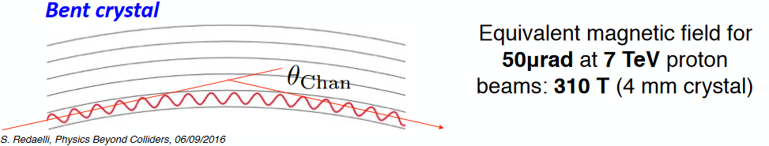
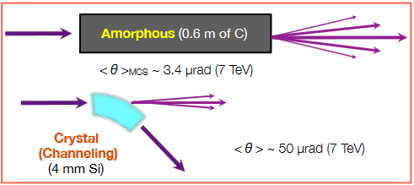
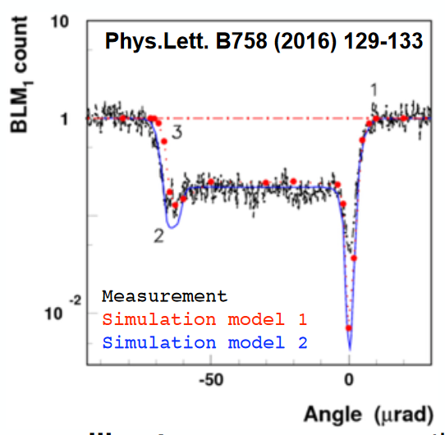
4 mm Si in LHC
Bent Crystals in the 7 TeV LHC Beams
~2 mrad at 7 TeV
~99.5% efficiency
Or l_d ~ 4mm/0.005=0.8m

Slide 9
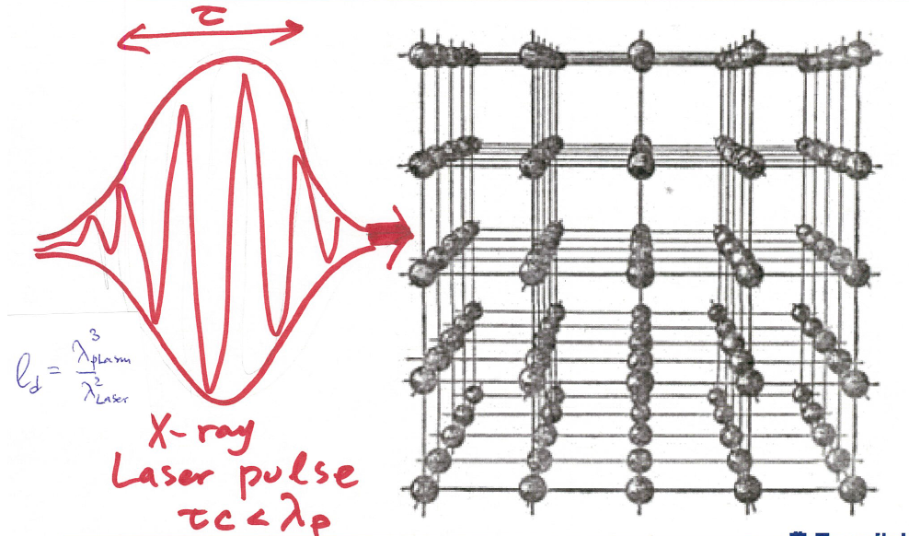
Ways to excite the crystal (1)

Slide 10
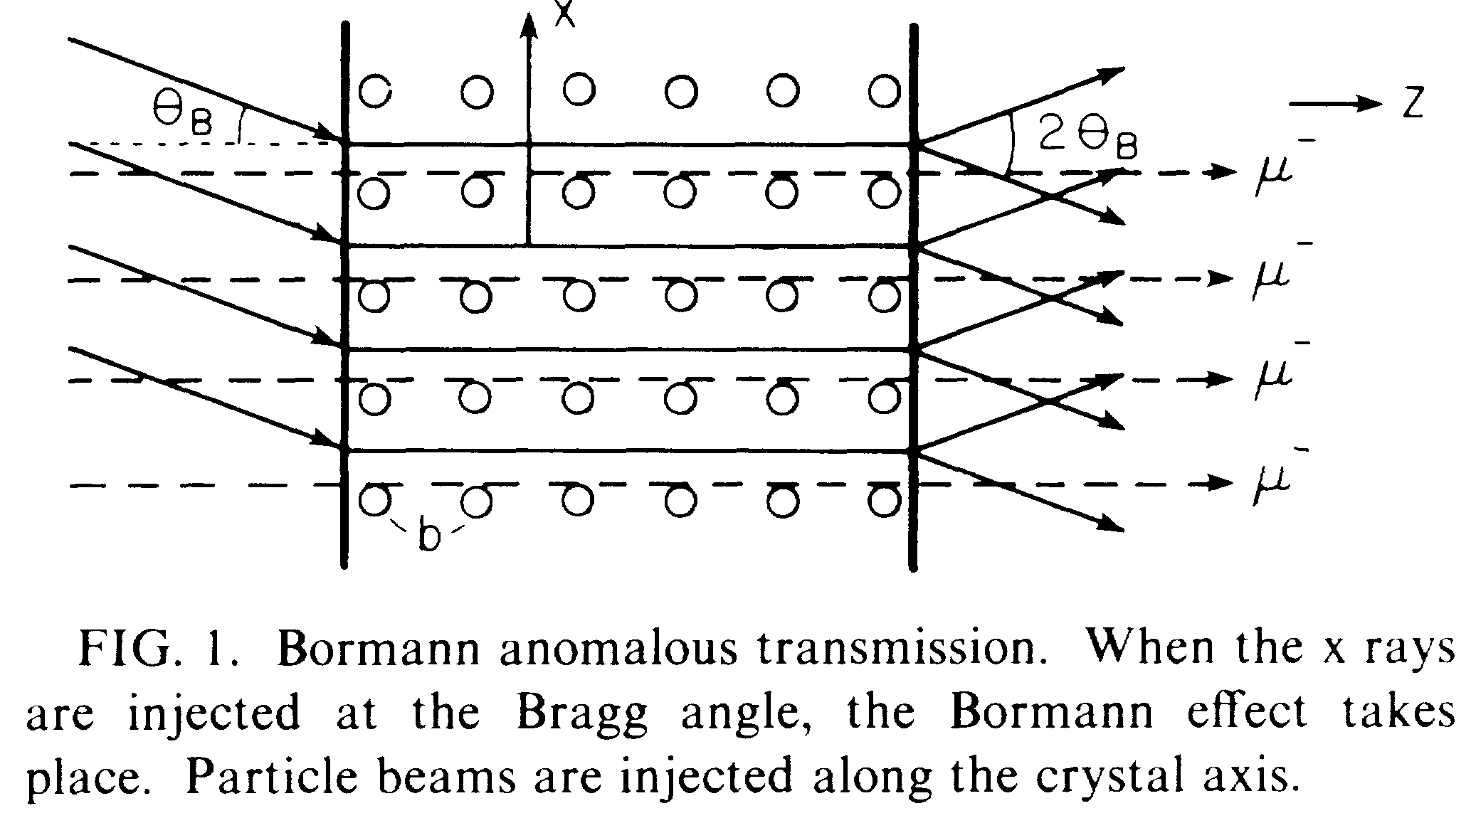
Crystal Excitation by X-Rays
Tajima,Cavenago, Phys. Rev. Lett. 59 (1987), 1440
Muons preferred
  No bremstrahlung, no nucl.
μ+ rad length 10^9 cm
  total energy~10^9 GeV
Need 40keV high peak power x-rays
  now available from SASE FELs like LCLS
Gradients >1GV/cm

Slide 11
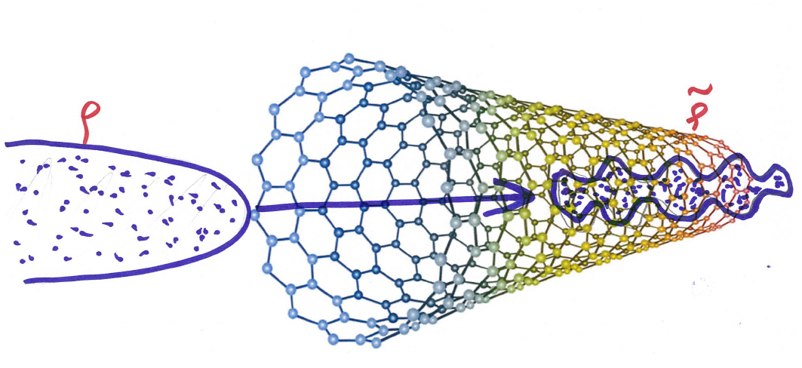
…several other ways were proposed (short bunches, ion clusters, dislocations, etc)…
Excite Nanotubes/Crystals (5) by Self-Mod’n Instability in long(er) charge particle beams

Slide 12
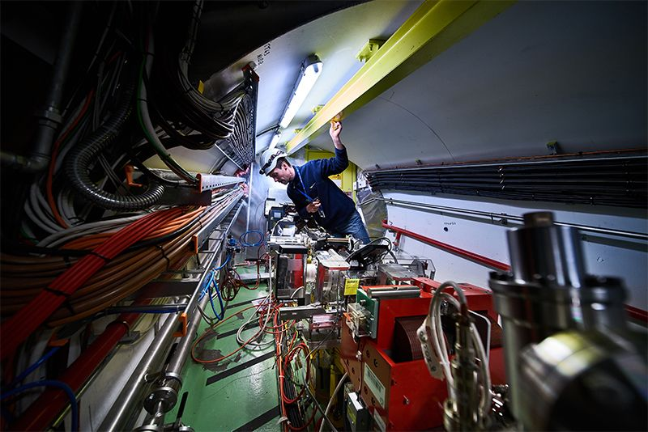
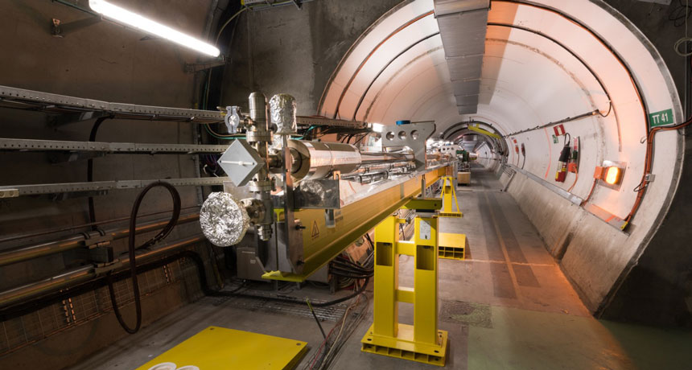
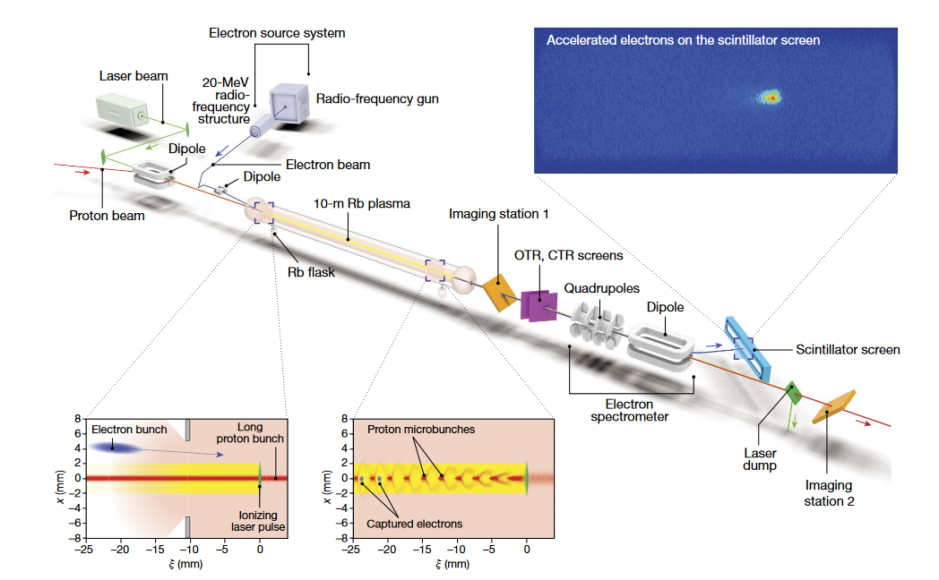
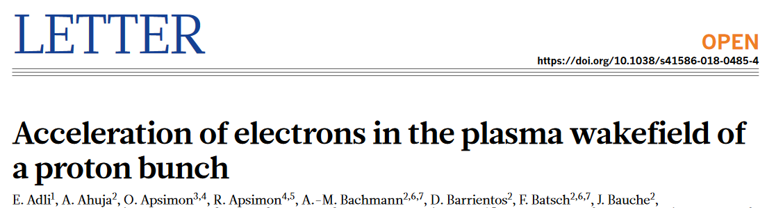
AWAKE

Slide 13
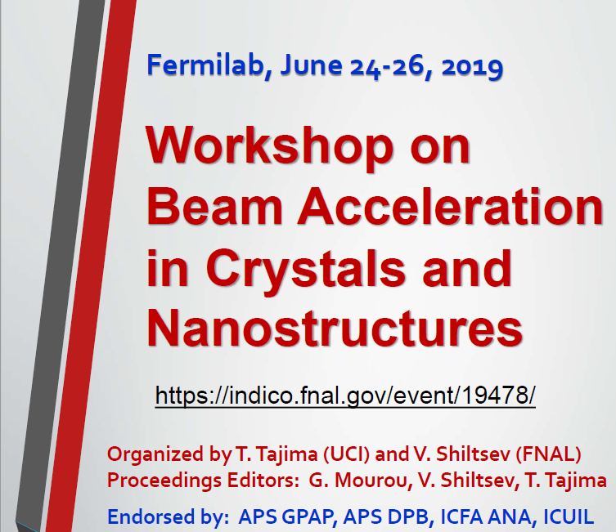

Slide 14
TOPICS FOR STUDIES (WORKSHOP’19)
overview of the past and present theoretical developments toward crystal acceleration, ultimate possibilities of the concept
concepts and prospects of PeV colliders for HEP
effective crystal wave drivers : beams/SMI*, lasers , other
beam dynamics* in crystal acceleration
instabilities in crystal acceleration (filamentation*, etc)
acceleration in nanostructures (CNTs*, etc)
muon sources* for crystal acceleration
application of crystal accelerators (Xray sources, etc)
steps toward "proof-of-principle" : 1 GeV gain over 1 mm, open theory questions, modeling and simulations
possible experiments at FACET, FAST, AWAKE, AWA, or elsewhere
* can be studied at FAST

Slide 15

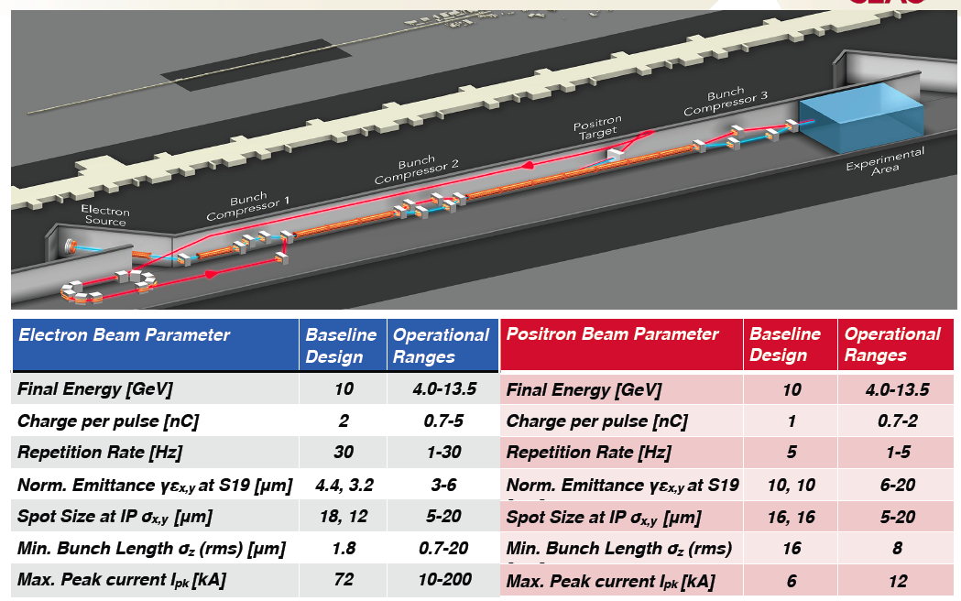
Ultimate Testbed

Slide 16
FACET-II Beams
Compression X Y Z 8x7x2 um , 2 nC →
  n_e~0.6e19 cm-3
Compression X Y Z 2x2x0.4 um , 2 nC →
  n_e~2e20 cm-3
Peak currents:
  70…100…300 kA !

Slide 17
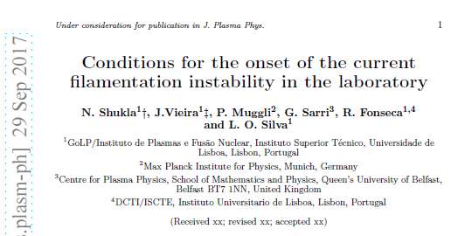
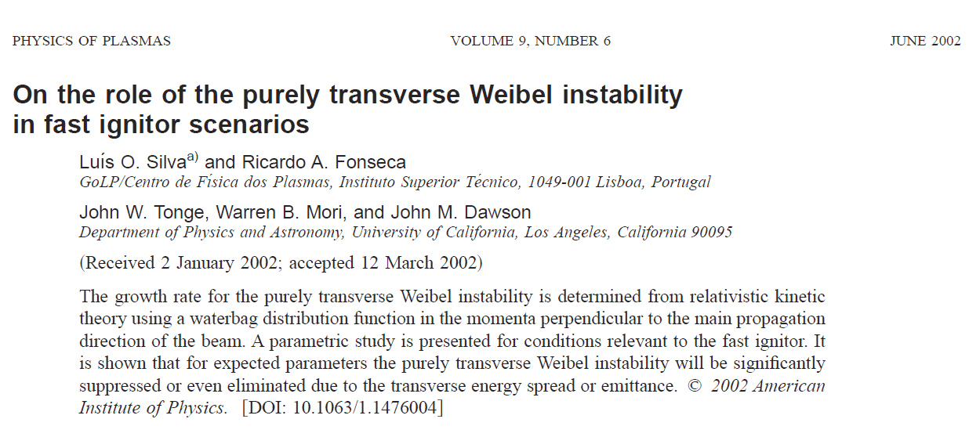
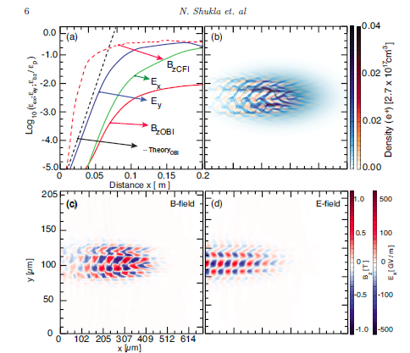
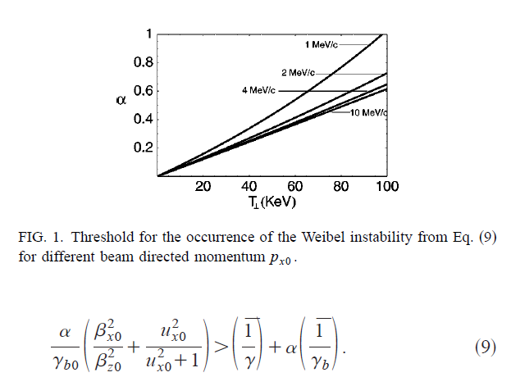
Weibel (Filamentation) Instability

Slide 18
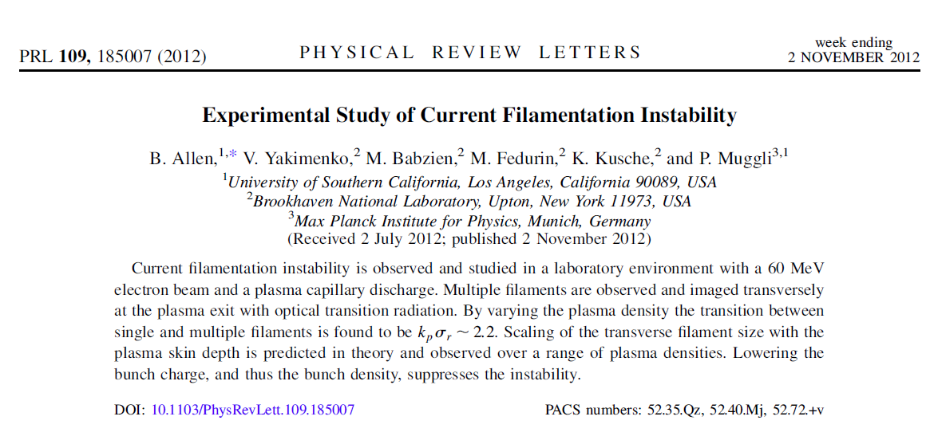
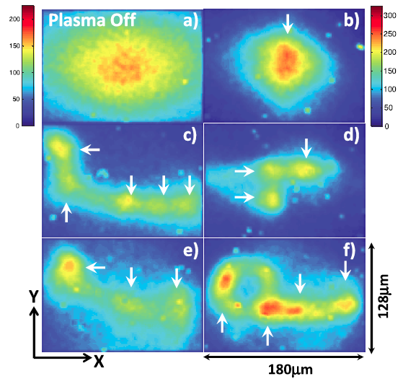
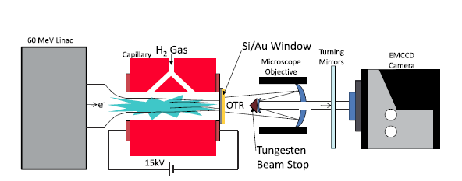

Slide 19
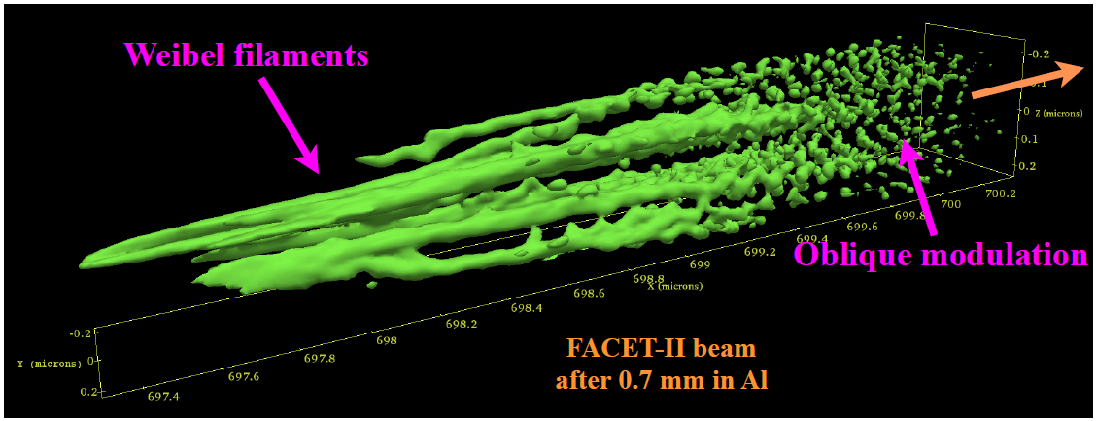
FACET-II
Proposal #43: Beam filamentation and bright gamma-ray
bursts
  Sébastien Corde(ÉcolePolytechnique/LOA)
  Ken Marsh (UCLA)
  Frederico Fiuza (SLAC)

Slide 20
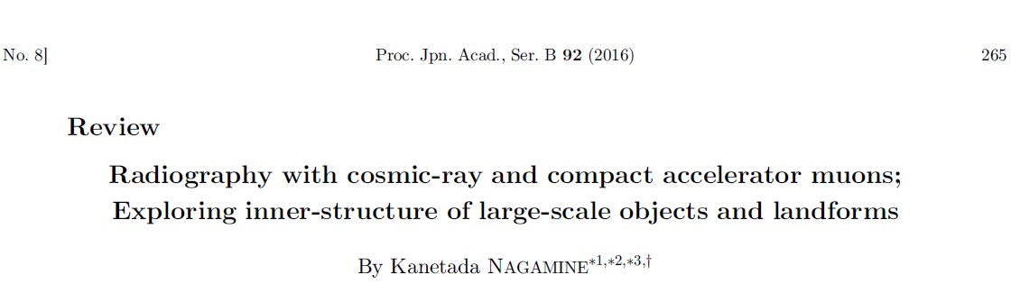
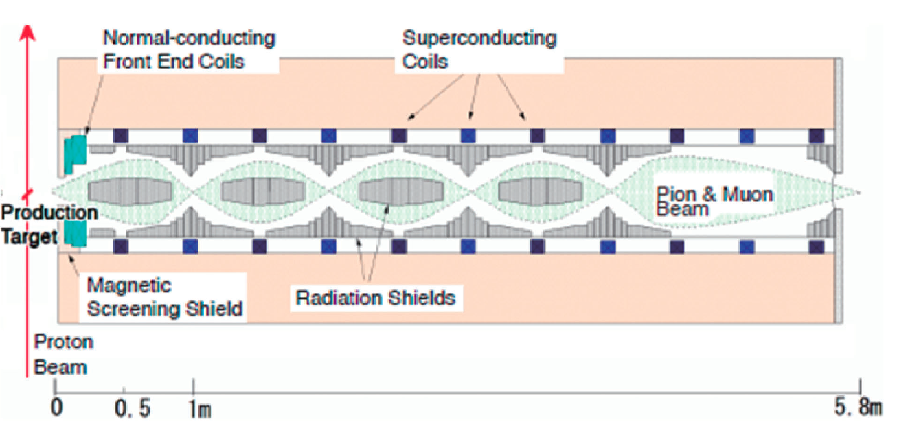
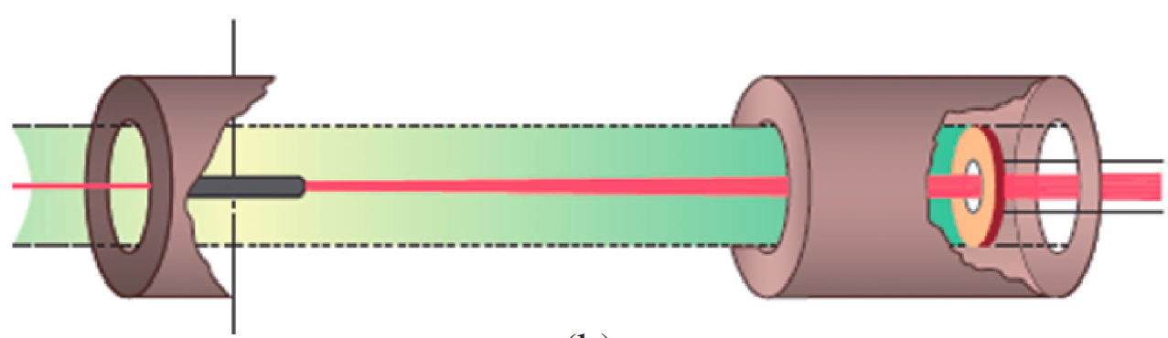




MUON PRODUCTION AND CHANNELING
Advanced schemes
Simplified schemes (for FAST/FACETII)
crystals &
detectors
Thick
target
μ-+
10 cm C
½ r.l.
π-+
Thin
target
μ-+
π-+
e-
γ
e-
e-
Upto 2 r.l.
~0.1 r.l.

Slide 21
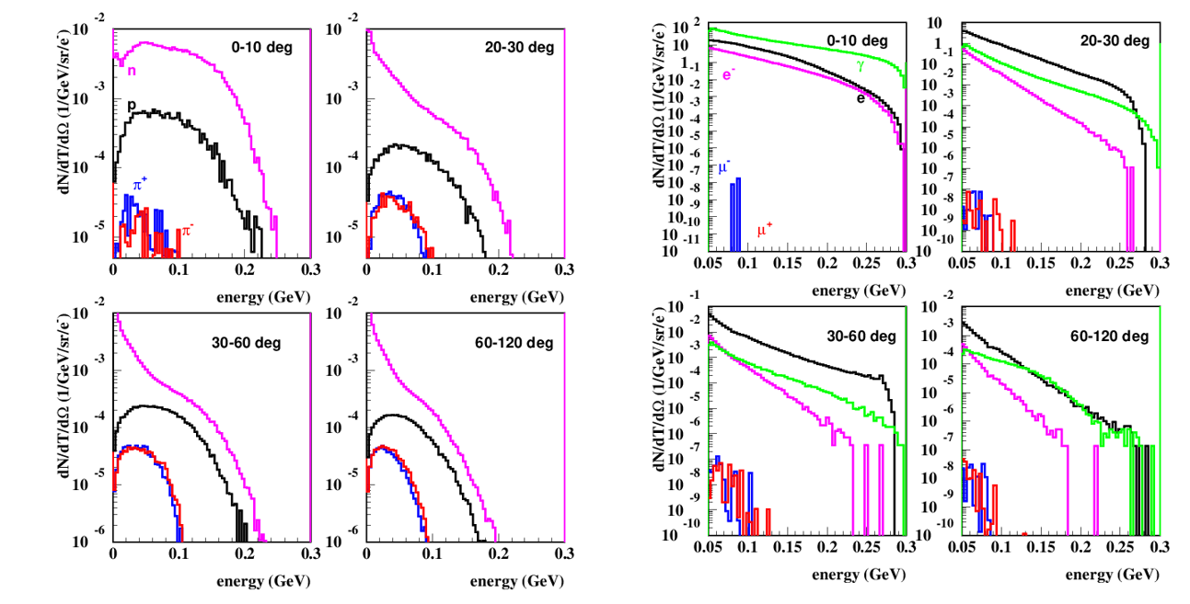
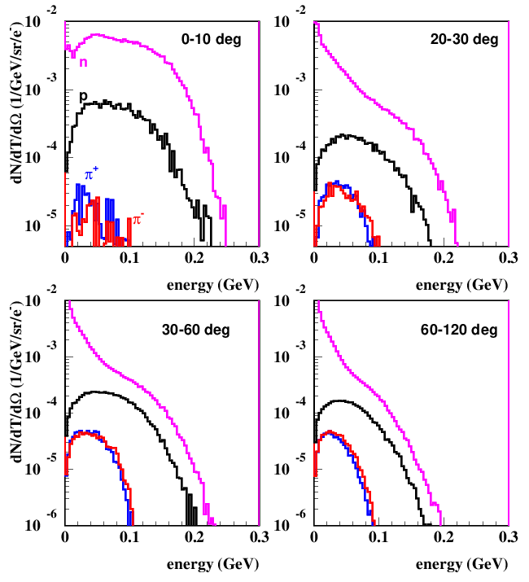
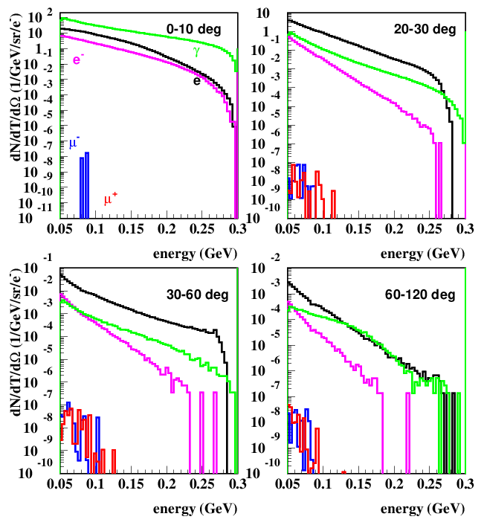
Secondary particle production
300 MeV electron on 2 radiation length of carbon target
Courtesy S.Striganov

Slide 22
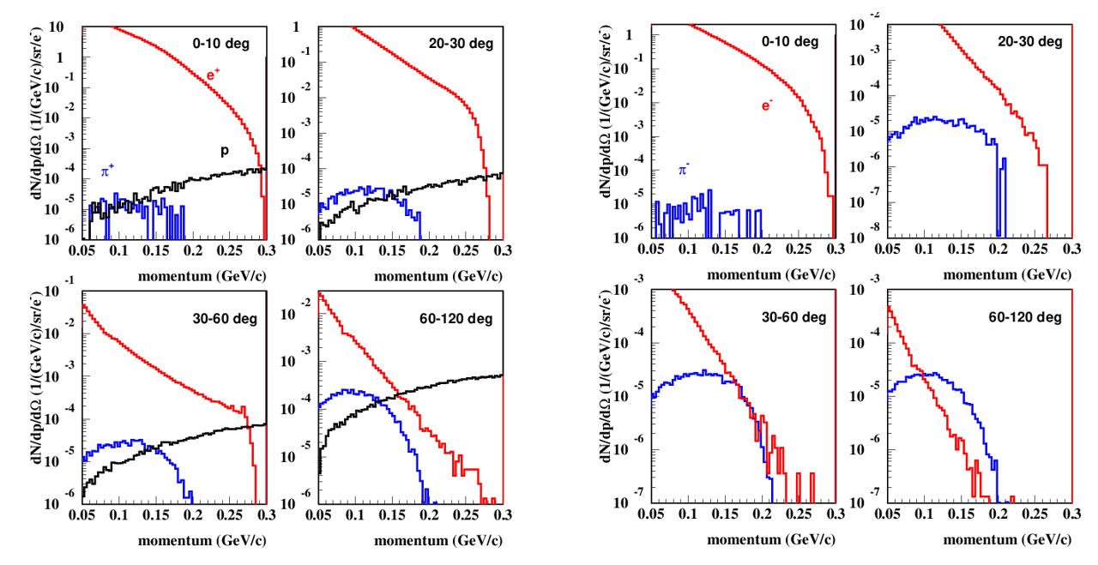
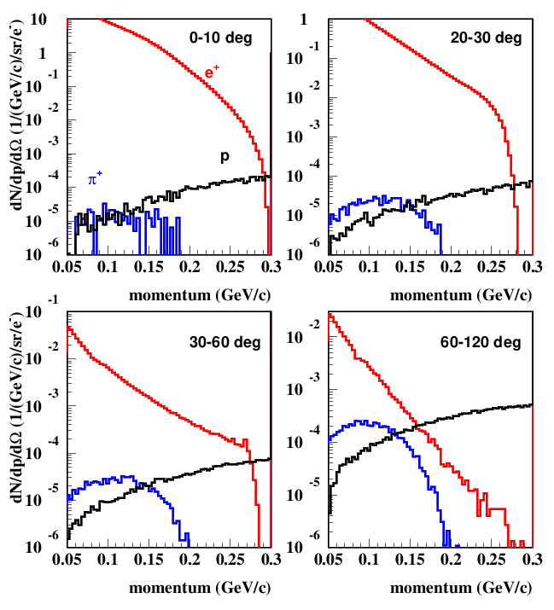
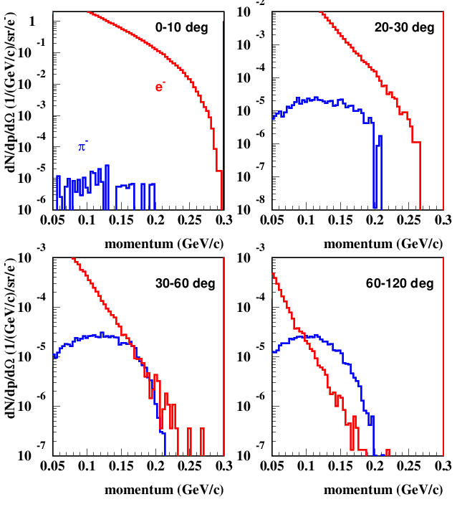
Positive pions has very big positron/proton escort, large angle & high momentum; negative pion could be focused and extracted
Courtesy S.Striganov

Slide 23
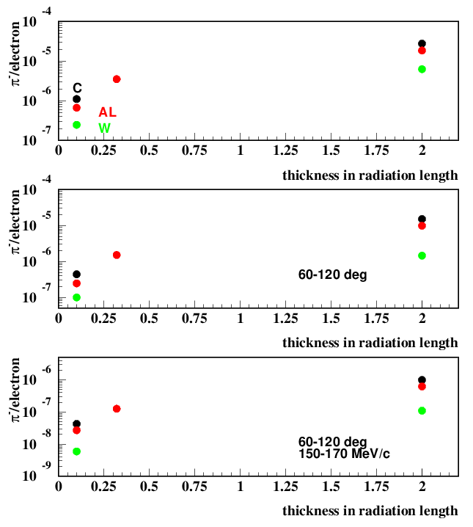
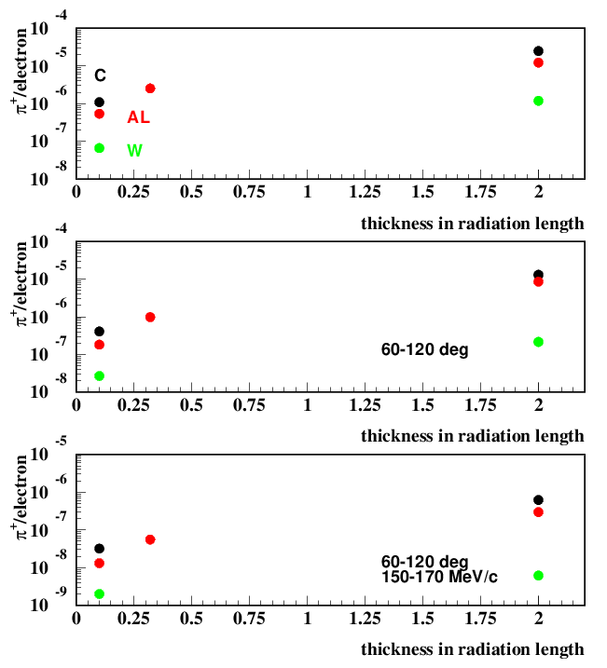
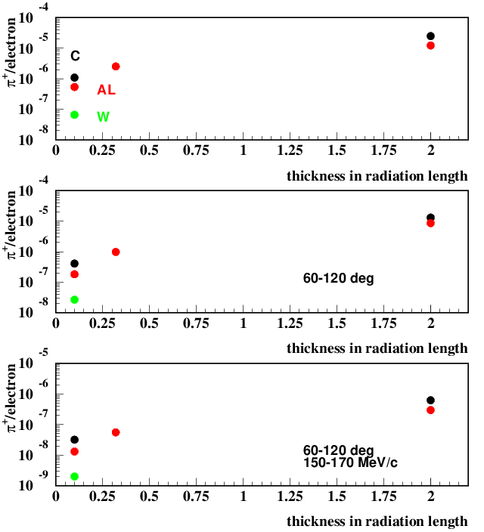
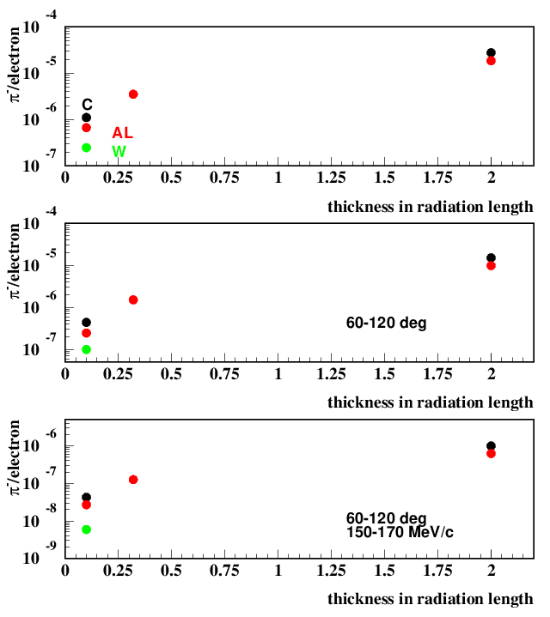
More pion could be obtained for larger thickness & low Z. target material. Larger thickness – large radiation problem, low Z - longer target (more difficult to collect)
Courtesy S.Striganov

Slide 24
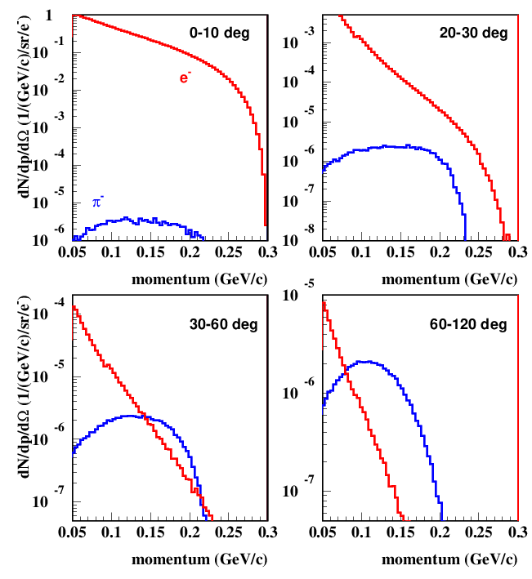
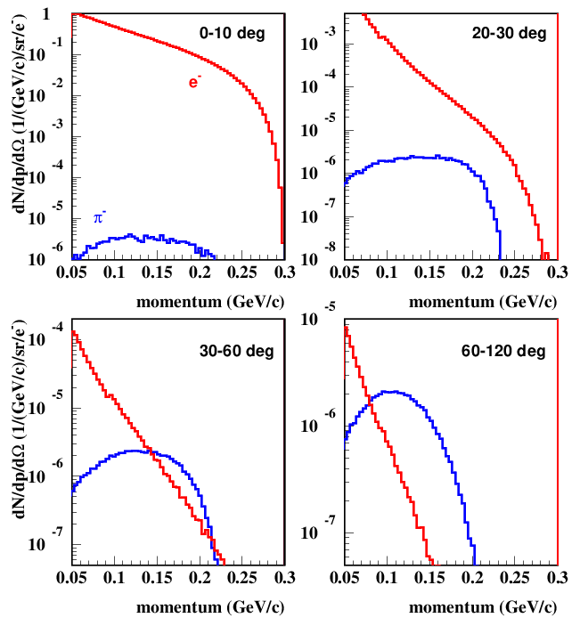
Low radiation scenario
Courtesy S.Striganov
Two production targets – photon production and pion/muon production.
Photon production target should be thin (~10% radiation length). Primary electrons can be swept and miss pion/muon target – compact muon source design (Nagamine at al 2001).
They made analytical estimate for 10% tungsten photon and 10 cm carbon pion/muon production target. For pion produced at 45 degree with acceptance 1 steradian and momentum from 150 to 163 MeV/c they got 3.5 10⁻⁹ π/electron in 2001 (4.7 10⁻⁸ π/electron in 2016). Our simulation shows that at 45 degree pions have heavy electron/positron escort, but at 90 degree we could get 3.7 10⁻⁸ negative pion/electron in above angular & momentum range. With such two target design we could get about 3 times more pion then with one 10% radiation length carbon target.
Large Omega muon optics channel could capture pion beam with dE=10 MeV and dΩ=1 steradian and produce 0.4 muon/pion.

Slide 25
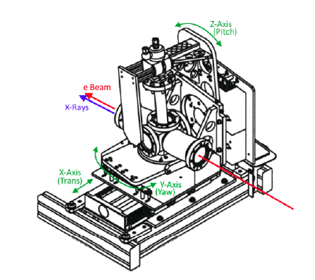
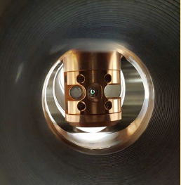
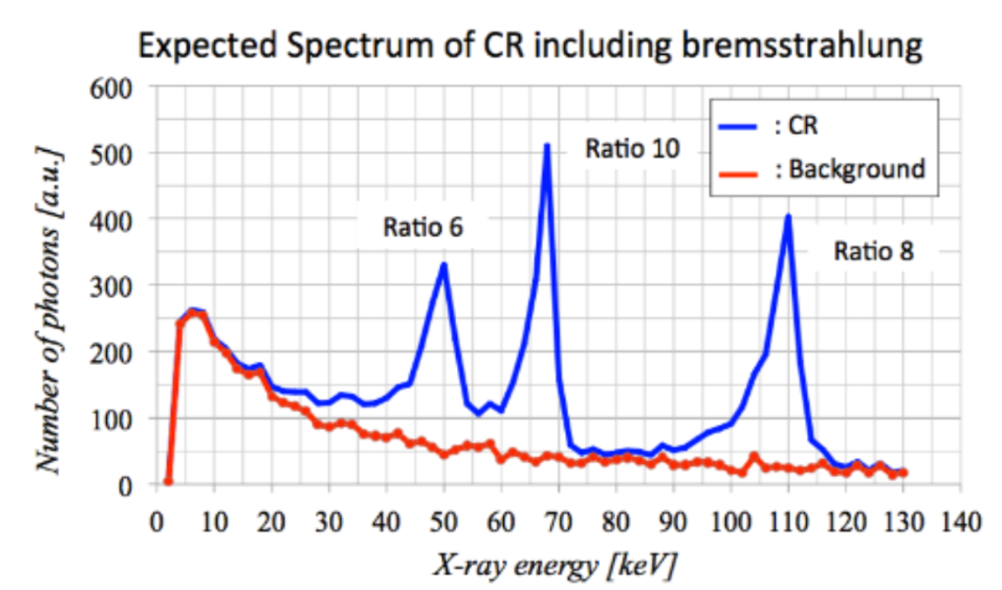
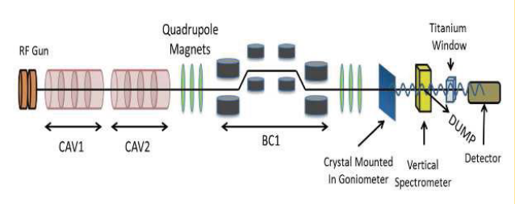
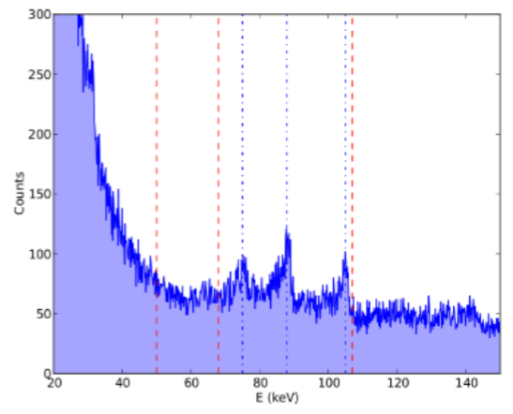

2015-2017 CRYSTAL CHANNELING EXPT @ FAST
P.Piot, T.Sen, A.Halavanau, D.Edstrom, J,Hyun, et al
helpful experience

Slide 26
Summary
Acceleration of muons in crystals/CNTs has great promise
There are many issues related to muon production, channeling and acceleration
Some modes of the crystal/CNT excitations can be tested at FACET-II – eg by SMI
Beam filamentation is of serious concern and can be studied at, e.g., FAST
  Past experience and hardware very helpful
Also can be tried at FAST : i) muon production; ii) muon detection; iii) experiment integration; iv) calibration of models
“Workshop on Acceleration in Crystals & Nanostructures” will take place at Fermilab, June 24-25 – please, join!

Slide 27
Thank You for Your Attention!

Slide 28

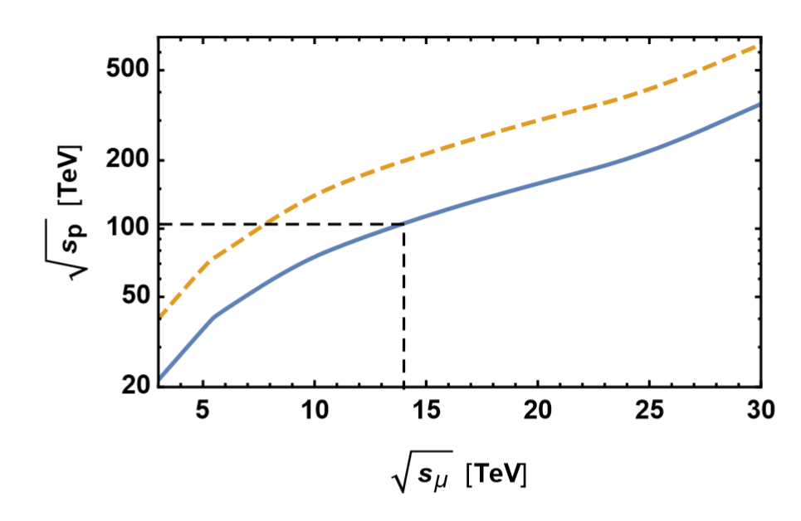
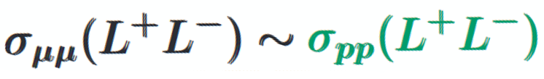

High Energy μ+μ- Colliders
Input #120
Advantages:
μ’s do not radiate / no beamstrahlung→ acce-leration in rings → low cost & great power efficiency
~ x7 energy reach vs pp
JINST Special Issue (MUON)
M_{NewPhysics} = sqrt(s)/2
μμ @ 14 TeV
=
pp @ 100 TeV
Offer “moderately conservative - moderately innovative” path to cost affordable energy frontier colliders:
  US MAP feasibility studies were very successful → MCs can be built with present day SC magnets and RF; there is a well-defined path forward
  ZDRs exist for 1.5 TeV, 3 TeV, 6 TeV and 14 TeV * in the LHC tunnel
Key to success:
  Test facility to demonstrate performance implications - muon production and 6D cooling, study LEMMA e⁺-45 GeV + e⁻ at rest →μ⁺-μ⁻ , design study of acceleration, detector background and neutrino radiation
* more like “strawman” parameter table

Slide 29

Ways to excite the crystal (2)
Ways to excite the crystal (2)

Slide 30

Ways to excite the crystal (3)

Slide 31

Ways to excite the crystal (4)
Controlled generation of dislocations

Slide 32

Nanotubes(1)

Slide 33

Nanotubes (2)

Slide 34

Combine (funnel) Channels

Slide 35

SMI: Self-Modulation Instability (in 400 GeV protons)

Slide 36



Self-Modulation Instability in AWAKE p+ Bunch

Slide 37









Collider considerations
i.e. irrelevant

Slide 38




