Slide 1


Quantum Computing on Crystalline Beams of Ions
(the concept and proof-of-principle experiments at IOTA)
A. Murokh (RadiaBeam Technologies LLC)
T. Shaftan (BNL), S. Nagaitsev (Fermilab)
Fast/IOTA Collaboration Workshop, 10-12 June 2019

Slide 2
Outline
Introduction
Quantum Computer (QC) on ion traps
Crystalline beams
Quantum Computer (QC) on crystalline beams
Challenges and potential experiments at IOTA
Conclusions

Slide 3
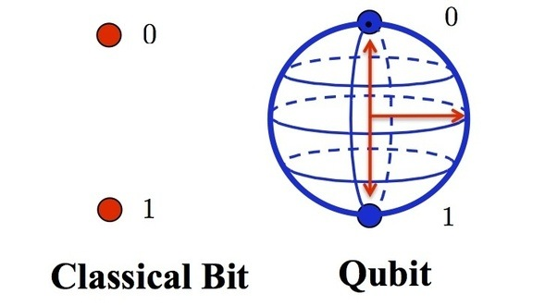
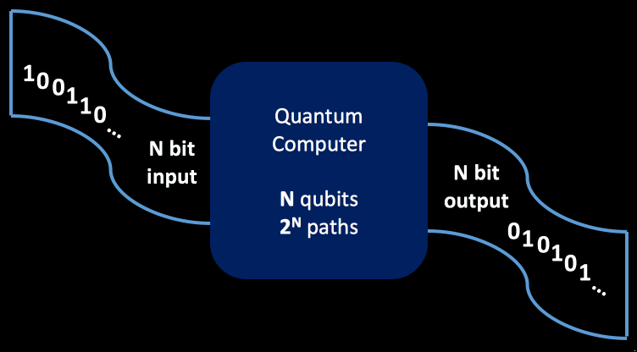

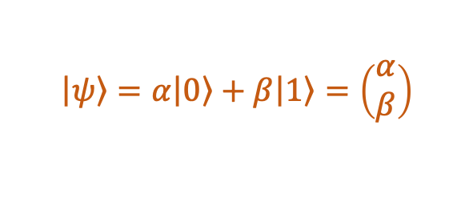


QC Background
$$\left|\left.ψ\right\rangle \right.$$
A quantum two-level system can (i.e. an ion w/spin up or down) can serve as a qubit
Qubit is the basic unit of information in QC, and its quantum state at any given time is generally a superposition of its basis states
Multiple qubits being quantum systems may be entangled
A register of N ideal qubits is a superposition of 2^{N} states
Thus an ideal quantum computer (no noise, long decoherence time) based on N qubits can simultaneously sample 2^{N} scenarios, which could be of the great benefit to some computational problems.
0 or 1
α|0⟩ + β|1⟩
Ground state $\left|\left.0\right\rangle \right.$
$$\left|\left.ψ\right\rangle \right.=α\left|\left.0\right\rangle \right.+β\left|\left.1\right\rangle \right.=\left(\begin{aligned}α \\ β\end{aligned}\right)$$
Excited state $\left|\left.1\right\rangle \right.$

Slide 4
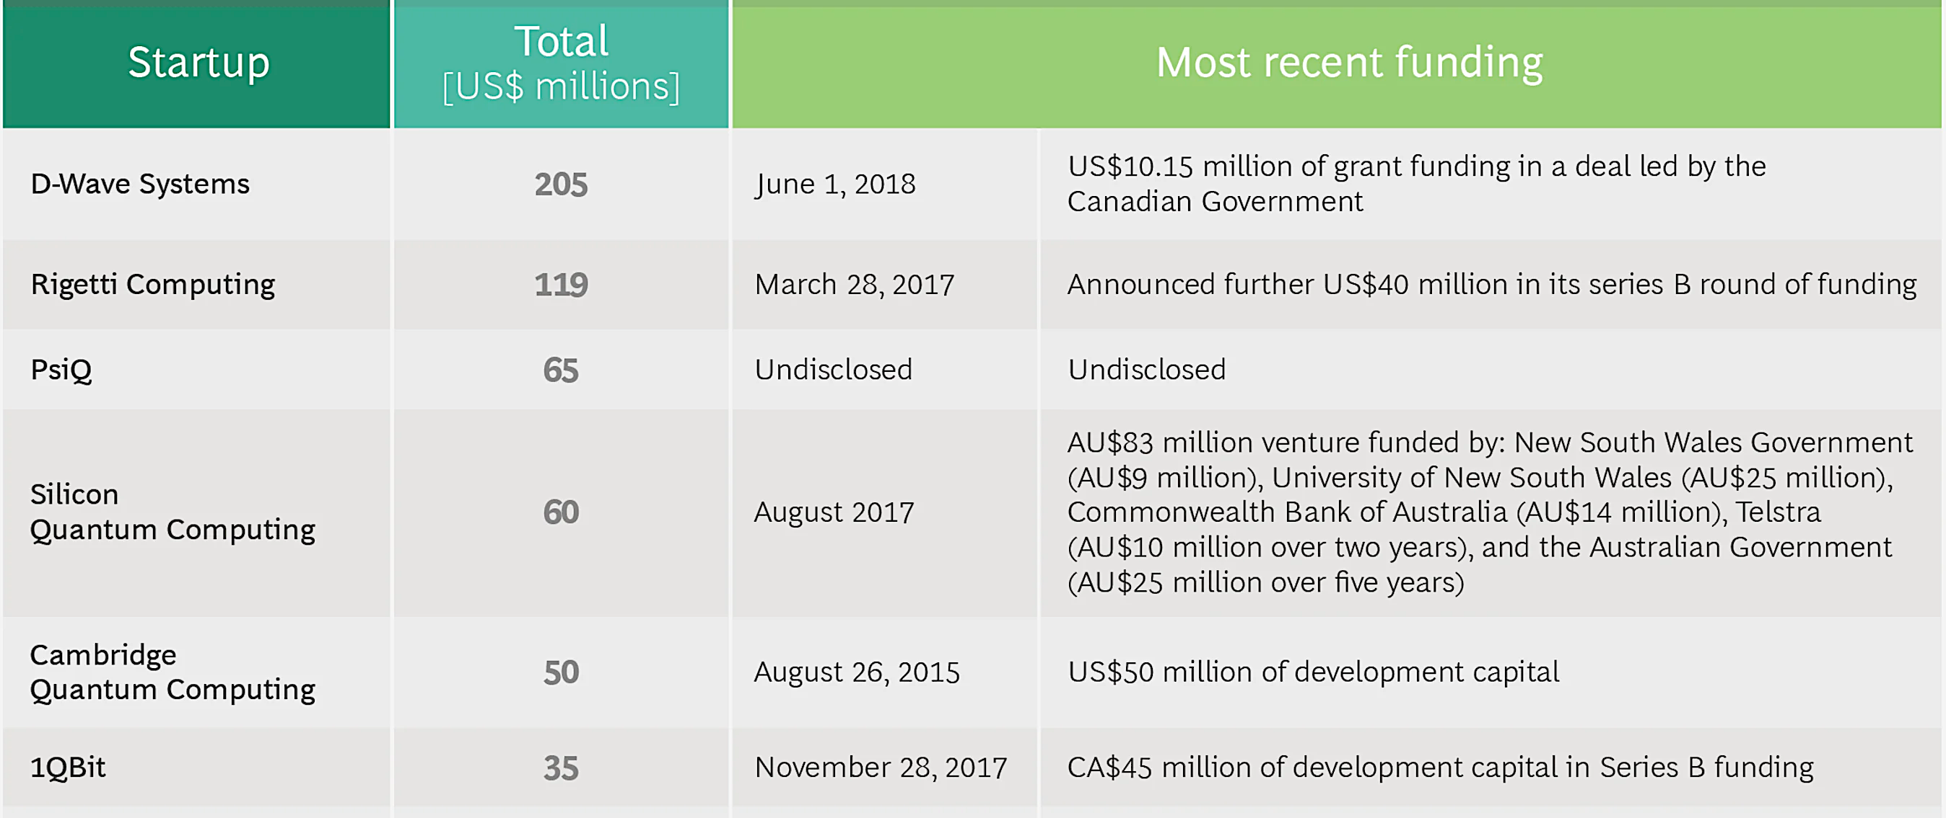
Why QC is important ?
Follow the money:
  US government ($1.275 bb)
  EU (€ 1.1 bb)
  Chinese government ($3 bb)
  Alibaba ($15 bb)
  Google, IBM, Microsoft, etc.
https://www.bcg.com/en-us/publications/2018/next-decade-quantum-computing-how-play.aspx

Slide 5
Present TRL
NISQ (Noisy Intermediate-Scale Quantum devices)
https://www.bcg.com/en-us/publications/2018/next-decade-quantum-computing-how-play.aspx

Slide 6
Outline
Introduction
Quantum Computer (QC) on ion traps
Crystalline beams
Quantum Computer (QC) on crystalline beams
Challenges and potential experiments at IOTA
Conclusions

Slide 7
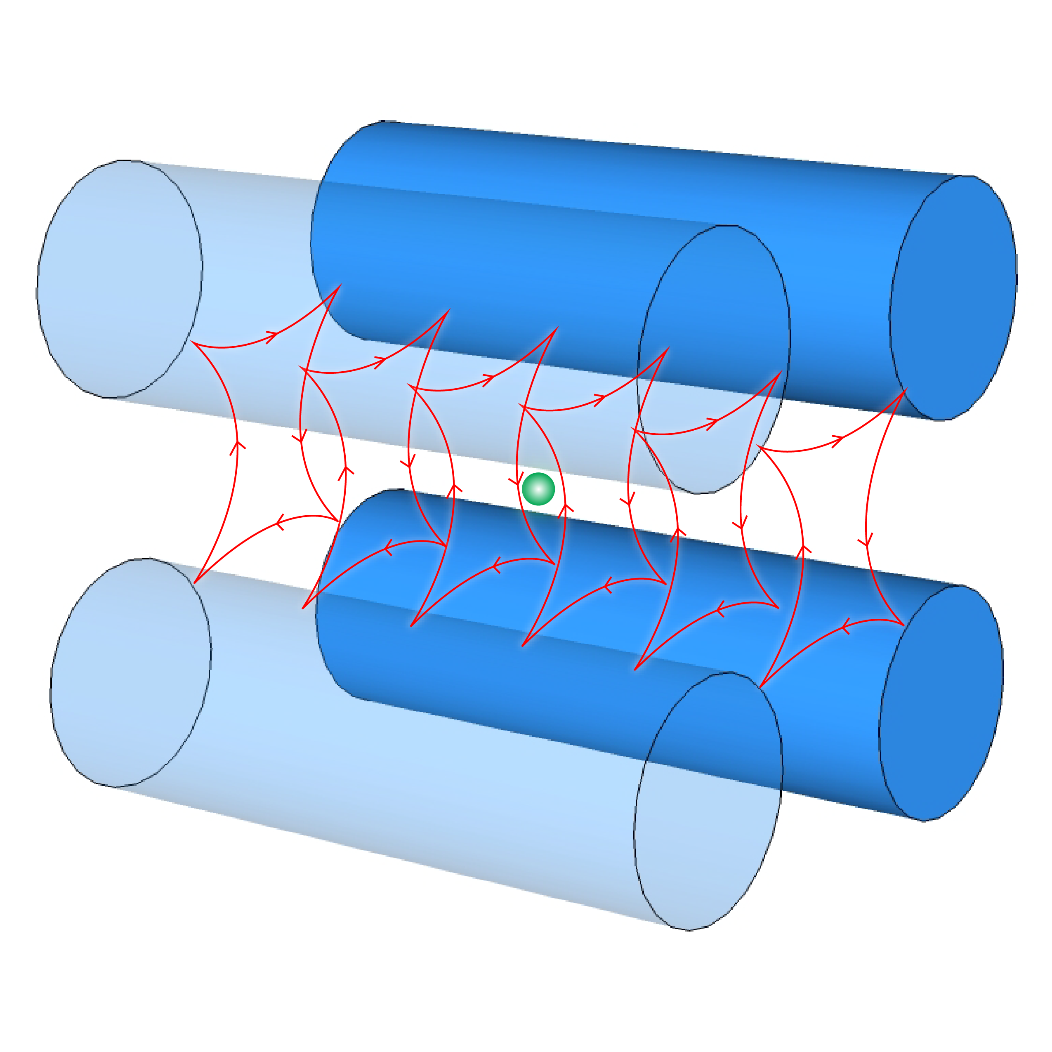
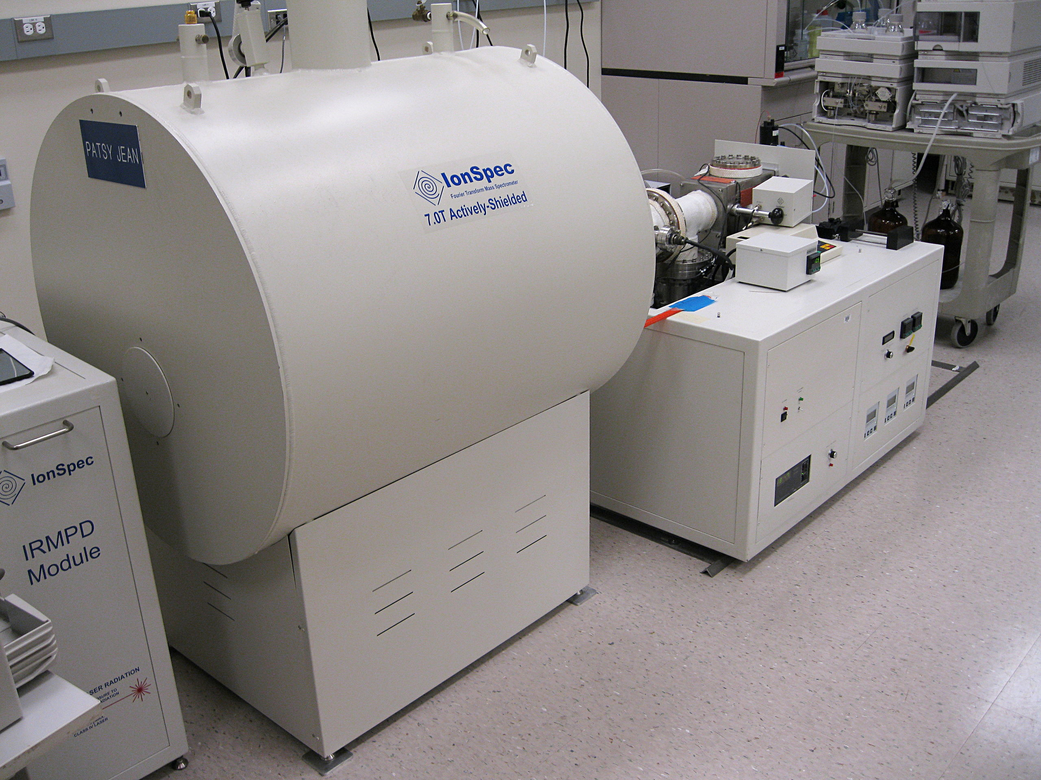
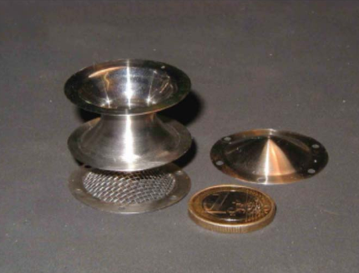
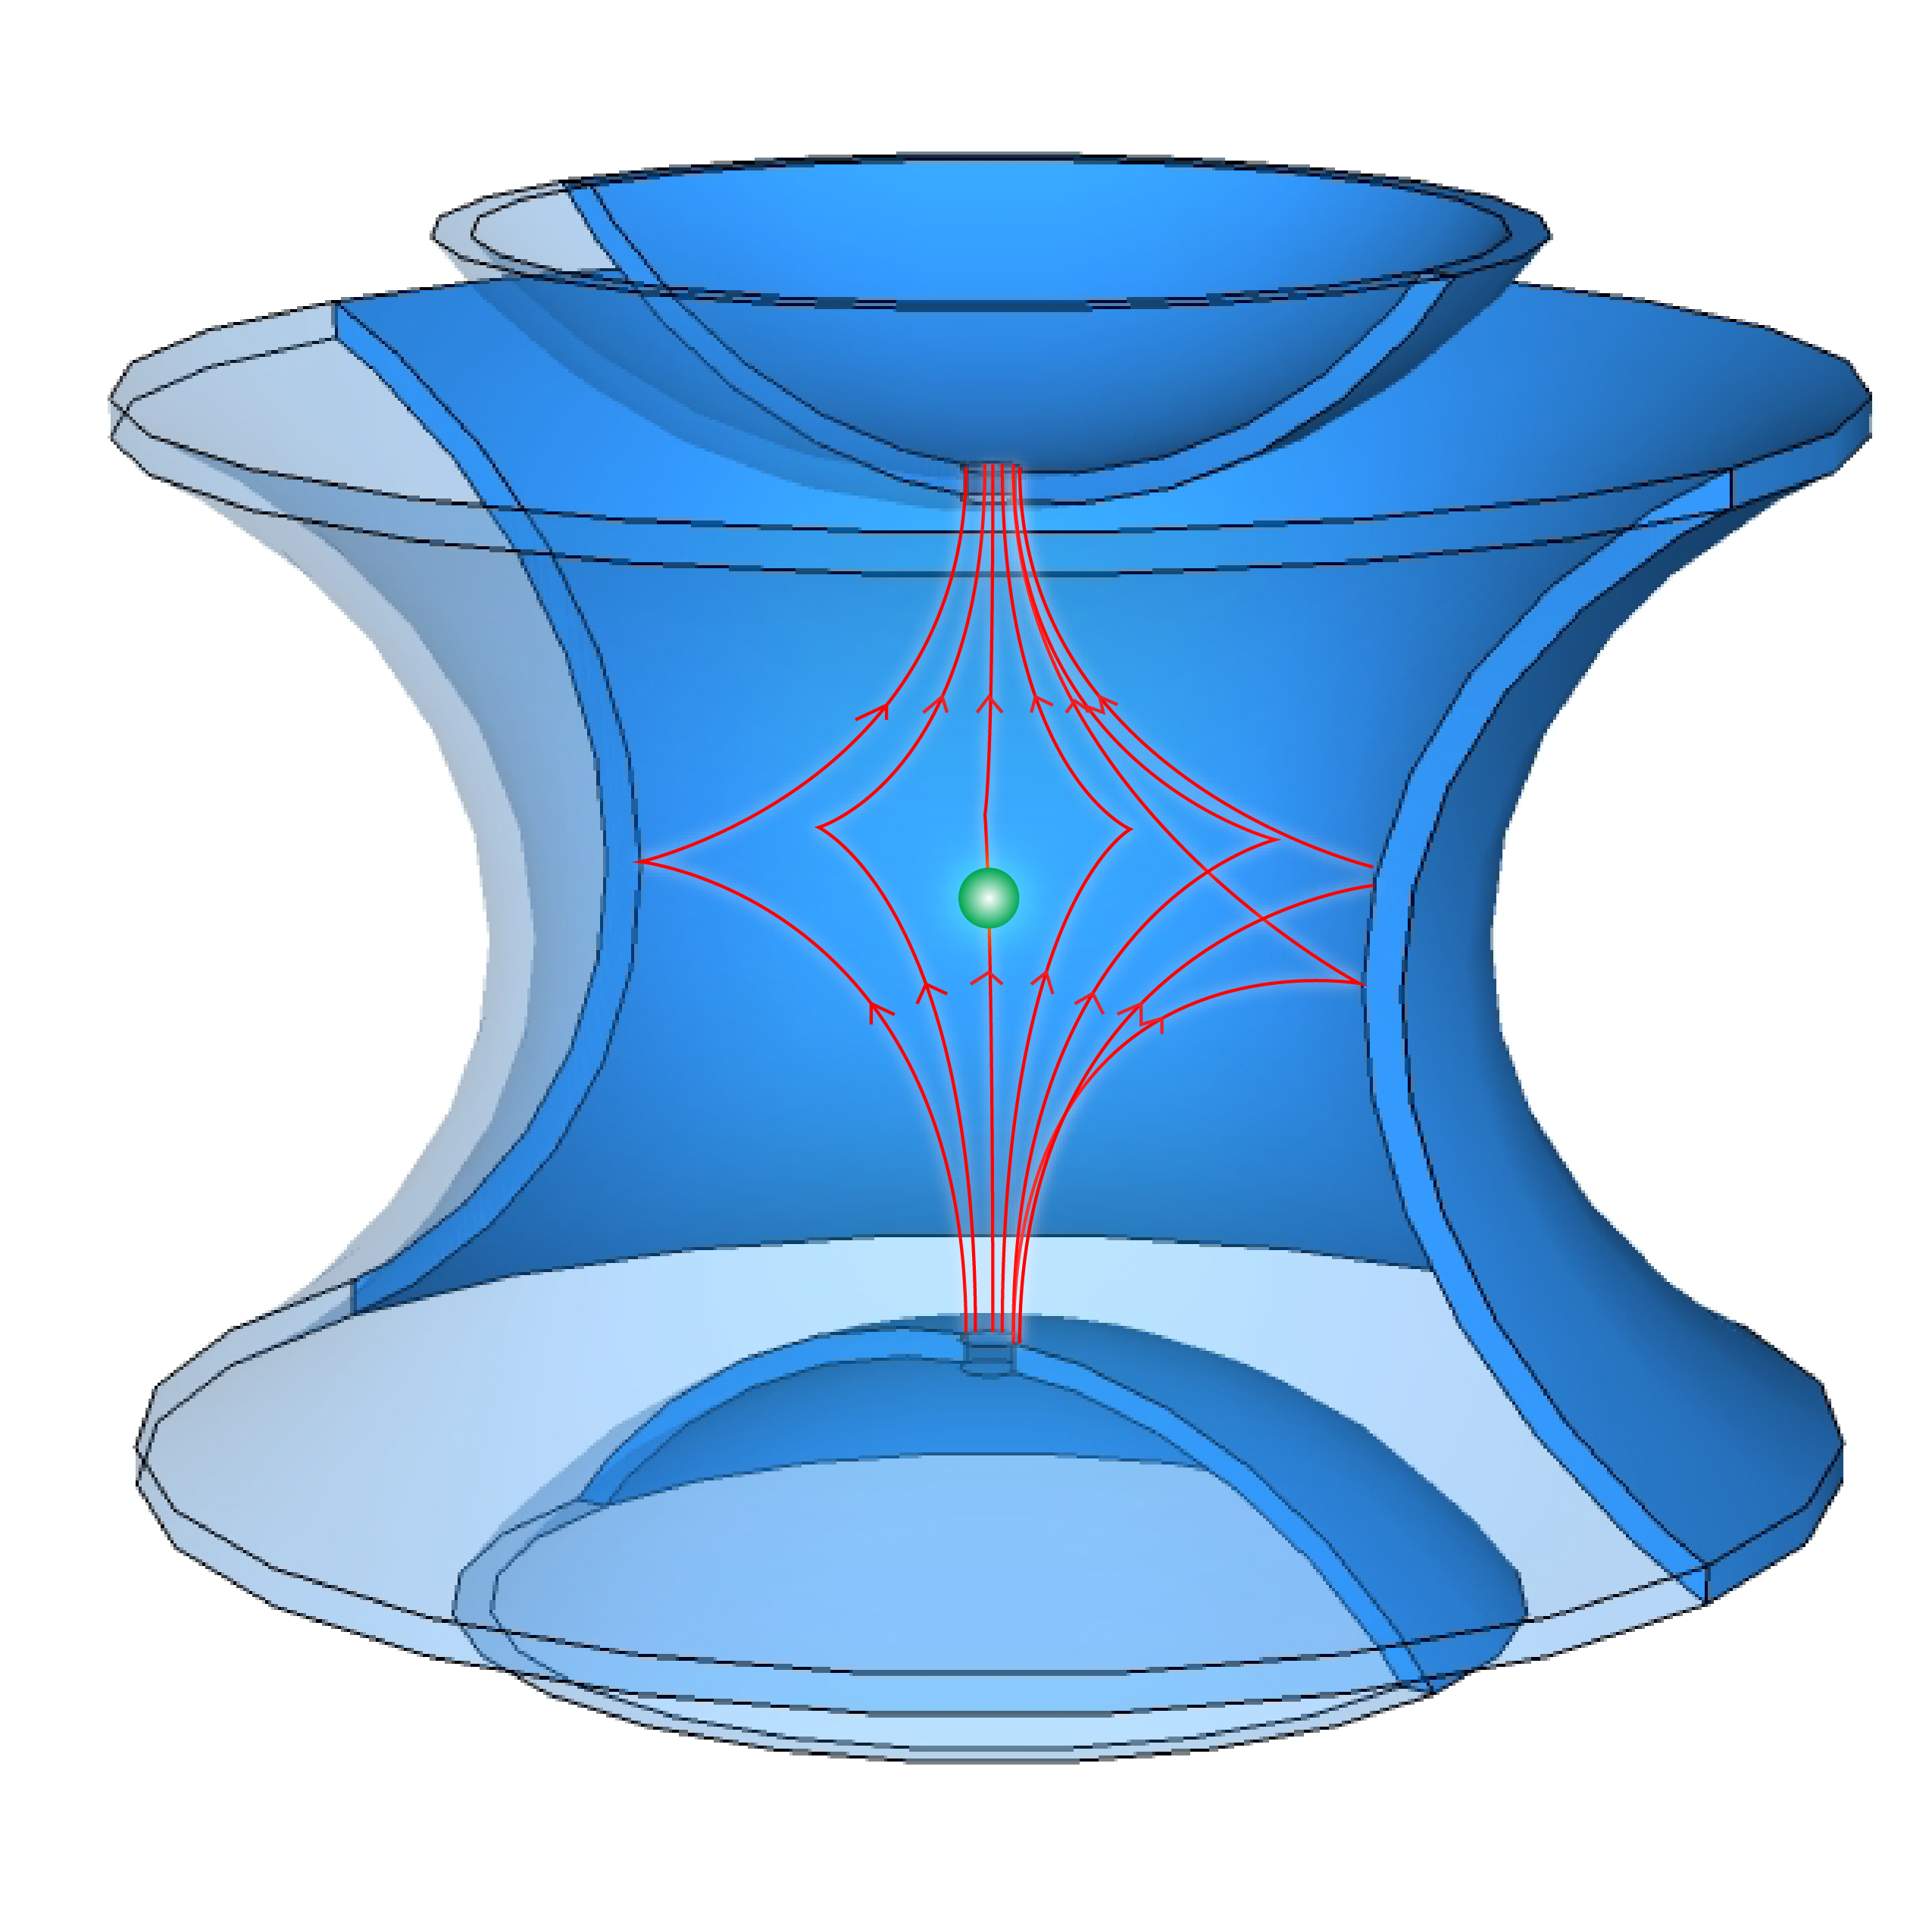
Ion Traps
Paul trap
Ion traps use combinations of DC and AC fields to trap an ion
Ion traps are used for mass spectroscopy and can also be applied to QC
Penning trap
W. Paul,
Nobel Prize 1989
«I believe, it is a sad fact in all our chemistry, that we are not able to freely suspend the elementary constituents» Georg Christoph Lichtenberg (1742-1799)
https://www.triumf.ca/headlines/current-events/nobel-laureate-visits-triumf

Slide 8
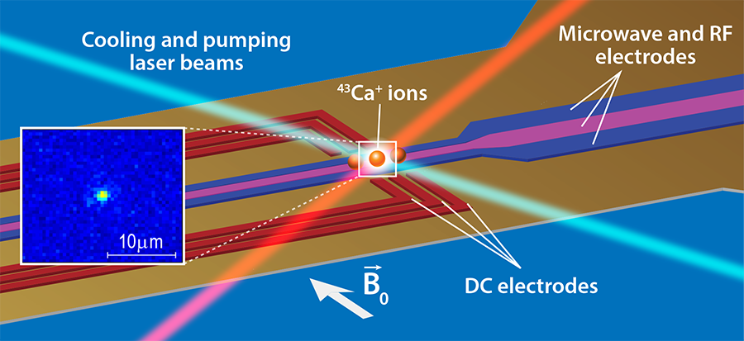
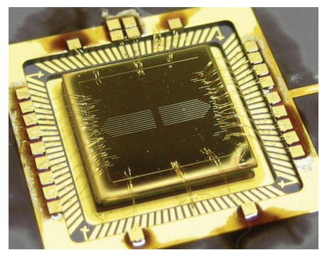
Quantum Computers on Ion traps
ion-trap quantum computer at U of Innsbruck
(a string of 6 Ca 40 ions in a linear Paul trap)
Ion is a quantum system and may be used as a two-level system qubit
Ions are trapped in EM fields, cooled with lasers
Qubit is controlled and read-out with lasers or RF pulses.
https://quantumoptics.at/en/research/quantum-information.html
D-wave ion trap

Slide 9
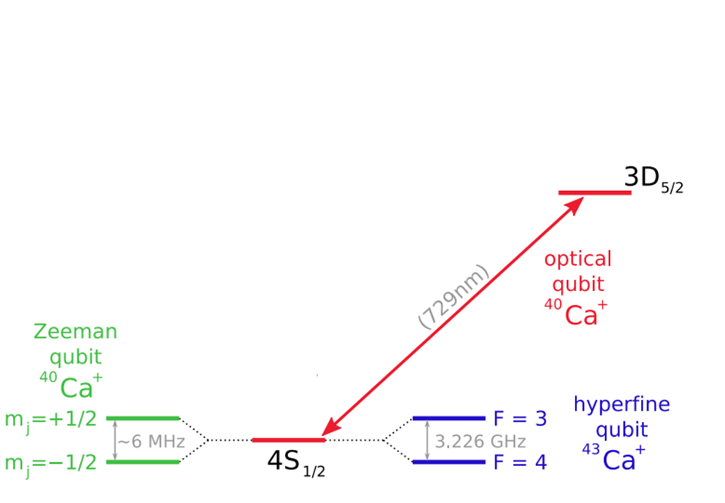
Trapped ions qubit types
Three ways to form a qubit using the electronic states of an ion:
Two ground state hyperfine levels ("hyperfine qubits"):
  Almost infinitely stable
  Needs stable RF to operate (easy)
Two ground state Zeeman-split sub-levels – “Zeeman qubits”
  Decoherence ~1 ms
  Low single qubit read out fidelity (~92%)
A ground state level and an excited level ("optical qubits"):
  Needs stable laser sources to operate (hard)
  Decoherence ~1 sec
Laser
read out
Coherence | ~1-10 sec (record: 1000 sec)
Gate time | ~10 µs
Entanglement | ~10…50 qubits
B ~ 2 G
RF read out
RF read out

Slide 10
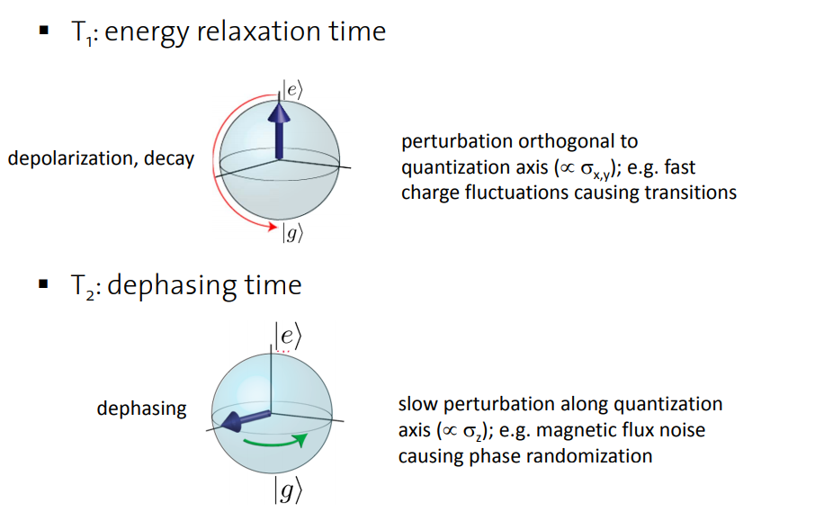
Why these are NISQ ? (Noisy Intermediate-Scale Quantum devices)
Decoherence (coupling to a macroscopic systems may cause degradation of a qubit state).
Long gate time (depends on the control and read out techniques)
Readout and excitation errors
Scaling towards large qubit systems, multiple processors
  Solutions:
  error correction protocols, redundancy in operations
  redundancy of qubits in a register
  quantum Zeno effect as a mechanism of reducing T₁ and T₂
  new architectures

Slide 11
Outline
Introduction
Quantum Computer (QC) on ion traps
Crystalline beams
Quantum Computer (QC) on crystalline beams
Challenges and potential experiments at IOTA
Conclusions

Slide 12
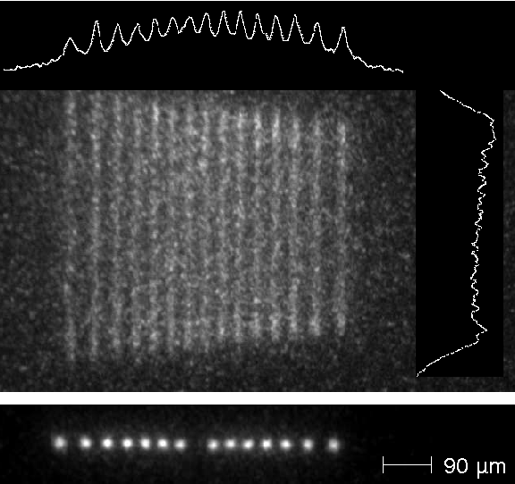
New Architecture: Crystalline Ion Beams
PALLAS (U of München)
  RF Quadrupole ring trap
  U_{RF}~300 V at 6.3 MHz
  aperture of 2.5 mm, periodicity ~ 800
  Number of particles ~1000
²⁴Mg⁺ ions @ 1 eV
  T|| ~ 3 mK
laser cooling

Slide 13
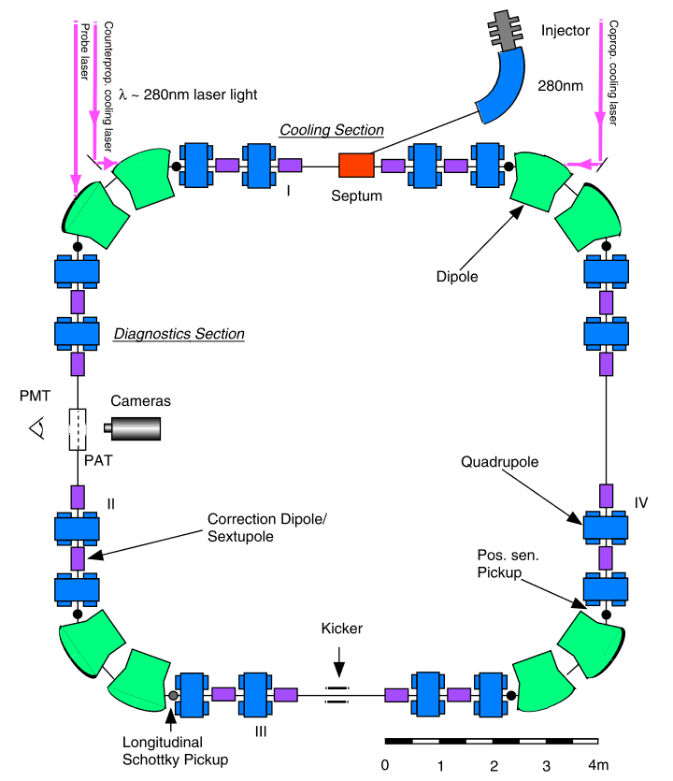
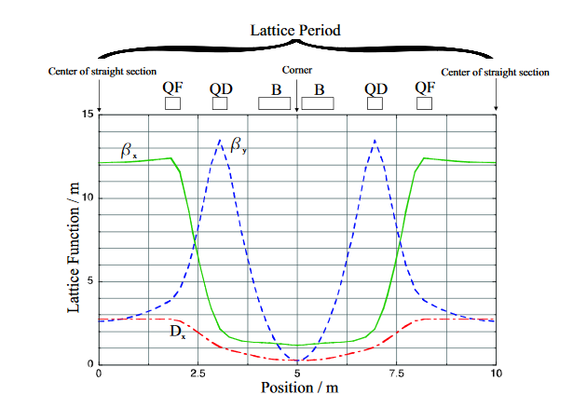
Crystalline Ion Beam @ ASTRID
ASTRID ring, U. of Aarhus (Denmark)
  ~ 40 m circumference
  Distance between particles ~ 22 um
  Number of particles ~ 350,000
laser cooling
⁷Li⁺ ions @ 100 keV
  T|| ~ 1 mK

Slide 14
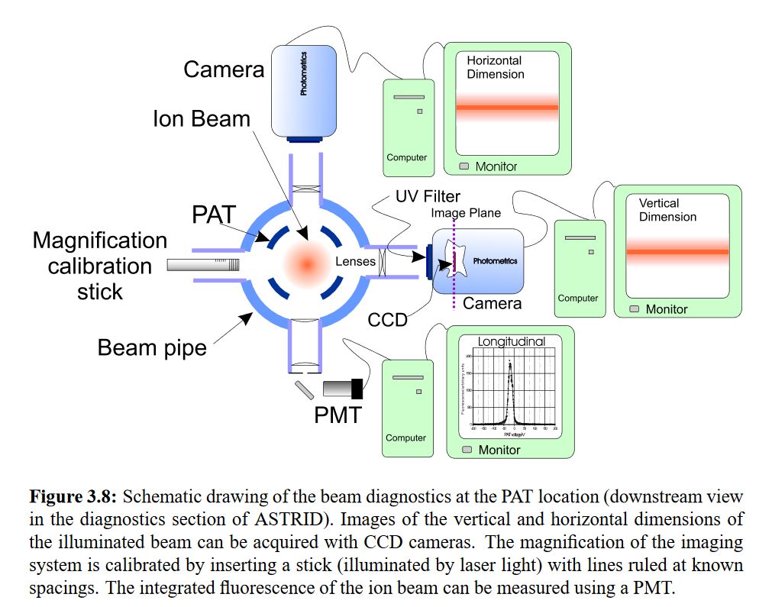
Crystalline Ion Beam @ ASTRID

Slide 15
Techniques for storing, cooling and controlling ions
Many techniques have already been developed for ion traps and crystallin beams
Ion traps:
  Ejection with “Tickle”
  Detection of image currents

Slide 16
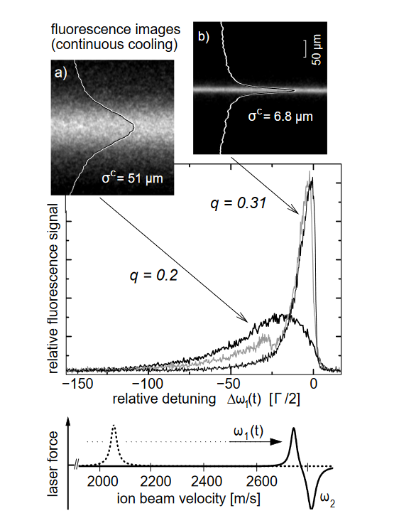
Techniques for storing, cooling and controlling ions
PALLAS / ASTRID
  Injection /storage of majority of elements in the periodic table
  Cooling and detection of fluorescence from ions
  Control of ion’s cloud
  (Chain→zigzag→3D crystals)
T. Schätz, U. Schramm & D. Habs, Nature 412, pp 717–720 (2001).

Slide 17
Outline
Introduction
Quantum Computer (QC) on ion traps
Crystalline beams
Quantum Computer (QC) on crystalline beams
Challenges and potential experiments at IOTA
Conclusions

Slide 18
Crystalline Ion Beams Qubits (CiQub)
“Proposal on building Quantum Computer using Crystalline beams of ions in a synchrotron”, T. Shaftan, NSLSII-ASD-TN-299, March 2019
Advantage of crystalline beams over stationary ion traps:
Scalability, a possibility of storing hundreds of thousands or even millions of ions separated by tens of microns.
Redundancy, enabling a more efficient Quantum Error (QE) corrections as a single qubit can be stored in many ions and there are more candidates for the checkbits.
Readout efficiency, the ions moving through interaction regions with laser beams permit for time domain analysis in addition to the frequency domain in collecting information from the phonon excitation bus.

Slide 19
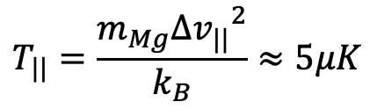
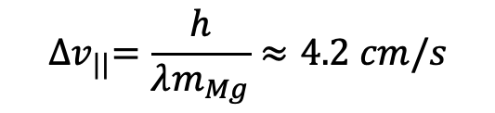
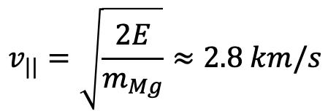
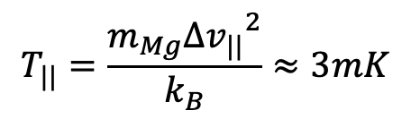
Requirements to enable CiQub
Longitudinal Temperature in QC on ion trap
  Assume that visible light photon is absorbed by ²⁴Mg⁺ ion
  The ion gains velocity of 4 cm/s after absorption of a photon, T is 5 μK
Comparison to PALLAS
  ²⁴Mg⁺ ion’s energy 1 eV, velocity 2.8 km/s
  Reported that after laser cooling spread in velocities is ~3.5E-4 (1 m/s)
  Longitudinal T in crystalline beams is 1000 x higher than needed for QC
$${∆v}_{||}=\frac{h}{λm_{Mg}}≈4.2 cm/s$$
$$T_{||}=\frac{m_{Mg}{{∆v}_{||}}^{2}}{k_{B}}≈5μK$$
$$v_{||}=\sqrt{\frac{2E}{m_{Mg}}}≈2.8 km/s$$
$$T_{||}=\frac{m_{Mg}{{∆v}_{||}}^{2}}{k_{B}}≈3mK$$

Slide 20
Outline
Introduction
Quantum Computer (QC) on ion traps
Crystalline beams
Quantum Computer (QC) on crystalline beams
Challenges and potential experiments at IOTA
Conclusions

Slide 21
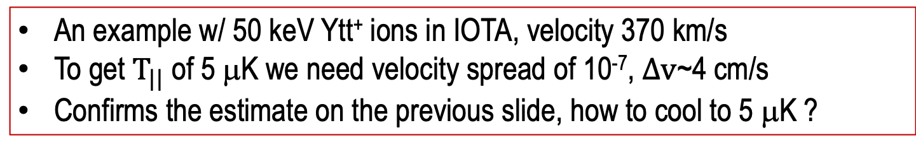
Potential experiments at IOTA
Proof-of-principle experiments to address feasibility of CiQub
Diagnostics
  Improving fluorescence photons diagnostics
  Phonon? Is it possible to detect a phonon mode?
Reliable control over ion’s state
  Set ion’s state with an external laser
Cooling – Is it possible to reach µK range?
Gating, controlling number of stored ions
Can RF techniques be used? Highly accurate Barrier RF?
An example w/ 50 keV Ytt⁺ ions in IOTA, velocity 370 km/s
To get $T_{||}$ of 5 μK we need velocity spread of 10⁻⁷, $∆v$~4 cm/s
Confirms the estimate on the previous slide, how to cool to 5 μK ?

Slide 22
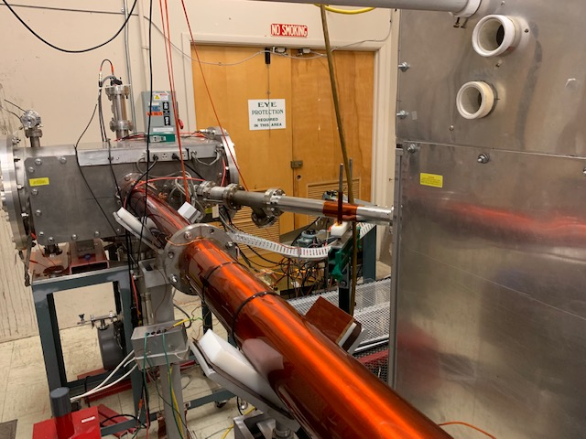
Basic layout of Ion injector for IOTA
(with D. Raparia, BNL)
Emitter box
Goal: 1000s of ions per shot at 50 kV
Solid emitters are available for almost any kind of ion species (heater + laser power determine intensity of ion beam)
Pulse width ~100 ns (needs chopper and collimation system)
Commercially available laser system synchronized with injector kicker
50 kV DC power supply
Transport line leading to injection septum and electrostatic lenses
Non-trivial question: diagnostics, sensitive to low current ion beams (PMTs?)
laser
Laser beam
Solenoid channel
Ion beam
Diagnostics
RHIC’s ion source lab
Laser
Source
Chopper
Beam Diagnostics
Heater
pulser
Collimator
PS
-V
Emitter
Septum
HV PS
HV PS
IOTA
HV PS
focusing

Slide 23
Conclusions
Quantum Computer on Crystalline beams
  The main advantage = large qubit capacity
  Ability to develop algorithms to combat errors due to decoherence
Now is a good timing to discuss and plan proof-of-principle experiments
  Need to prove feasibility of the CiQub concept
  IOTA is a natural place in the US to host such program
Questions to answer
  Develop cooling techniques and also conditions for storing low temperature crystals to see phonon modes
  sensing techniques: photon counting and RF pickup of low intensity signals
  controlling crystal shape?
Successful demonstration of these techniques at IOTA may lead to opening new horizons in the rapidly emerging field of Quantum Computing

Slide 24
Acknowledgement and additional resources
The work was partially supported by DOE SBIR grant No. DE-SC0018773
History of cooling and crystalline beams, NAP-M ring at BINP in 80s
  A few μA proton beam was cooled until the Schottky noise signal (for measurement of beam’s 𝑇_(||)), became independent from beam current. V. Parkhomchuk suggested that very cold ions could be Coulomb-ordered to explain this effect of Ion Crystals.
Excellent reviews
  Quantum Computers: Andrew Steane, “The ion trap quantum information processor”, Appl. Phys. B 64, pp. 623–642, 1997
  Crystalline Beams: Jie Wei, X. P. Li, and A. M. Sessler, “Low-Energy States of Circulating Stored Ion Beams: Crystalline Beams”, Phys. Rev. Lett. 73, 3089, 1994

