Slide 1
Near-Infrared Scintillation of Liquid Argon
Carlos O. Escobar
FERMILAB
Detector R&D Fermilab April 19, 2019

Slide 2
Why bother investigating the NIR?
The standard way of using the light signal in LNG’s TPC’s (for neutrino physics or dark matter exps.) is to detect the VUV light (128nm for LAr). This presents several challenges such as using wavelength shifters to coat surfaces of light guides or photodetectors (stability of coatings, efficiency); adverse effects of Rayleigh scattering (for large volume TPCs) arising from a short Rayleigh scattering length at 128 nm: 55cm (Grace and Nikkel (arXiv:1502.04213 v4) ) which is supported by results from the ArDM collaboration at 52 +/- 7 cm (arXiv:1611.02481) and DarkSide-50 at 46 +/- 11 cm.
Going to the NIR avoids Rayleigh scattering, avoids opaqueness of metal surfaces, shadowing by wire meshes and allows for improved charge collection by doping with chemicals such as TMG (an old ICARUS proposal).

Slide 3
NIR scintillation from condensed noble gases: history and background: pure LNG, no “doping”
NIR light emission from noble gases has been known since the late 40’s with lines around 1,300 nm.
In condensed noble gases NIR emission was seen in transient optical absorption experiments via electron excitation in late 60’s and early to mid 70’s by various groups. Next slide gives one example for Ar.
Bressi and collaborators pursued for many years the study of NIR emission in both gaseous and liquid states for xenon and argon: clear evidence for NIR emission from gas but much lower LY in liquid.

Slide 4
History and background cont.
example of spectrum obtained in argon:
from Suemoto et al (1977)
Top: solid
Middle: liquid
Bottom: gas
Similar results were
obtained by Arai and
co-workers → evidence
for excited neutral rare
gases molecules (excimers)
(1.3 eV = 954 nm)
Suemoto et al: Phys. Lett 61A, 131 (1977)

Slide 5
Recent Investigations
Two groups have pursued the investigation of the NIR scintillation in LAr very vigorously in recent years
Novosibirski (Bondar, Buzulutskov et al.) and TU Munich (Ulrich, Schoenert and various students and postdocs).
Both use table-top setups(cubic centimeter volumes)
and very intense, pulsed low energy beams (12 keV electrons Munich and pulsed X-rays between 30 and 40 keV-Bondar et al.)

Slide 6
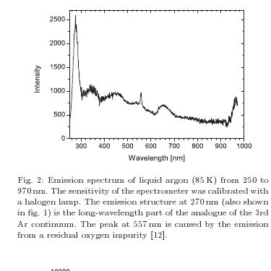
Summary of the results of the two groups
Munich group
results from the Munich group indicated NIR emission from LAr: No absolute light yield but spectral information:
Ref: T. Heindl et al. , Europhys. Lett. 91 (2010) 62002

Slide 7
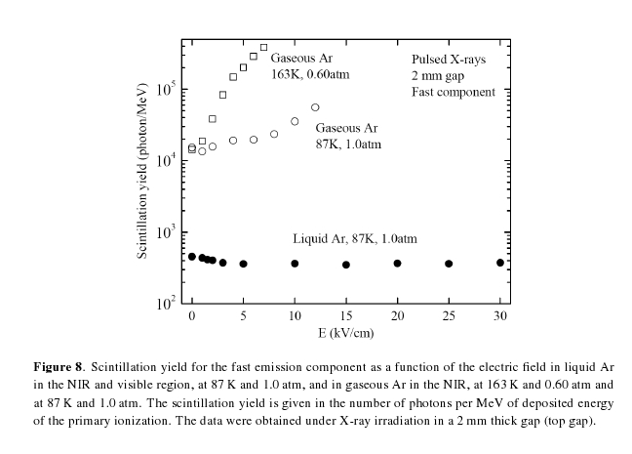
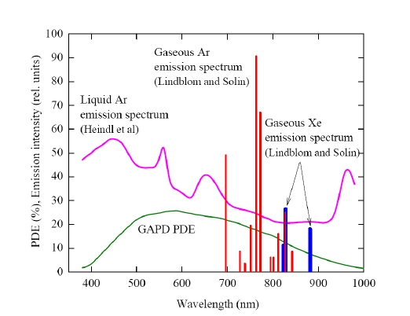
Results from the two groups cont.
Novosibirski
510+/-90 photons/MeV from 400nm to 1000nm
Ref: Buzulutskov et al. JINST 7:P06014,2012

Slide 8
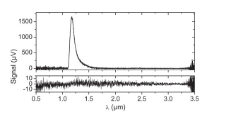
Recent investigations-cont.
But, more recently (end of 2014 and beginning of 2015) the Munich group revisited their NIR results in LAr, claiming that impurities had caused the 1st result. Their new line of investigation is mixing small parts of xenon into argon (10 ppm produces the best results: 10,000 NIR photons/MeV at 1,180 nm)
Buzulutskov et al. have
not reconsidered their
results

Slide 9
Our own results
At PAB we have investigated NIR with pure LAR since the summer 2015 and have had clear inidication of NIR emission at wavelengths longer than 715 nm and less than 1,000 nm (QE of our photon detectors-both SiPMs and IR PMTs).
Results can be found in:
JINST 13 CO3031 (2018)
JINST 11 C03010 (2016)
Next slide shows a sample of the results

Slide 10
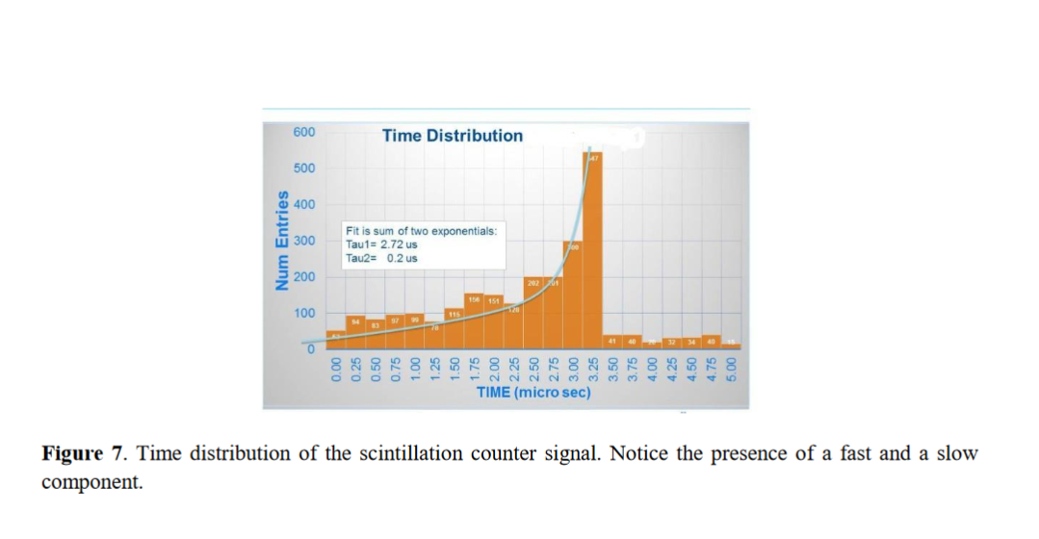
NIR results obtained at PAB using tagged Na22 gammas

Slide 11
Doping LAr with Xe
I will only consider the near-infrared, no discussion of using LAr doped with trace amounts (less than 100ppm) of xenon for 172 nm light detection. This can be found in docdb 11965 (Denver Whittington) and docdb 9423 (CE).
New result from the Munich group (A. Ulrich et al): strong emission in the NIR with low concentrations of Xe (maximum yield at 10 ppm only).
See next slides

Slide 12
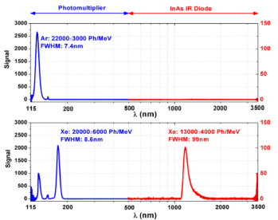
Munich results on Xe doping
VUV: shift from 128nm to 174 nm
NIR: strong emission at 1,180 nm

Slide 13
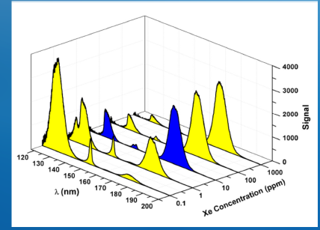
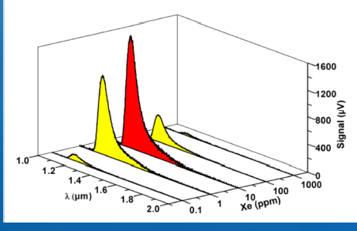
.
dependence on Xe concentration: at 10 ppm of Xe
the energy transfer from 128 nm to 174 nm is almost complete. Also at 10 ppm the NIR emission is at a maximum

Slide 14
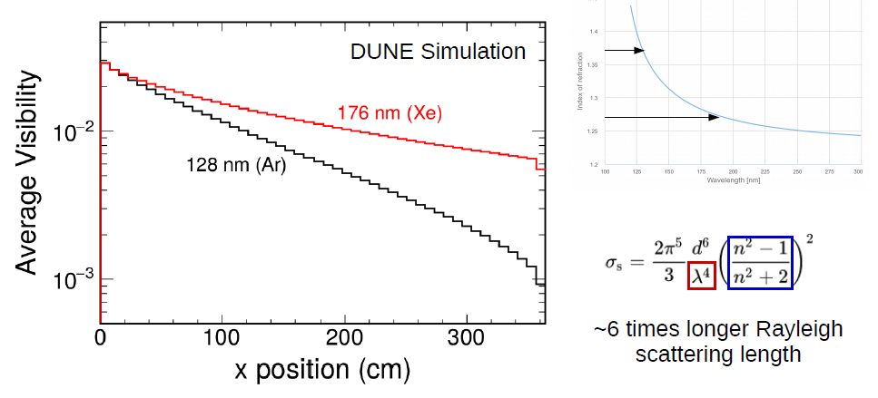
Visibility increase as Rayleigh scattering length increases: ex. from 128 nm to 176 nm shift after Xe doping (DUNE FD TPC)

Slide 15
How to see the NIR light?
New developments in NIR sensitive SiPMs / MPPC
Ex. FBK and Hamamatsu have developed NIR SiPMs with pde > 10% at 905 nm.
These devices would be adequate IF our claim that there is significant NIR emission around 900 nm is confirmed and quantified (light yield and time strucuture)
If we explore IR with Xe doping at 10 ppm only then a new development from Hamamatsu could be considered;
InGaAs MPPC. See next slide

Slide 16
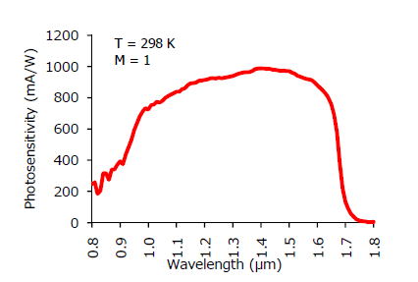
InGaAs MPPC Proc. SPIE 10528, Optical Components and Materials XV, 105280Z

Slide 17
Thank you!
!

Slide 18
Additional slide

Slide 19
Liquid argon purity
O2 < 1 ppb
H2O < 1 ppb
CO < 1 ppb
CO2 < 1 ppb
H2 < 1 ppb
N2 < 1 ppb
CH4 < 1 ppb

