Slide 1
Detector WG – Energy Frontier Part Attempt at Grouping
P. Merkel
SAC Detector WG Meeting
10 May 2019

Slide 2
Collider Experiments: 2017 and 2018 WG Topics
Overview of Energy Frontier (Petra Merkel)
Highlights from CERN R&D Workshop (Alan Prosser)
Detector Challenges for a Muon Collider (Ron Lipton)
High Speed Links for HEP (Alan Prosser)
ASIC Group Considerations (Gregory Deptuch)
Future Testbeam and Irradiation Needs (Mandy Rominsky)
Summary from Energy WG (Anadi Canepa)
Quantum dot scintillator R&D (Pasha Murat)
Plastic scintillators for future experiments (Anna Pla-Dalmau)

Slide 3
Detector Challenges for ILC/CLIC

Slide 4
Detector Challenges for FCC-ee and Muon Collider

Slide 5
Detector Challenges for HE-LHC/FCC-hh

Slide 6
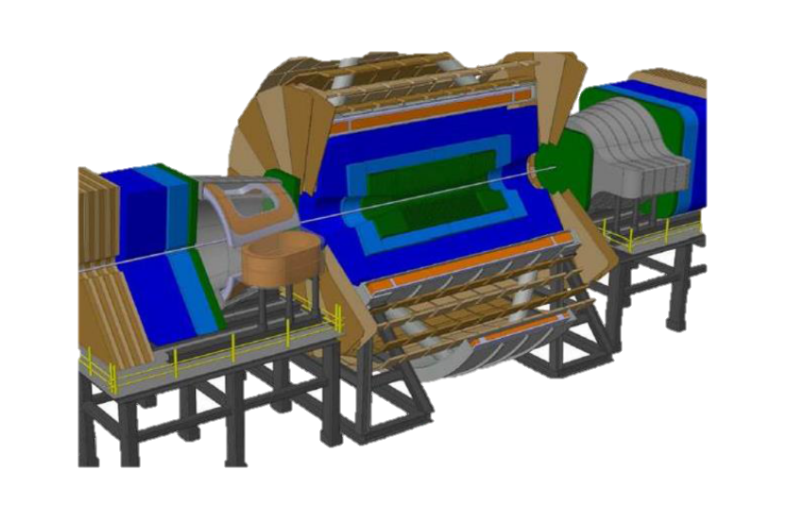
A sense of scale
Challenges:
Embedded readout electronics at 1mW/channel = 1.5 MW of power
Timing on a system scale of millions of channels at the level of 50 ps
In order to maintain good momentum resolution, enormous magnet needed (6T, 12m bore: ~60 GJ stored energy)
Pile-up reaching 1000 events per bunch crossing
Simply scaling CMS High Granularity Calorimeter would require >5,000 m² of silicon!

Slide 7
Radiation Damage
For radii <50 cm (well into the tracker) the fluence exceeds the HL-LHC value by two orders of magnitude! Forward region even worse.

Slide 8
Detector R&D Topics under Discussion in this Context

Slide 9
From CERN R&D Workshop: Silicon Detectors

Slide 10
From CERN R&D Workshop: Silicon Detectors

Slide 11
From CERN R&D Workshop: Calorimetry

Slide 12
High speed links: What might be next? (Alan Prosser, SCD)
E.g. Multi-level signaling
E.g. Wavelength-division multiplexing fibers (WDM Mux/Demux)

Slide 13
High speed links: What might be next?
E.g. Free Space Optics
Very early setup at FNAL:

Slide 14
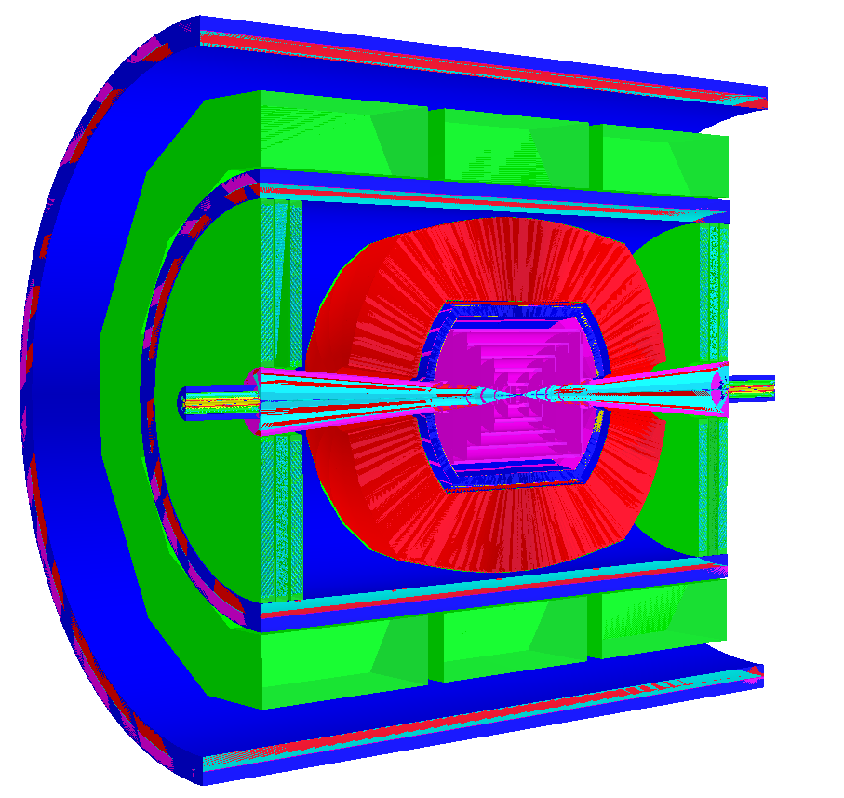
Muon Collider Detector Studies (Ron Lipton, PPD)
Detector is based on ILC concepts (SiD, ILD, 4th)
Fine pitch pixelated vertex and forward detectors (~20 μm) based on SiD
More coarsely (50 μm) pixelated tracker
Both with sub-ns timing resolution
Dual readout (scintillator/Cerenkov) calorimeter to optimize hadronic shower resolution
ILCROOT Detector Model

Slide 15
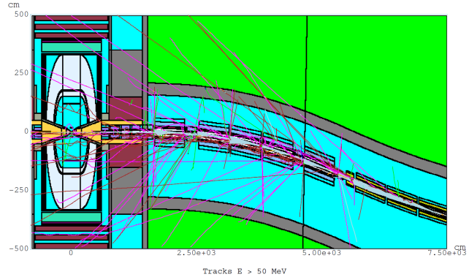
Muon Collider: Backgrounds
From the detector side the central issue in a muon collider are backgrounds due to muon beam decays.
For a 0.75-TeV muon beam of 2x10¹²/bunch
4.28x10⁵ decays/m per bunch crossing
0.5 kW/m.
3.24x10⁸ particles into detector per crossing
W-poly nose
MARS simulations
Needed – small pixels, fast (50ps) timing, fast correlation of hits in φ and θ

Slide 16
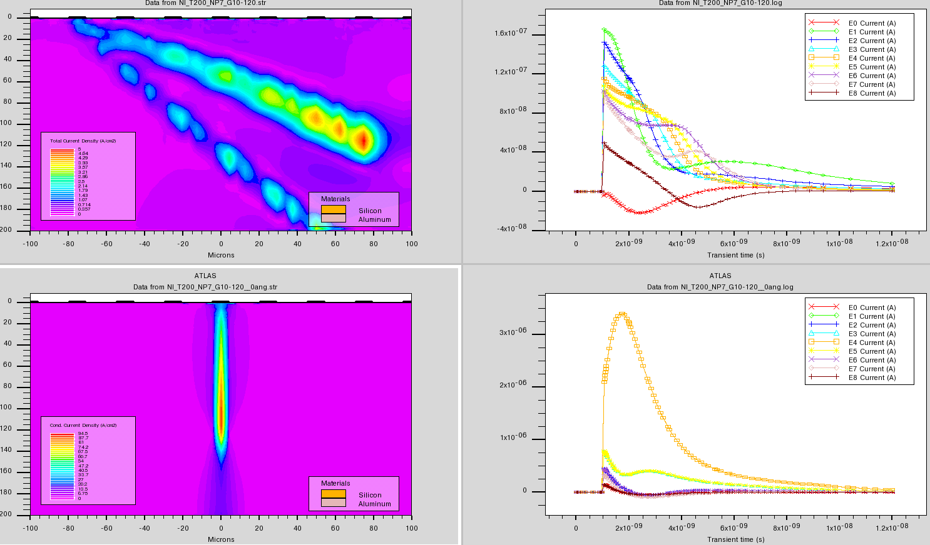
A more sophisticated approach
Analyze the shapes (peak/width) and patterns of the pulses to determine the track angle and timing. Cut differently on φ and θ pixels. Need fast, smart (3D integrated) electronics. This is not far from current capabilities
25 micron pitch 200 micron thick pixel detector
Background Track path
Electrons & holes
100 ps after
impact
Current
Pulses
Large angle
background
Signal Track path
Normal
incidence
signal
Current
Pulses

Slide 17
ASIC R&D (Gregory Deptuch, PPD)
ASIC design is highly specialized and competitive and requires continuous improvement of skills
There is a lot to do to stay current with industry standards
Anticipate technical needs in HEP through investigations and partnerships with other fields and labs
Investigating new technology nodes in anticipation of project needs
When a project requiring 28 nm arises there will be a steep learning curve which delays project delivery, or may eliminate us from the game
e.g. CERN is already investigating 28nm and we are not
Fermilab ASIC Group will not be a suitable collaboration partner without the right knowledge

Slide 18
Scintillator R&D (Jim Freeman, Anna Pla-Dalmau, Pasha Murat)
Radiation hardness and doping R&D ongoing
Dopants: presence of high Z materials improves sensitivity to high energy photons
Explore 3D printing of scintillators; explore new materials, such as polysiloxanes
Develop ink and scintillator formulas
R&D on quantum dot semiconductor scintillator just started
Higher light yield, more rad hard, potentially very fast
Characteristic scintillation time <1ns
Light produced in semiconductor gets reabsorbed, so they are not transparent to their own emission
Possible solution is to embed quantum dots of different material with E_{gap}>E_{γ}
Currently investigating InAs QDs (E_{γ}~1.08eV) in GaAs bulk (E_{gap}=1.4eV)
~20μm thin sensor!
First measurements: ~0.8ns fast signal!

Slide 19
A List
CMOS sensors: FNAL has not been involved in this so far
Hybrid pixels: FNAL has expertise with 3D interconnects
Large pitch silicon calorimeter: FNAL is gaining/has expertise in system level challenges, ASIC, sensor design
Ultra-fast silicon sensors: FNAL has expertise; already started R&D for future sensors; expertise in ASIC and system level challenges
Small pixel silicon: FNAL has expertise
Alternative semiconductor material, e.g. graphene: FNAL is gaining expertise
Silicon device modelling and simulation: FNAL has expertise
Interconnection and module construction materials: FNAL has expertise
Homogeneous crystal calorimeter with long. segm.: FNAL not involved so far
Sampling calorimeter: FNAL has expertise
Segmented gas amplification structures: FNAL has not been involved in this so far
SiPMs on scintillator tiles or strips: FNAL is gaining some expertise
High granularity calorimeters for FCC-hh based on noble liquids: FNAL/ND has expertise
Rad-hard scintillators: FNAL has expertise
Scintillator doping and new scintillator materials: FNAL has expertise
ASIC design: FNAL has expertise
High-speed links: FNAL has expertise

