Slide 1
Accelerator Status
Rob Ainsworth
Proton PMG
04 April 2019

Slide 2
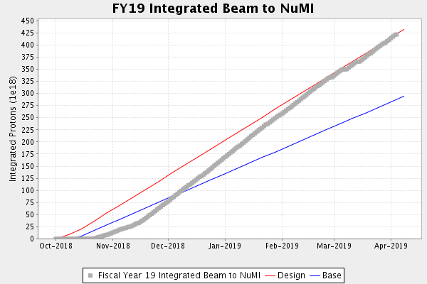
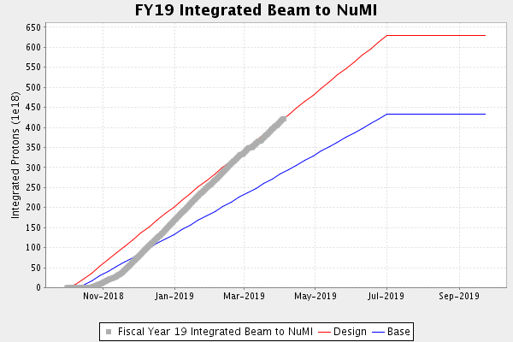
NuMI Operation
4.22e20 POT integrated as of 00:00 04/04/2019

Slide 3
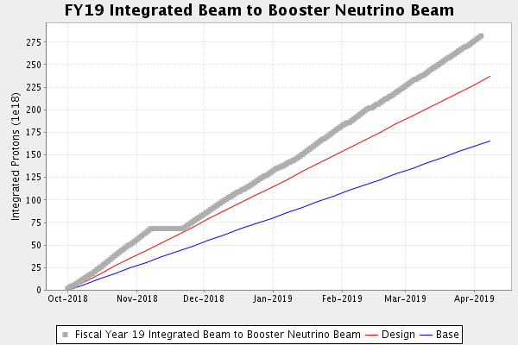
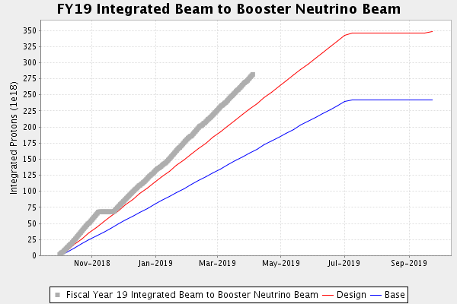
BNB Operation
2.77e20 POT integrated as of 00:00 04/04/2019

Slide 4
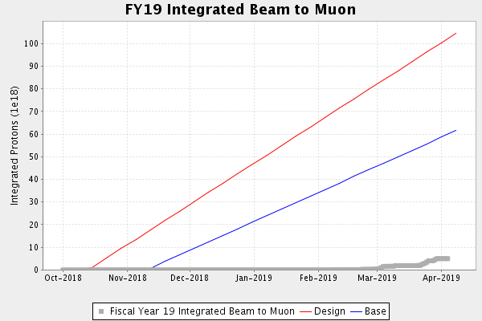
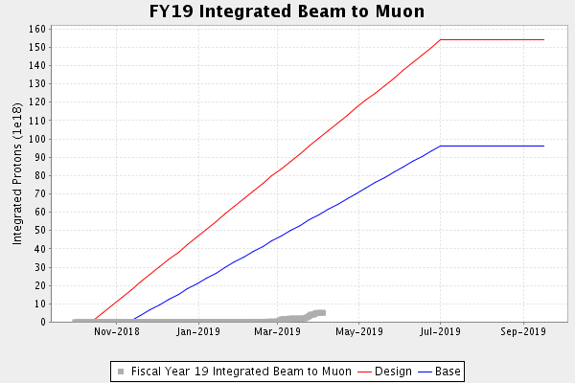
Muon Operation
1.92e18 POT integrated as of 00:00 04/04/2019

Slide 5
Complex Status
Linac/Booster
Beam to BNB
Beam to RR/MI
RR/MI
Delivering ~750 kW to NuMI
Beam to Muon
Beam to SY upon request

Slide 6
Complex Status (cont’d)
BNB
Receiving 14.3 Booster turns @ 5 Hz
Switchyard
MTest - receiving beam when requested
MCenter – receiving beam when requested
Neutrino-Muon – installation continues
Muon
Ready to deliver beam to G-2
NuMI
750 kW on target

Slide 7
Muon Intensity Effects
NuMI will go from 1.33 s to 1.4 s
Small hit to power
BNB rate will drop from 5 Hz to ~ 3.6 Hz

Slide 8
Upcoming Downtimes
Dedicated Booster studies
Wednesday, April 24th
1 shift (8hrs) per month, affects all users

Slide 9
After hour call-ins
Restricting call-ins after hours
Repairs will be made the next working day
Some exceptions
Systems need to be in a safe state

