Slide 1
REDTOP experiment:
Status Update
Rare Eta Decays with a
Tpc for Optical Photons
Corrado Gatto
INFN Napoli and Northern Illinois University
For the REDTOP Collaboration

Slide 2
The Physics Landscape for REDTOP
  SM is showing its age
    SM matter: Dark matter:Dark energy=5%:25%:70%
    Baryon Asymmetry of the Universe
    Expansion of the universe is accelerating (hint to more forces)
    . . . .
  New physics is elusive: probability of processes where new physics is coupled to SM physics is low
  LHC found no hint of new physics at high energy so far
  Newest theoretical models prefer gauge bosons in MeV-GeV mass range as “…many of the more severe astrophysical and cosmological constraints that apply to lighter states are weakened or eliminated, while those from high energy colliders are often inapplicable” (B. Batell , M. Pospelov, A. Ritz – 2009)
  High intensity-low energy experiments are growing in popularity (Fixed target and beam dump)

Slide 3
Why the η meson is special?
It is a Goldstone boson
It is an eigenstate of the C, P, CP and G operators (very rare in nature): I^{G} J^{PC} =0⁺ 0⁻⁺
All its additive quantum numbers are zero
Q = I = j = S = B = L = 0
All its possible strong decays are forbidden in lowest order by P and CP invariance, G-parity conservation and isospin and charge symmetry invariance.
EM decays are forbidden in lowest order by C invariance and angular momentum conservation
The η decays are flavor-conserving reactions
Symmetry constrains its QCD dynamics
It can be used to test C and CP invariance.
Its decays are not influenced by a change of flavor (as in K decays) and violations are “pure”
It is a very narrow state (Γ_{η}=1.3 KeV vs Γ_{ρ}=149 MeV)
Contributions from higher orders are enhanced by a factor of ~100,000
Excellent for testing invariances
Decays are free of SM backgrounds for new physics search
η is an excellent laboratory to search for physics Beyond Standard Model

Slide 4
Detecting BSM Physics with REDTOP (η/η’ factory)
  Assume a yield 2.5 x 10¹³ η mesons/yr and 2 x 10¹¹η’ mesons/yr
  C, T, CP-violation
  CP Violation via Dalitz plot mirror asymmetry: η → π^{ο} π⁺π⁻
  CP Violation (Type I – P and T odd , C even): η−> 4π^{ο} → 8γ
  CP Violation (Type II - C and T odd , P even): η → π^{ο} l⁺l and η → 3γ
  Test of CP invariance via μ longitudinal polarization: η → μ⁺μ –
  Test of CP invariance via γ∗ polarization studies:η → π⁺π –e⁺e – and η → π⁺π –μ⁺μ –
  Test of CP invariance in angular correlation studies:η → μ⁺μ – e⁺e –
  Test of T invariance via μ transverse polarization: η → πºμ⁺μ – and η → γ μ⁺μ –
  CPT violation: μ polariz. in η → π⁺μ⁻ν vs η → π⁻μ⁺ν and γ polarization in η → γ γ
  New particles and forces searches
  Scalar meson searches (charged channel): η → π^{ο} Η with H→e⁺e⁻ and H→μ⁺μ⁻
  Dark photon searches: η → γ Α’ with Α’ → l⁺l⁻
  Protophobic fifth force searches : η → γ X₁₇ with X₁₇ → e⁺e⁻
  New leptophobic baryonic force searches : η → γ B with B→ e⁺e⁻ or B→ γ π^{ο}
  Indirect searches for dark photons new gauge bosons and leptoquark: η → μ⁺μ⁻ and η → e⁺e⁻
  Search for true muonium: η → γ (μ⁺μ – )|_{2Mμ} → γ e⁺e –
  Other discrete symmetry violations
  Lepton Flavor Violation: η → μ⁺e – + c.c.
  Double lepton Flavor Violation: η → μ⁺μ⁺e – e – + c.c.
  Other Precision Physics measurements
  Proton radius anomaly: η → γ μ⁺μ – vs η → γ e⁺e⁻
  All unseen leptonic decay mode of η / η ‘ (SM predicts 10⁻⁶ -10⁻⁹)
  Non-η/η’ based BSM Physics
  Dark photon and ALP searches in Drell-Yan processes: qqbar → A’/a → l⁺l–
  ALP’s searches in Primakoff processes: p Z → p Z a → l⁺l– (F. Kahlhoefer)
  Charged pion and kaon decays: π+ → μ⁺ν Α’ → μ⁺ν e⁺e– and Κ+ → μ⁺ν Α’ → μ⁺ν e⁺e–
  Neutral pion decay: πº → γA’ → γe⁺e–
  Nuclear models
  Chiral perturbation theory
  Non-perturbative QCD
  Isospin breaking due to the u-d quark mass difference
  Octet-singlet mixing angle
  Electromagnetic transition form-factors (important input for g-2)
  High precision studies on medium energy physics

Slide 5
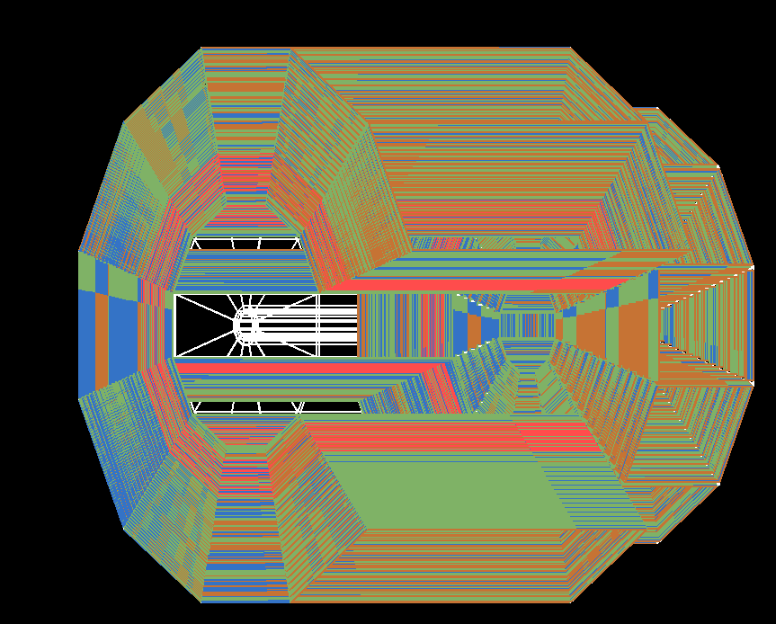
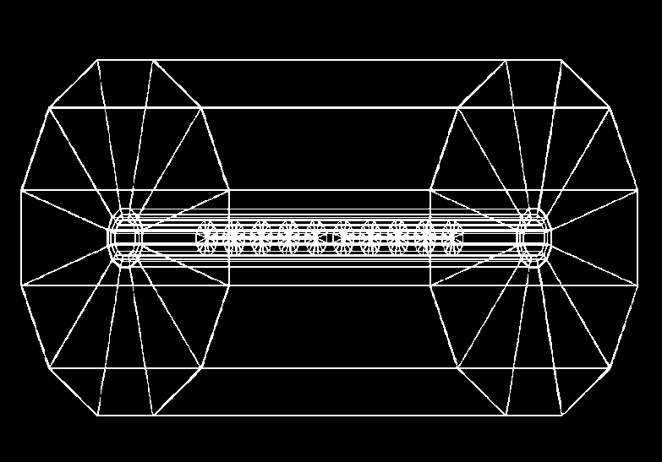
REDTOP detector
Optical TPC
~ 1m x 1.5 m
CH₄ @ 1 Atm
5x10⁵ Sipm/Lappd
98% coverage
ADRIANO2 Calorimeter (tiles)
Scint. + heavy glass sandwich
20 X ₀ ( ~ 64 cm deep)
Triple-readout +PFA
96% coverage
μ-polarizer
Active version (from TREK exp.) - optional
2.4 m
10x Be or Li targets
0.33 mm thin
Spaced 10 cm
1.5 m
2.7 m
Fiber tracker
for rejection of g-conversion and vertexing
1 m
Aerogel
Dual refractive
index system
OTPC

Slide 6
Recent History of the Project
  Sept. 2017
    LOI submitted to Fermilab’s PAC in Sept. 2017
    PAC recommendation: “The PAC finds that the science goals of the experiment are very interesting….., the PAC does not recommend that the Laboratory invest resources into furthering the REDTOP proposal at this time.”
    Fermilab’s Director recommended a two-year waiting period (still ongoing).
  Jan. 2018
    REDTOP admitted into the “Physics Beyond Colliders” program to explore a possible implementation at CERN
    Near full simulations studies indicate very good sensitivity studies to physics BSM for 3 out of 4 “portals”
    Final report from PBC indicate that the experiment is feasible at CERN, but with lower (1/10x) beam luminosity and larger impact on existing physics program cfr. FNAL
  Dec. 2018
    EOI submitted to European Strategy for Particle Physics

Slide 7
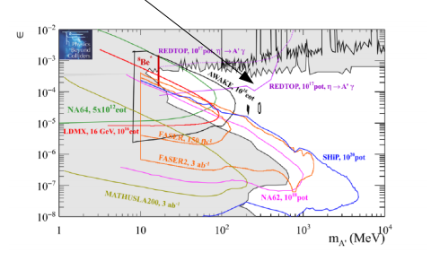
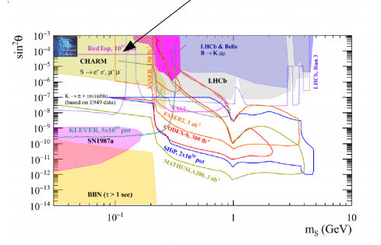
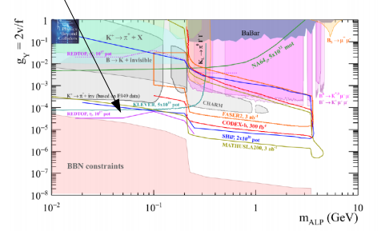
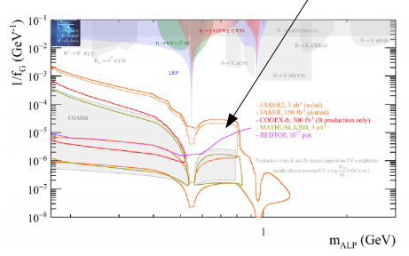
Summary of PBC Studies for 10¹⁷ POT (CERN)
Dark photon searches
Dark higgs searches
ALPs with fermion coupling searches
ALPs with gluon coupling searches
7

Slide 8
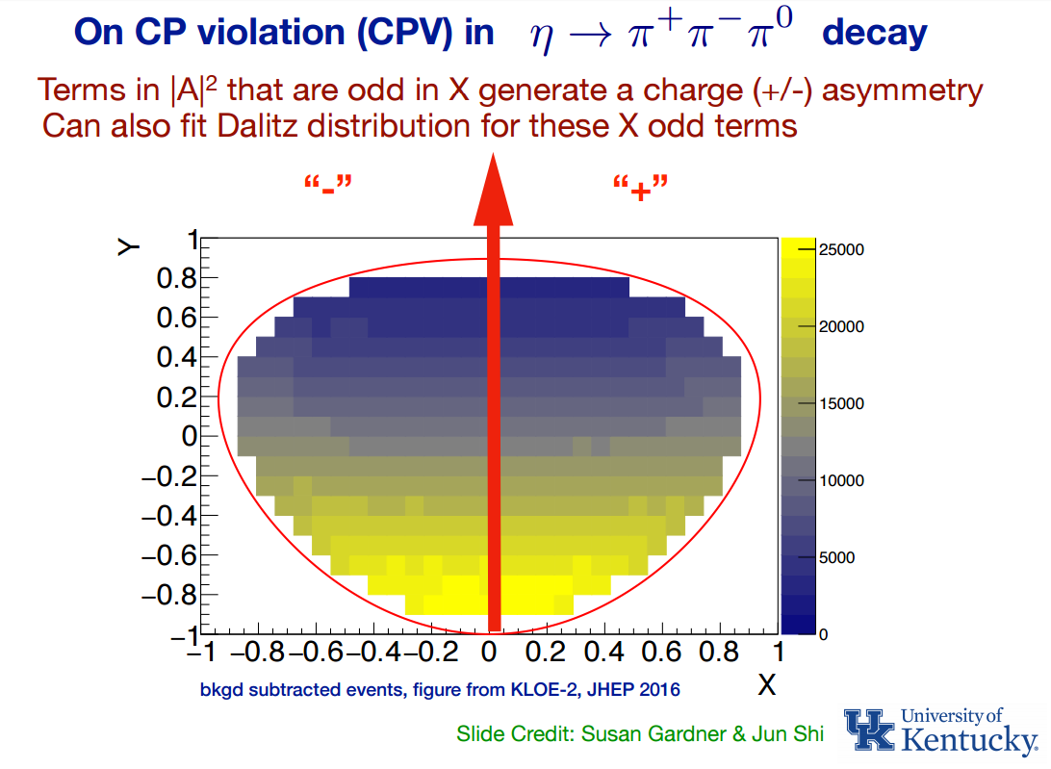
  CP Violation from Dalitz plot mirror asymmetry in η−> π⁺π⁻π^{ο}
  CP-violation from this process is not bounded by EDM as is the case for the η→4π process.
  Complementary to EDM searches even in the case of T and P odd observables, since the flavor structure of the eta is different from the nucleus
  Current PDG limits consistent with no asymmetry
  REDTOP will collect 4x10¹¹ such decay (factor 100 in stat. error)

Slide 9
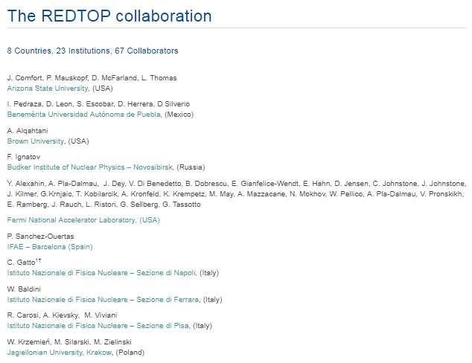
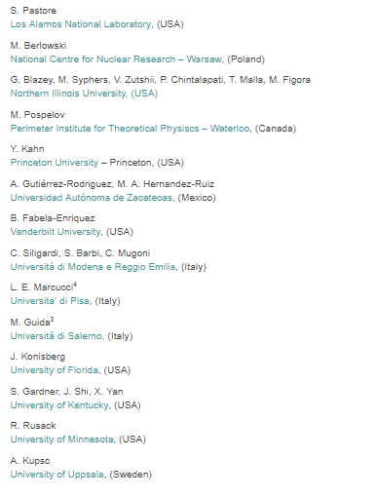
Status of the collaboration
  Potential hosting laboratories: BNL, CERN, FNAL (either DR or PIP-II)

Slide 10
Ongoing activities - simulations
Event generation
  GenieHad (Genie add-on) event generator interfaces to: Urqmd, Gibuu, Phsd, Abla, Gemini, SMM, G4EM processes, Incl++, IAEA tables, LELAPS
  New interfaces to JAM (JPARC) and ALPS (for PIP-II simulations) in preparation
Simulation, digitization, reconstruction and analysis
  Based on ILC frameworks (slic, lcsim and ilcroot)
  Full simulation in place (except for OTPC-reco and vertexing)
Detector optimization and sensitivity studies are ongoing
  Improvement on BSM physics from detached vertices

Slide 11
Ongoing activities – detector R&D
ADRIANO
  ADRIANO2 prototype under construction at NIU (INFN-NIU-UMN collaboration). FNAL probably joining (J. Freeman)
  Inherits from 10+ years R&D by T1015
O-TPC
  UC (H. Frish) only existing prorotype
  Requires a more structured collaboration
Fiber tracker
  No R&D needed: technology is exact copy of LHCB’s new tracker
  In talk with Aachen-RWTH for joining
  Otherwise, technology&tools transfer to REDTOP

Slide 12
Timeline
Once approved and funded, REDTOP needs about 2 years detector R&D + 1 year detector construction
  Solenoid and ¾ of Pb-Glass for ADRIANO in-kind contributions from INFN (Finuda and NA64 experiments)
Accelerator mods requires:
  BNL: <1yr (only requiring a new electronics for the extraction line (C4)
  CERN: need further studies
  FNAL: ~1yr (add a SC cavity to the DR and build an extraction line
Total cost: ~50 M$ (includes 50% contingency)

Slide 13
Future Prospects
The Collaboration is currently engaged in the ESPP and P5-Snowmass processes
Endorsement by the community and/or laboratories is needed to fund detector R&D activities
Current activities aim at the preparation of a full proposal in about 2-3 years (corresponding to the ESPP conclusion)
  Fermilab best : either DR or PIP-II (tREDTOP)
  Detector optimization and sensitivity studies
  Detector R&D
Competition from several other experiments (LHCB, et. Al.)
  However, experimental techniques are quite different
More details: http://redtop.fnal.gov

Slide 14
Backup slides

Slide 15
Present & Future η Samples
 | Technique |  | η → 3πº | η → e⁺e⁻γ | Total η
CB@AGS | π⁻⁻p→η n |  | 9×10⁵ |  | 10⁷
CB@MAMI-B | γ⁻p→η p |  | 1.8×10⁶ | 5000 | 2×10⁷
CB@MAMI-C | γ⁻p→η p |  | 6×10⁶ |  | 6×10⁷
KLOE | e+e-→Φ→ηγ |  | 6.5×10⁵ |  | 5×10⁷
WASA@COSY | pp→η pp pd→η ³He |  |  |  | >10⁹ (untagged) 3×10⁷ (tagged)
CB@MAMI 10 wk (proposed 2014) | γ⁻p→η p |  | 3×10⁷ | 1.5×10⁵ | 3×10⁸
Phenix | d Au→η X |  |  |  | 5×10⁹
Hades | pp→η pp p Au→η X |  |  |  | 4.5×10⁸
Near future samples
GlueX@JLAB (just started) |  | γ_{12 GeV}p → η X → neutrals |  |  | 5.5×10⁷/yr
JEF@JLAB (recently approved) |  | γ_{12 GeV}p → η X → neutrals |  |  | 3.9×10⁵/day
REDTOP@FNAL (proposing) |  | p_{1.8 GeV}Be → η X |  |  | 2.5×10¹³/yr

Slide 16
Experimental Techniques- η/η’ production+detection
  Incident proton energy ~1.8 GeV (3.5 GeV for η’)
  CW beam, 10¹⁷-10¹⁸ POT/yr (depending on the host laborarory)
  from inelastic scattering of protons on Nb (same as Hades experiment) or Be targets
  Use multiple thin targets to minimize combinatorics background
  charged tracks detection
  Use Cerenkov effect for tracking charged particles
  Baryons and most pions are below Č threshold
  Electrons and most muons are detected and reconstructed in an Optical-TPC
  γ detection
  Use ADRIANO calorimeter for reconstructing EM showers
  σ_{E}/E < 5%/√E
  PID from dual-readout to disentangle showers from γ/μ/hadrons
  96.5% coverage
  Fiber tracker (LHCB style) for rejection of background from γ-conversion and reconstruction of secondary vertices (~70μm resolution)

Slide 17
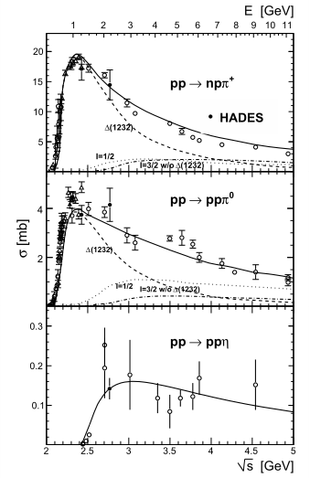
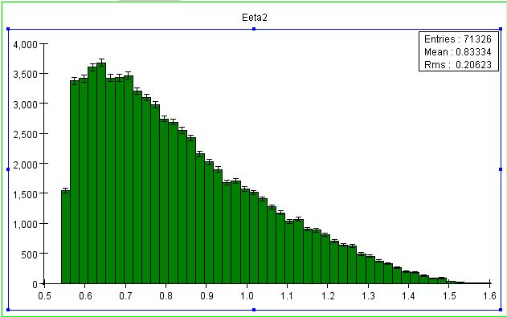
Beam Requirements for η-factory (1)
  Beam energy
  Constraints:
    Beam energy large enough to get Γ(η)/Γ( pX) ~ 1%
    Beam energy low enough to make slow baryons (minimize background)
    η meson energy low enough to make slow pions
  T_{beam} = 1.8 − 2.1 GeV (still under optimization but 1.9 GeV seems preferred)
Total cross sections @ 2 GeV
pp → ppη
140 μbarn
Total inelastic cross sections @ 2 GeV
About 200x
G. Agakishiev et al.
PHYSICAL REVIEW. C, NUCLEAR PHYSICS 2012, 48, 74-1
Total η energy

Slide 18
Expected η Yield
  Assume: 1x10¹¹ POT/sec – CW
    Beam power @ 1.9 GeV: 10¹¹ p/sec × 1.9 GeV × 1.6 × 10⁻¹⁰ J/GeV = 30 Watts
  Target system : 10 x 0.1mm Nb or 10 x 0.33mm Be foils, spaced 10 cm apart
    Nb is thinner (better vertex resolution) but makes more primary hadrons (final state hadron multiplicity ≈ A^{1/3})
    Prob(p + target → X) = 0.5%
  Power dissipated from target:
    150 mW total
    15 mW per target foil
  p-inelastic production: 5 x 10⁸ evt/sec (1 interaction/2 nsec in the targets)
  Probability of 2 events in the same target in 20 nsec: 70%
  η production: 2.5 x 10⁶ η /sec or 2.5 x 10¹³ η /yr
  Charged mode (1% acceptance) : 1 L0 trigger/200 nsec or 5 x 10¹³ trigger/yr
  Neutral mode (10% acceptance) : 1 L0 trigger/20 nsec or 5 x 10¹⁴ trigger/yr

Slide 19
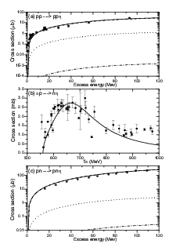
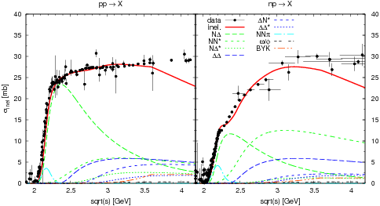
Beam Considerations for η’ -factory
  Constraints:
    Same as for η-factory
  E_{beam} = 3.0 − 4.0 GeV (yet to be optimized)
  R_{η’}=σ(pp →pnη’)/σ(pp →ppη’) slightly lower than R_{η}
Total cross sections @ 3.8 GeV
pp → ppη ’
1 μbarn
Total inelastic cross sections @ 2 GeV
About 25,000x
Xu Cao and Xi-Guo Lee
Phys. Rev. C 78, 035207 –2008

Slide 20
Expected η’ Yield
  Assume: 1x10¹¹ POT/sec – CW
    Beam power @ 3 GeV: 10¹¹ p/sec × 3 GeV × 1.6 × 10⁻¹⁰ J/GeV = 48 Watts
  Target system : 10 x 0.1mm Nb or 10 x 0.33mm Be foils, spaced 10 cm apart
    Nb is thinner (better vertex resolution) but makes more primary hadrons (final state hadron multiplicity ≈ A^{1/3})
    Prob(p + target → X) = 0.5%
  p-inelastic production: 5 x 10⁸ evt/sec (1 interaction/20 nsec in any of the 10 targets)
  Probability of 2 events in the same target in 20 nsec: 70%
  η ’ production: 1.5 x 10⁴ η ’/sec or 1.5 x 10¹¹ η ’ /yr
  Expect similar trigger rate as with η-factory: ~ 10¹³ trigger/yr

Slide 21
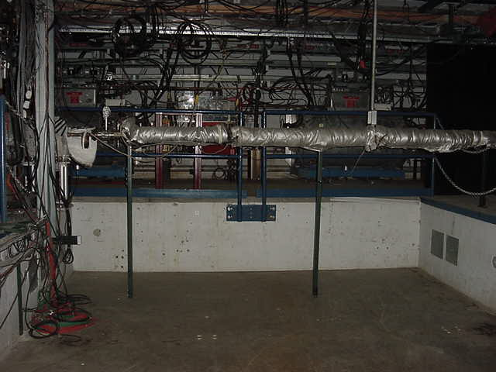
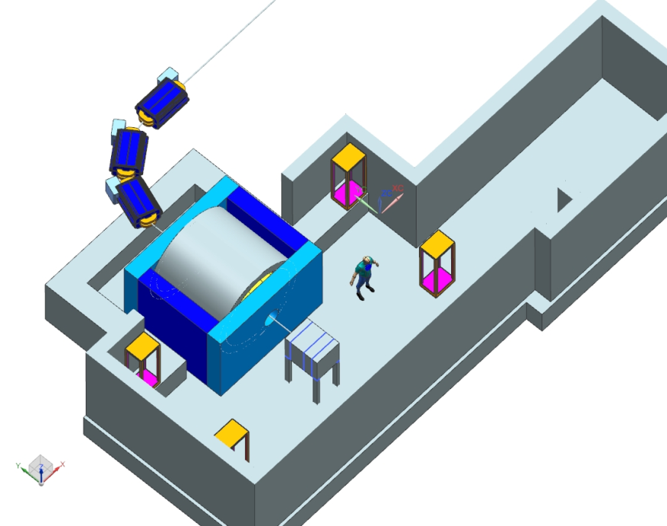
Accelerator complex for REDTOP
Fermilab Option: AP50 hall
Use delivery ring and extract beam at AP50
Decelerate the 8 GeV beam to desired energy.
REDTOP

Slide 22
Acceleration Scheme
Single p pulse from booster (≤4x10¹² p) injected in the DR (former debuncher in anti-p production at Tevatron) at fixed energy (8 GeV)
Energy is removed by adding 1-2 RF cavities identical to the one already planned for mu2e (J. Dey)
Spare RF cavities already existing (owned by mu2e and AD)
Debunching occurs adiabatically inside the DR
Slow extraction to REDTOP over ~40 seconds.
The 270º of betatron phase advance between the Mu2e Electrostatic Septum and REDTOP Lambertson is ideal for AP50 extraction to the inside of the ring. A DEDICATED SEPTUM IS NOT REQUIRED
Total time to decelerate-debunch-extract: 51 sec: duty cycle ~80%

Slide 23
Accelerator Design at FNAL
Fermilab’s AD has been supportive of the project
  enhances use of the Muon Campus for additional program
  selectable energy can create new opportunities for future experiments
  standard accelerator technologies, techniques
Two working groups:
Accelerator/beamline, coordinated by M. Syphers (NIU/FNAL): Y. Alexahin, E. Gianfelice, J. Johnstone (APC/AD) and C. Johnstone (EB/AD)
  potential showstoppers in the beam deceleration and delivery (reversing current in shunt, beam disruption through transition, etc.)
MARS15 : N. Mokhov and V. Pronskikh (APC/AD)
  General radiation and background studies
  Shielding
  Beam dump
Goals for 2017:
  Simulations of deceleration, extraction at ~2 GeV with enhanced optics (Y. Alexahin, E. Gianfelice)
  Extraction and transport line development (C. Johnston)
  MARS15 simulations of radiation dose in the detector, in AP50 enclosure and design of beam dump (V. Pronskikh)

Slide 24
Transitionless Deceleration in the Delivery Ring (J. Johnstone)
Large beam losses will occur if beam is decelerated from injection @ 8 GeV (γ = 9.53) to 2 GeV (γ = 3.13) through the DR natural transition energy γ_{t} = 7.64.
Transition is avoided by using select quad triplets to boost γt above beam γ by 0.5 units throughout deceleration until γ_{t} = 7.64 and beam γ = 7.14 (5.76 GeV kinetic).
Below 5.76 GeV the DR lattice reverts to the nominal design configuration
Optical perturbations are localized within each triplet
Straight sections are unaffected thereby keeping the nominal M3 injection beamline tune valid.

Slide 25
The Experimental Apparatus
  Baseline detector
  Beryllium or carbon fiber beam pipe, 10 cm dia x 1.5 m long
  1 cm dia targets disk inside the pipe, spaced 10 cm apart
  Multi-Aerogel around the beam pipe, 3cm thick (for most muons and fast pions detection)
  Optical-TPC 1m diameter x 1.5 m long
  γ-polarimeter in the rear section of the Optical-TPC (optional)
  ADRIANO calorimeter: ~20 Xo (same as ORKA) or 64 cm deep. Inner and outer sections to accommodate the μ-polarimeter in between
  Total detector dimensions: 2.2 m dia x 2.7 m long
  2.7 m long solenoid run at 0.6-0.8 T (2.4 m inner diameter) – Finuda magnet an excellent candidate.
  AP50 cryogenics and control room already in place

Slide 26
The REDTOP Detector (baseline)
Optical TPC
~ 1m x 1.5 m
CH₄ @ 1 Atm
5x10⁵ Sipm
98% coverage
  Beam & Target
Aerogel
Dual refractive
index system
γ-polarizer
(optional)
10x Be targets
0.33 mm thin
Spaced 10 cm
μ-polarizer
Active version (from TREK exp.)
ADRIANO Calorimeter
Scint. + heavy glass sandwich
20 X ₀ ( ~ 64 cm deep)
Triple-readout mode
96% coverage
Solenoid
0.6-0.8 T
Fiber tracker under discussion (for rejection of γ-conversion)

Slide 27
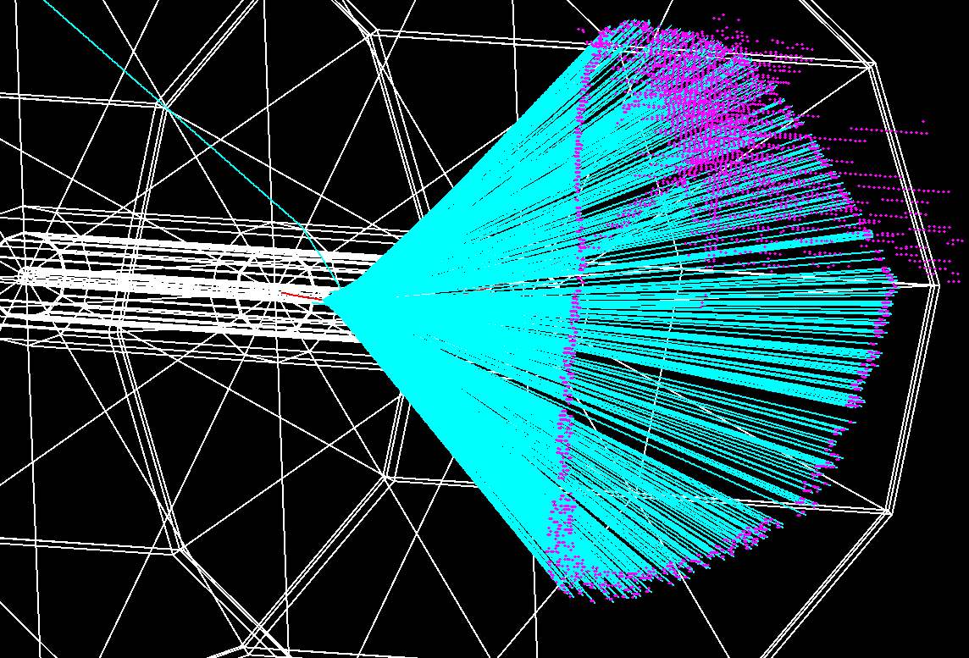
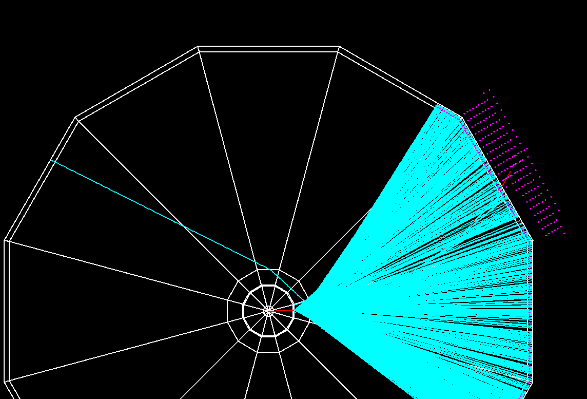
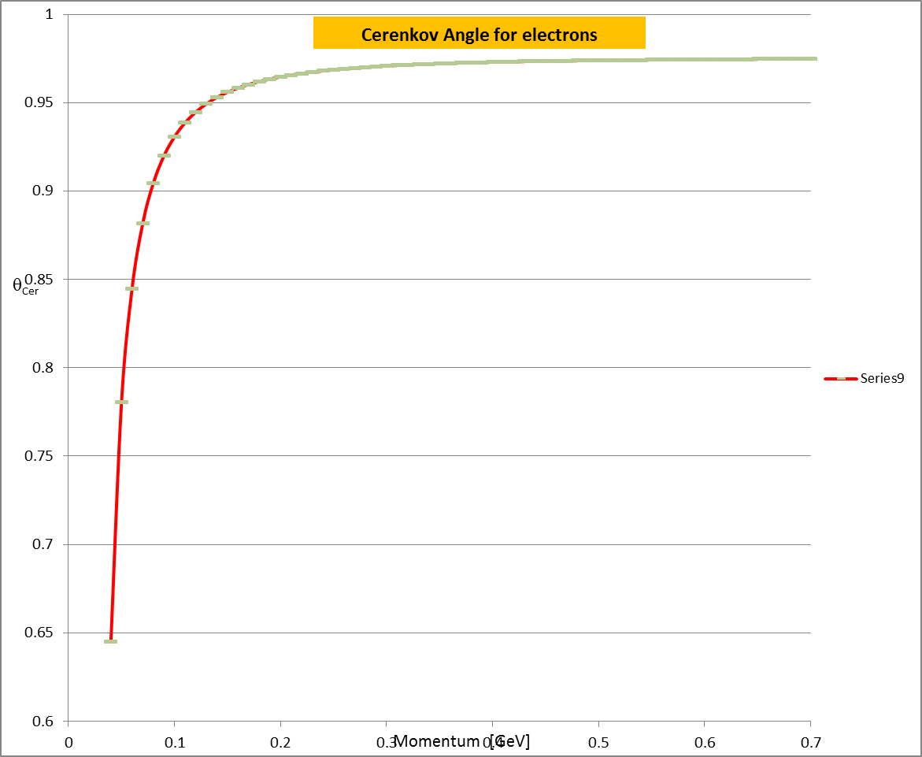
Electron Detection
100 MeV electron
100 MeV electron
n_{D}(N₂@2.7psi)=1.000145
Č threshold for e- in N₂: P=40 mev
n_{D}(aerogel1)=1.12
n_{D}(aerogel2)=1.22

Slide 28
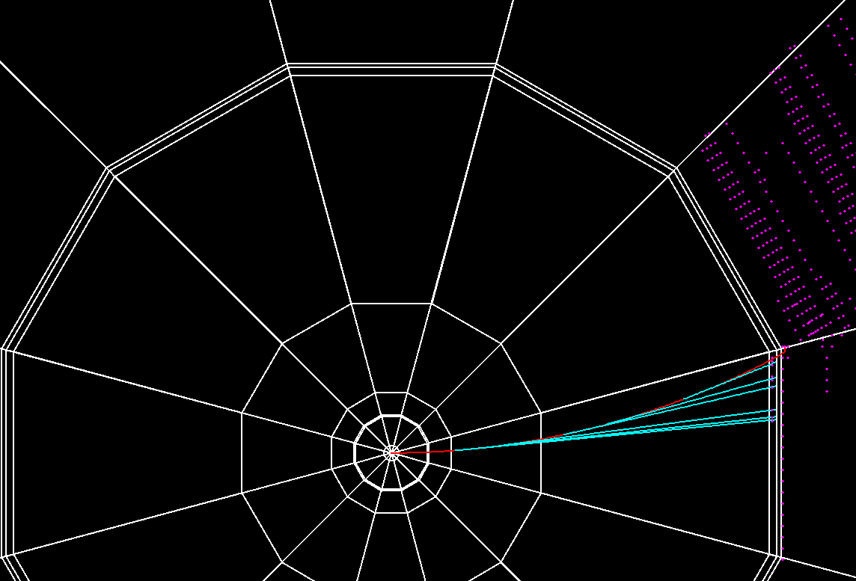
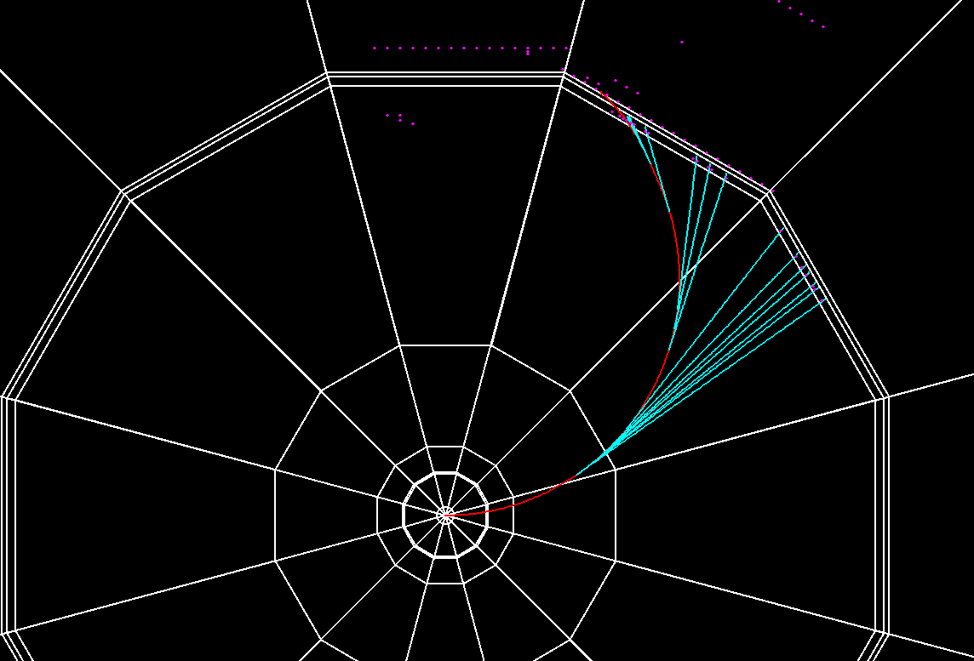
Electron Momentum Reconstruction
200 MeV electron
50 MeV electron
15 cm
5 cm
Electrons are recognized by:
  a large (>30 cm dia) circle of photons generated in the aerogel
  A sweep of photons circles with dia < 1cm and several cm long (depends on P_{t})
  An EM shower in ADRIANO (identified by Č vs S)

Slide 29
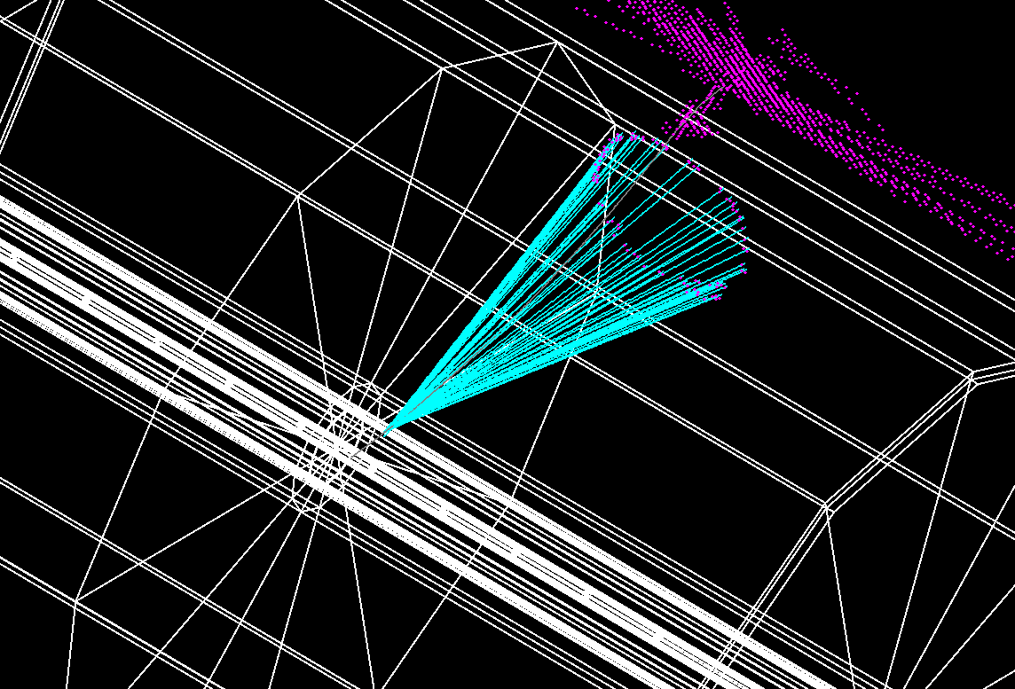
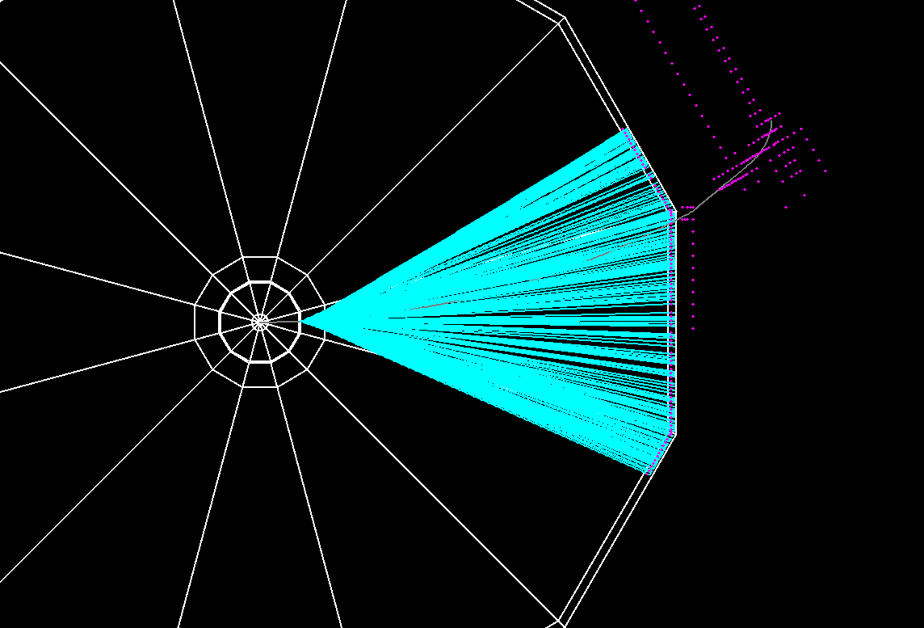
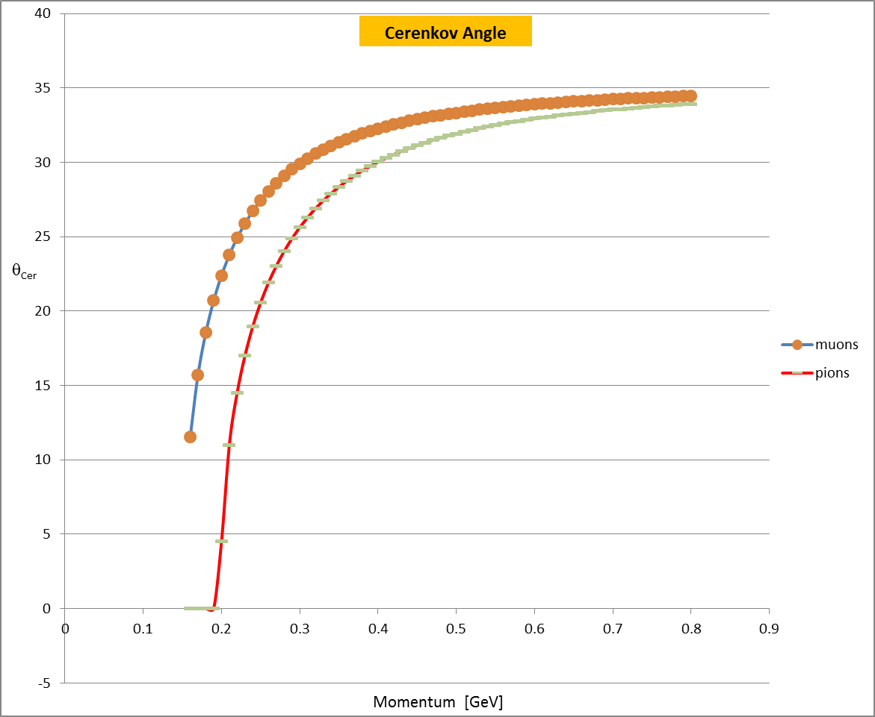
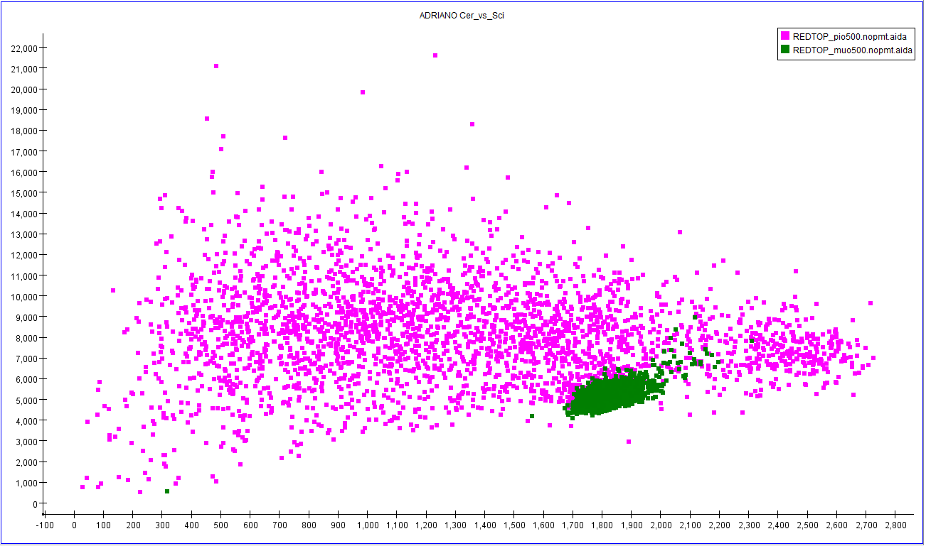
Muon/pion Detection
n_{D}(aerogel)=1.22/1.12
Č threshold for muons: P=160 mev
Č threshold for pions: P=200 mev
95 MeV muon
120 MeV muon
Dual-readout: Č vs S for μ and π with P=500 MeV

Slide 30
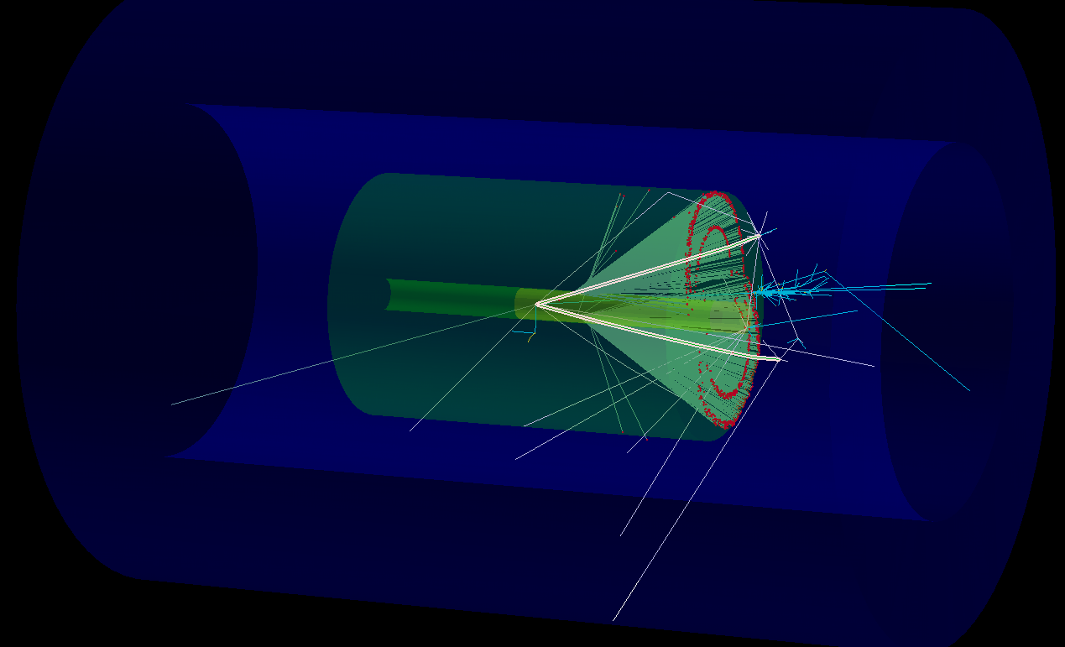
  η−> π⁺π⁻π^{ο}
Ilcroot simulation

Slide 31
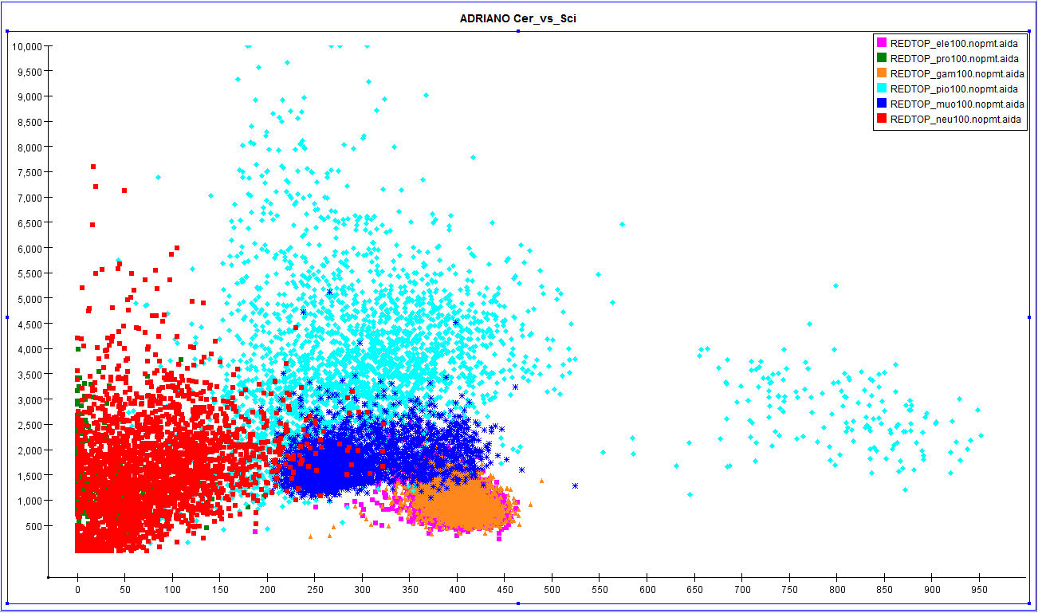
ADRIANO PID @ 100MeV
pions
p/n
muon
e/γ

Slide 32
Part III
Organization
Plans
Summary

Slide 33
REDTOP Running Phases
Phase I: η-factory
  Beam: protons
  T_{beam}: 1.8-2.1 GeV
  Detector: baseline
Phase II: η ’-factory
  Beam: protons
  T_{beam}: 3.0-4.0 GeV (to be optimized)
  Detector: baseline (change O-TPC gas pressure, probably the Aerogel section)
Phase III: Muon Scattering Experiment (optional)
  Beam: muons
  T_{beam}: 0.2< <0.8 GeV (to be optimized)
  Detector: baseline + front graphite target
Phase IV: Rare Kaon Decays: K⁺ → π ⁺ ν ν
  Beam: kaons
  T_{beam}: from 8 GeV protons
  Detector: might need upgrade target and central tracker, add range stack

Slide 34
Possible Intermediate Phases
Pre-REDTOP with OTPC only
p ⁷Li → ⁸Be* → e⁺ e⁻ X
  At 2.5 MeV IOTA proton source (Fermilab)
  Confirm 17 MeV bump found in Prague experiment
p D → ³He e⁺ e⁻ (M. Viviani ,L. E. Marcucci and A. Kievsky)
  At 40 MeV Fermilab p linac (Fermilab) or ATLAS facility (ANL)
p ⁹Be → ⁸Be* + X → e⁺ e⁻ X
  At MCenter 2 GeV p beam (Fermilab)
μ ⁺ Nucleus scattering in fixed target mode
  1.5-3 GeV muon campus – Fermilab
μ⁺ Nucleus in beam dump mode
e⁻ Nucleus in fixed target mode
  250-500 MeV, 50 mA IOTA facility – Fermilab
e⁻ Nucleus in beam dump mode
OTPC test with 2 GeV protons dumped by g-2 - Fermilab

Slide 35
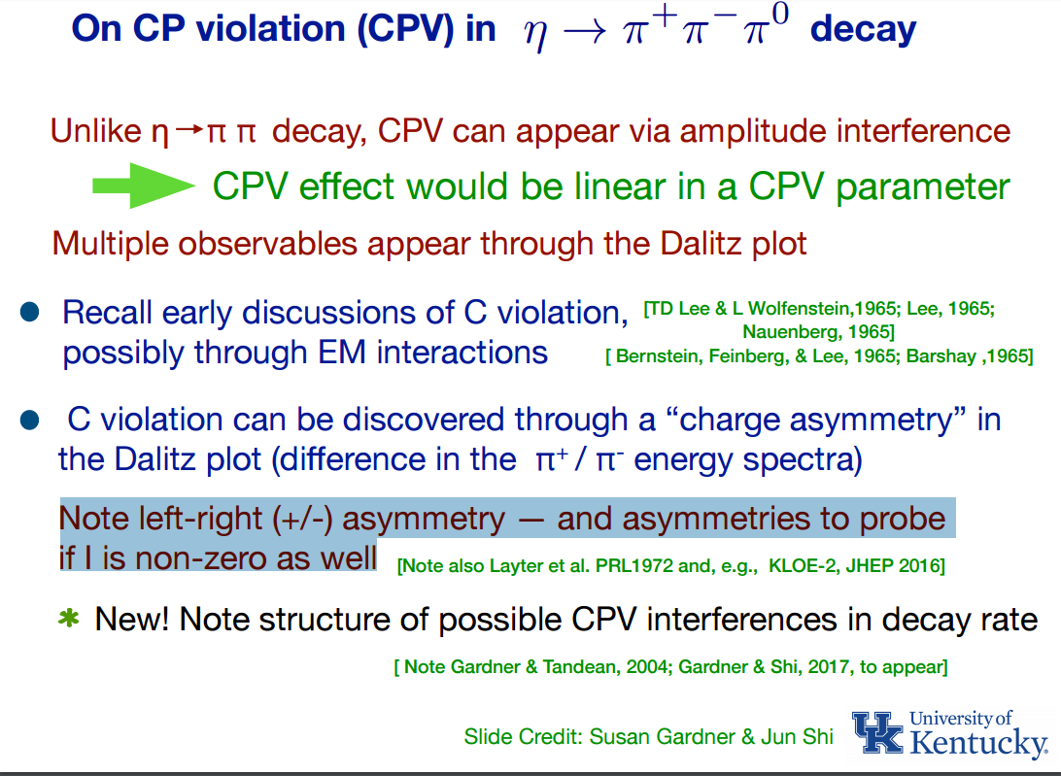

Slide 36

Old method

Slide 37
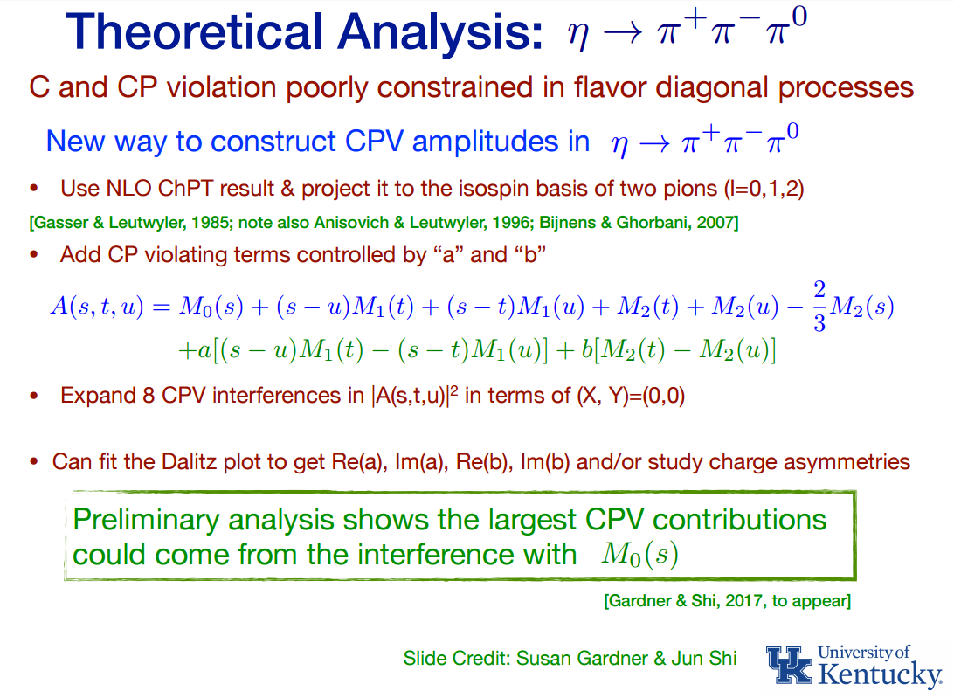

Slide 38

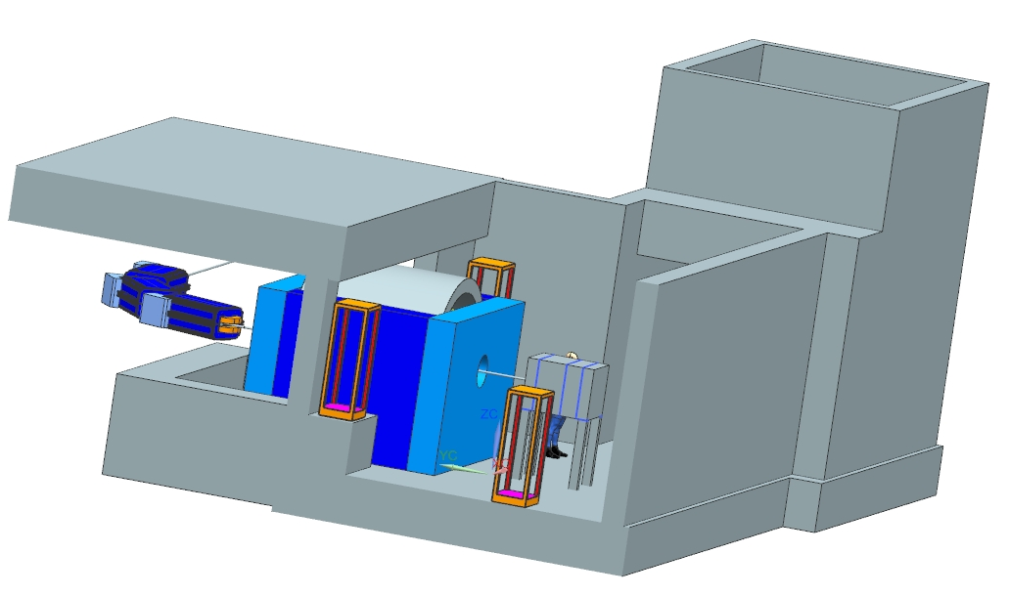
REDTOP detector in AP50
J. Kilmer
J. Rauch
E. Barzi (Solenoid and yoke)
(Many thanks to K. Krempetz, as well)

Slide 39
15 Prototypes Performance Summary
Prototype | Year | Glass | gr/cm³ | Cerenkov L. Y./GeV | Notes
5 slices, machine grooved, unpolished, white | 2011 | Schott SF57HHT | 5.6 | 82 | SiPM readout
5 slices, machine grooved, unpolished, white, v2 | 2011 | Schott SF57HHT | 5.6 | 84 | SiPM readout
5 slices, precision molded, unpolished, coated | 2011 | Schott SF57HHT | 5.6 | 55 | 15 cm long
2 slices, ungrooved, unpolished, white wrap | 2011 | Ohara BBH1 | 6.6 | 65
5 slices, scifi silver coated, grooved, clear, unpolished | 2011 | Schott SF57HHT | 5.6 | 64 | 15 cm long
5 slices, scifi white coated, grooved, clear, unpolished | 2011 | Schott SF57HHT | 5.6 | 120
2 slices, plain, white wrap | 2011 | Ohara | 7.5 | - | DAQ problem
10 slices, white, ungrooved, polished | 2012 | Ohara PBH56 | 5.4 | 30 | DAQ problems
10 slices, white, ungrooved, polished | 2012 | Schott SF57HHT | 5.6 | 76
5 slices, wifi Al sputter, grooved, clear, polished | 2012 | Schott SF57HHT | 5.6 | 30 | 2 wls/groove
5 slices, white wrap, ungrooved, polished | 2012 | Schott SF57HHT | 5.6 | 158 | Small wls groove
ORKA barrel | 2013 | Schott SF57 | 5.6 | 2500/side | molded
ORKA endcaps | 2013 | Schott SF57 | 5.6 | 4000 | molded
10 slices – 6.2 mm thick, scifi version | 2014 | Schott SF57 | 5.6 | 338 | molded
10 slices – 6.2 mm thick, sci-plate version | 2014 | Schott SF57 | 5.6 | 354 | molded
ADRIANO 2015 (for lepton colliders) is currently in the beam at FTBF

Slide 40
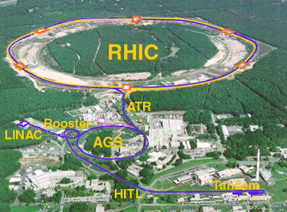
BNL hadron complex
REDTOP
Notes:
Add more red boxes

Slide 41
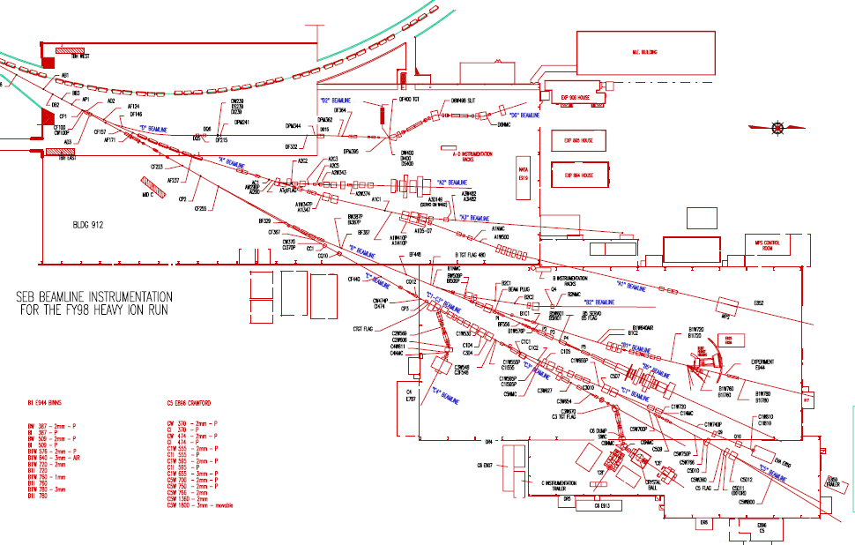
Building 912 AGS Experimental Area (1998)
In use for SRF and ATF-II
REDTOP

