Slide 1
Imager Testing Projector Using a Micromirror Array
By: Brody Oleson

Slide 2
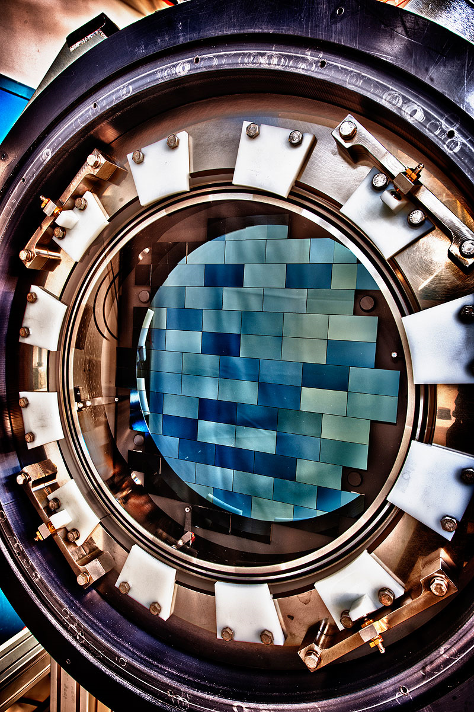
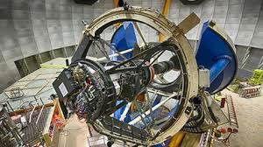
Introduction
Fermilab is involved in building large instruments for Cosmology.
The dark energy camera mapping the structure of the universe from a four meter telescope in Chili.

Slide 3
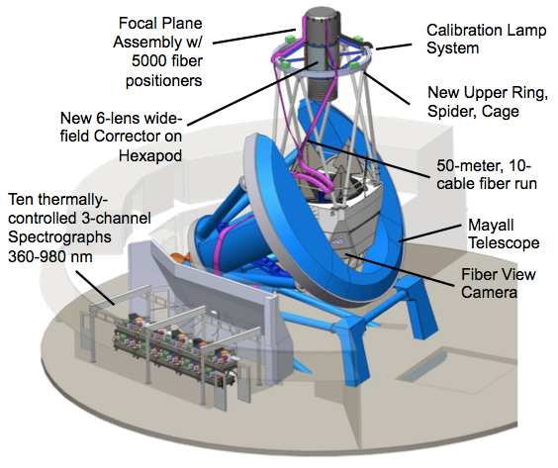
This is the dark energy spectroscopic instrument (DESI) that will start operations next year in Kitt Peak, near Tucson.

Slide 4
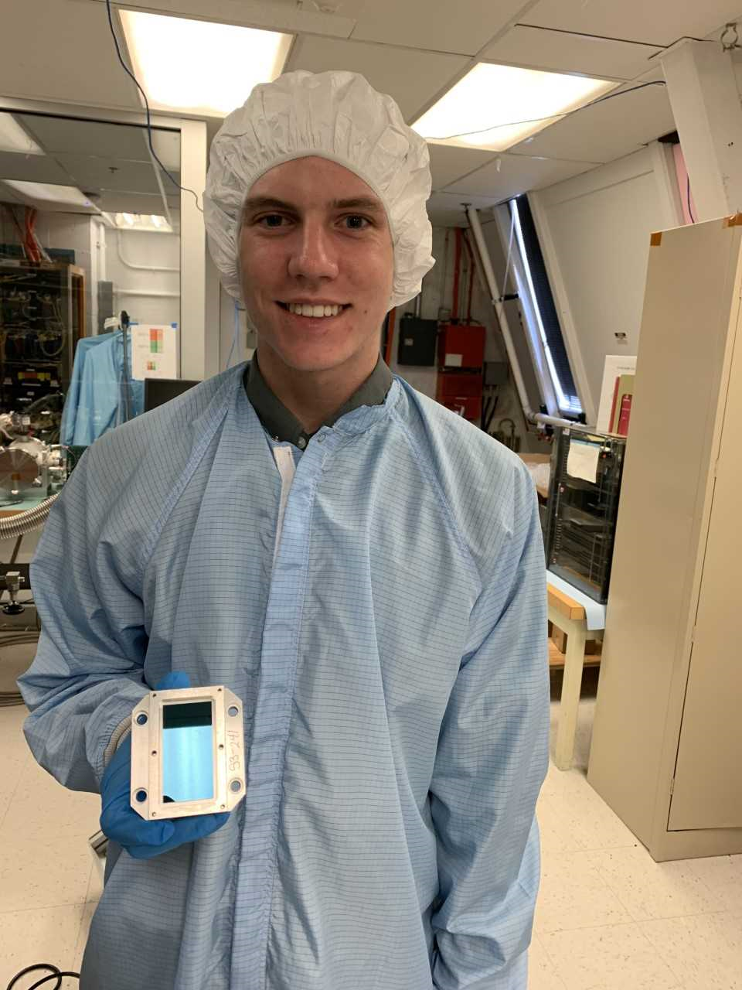
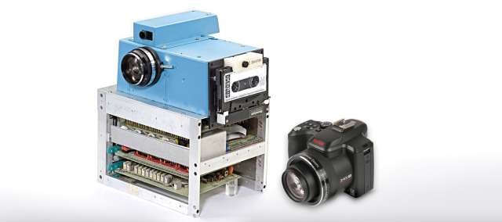
At the core of all of these instruments, we have scientific CCDs that are fabricated and characterized at Fermilab.

Slide 5
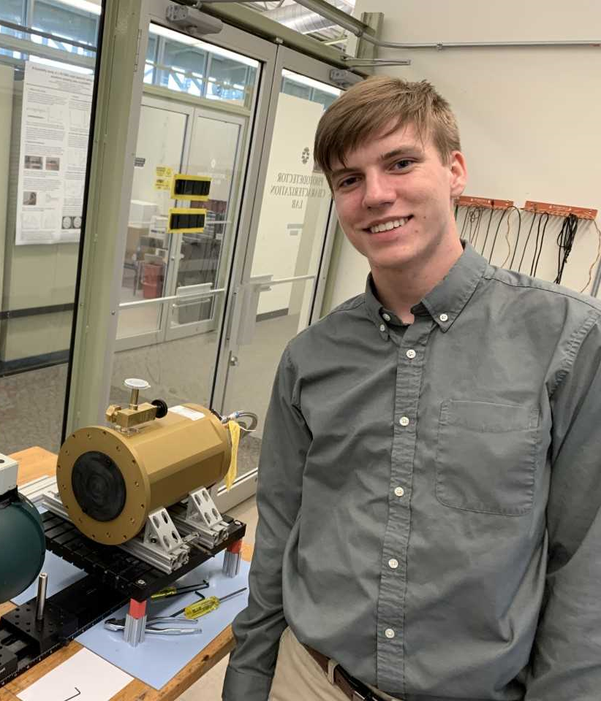
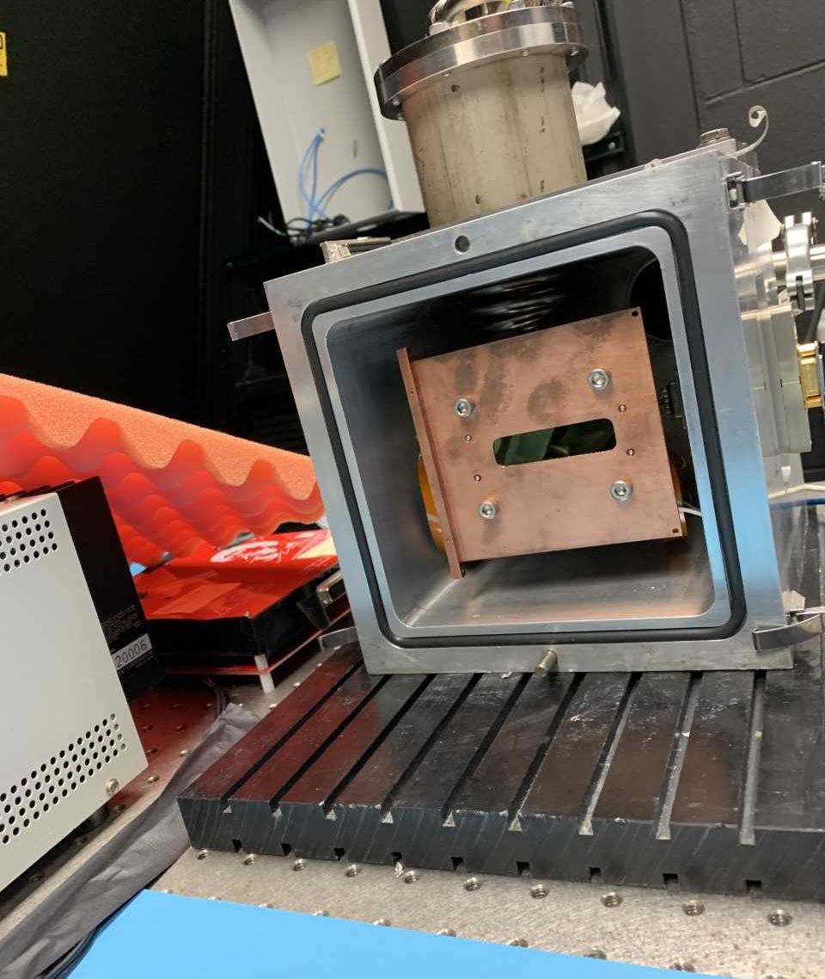
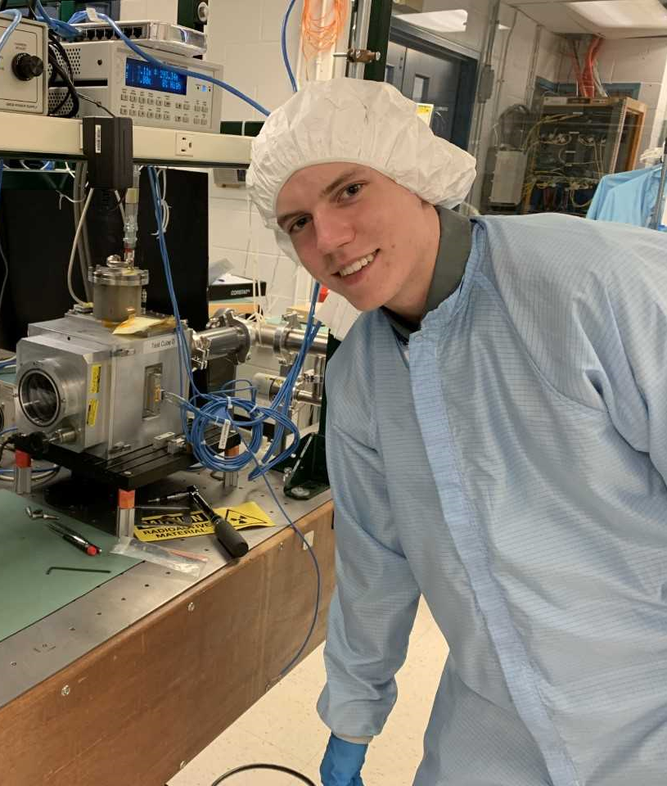
CCDs are installed in vacuum chambers and cooled to -100°C for their characterization (cooling is needed to reduce noise). We then use illumination systems to check the performance of the sensors, and their response to light.

Slide 6
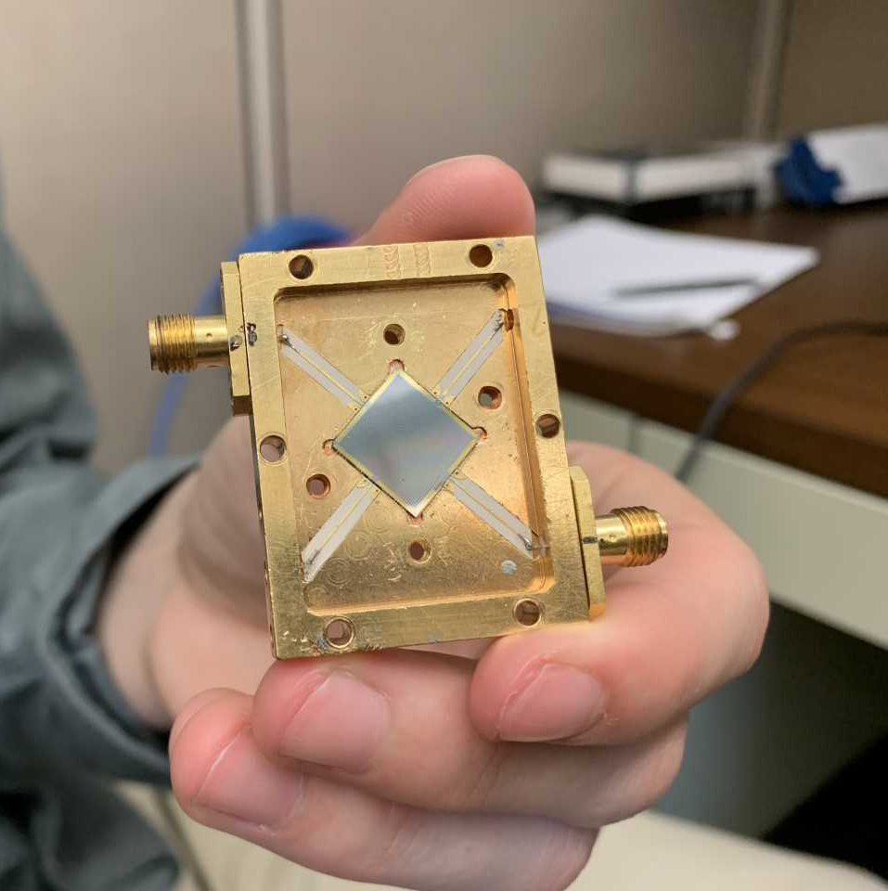
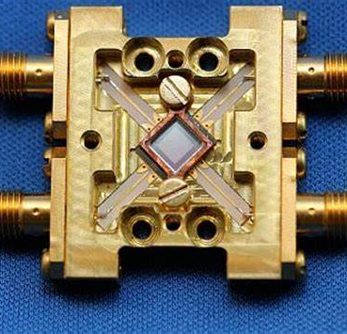
Along with CCDs, Fermilab also uses detectors called MKIDs that can detect the energy of the light being illuminated on it.

Slide 7
My work at Fermilab
As part of the testing and characterization of the CCDs, we have to illuminate them and check their response to light. I am building a new way of performing this illumination testing, with more control and more flexibility than ever before.

Slide 8
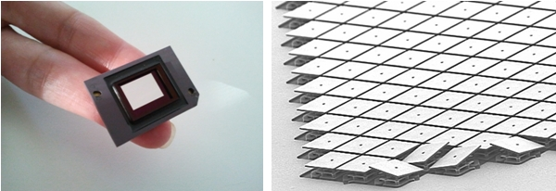
Enabling technology: Micromirror array

Slide 9
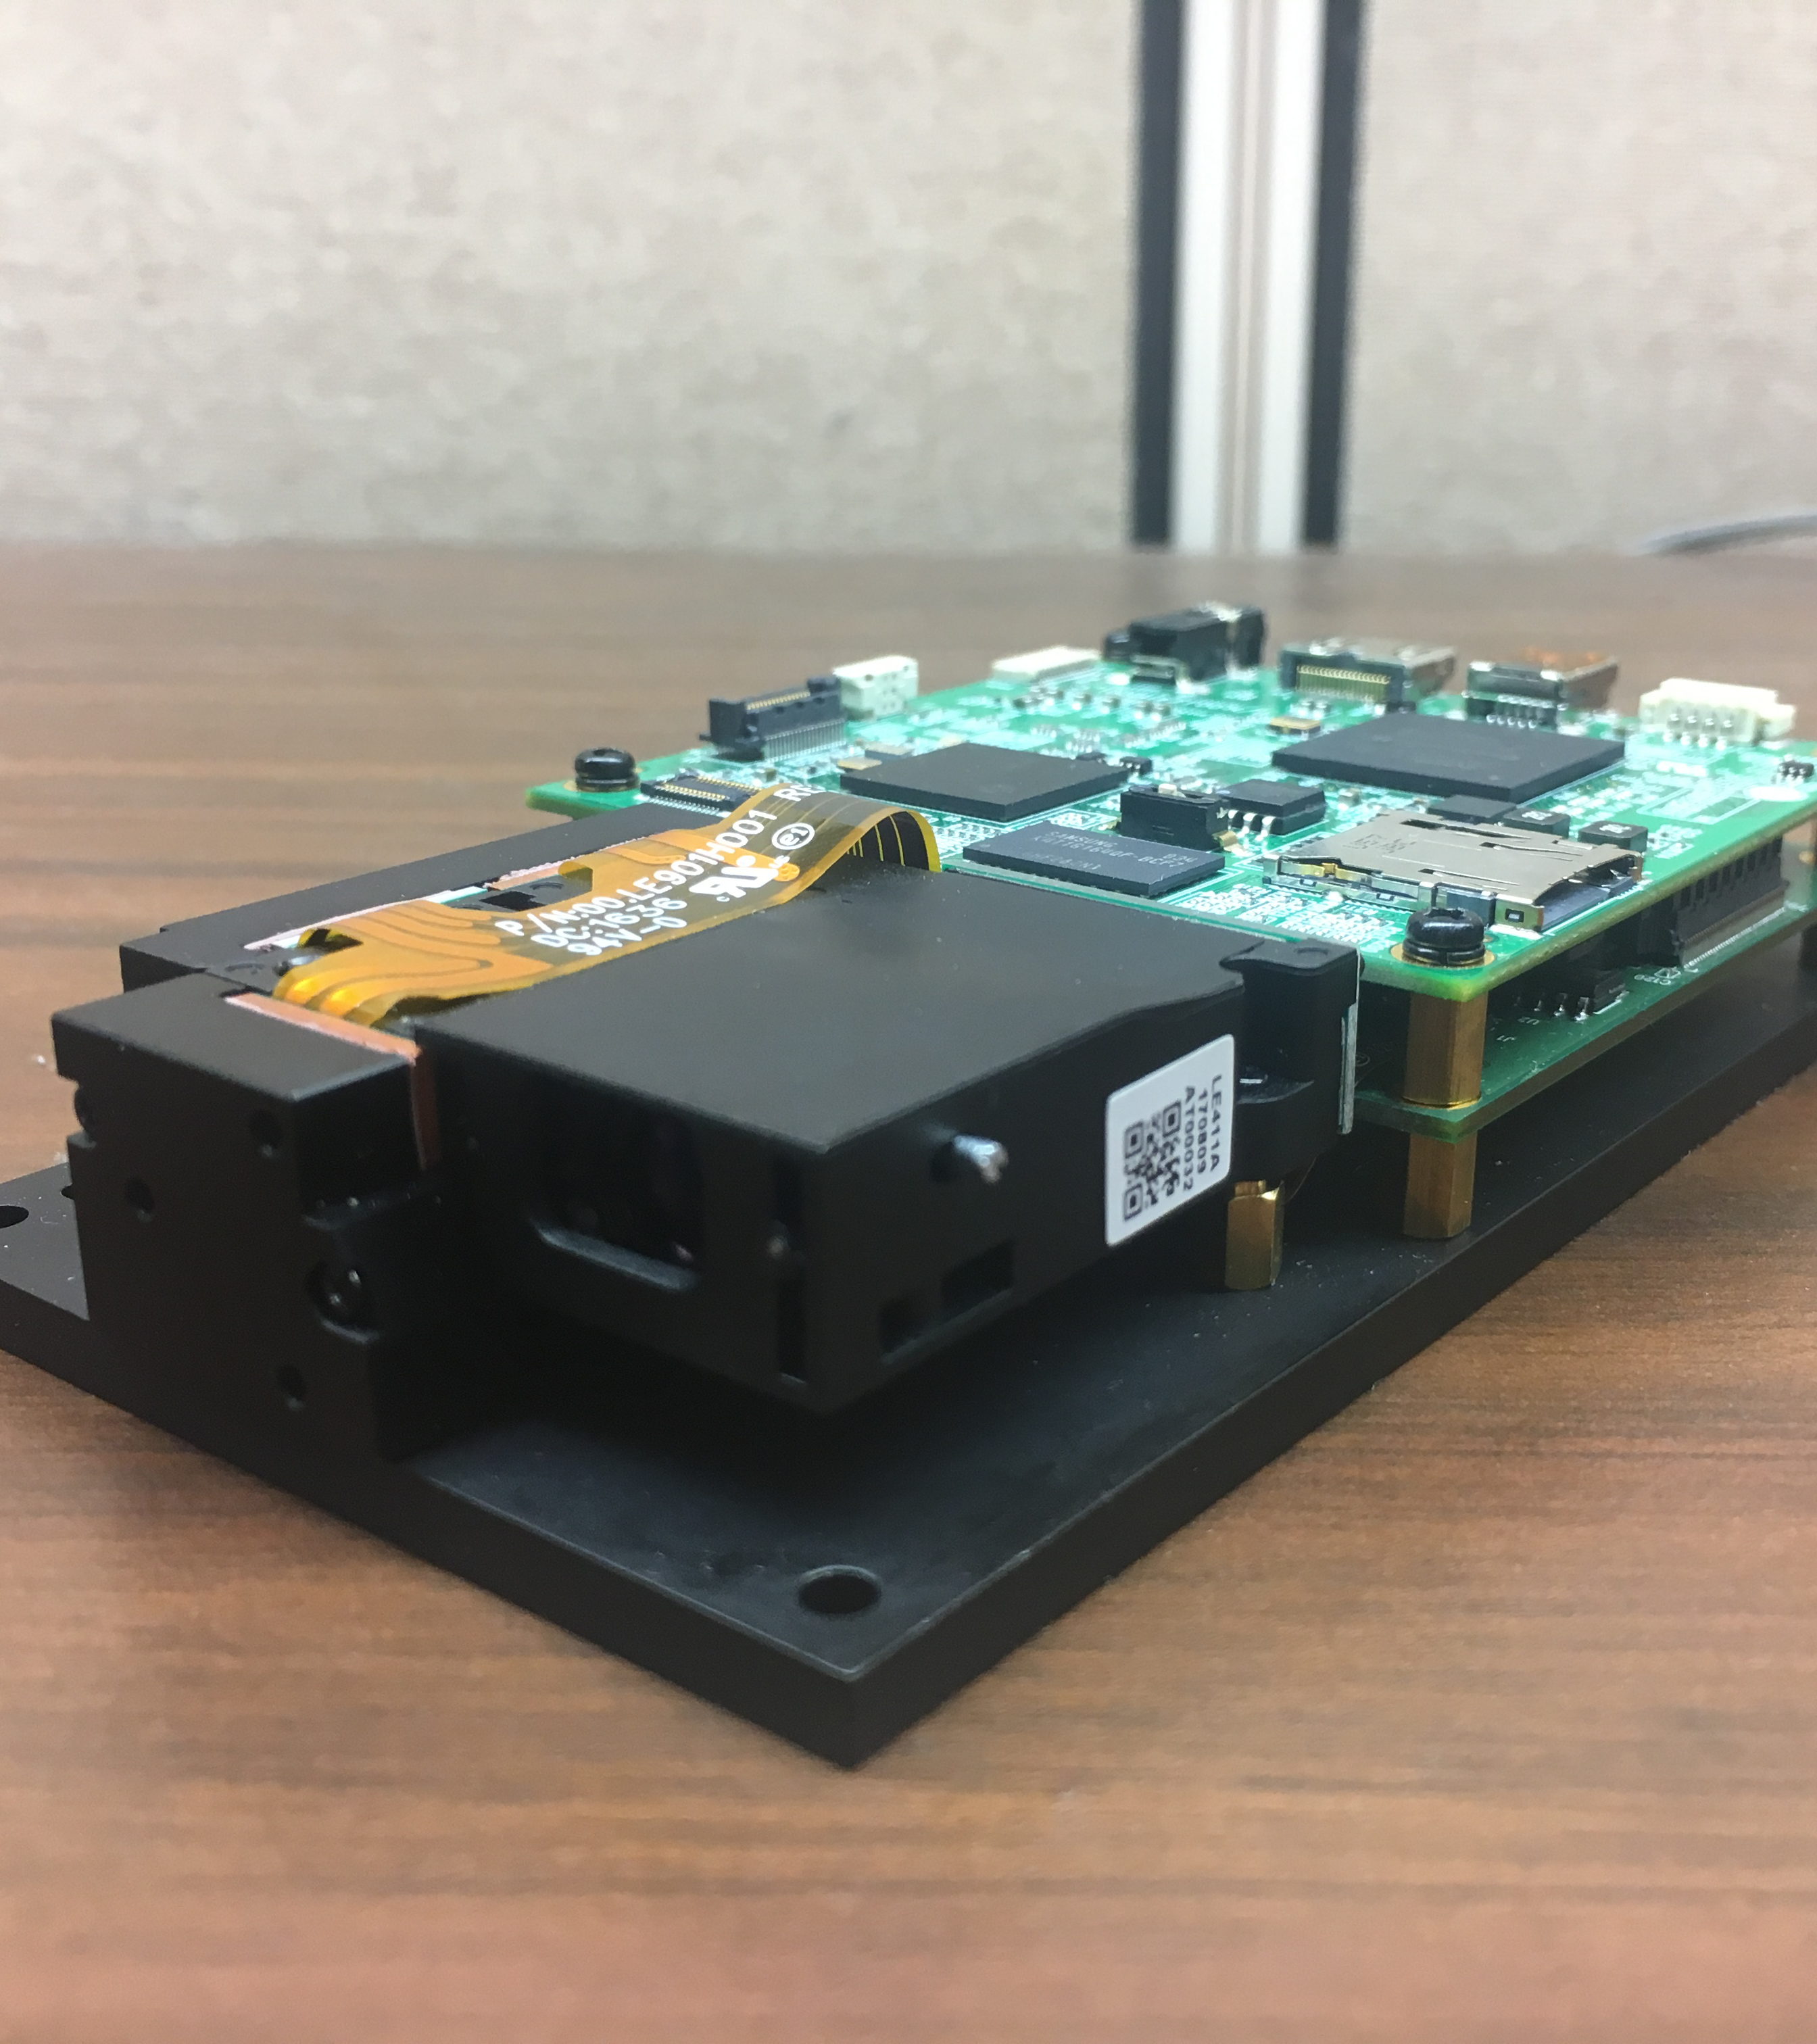
The Projector
DLP3000 digital micromirror device
  Features: 0.3 inch micromirror display, 16.6 millimeters x 7.0 millimeters x 4.6 millimeters frame, 20+ Lumen light output, 128MB NAND flash memory, and the DLP 0.3 WVGA chipset.
  The 0.3 inch micromirror display consists of 415,872 mirrors. Each mirror is 7.637 nanometers x 7.637 nanometers.
  Made and produced by Texas Instruments.

Slide 10
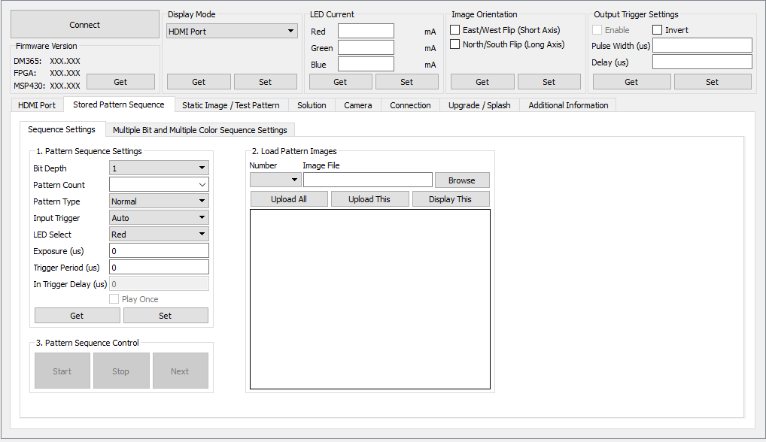
Design Process: Step One
I faced one significant challenge at the star of this project: figuring out how to work the DLP LightCrafter projector. Initially, I tried to use the GUI, DLP LightCrafter Control Software 5.0.0, created by Texas Instruments. The functionality of the GUI allows the projector to do basic operations. However, these operations were too simple for the task at hand.

Slide 11
Design Process: Step Two
It was apparent that the GUI and the projector alone could not complete the task. This is when the design of the dark box itself came in to action.
Dark Box Requirements:
Focusing: linear stage to move small increments (100um)
Low level light control: fast shutter
Low background: no outside light / dark box
Operational:
Not allow the projector to overheat
Securely hold projector
Complete control through one computer

Slide 12
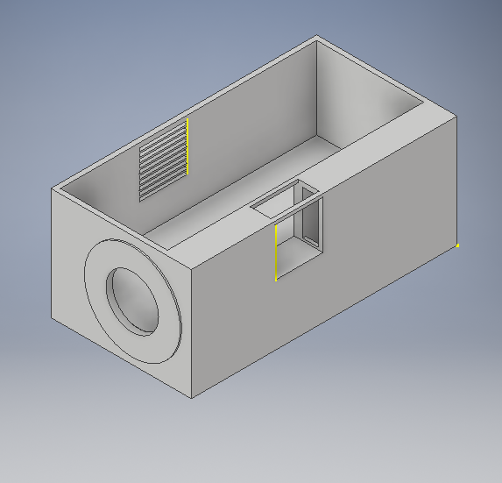
Securely Holding the Projector
3D Printed Box Design

Slide 13
Creating the Dark Box
Constraints:
  Easily insert and remove projector
  Ventilation for fan
  Holes for cords and projector light
  Concealed enough to not have any excess light showing
  The box was created using Autodesk’s Inventor Professional 2019. Along with the box, a lid was also needed to shield the light. This software allowed for the production of the dark box and the accessibility of printing it from stp and stl files.

Slide 14
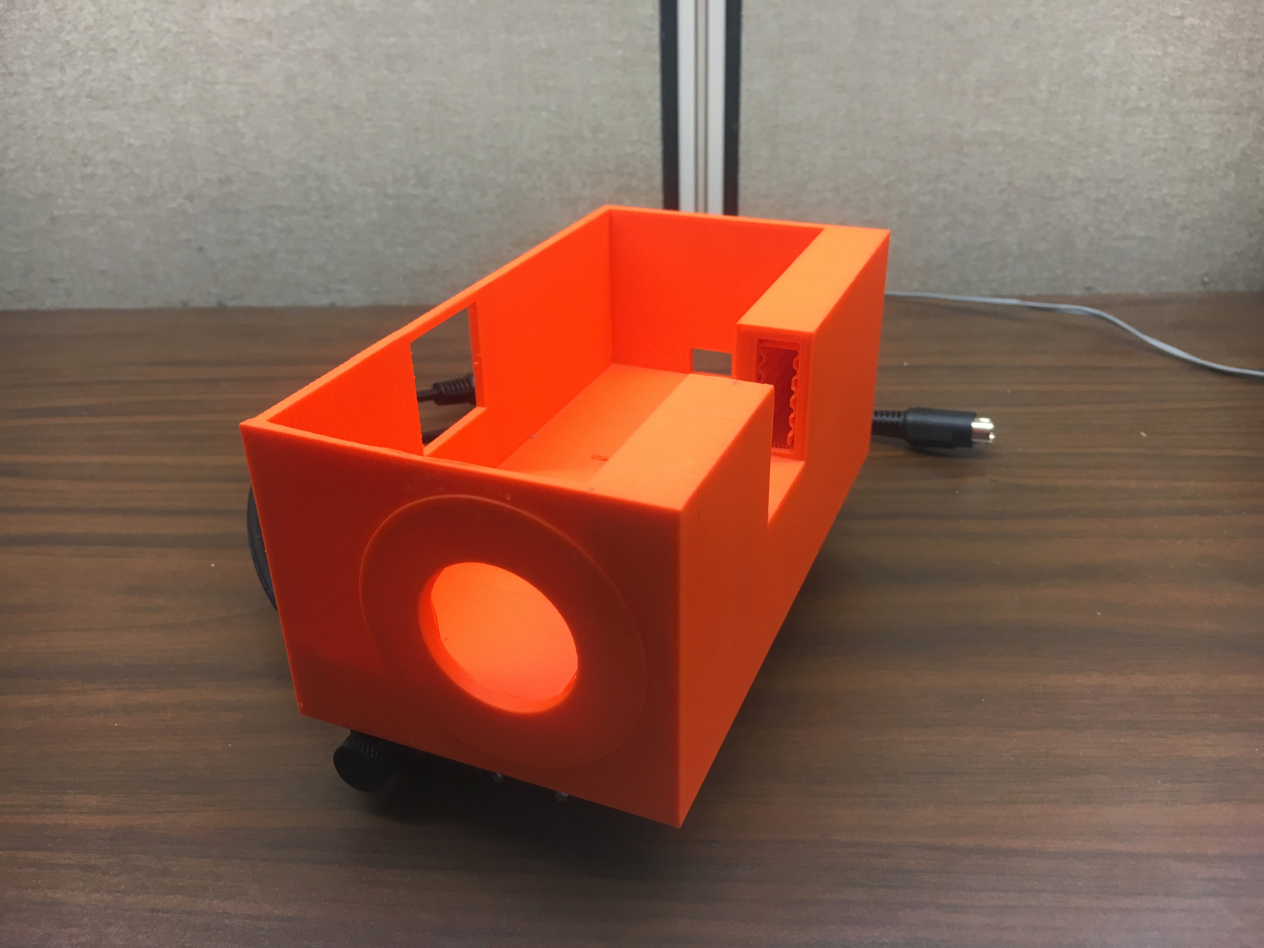
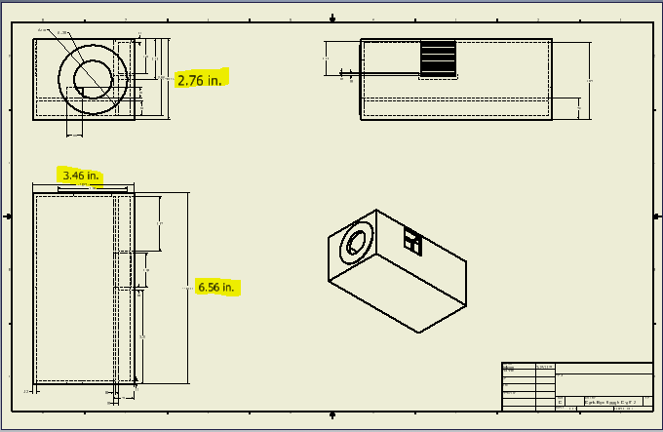
Dark Box Final Product

Slide 15
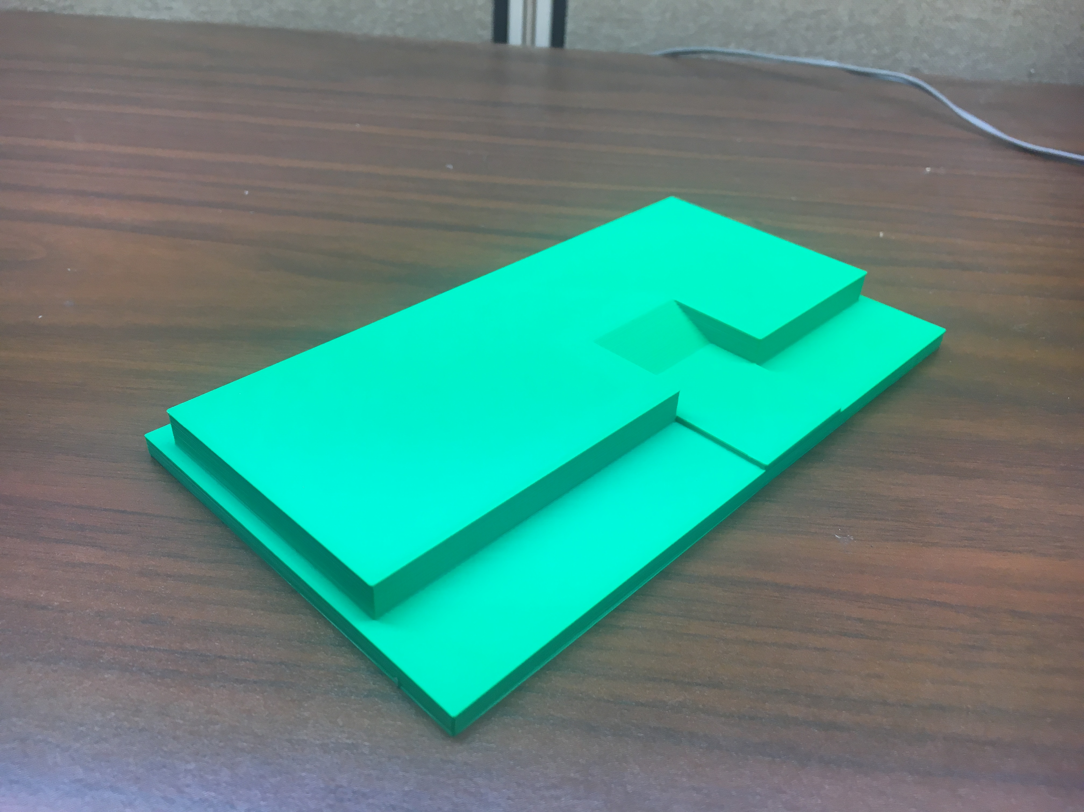
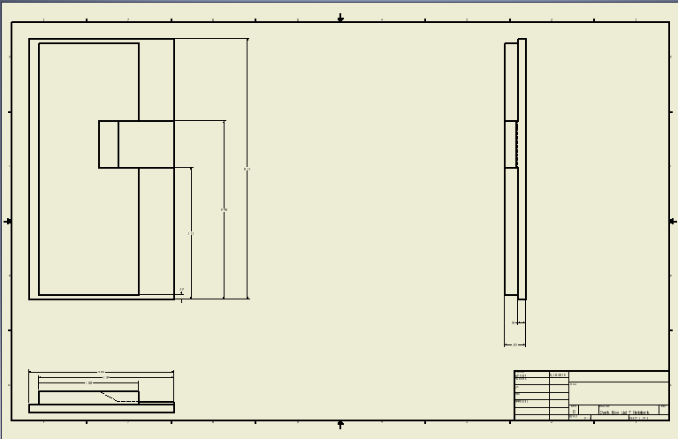
Dark Box Lid Final Product

Slide 16
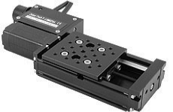
Focusing the Projector
Zaber™ 50mm Travel Motorized Stage System with Manual Control

Slide 17
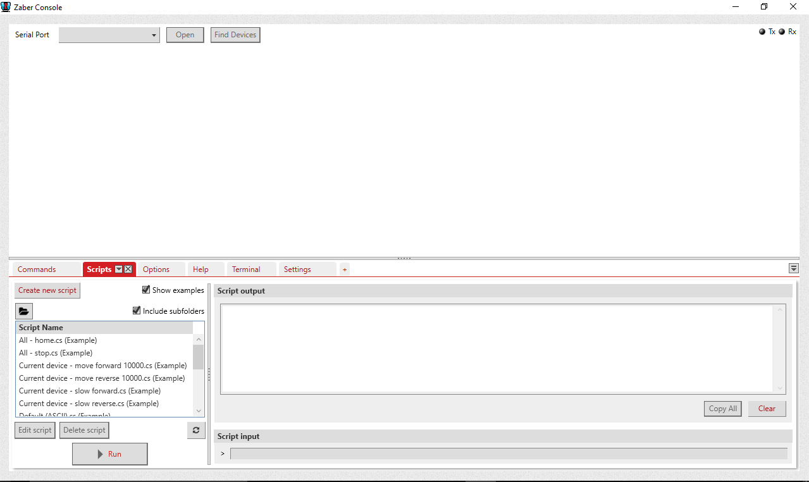
Linear Stage
Zaber™ 50mm Travel Motorized Stage System:
  45 millimeters x 172.9 millimeters stage size (0.32 kg)
  Manual control / control through computer GUI
  Repeatability <3 nanometers
  2 phase stepper motor with a crossed roller bearing guide system
  To control this device, I used the ZaberConsole v2.4.2.3614. The console allows for complete control over the distance the stage travels and the speed.

Slide 18
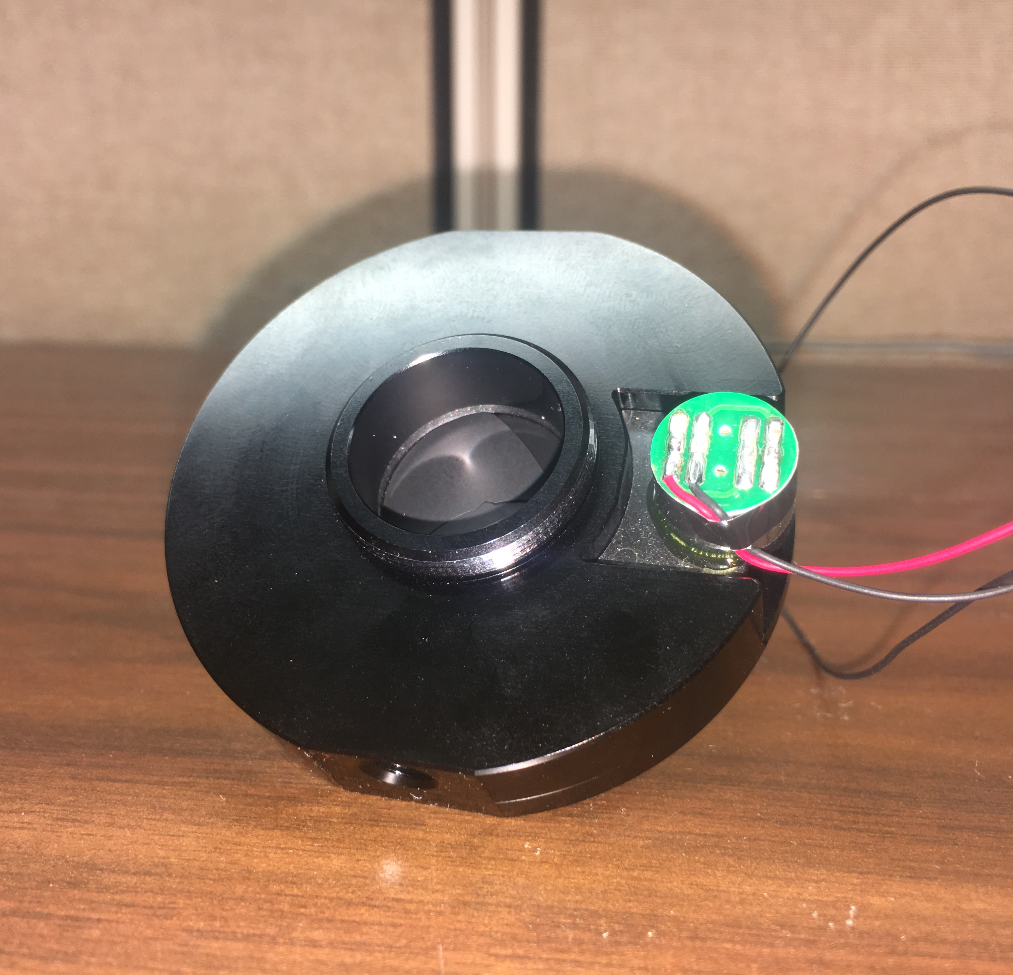
Low Level Light Control
C-Mount Electrical Shutter

Slide 19
Automated Shutter
Edmund Optics C-Mount Electrical Shutter:
  4.5V-5.5V requirements
  20 millimeter aperture size
  80 grams in weight
  Unlike the stage or the projector, the shutter does not require a GUI to operate. A simple code from using a Raspberry Pi will function properly.

Slide 20
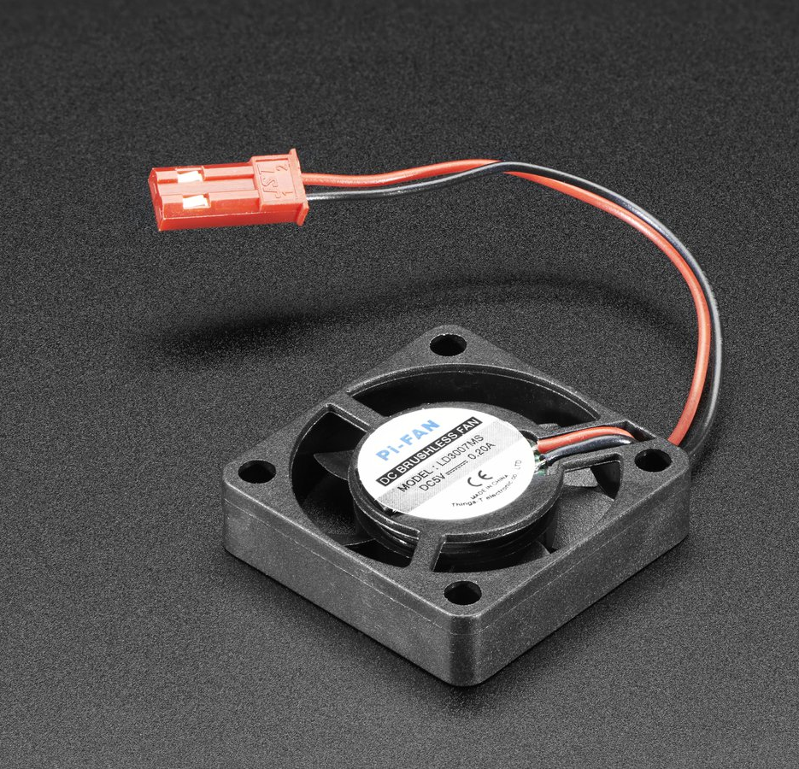
Preventing the Projector From Overheating
Miniature 5V Cooling Fan

Slide 21
Miniature 5V Cooling Fan
Based off of the previous trials with the GUI and the projector only, it was apparent that the projector was getting too hot. The projector began to overheat and with the enclosure of the dark box the heat would only get worse.
Adafruit 5V cooling fan:
  Operating voltage: 5V
  30 millimeters x 30 millimeters x 8 millimeters
  6.2 grams in weight
  Along with the shutter, the fan can be operated right from the Raspberry Pi.

Slide 22
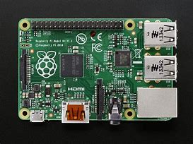
Functional From One Source/Computer
Raspberry Pi

Slide 23
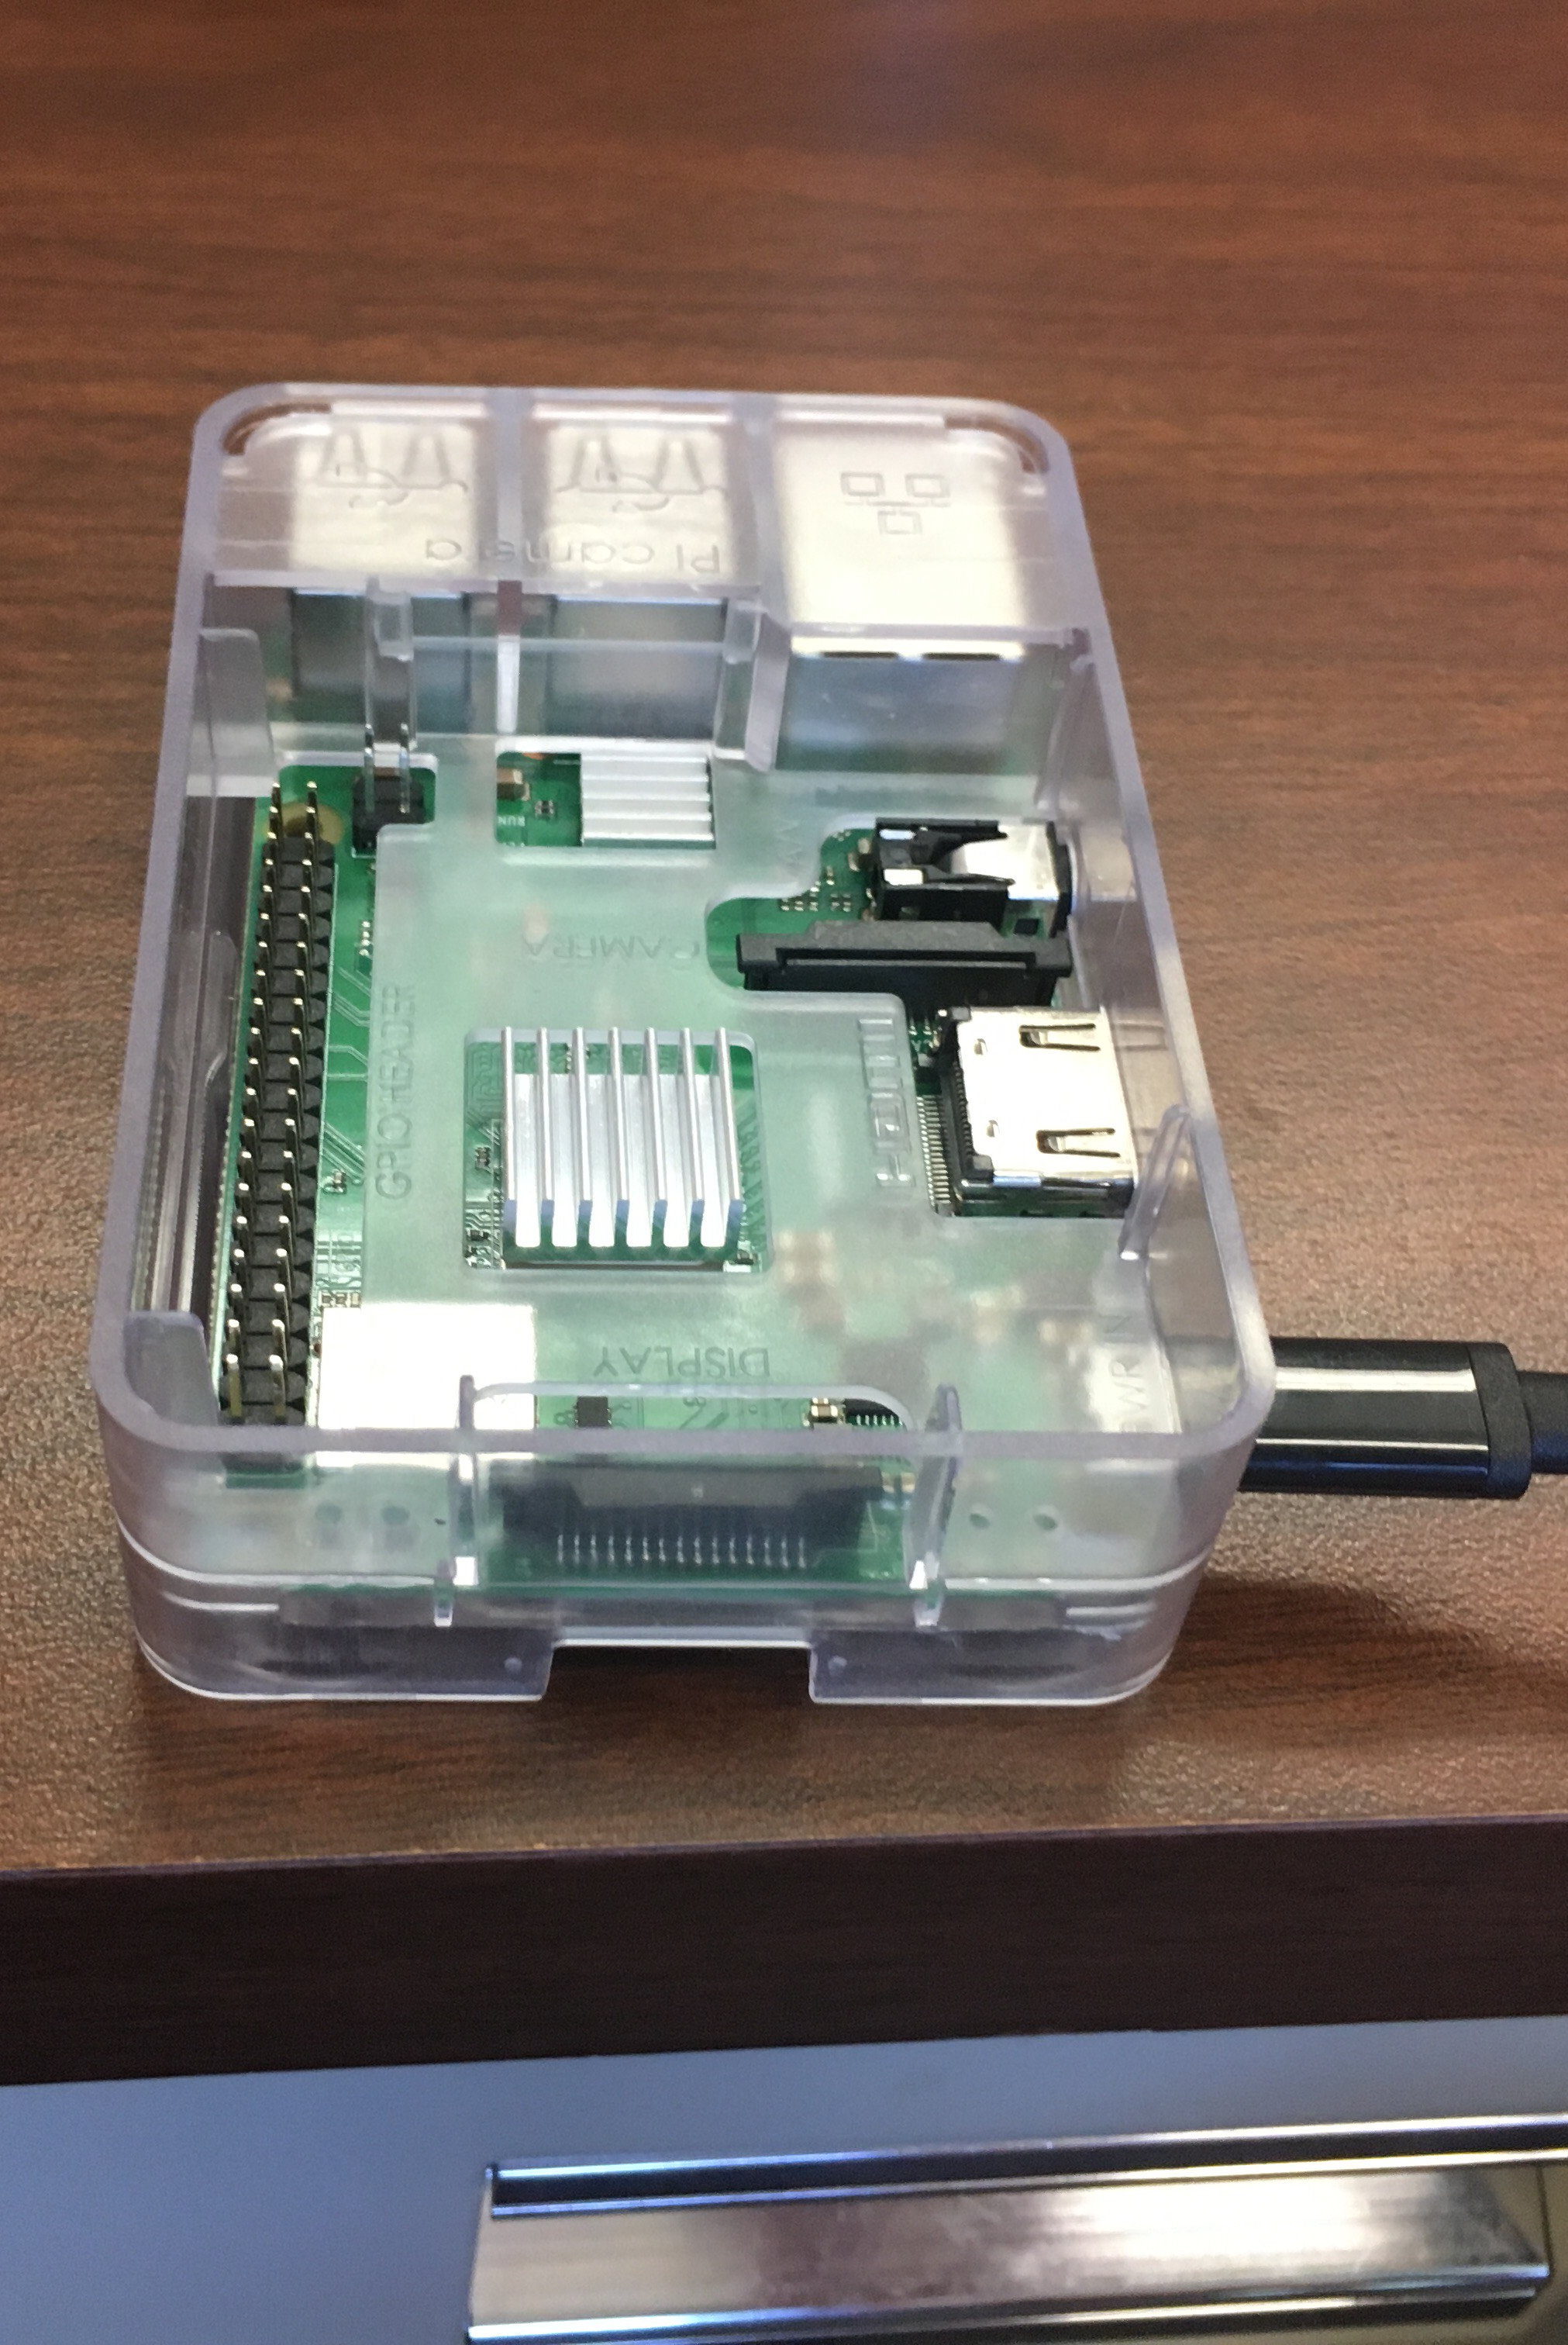
Raspberry PI
Raspberry Pi 3 Model B+ :
  1 GB of RAM
  On board wireless LAN and Bluetooth, 300Mbit/s ethernet
  4 USB ports, HMDI 1.3a port, microSD slot, 40 GPIO pins
  1.4 GHz 64-bit quad-core ARM Cortex-A53 CPU
  The Raspberry Pi is a key component is the project when analyzing the functionality of the box. The Raspberry Pi controls the shutter and the fan, allowing for efficient use to the parts that don’t require an interface via computer.

Slide 24
Questions?
.

