Slide 1
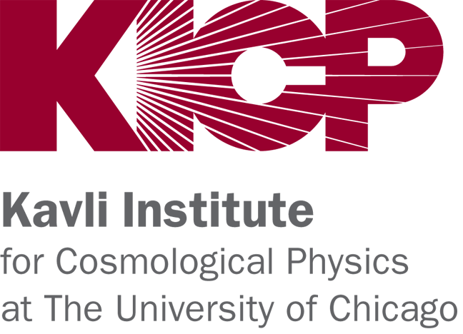
Strong Lensing Science from Current and Future Imaging Surveys
Jason Poh, Brian Nord, Clecio de Bom
Deep Skies Collaboration
June 10 2019
New Perspectives 2019

Slide 2
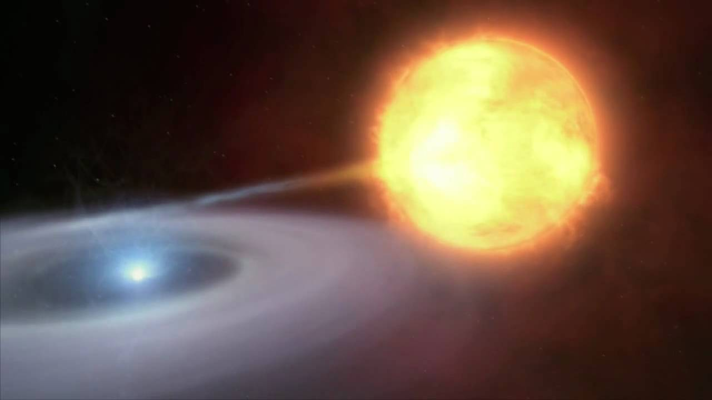
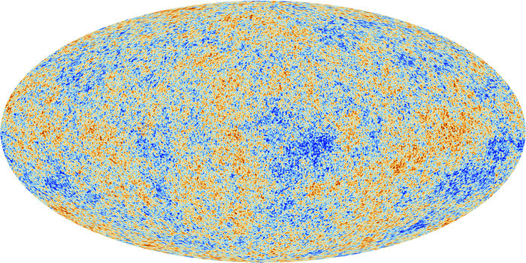
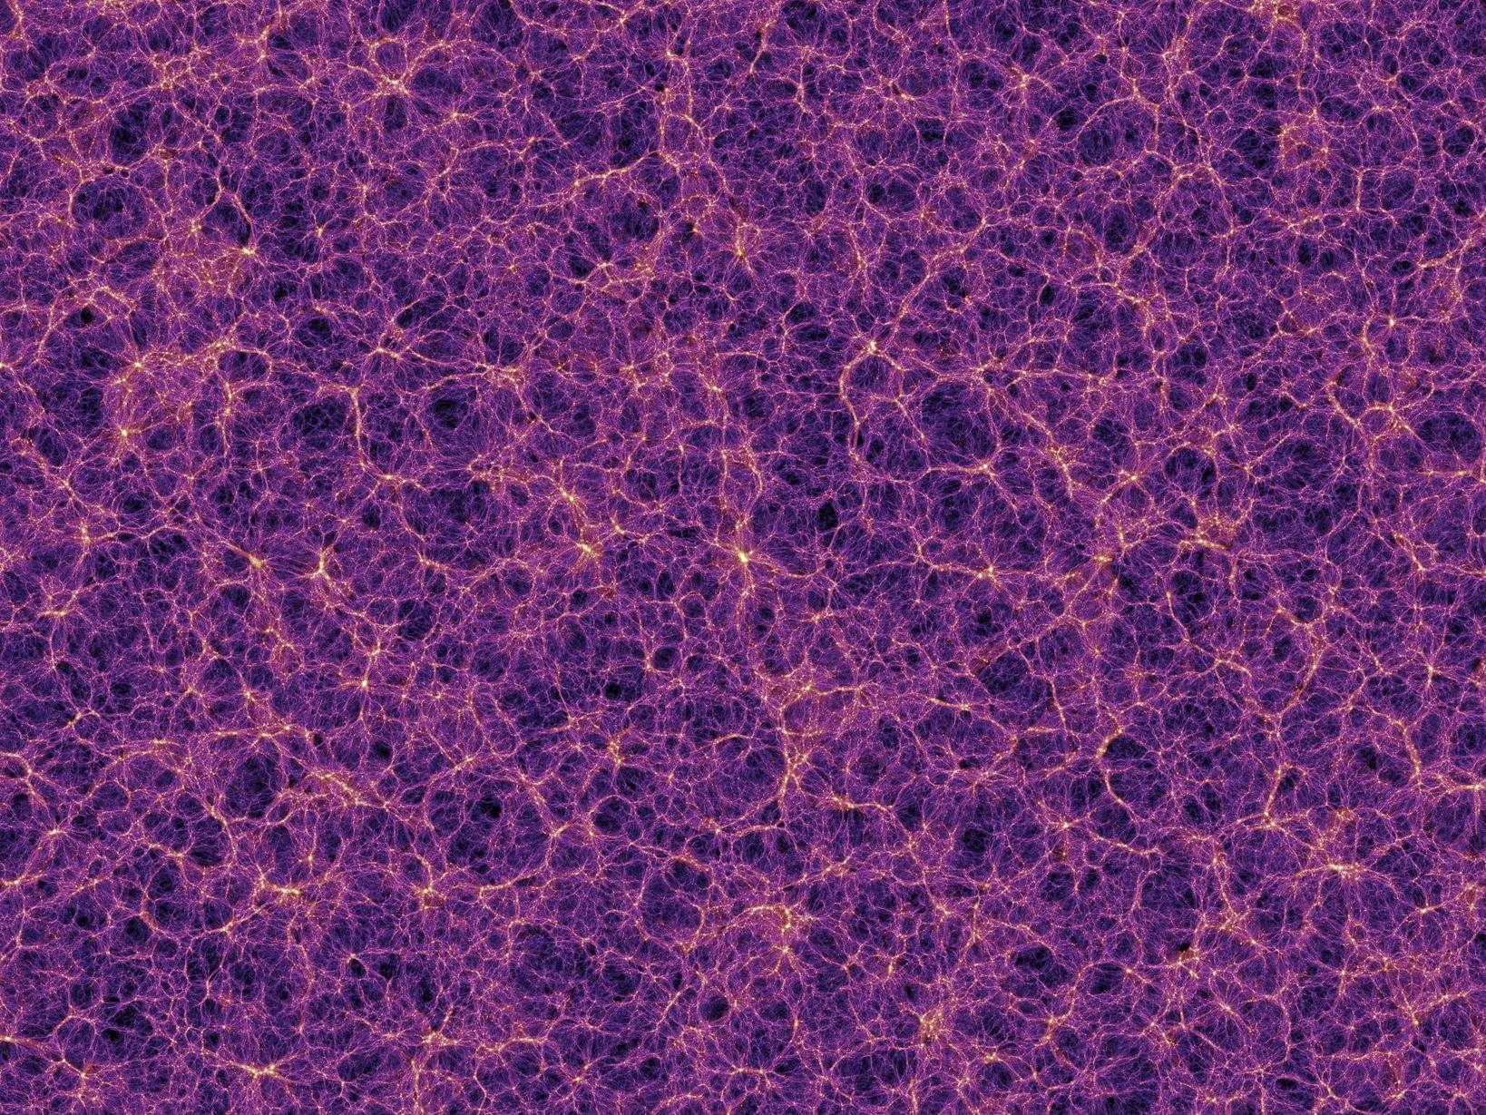
Cosmological Probes of Dark Energy
Universe is accelerating - Dark Energy
Dark energy models make predictions on:
Expansion history
Growth of structure in the universe.
Observational probes can test these predictions
Type Ia Supernovae
Cosmic Microwave Background
Large Scale Structure
Notes:
In the late 1990s, we discovered that the universe was accelerating.
This acceleration indicated the presence of a fundamentally new component in the universe, which we call dark energy.
So far, we don’t know what dark energy is, but models of dark energy make predictions on the expansion history and growth of structure in the universe.
These predictions can be constrained by observational probes.

Slide 3
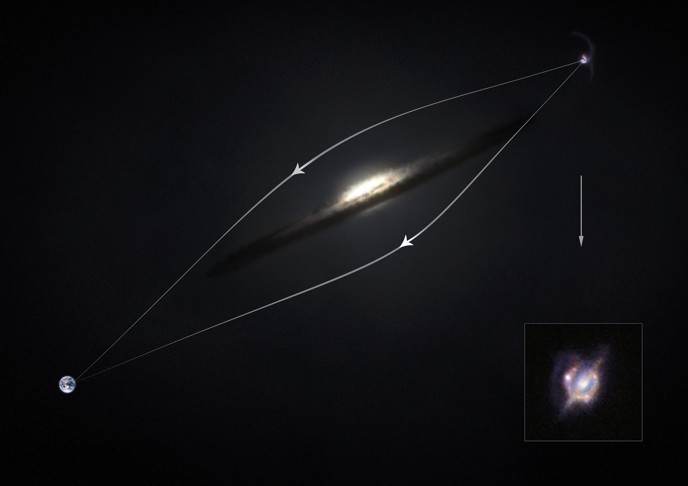
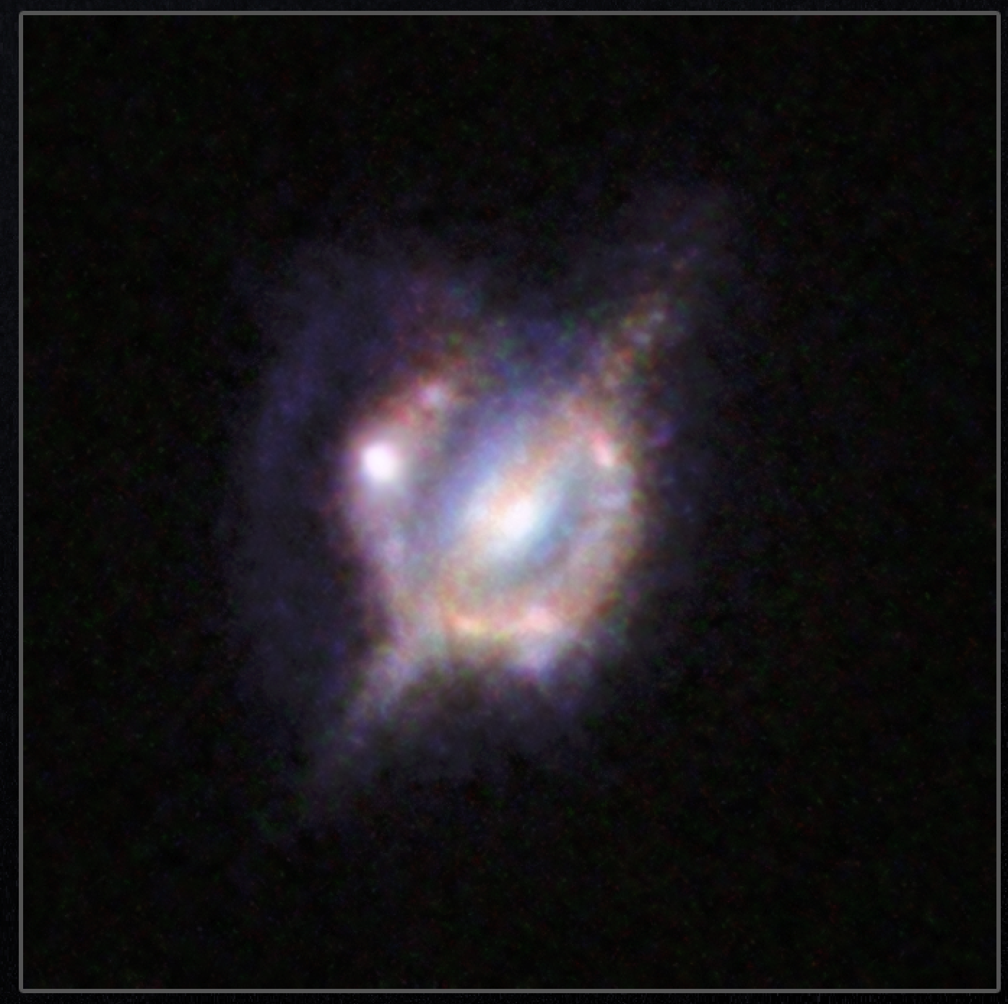
(Image: NASA)
Notes:
I’m going to be talking a novel probe of cosmology from strong graviational lensing.
Strong lensing is a phenomenon where light from a distant source is gravitationally lensed by the

Slide 4
(Image: NASA)

Slide 5
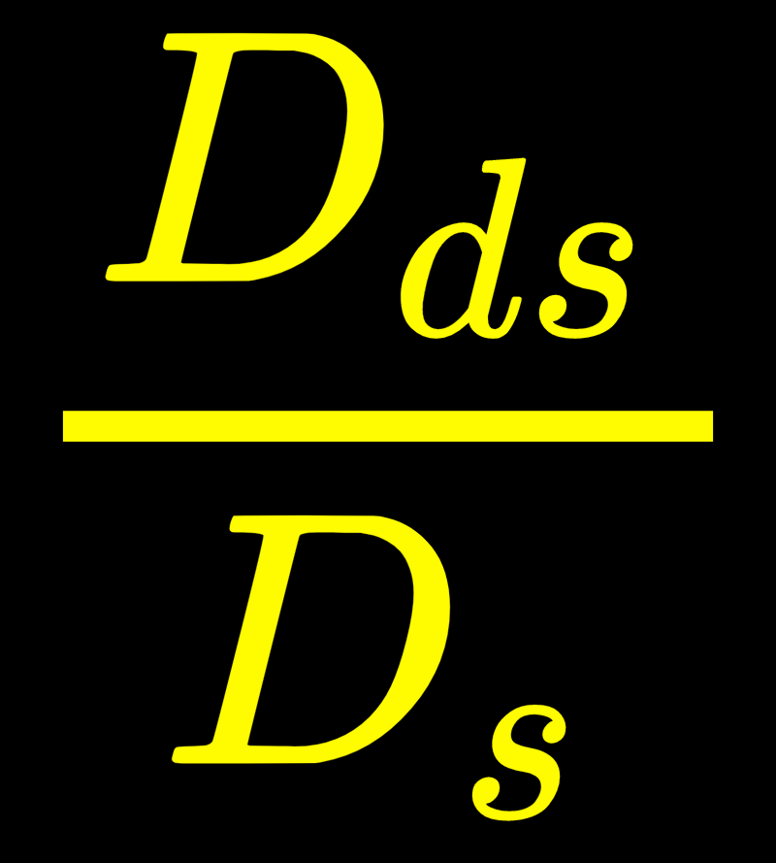
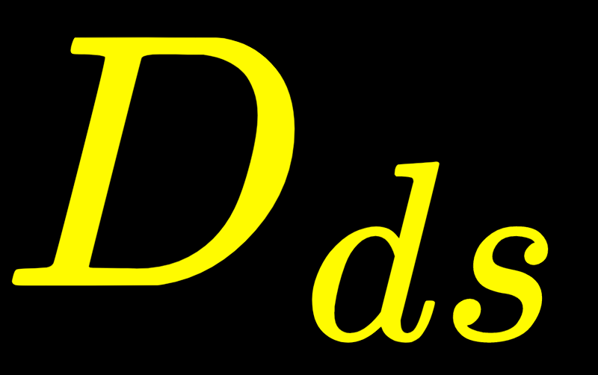
(Image: NASA)

Slide 6
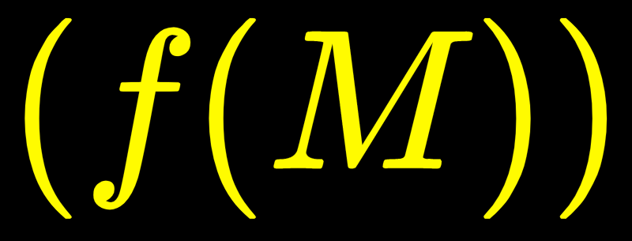
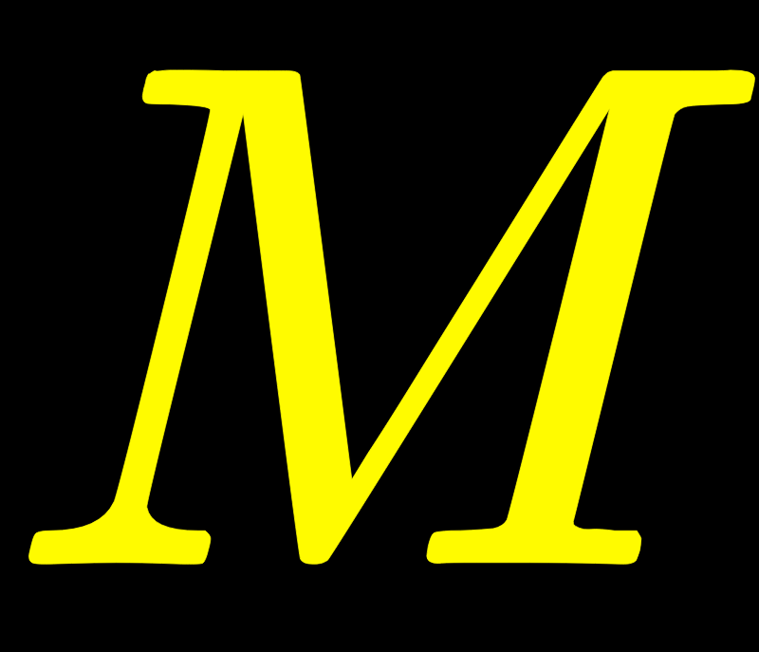
(Image: NASA)

Slide 7
(Image: NASA)

Slide 8
Future Predicted Lens Populations
Today | 1,000
DES | 2,400
LSST | 120,000
Euclid | 160,000
(Moustakas, 2012, Nord+ 2016, Collett 2015, Oguri & Marshall 2010)

Slide 9
Future Predicted Lens Populations
Today | 1,000
DES | 2,400
LSST | 120,000
Euclid | 160,000
500 lens candidates from DES Y1 data
(Diehl et al, 2017, Jacobs 2018)
(Moustakas, 2012, Nord+ 2016, Collett 2015, Oguri & Marshall 2010)

Slide 10
Future Predicted Lens Populations
Today | 1,000
DES | 2,400
LSST | 120,000
500 lens candidates from DES Y1 data
(Diehl et al, 2017, Jacobs 2018)
(Moustakas, 2012, Nord+ 2016, Collett 2015, Oguri & Marshall 2010)

Slide 11
Within the next decade or so, we are going to find on the order of 10⁵ strong lensing systems!
Question 1:
How do we measure all these lenses?

Slide 12
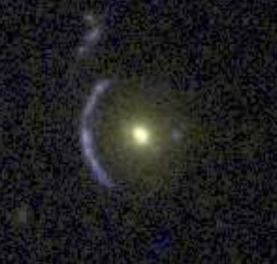
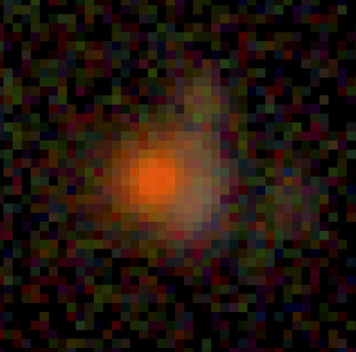
How can we obtain parameters for 10⁵ lenses?
Conventional modeling technique:
Use MCMC to simultaneously fit lens model parameters.
Require hours to model a single lensing system.
Bad for 100,000 lenses.
Automated parameter inference with deep learning:
Emerged in 2017
First proof of concept was done on Hubble-quality space images (Hezaveh et al, 2017).
HST
DES

Slide 13
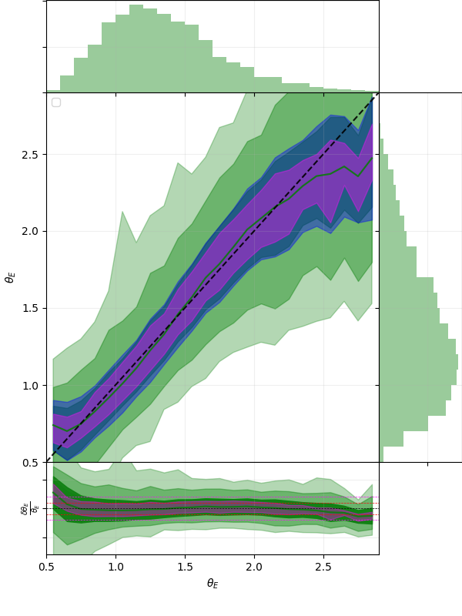
Automated Parameter Inference from Ground-based Imaging
We extend this analysis to ground-based survey-quality data (de Bom et al 2019, submitted to A&C).
Inferred Einstein radii are within 10% of the true values.
True Einstein Radius
Inferred Einstein Radius

Slide 14
Question 1:
How do we measure all these lenses?
Question 2:
How well can we constrain cosmology with these lenses?

Slide 15
Cosmological Forecast from Strong Lensing Distance Ratios
Use real and mock data, MCMC to infer posterior cosmology for flat wCDM cosmology.
Baseline Scenarios
Survey | Number of Lenses | Error in distance ratio per lens
Current | 158 | 25%
DES | 2400 | 30%
LSST | 120000 | 30%

Slide 16
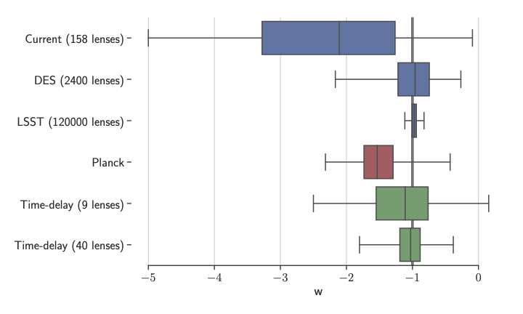
Cosmological Constraints on Dark Energy Equation of State

Slide 17
Conclusion
Lot of interesting science to be done with strong lenses in the era of survey astronomy.
Automated techniques to find and analyze strong lenses.
Potentially powerful cosmological probe.
Notes:
We expect to discover 10⁵ strong lenses in the near future from ground-based surveys
We demonstrate the feasibility of automated parameter inference from ground-based wide-field imaging data.
A lot of room for improvement in this space - e.g. more realistic simulations for training.
We forecast cosmological constraints from strong lensing distance ratios in the LSST era.
The large number of new lenses improves the constraining power of this probe.

