Slide 1
Accelerator Report
SAC Meeting
Sam Posen, Tiziana Spina, Patrick Hurh, Jonathan Jarvis, Sasha Valishev
April 8, 2019

Slide 2
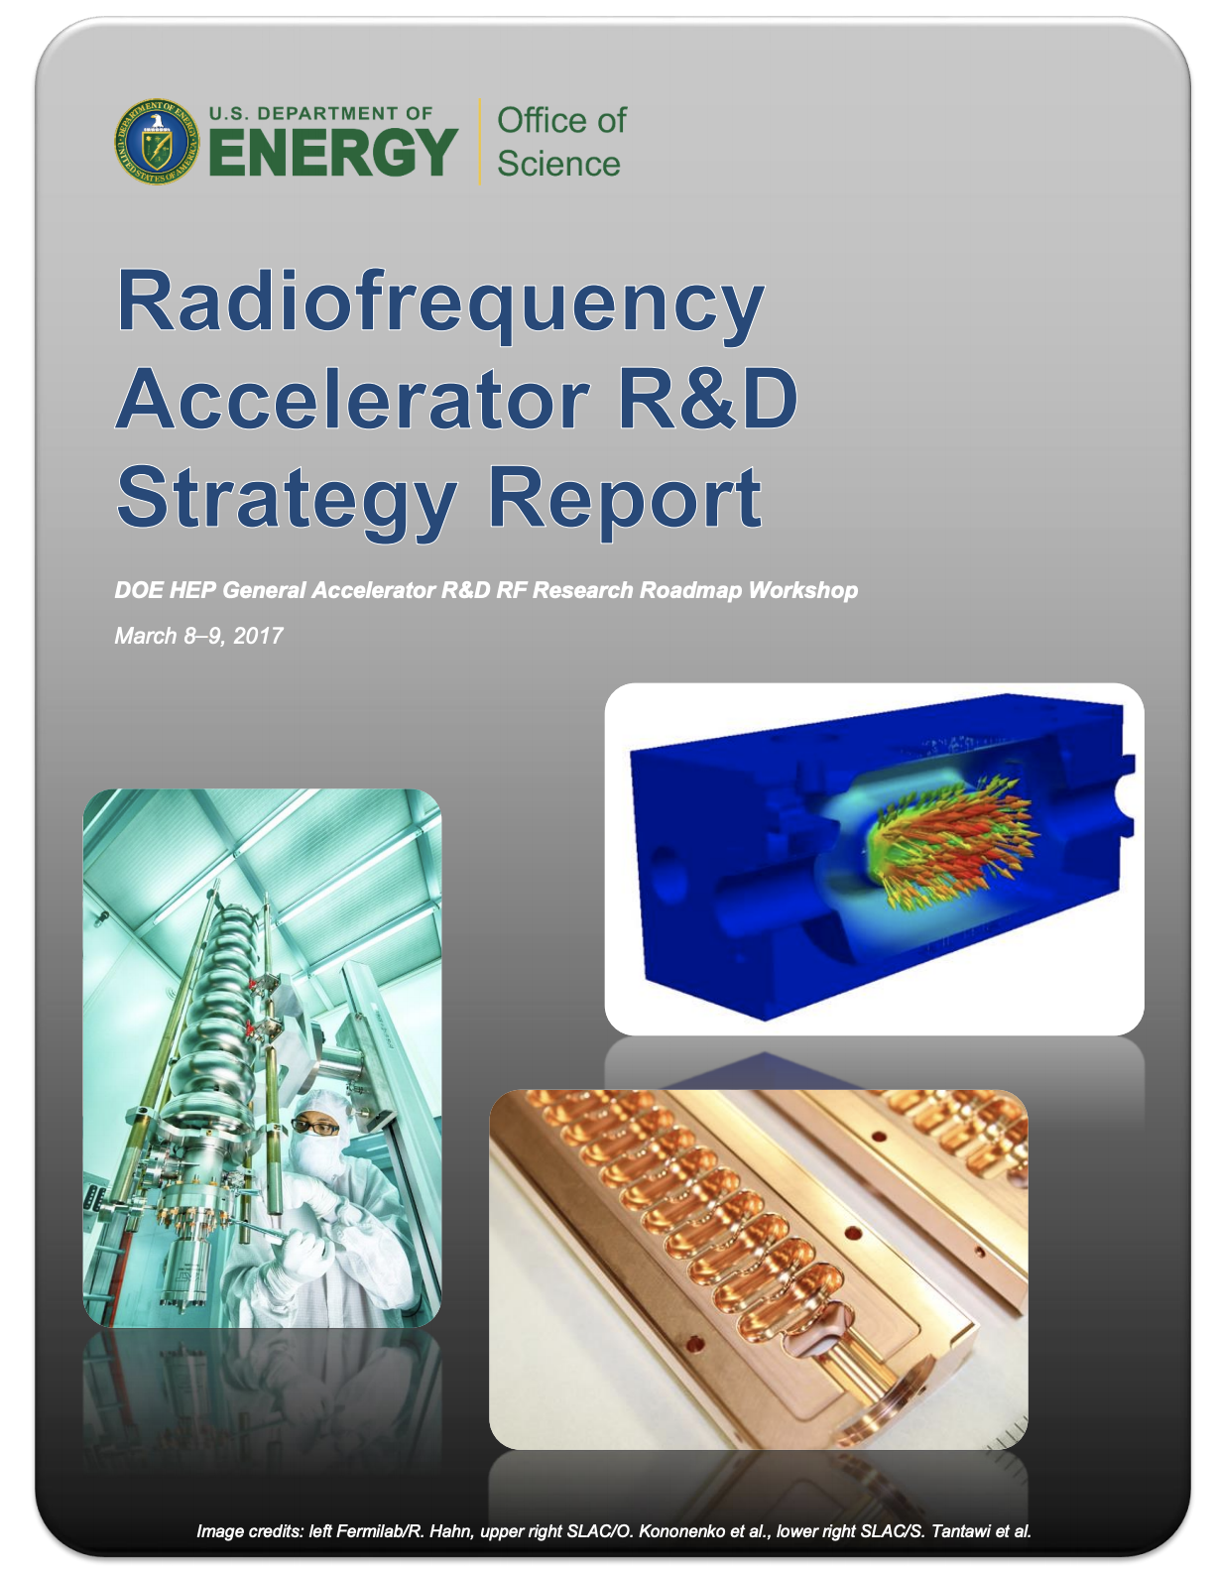

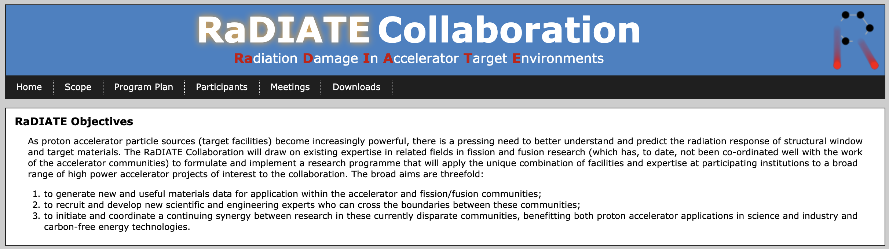
List of Technologies for Accelerator WG
Accelerator WG leaders made decision to generate 5 mini-WGs to develop individual lists: SRF, Magnets, Targets, Beam Dynamics, Ancillaries
Decision motivated by concentration of experts as well as thrusts within the DOE HEP GARD (General Accelerator R&D) program
Assumed 15-20 technologies per thrust

Slide 3
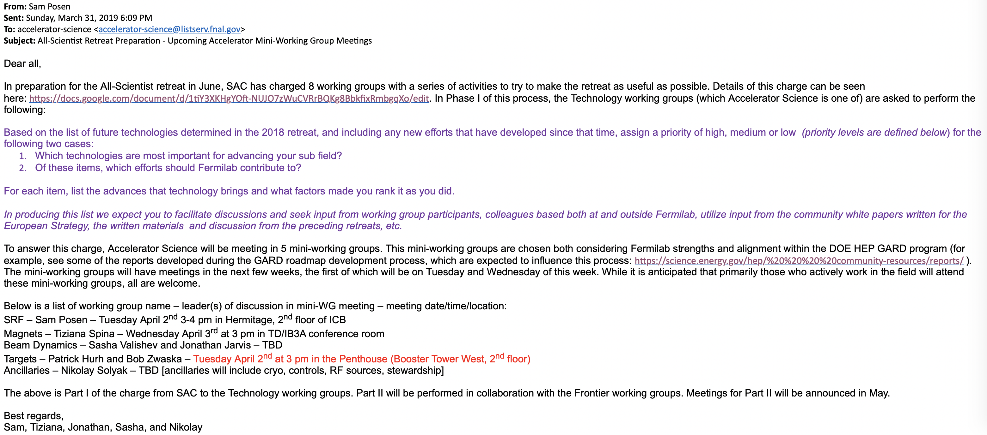
Email to Accelerator-Science Listserv

Slide 4
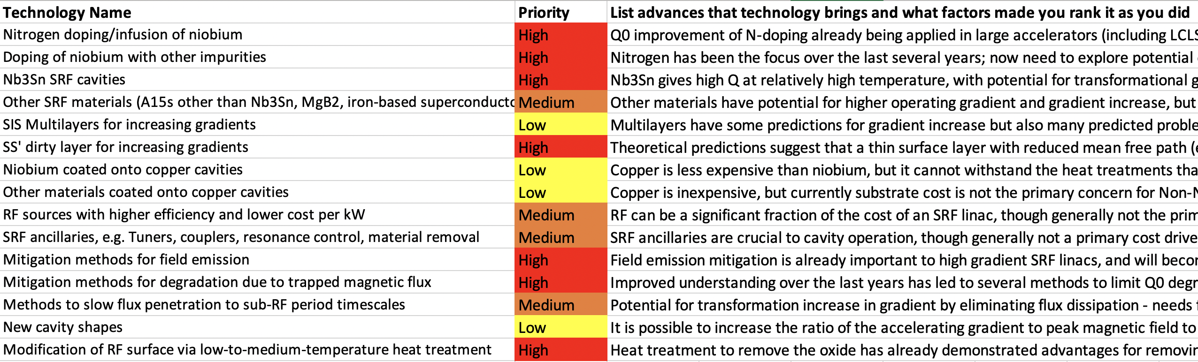
SRF Mini WG

Slide 5
SAC meeting: SC mini-working Group 1
Tiziana Spina
April 8, 2019

Slide 6
Summary of Charges
Part I: Prioritization of effort
Timescale: Deliver draft by May 1, 2019
Using work from previous retreats working groups which has identify options
Working groups will prioritized that list in broad categories high/medium/low.
Part II: Resource Identification
Timescale: June 14, with continued efforts feeding into Part III
From Part I groups should have a reduced list of items to consider and now technology and frontier groups can start working together to discuss what is needed for these options
Part III Fermilab input to the Community
Timescale: Continuous efforts pre and post retreat with report in Fall
Developing the work from Part II into an ongoing effort which will enable Fermilab to be a strong contributor to the community efforts

Slide 7
Charge for 2019 Retreat
Part I: Prioritization of effort
Timescale: Deliver draft by May 1, 2019
Based on the list of future technologies determined in the 2018 retreat, and including any new efforts that have developed since that time, assign a priority of high, medium or low (priority levels are defined below) for the following two cases:
Which technologies are most important for advancing your sub field?
Of these items, which efforts should Fermilab contribute to?
For each item, list the advances that technology brings and what factors made you rank it as you did.
In producing this list we expect you to facilitate discussions and seek input from working group participants, colleagues based both at and outside Fermilab, utilize input from the community white papers written for the European Strategy, the written materials and discussion from the preceding retreats, etc.
Charge: https://docs.google.com/document/d/1tiY3XKHgYOft-NUJO7zWuCVRrBQKg8BbkfixRmbgqXo/edit?usp=sharing

Slide 8
From Previous Retreat (April 2018)
Accelerator Science and Technology Working Group Summary
J. Jarvis, M. Martinello, N. Solyak, C. Thangaraj, A. Valishev
04/26/2018

Slide 9
High Field Magnets R&D Roadmap
April 2018
TD is conducting a High Field Magnet Task Force (now writing the final report, will be presented to DOE in June), to construct a roadmap containing our future research directions
One of main directions would be demonstration and cost reduction of 16T Nb3Sn magnets (new ideas from the conductor to the fabrication to understanding and finding a solution to quench training)
Another main research direction would be reaching fields 20 T or above via low T/ high T SC magnets
Nb3Sn 16 T and cost reduction (fabrication, conductor, training)
LTS/HTS Hybrid Magnets: 20T technology development and cost reduction
High Field Magnets R&D Progress
HEP Accelerators
High Lumi LHC
HE-LHC
FCC

Slide 10
Magnet Summary
April 2018
Push energy frontier: E(TeV) ≈ 0.3R(km) • B(T): increasing size or field?
More design studies needed for different scenarios – Nb₃Sn/NbTi hybrid, whole Nb₃Sn, Nb₃Sn/HTS hybrid: achievable field, cost, stress, etc.
R&D - two directions: Nb₃Sn (15-16 T) cost reduction, Nb₃Sn/HTS (20 T)
For cost effectiveness and near-future realization (before 2040), Nb₃Sn magnets (or Nb₃Sn/NbTi hybrid) are the practical plan.
Cost reduction of Nb₃Sn magnets should be a key task, which needs:
  Improving conductor J_{c} (within 5 years)
  Reducing magnet training (within 5 years)
  Exploring ways to reduce labor and materials cost (within 10 years)
Push on the Nb₃Sn/HTS hybrid magnets as a long-term R&D topic

Slide 11
New HFM Roadmap: last update
Temporary HFM roadmap until the final version of MDP roadmap will be ready (next Jan/Feb 2020)

Slide 12
New HFM roadmap (by G. Velev)

Slide 13

List of enabling technology: work in progress

Slide 14
Questions for the SAC community
To complete this SC magnet enabling technology list, we would like to know the “Lab’s assumptions” beyond 2026 thus to assign the right prioritization (high/medium/low).
What studies do we assume as finished by 2026?
Should we focus on FNAL specific strength only, or suggest new areas that we should invest in ?
Technology transfer: do we assume a higher level of cooperation between FNAL and industry, will there be more support from the IARC site to bring external companies on site?
Do we assume a specific HEP accelerator (VL-LHC (CERN), FCC (?), ILC (Japan))?

