Slide 1
Coil Working Group Meeting
Wedge Drawing and Procurement Review
Miao Yu
April 8, 2019

Slide 2
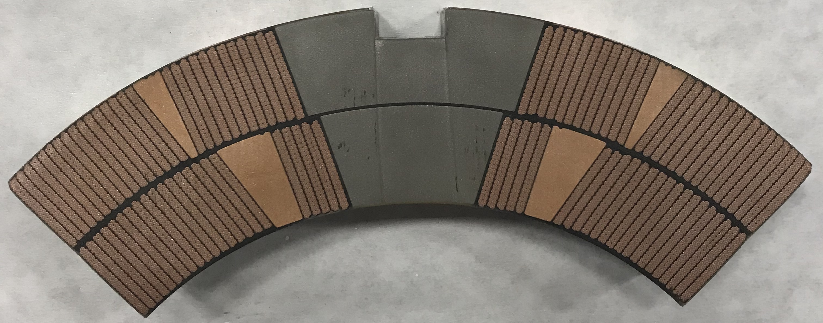
QXFA 108 Cross-section

Slide 3
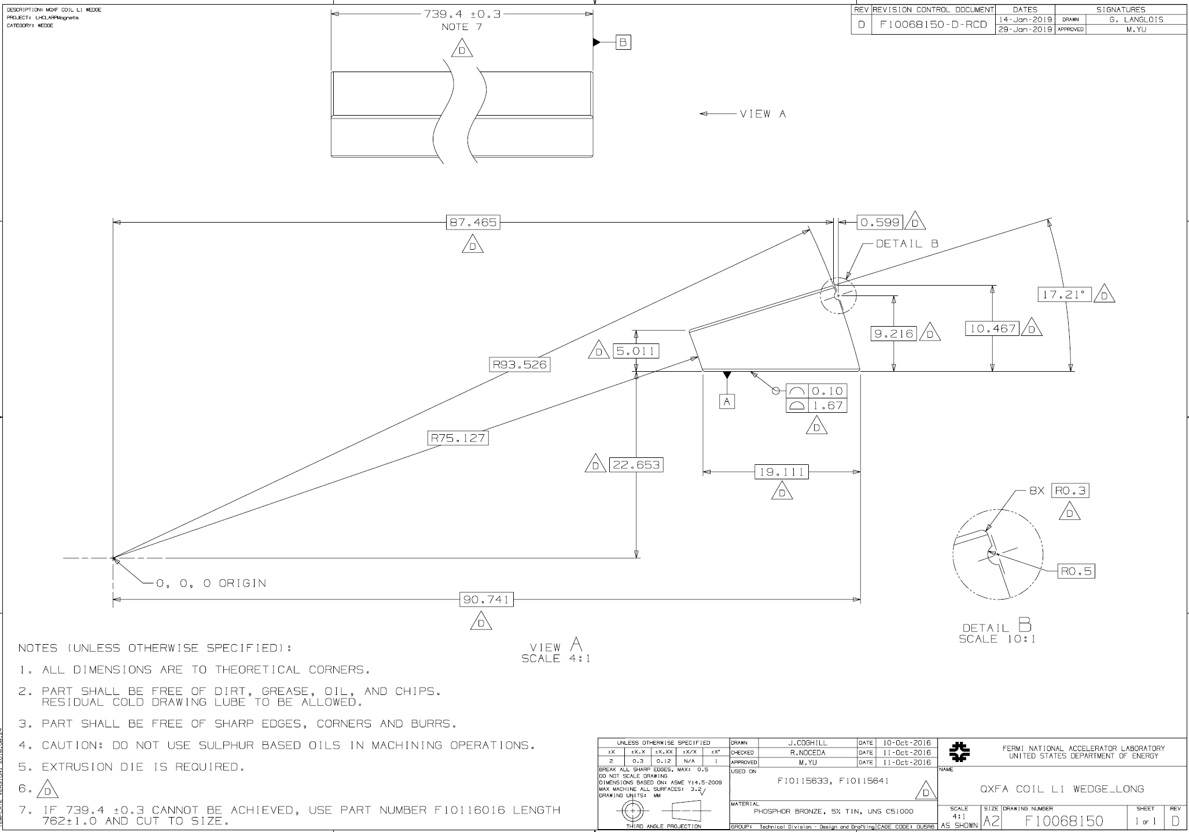
L1 Wedge

Slide 4
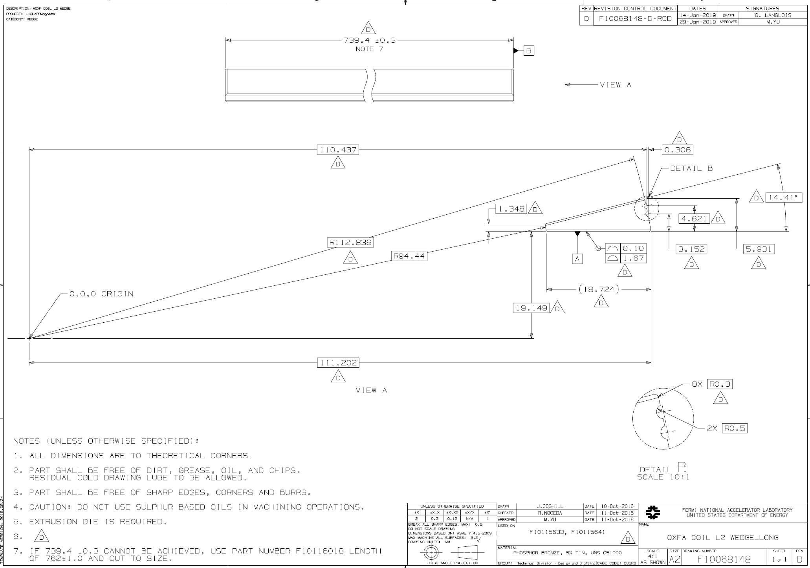
L2 Wedge

Slide 5
Wedges Fabrication Process
Material: Phosphor bronze used as wedge material from HQ/LHQ
Drawing process through multiple stations (dies): the uniformity of one wedge, and the consistence between POs.
Procurement history:
  In 2016, the vendor designed the dies and fabricated samples which passed the inspection
  In late 2016, 1st procurement of 2m ~ 4m long (F10039326 for L1 and F10039328 for L2), used in QXFS, QXFP and early QXFA coils.
  In 2018, 2nd procurement of 0.739 m long (F10068150 for L1 and F10068148 for L2), enough for 20 coils

Slide 6
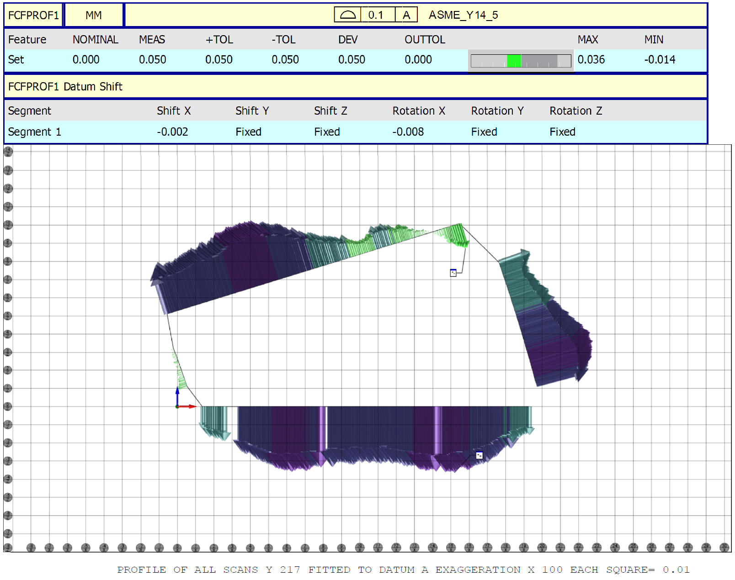
L1 Wedge QC Report
~0.03 mm
~0.03 mm
217 mm from one end
0.036 mm

Slide 7
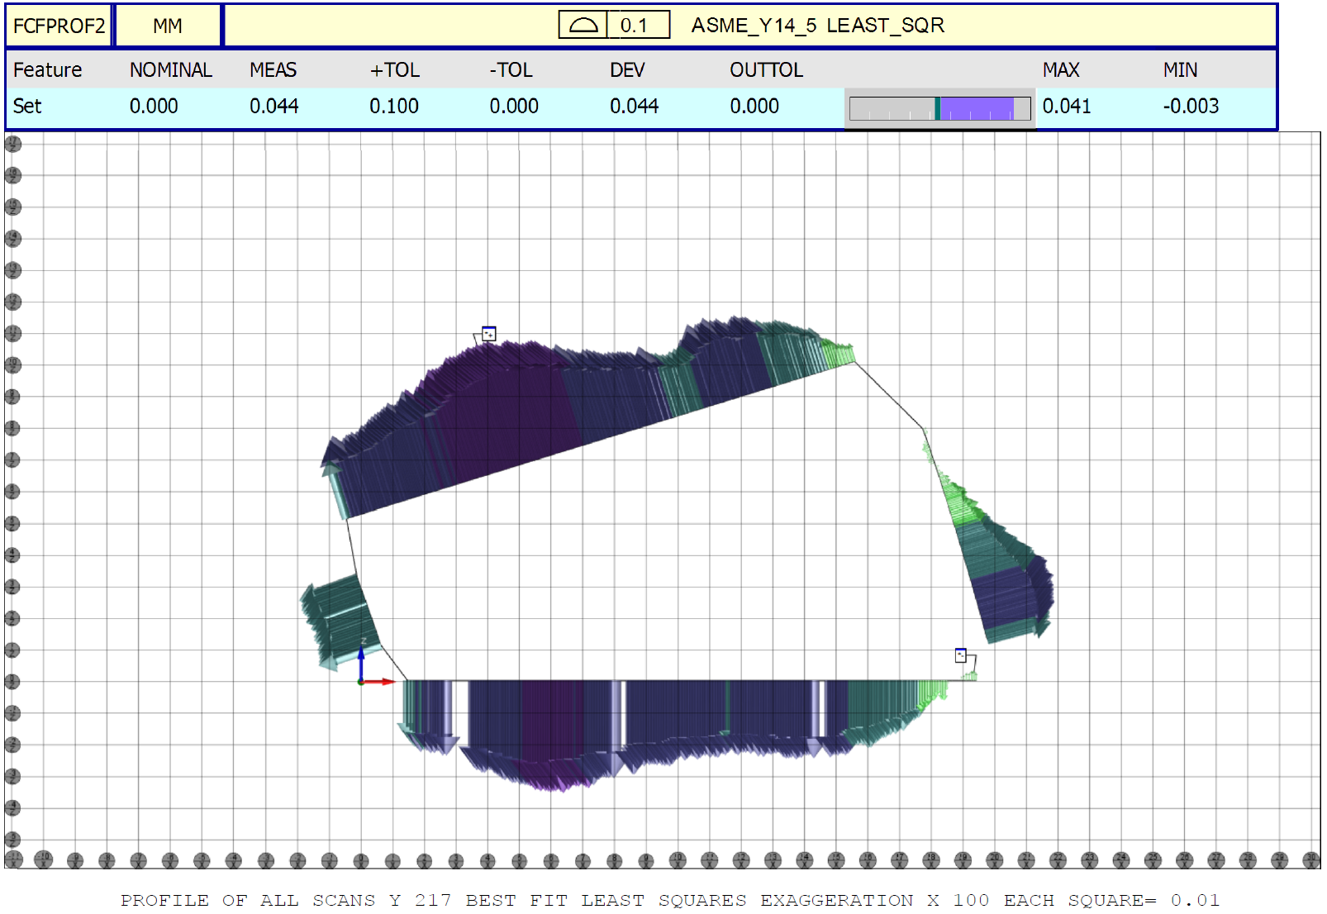
L1 Wedge QC Report Cont.

Slide 8
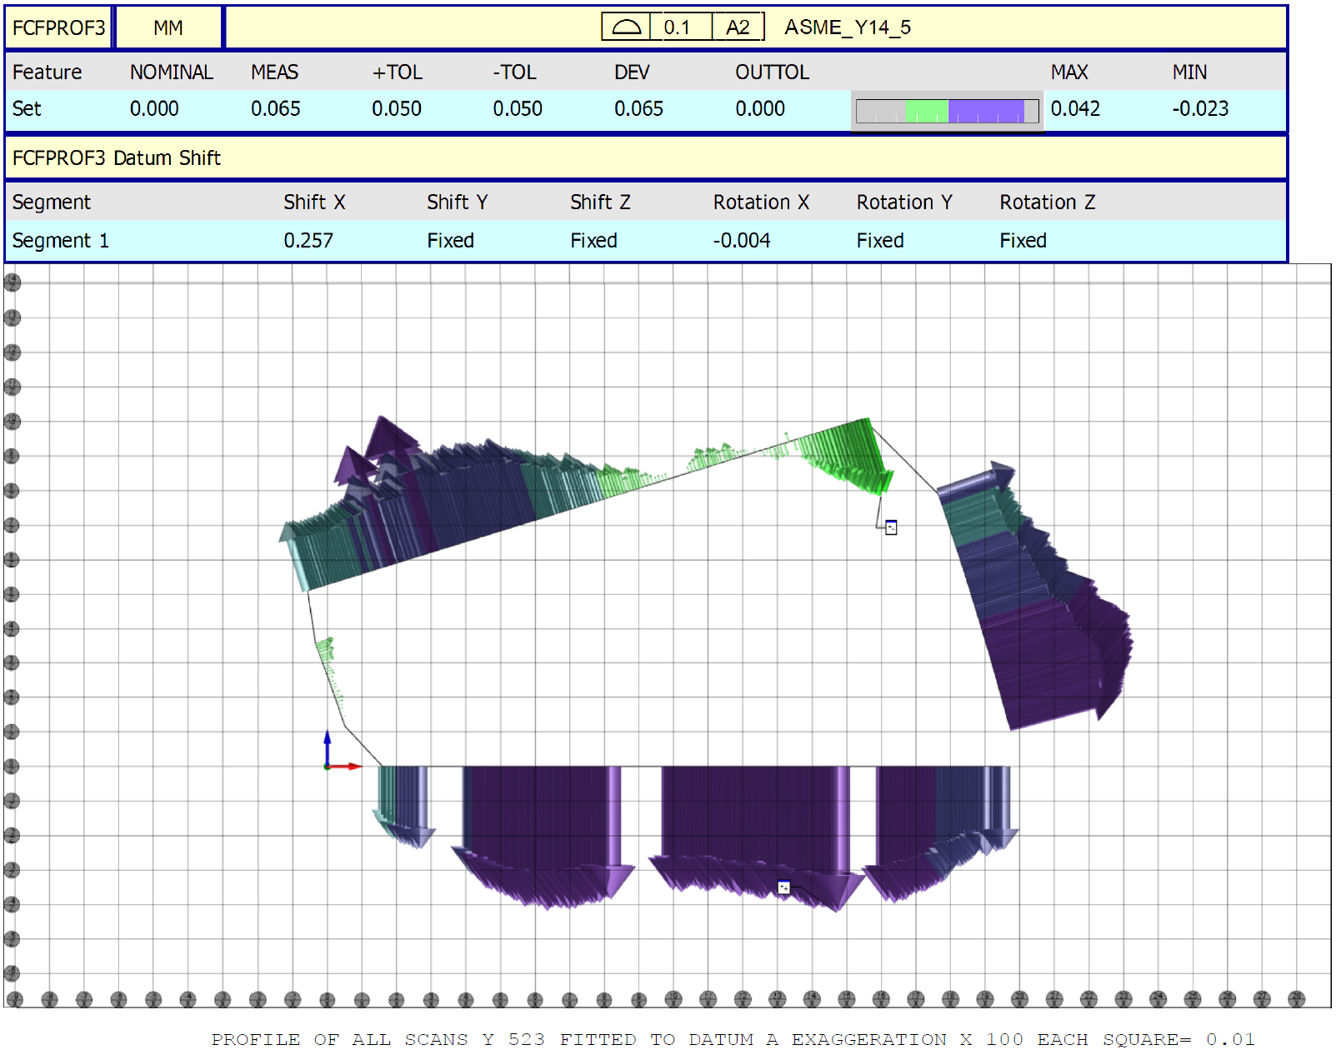
L1 Wedge QC Report Cont.
~0.04 mm
~0.04 mm
523 mm from one end
0.042 mm

Slide 9
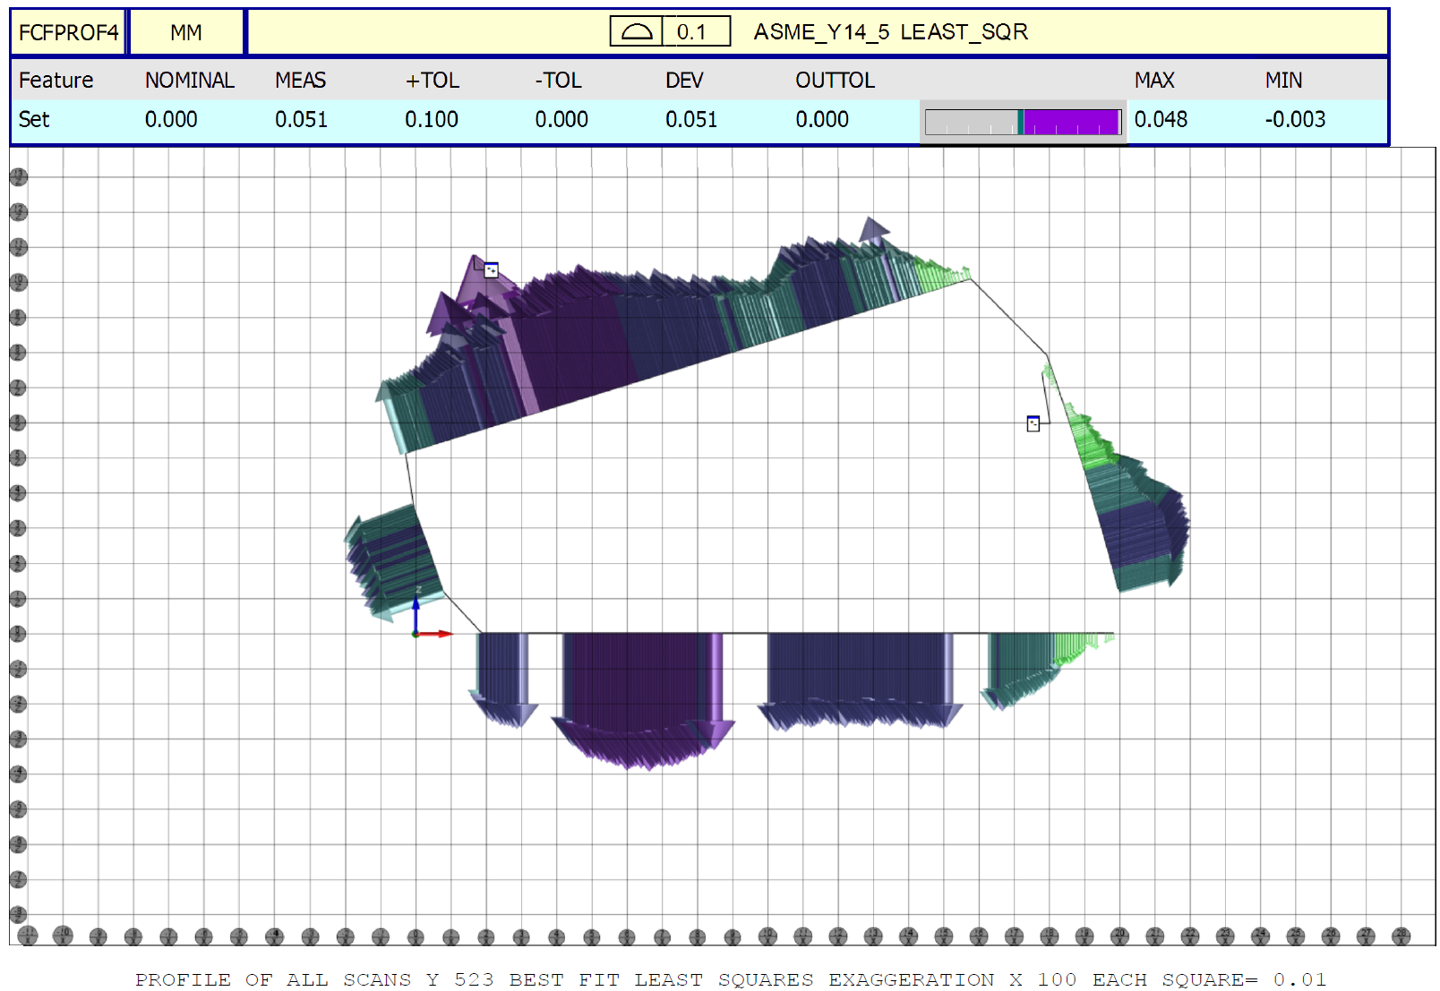
L1 Wedge QC Report Cont.

Slide 10
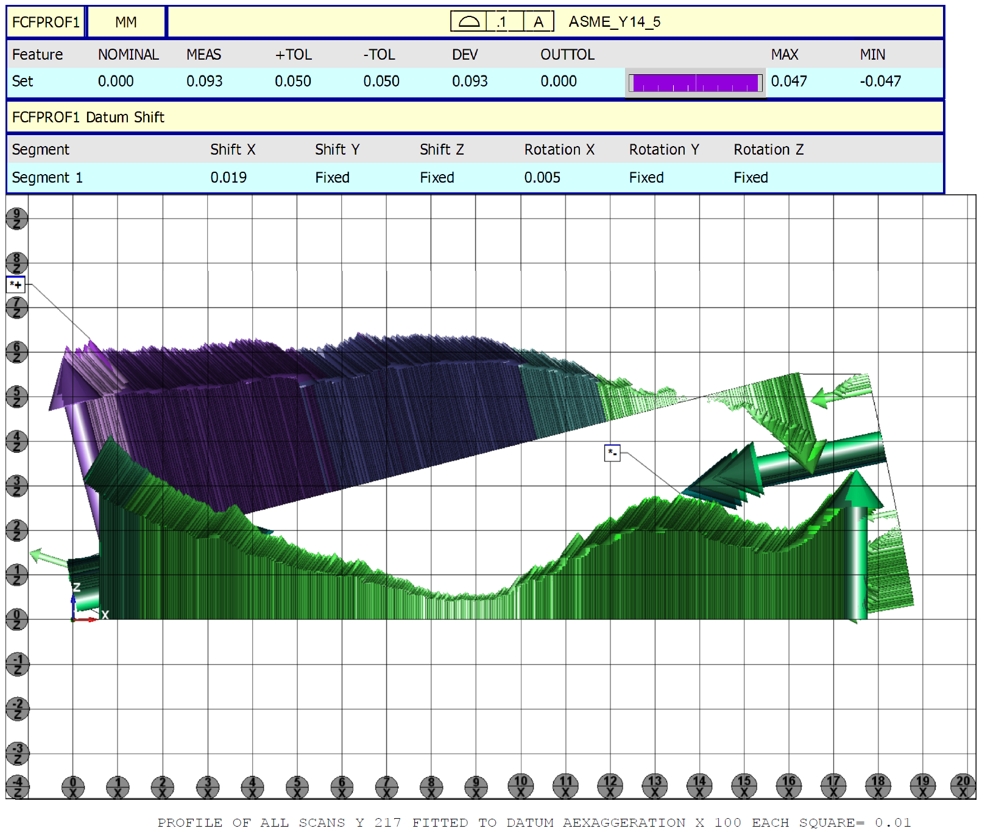
L2 Wedge QC Report
0.047 mm
-0.047 mm
217 mm from one end

Slide 11
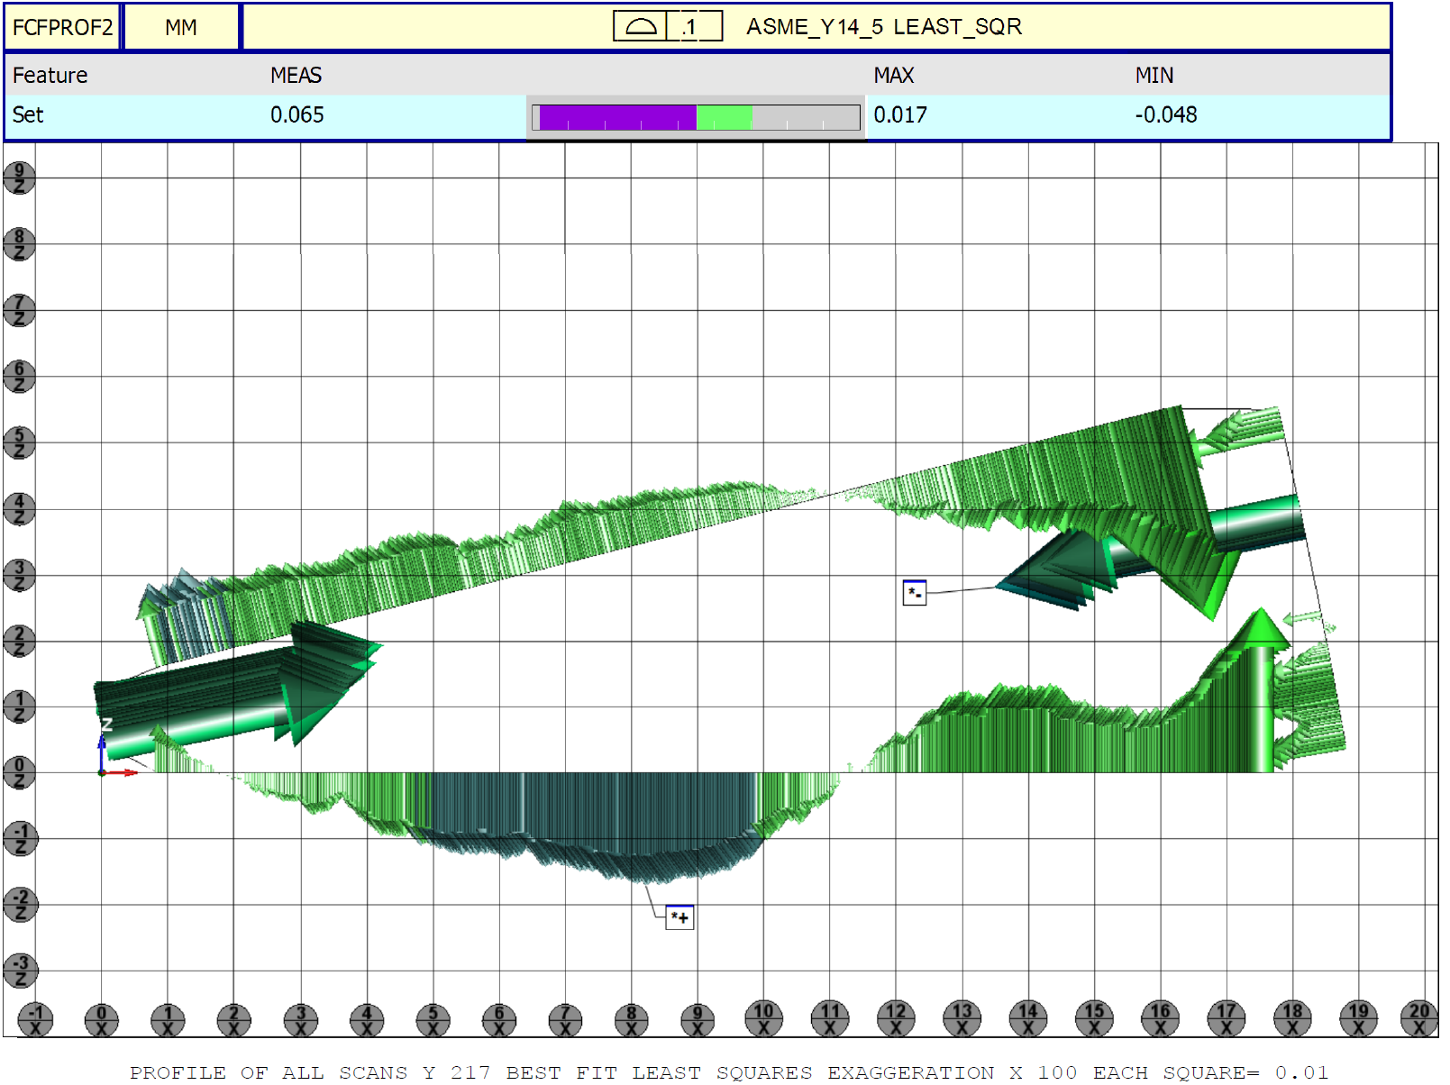
L2 Wedge QC Report Cont.

Slide 12
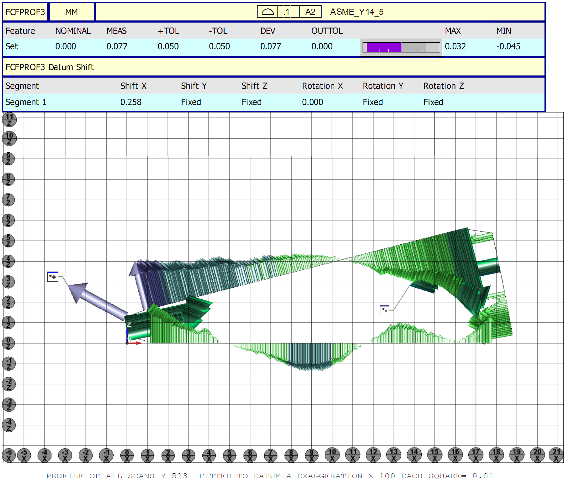
L2 Wedge QC Report Cont.
~0.03 mm
-0.045 mm
523 mm from one end

Slide 13
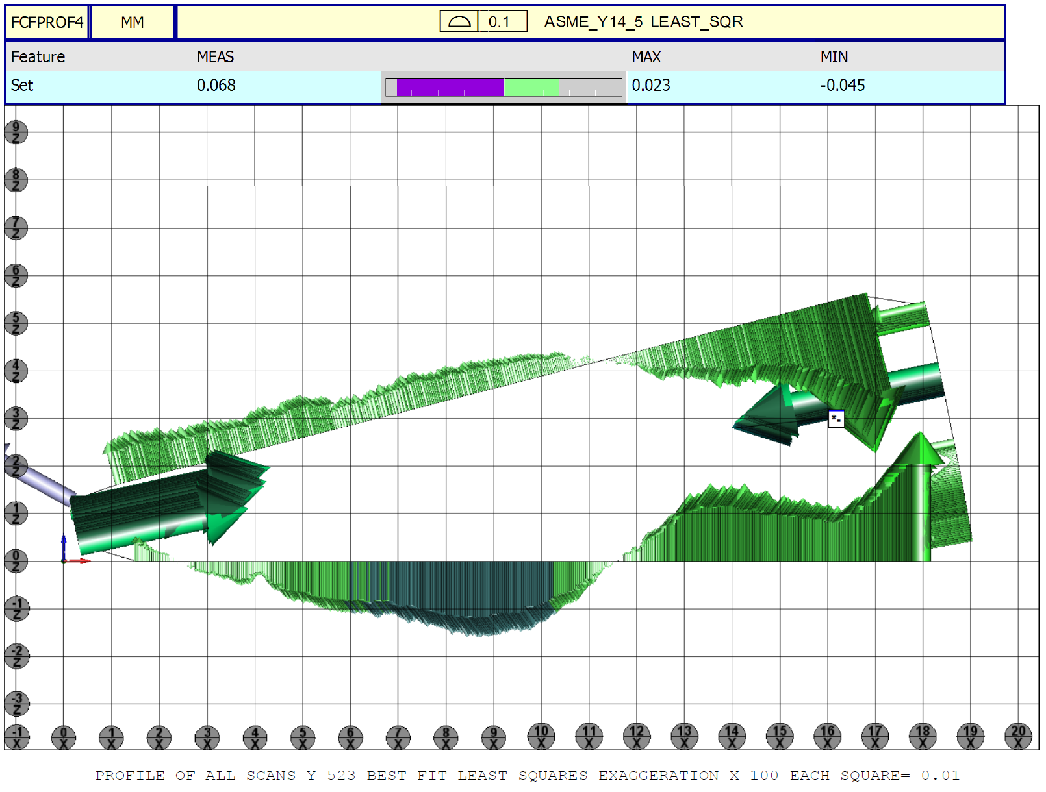
L2 Wedge QC Report Cont.

Slide 14
Procurement Plan
In April, procure the wedges from the same vendor for the entire project.
Provide the procurement specification to the vendor, including
  The vendor shall use the same dies. If the dies need to be modified or replaced, the vendor shall notify FNAL.”
  Deliver 10 pcs of samples for QC before production.
Visit the vendor in the week of April 15.

Slide 15
QC Plan (Docdb 2168)
The vendor shall mark label “first batch” showing the first piece of the wedge drawn through the dies and cut into shorter pieces, and “last batch” showing the last piece of the wedge drawn through the dies and cut into shorter pieces.
FNAL will inspect the samples randomly selected from the first batch and the last batch according to ISO 2859_2014, single sampling plans for normal inspection. FNAL will also inspect 2 samples randomly selected from each shipping crate.
  Measure the cross-section profile and the length using a coordinate measuring machine (CMM).
  Inspect the straightness. Put the wedge on the granite table on one side surface, press one end and measure the gap between the wedge and the table from the other end.

