Slide 1
protoDUNE photon Detector MC
Leon Mualem
Caltech

Slide 2
Some MC notes
Based on wiki for photon detector MC tutorial
  https://cdcvs.fnal.gov/redmine/projects/dunetpc/wiki/Photon_Simulation_Tutorial
Using dunetpc v08_14_00 (fixed a +-X swap mapping to OpChannels)
Instead of using “DUNE” version as in the tutorial, use protoDUNE version of fcl(s) found in the protoDUNE subdirectory
In /srcs/dunetpc/dune/PhotonPropagation/Tutorial/protoDUNE/
My example in:
  /dune/app/users/mualem/pdune_201903/srcs/dunetpc/dune/PhotonPropagation/Tutorial

Slide 3
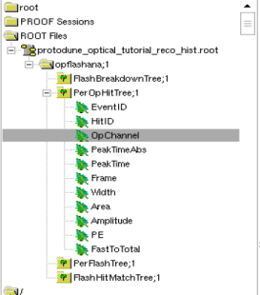
Some MC notes
root –l protodune_optical_tutorial_reco_hist.root
TBrowser mine;
Navigate to OpChannel

Slide 4
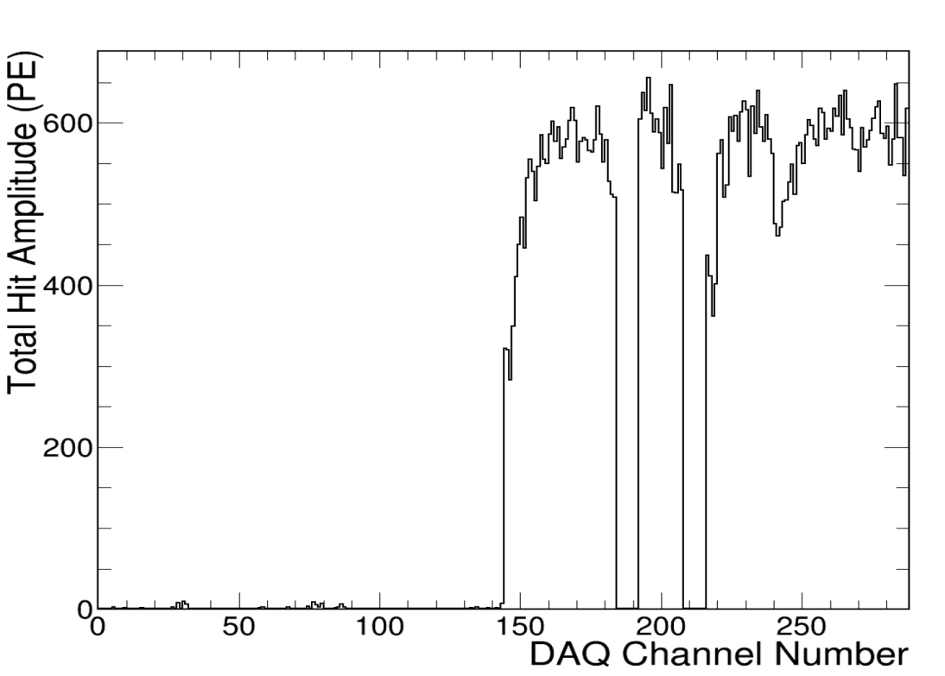
Along Faces of APA 5,6,4 in sequence
100 10 GeV/c Mu+
Along Z axis
  ThetaXZ=0
  ThetaYZ=0
Near APA non-beam drift (X=300)
Centered Top to Bottom (Y=300)
Start at beam face (Z=0)
All (almost) Hits on non-Beam, some leakage out the side reduces APA 1

Slide 5
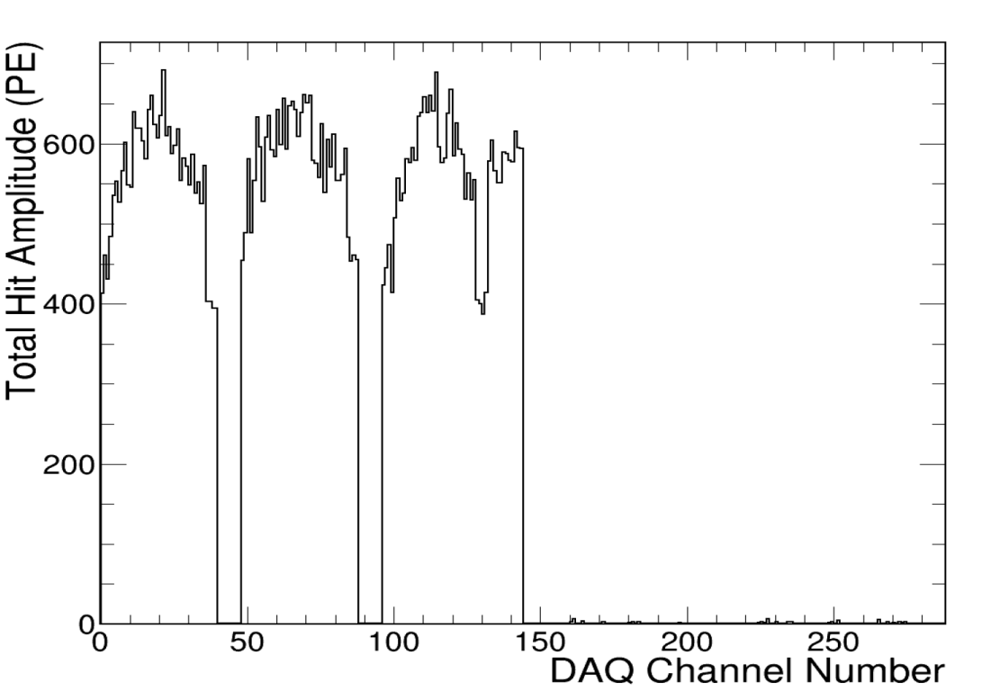
Along Faces of APA 3,2,1 in sequence
100 10 GeV/c Mu+
Along Z axis
  ThetaXZ=0
  ThetaYZ=0
Near APA beam-side drift (X=-300)
Centered Top to Bottom (Y=300)
Start at beam face (Z=0)
All (almost) Hits on Beam-side
Equal APA distribution
Small leakage across CPA

Slide 6
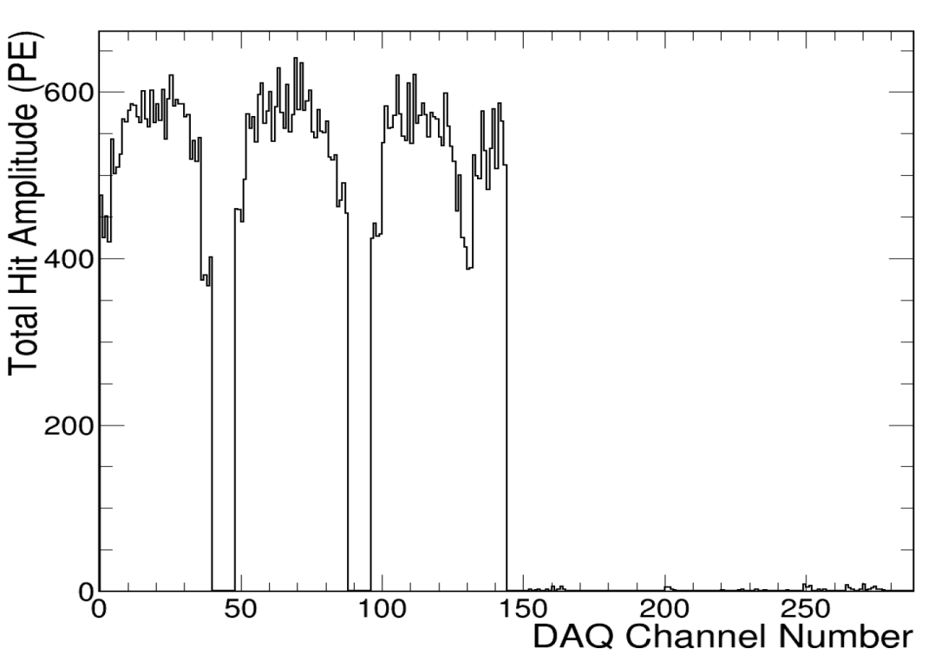
Mid-Drift in front of APA 3,2,1
100 – 10 GeV/c Mu+
Along Z axis
  ThetaXZ=0
  ThetaYZ=0
Centered in beam-side drift (X=-180)
Centered Top to Bottom (Y=300)
Start at beam face (Z=0)
Almost all hits on beam side, small leakage to non-beam, probably 1 of 100 muons had photon cross the CPA

Slide 7
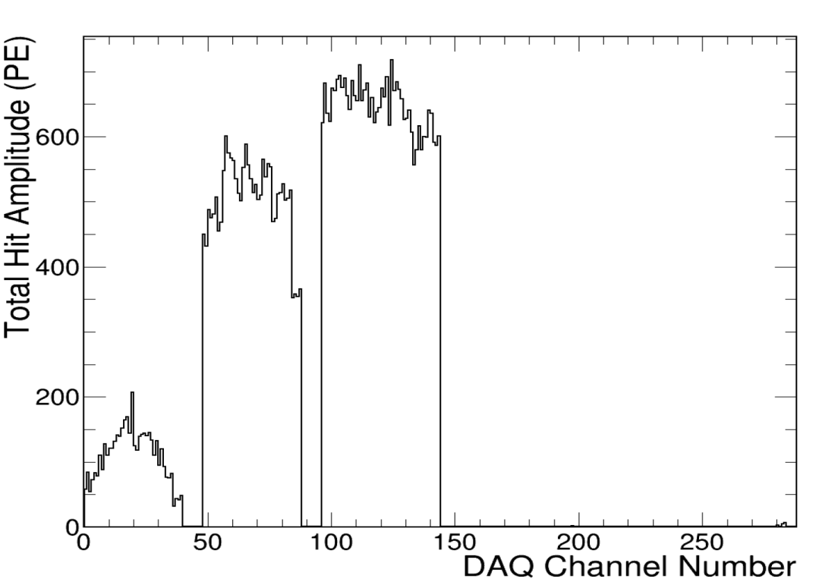
Down Face of APA3
100 10 GeV/c Mu+
Along Y axis
  ThetaXZ=0
  ThetaYZ=-90
Near APA beam-side drift (X=-350)
Start At Top (Y=600)
Mid-APA3 (Z=110)
Largest hits on APA3
  less on APA2
    Least on APA1

Slide 8
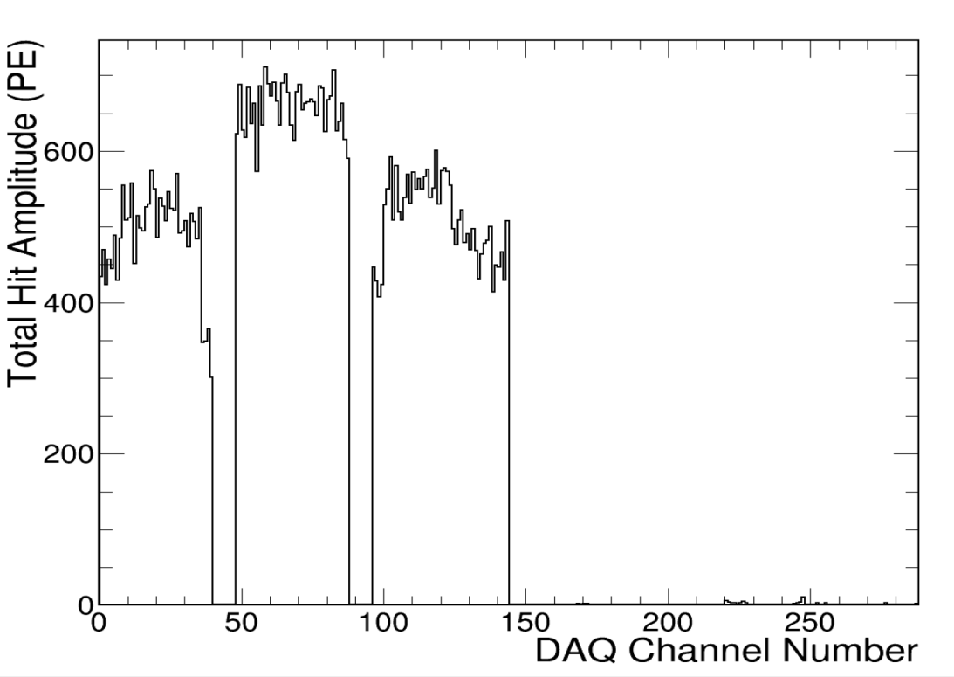
Down Face of APA2
100 10 GeV/c Mu+
Along Y axis
  ThetaXZ=0
  ThetaYZ=-90
Near APA beam-side drift (X=-350)
Start At Top (Y=600)
Mid-APA3 (Z=330)
Largest hits on APA2
  less on APA3 = ~APA1

Slide 9
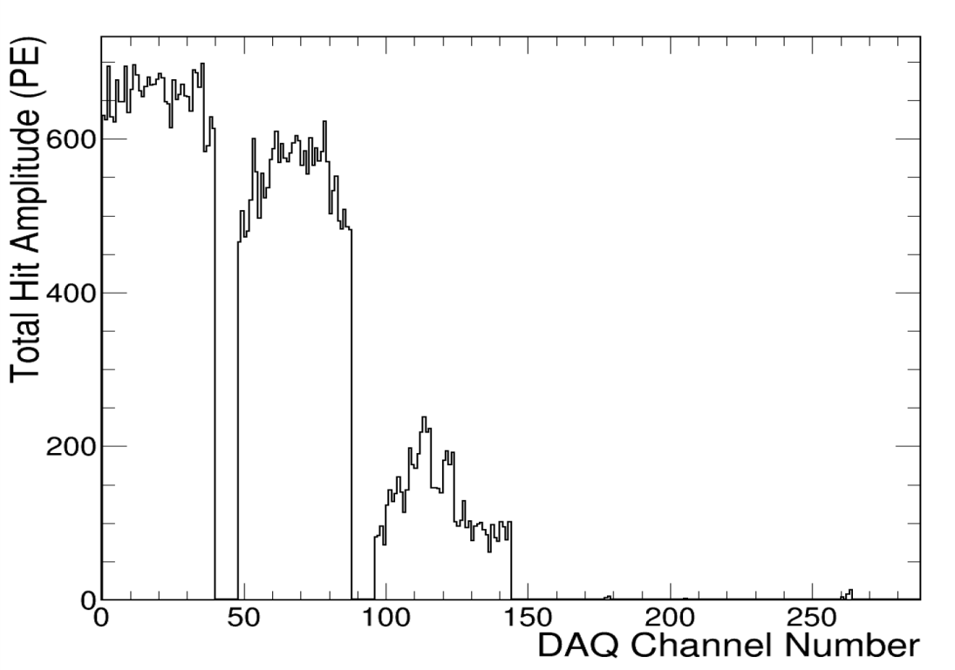
Along Face of APA1
100 10 GeV/c Mu+
Along Y axis
  ThetaXZ=0
  ThetaYZ=-90
Near APA beam-side drift (X=-350)
Start At Top (Y=600)
Mid-APA3 (Z=550)
Largest hits on APA1
  Less on APA2
    Least on APA3

Slide 10
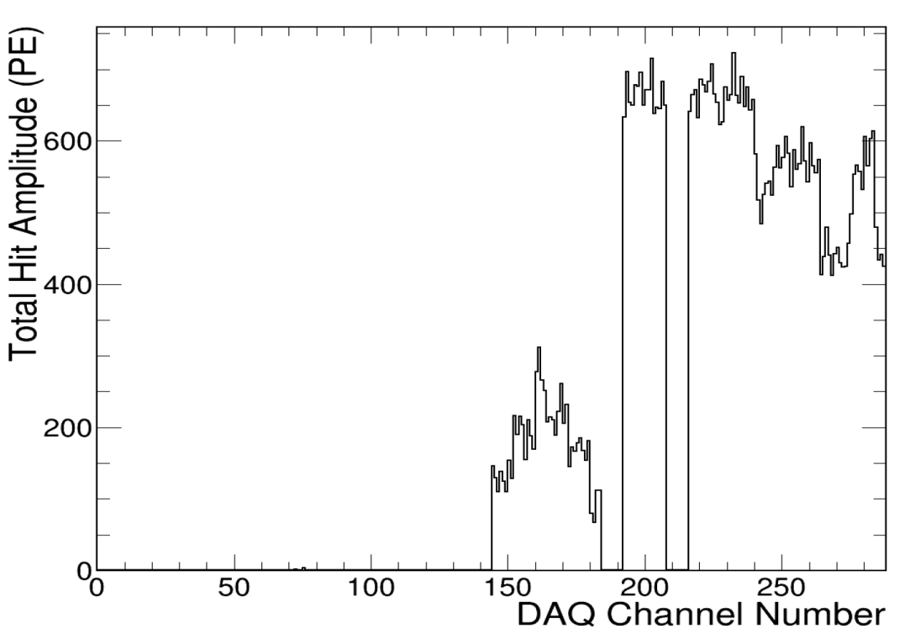
Along Face of APA5
100 10 GeV/c Mu+
Along Y axis
  ThetaXZ=0
  ThetaYZ=-90
Near APA beam-side drift (X=350)
Start At Top (Y=600)
Mid-APA5 (Z=110)
Largest hits on APA5
  Less on APA6
    Least on APA4

Slide 11
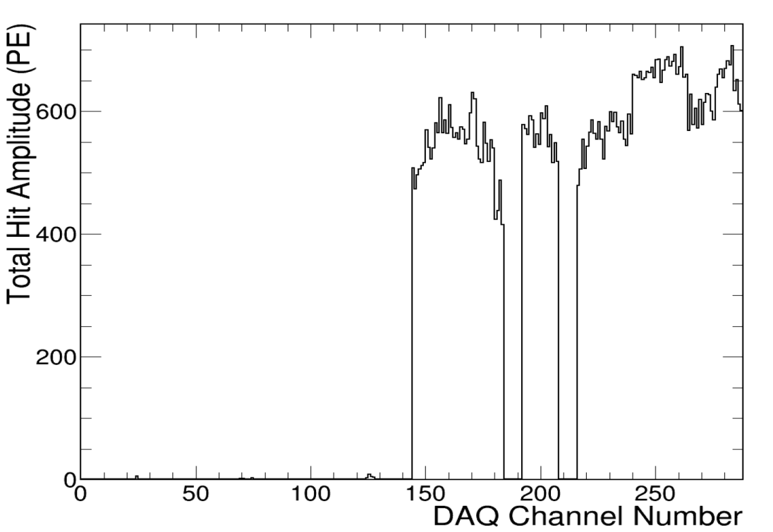
Along Face of APA6
100 10 GeV/c Mu+
Along Y axis
  ThetaXZ=0
  ThetaYZ=-90
Near APA beam-side drift (X=350)
Start At Top (Y=600)
Mid-APA5 (Z=330)
Largest hits on APA1
  Less on APA2
    Least on APA3

Slide 12
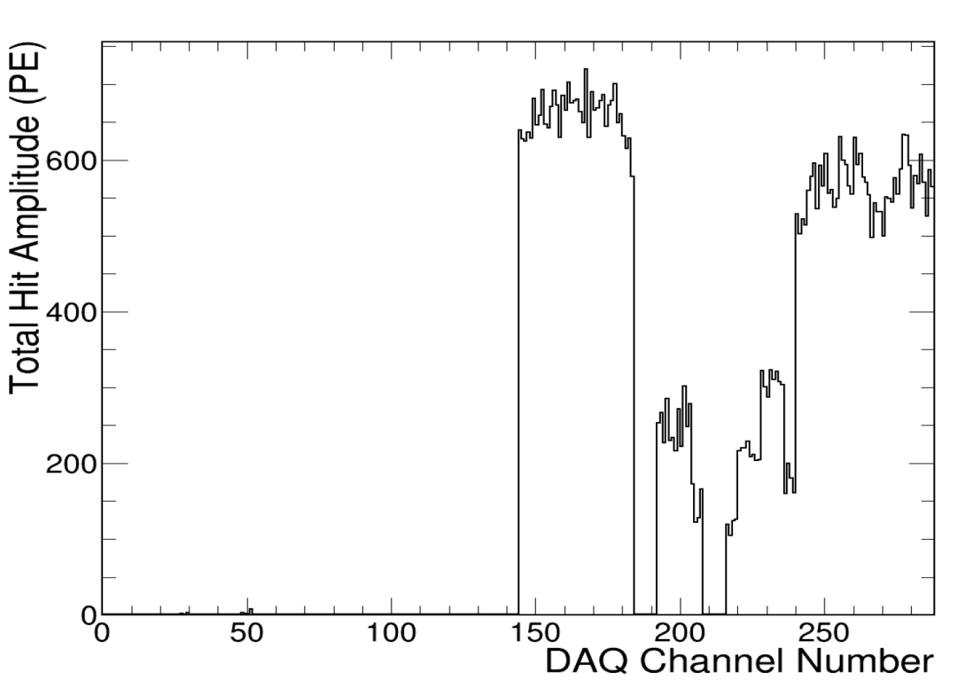
Along Face of APA4
100 10 GeV/c Mu+
Along Y axis
  ThetaXZ=0
  ThetaYZ=-90
Near APA beam-side drift (X=350)
Start At Top (Y=600)
Mid-APA5 (Z=550)
Largest hits on APA4
  Less on APA5
    Least on APA6 (furthest away)

Slide 13
Conclusions
Re-Checked the correspondence of channel map in MC to Data.
Versions now agree, in prior versions channels were swapped in X
  (any earlier MC needs re-digitizing)
Geometry of the MC looks consistent with reality
  +Y axis = up and origin ~ bottom of CPA/APA
  +X axis = toward beam left, Jura, origin at ~CPA plane
  +Z axis = along the CPA plane, origin ~upstream end of APAs
    Caveat: did not test to cm or mm precision

Slide 14
BACKUP Details on how to run
(possibly out of date)

Slide 15
Some MC notes
Based on wiki for photon detector MC tutorial
  https://cdcvs.fnal.gov/redmine/projects/dunetpc/wiki/Photon_Simulation_Tutorial
Instead of using “DUNE” version as in the tutorial, use protoDUNE version of fcl
In /srcs/dunetpc/dune/PhotonPropagation/Tutorial
My example in:
  /dune/app/users/mualem/pdune_201809/srcs/dunetpc/dune/PhotonPropagation/Tutorial

Slide 16
Some MC notes
testgen.sh in that directory runs each step sequentially
Successfully ran up to about 5000 events. (files get too big if I recall)
Sim – Particle production, interaction, energy deposits, …. (GEANT bascially)
Digi – Take particle tracks, energy deposits and make into waveforms
Reco – Take waveforms and make hits, flashes, energy deposits in OpChannels
Each stage above produces file “gen” (big, all info) and “hist” (small, summary info)

Slide 17
Some MC notes
root –l protodune_optical_tutorial_reco_hist.root
TBrowser mine;
Navigate to OpChannel

Slide 18
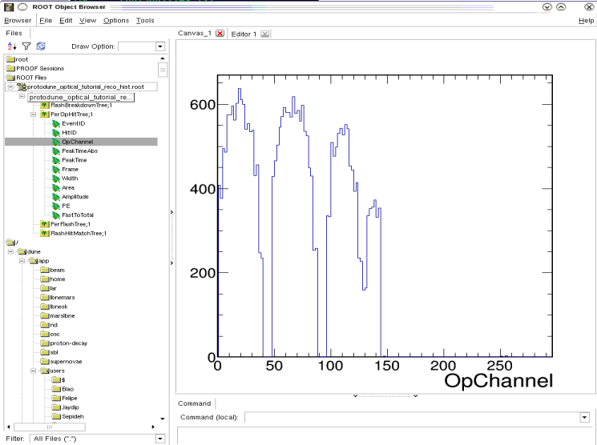
Some MC notes
root –l protodune_optical_tutorial_reco_hist.root
TBrowser mine;
Navigate to OpChannel

Slide 19
Some MC notes
Particle hints:
  /dune/app/users/mualem/pdune_201809/srcs/dunetpc/dune/PhotonPropagation/Tutorial
  …protoDUNE/protodune_optical_tutorial_sim.fcl
  Particle type:
  Particle Momentum:
# In this example, which primary particle(s) we'll focus on in an event.
# PDG code 13 = mu-.pi+ = 211 proton = 2212 mu+ = -13
PDGcode: 211
physics.producers.generator.P0: [3.0]

Slide 20
Some MC notes
Geometry hints:
  /dune/app/users/mualem/pdune_201809/srcs/dunetpc/dune/PhotonPropagation/Tutorial
  …protoDUNE/protodune_optical_tutorial_sim.fcl
  We believe origin at upstream (wrt beam) bottom edge of cathode plane (maybe lowest wires?)
# positive x axis
# physics.producers.generator.Theta0XZ: [ 90 ] # degrees angle in xz plane from z axis ?
# physics.producers.generator.Theta0YZ: [ 0 ] # degrees angle in yz plane from z axis ?
# positive z axis
# physics.producers.generator.Theta0XZ: [ 0 ] # degrees angle in xz plane from z axis ?
# physics.producers.generator.Theta0YZ: [ 0 ] # degrees angle in yz plane from z axis ?
# negative z axis
# physics.producers.generator.Theta0XZ: [ 0 ] # degrees angle in xz plane from z axis ?
# physics.producers.generator.Theta0YZ: [ 180.0 ] # degrees angle in yz plane from z axis ?
# vertically down
# physics.producers.generator.Theta0XZ: [ 0 ] # degrees angle in xz plane from z axis ?
# physics.producers.generator.Theta0YZ: [ -90.0 ] # degrees angle in yz plane from z axis ?

Slide 21
Beam Plug position?
Possibly the beam plug location – Paola probably knows best
# This block defines starting parameters for beam window 3 ( with beam plug) in protodune_v4.gdml geometry
physics.producers.generator.PosDist: 0 # Position distribution (0=uniform, 1=gaussian)
physics.producers.generator.X0: [7.966] # Starting position (cm)
physics.producers.generator.Y0: [460.84]
physics.producers.generator.Z0: [-191.60]
physics.producers.generator.SigmaX: [0.0]
physics.producers.generator.SigmaY: [0.0]
physics.producers.generator.SigmaZ: [0.0]
physics.producers.generator.AngleDist: 0 # Angle distribution (0=uniform, 1=gaussian)
#physics.producers.generator.Theta0XZ: [-11.844] # Starting angles (degrees)
# Flip the angle for the photon detectors. UGH!
physics.producers.generator.Theta0XZ: [11.844] # Starting angles (degrees)
physics.producers.generator.Theta0YZ: [-11.107]
physics.producers.generator.SigmaThetaXZ: [0.]
physics.producers.generator.SigmaThetaYZ: [0.]

