Slide 1
New SAM station
Complete rewrite of the SAM station – jettison much legacy stuff (was a 20 year C++ codebase)
Now running for DUNE
API is mostly unchanged
Dropped some legacy stuff; hopefully nobody is using it
New features
Improved monitoring – send info to elasticsearch each time anything happens
Better handling of restarted jobs - if we detect a restarted job, mark the old one as “cancelled” and give the new one the same set of files as before.
Improved treatment of distributed storage sites – can independently prioritize source locations depending on where you run

Slide 2
Detailed monitoring info

Slide 3
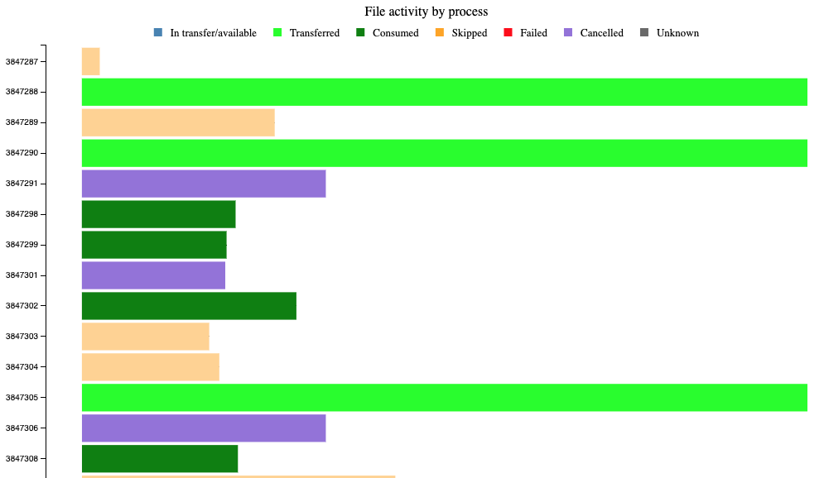
Restarted jobs

Slide 4
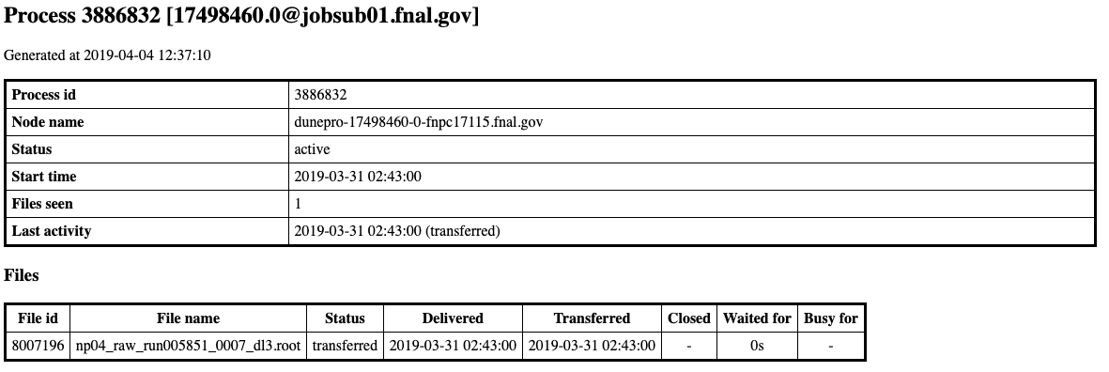
Restarted job gets the same file

Slide 5
Changes needed by jobs
Everything should still work without changes on from the jobs
However, the restart feature requires that the SAM “process description” field is set to the batch job id
That’s how we know it’s the same job as before
The enhanced monitoring is also more useful if the job id is included as then the information can be matched to the batch system
Some scripts are already doing this
We’ve been recommending it for a long time
POMS fife_wrap does.
We’ve noticed that many DUNE user jobs don’t (project.py?)

