Slide 1
LCLS-II pCM Shipping Restraint
January 11, 2019
Tom Nicol

Slide 2
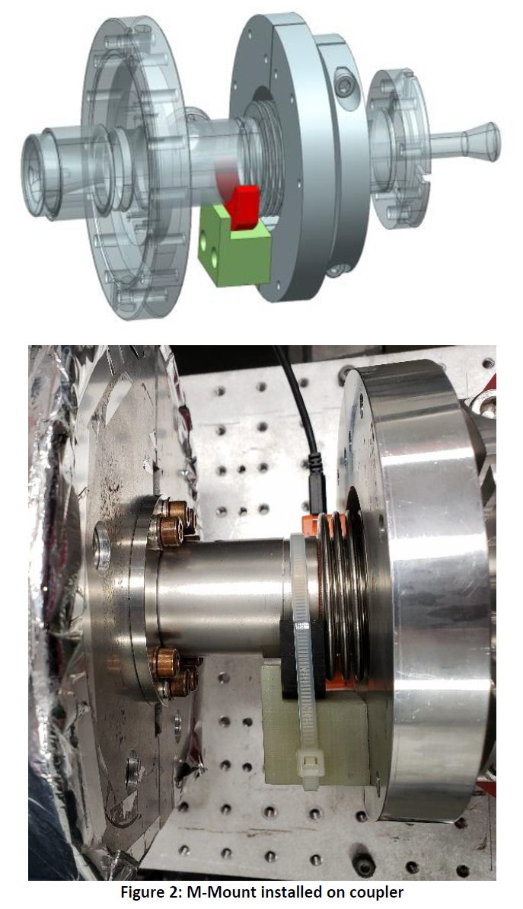
Production M-mount

Slide 3
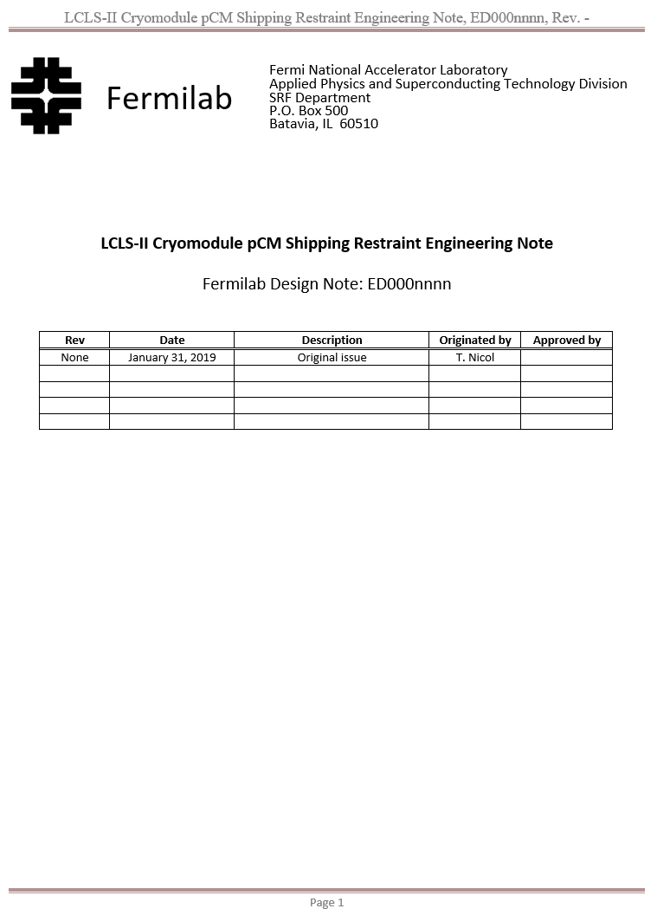
Modified M-mount engineering note

Slide 4
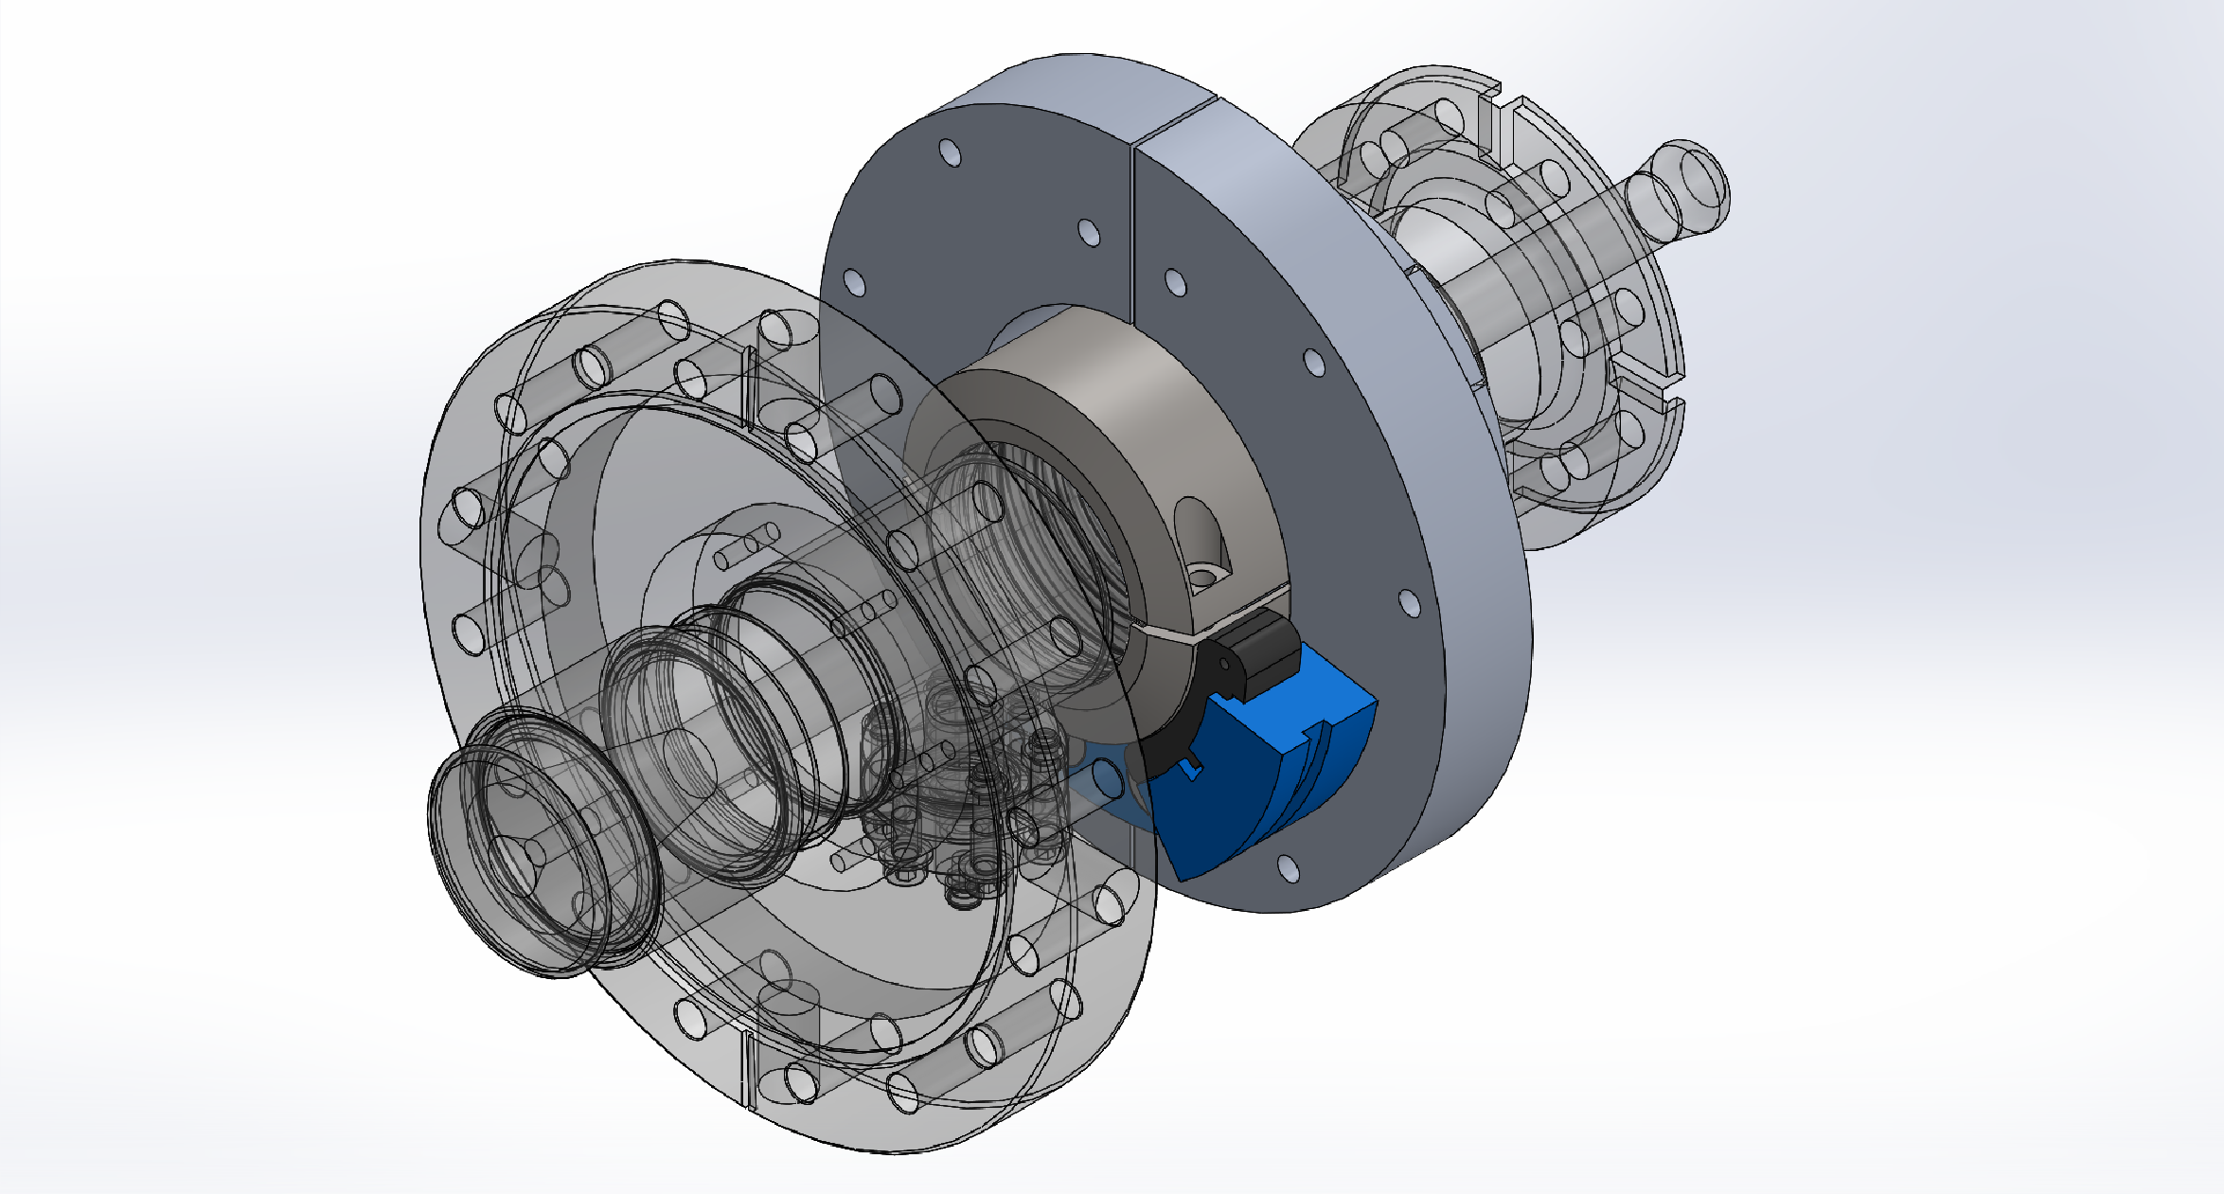
pCM shipping restraint model

Slide 5
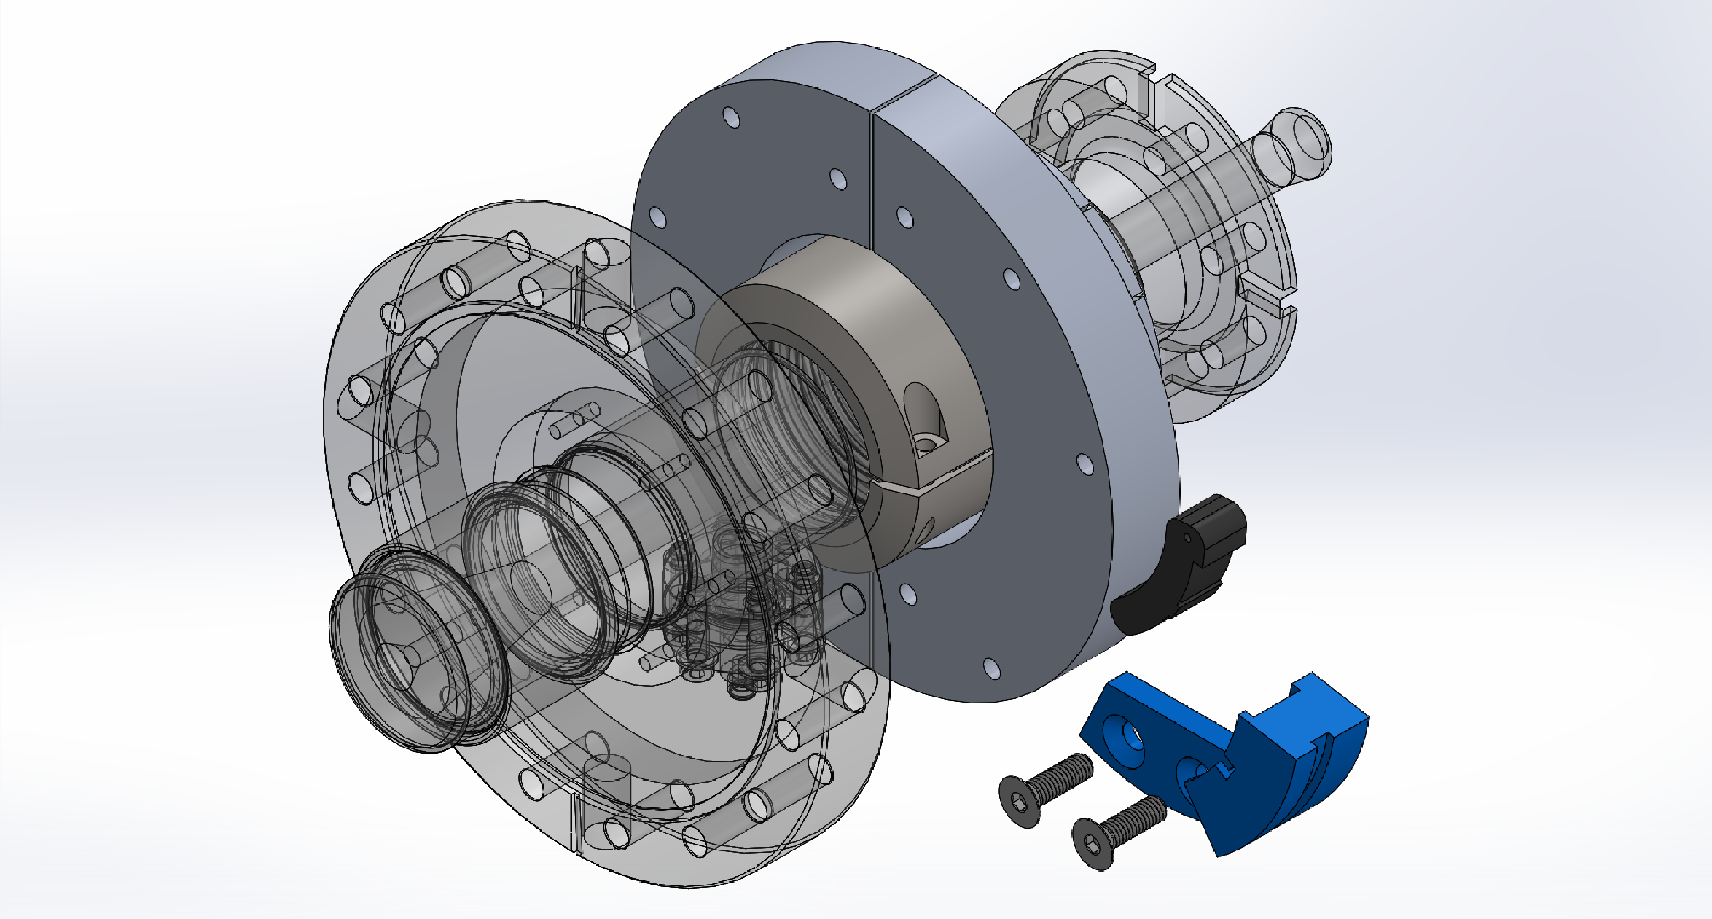
pCM shipping restraint model

Slide 6
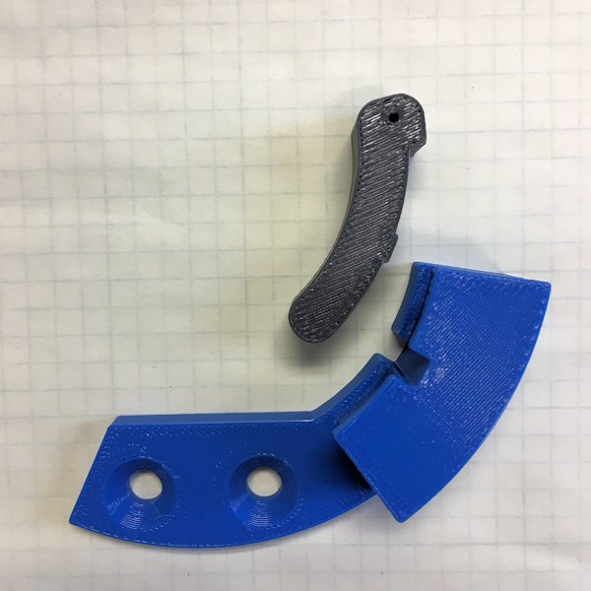
pCM shipping restraint model

Slide 7
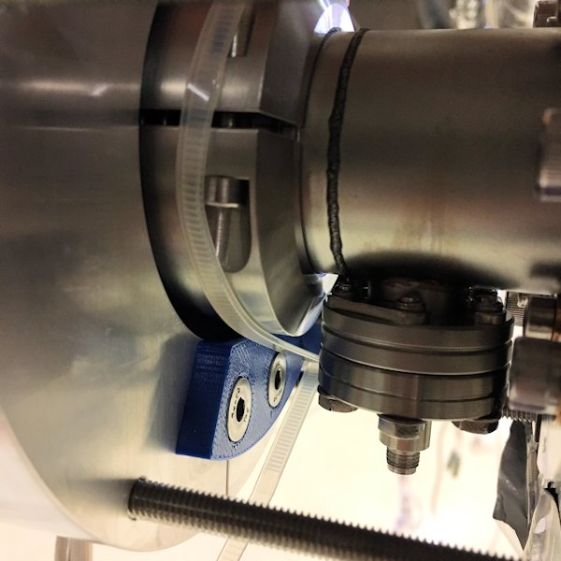
pCM shipping restraint model

Slide 8
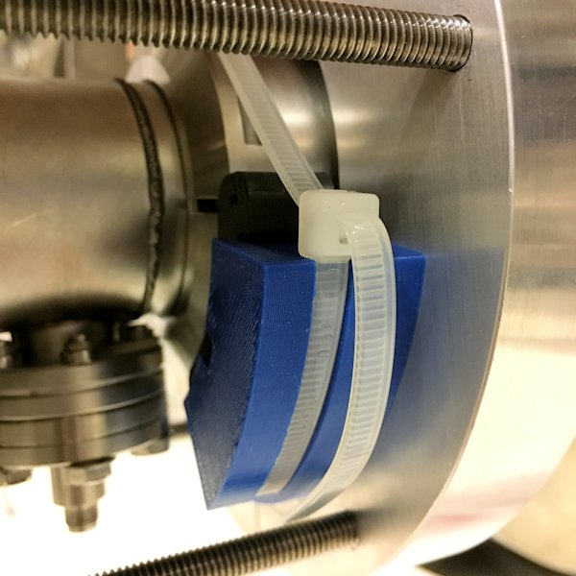
pCM shipping restraint model

Slide 9
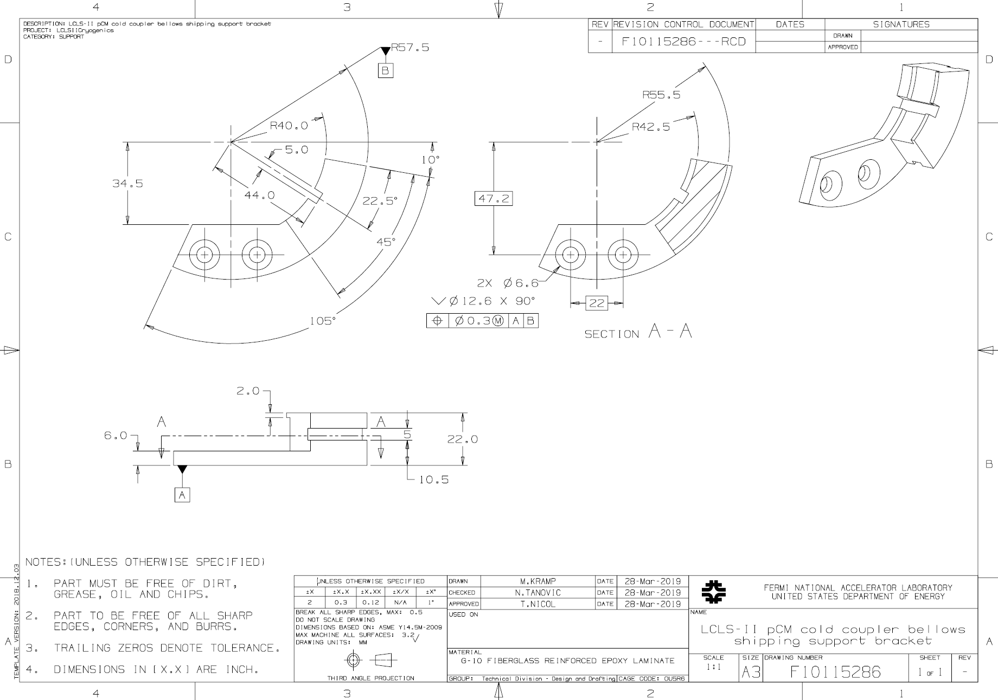
pCM shipping restraint support bracket

Slide 10
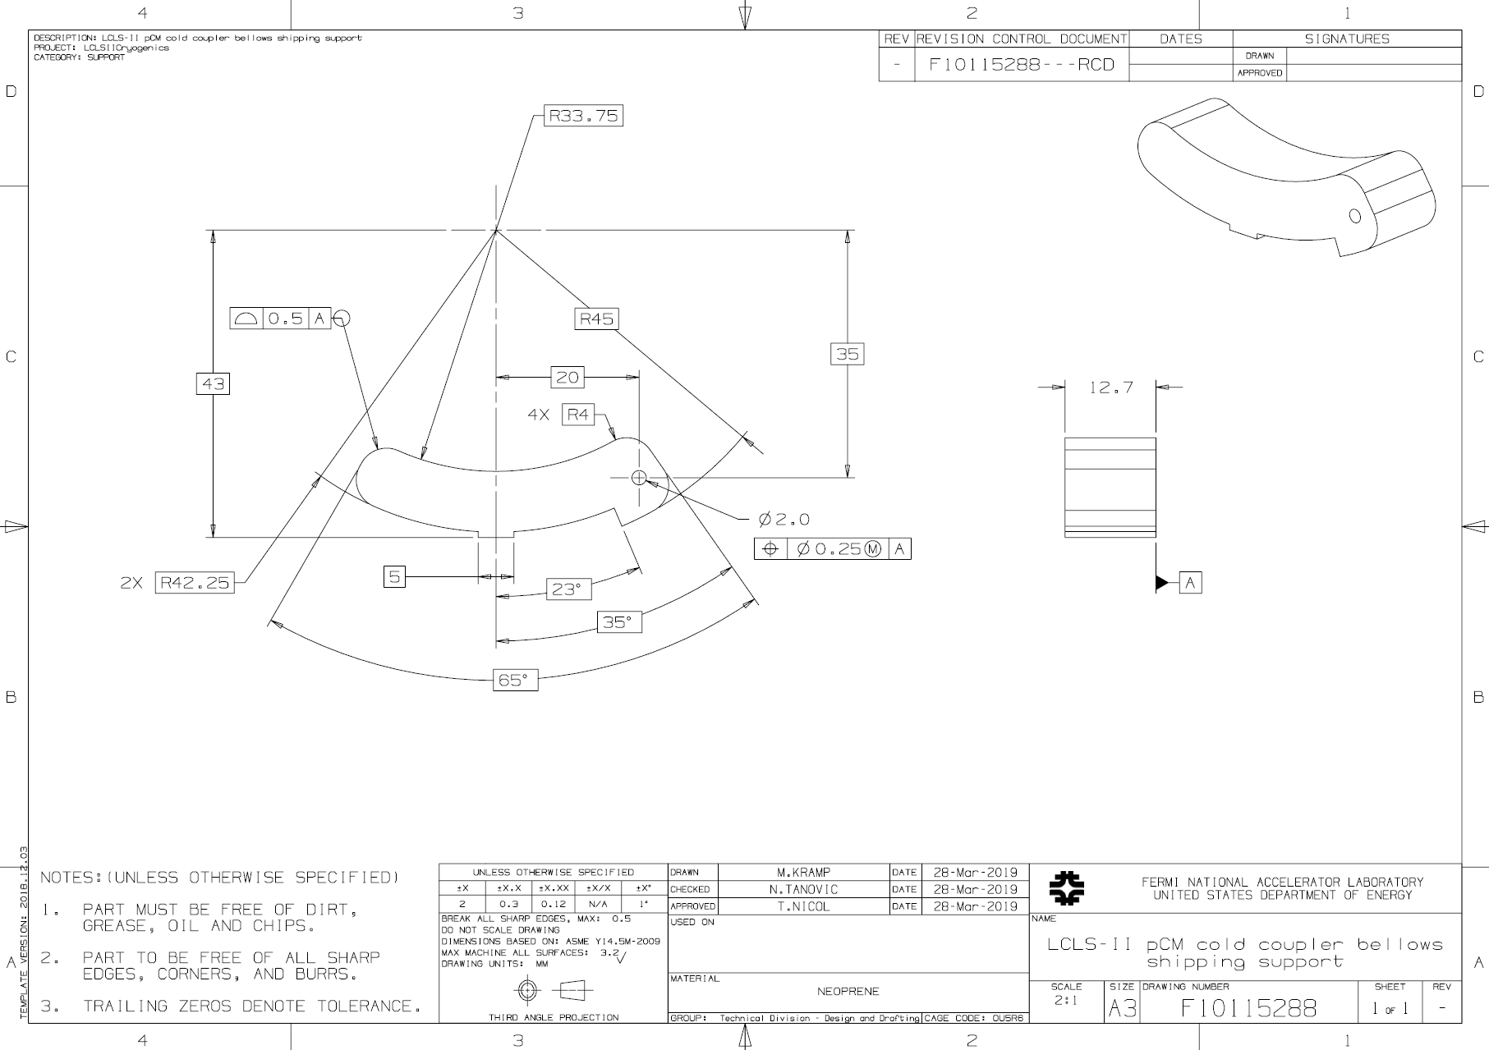
pCM shipping restraint support

Slide 11
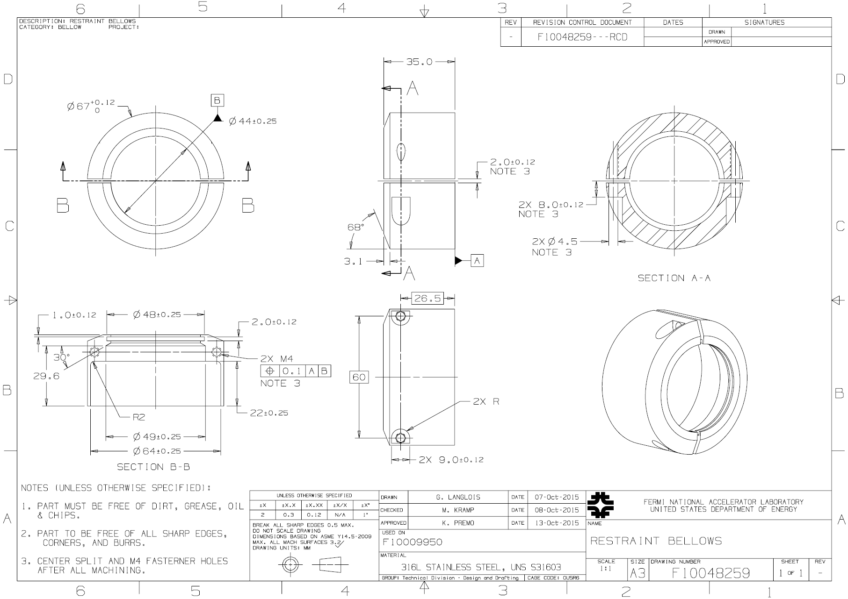
pCM shipping restraint collar (for testing only)

Slide 12
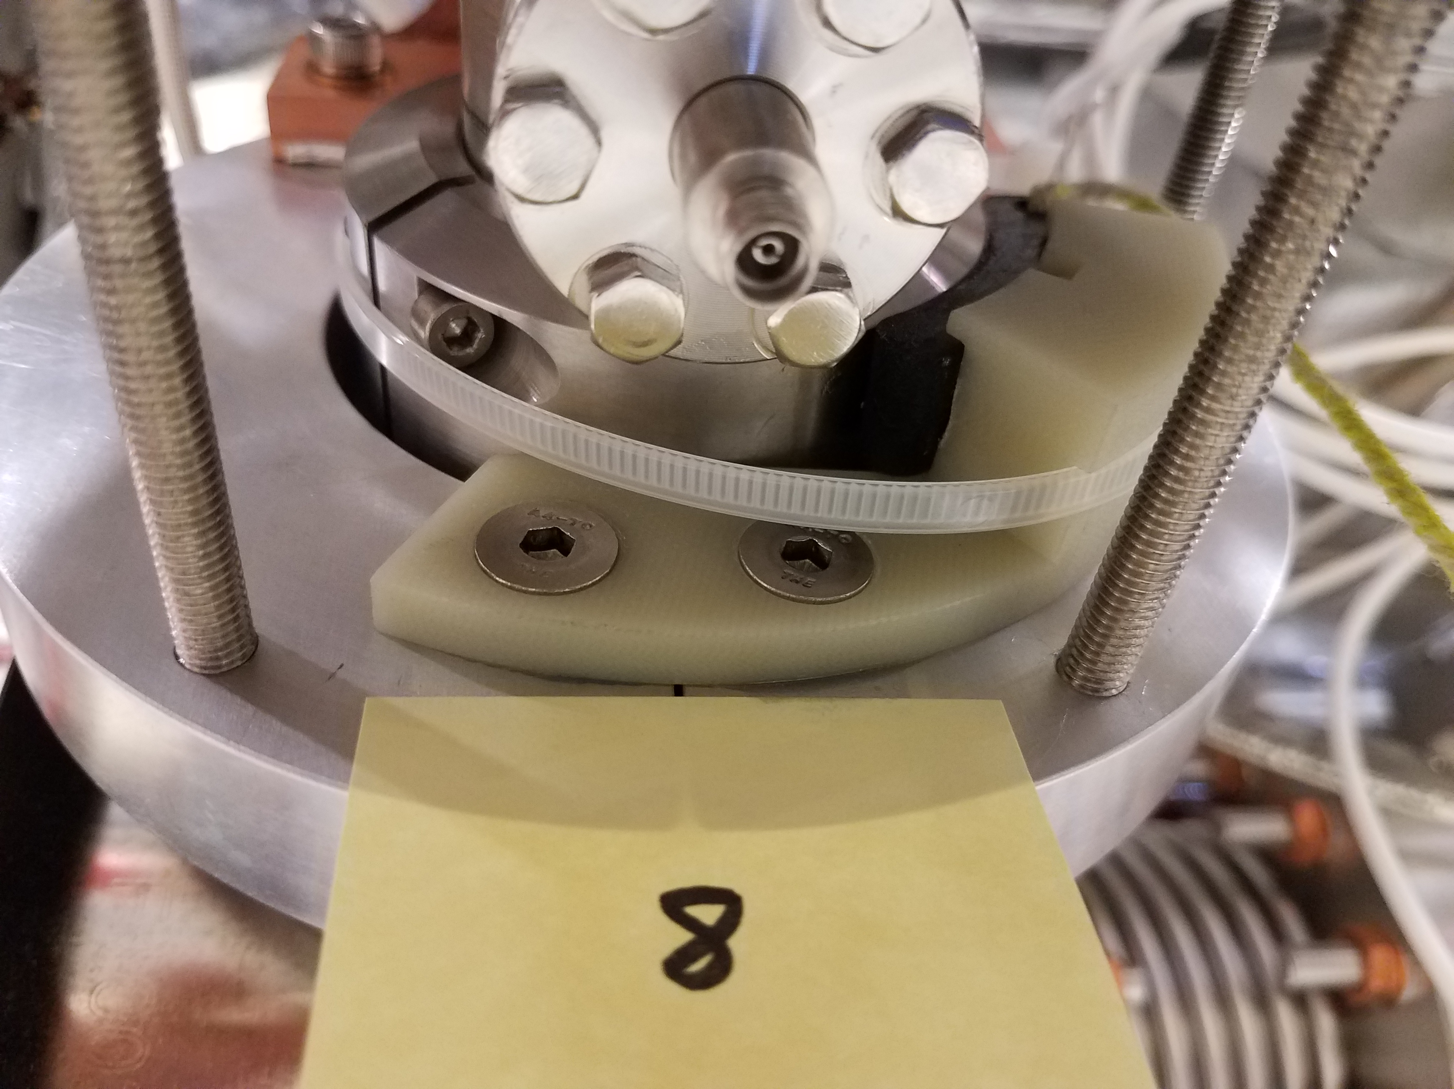
pCM shipping restraint installed (1 of 8)

