Slide 1
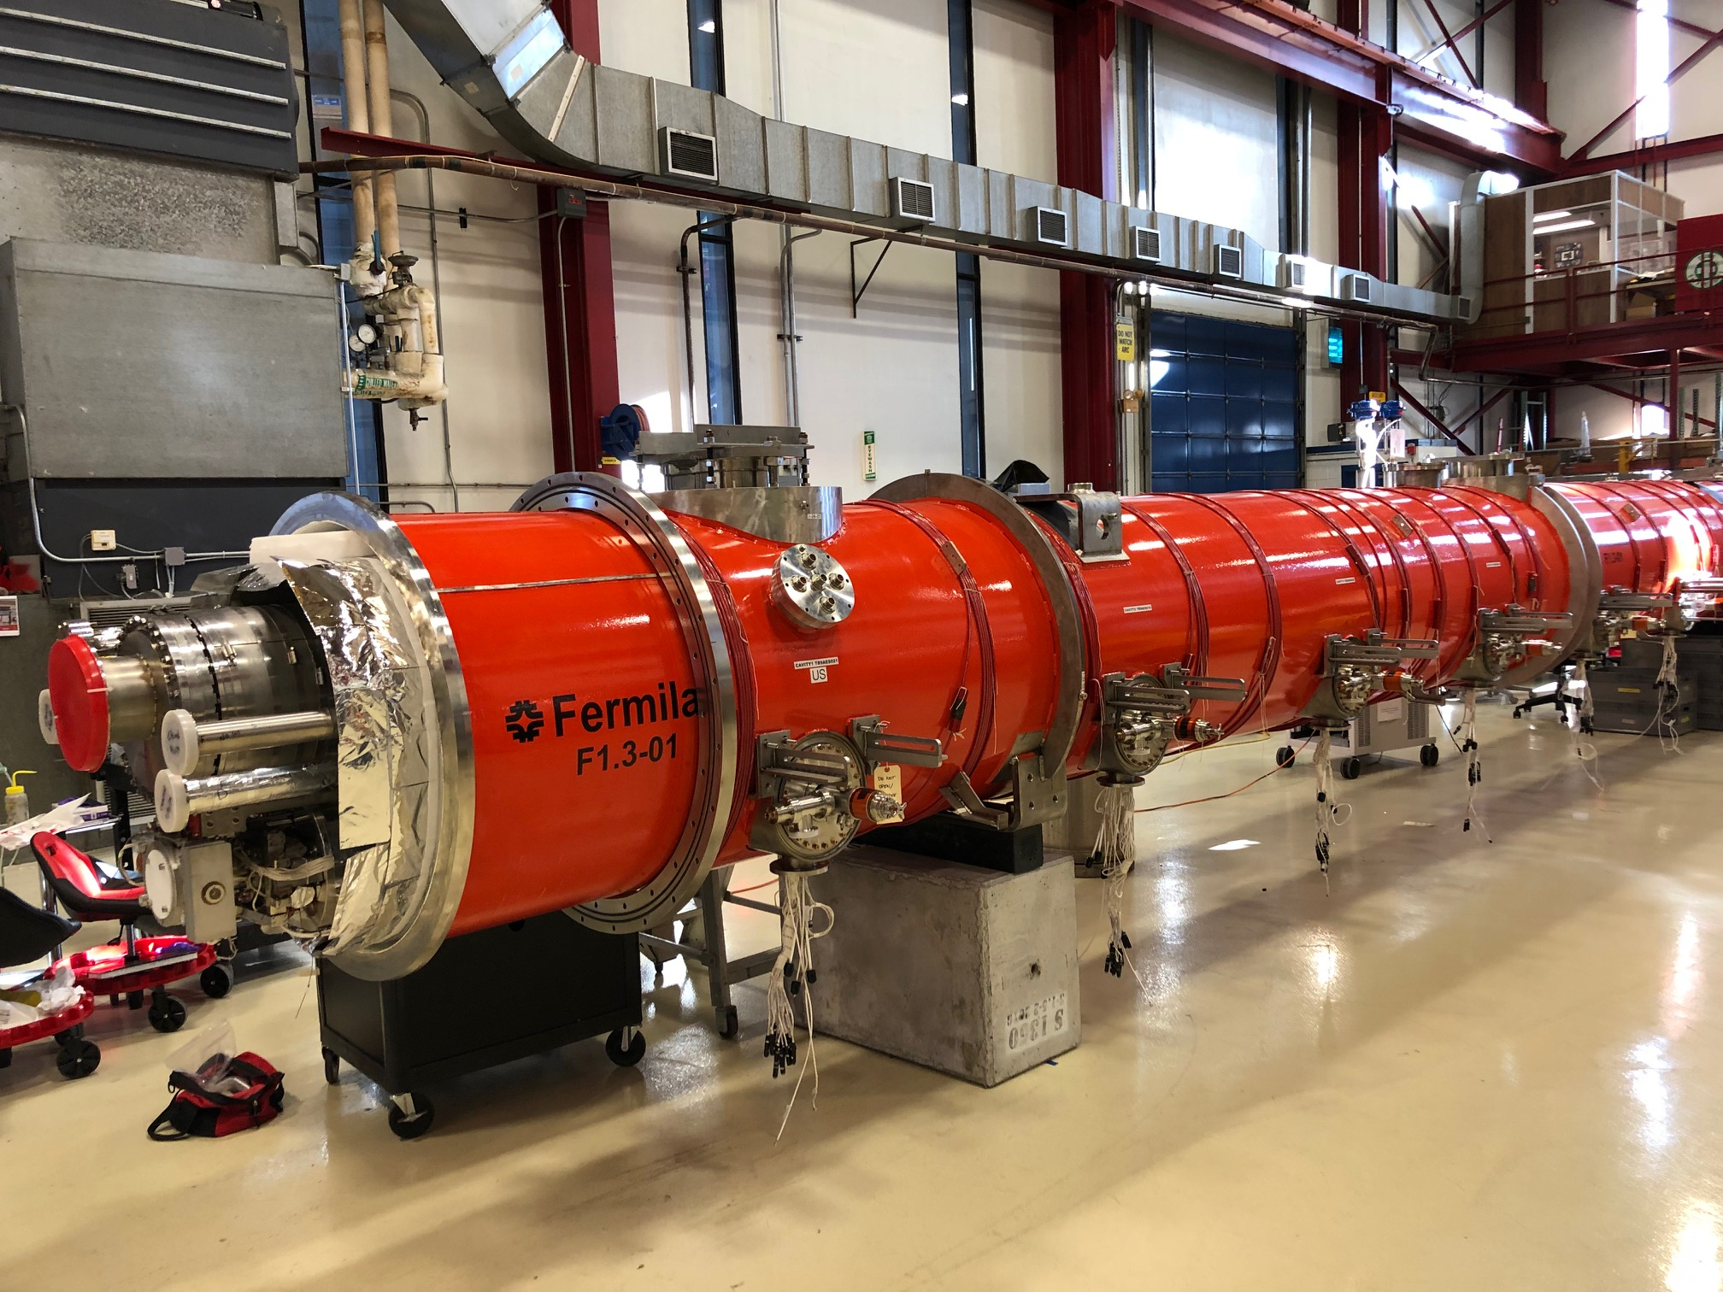
pCM (F1.3-1) at WS5
Warm end couplers are being assembled
Instrumentation flanges installation is completed
Cryogenics valves welding is completed. X-ray is scheduled for tomorrow 4/6 Saturday
Remaining tasks:
Low pressure test of the 2-phase circuit
Insulating vacuum leak check
Beamline configuration for shipping and leak check
Estimated completion at WS5 is 4/26 Friday
Estimated shipping to SLAC: mid May

Slide 2
Repair the vacuum vessel leak: YES
completed
Demag the vacuum vessel post welding: NO, not needed post measurements showed
BPM repair, beamline leak check and vent: YES
completed
What do we do with the upstream end gate valve support? Leave as-is
Add Line D vertical supports: YES
completed
Replace RF cables with latest design? YES
completed
Replace aluminum needle bearings with stainless bearing then alignment: YES
completed
Baffle and vortex generator welding to 2-phase pipe (difficult because cables are running inside the 2-phase) then leak check: NO
Follow 464408 traveler and all stated retrofits. Please add sticky notes and comments for additional work: YES
completed

Slide 3
Pay extra attention to Cav5 cold end coupler ceramic which looks strange with some discoloration. Assess the problem: No performance issues from pCM test at CMTS. Nikolay Solyak recommended to leave as-is
Modify upper heat shields and weld lower heat shields for latest design FPC 50K thermal intercept sink: Requires drilling new holes to the upper heat shields and cutting notches for the lower heat shields. Completed
Use MLI blanket, throw away old MLI blanked (installed layer by layer): YES
completed
Use old design thermal shield for cryogenic valves box: YES
Gas guarded cryogenic valves with reverse configuration: YES
completed
Weld cold mass support tie down nuts to the vacuum vessel: YES
completed

Slide 4
Use WS4 and WS5 traveler for reassembly: YES
Instrumentation (do we keep all the extra (tested and read at CMTS) instrumentation operational)?: YES
Any other thermal intercept optimizations? NO
Any shipping related optimizations? YES.
N-mounts
Any magnet and its thermal intercept related optimizations? NO during planning phase then YES
due failures during retrofit. See DR
https://vector-onsite.fnal.gov/Tools/DiscrepancyReport/DisplayDiscrepancyReportReadOnly.asp?qsDRNo=11720
All the passive mitigations measures to suppress microphonics? YES
completed

Slide 5
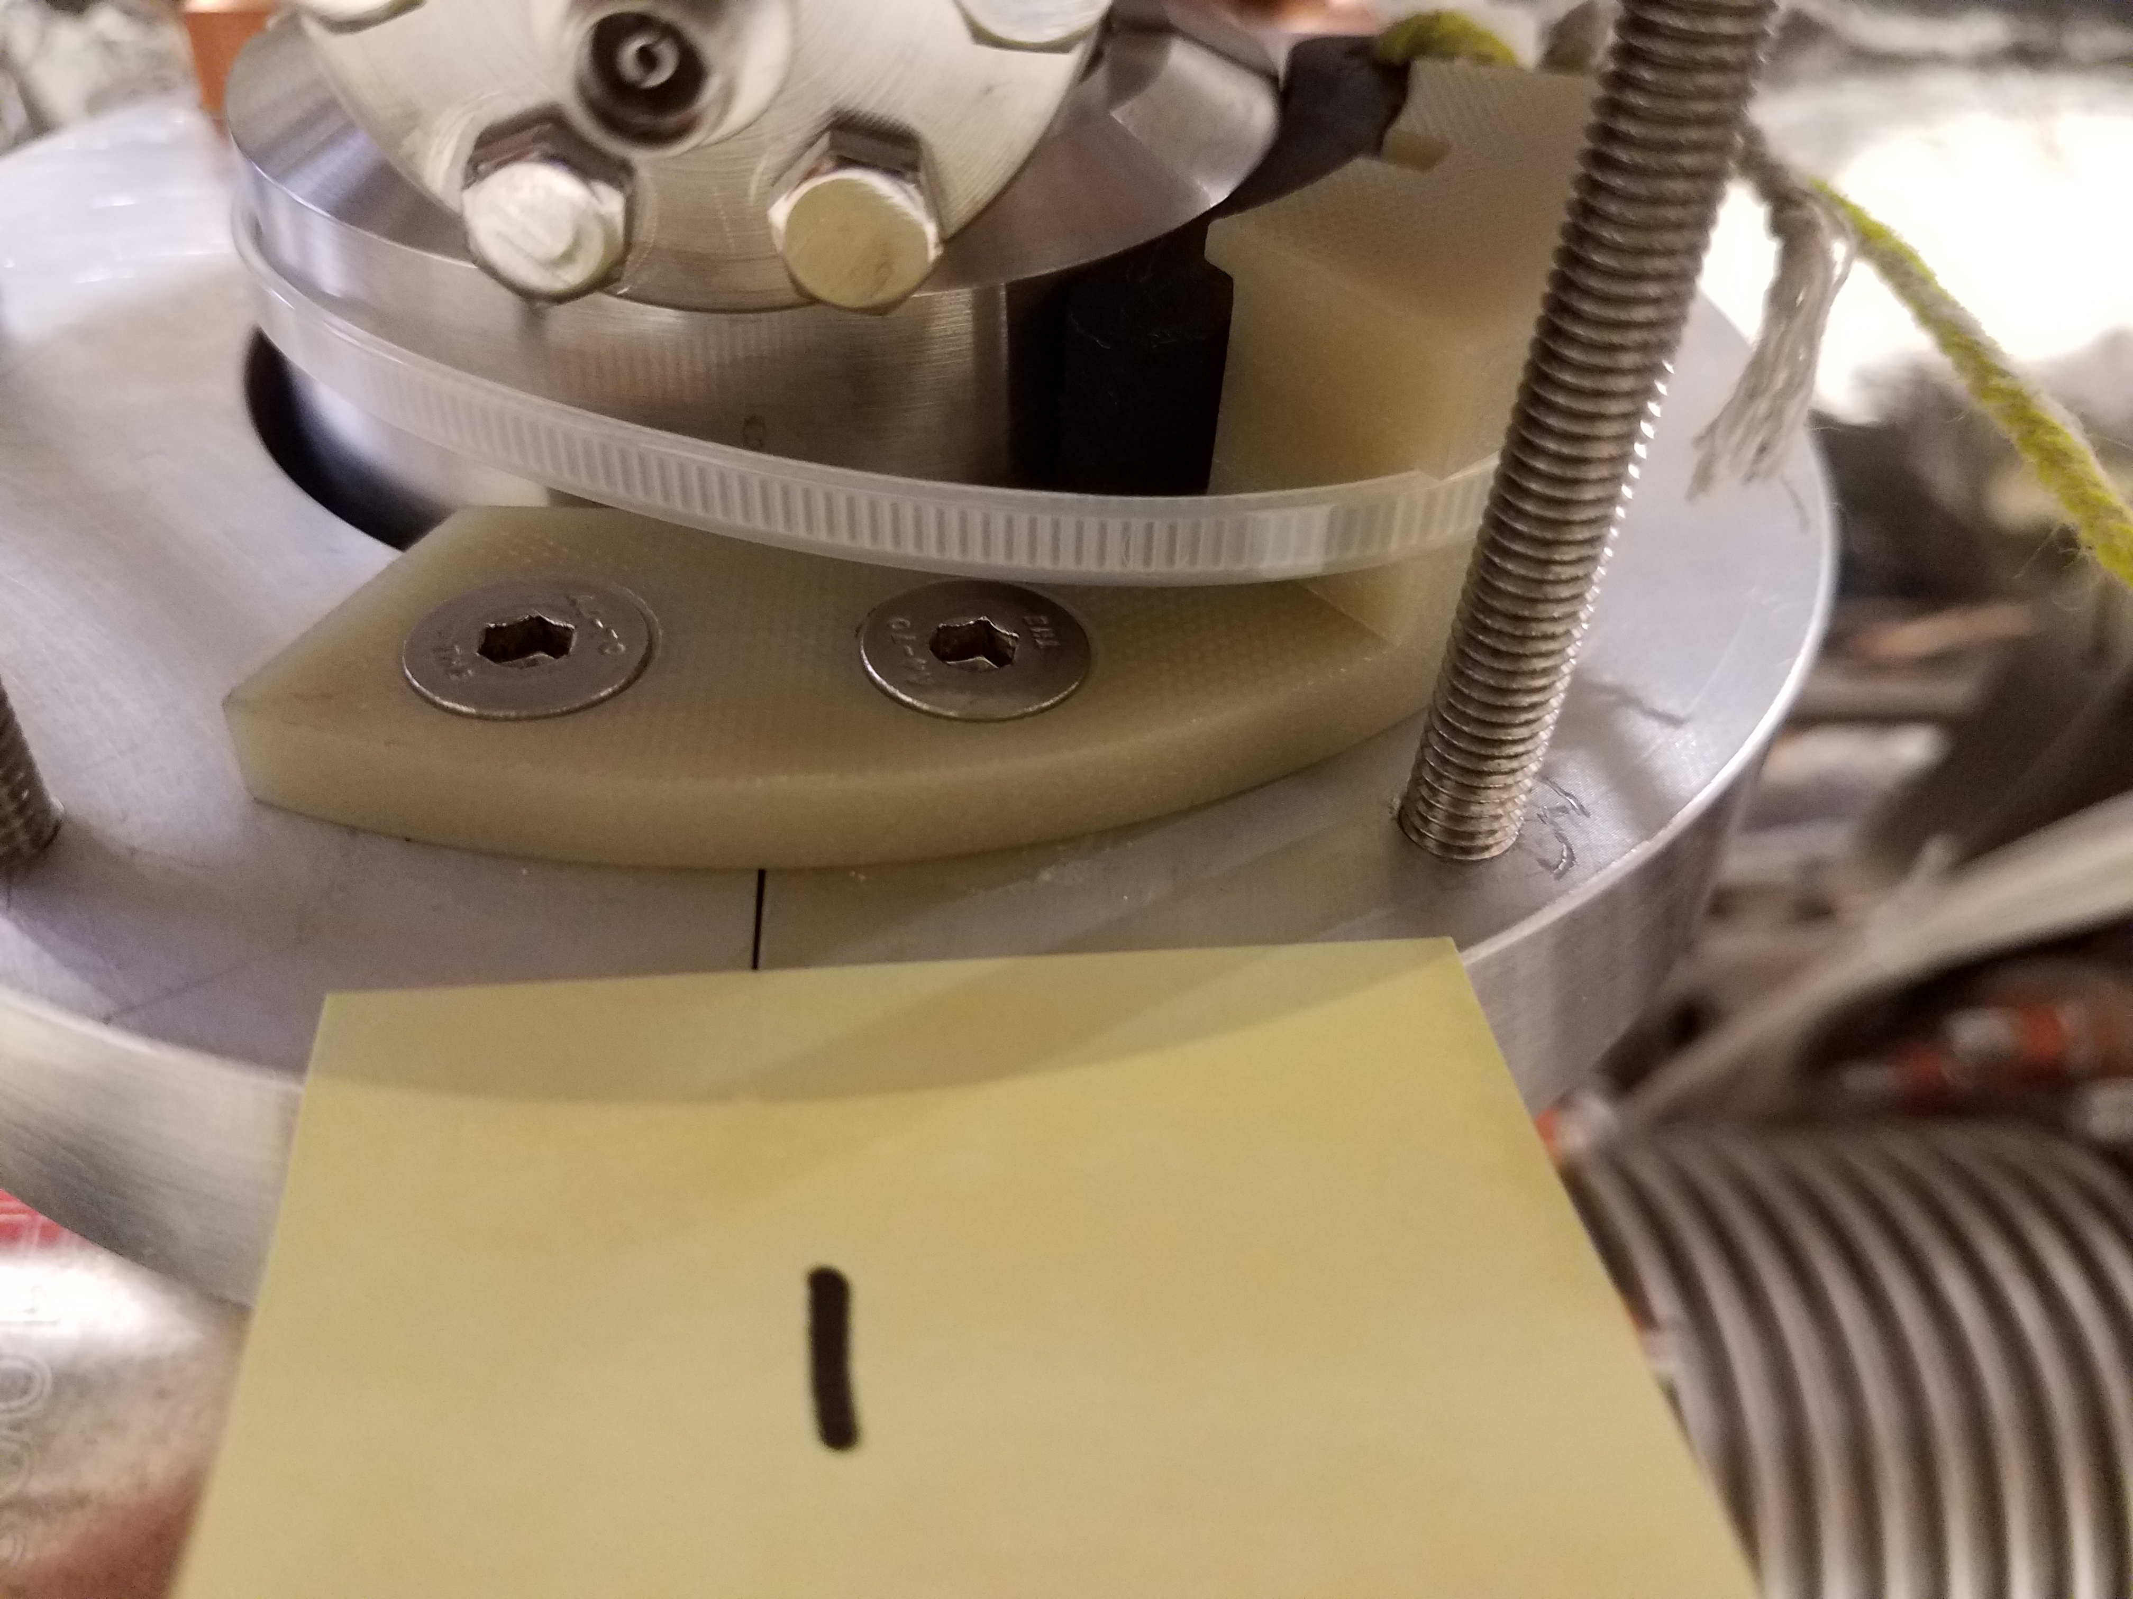
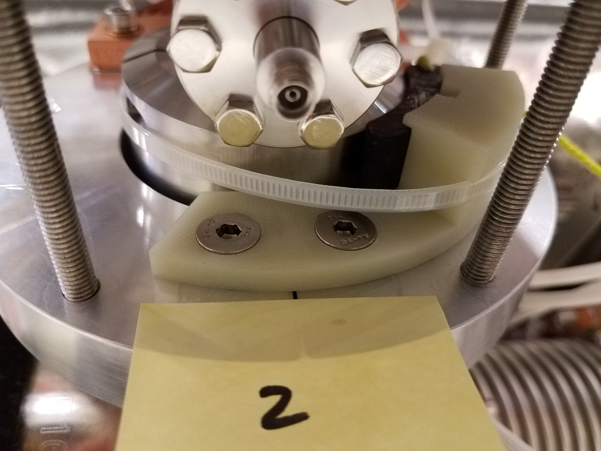
N mount installed

