Slide 1
Microphonics Lessons Learned at JLAB
Tom Powers
LCLS-II-HE
25 April 2019

Slide 2
Measurements made at JLAB
Modal measurements were made of the sub cavities, string and assembled cryomodule prior to cool-down.
Modal measurements were analyzed in order to characterize the modal shapes of the string, coupler vacuum manifold, etc.
Background microphonics (frequency shift) were measured for most of the cryomodules.
Impulse hammer to cavity frequency shift measurements were made on three of the cryomodules, PCM, CM3 and CM10.
One of the next tasks is to measure the microphonics, impulse response and vibrations on auxiliary components such as cryo-lines and waveguides in the LERF (this summer).

Slide 3
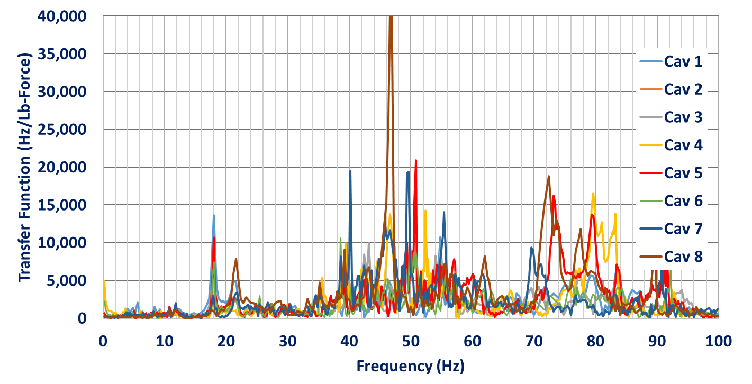
Impact Hammer to Cavity Frequency Shift CM3
Strike beam line at cavity 8 end.
Resonances observed at 18, and 22 Hz with a number of modes between 40 and 56 Hz.

Slide 4
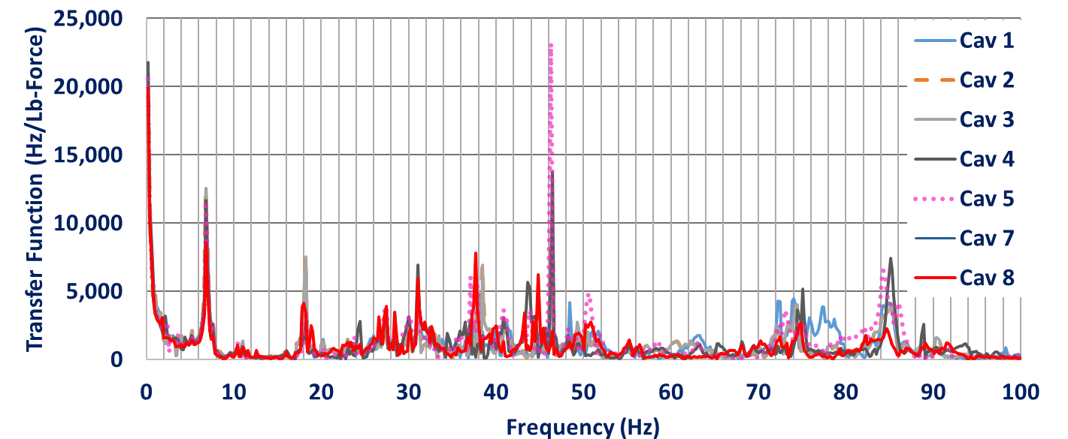
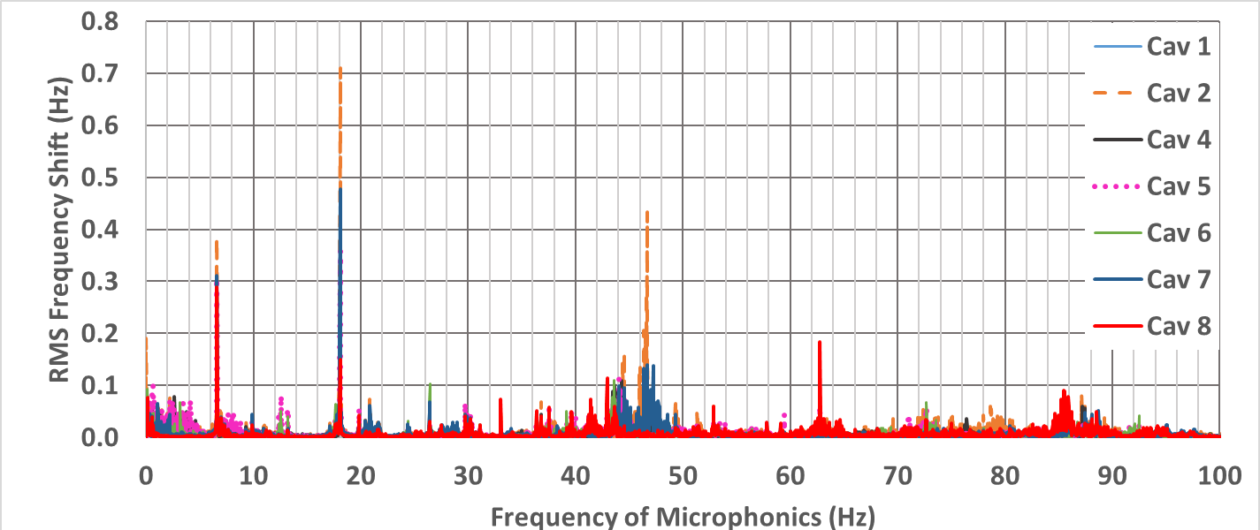
Impact Hammer to Cavity Frequency Shift CM3
Impulse Response
Strike beam line at cavity 8 end.
Resonances observed at 7, 18, and 32 Hz with a number of modes between 40 and 52 Hz.
Excitation by external sources at or near resonances can lead to excessive microphonics at that frequency.
The 7 Hz mode is a little un-nerving as our chilled water towers and piping vibrate in this frequency band.
Background Microphonics

Slide 5
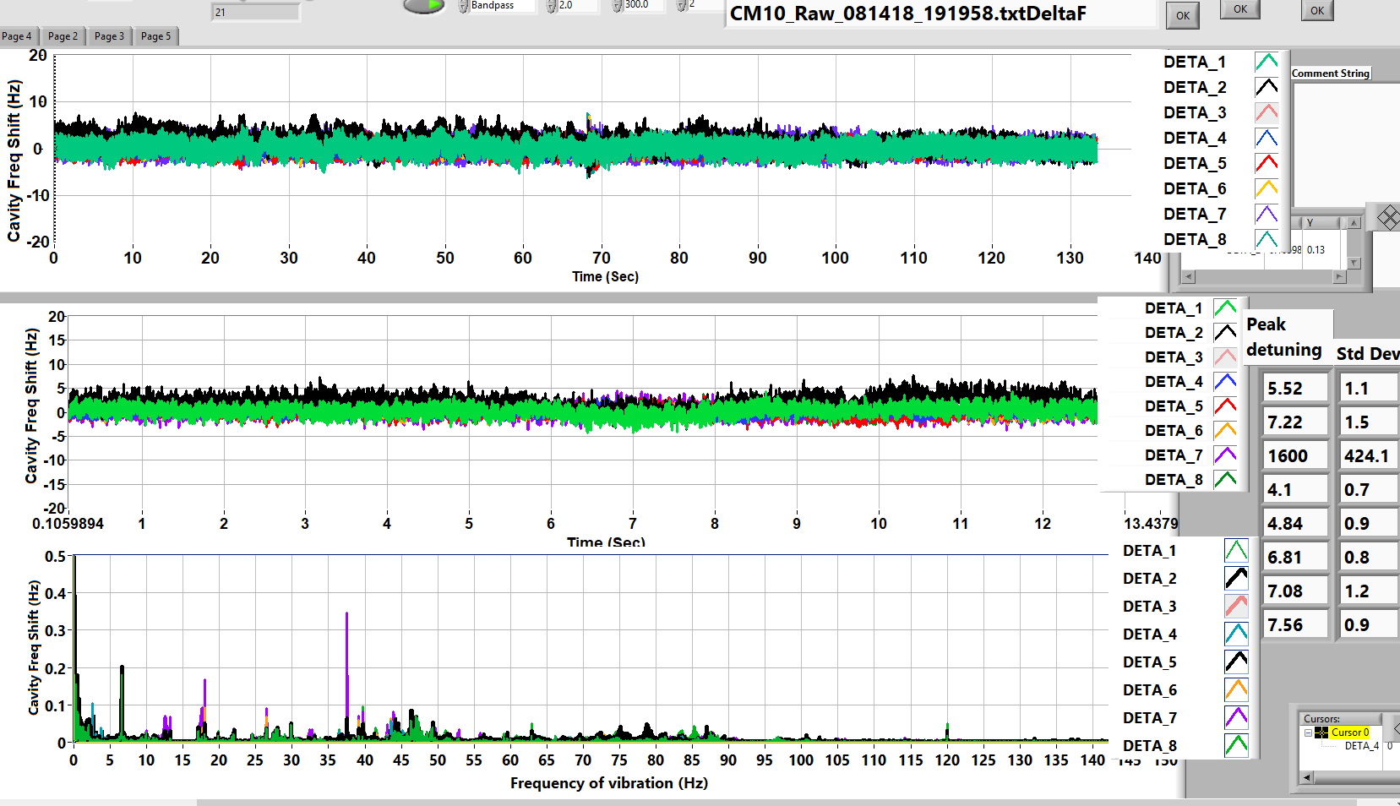
Background microphonics CM10
Meets Spec Life is good

Slide 6
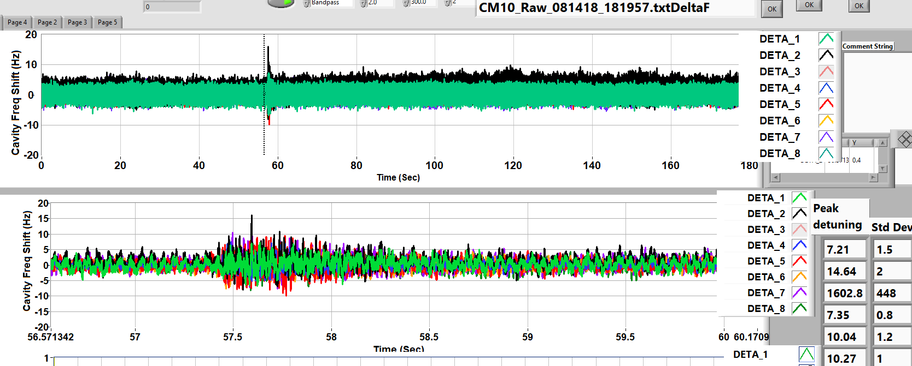
CM10 Background Microphonics With Perturbations
Tuner Algorithm Dead Band
JT Valve Operation
Life is good
Until it is not!
Excessive transients will require that, as a minimum, the cavity be switched to SEL mode and the that the beam be interrupted.
We do not know what types of transient perturbations are going to occur in the LCLS II tunnel

Slide 7
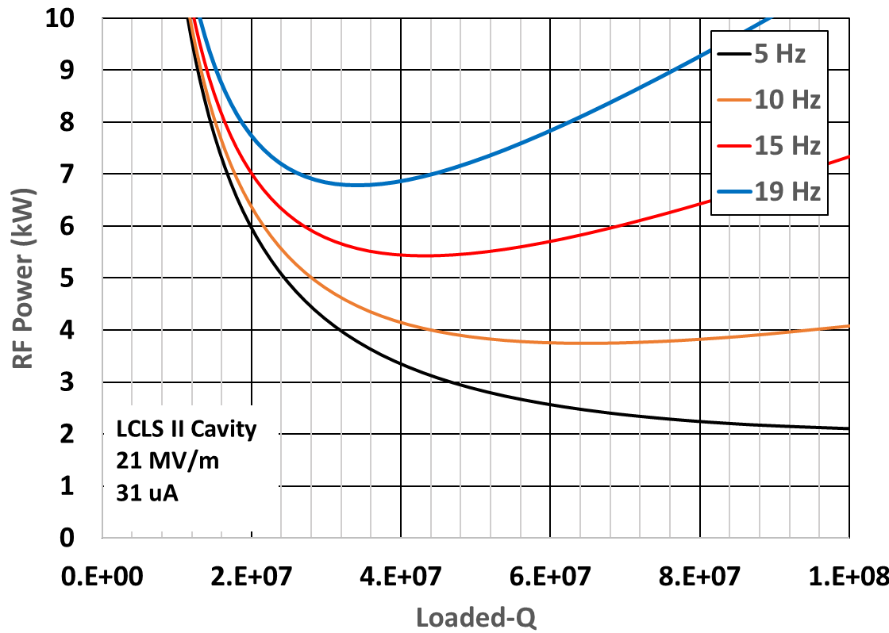
RF Power as a Function of Loaded-Q for Various Levels of Microphonics
Loaded-Q of 6e7 is the minimum power for 10 Hz of microphonics but decreases the microphonics margin.
Recommend setting loaded Q to about 3.4e7 to allow for maximum microphonics margin for the RF power.
Add contingency for at least 20% more RF power and decide to exercise it based on operational transient microphonics in LCLS II tunnel.

Slide 8
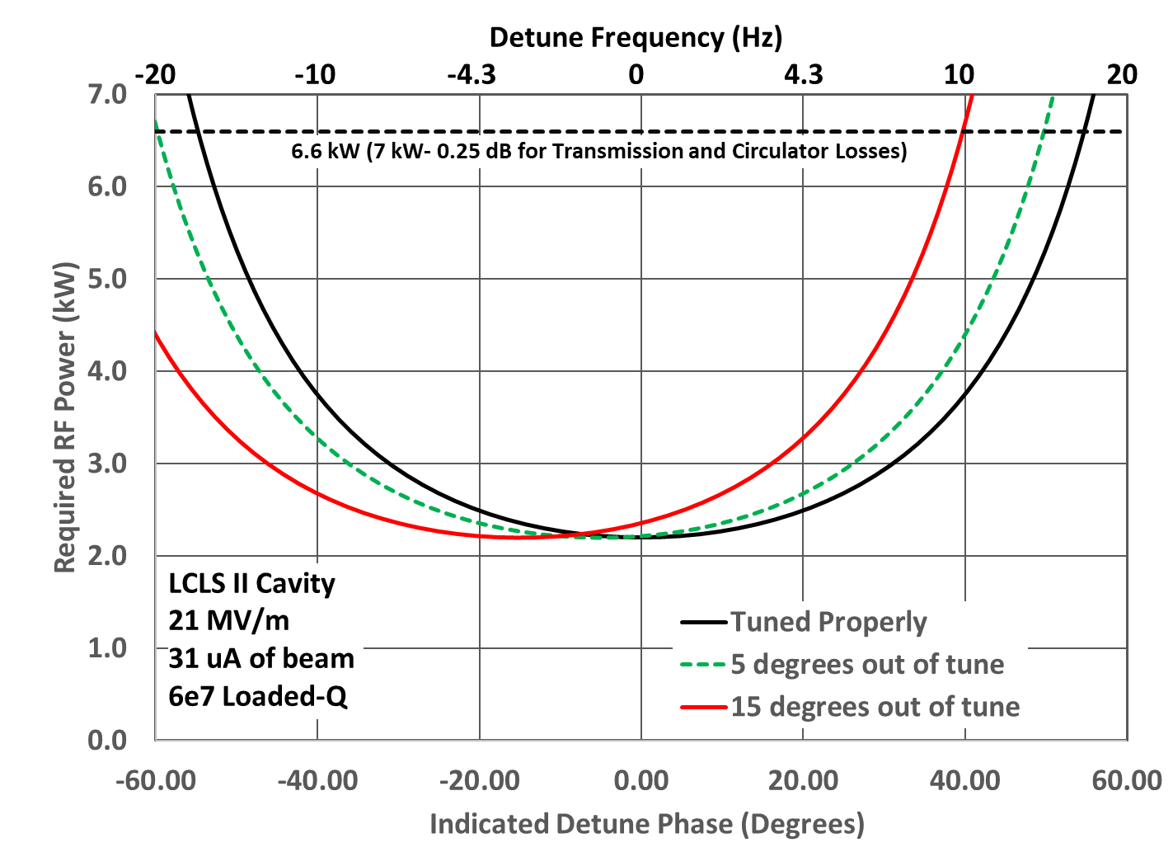
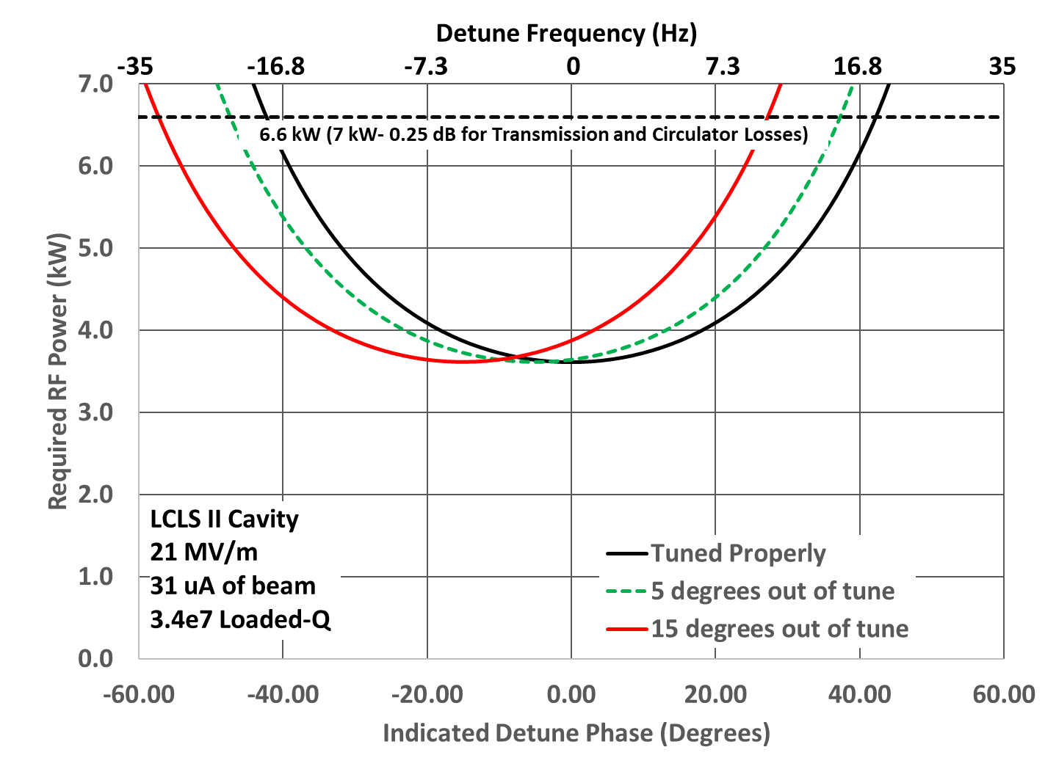
Effects of Detune Offset Errors
16.6 Hz
18.2 Hz

Slide 9
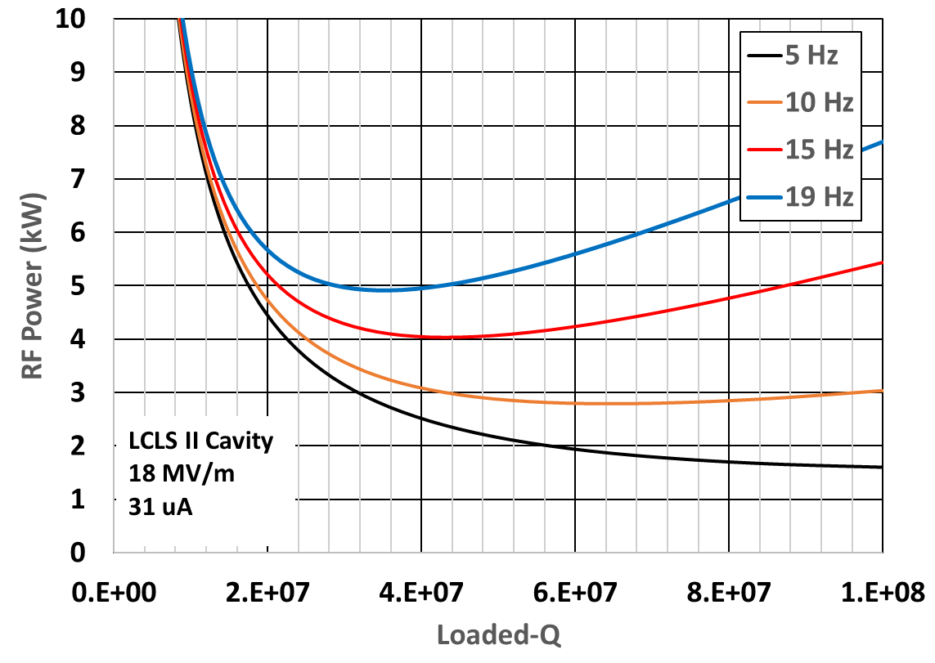
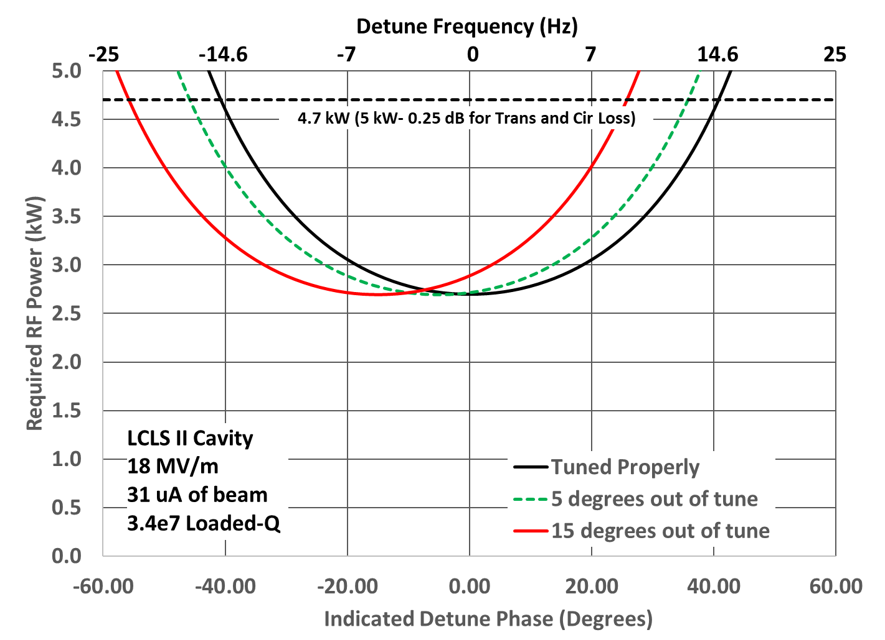
Previously Installed Cavities With 5 kW HPA

Slide 10
Summary
Although steady state “background” microphonics is very good less than 5 Hz peak. Transient microphonics is what causes machine faults. We typically get 15 to 18 Hz peak excursions coincident with JT valve operation.
Recommend setting loaded-Q to about 3.4e7 rather than 6e7 to allow for maximum microphonics margin for the given RF power.
Recommend adding a contingency for at least 20% more RF power and decide to exercise it based on operational transient microphonics in LCLS II tunnel.
The 7 Hz mode in the cryomodules with the bellows on cavity 1 is a un-nerving as this is the vibrational mode of the chiller towers at CEBAF and we know that we had beam energy jitter problems when a motor on a chiller tower was failing and caused vibrations which matched the 10 Hz string mode in the C100 cryomodules.
The other concern is leakage in the cooldown valve causing excessive microphonics. I can not say that we have seen this problem at JLAB. This is also a concern for the initial installation as this type of valve is known to leak from time to time.

