Slide 1
LCLSII HE Cavity Procurement Overview
Jarrod Fitzpatrick
LCLS-II HE Cryomodule Performance Workshop
April 25-26, 2019

Slide 2
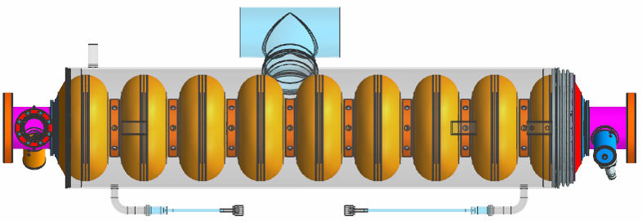
Outline
Introduction
Requirement
Stakeholders/ Environment
SOW
Roles/ Responsibilities
Procurement Strategy/ Process
Timeline of Events
Vendor (Subcontract) Management Plan
Issues
Addressing Lessons Learned
Documentation Package

Slide 3
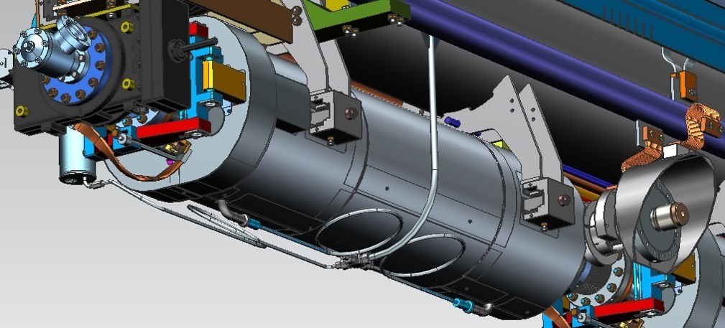
Requirement
1.3 GHz SRF Dressed Cavities
  Qty: 160 (20 Cryomodules)
  Options: Up to 80 cavities
  Design: Build-to-Print
  Mechanical Specification: 9 Cell LCLSII Mech Design
  Material Spec: TBD
  Processing Recipe: TBD

Slide 4
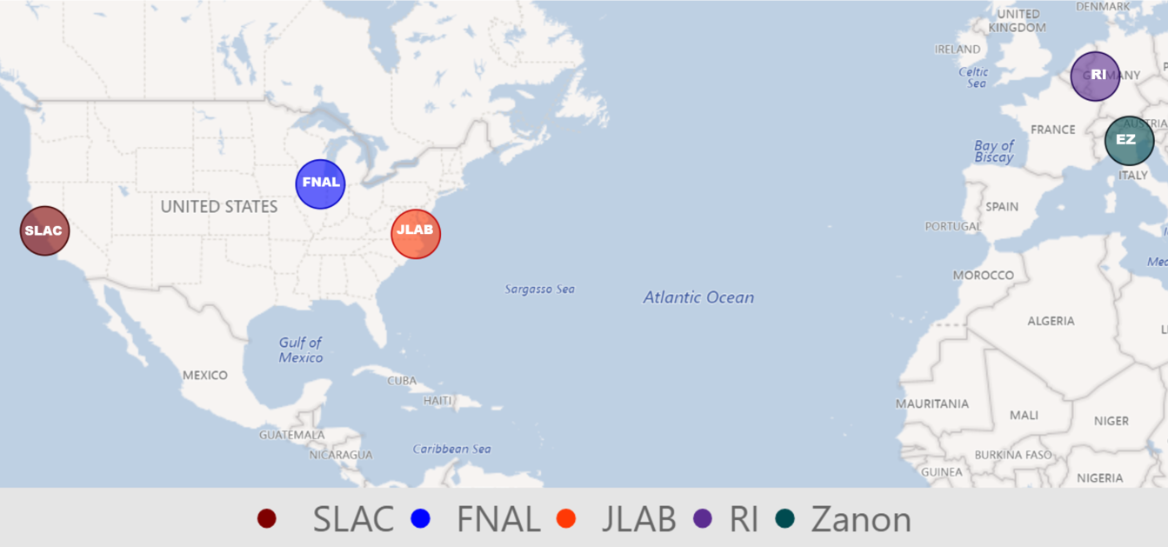
Stakeholders/ Environment
LCLSII HE Partner Labs
Cavity Fabrication Vendors
4
September 25, 2014 Business Sensitive

Slide 5
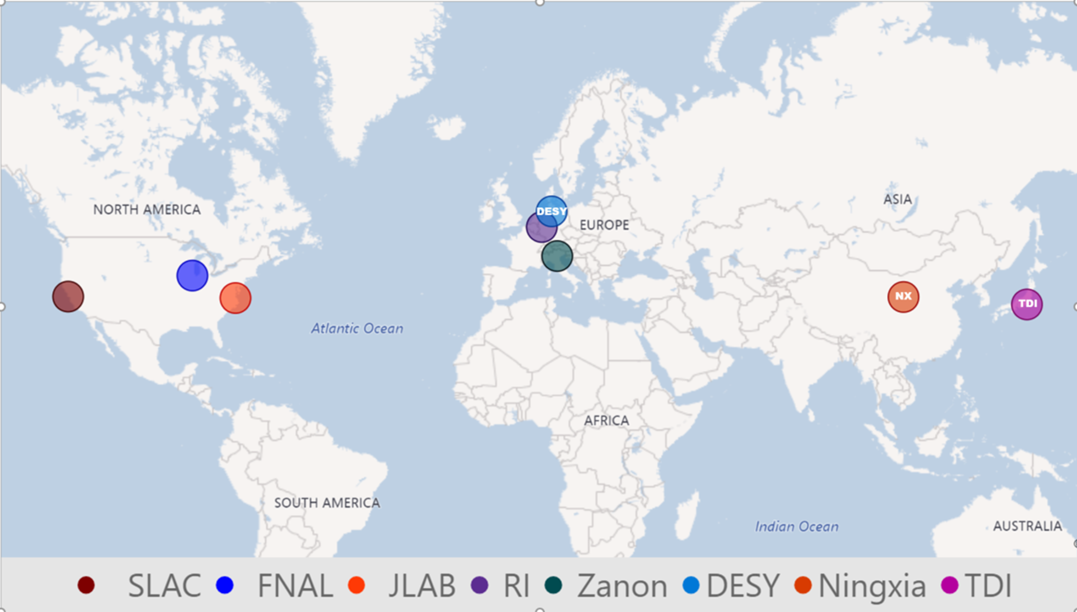
Stakeholders/ Environment
Nb Inspection &
Cavity Testing Equipment Supplier
Nb Material Suppliers
5

Slide 6
Scope of Work
Given the environment……..
Revised SOW
  Fabrication, inspection, chemical processing, packaging & delivery
  *Provide any/all testing equipment: (CTM, Hazemema, etc.)
  *Supply & *inspect all component materials (sheet & non-sheet)
  *Supply all hardware, fixtures, tooling, etc.
    Exception (GFP): Component materials for (120) bare cavities, Feedthroughs

Slide 7
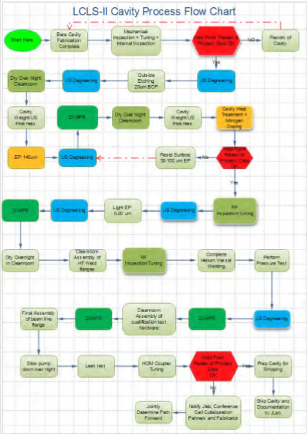
Scope of Work - Acceptance
LCLSII Acceptance Criteria
  Mechanical/ dimensional inspection
  Defined by:
  Adherence to mechanical fab specifications
  Cavity Processing Recipe
  No required performance threshold
  Opportunities for HE……

Slide 8
Roles & Responsibilities
Subcontract Management Team
  SLAC
    Subcontracting Officer (SO)
    Lead Technical Representative (SOTR)
    SME(s)
  FNAL
    Technical Representative (SOTR)
    SME(s)
  JLAB
    Technical Representative (SOTR)
    SME(s)
APP Development in-progress…..

Slide 9
Procurement Strategies
    Solicitation Type:
  Unrestricted – Full & Open Competition
      Must meet minimum SRF cavity processing requirements
Dual sourcing:
  Mitigate risks of vendor equipment/ performance issues
  Competition, Competition, Competition
Incentives:
  Schedule Acceleration
  Improve Quality/ Performance**
First Articles:
  VTA testing feedback loop
  Mitigation against cavity processing issues

Slide 10
Source Selection
  Best Value – Trade-Off
    (Technical Factors over Price)
Evaluation Strategy
  SSO, Chairperson
  Voting Members
  Advisors
Source Selection Board (SSB)
  Experience & Past Performance
  Resources, Facilities, Planning & Mgmt
  Quality Assurance, etc.
Factors & Subfactors
  Ascending, Descending Order
  Equal Importance
Level of Importance
  Include in Instructions to Offerors
  Gain Approvals
Complete the Plan

Slide 11
Subcontract Phases
  Subcontract Award……est 10/31/19
  Phase I – Vendor Qualification
    Vendor A - Furnace Validation (3 months)
    Vendor B – Not Required
  Phase II – First Article Fabrication & Delivery
    Vendor A - 10 Cavities (6-8 months)
    Vendor B – N/A
  Phase III – Full Production
  Production deliveries begin (8 months)
  Remaining deliveries complete (24 months)
  Phase IV – Optional Future Quantities
  (0-80) Cavities, executed 6 months prior to final production delivery
11

Slide 12
Subcontract Management Plan
Each Partner Lab provides technical representation, oversight.
FNAL (Designer of Record) manages design/ specification.
SLAC (Procurement Lead) manages contract(s), vendor communication
Oversight, oversight, oversight
Weekly Status Meetings
Onsite Presence…Especially early on!
Subcontract Management Team
FNAL
SOTR &/or CAM, SME(s)
SLAC
CAM
SME(s)
JLAB
SOTR, &/ or
CAM, SME(s)
SLAC SOTR/ SO
Vendor(s)
12

Slide 13



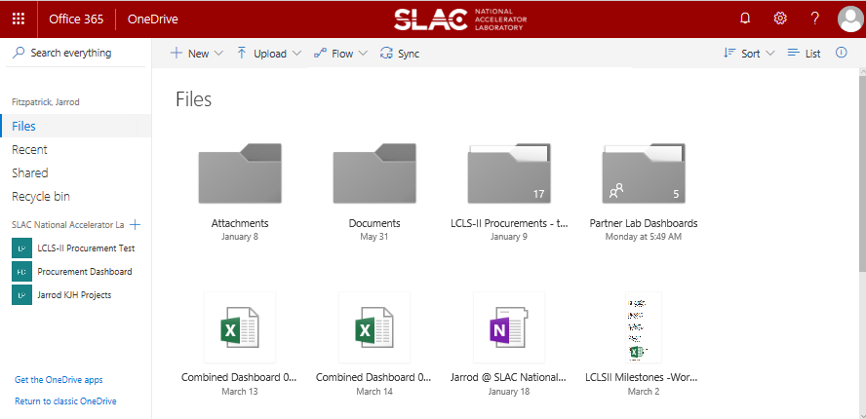
Vendor Communication
  Communication Tools
    Web Conferencing: WebEx, GTM, etc.
    Doc Sharing
    Tracking Issues, Deliverables, etc.
    Considerations:
      Language, Time Zones, Training Required
    Intent
        Clarifying Expectations
        Building trusting relationship
        Develop understanding vendor’s strengths/ weaknesses, motivations
        Identifying problems early

Slide 14
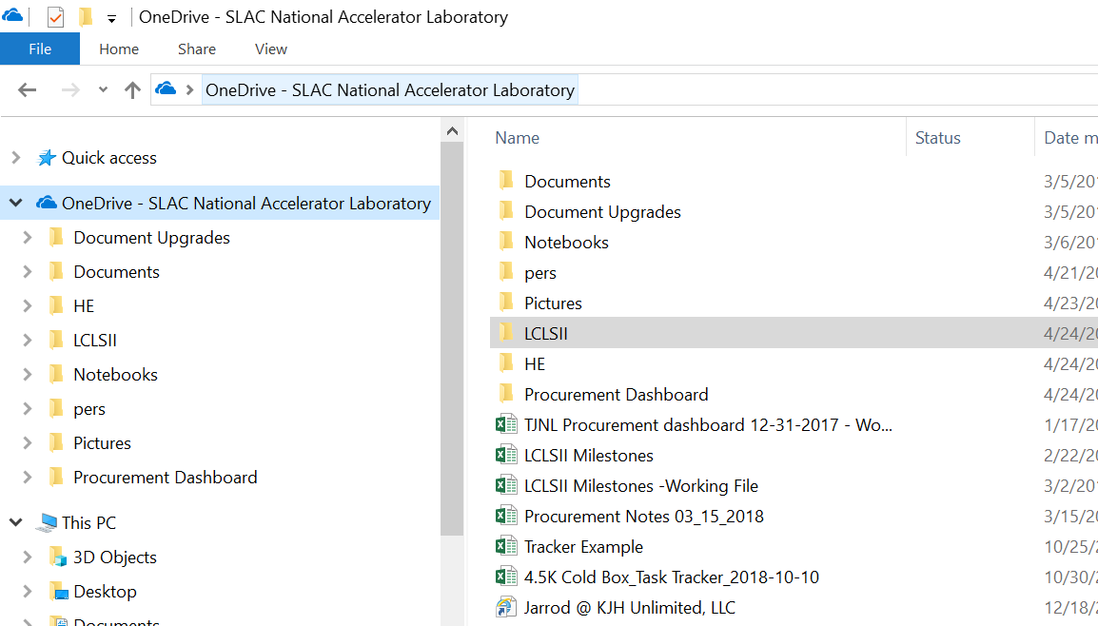
Cavity Procurement Overview
Notes:
Intent
Clarifying Expectations
Building trusting relationship
Develop understanding vendor’s strengths/ weaknesses, motivations (Zanon)
Identifying problems early

Slide 15
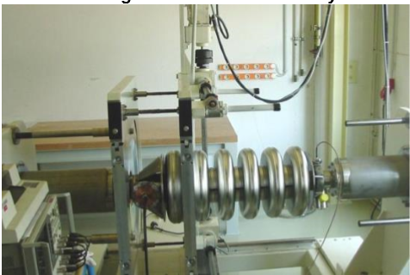
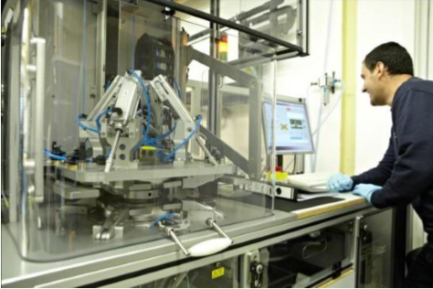
Cavity Testing Equipment
RF measurement of XFEL dumb-bell in HAZEMEMA
Cavity Testing Machine (CTM) w/ SNS cavitiy
BACK
Notes:
Intent
Clarifying Expectations
Building trusting relationship
Develop understanding vendor’s strengths/ weaknesses, motivations (Zanon)
Identifying problems early

Slide 16
Cavity Procurement Overview
?
Notes:
Intent
Clarifying Expectations
Building trusting relationship
Develop understanding vendor’s strengths/ weaknesses, motivations (Zanon)
Identifying problems early

