Slide 1
Clean Room Assembly Lessons Learned at Jlab
Kirk Davis
LCLS-II-HE
25 Apr, 2019

Slide 2
Cavity String Improved Practices: Field Emission
String Number | Date | Improvements Made to Reduce FE
8 | Oct 2017 | Improved bellows cleaning practices
8 | Oct 2017 | FE free cavities required for cavity strings
10 | Nov, 2017 | Eliminated 24MV/m admin limit in vertical test All cavities vertical tested to maximum gradient.
 | Dec 2017 | String audit by Stephane Berry
11 | Feb 2018 | Introduced external rinsing procedure and cage cleaning from Vendor practices. Incorporated recommendations from S. Berry audit, such as new Gore-Tex gaskets for each string and bellows attachment using 4 bolts in vertical orientation
12 | Mar 2018 | Improved HPR procedure Improved cavity exterior cleaning procedure

Slide 3
Cavity Test and String Infrastructure
Need more pump systems for slow pumpdown, slow bleedup, leak check (presently three in cleanroom)
Cavity bleed-up after qualification; cavity assembly for re-test
String assembly
FPC receipt inspection
Need one more full set of string tooling (currently two)
Rework and cleaning between strings takes up to one week
Decouples rail return from cryomodule assembly
Magnetic field sensors and temperature sensors were in short supply
Vertical test requires constant replenishment
Cleanroom has only one parking spot for 3-cavity vertical test stands
Cleanroom needs permanent clean N2 and clean He supply systems
Facilitates clean assembly
FPC string tooling has excessive slop

Slide 4
Cleanroom String Assembly Components
Bellows and spools multiple issues
Copper plating anomalies
Dents
Flange scratches
Rotatable flanges
Cavity parts-in-circulation were in short supply
Cavity field probe specification changed mid-project
HOM tuning is not robust after setting, must be checked/re-tuned often
Early production cavities were dirty externally and internally (field emission)
String gate valves varied in condition wrt cleanliness, oxidation

Slide 5
Cavity & String Assembly Quality and Procedures
String was pumped down without proper restraints on rail.
Added a hold point to traveler for independent verification
Tracking the status of bellows became cumbersome because of multiple rework cycles including re-plating
Early cryomodule field emission was traced to variation in details of removing cavities from HPR
A detailed procedure was documented
Training was provided
Most Cavity Receipt Inspection NCRs are dimensional and receive the disposition “Use As Is.”
Revise specifications for HE

Slide 6
Cavity & String Assembly Safety
Worker suffered a shoulder injury while disassembling a cavity flange.
Workers should be trained and qualified for their tasks
Worker inadvertently began process to remove a vertical test stand from a cold dewar.
Added local red/green status lights to all eight dewars

Slide 7
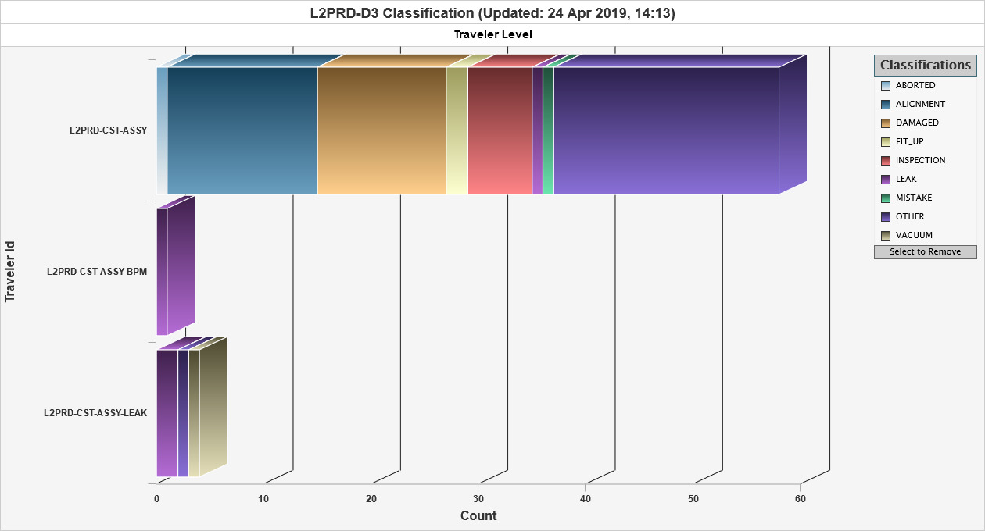
Cavity String Assembly (CST-ASSY) Deviations, Detours and Discrepancies (D3s)

Slide 8
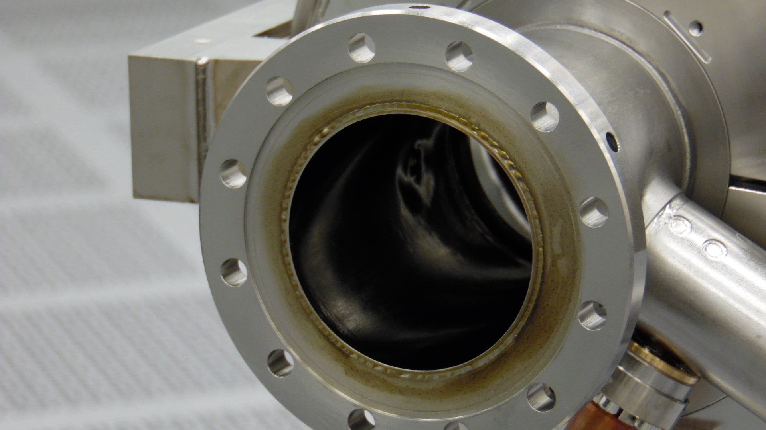
CST-ASSY D3: Stains

Slide 9
CST-ASSY D3: Greatest Hits
Roll on FPC cavity flange was off
Scratches and dents, discoloration on bellows
VAT gate valve stains
Fastener galling
Residual water in cavity (incomplete drying following HPR)
Wrench slipped and hit another component (HOM feedthrough, bellows)

