Slide 1
Cryomodule Test Procedures and Gradient Limitations at Jefferson Lab
Michael Drury
LCLS-II HE Cryomodule Performance Workshop
April 25 - 26, 2019

Slide 2
Outline
Acceptance Testing at Jefferson Lab
  Cryomodule Test Facility
  Low Energy Recovery Linac (LERF)
  Test Sequence
  Gradient
  Field Emission
  Q₀’s

Slide 3
Cryomodule Test Facility
The Cryomodule Test Facility (CMTF) at Jefferson Lab has carried out at least 40 successful cryomodule tests.
  The CMTF currently includes:
    Dedicated shielded cave with Personnel Safety System (PSS)
      Radiation shielding – 4.5 ft thick concrete walls and 3 ft. concrete roof.
      Magnetic shielding – magnetic fields in the vicinity of the cryomodule of 50 mG or less.
    Access to CTF (Close loop 2K helium refrigerator shared with the Vertical Test Area)
      Primary circuit supply up to 7- 8 g/s, 2.8 Bar, 4K supply for cool-down
        Steady state ~2-3 g/s
      50 K shield circuit, several g/s
    8 channels of HPRF, 3.8 kW each, Solid State Amplifiers operating at 1300 MHz
    Low level RF:
      Addition of eight digital Field Control Chassis
        Based on C100 design- modified for CMTF operation and for 1.3 GHz
    New interlock chassis
    New Resonance Control chassis – cavity tuning (steppers and piezos)
  Variety of Instrument and instrumentation
*Continuous Electron Beam Accelerator Facility

Slide 4
LERF as a Test Facility
The LERF accelerator is located in the basement of the LERF (Building 18) in an area known as the LERF Vault. The Vault is a below-grade, concrete enclosure that provides radiological isolation for the accelerator control room, support equipment areas, and laser laboratories above.
Two LCLS-II Cryomodules can be installed in the Vault as shown
A set of 16 SSA’s, along with racks containing llrf, resonance control, interlock and magnet controls, have been installed in the gallery on the 2nd floor. Waveguide from the SSA’s extend down into the vault through existing penetrations.

Slide 5
Acceptance Testing
Questions to Answer:
Will the Cryomodule survive a cool down?
Does the cryomodule meet specification?
  Instrumentation, Interlocks
  Vacuum spaces
  Static Heat Loads
Do the tuners work (mechanical and piezo)?
  Range
  Resolution (prototypes / early production
  Hysteresis
Do the Cavities meet specification?
  Frequency / passbands
  Qext’s - Fundamental Power Coupler (FPC), field probe (FP), Higher Order Mode (HOM) couplers
  Maximum Gradient / Usable Gradient
  Qo (unloaded Q)
  Field Emission
  Higher Order Modes
Are the Cavities Controllable?
  Microphonics
  Lorentz Detuning
  Pressure Sensitivity

Slide 6
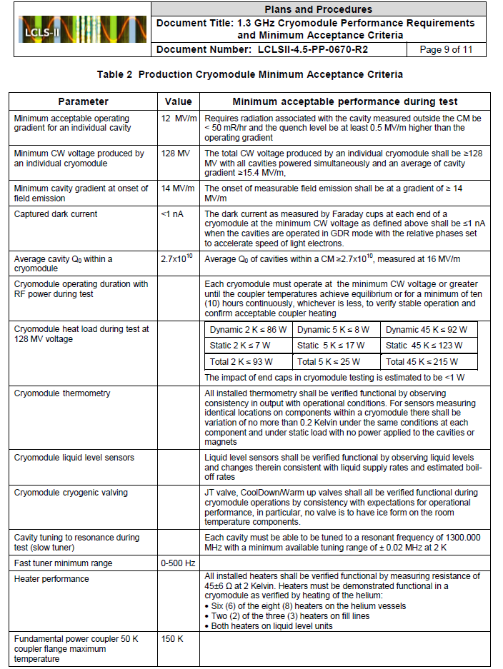
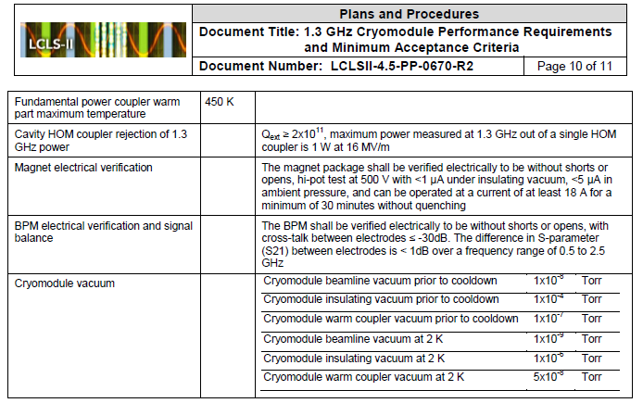
Minimum Acceptance Criteria (production)
Eight cavity runs at spec gradient are not workable in the CMTF
Can be done in the LERF
Rules out determination of dark current according to this criteria.
Fast Cool Downs were a challenge in the CMTF – now almost routine

Slide 7
Testing – Typical Test Cycle (LCLS-II)
Install Cryomodule in the Cave
Prep the cryomodule for cool down and testing ~3 days
Cool Down / Pump down (3 – 4 days)
High Power RF (2-4 shifts)
  HP Checklist
  Mechanical Tuner Checks / Tune cavities
  Piezo Tuner Checks
  HOM Coupler Notch Measurements (no longer necessary)
Coupler Tuning and HOM mapping at low power (network analyzer)
Back to High Power RF (~12 shifts)
  Emax Determination
    Processing
    One Hour Runs
    Field Emission
Temperature Bump and Fast Cool Down
    Qo vs. Eacc / Pressure Sensitivity
    Lorentz Detuning Measurements
Multiple Cavity runs (in the CMTF – two 4 cavity runs) ~4 shifts
Magnet Test (1/2 shift)
Extended multiple cavity operations ~4 shifts
Warm up (3 days to u-tube removal)
Two to three weeks to complete (5 day week / 16 hour day)

Slide 8
Testing- Emax Procedure
Calibrate the Gradient
  Measure Qext’s (FPC, Field probe, HOM couplers)
  Adjust gradient calibration in Field Control Chassis
Ramp the power up and find limits on gradient (Emax)
Attempt to process if warranted
Determine the useable gradient (max gradient for stable operation) through the use of:
  One hour runs
  Field emission measurements
Final field emission measurements (after one hour run)

Slide 9
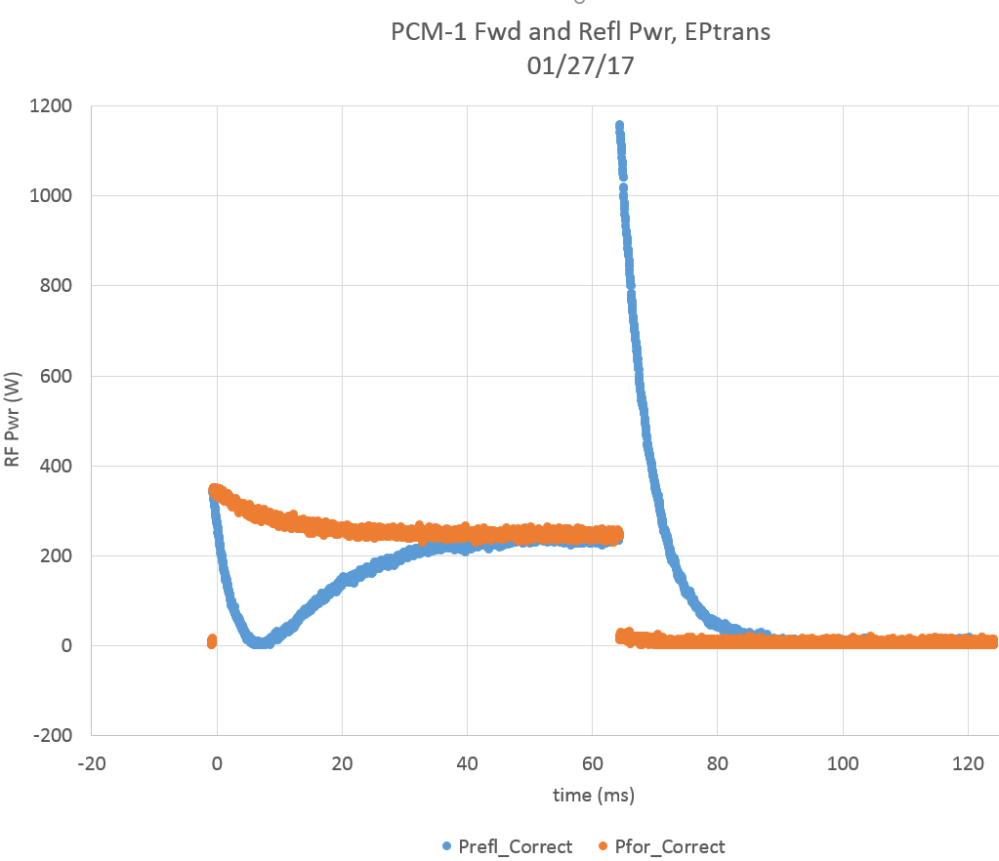
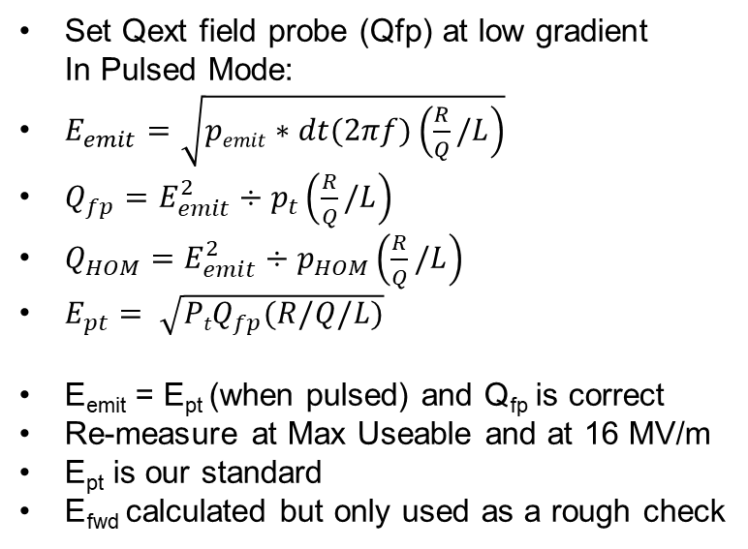
Testing - Gradient Calibration and Calculation
Set Qext field probe (Qfp) at low gradient
In Pulsed Mode:
$E_{emit}=\sqrt{pemit∗dt(2πf)\left(\frac{R}{Q}/L\right)}$
$Q_{fp}=E_{emit}^{2}÷p_{t}\left(\frac{R}{Q}/L\right)$
$Q_{HOM}=E_{emit}^{2}÷p_{HOM}\left(\frac{R}{Q}/L\right)$
$E_{pt}= \sqrt{{PtQ}_{fp}(R/Q/L)}$
E_{emit} = E_{pt} (when pulsed) and Q_{fp} is correct
Re-measure at Max Useable and at 16 MV/m
E_{pt} is our standard
E_{fwd} calculated but only used as a rough check
Typical calculated uncertainty in Qfp ≈ ±8%
Typical calculated uncertainty in Ept ≈ ± 4%
(at our Admin Limit, 21 MV/m ± 0.8 MV/m)
Pt = power transmitted by field probe
PHOM = power transmitted by HOM coupler
Pemit = power emitted from FPC after RF shut off

Slide 10
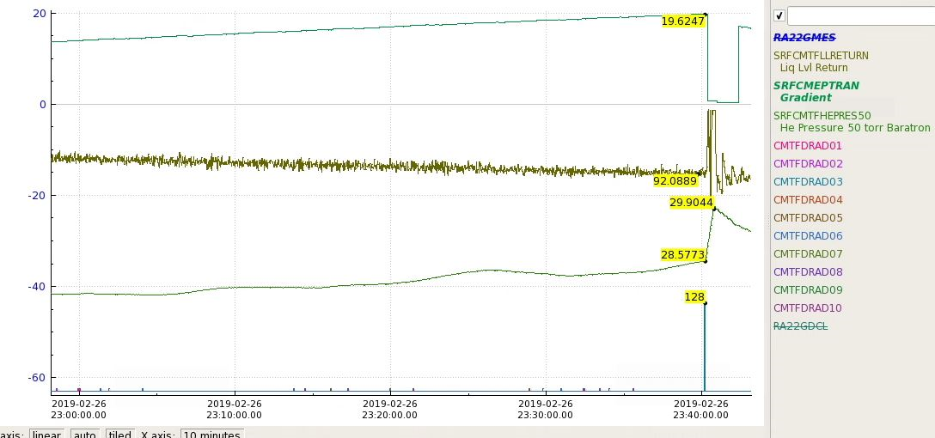
Testing – Emax Determination
  Initial Ramp up with Pulsed RF (SEL mode)
      low duty cycle – 70 ms On / 840 ms Off (default – may change if processing)
  Automated gradient ramp- Increase gradient in steps of 0.1 – 0.2 MV/m every 60 s
  Looking for Field Emission
  Looking for the limit – (quench, vacuum, heat load, FE, out of power, Admin)
  If the Cavity Quenches – is it a “hard quench”?
    Reduce gradient try again – several times
    Look for signs that processing may be appropriate
J1.3-13-2
Pulsed mode:
Better for processing
Faster recognition of quenches
Lower average power during quenches
Helps with detection of “end group” quenches
Acceptance Criteria:
Target for Useable Gradient - 16 MV/m per cavity
Minimum Useable Gradient - 12 MV/m
Total Voltage per string – 128 MV

Slide 11
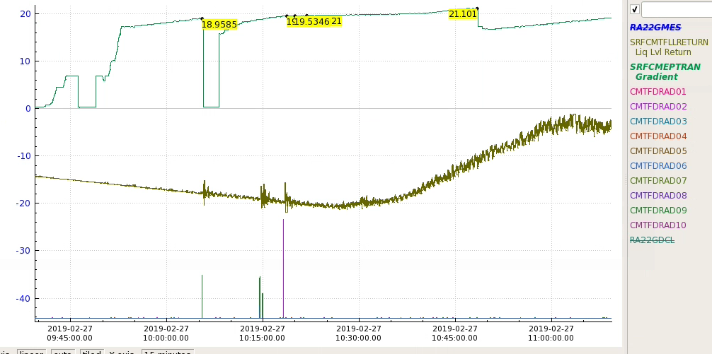
Testing – Quench Processing
When is it appropriate?
  Large Discrepancies wrt to VTA Emax
  Field emission bursts on quench
  BLVac excursions on quench
J1.3-13-2

Slide 12
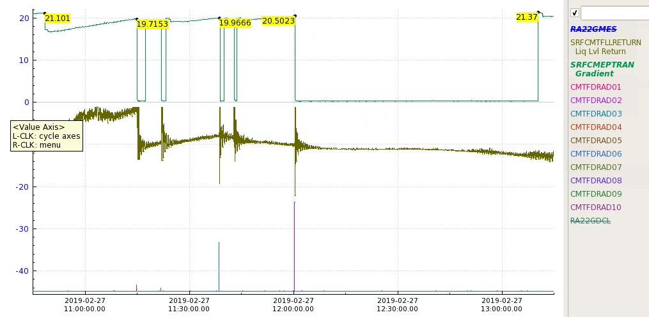
Testing – Quench Processing
When satisfied that the pulsed limit is a “hard limit:
  Lower the gradient several MV/m
  Switch to CW SEL
  Ramp up again
    In some cases more processing
    Also looking for heat load issues
    Coupler heating / vacuum issues
CW Limit is Emax

Slide 13
Testing – Emax Determination
Expected Gradient Limitations:
  Cavity Quench
  End Group Quench (HOM Coupler)
  Admin Limit = 21 MV/m
  Field Emission (Sets off Area Monitor or a decision is made to cease ramp up)
  Vacuum Degradation – Coupler / Beamline
  Coupler Arcs
  Heat Load
  Actual Gradient Limits (12 CM’s)
Quench | 47
Admin | 31
FE related | 10 | CARM alarms or admin decision
End group quench | 5 | None observed since CM05
Coupler issues | 1 | CM01-7
HOM Heating | 1 | CM12-1 Odd heating at HOM Clamp
Forward Pwr | 1 | Low QextFPC

Slide 14
Testing - Useable Gradient Determination
Determine Emax
Determine the Maximum Useable Gradient.
If cavity is quench limited or interlock fault that causes RF to shut down
    Lower gradient by 0.5 MV/m
      Complete a One Hour Run at the lower gradient
      If cavity is unable to complete the One Hour Run, lower gradient another 0.5 MV/m.
      Repeat until One Hour Run is completed.
  If cavity reaches Admin limit, attempt One Hour Run at Admin limit
    Lower gradients by 0.5 MV/m increments if cavity cannot complete the One Hour Run.
  If cavity has field emission:
    Determine gradient at which dose rate from any decarad channel reaches 50 mR/hr.
This gradient is designated the Maximum Useable Gradient.

Slide 15
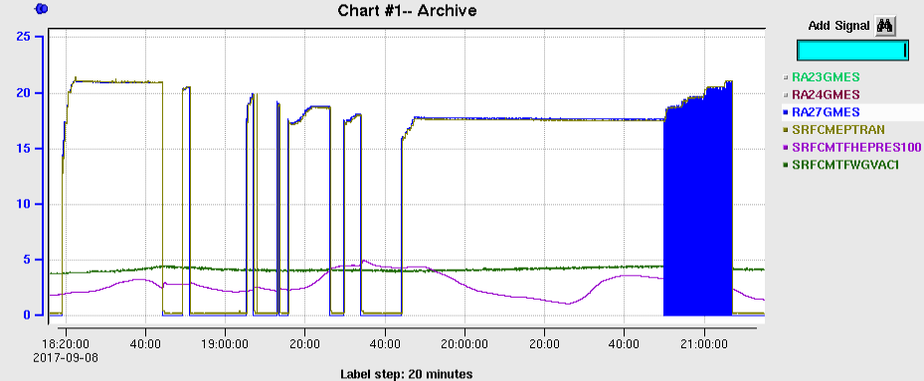
Testing - Why a One Hour Run?
Example : J1.3-03-7 (End Group Quench)
Cavity reaches Admin limit
One Hour Run attempt at 21 MV/m
Quench after ~ 20 min
Successive gradient reductions required
Successful One Hour Run at 17.0 MV/m

Slide 16
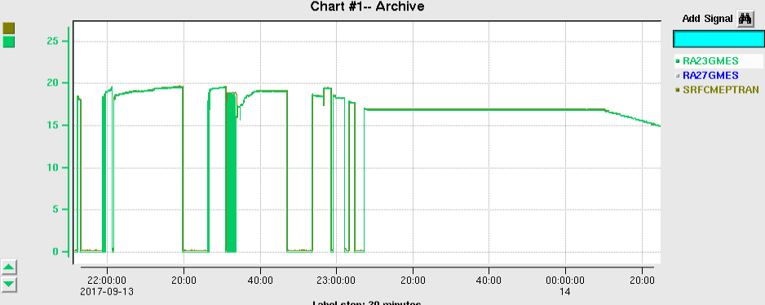
Testing - Why a One Hour Run?
Example : J1.3-03-3 (End Group Quench)
Emax reached and verified
Quench at 19.6 MV/m
Successive One Hour Run fails
At 19.1, 18.3, 17.7 MV/m
Successful One Hour Run at
Quench at 17.0 MV/m

Slide 17
Testing - Why a One Hour Run?
One hour runs help us discover cavity performance issues not readily apparent by just driving a cavity to its limit.
Issues include
  “End group quenches”
  Cavities that are close to quenching at the Admin limit
  HOM Clamp heating seen at CM12-1
  Coupler problems

Slide 18
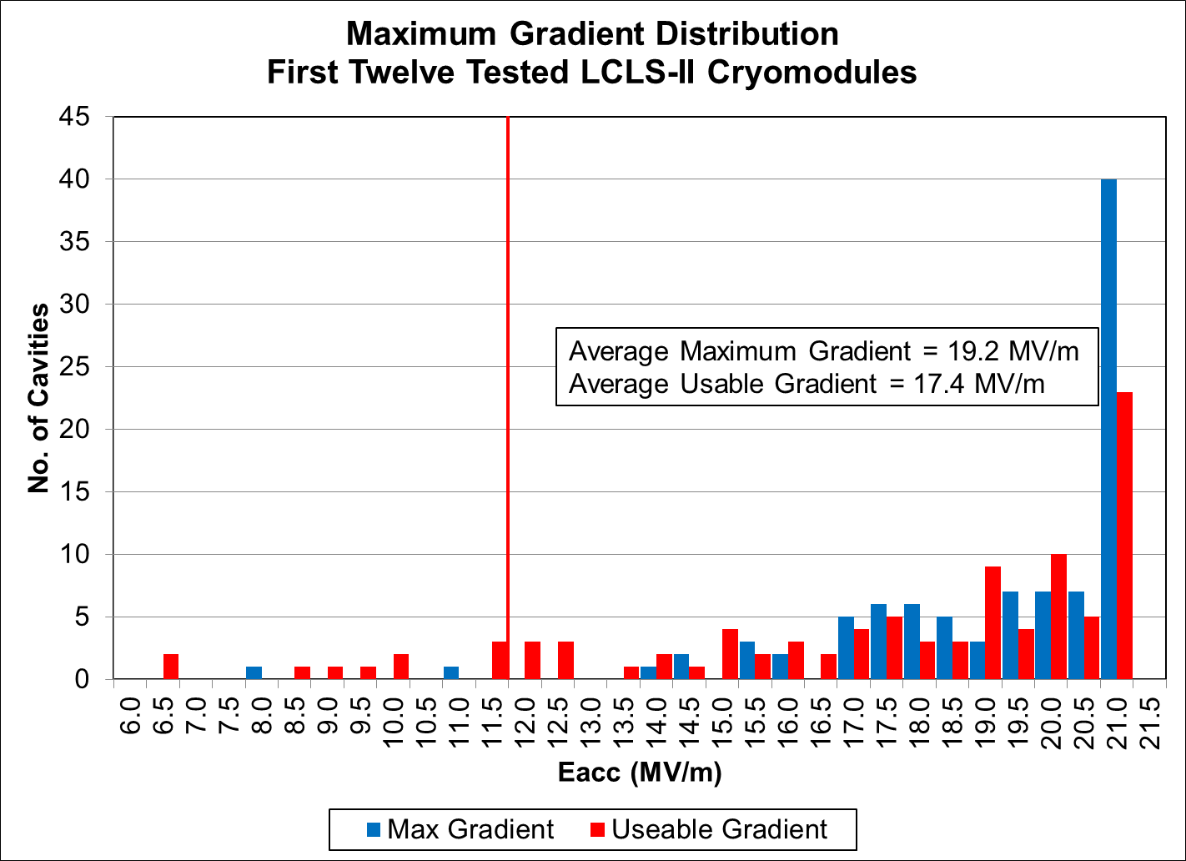
Current Gradient Distribution

Slide 19
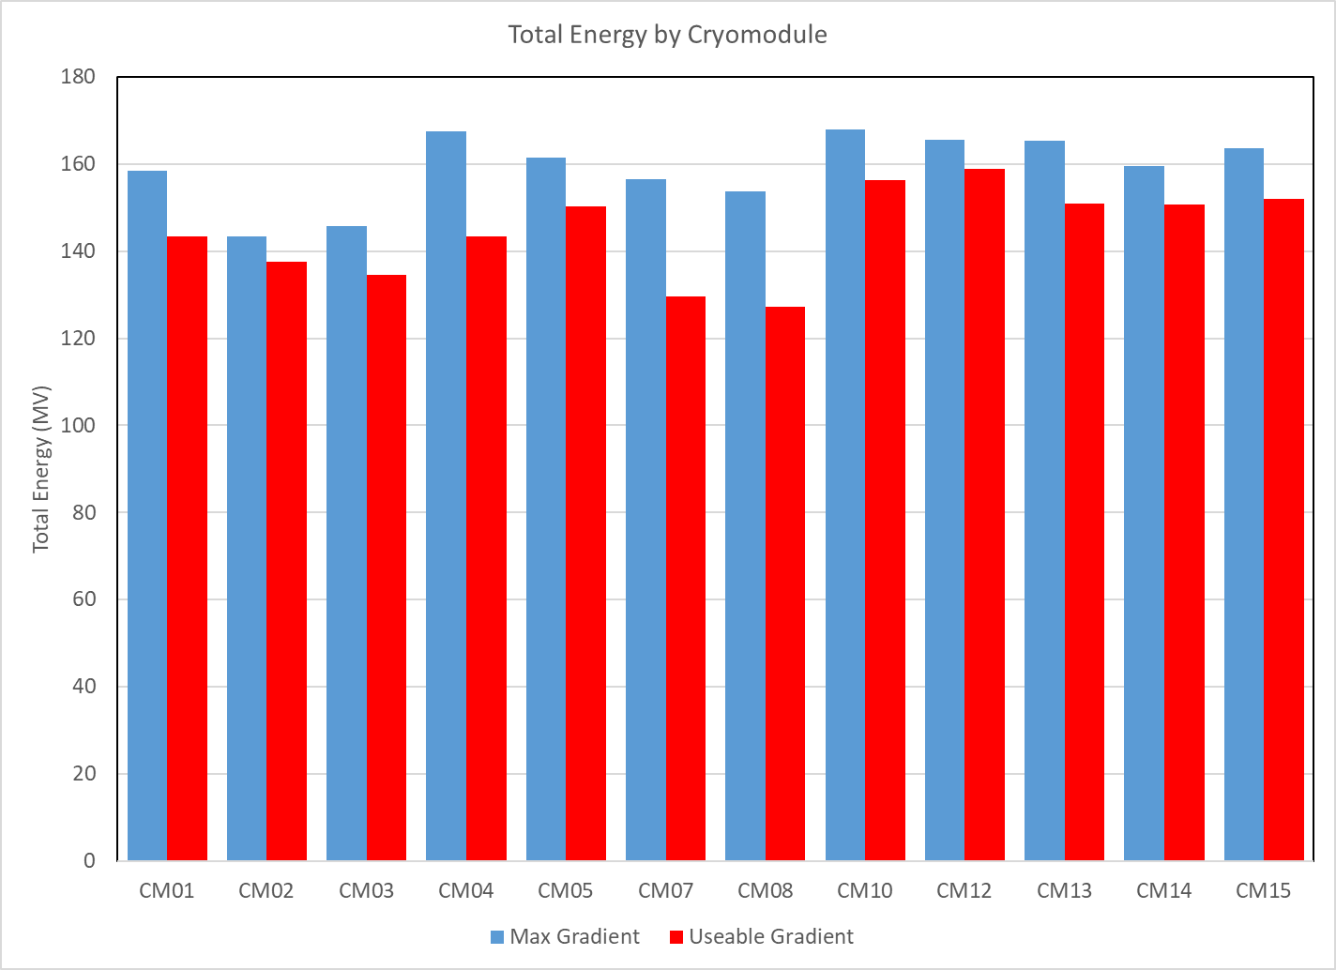
Maximum Energy by Cryomodule

Slide 20
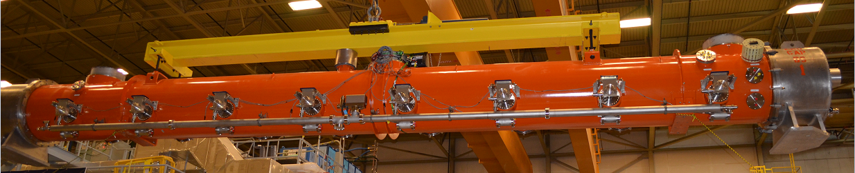
Testing – Field Emission
Generally measured after the Emax measurements, any processing attempts and the One Hour Run
GM Tube Layout for FE Measurements
Ch9
Ch1
Ch2
Ch3
Ch4
Ch5
Ch6
Ch7
Ch8
Ch10
Faraday Cup and Fox Detector

Slide 21
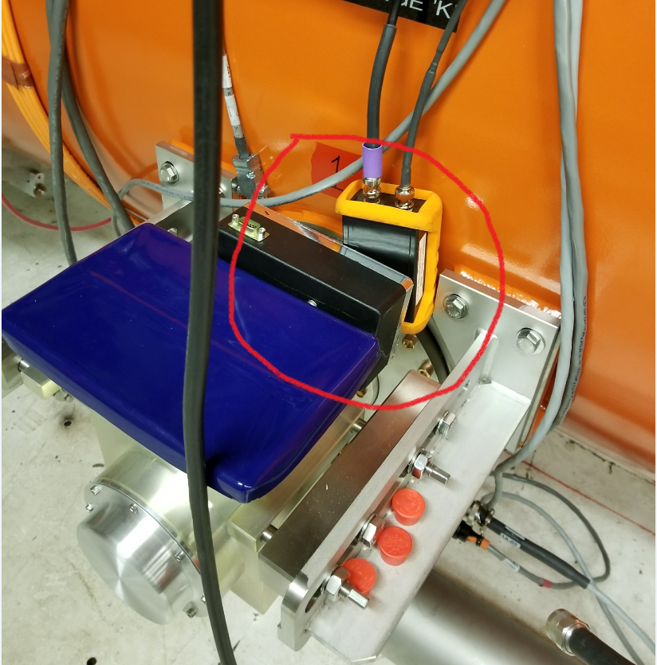
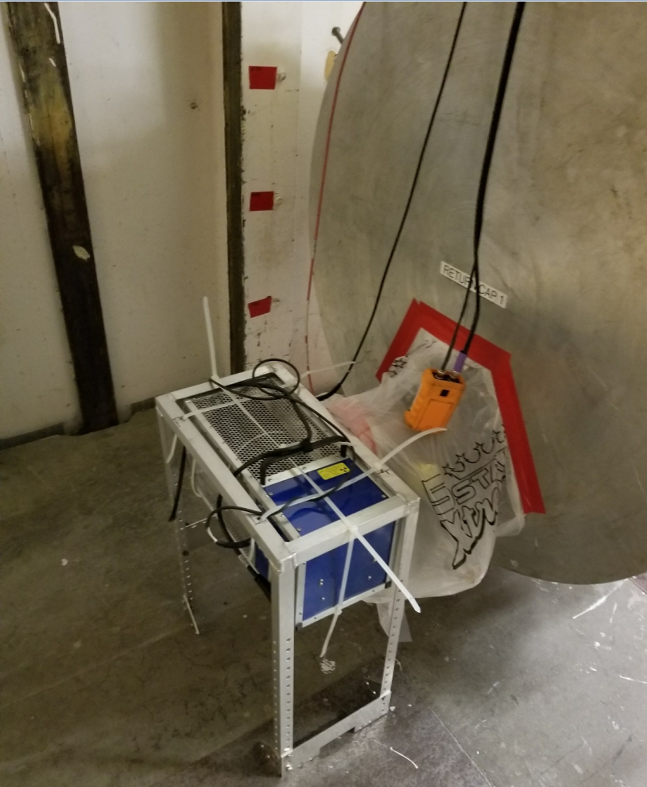
Testing – Field Emission
GM Tube Locations
BL Location
with FNAL Fox Detector
Coupler Location

Slide 22
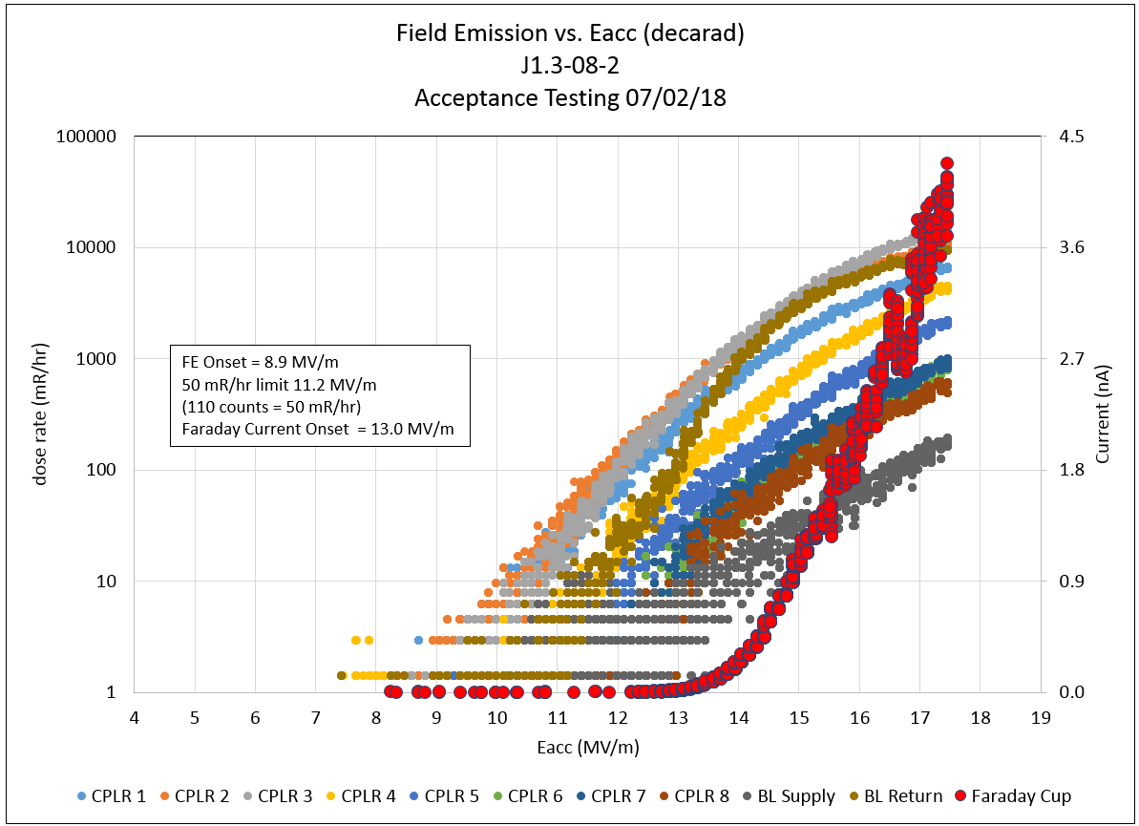
Testing - Field Emission Example

Slide 23
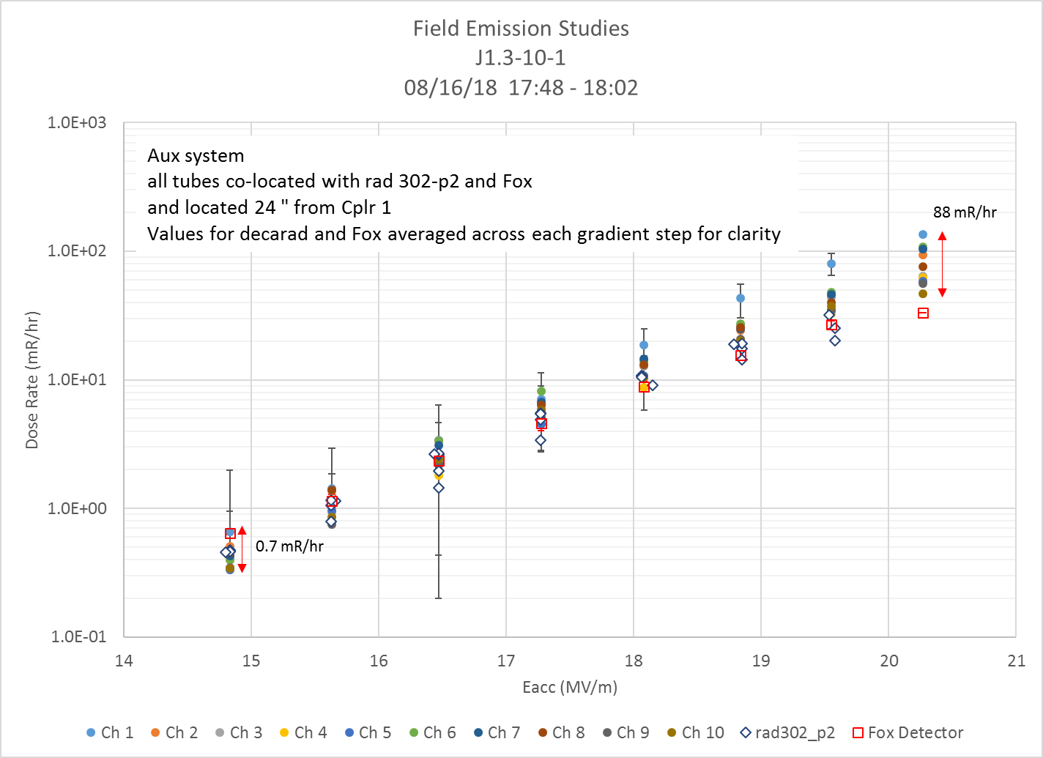
Comparison of FE Instrumentation
Using the current decarad calibration,
The GM tubes tend to read higher than the ion chamber.
Effect more pronounced at higher dose rates
Ex: at 19.6 MV/m, average tube reading is 46 mR/hr. Average ion chamber reading is 26 mR/hr
Fox detector appears to track ion chamber more closely than tubes

Slide 24
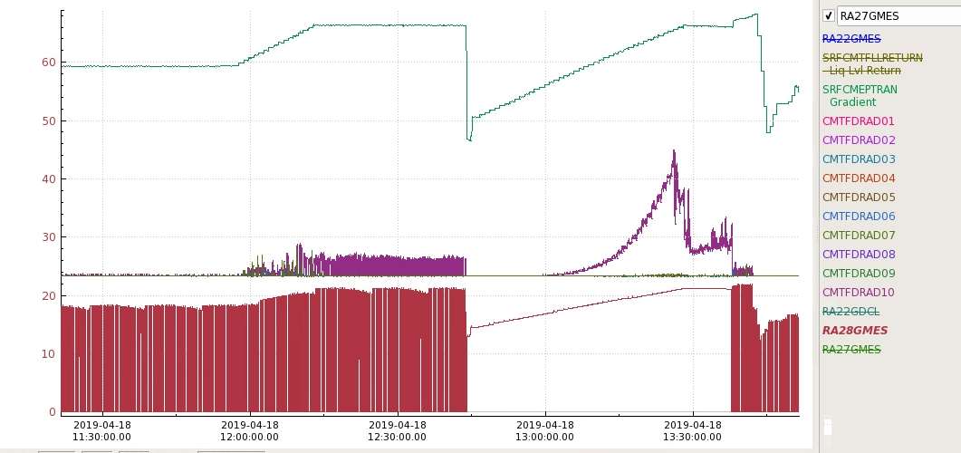
Testing – Response to Field Emission
J1.3 -15 - 8
FE turn off
One can try short pulse higher power processing- SSA’s may not have the capacity
New (to us) technique-
When field emission turns on - halt ramp up and wait
Lower energy deposited at emitter site over longer periods may have beneficial effects on surface particles that reduce FE generation

Slide 25
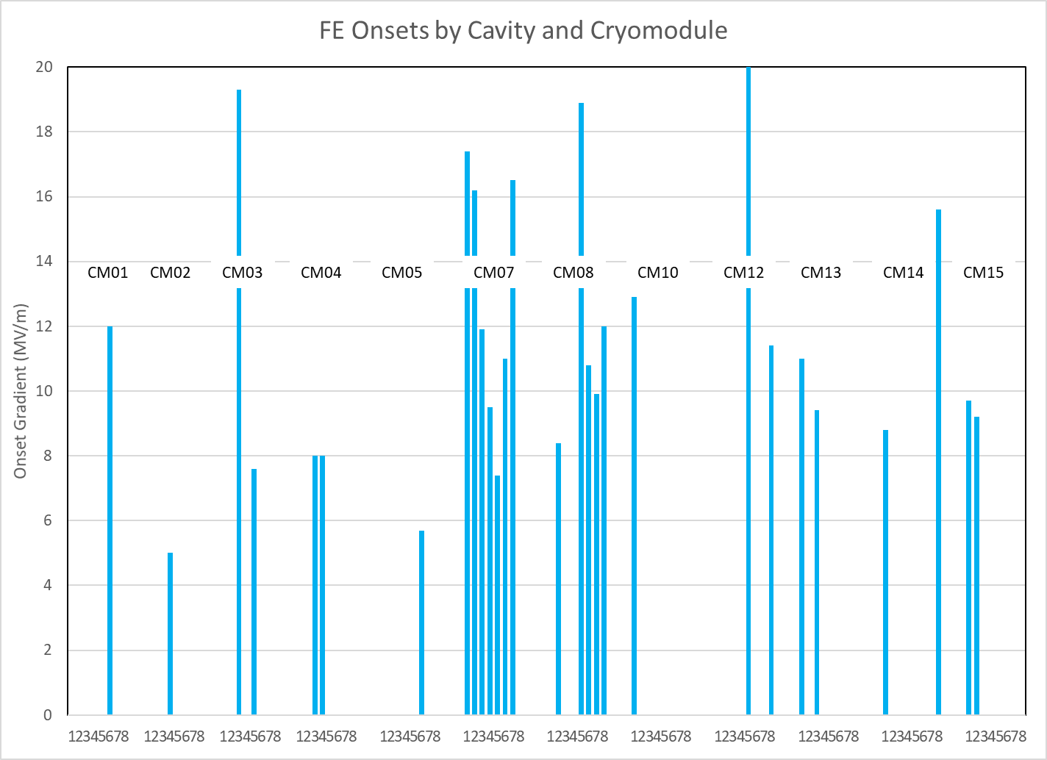
FE Onsets by Cavity
Change in VTA procedure after CM10 removed 24 MV/m Admin limit
After this change, we’ve experienced one “emitter creation” event.
Field emitters appear to have moved to the ends of the strings as opposed to the middle of the strings.
Field Emitting Cavities | 28
FE onset low (> 14 MV/m) | 21
Limit useable gradient | 21

Slide 26
Testing - Fast Cool Down
After Maximum gradient studies are completed
Most cavities in a string have been quenched at least once.
Quenches result in reduced Q₀ (unloaded Q)
Lower Q₀ = higher dynamic heat load
We take a break from HPRF testing
Reestablish high Q₀’s:
  Temperature Bump to 40K
  Cool Down through Transition temperature at 30 - 40 K/min
Requirement Q₀ ≥ 2.7x10¹⁰ (at 16 MV/m- heat load of ~10 W)

Slide 27
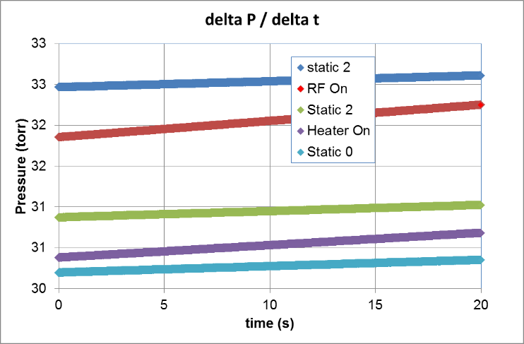
Testing - Q₀ Measurement
Calorimetric Method
Has been in use at Jefferson Lab for ~30 years
Used on a variety of cryomodule designs
  Isolate the cryomodule from refrigerator
    Close JT and Return (RT) valves
  Perform a series of measurements of ΔP /Δt
    No input heat (other than static)
    Known heat load from heater
    RF on at desired gradient
  ΔP /Δt linear with heat load over the operating temperature range
$${Pwr}_{RF}={Pwr}_{Htr}\frac{{(∆P}_{RF+static}−{average({∆P}_{static1},∆P}_{static2})}{{(∆P}_{htr+static}−{average({∆P}_{static0}∆,P}_{static1})}$$

Slide 28
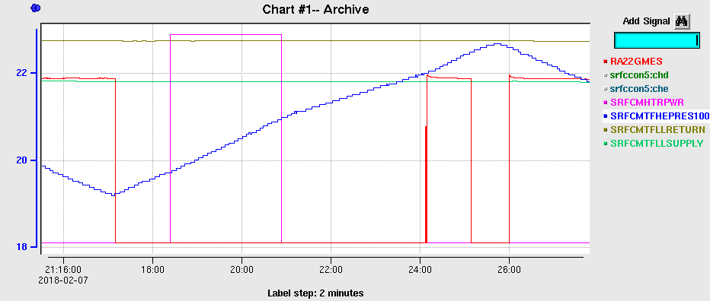
Testing - dP/dt Measurement example
Heater power
gradient
pressure
LL Supply at 77%
LL return at 96%
RF Heat Load at 2.0K =12.6 W ->
Qo at 2.0 K = 2.2E+10

Slide 29
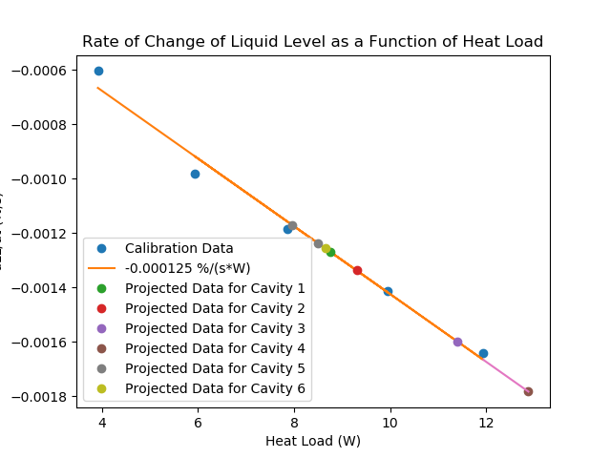
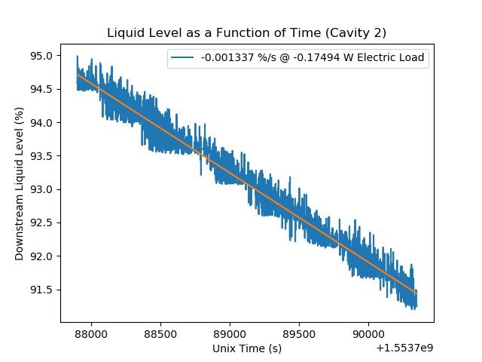
Testing – Qo Measurement – dLL / dt method
Developed and used in the LERF on CM12
Analogous to the dP/dt method
Uses changes in liquid level to determine heat load
Potentially less invasive but more time consuming
Good alternative when there is a leaking JT valve

Slide 30
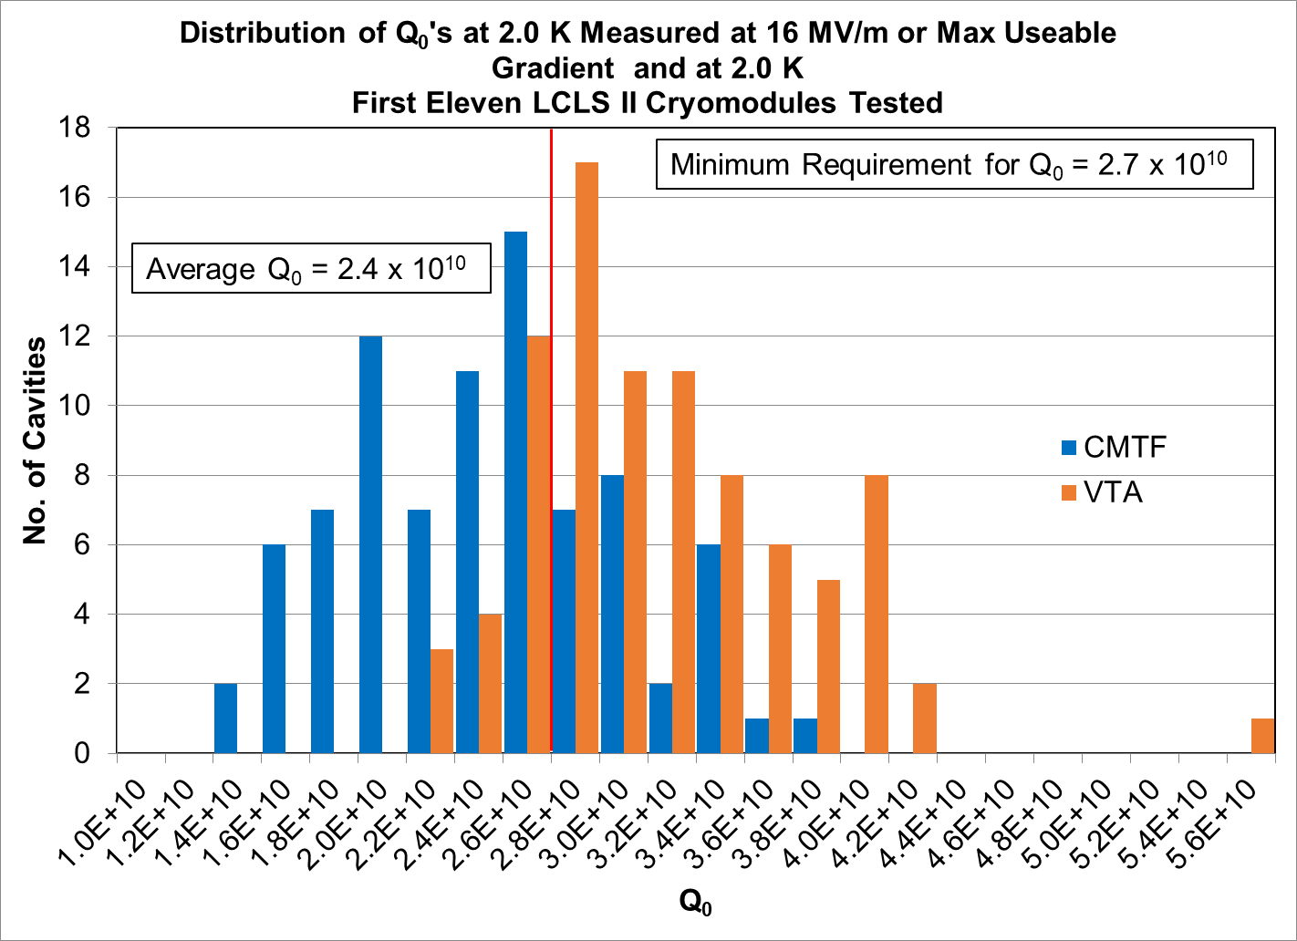
Q₀ Distribution

Slide 31
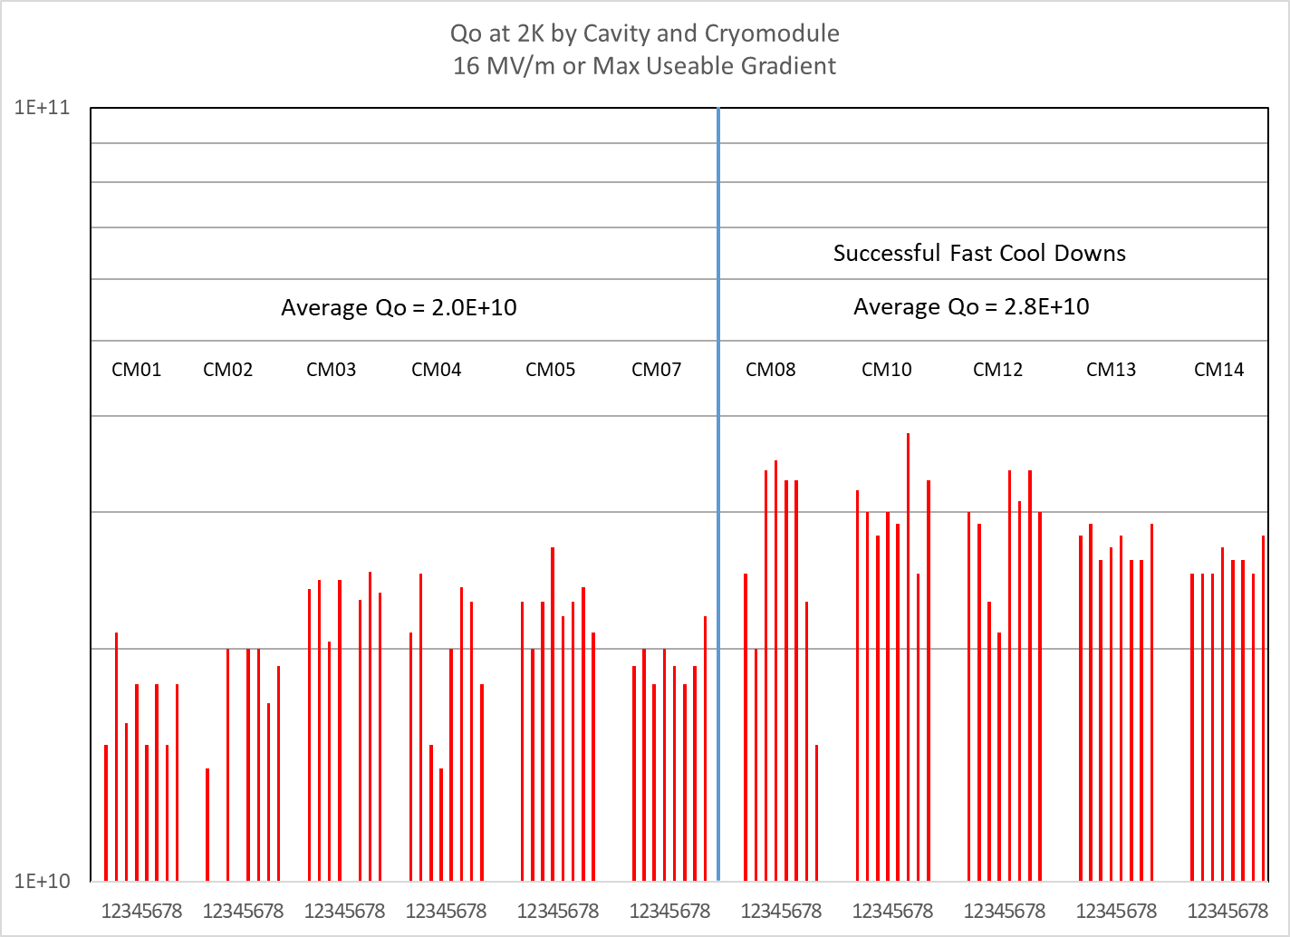
Q₀’s by Cavity and Cryomodule

Slide 32
Testing – Summary
Gradient Limitations
The majority of cavities are limited by quenching and FE and by the Admin Limit.
“Quench processing” will improve gradient performance in some cases
The behavior that we label as an End Group quench appears to have faded away after CM05 and also appears to be coincident with the advent of a successful tuning method for the HOM couplers.
There has been some change in the FE behavior of cavities since the VTA procedural change

Slide 33
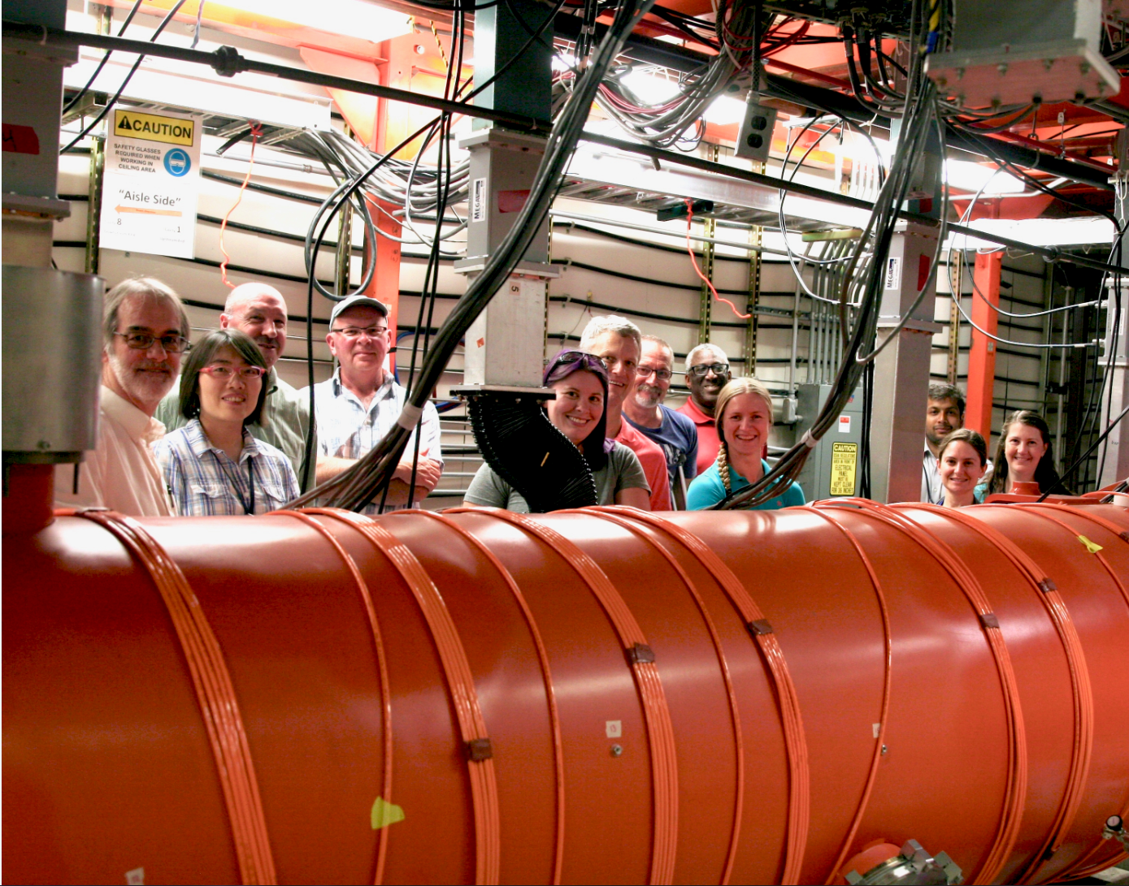
Acknowledgements
The LCLS-II Testing Team - These are the people who make it happen.
Working long hours, nights and weekends to get it done.

