Slide 1
VT/CM Performance for Flux Expulsion
Sam Posen
LCLS II HE Cryomodule Performance Workshop
25 April 2019

Slide 2
Acknowledgements
LCLS-II cryomodule production in partnership with teams at FNAL, JLab, and SLAC
All cryomodule measurements shown here are by FNAL LCLS-II team
Major thanks to Genfa Wu, Anna Grassellino, Elvin Harms, Nikolay Solyak

Slide 3
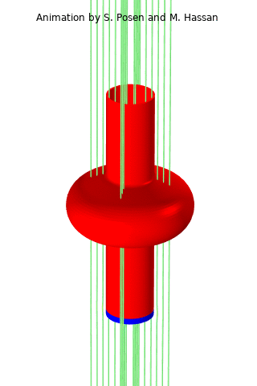
What is Flux Expulsion?
For practical magnetic shielding, we expect some residual ambient field at the cavity
During cooldown, thermal gradients over the surface generate a force that expels magnetic flux out of the superconductor; expulsion force competes with pinning forces
Desirable to expel all flux during cooldown to minimize Q₀ degradation
Pinning point
Magnetic field lines
$$y$$
$$g(x)$$
$$f_{p}$$
Flux Expulsion
$$f$$
Meissner State
Mixed State
$$x$$

Slide 4
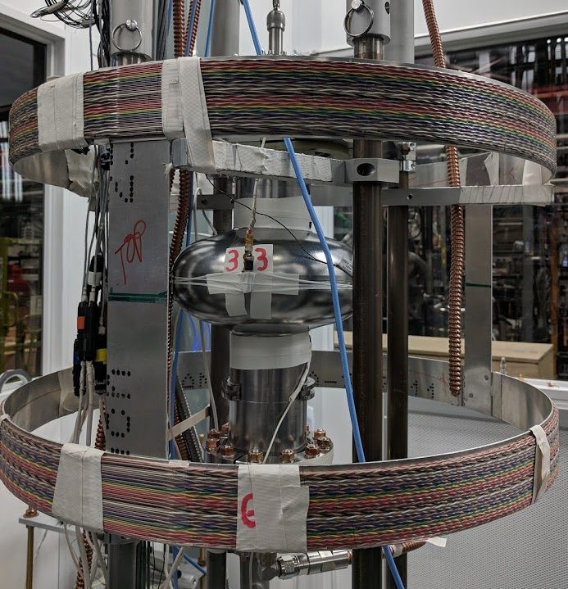
Measuring Flux Expulsion in Vertical Dewar Test
Magnetic
field coils
(tens of mG applied field)
Fluxgate magnetometers
(3 around cell
of cavity)
Temperature
Sensors
(Top, middle, bottom of cell)

Slide 5
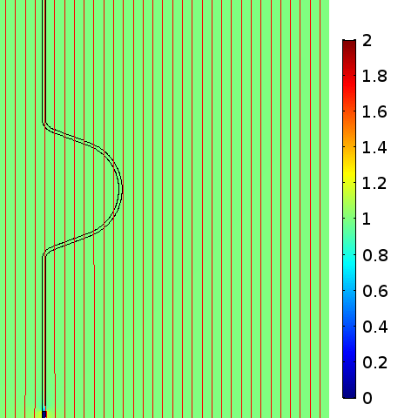
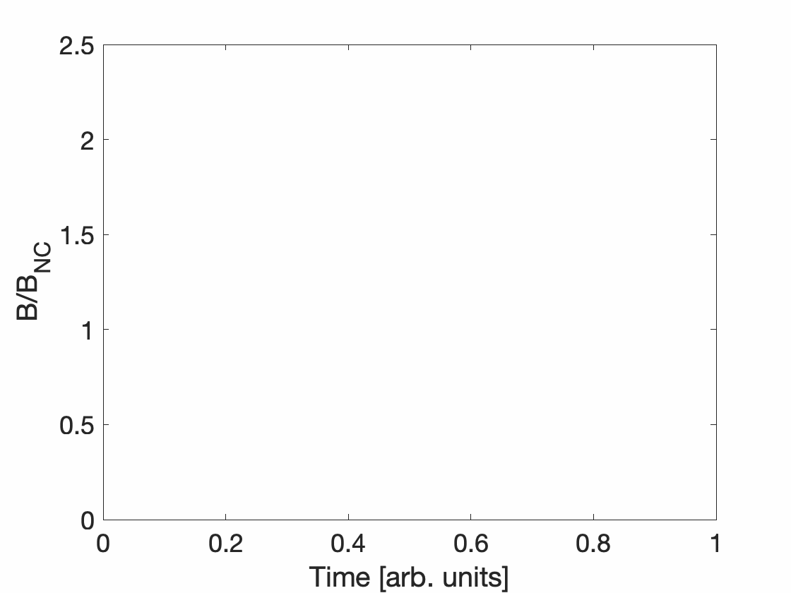
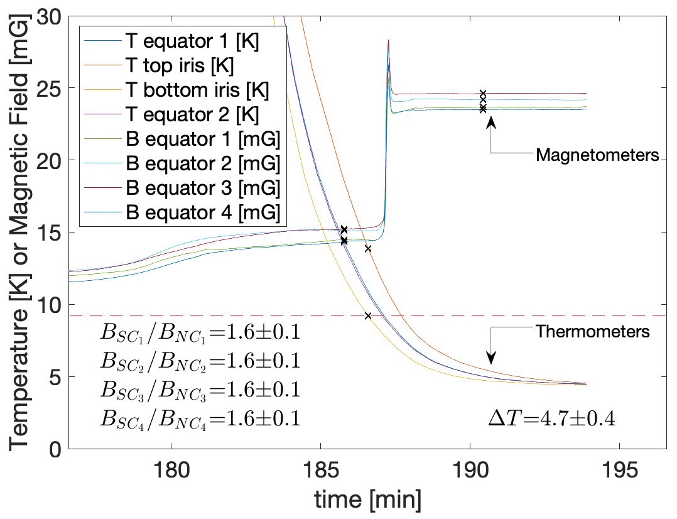
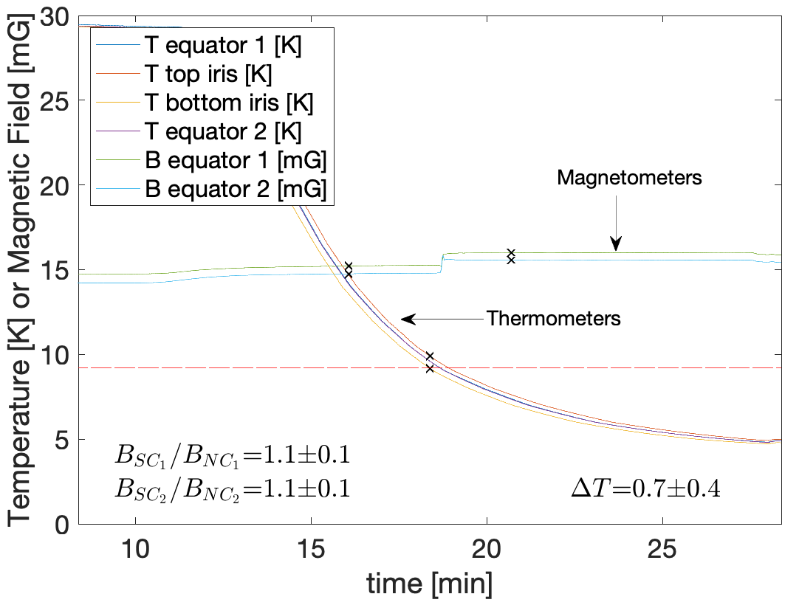
Flux Expulsion Comsol simulation
Flux Trapping Comsol simulation
Field lines bend around wall
Field lines go through wall
Fluxgate magnetometer
Fluxgate magnetometer
B_{SC}/B_{NC} ~ 1.7
B_{SC}/B_{NC} ~ 1
Flux Expulsion Measurement
Flux Trapping Measurement

Slide 6
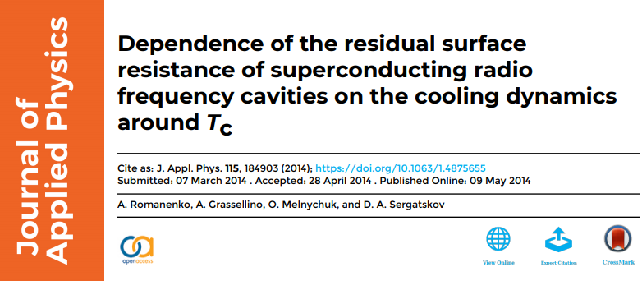
Fast/High massflow cool-down leads to large thermal gradients which promote strong flux expulsion
Slow/low massflow cool-down → poor flux expulsion

Slide 7
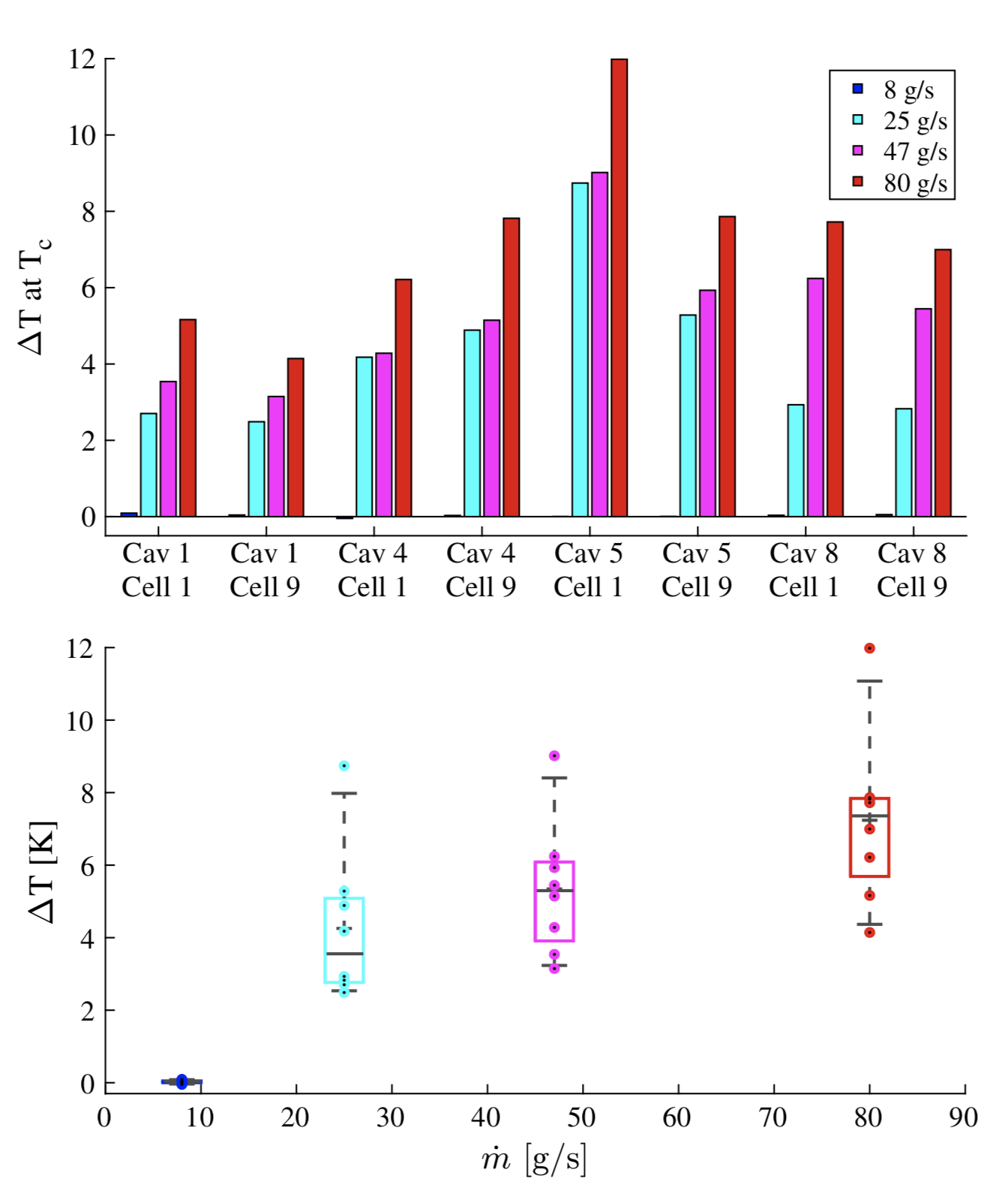
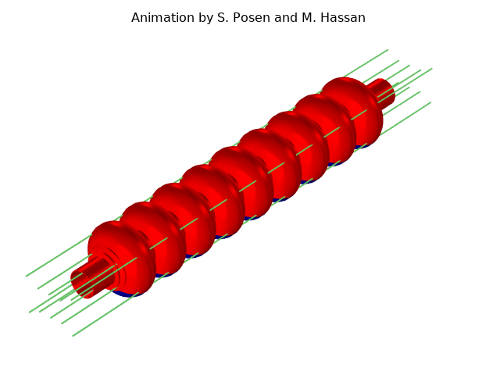
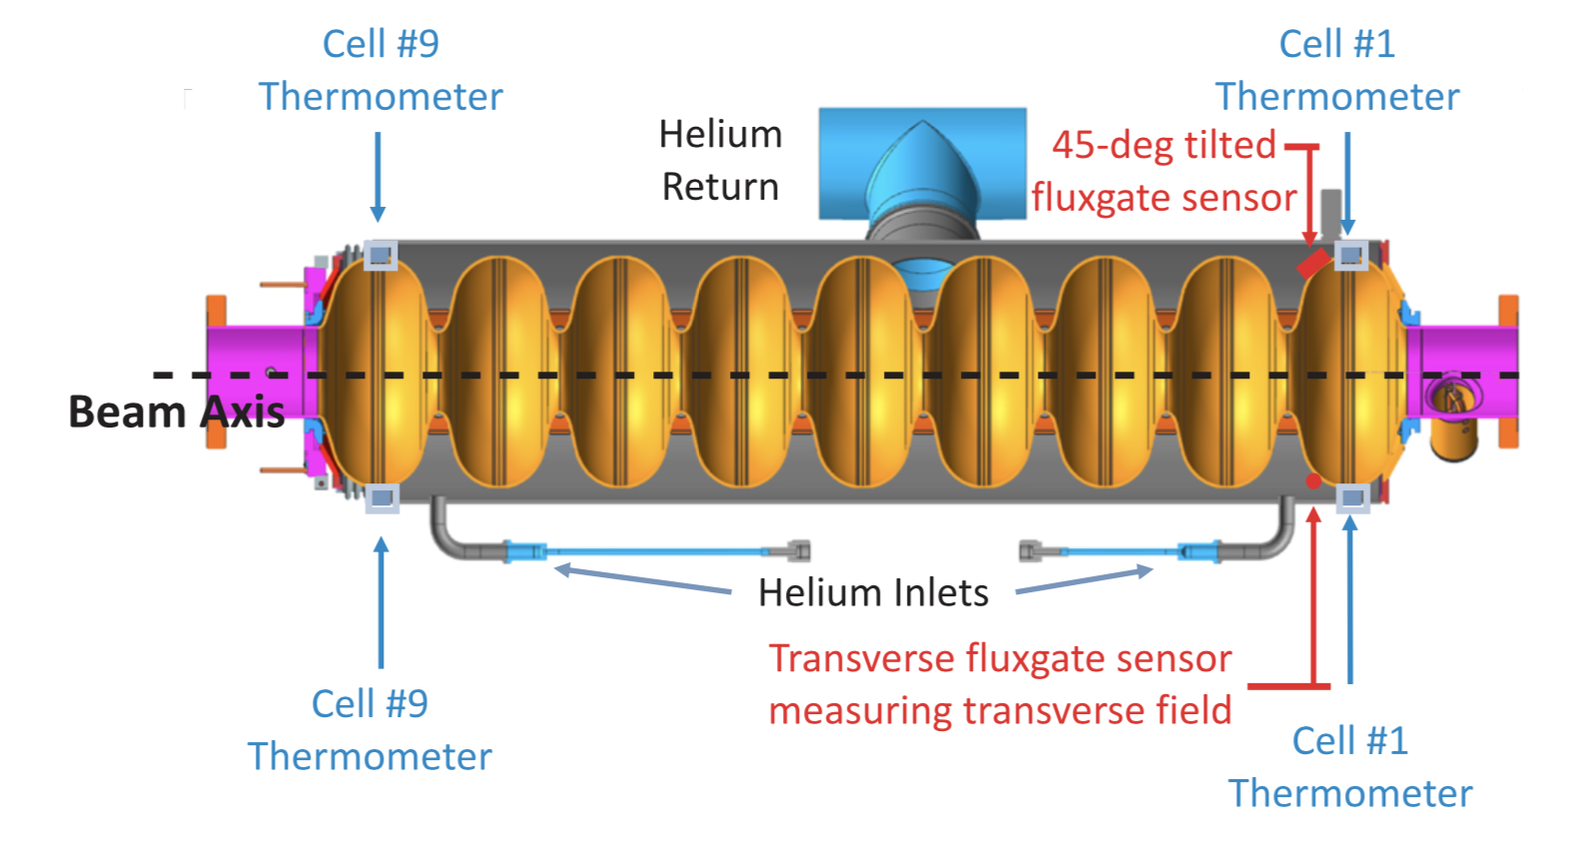
Thermal Gradient in CM Test
Measured thermal gradient in CM with prototype cryomodules
Data from FNAL pCM: low massflow results in very small top-bottom thermal gradient

Slide 8
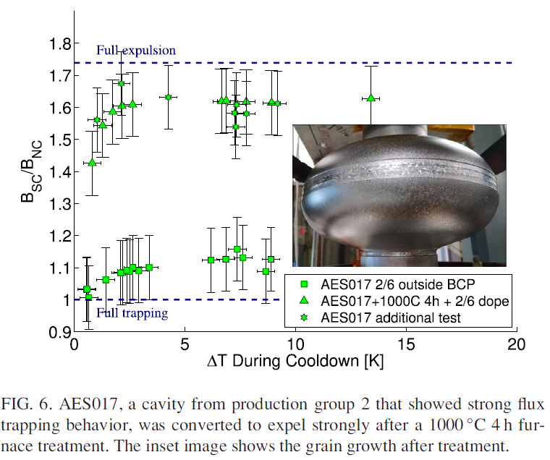
Significant variation in flux expulsion behavior for high RRR niobium given 800 C furnace treatment
Developed “cure” for poorly expelling material – heat treatment at 900-1000 C

Slide 9
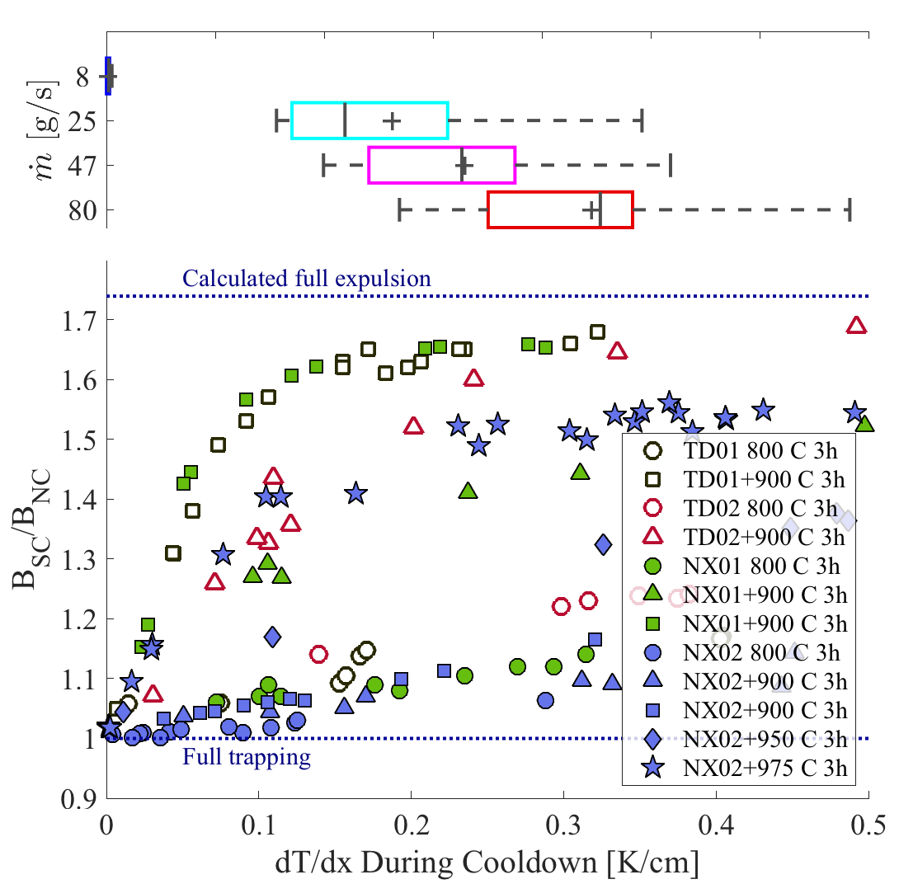
Original LCLS-II Production Material
Fermilab pCM data shows importance of high massflow – of 4 cooldowns, only those with massflow >25 g/s extend into acceptable expulsion range; more g/s expected to achieve better expulsion
Conclusion about original LCLS-II Nb:
Very poor expulsion with only 800 C 3 h
TD needs 900 C 3h (both cavities)
NX needs 950 C – 975 C (NX2 more stubborn than NX1)

Slide 10
Effect of Heat Treatment in Vertical Test
TD 900 C 3 h: Q₀ robust to applied field
TD 800 C 3 h: Q₀ degraded significantly even for relatively small applied field

Slide 11
Effect of Heat Treatment in Vertical Test
TD 900 C 3 h
TD 800 C 3 h

Slide 12
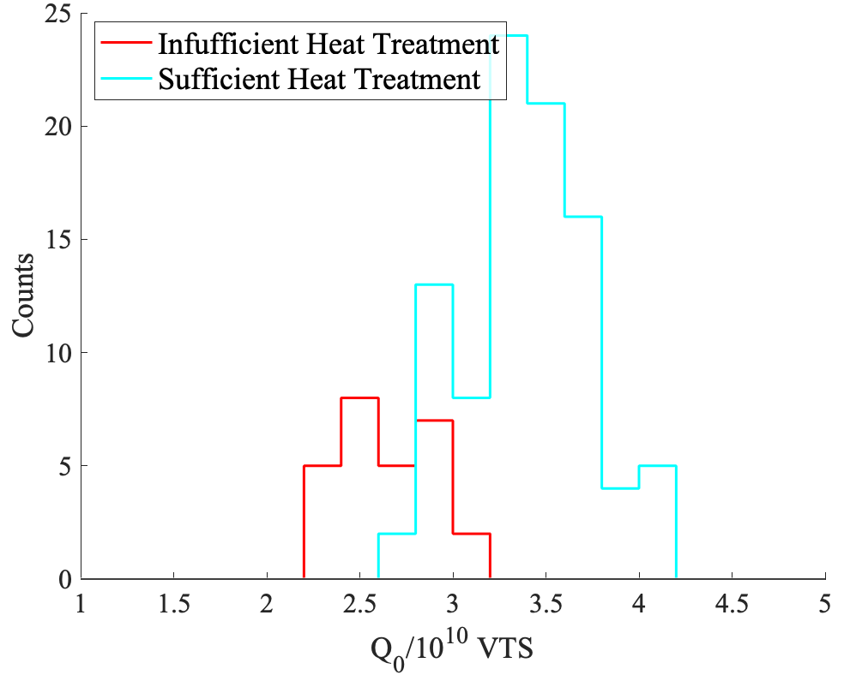
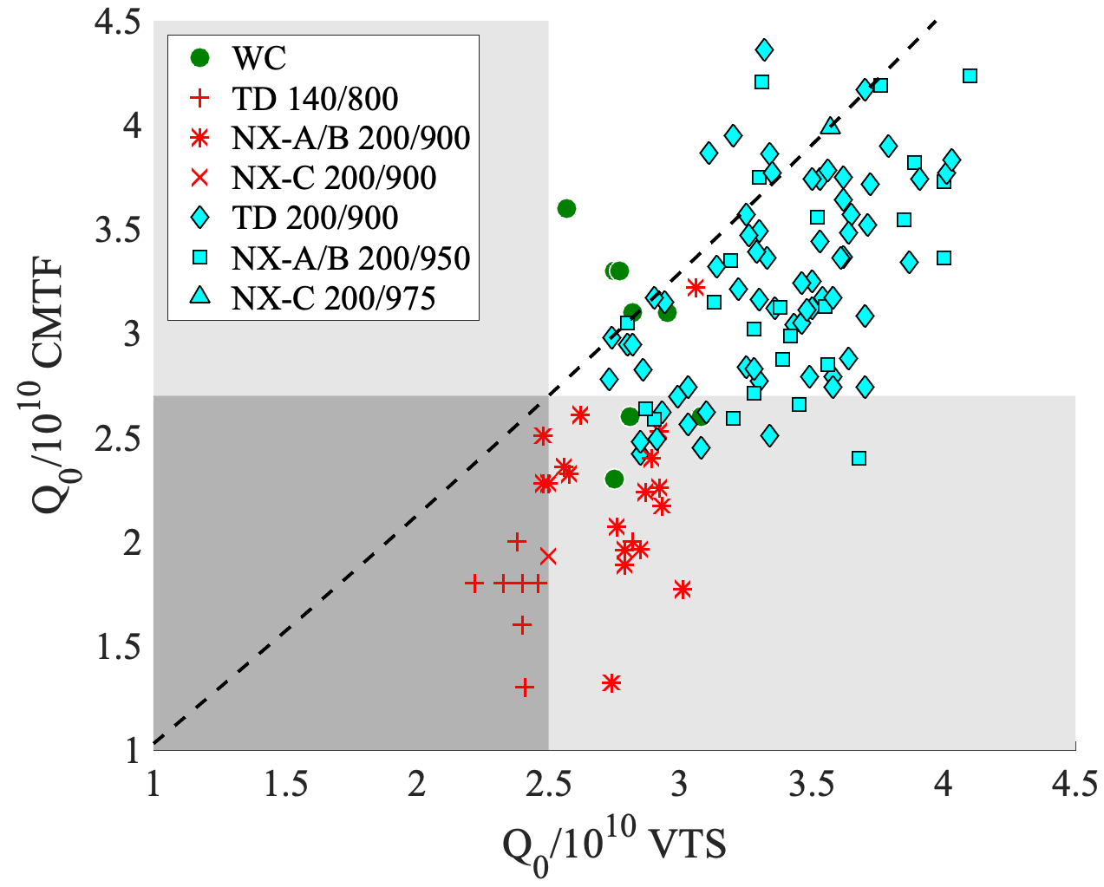
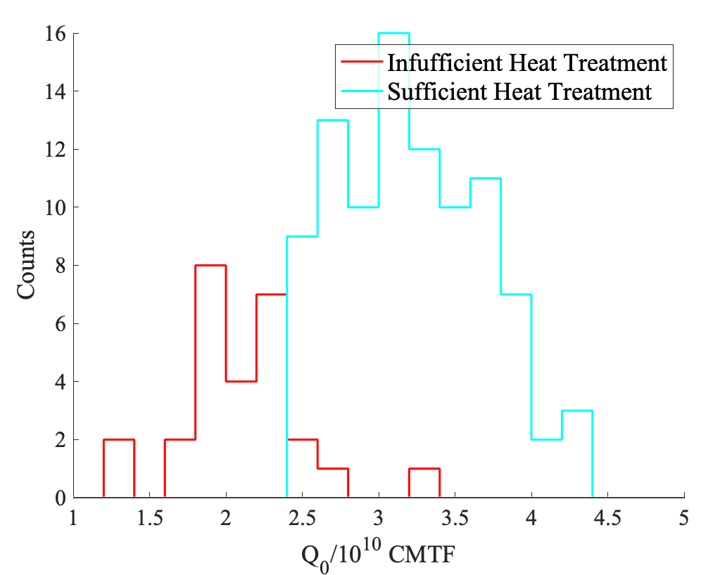
Fermilab CMTF and VTS Data F1.3-01 through 016
Dashed line includes correction at VTS for stainless flanges
Fermilab vertical test
Fermilab module test

Slide 13
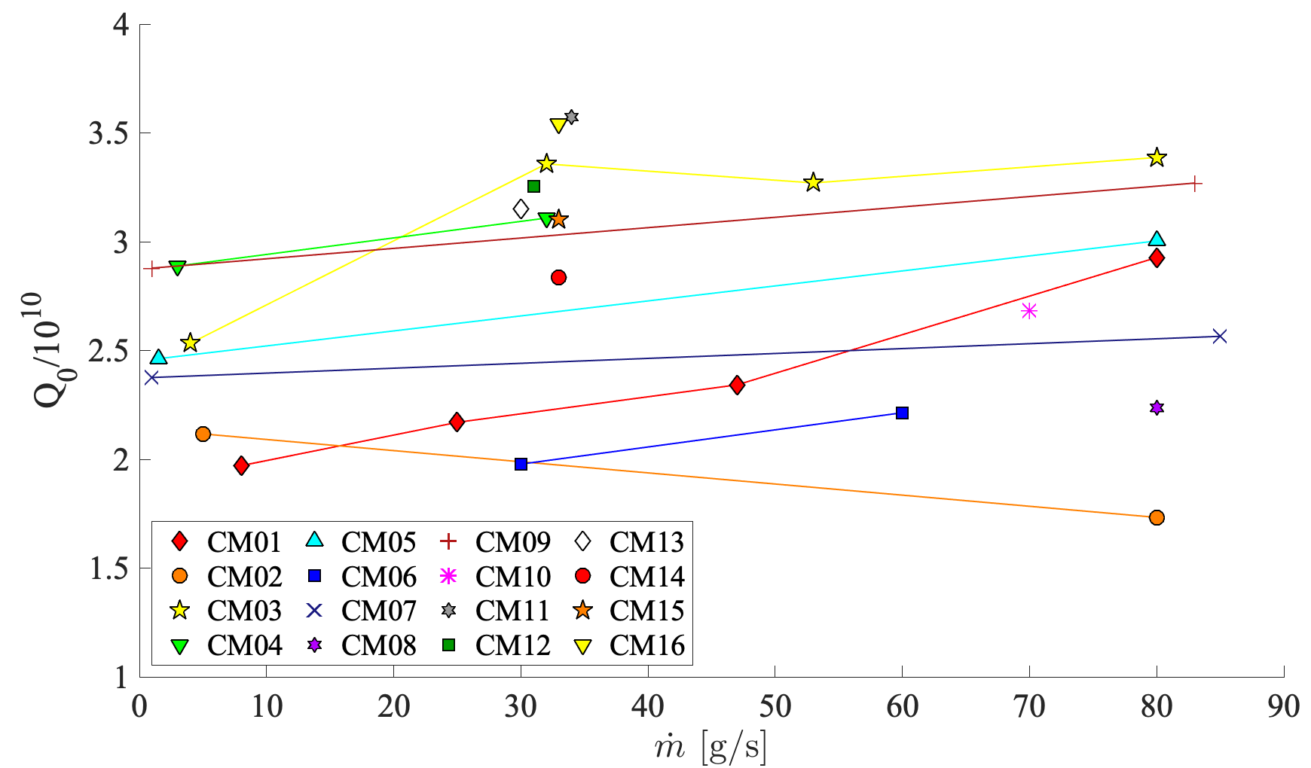
Effect of Massflow on Q₀
Expected trend is observed – higher massflow -> improved expulsion -> higher Q₀
(Appears to be effect of insufficient ‘soaking’ time to thermalize before Q₀ measurement)

Slide 14
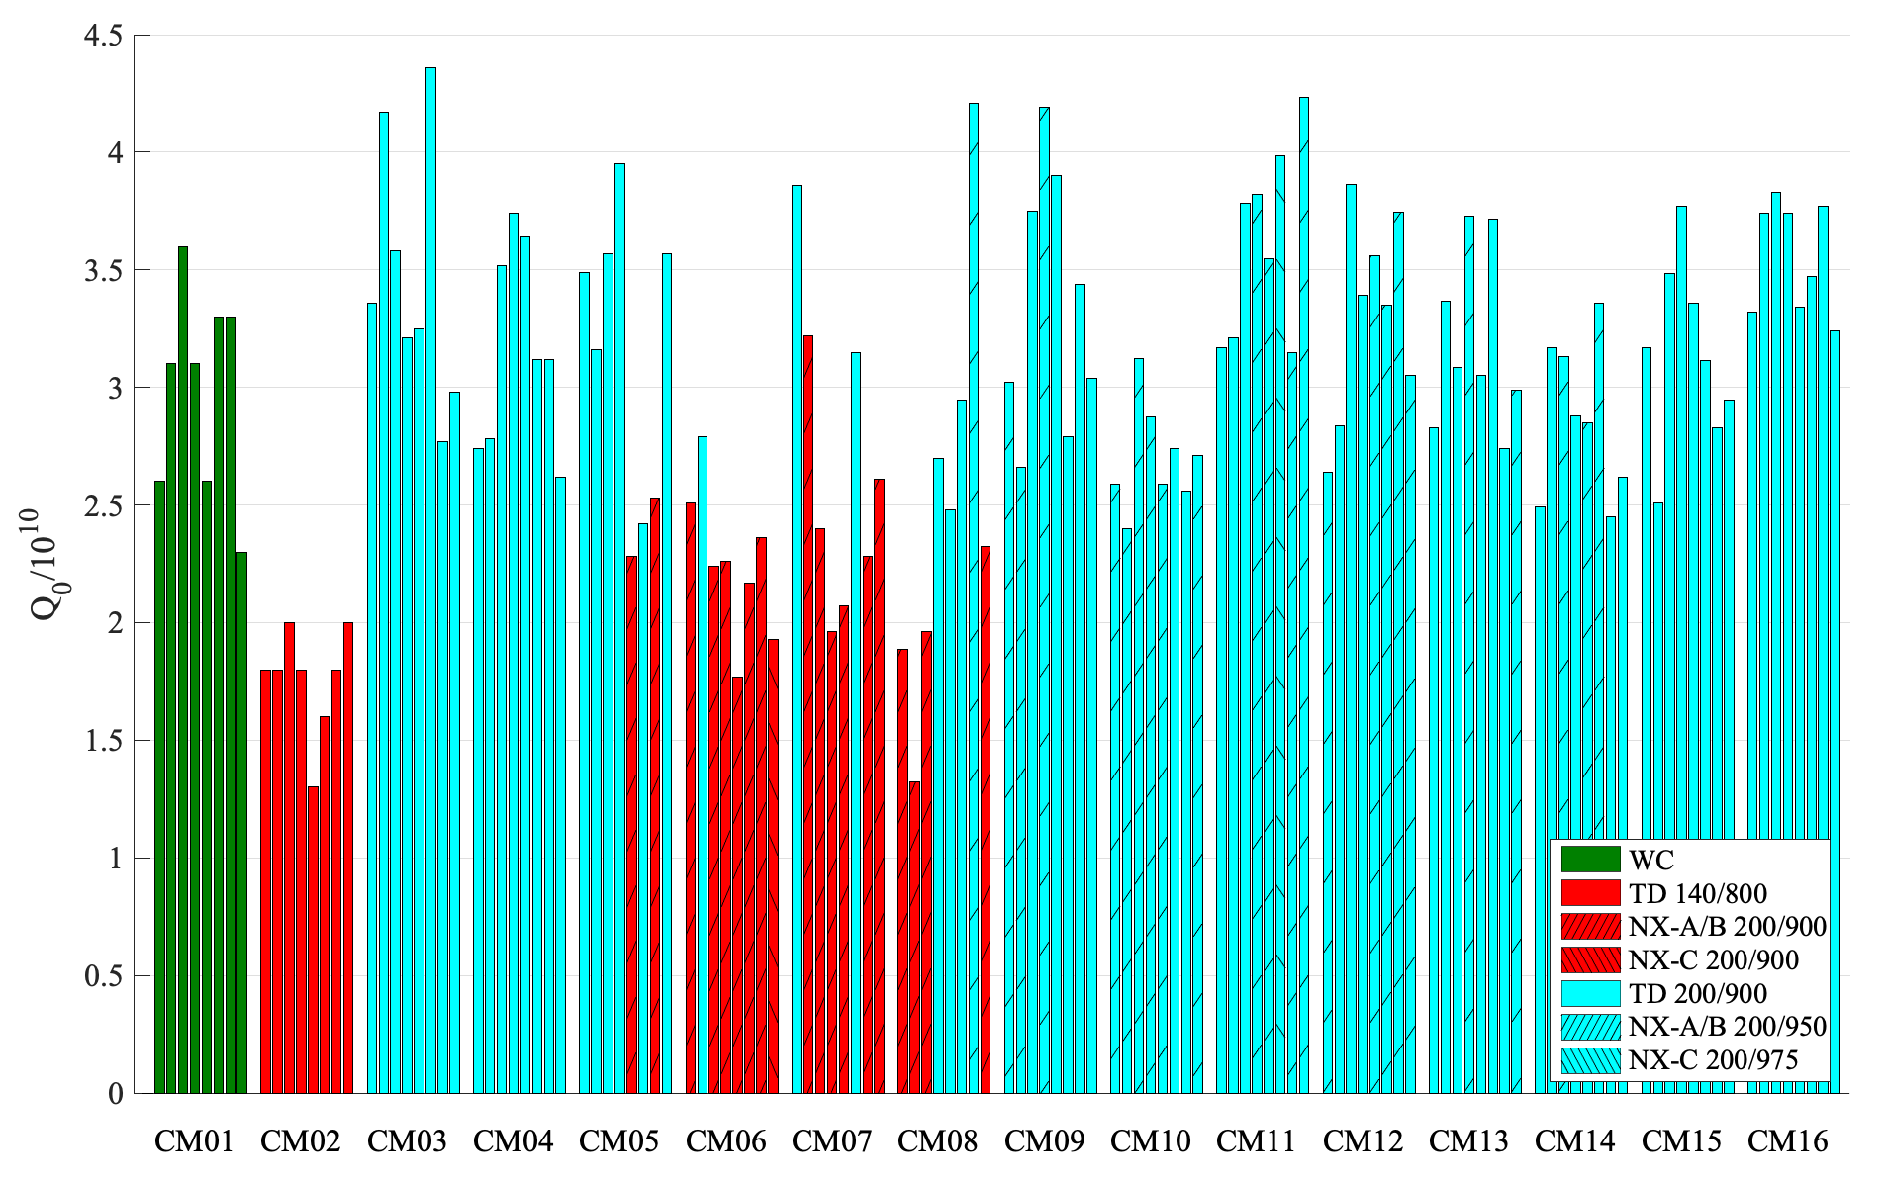
Fast cooldown at CMTF, E_{acc} ~ 16 MV/m, 2.0 K

Slide 15
TD cavities with insufficient heat treatment
Fast cooldown at CMTF, E_{acc} ~ 16 MV/m, 2.0 K
NX cavities with insufficient heat treatment
Sufficient heat treatment applied
Blue - Higher temperature heat treatment
Red - Lower temperature heat treatment

Slide 16
TD cavities with insufficient heat treatment
Fast cooldown at CMTF, E_{acc} ~ 16 MV/m, 2.0 K
NX cavities with insufficient heat treatment
Sufficient heat treatment applied
For HE, we want to avoid insufficient heat treatment as much as possible
Blue - Higher temperature heat treatment
Red - Lower temperature heat treatment

Slide 17
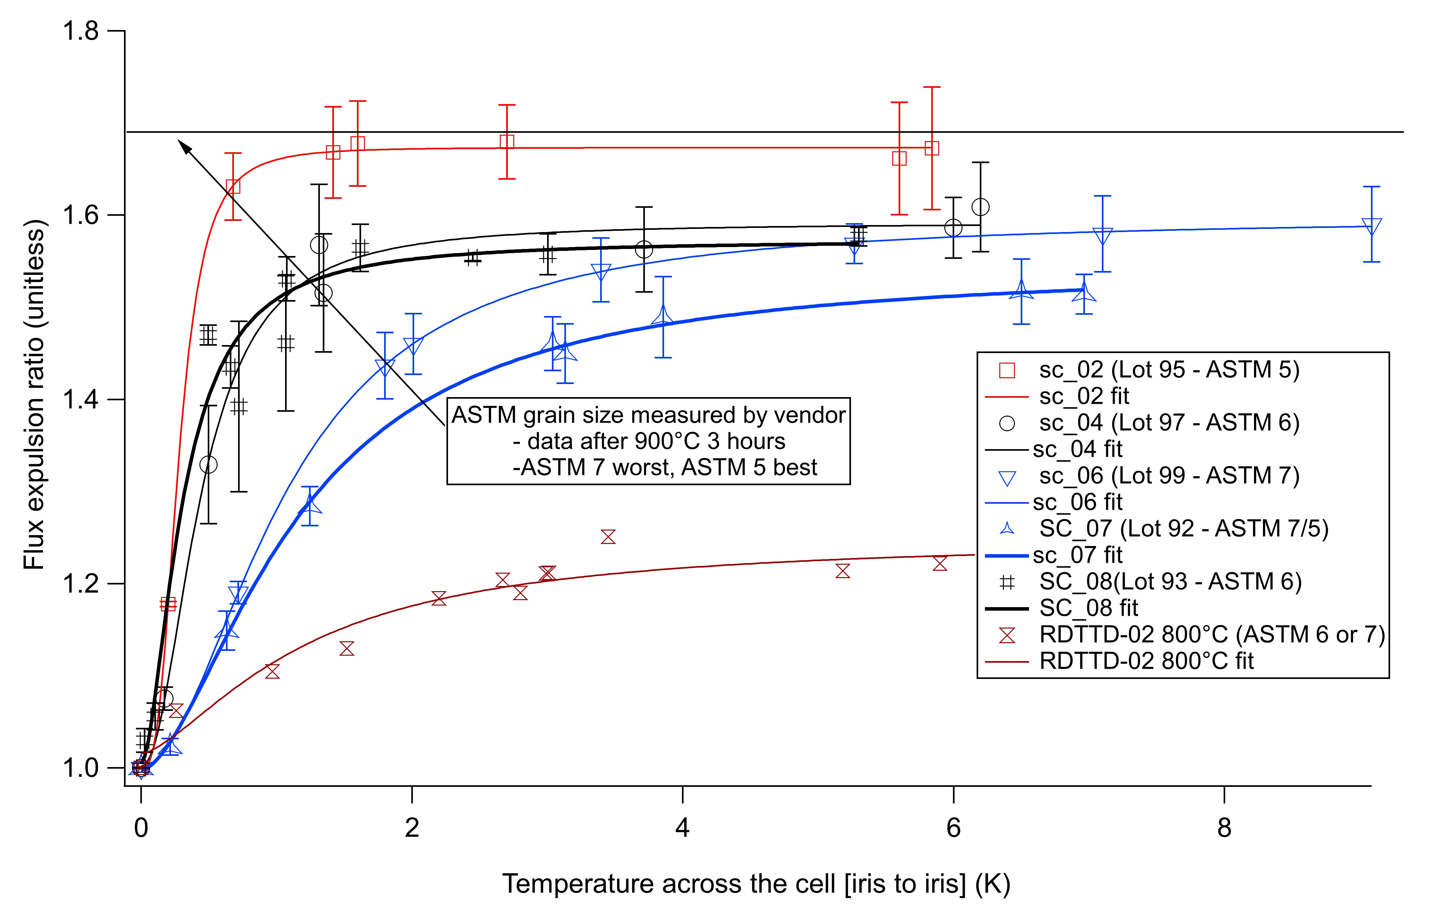
New Material from Tokyo Denkai
All baseline LCLS-II niobium from TD expelled well after 900 C 3 hours
New material purchased from Tokyo has more variability
A. Palczewski, JLab
Trip planned to visit TD to discuss differences in niobium production that could have caused this variability
Need to improve specifications to avoid this issue in the future and to better evaluate this new TD material

Slide 18
Simple Measurements to Predict Flux Expulsion
Also performing R&D to explore simple method (e.g. can be done at vendor) to predict expulsion
Study correlation between grain GROWTH during heat treatment and flux expulsion
E.g. original TD material showed minimal change in expulsion after 800 C 3 hr, but strong after 900 C 3 hr. Similar for NX after 950 C 3 hr
Search for change in grain growth at 900 C/950 C in corners from single cell cavities with well characterized expulsion

Slide 19
Search for Correlation
Full expulsion
Grain Growth
Flux Expulsion/Grain Size
Initial grain size
Strong flux trapping
Heat treatment Temperature

Slide 20
Search for Correlation
Temperature chosen for acceptable flux expulsion
Full expulsion
Expulsion vs temperature characterized for several LCLS-II single cells
Grain Growth
Flux Expulsion/Grain Size
Initial grain size
Strong flux trapping
Heat treatment Temperature

Slide 21
Search for Correlation
Temperature chosen for acceptable flux expulsion
Full expulsion
Expulsion vs temperature characterized for several LCLS-II single cells
Grain Growth
Flux Expulsion/Grain Size
Initial grain size
Need to measure grain growth vs temperature for the same material
Strong flux trapping
Heat treatment Temperature

Slide 22
Summary
Poor flux expulsion created a risk of low Q0 for LCLS-II production material with baseline recipe. This was mitigated via a 900-1000 C heat treatment developed in timely R&D
Q₀ ~ 3x10¹⁰ is regularly being achieved in LCLS-II cryomodules with modified heat treatment
Temperature required was found to depend on niobium production run, but material from both vendors was made to satisfy the stringent requirements of LCLS-II
Looking towards HE, we want to avoid cavities with poor flux expulsion as we had early in LCLS-II production
We are actively working on R&D to guide modifications to material specifications for HE

